Slide 1
Reoccurring apple diseases in New Brunswick
NB Hort-Congress 2023
Michael Tesfaendrias, Ph.D., P. Ag.
NBDAAF
IPM Specialist (Plant Pathologist)
(506) 453 3478
Michael.tesfaendrias@gnb.ca

Slide 2
Fire Blight
Caused by a bacterium Erwinia amylovora
Starting mid-June 2022, incidences observed in few NB orchards
Can cause considerable damage and economic losses in apple and related crops
Infects a wide host range within Rosacea
  Raspberry and blackberry infected by a different strain
Attacks different plant parts
  Blossom blight -Root stock blight
  Shoot blight -Trauma blight (NB high incidence 2014)
  Fruit blight
  Canker blight

Slide 3
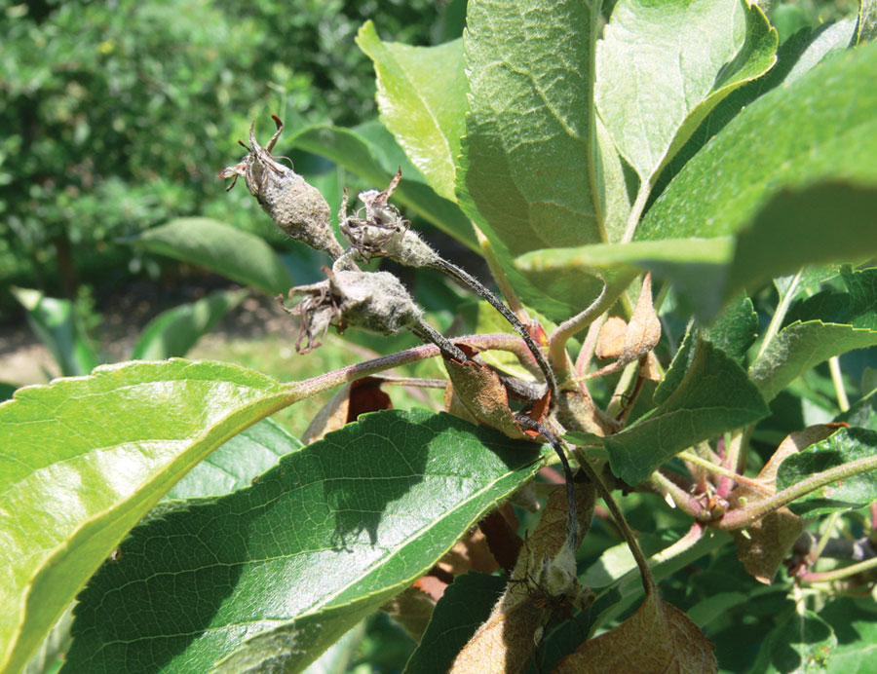
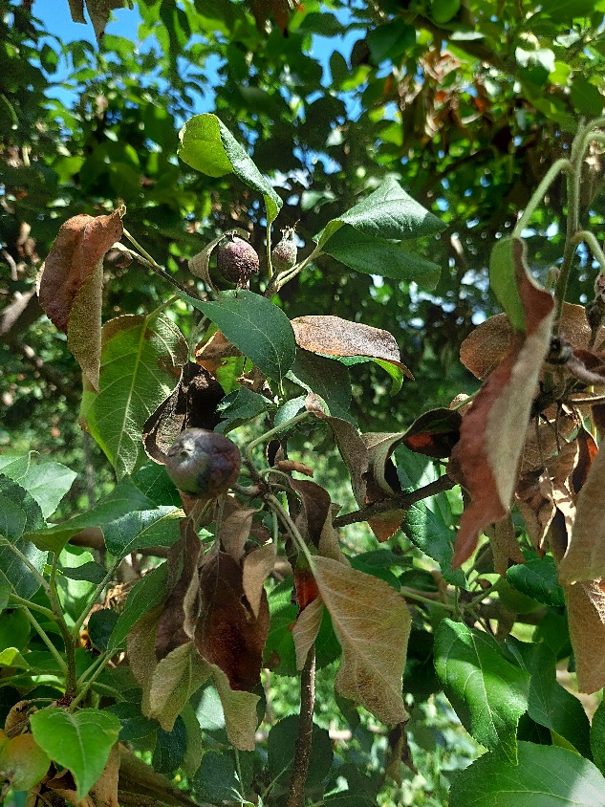
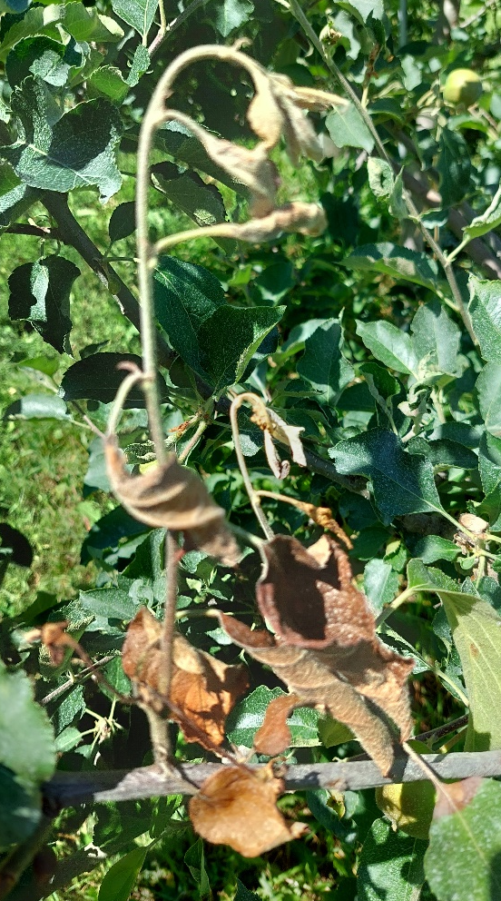
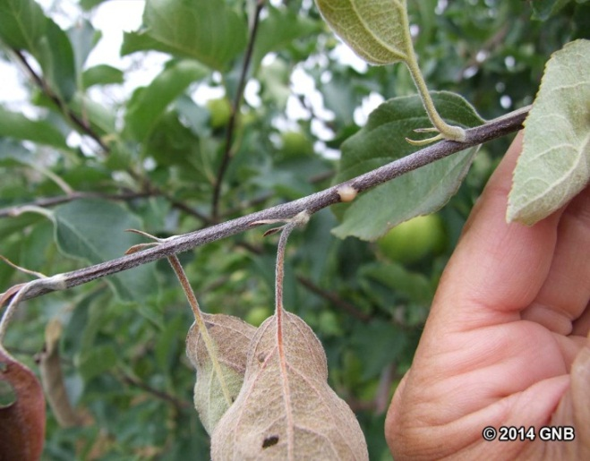
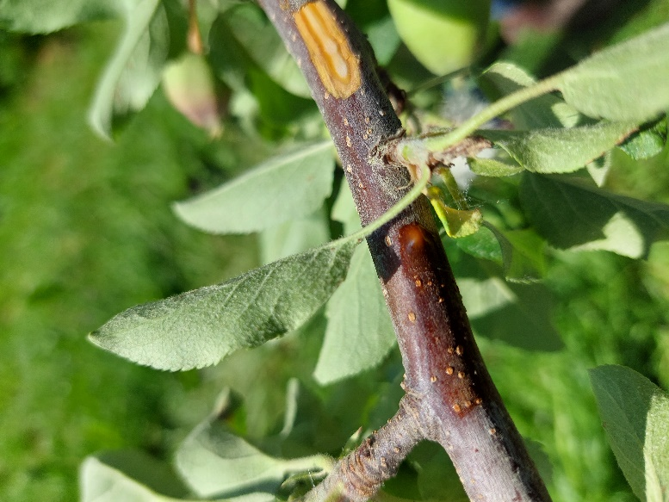
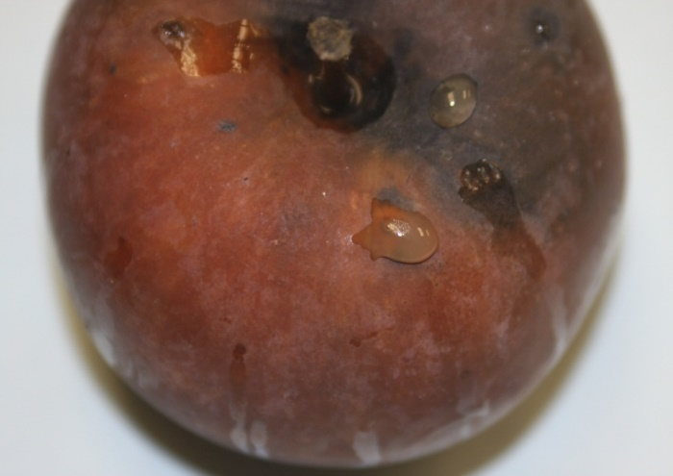
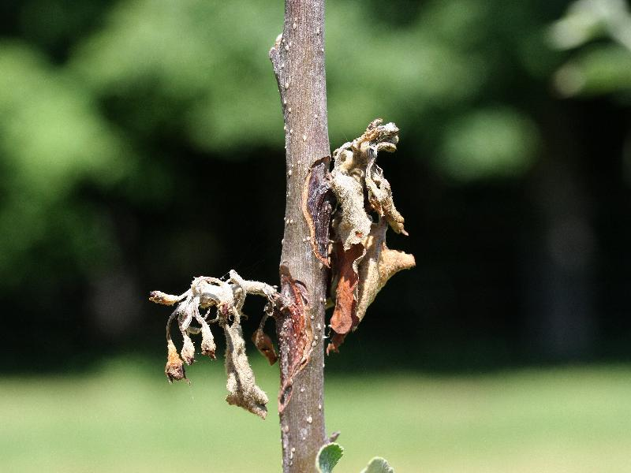
OMAFRA
NBDAAF
NBDAAF
NBDAAF
NBDAAF
NBDAAF
Notes:
NBDAAF

Slide 4
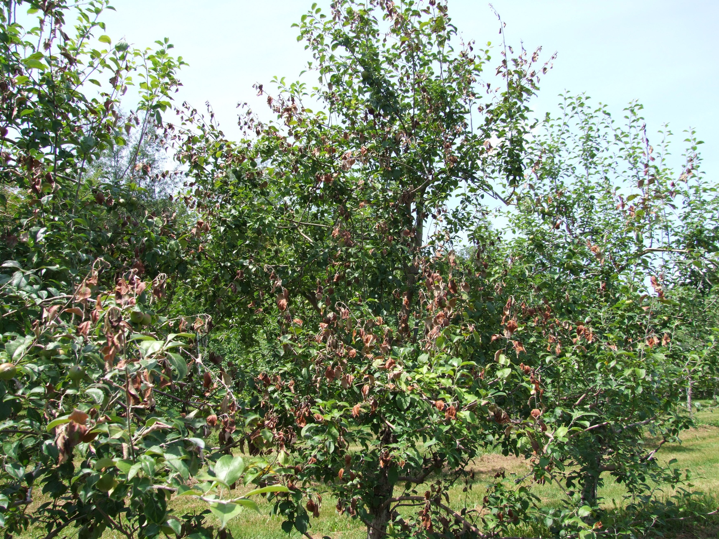

Slide 5
Fire blight management
Select resistant cultivars and root stocks
Remove unwanted alternate hosts
Monitor weather conditions and crop growth
Dormant season: Remove cankers and dead branches; delayed dormant copper spray
Bloom: Monitor weather conditions; apply chemicals if needed (biologicals, antibiotics); thinning agents (Apogee) to supress shoot blight
Post bloom: Remove strikes, Insect pest control
( aphids, leafhoppers and pear psylla)
Post harvest: Apply copper if fire blight is active; remove new infections

Slide 6
Bitter rot
Caused by Colletotrichum fioriniae (Colletotrichum acutatum Complex).
Wide host range (blueberry, tomato, pepper, strawberry, grapes, eggplant, …)
Develops primarily during periods of extended hot and wet weather (5h wetness at 26ºC)
  Warm, wet weather during fruit maturity favours disease development
Spore dispersal: wind-driven rain, cultivation tools, and human contact.
Infection most common from mid- to late season
Reduces fruit’s shelf life and quality

Slide 7
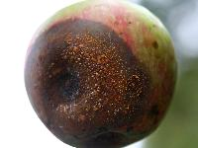
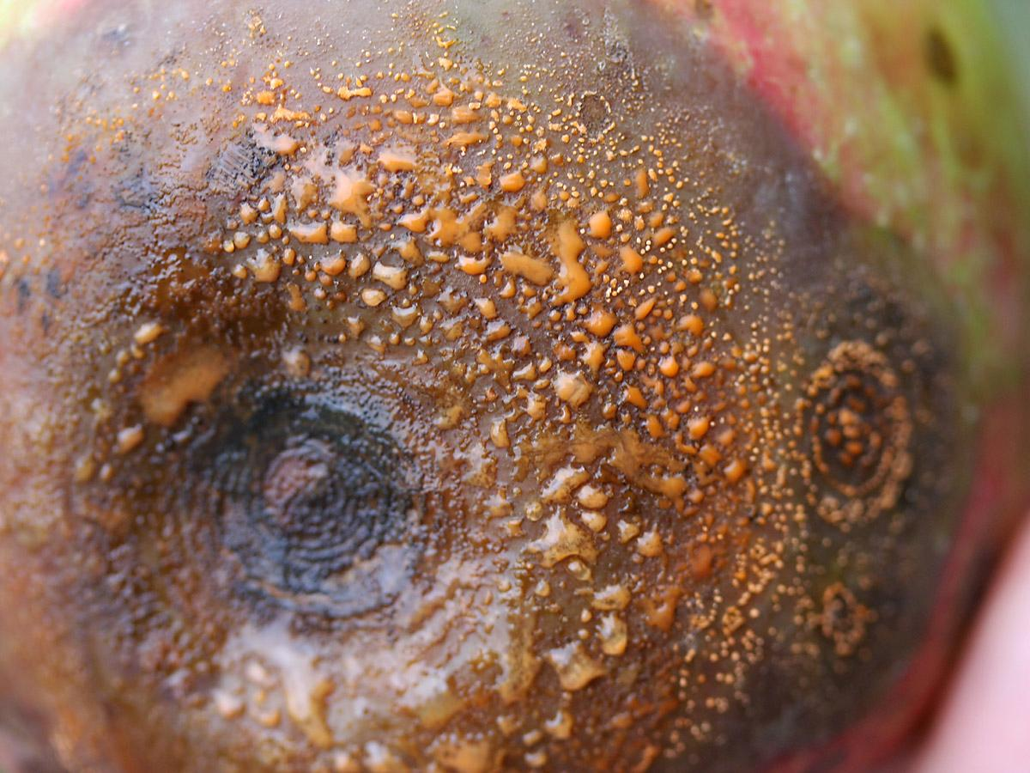
Bitter rot
Damp weather: lesions are light tan, slightly sunken, and often develop masses of pink spores
Dry weather: lesion surfaces appear rough with dark fruiting structures.

Slide 8
Bitter rot
Newly discovered pathogen in NY apples causes bitter rot disease (Cornel University, July 6, 2020)
C. fioriniae, C. chrysophilum and C. noveboracense
If apple plants are not protected in a timely manner, apple losses from bitter rot in NY state:
  Average up to 25% per year
  Some organic farms losing up to 100%
  Up to 5% additional loss of marketable fruit in storage post-harvest.
High incidence of bitter rot in NY in recent years could
be due to: Change in PHI for mancozeb to 77 days,
more summer warm wetting events, absence of sanitation,
susceptible cultivars and late maturing cultivars.

Slide 9
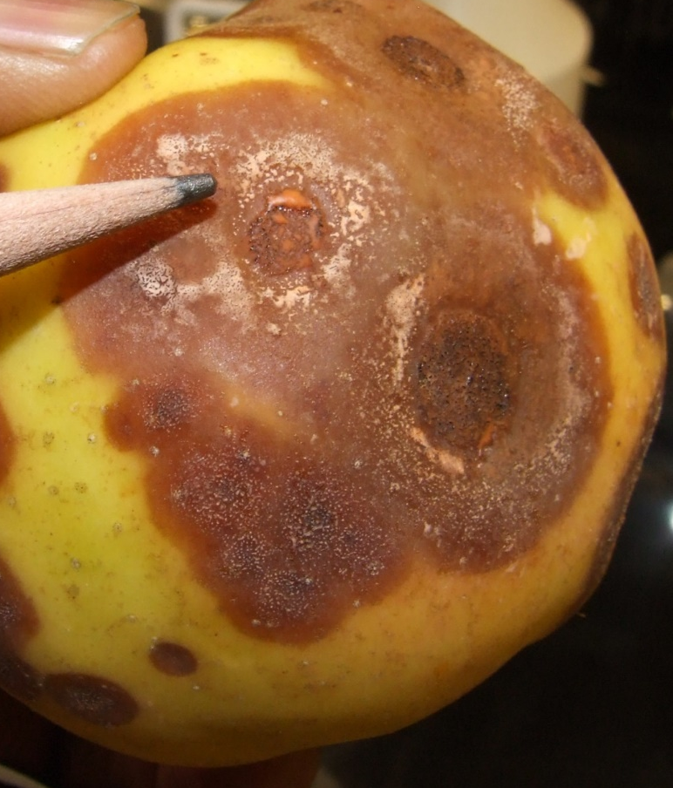
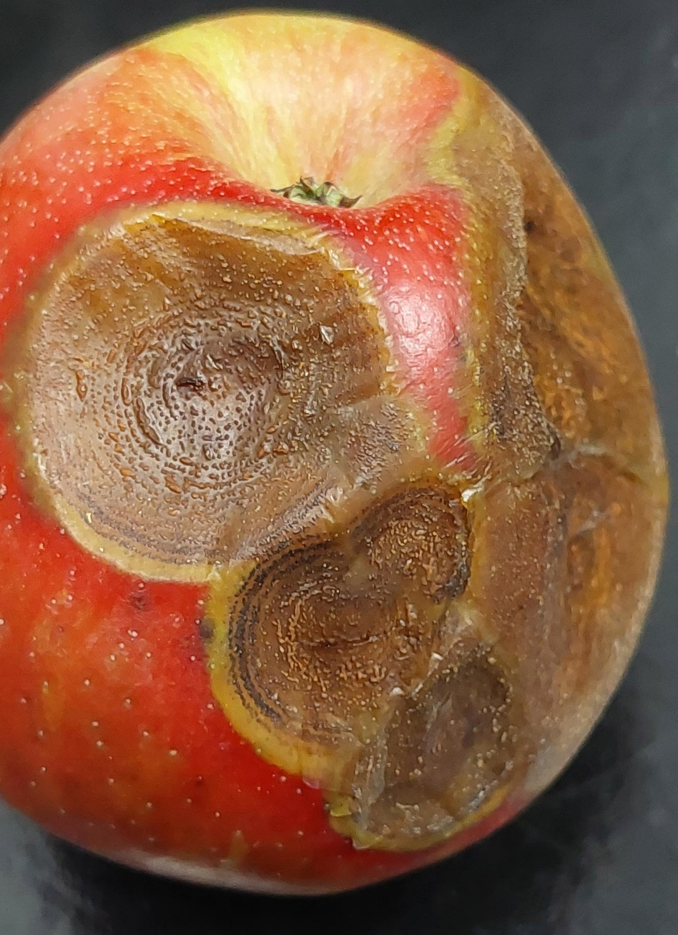
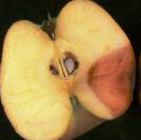
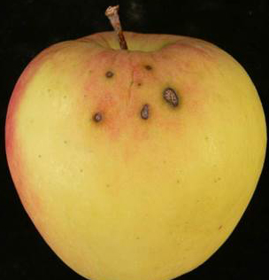
Bitter rot
Bitter rot in storage
OMAFRA
OMAFRA
Notes:
OMAFRA

Slide 10
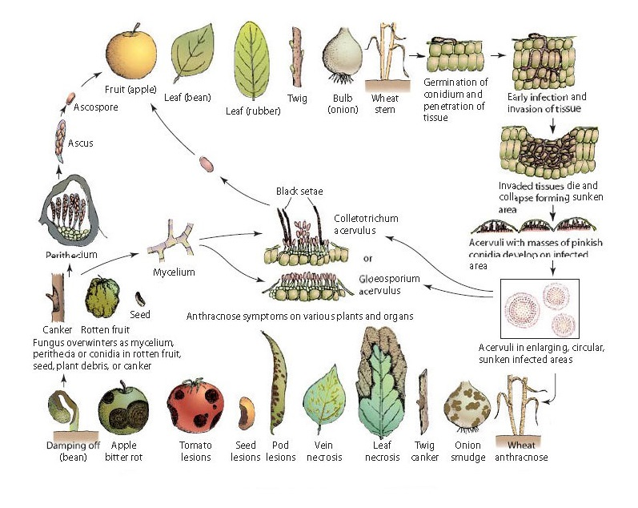
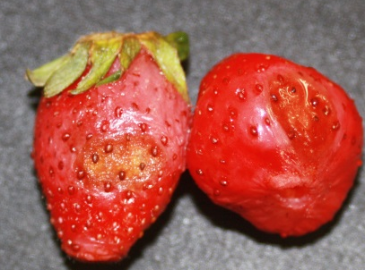
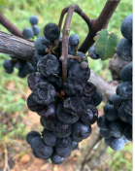

Slide 11
Colletotrichum
Notes:
Colletotrichum

Slide 12
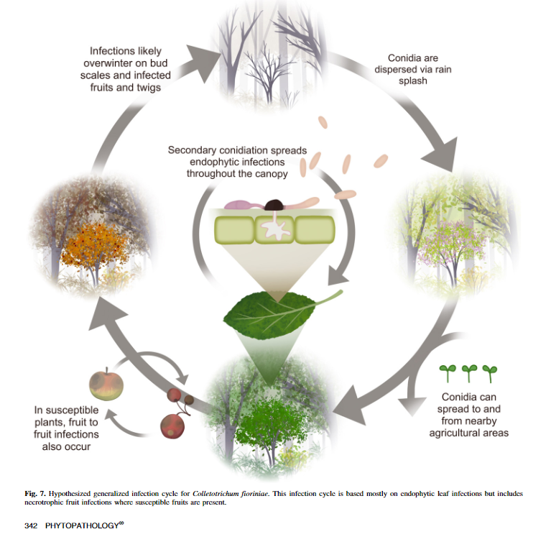
Apple bitter rot cycle
13 Jan 2021https://doi.org/10.1094/PHYTO-05-20-0157-R

Slide 13
Bitter rot management
Sanitation:
  Remove old cankers and dead wood from orchard, mummified fruit, diseased fruit
Protectant fungicides (10-14 days interval: Petal fall to subsequent summer sprays and under favourable conditions)
  Orchards with a history of infections: Apply fungicides preventatively to susceptible cultivars (Empire, Ambrosia, Honeycrisp and Golden Delicious) starting
  Protectant fungicides (Maestro or Supra Captan)
  Pristine, Allegro
  Regalia Maxx

Slide 14
Silver Leaf
Caused by Chondrostereum purpureum
It occurs occasionally on isolated trees
Wide host range (Apple, sour cherry, plums, peaches and nectarines).
Opportunistic pathogen infecting trees through damaged wood
The pathogen limits water movement in infected branches
Mostly appears after cold winters

Slide 15
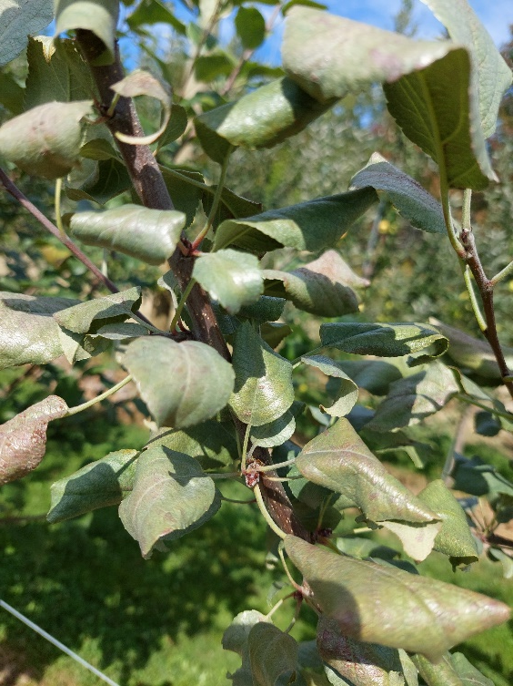
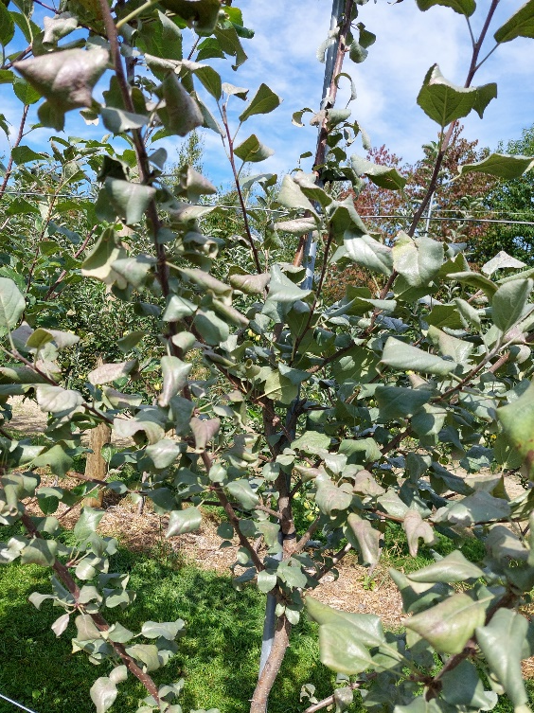
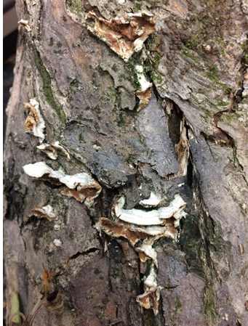
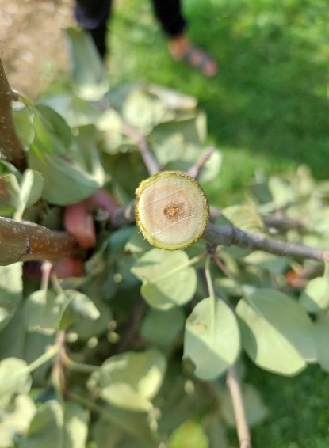
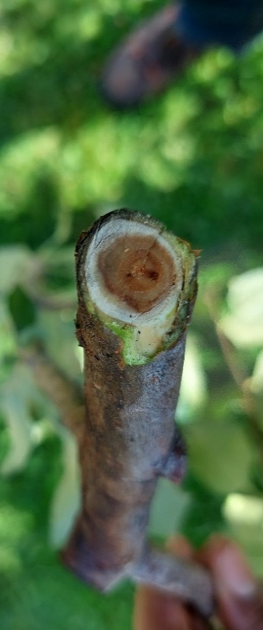
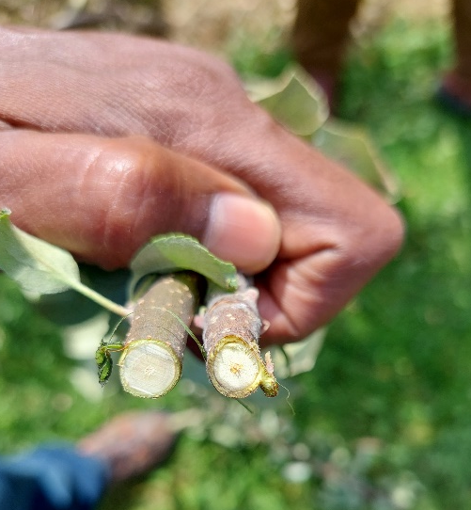
Silver Leaf
Konks (reproductive structures)
(U of Wisconsin)
Notes:
Konk

Slide 16
Silver leaf management
Maintain trees in good vigour
Prune out branches showing leaf symptoms
Pruning off broken and dead limbs
Decontaminate pruning tools after each cut
Avoid pruning during wet periods
Burn or bury all infected branches or trunk sections removed from trees.
Remove conks to limit production of spores
Provide adequate water to affected trees

Slide 17

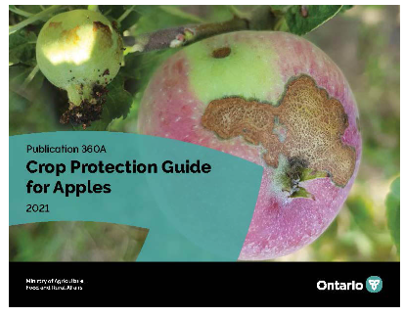
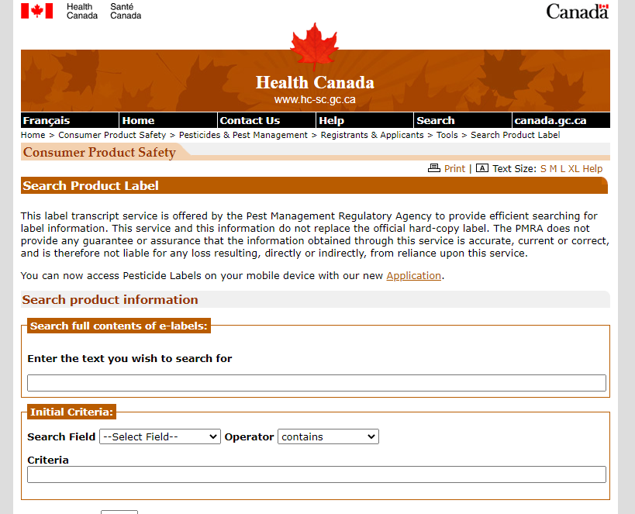
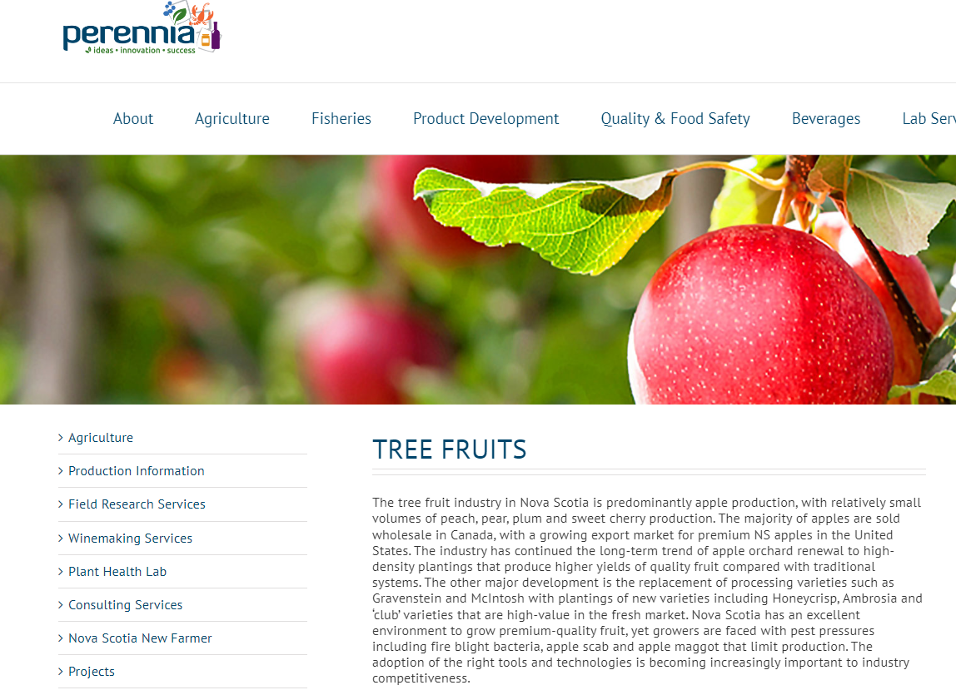
Resources
http://hc-sc.gc.ca/cps-spc/pest

Slide 18
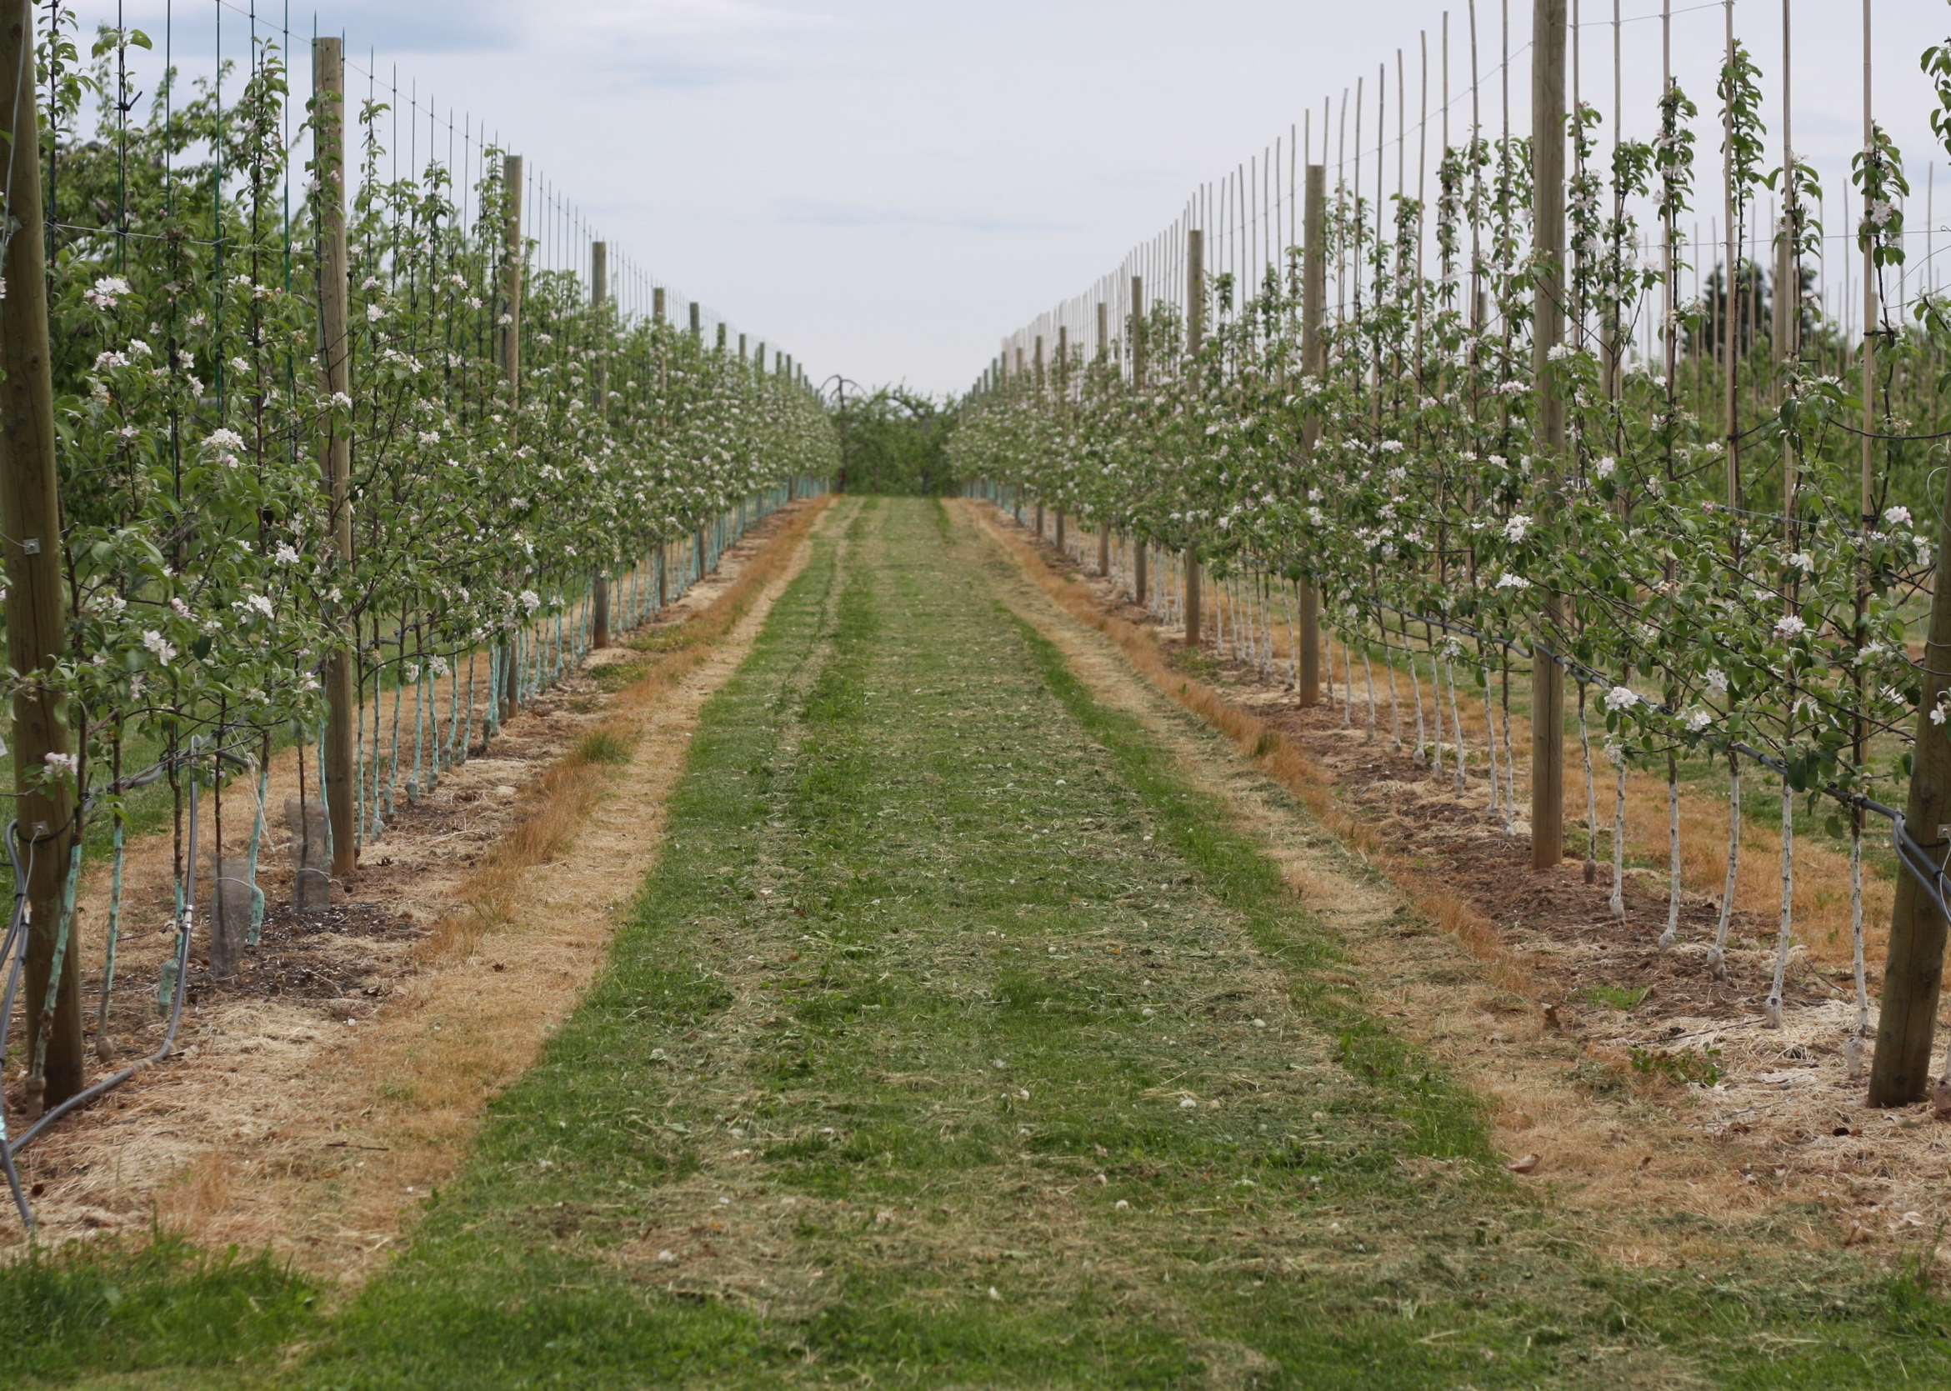
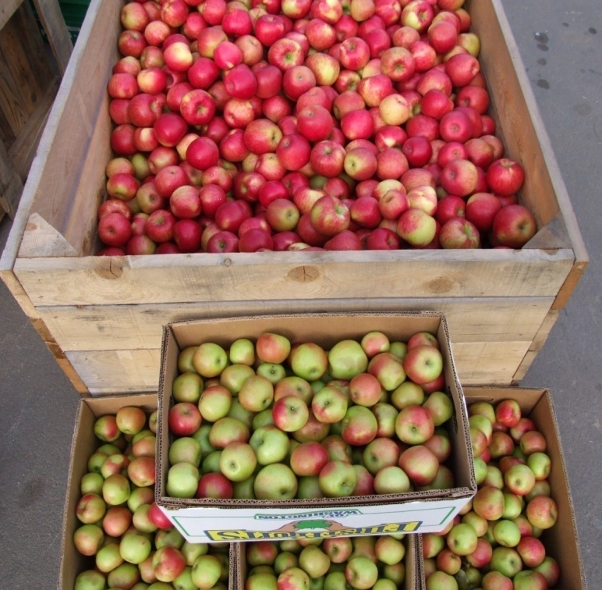
Fire blight management
Thank You
Merci
Monitoring and disease forecasting
Cultural practices
  Pruning infected branches
  Sanitation:
  Reduce practices that promote excessive growth
  remove unwanted alternate hosts
  monitor for blossom infection, infected spurs or overwintering canker remove infected parts

