Slide 1
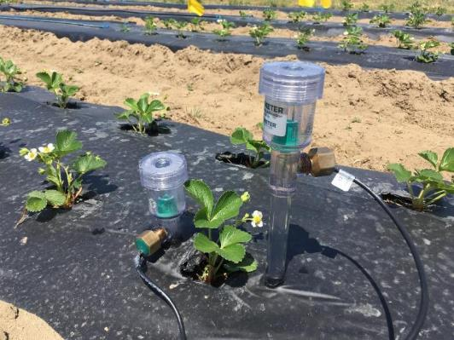
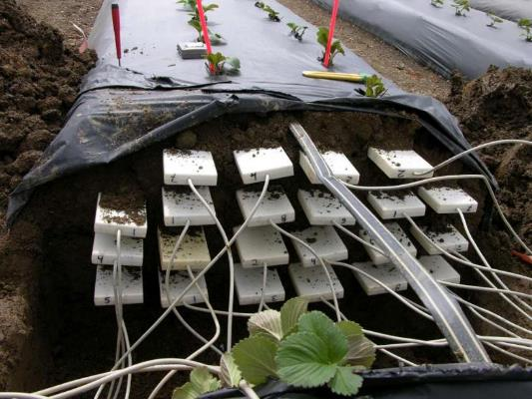
Paul Deschênes
Development in Rational Irrigation Management
NB Hort Congress
March 16 2023
Fredericton, New Brunswick

Slide 2
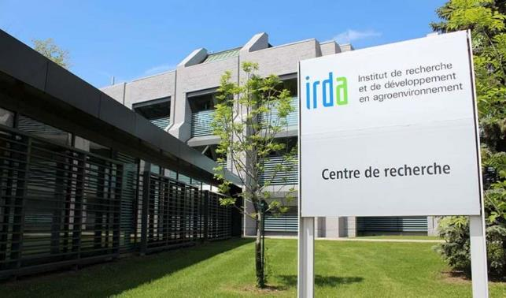
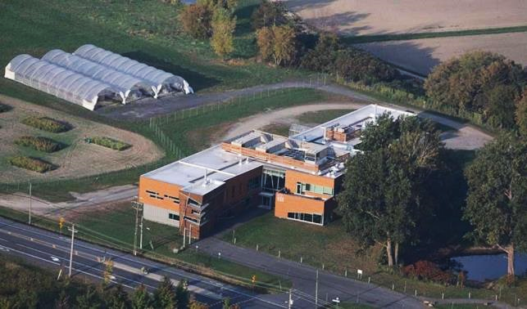
Research and Development Institute for the Agri-Environment (IRDA)
IRDA is a non-profit research corporation whose mission is to engage in agri-environmental research, development and transfer activities that foster agricultural innovation from a sustainable development perspective.
Québec city
Head office
Laboratory
Saint-Bruno-de-Montarville
Innovation center in organic agriculture
Laboratory

Slide 3
Presentation Plan
Irrigation management basics
  Soil texture’s influence over soil water dynamic
  Cropping system’s importance in soil moisture
  Crop water needs
  Crop uptake zones (soil, roots, water, fertilizer)
  Irrigation management decision-support tools
On-going projects
Conclusion

Slide 4
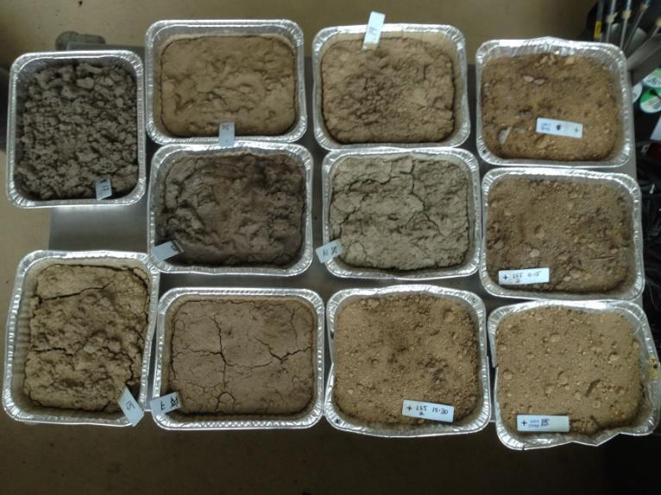
Soil Texture
Soil texture influence water movement and retention
  Soil particules sizes (sand, silt, clay)
    Microporosity and macroporosity
    Capillarity and gravity water movement
  Gravel/pebbles (> 2 mm diameter)
    Causes macroporosity and downward water movement
  Those factors influence the soil water retention and the available water to the crop

Slide 5
Soil Texture
Soil Texture | Readily Available Water (RAW) (Available Water mm/Soil cm)
 | 1 | 2 | 3 | 4
Sand | 0,5 - 0,8 | 0,6 - 0,75 | 0,83 | 0,4 - 0,8
Loamy sand | 0,7 - 1,0 | 0,75 - 1,10 | 1,0 | 0,6 - 1,2
Sandy loam | 0,9 - 1,2 | 1,0 - 1,6 | 1,25 | 1,1 - 1,5
Loam | 1,3 - 1,7 | 1,5 - 2,2 | 1,75 | 1,7 - 2,3
Silty loam | 1,4 - 1,7 | 1,7 - 2,5 | n.a. | 1,7 - 2,3
Silty clay loam | 1,5 - 2,0 | 1,7 - 2,2 | 2,08 | 1,4 - 2,1
Clay loam | 1,5 - 1,8 | 1,7 - 2,2 | 2,0 | 1,4 - 2,1
Clay | 1,5 - 1,7 | 1,5 - 2,0 | 2,0 | 1,6 - 1,8
² Dugdale et coll. cité dans Stetson et Mecham (2011)
¹ OMAFRA (1990)
³ van der Gulik (2010)
⁴ NDSU (2017)

Slide 6
Soil Texture
RAW can be diffirent for the same soil texture
Information needed:
  Gravel/pebbles (> 2 mm) soil proportion
  Soil density
Soil Texture (samples) | Readily Available Water (RAW) Available Water mm/Soil cm | RAW 30 cm Soil
Sand (10) | 0,4 - 1,15 | 12 - 35
Loamy sand (19) | 0,45 - 1,25 | 13,5 - 37,5
Sandy loam (17) | 0,35 - 1,6 | 10,5 - 48
Loam (9) | 0,4 - 1,30 | 12 - 39
Sandy clay loam (12) | 0,4 - 1,45 | 12 - 43,5
Data from IRDA’s research projects

Slide 7
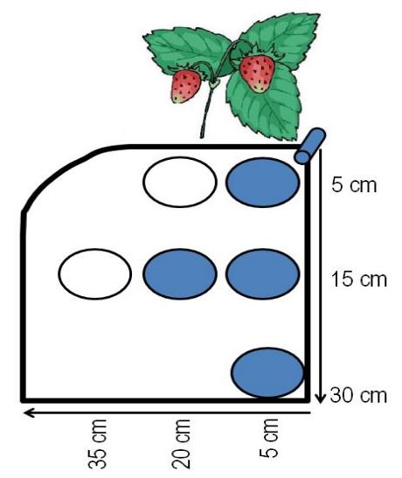

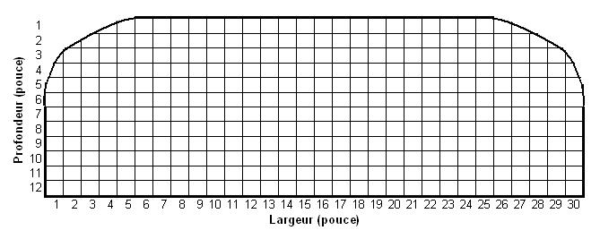
Soil Texture
Lateral and downward soil water movement
  Sandy clay loam (9 % > 2 mm)
  Loam to Sandy clay loam (30 % > 2 mm)
Deschênes et coll., 2017
Boivin et Deschênes, 2011

Slide 8
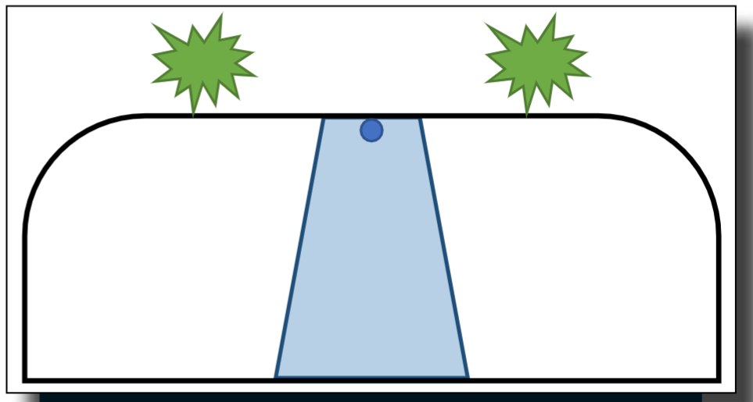
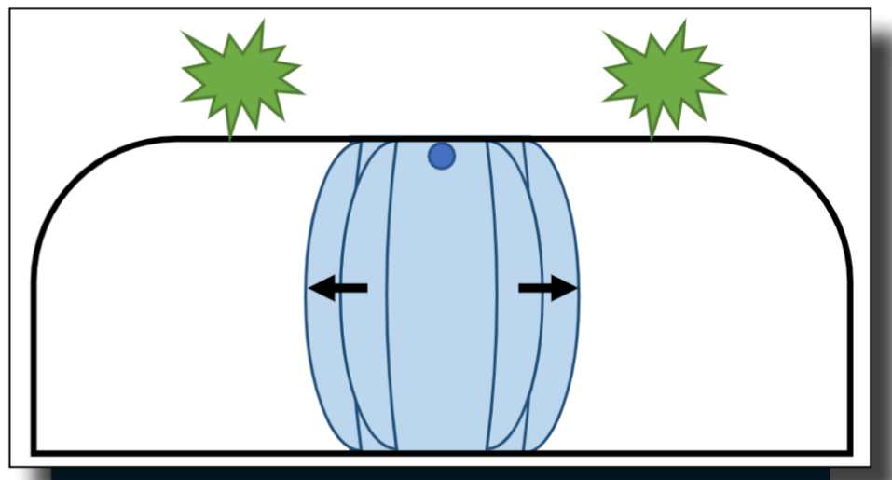
Soil Texture
Drip irrigation wetting pattern in clay loam with gravel
Lateral water movement in drip irrigation wetting pattern in heavy soils
(Boivin et coll., 2018)

Slide 9
Soil Texture
Drip irrigation
  Loam to Sandy clay loam (30 % > 2 mm)
    Day-neutral strawberries cv. Seascape
    Same amount of water per irrigation event
    8 in vs 12 in emitters spacing
      8 in: 13 to 20 % yield increase over maximum productivity period (Aug 2 – Oct 8)
  Larger water storage capacity
8 in, 1 drip line
12 in, 1 drip line
Boivin et Deschênes, 2011

Slide 10
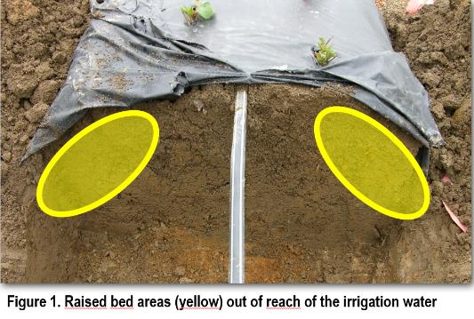
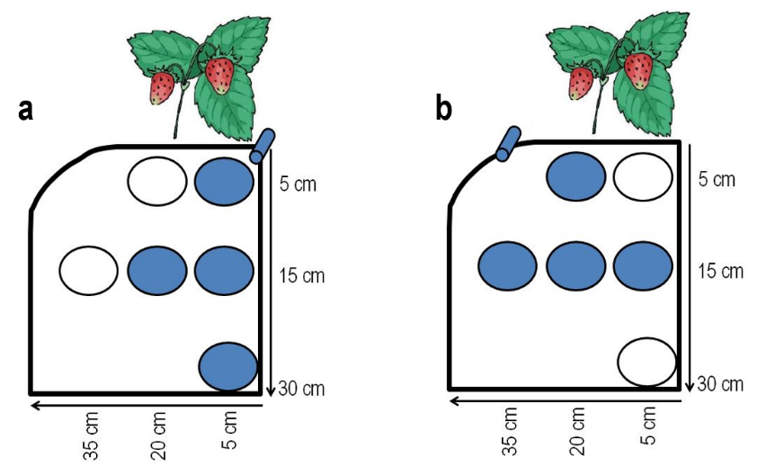
Soil Texture
Drip irrigation
  Sandy clay loam (9 % > 2 mm)
  June-bearing strawberries cv. Clery
  1 drip line, center
    Water application in the center part of the raised beds
    Progressive drying of the soil beneath the plastic mulch
  2 drip lines, in the shoulders
    Water application in the maximum root density soil layer (0-15 cm)
    Constant soil moisture inside the raised beds
Deschênes et coll., 2017

Slide 11
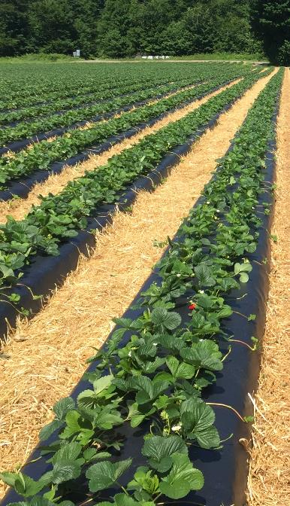
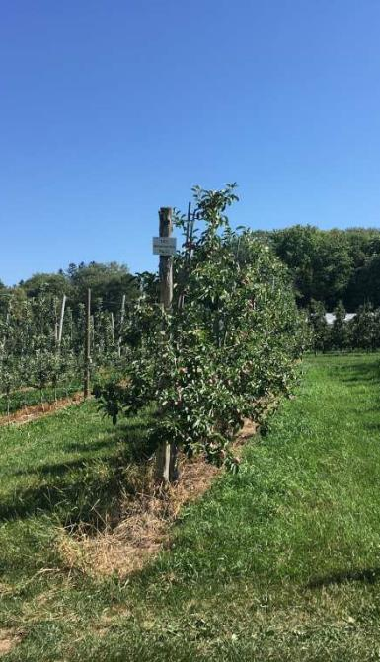
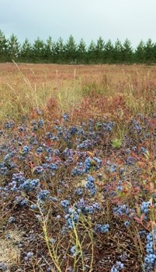
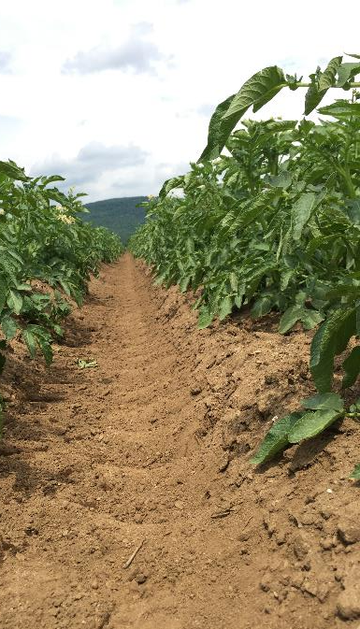
Cropping System
Day-neutral strawberries
Raised beds
Plastic mulch
Apple orchards
Perennial crop
Rows
Potatoes
Ridges
Bare soil
Wild blueberries
Full surface covering

Slide 12
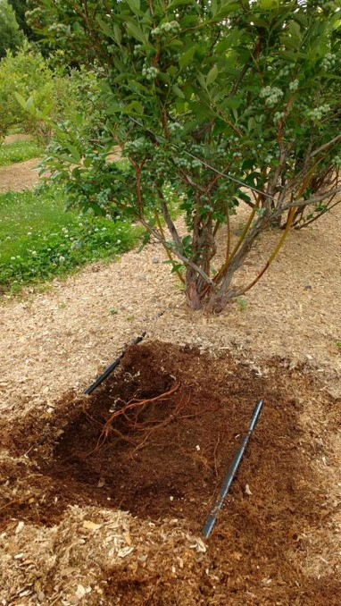
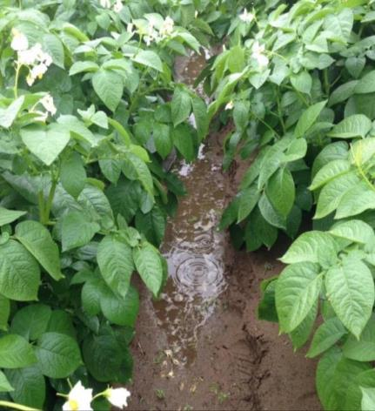
Cropping System
Cropping system types
  Umbrella
    Water is diverted away from roots by the soil architecture
    Ridges and raised beds
    Plastic mulch
  Funnel
    Water directed towards roots by soil architecture
    During the growing season, when roots reach in between rows
    No soil compaction
  Neutral
    No effect on water movement
    Flat surface
    Permeable mulch (organic mulch)

Slide 13
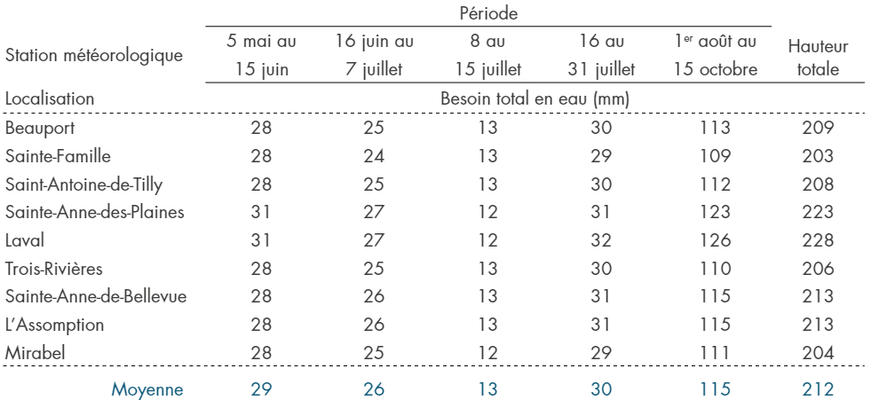
Crop Water Needs
Day-neutral strawberries (var. Seascape)
  Estimated water-use over growing season periods
Periods
Total height (mm)
Weather station locations
Total water needs (mm)
AVERAGE
Boivin et al., 2018
Notes:
Over the years, we measured many crop water needs in our projects. I’m presenting a summary of those values for the Day-neutral strawberries and potatoes.

Slide 14
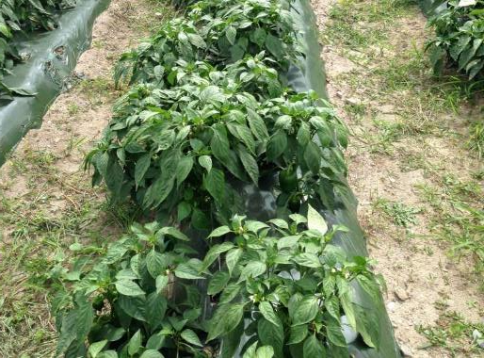
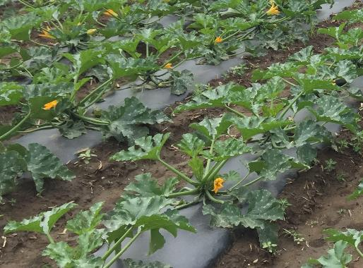
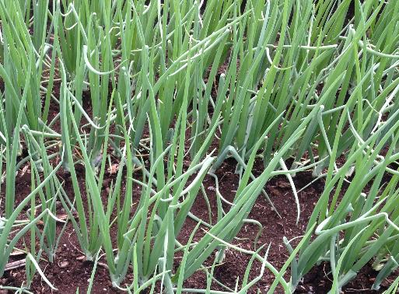
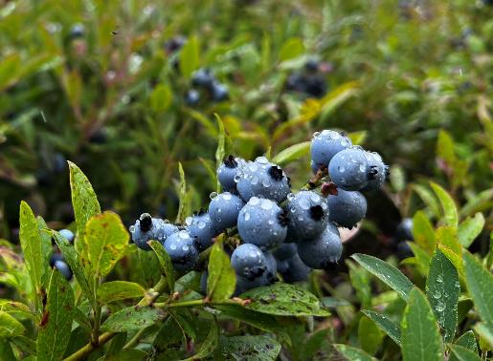
Cropping System
Crop types
  Umbrella
    Water diverted away from roots by crop canopy
    Potatoes, eggplants, peppers
  Funnel
    Water directed towards roots by crop canopy
    Stawberries, zucchinis, cabbages, cauliflowers, lettuces
  Neutral
    No effect on water movement
    Beans, wild blueberries, onions, carrots, cranberries

Slide 15
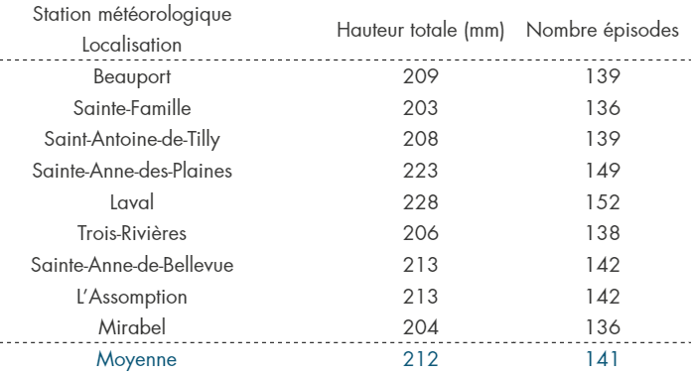
Crop Water Needs
Day-neutral strawberries (var. Seascape)
  1,5 mm irrigation events required to fulfill estimated crop water-use
Weather station locations
Total height (mm)
Irrigation events
AVERAGE
Boivin et al., 2018

Slide 16
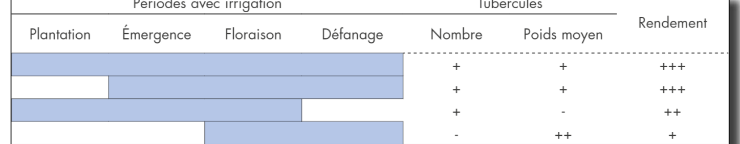
Crop Water Needs
Potatoes (var. Norland)
  Water stress impact depending on the growing stages
  Absence of blue line indicates crop is under water stress
    Planting: does not translate in yield reduction
    Emergence: decrease in tubers quantity and yield
Growing stages irrigated
Tubbers
Yield
Planting
Emergence
Flowering
Top-kill
Quantity
Mean weight
Boivin et al., 2018
Notes:
For potatoes, the water stress in the growing season will have different impacts depending of the crop growing stage.
The absence of blue line indicates the crop is under water stress. For exemple, water stress at planting do not translate in yield diminution, but if it occurs at emergence the number of tubbers will decrease importantly and it will have an negative impact on the yield.

Slide 17
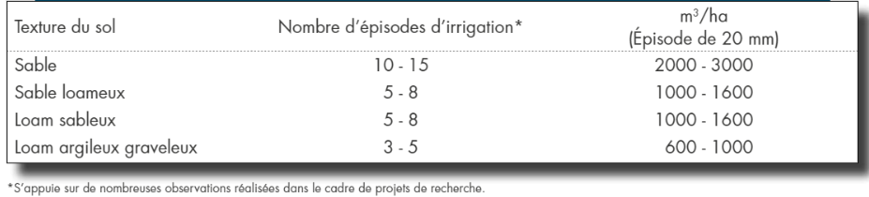
Crop Water Needs
Potato crop irrigation events depending on soil texture
  Québec City region
Soil texture
Irrigation events
(Events of
Sand
Loamy sand
Sandy loam
Clay loam with gravel
Boivin et al., 2018

Slide 18
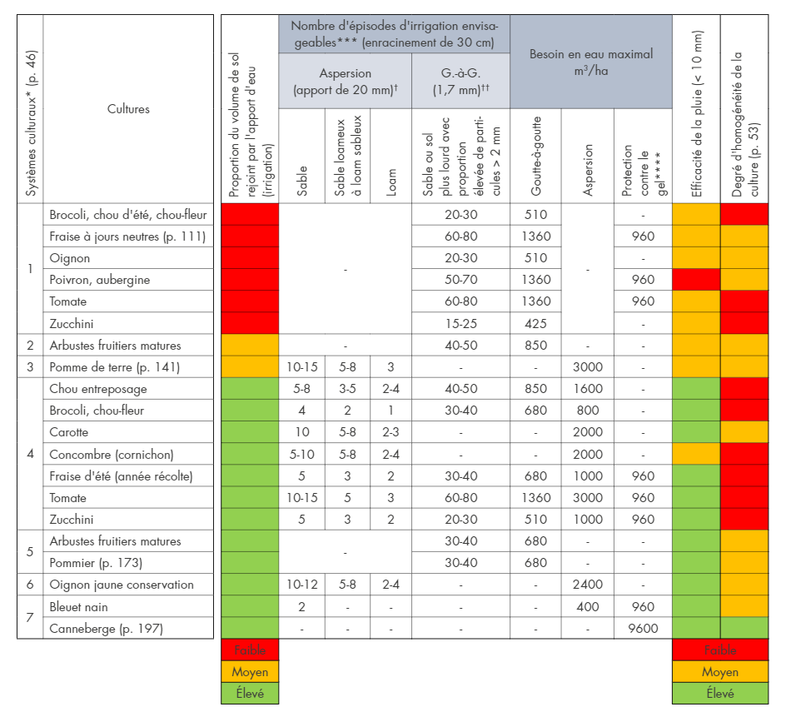
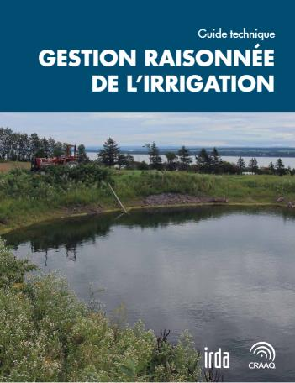
Crop Water Needs
Raised beds, plastic mulch, drip irrigation
Flat surface, no mulch, drip or overhead irrigation
Boivin et al., 2018

Slide 19
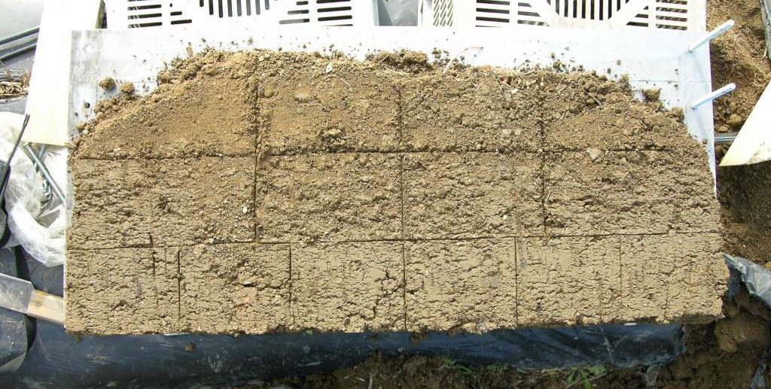
Crop Uptake Zones
Essential to optimal crop growth
  Soil, roots, nutrients, water
  Crop water and nutrient uptake efficiency
  May vary over time

Slide 20
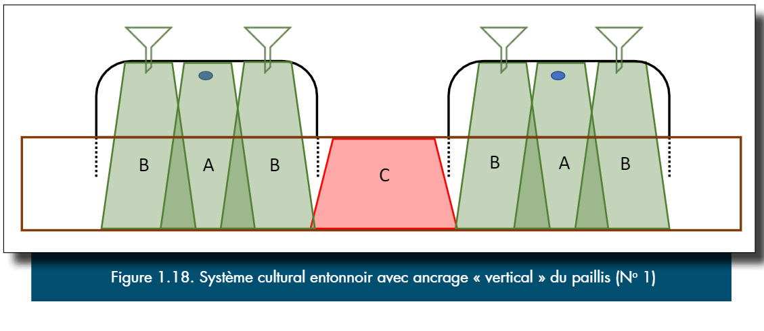
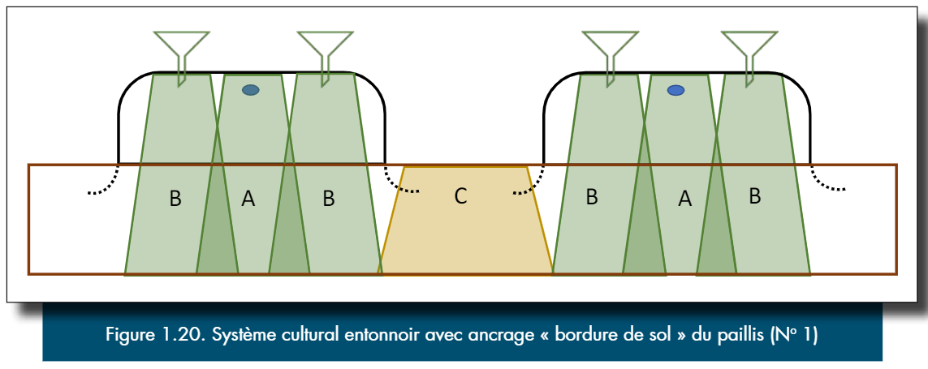
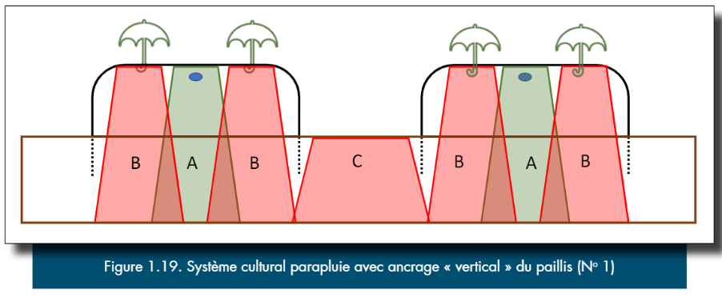
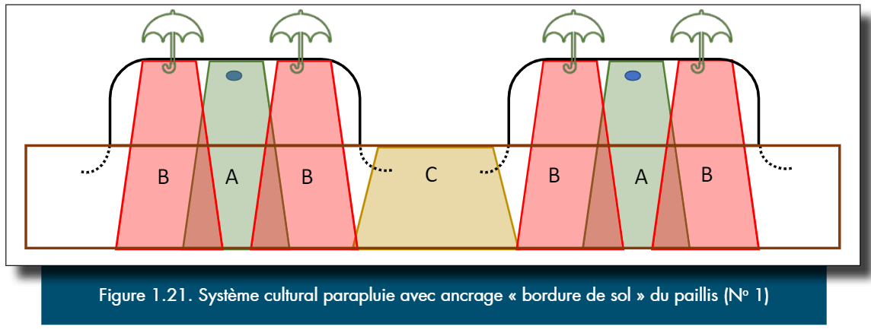
Crop Uptake Zones
(Boivin et coll., 2018)

Slide 21
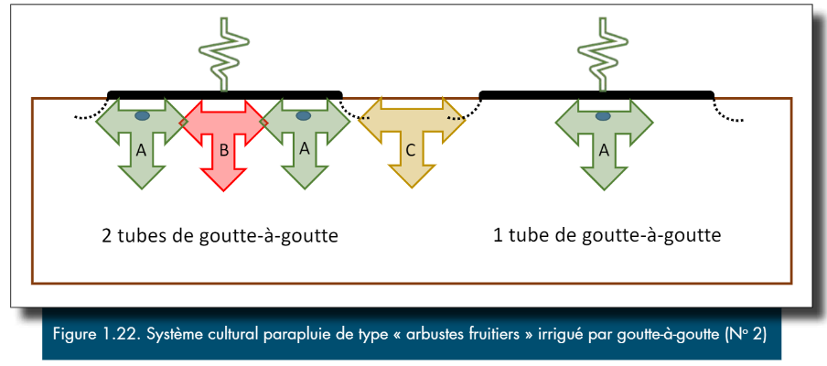
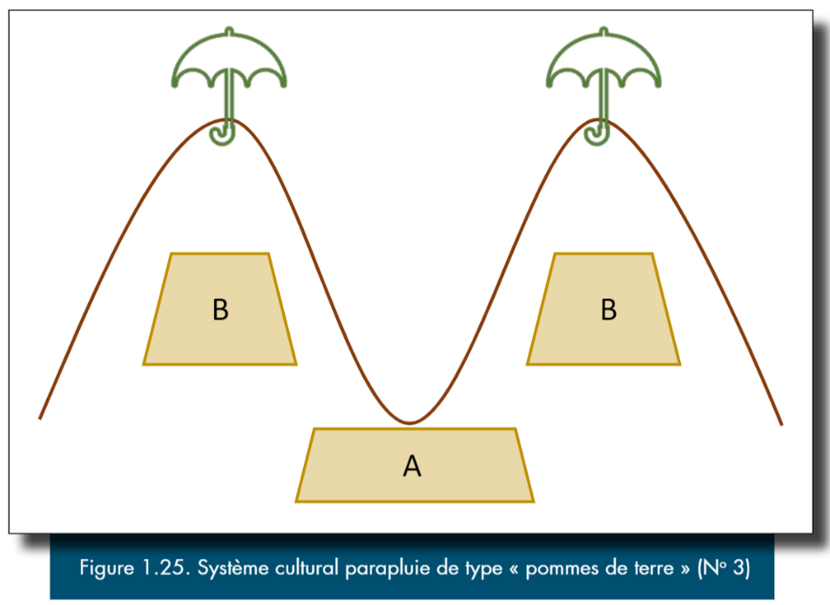
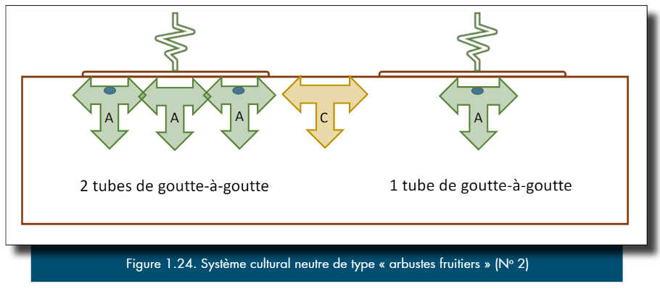
Crop Uptake Zones
(Boivin et coll., 2018)

Slide 22
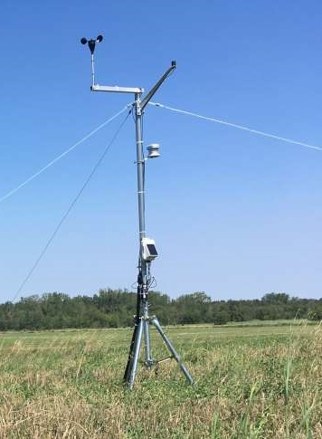
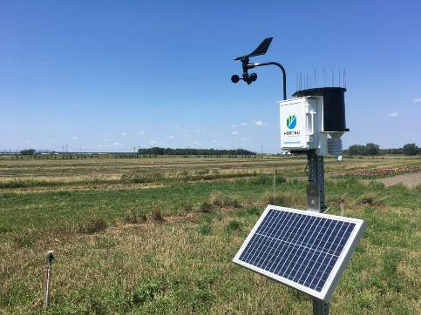
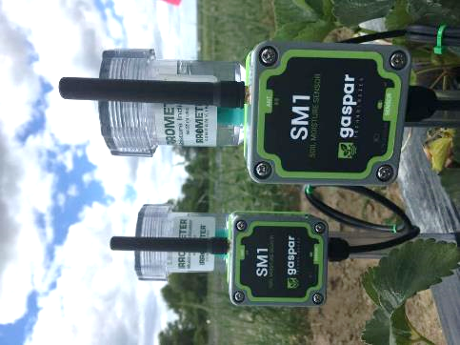
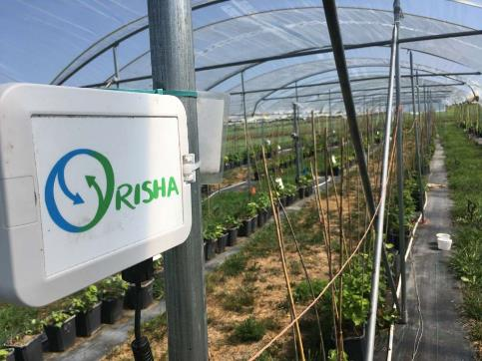
Decision-Support Tools
Quantitative measurements
  Soil moisture
  Weather conditions
  Irrigation system status
  Large diversity of sensors
    Ex.: Pressure, scale, leaf wetness, tension, water content, temperature…

Slide 23
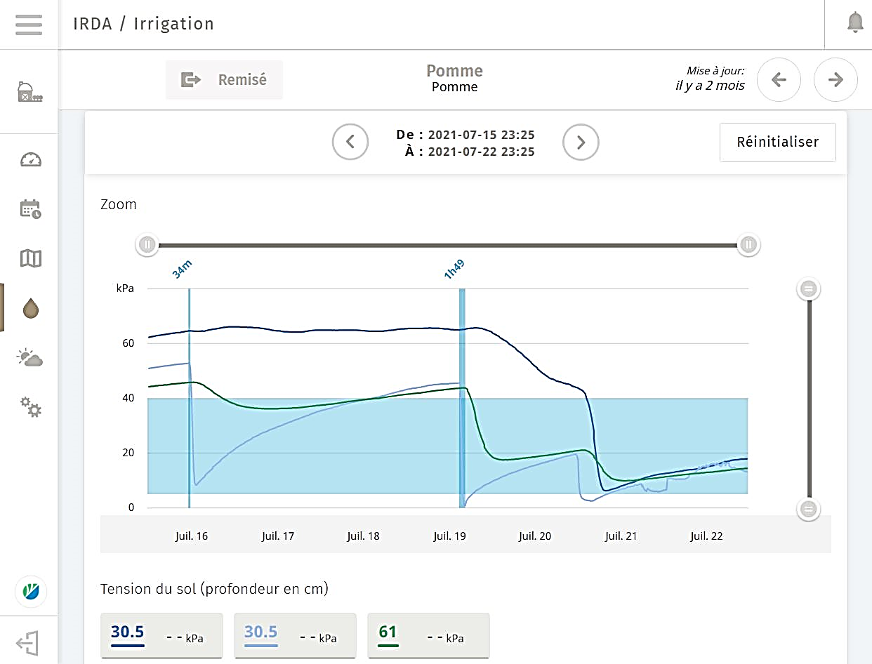
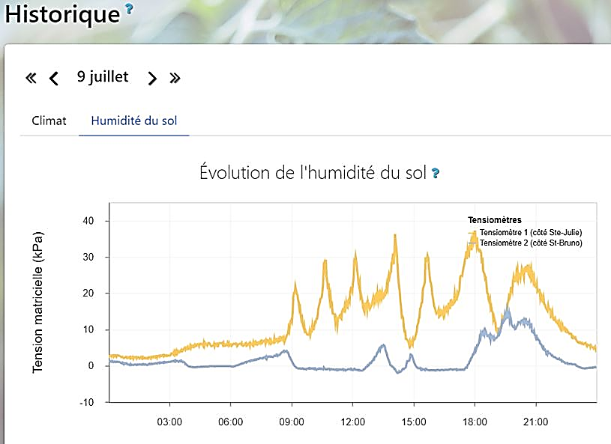
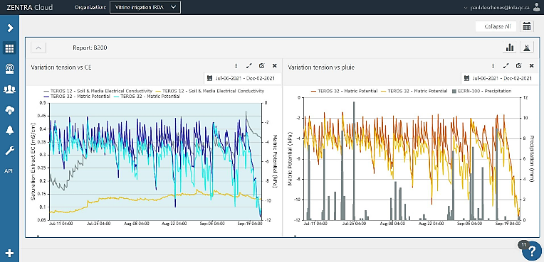
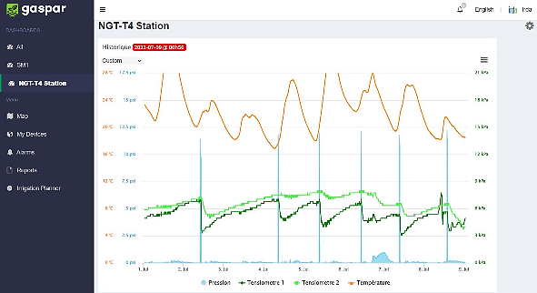
Decision-Support Tools
Various uses
  Anticipate irrigation start
  Validate irrigation threshold
  Validate irrigation duration
  Measure water input efficiency (rain, irrigation)
  Automatisation
  Water supplies management
  Real time data

Slide 24


Decision-Support Tools
Tensiometer
Volumetric water content probe
Notes:
The most common soil moisture probes utilized in our research projects and by growers in Québec are the tensiometers and the volumetric water content probes.

Slide 25
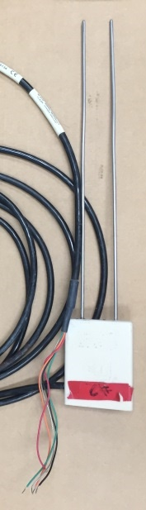
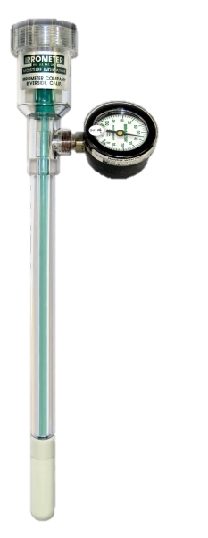
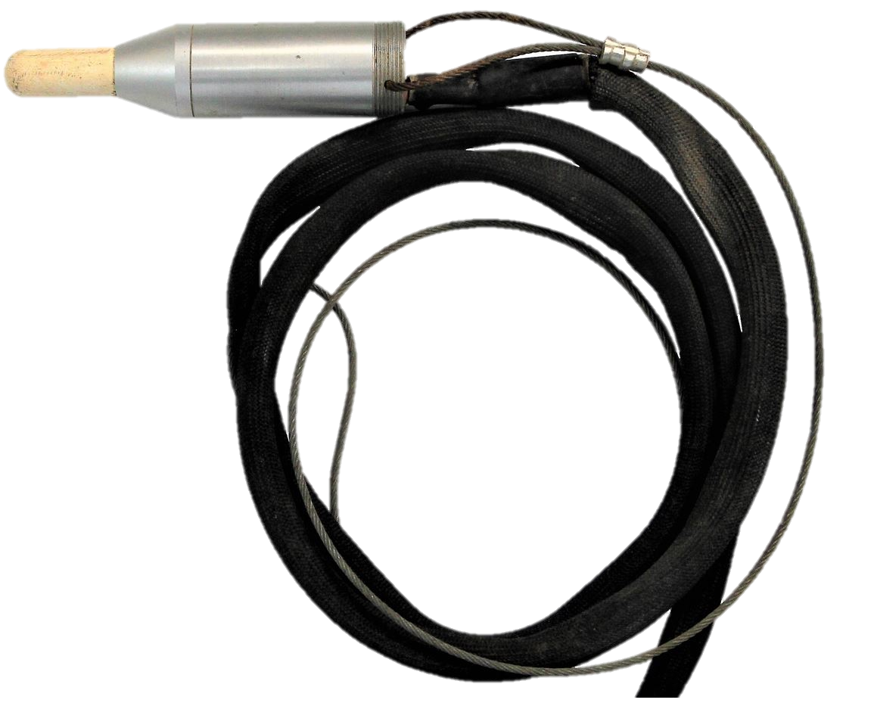
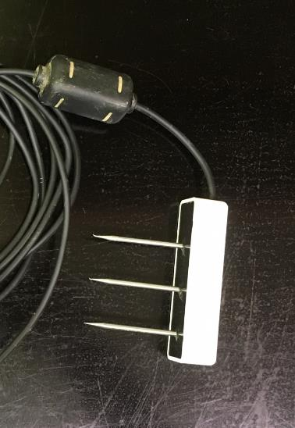
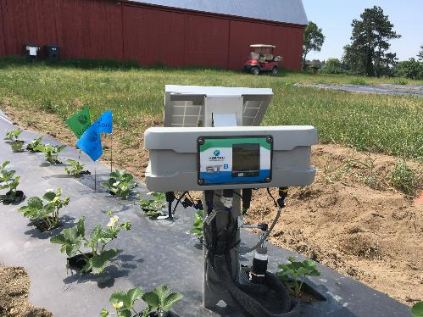
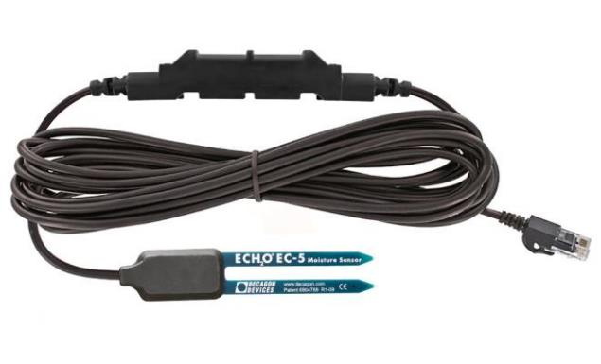
Decision-Support Tools
CS-625 - Campbell Scientific
SR Model - Irrometer
Teros 12 - Meter
ST Station - Hortau
ECH2O EC-5 - Onset
https://www.onsetcomp.com/products/sensors/s-smc-m005
Notes:
In our projects, tensiometers are mostly Irrometer models or from the Hortau company. For Irrometer models, several other companies utilize them with their technologies.
Water content probes are more diverse. We use mostly Campbell Scientific, Onset and Meter.

Slide 26
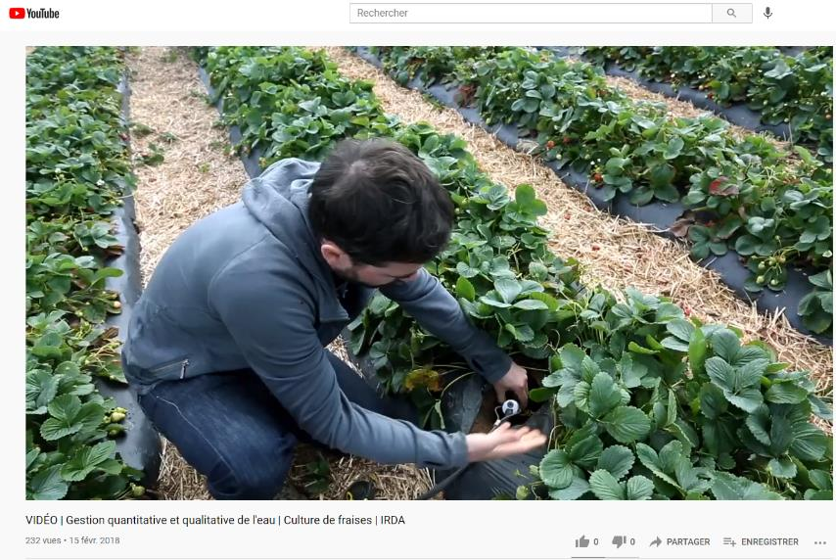

Decision-Support Tools
Tensiometer installation (strawberry and potato crops)
  https://www.youtube.com/c/IRDAgroenvironnement/videos
Notes:
We produced two short videos on tensiometer installation in strawberry and potato crops. You can watch them on IRDA’s youtube page.

Slide 27



Decision-Support Tools
Technology showcase of irrigation management decision-support tools (2020-2021)
https://www.irda.qc.ca/fr/projets-recherche/vitrine-irrigation/
(Deschênes, Boivin et Vallée, 2021)
Notes:
We did in 2021 a technology showcase presenting 18 tools in irrigation management and we evaluated them in different cropping systems. Our goal was to help growers make a decision on witch technology would be appropriate for their needs.
If your interested you can download the document on our web site.

Slide 28

Ongoing Projects –
Precision Mobile Drip Irrigation
Center pivot conversion to mobile drip irrigation system
Crop rotation: Potatoes - corn - soybean
Water inputs directly on soil
  Reduce water evaporation
  Avoid wetting the leaves
  Avoid pesticides washing
Less water per irrigation event
  Reducing nitrate leaching potential
Ongoing project IA221671

Slide 29


Ongoing Projects –
Rainfall Valorization Demonstration Project
Water supply is a challenge for many farms
Rain water recovery and storage has been identify as a potential solution
3 years demonstration project started in 2021
Water catchment
  Buildings surface
  High tunnels surface
Storage
  Burried tanks
  Existing irrigation ponds
Uses
  Seasonal employees (non drinkable water needs)
  Pesticide spraying
  Crop irrigation
Ongoing project PDS203002
Notes:
There’s an ongoing project studying rainfall valorization

Slide 30




On-going Projects –
Rainfall Valorization Demonstration Project
1 tunnel: 240 raspberry pots (268 m²)
100 % irrigation dependent
Daily irrigations
May 15 to Oct. 15 (153 days)
0,48 to 0,84 m³ : Daily water use
111 m³ : Growing season water use/tunnel
Rainfall hypothesis
  May 15 to Oct. 15 (2015 to 2019)
136 to 158 m³ could have been recovered
108 to 142 % of total water use
Must consider days without rain
Ongoing project PDS203002

Slide 31

Conclusion
Irrigation management must consider:
  Soil
  Cropping system
  Crop water needs
Field observations
  Don’t be afraid to dig (water distribution, roots growth…)
  Irrigation management decision-support tools (tensiometers, water content probes, weather stations data…)
Ask questions

Slide 32
References
Boivin et coll., 2018. Gestion raisonnée de l’irrigation, CRAAQ, 312 p.
Boivin, C et P. Deschênes. 2011. « Stratégies d'irrigation dans la fraise à jours neutres ». IRDA. 80 pages.
Deschênes, P., C. Boivin, D. Bergeron. 2017. « Évaluation de stratégies d’irrigation afin d’améliorer la nutrition minérale de la fraise d’été (cv. Clery) biologique produite sur sol recouvert de paillis de plastique noir ». IRDA. 15 p.
Deschênes, P., C. Boivin et J. Vallée, 2021. A technology showcase of irrigation management decision-support tools for use in a variety of contexts, Research report. IRDA. 14 p. and annexes.
Dugdale et coll., 2012. WATERpak – a guide for irrigation management in cotton and grain farming systems, Third Edition, Australian Government, Cotton research and Development Corporation, 495 p.
North Dakota State University (NDSU), 2017. Soil, Water and Plant Characteristics Important to Irrigation (AE1675 Revised), 16 p.
OMAFRA, 1990. Programme d'irrigation des tomates - Méthode du bilan hydrique, Agdex 257/560
Shock et coll., 2013. Irrigation monitoring using soil water tension, Oregon State University, Extension Service, EM 8900, 9 p.
Van der Gulik, 2010. Landscape Drip Irrigation Scheduling Calculator Users Guide, Irrigation Industry Association of British Columbia (IIABC), 26 p.
Ongoing project IA221671. Mise à l’essai d’un système d’irrigation goutte à goutte mobile en contexte d’entreprises spécialisées dans la production de pommes de terre. IRDA.
Ongoing project PDS203002. Projet pilote sur la valorisation de l'eau provenant des précipitations dans la filière des productions horticoles. IRDA.

Slide 33
Contact
Paul Deschênes, agr., M. Sc.
Research Assistant | Water Management
Research and Development Institute for the Agri-Environment (IRDA)
335 Vingt-Cinq Est road, Saint-Bruno-de-Montarville (Québec) J3V 0G7
Tel. : 450 653-7368, ext. 381 | Cell. : 450 502-0540
Email : paul.deschenes@irda.qc.ca | Website : www.irda.qc.ca

Slide 34
?
QUESTIONS

