Slide 1
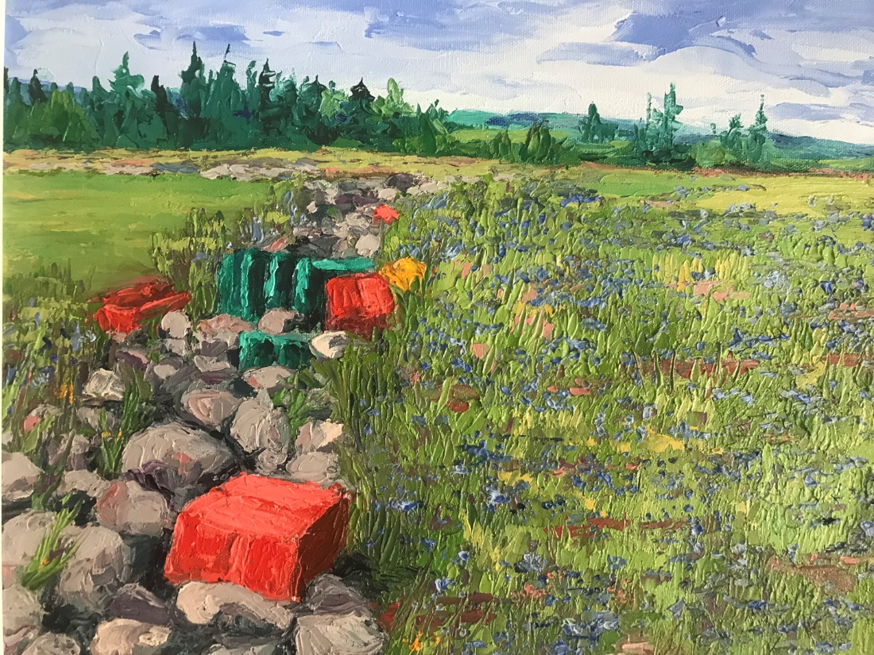
All we know about irrigating wild blueberry fields.
David Yarborough – University of Maine
Horticultural Congress Fredericton, NB
March 15-16, 2023
Notes:
This is the second talk that I have given on irrigation at the Horticultural Congress, the first was in 2000, a lot has happened since then.

Slide 2
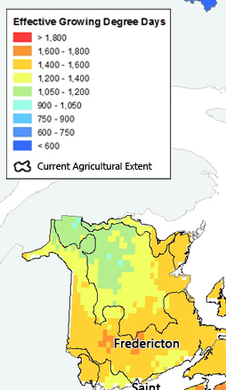
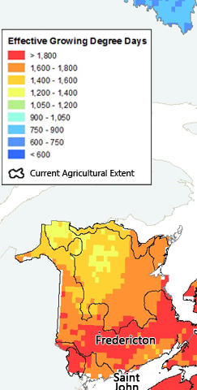

1971 -2000
2010 -2039
Notes:
Also see increase in growing degree days in NB but less in Tracadie region because of the influence of the ocean in moderating temperature

Slide 3
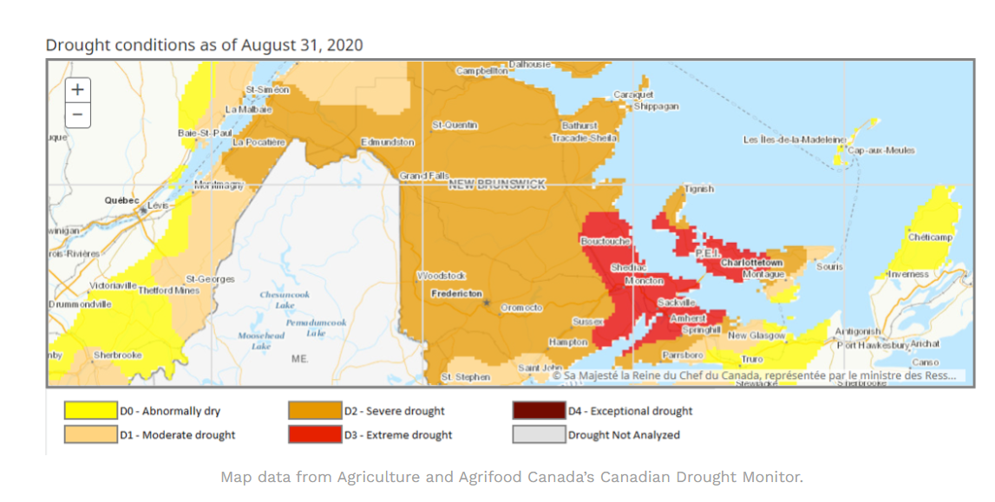
Precipitation in 2020 just 43% of previous levels and in 2017 59% of normal
Blue acres wild blueberry farm in Richibutuco lost 70% of the crop from drought and frost
from 2017-2020
Notes:
Drought events have reduced production in recent years

Slide 4
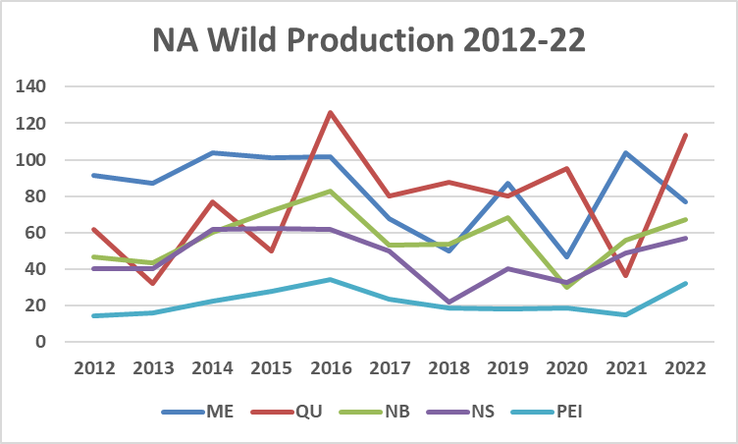
Notes:
Wild production continues to be highly variable principally caused by both uneven rainfall and frost and freeze events

Slide 5
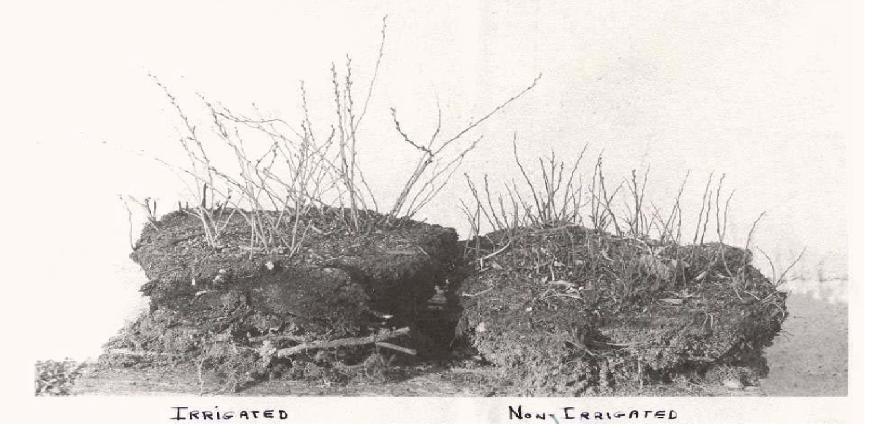
Irrigation work started in Maine in 1949 and continued for 7 yr Irrigation was beneficial in some year but not all
Determined that Irrigation should be done on both prune and crop year to get full potential
Notes:
These events have occurred in the past and research efforts on irrigation for wild blueberries have been conducted since 1949

Slide 6
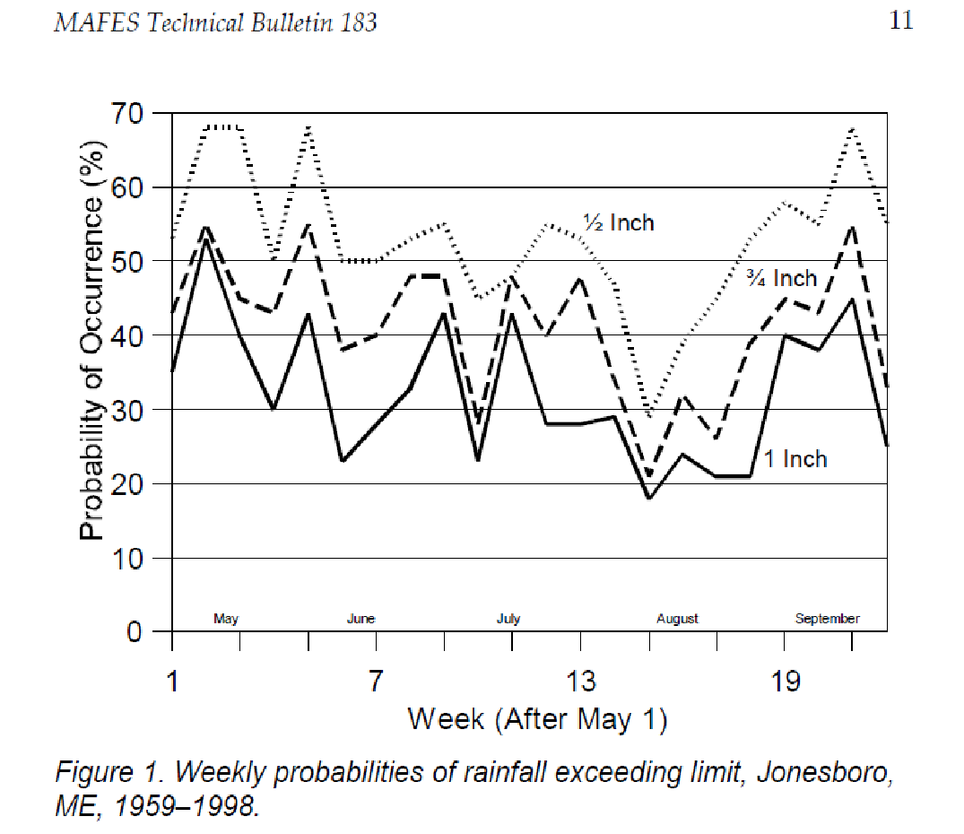
Dalton, Files Yarborough 2002 Investment, Ownership and Operating costs of supplemental Irrigation Systems for Maine Wild Blueberries
The probability of receiving 1” per week for
the entire growing season less than 50%
Notes:
A 2002 study conducted in Maine has determined The probability of receiving 1” per week for
the entire growing season less than 50% with the lowest probability coming in August

Slide 7
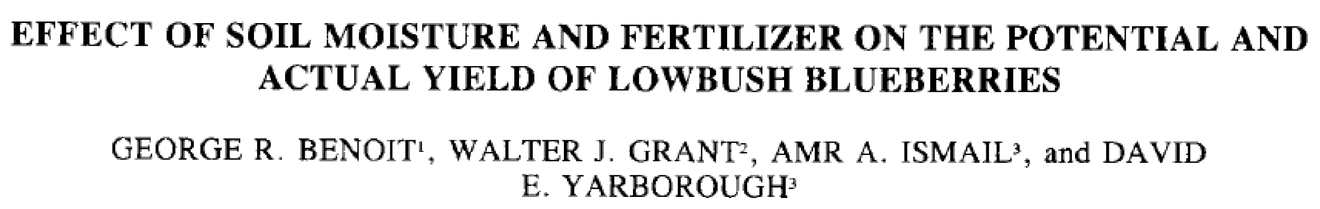
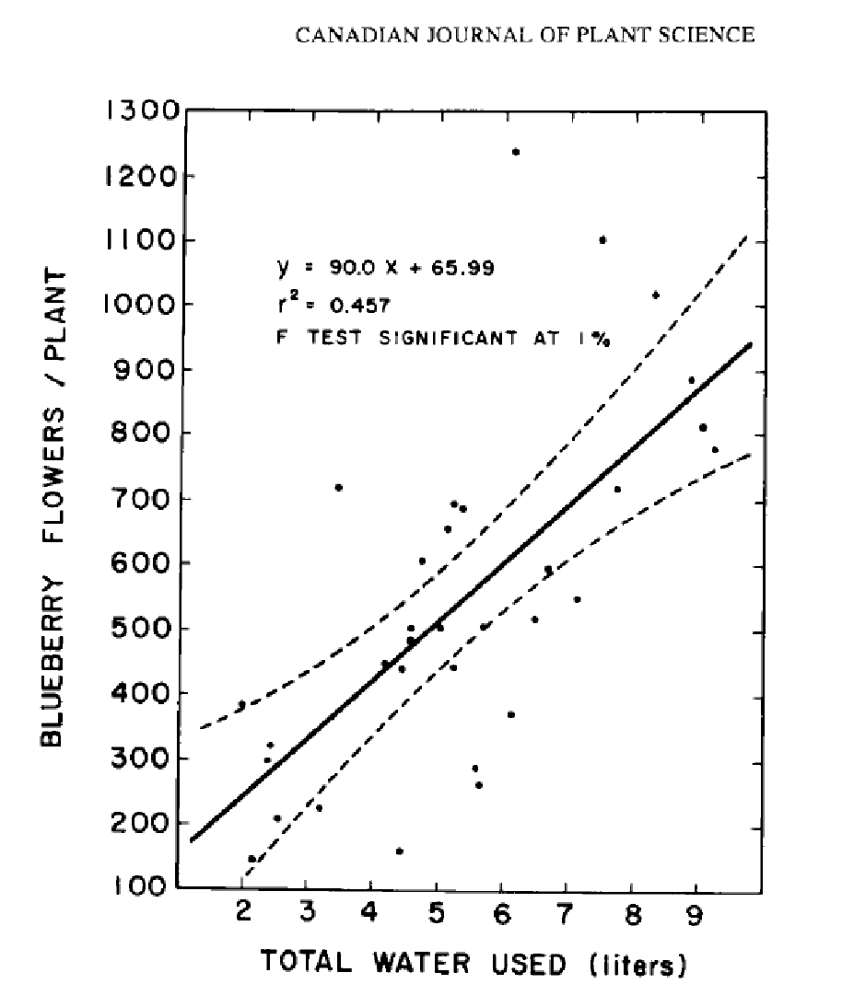
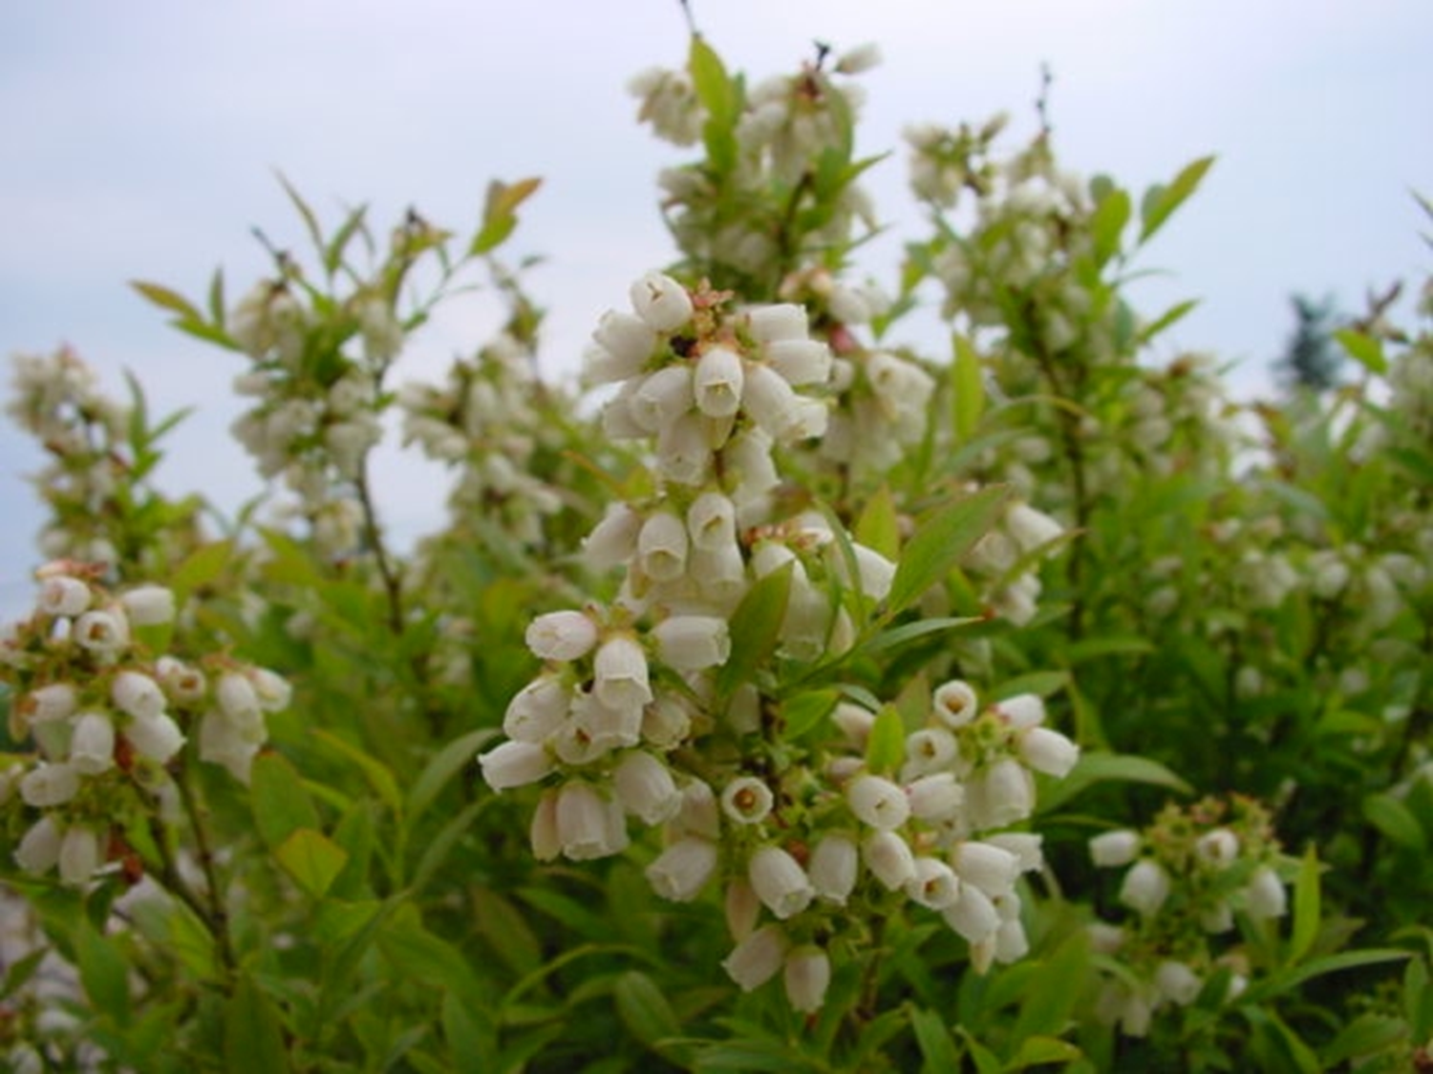
Irrigation in the prune year increased yield in the crop year 1984
Notes:
A 1984 study in Maine showed a strong relationship with the increase in flowers with available water

Slide 8
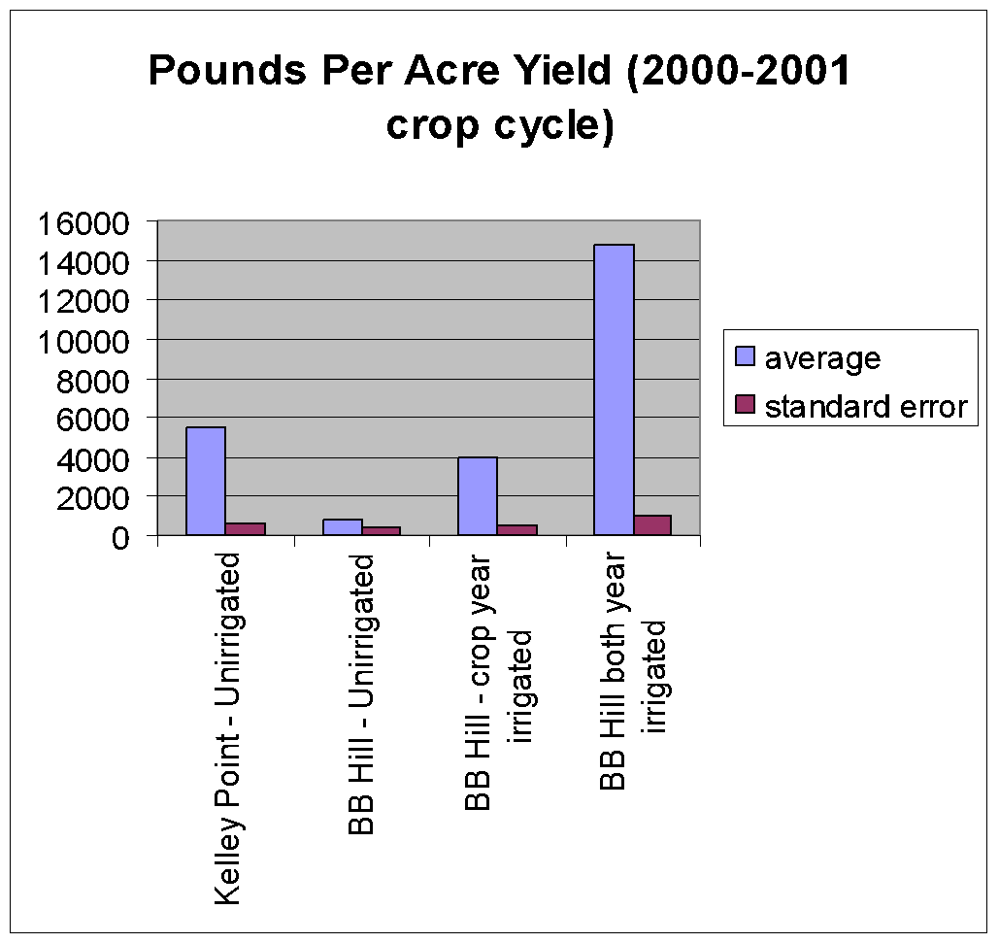
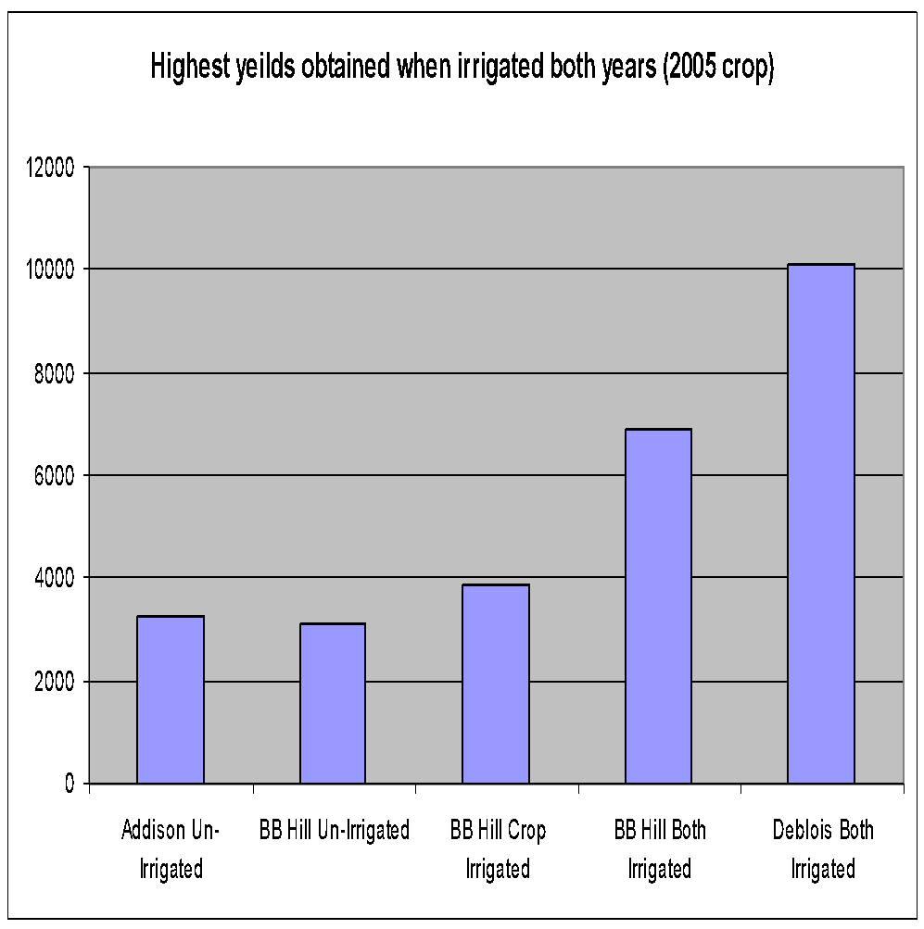
(Lb/a)
UMaine research 2000-2006 revealed significant increases in yield with both prune and crop year irrigation
Yields on irrigated fields 43% higher than rain fed fields in 2001
Notes:
Irrigation studies have shown that addition water in both the prune and crop years are needed to produce high yields

Slide 9
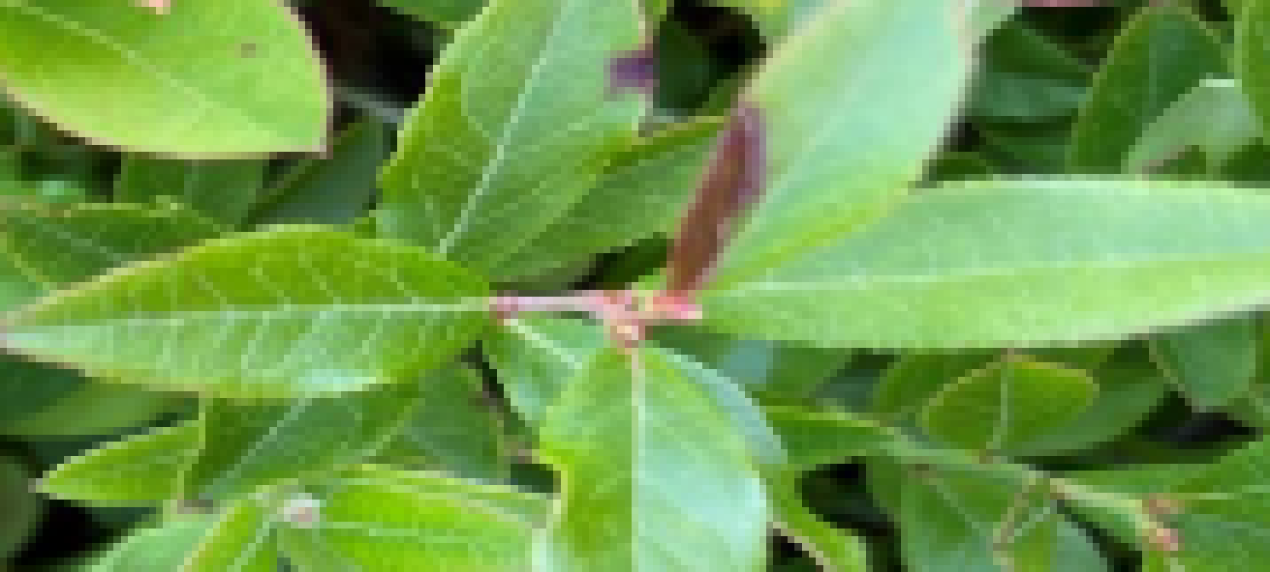

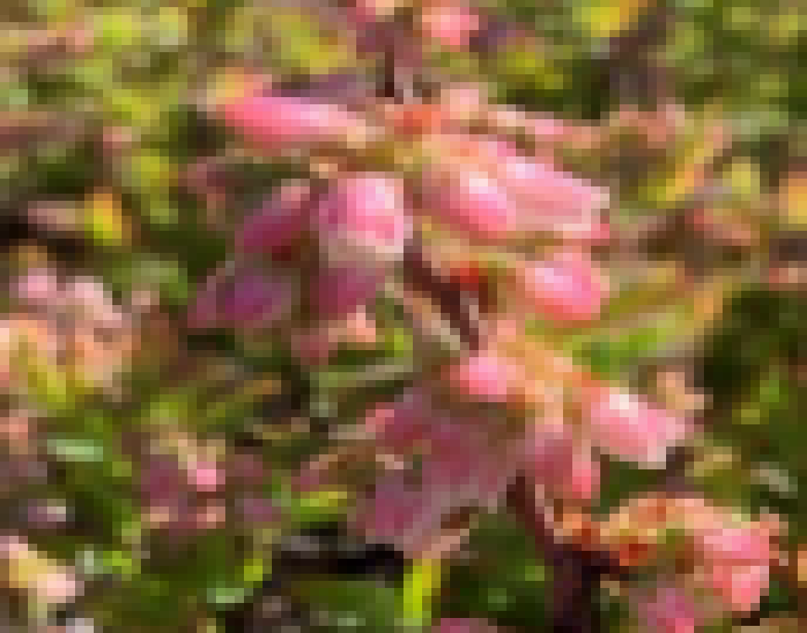
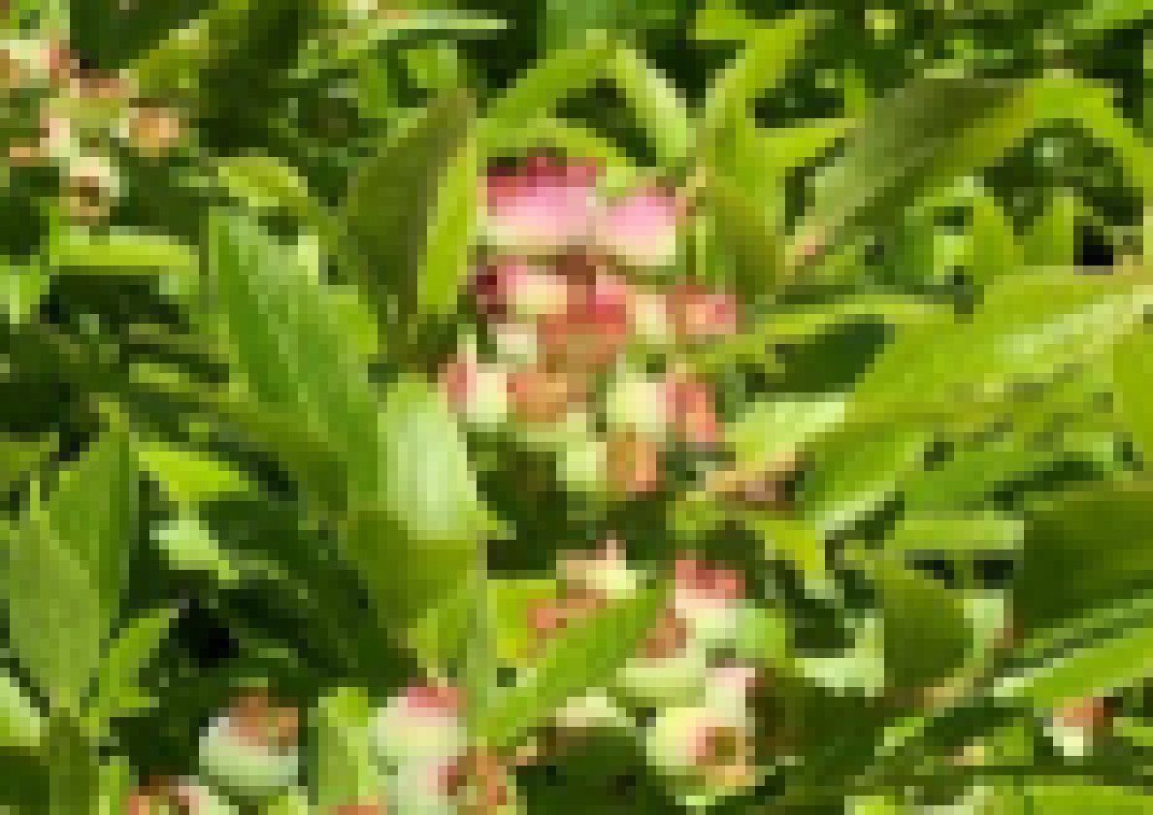
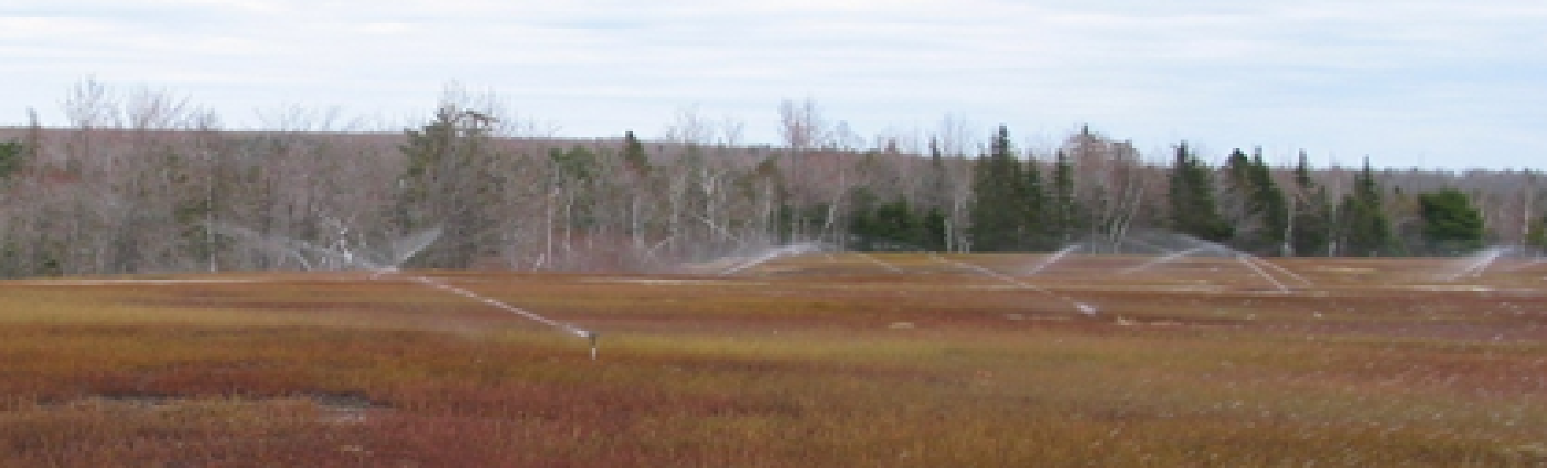
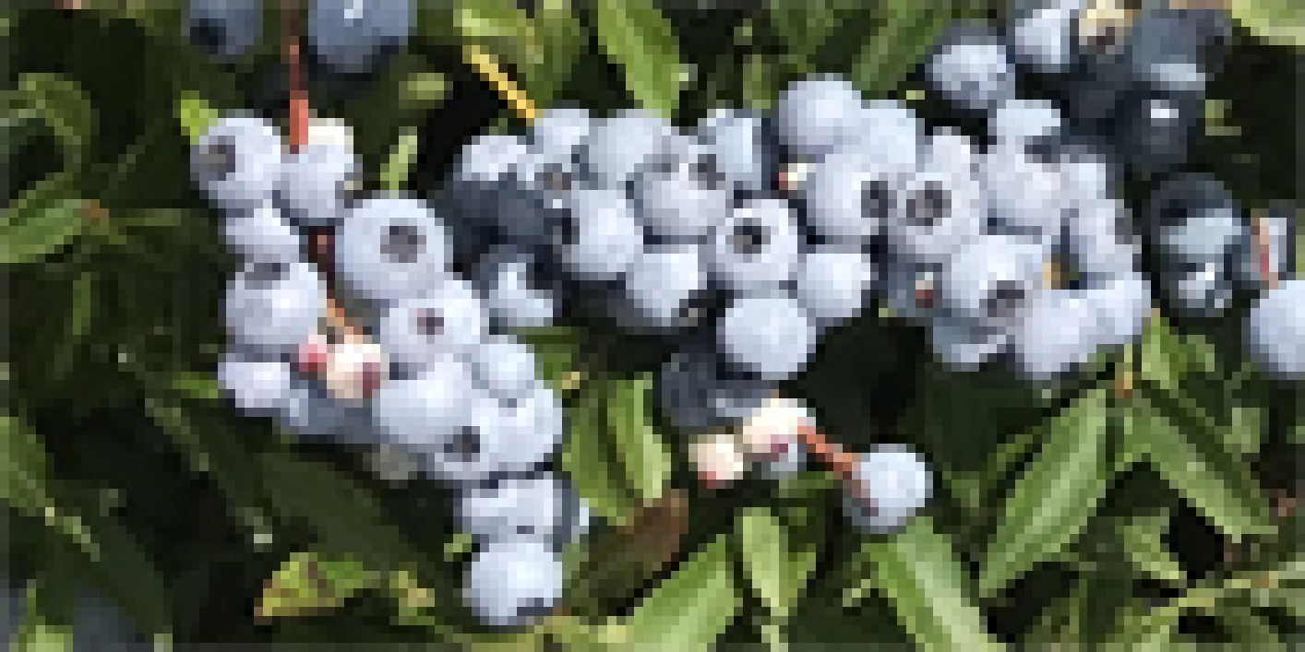
Wild blueberry plant physiology
Prune year
Requires adequate water for plant growth: stem length, buds and flowers formed
Also need water for cooling with high temperatures via transpiration from leaf stomata
Crop year
Requires adequate water for flower nectar and fruit development – fruit will be aborted with June drop and in July if there is not adequate water and will shrivel later in the season as the plant takes back moisture
Also need water for cooling with high temperatures via transpiration
Is Drought Increasing in Maine and Hurting Wild Blueberry Production? UMaine 2021
Kallol Barai, Rafa Tasnim, Bruce Hall, Parinaz Rahimzadeh-Bajgiran and Yong-Jiang Zhang
Will Climate Warming Alter Biotic Stresses in Wild Lowbush Blueberries? UMaine 2022
Yu-Ying Chen, Pratima Pahadi, Lily Calderwood, Seanna Annis, Francis Drummond and Yong-Jiang Zhang
Notes:
Drought has increased some diseases but reduced others, the warmer temperatures will result in less water available to the plants

Slide 10
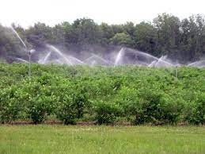
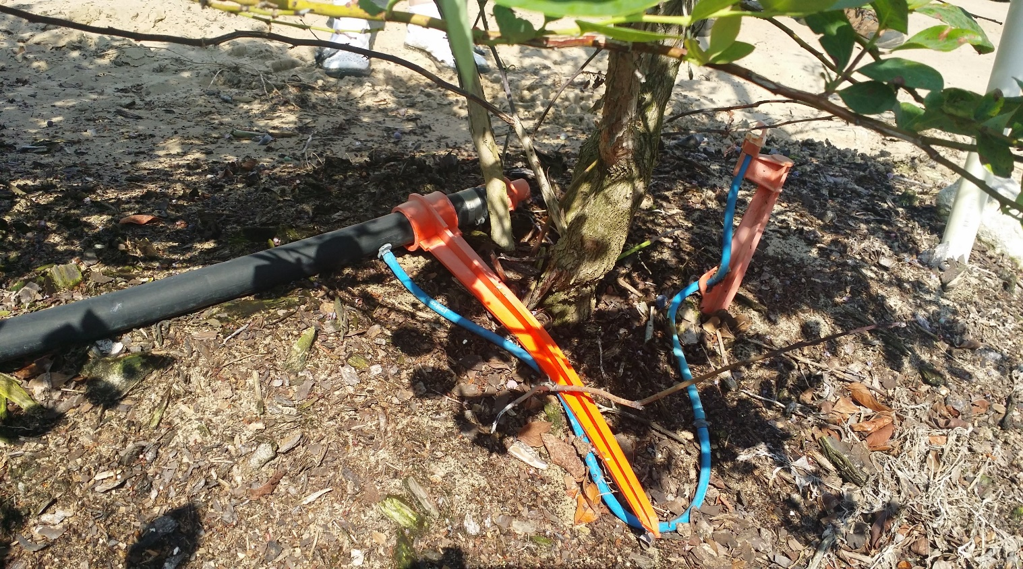
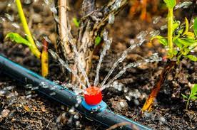
Cultivated blueberries typically have irrigation systems, overhead for frost and drip or trickle
MI has 70% of acres irrigated
Notes:
Most cultivated plants are irrigated with highly efficient drop for water and overhead for frost protection

Slide 11
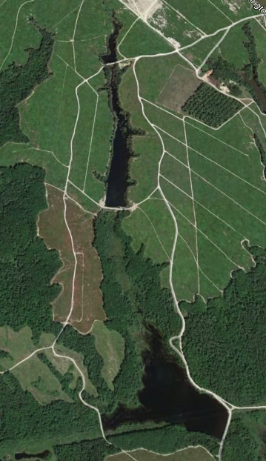
Water Sources
Rain – need 1” per week (27,154 gal/a)
Locating sufficient viable source first step
Pond/Reservoir – natural or artificial
Wells – need large capacity 18-24” or small well pumping
Into farm pond
River or streams – regulated
NB if > 50cuM/day= 13,1219 gal
NB farm well cost estimate in 2020 $250 to $500k
Need Diesel Irrigation Pump – 1000GPM > $25K
Investment System costs highly site specific
Regulatory and legal issues create risk and uncertainty
Notes:
Irrigation impoundments on wild blueberry barrens in Maine capture spring runoff

Slide 12
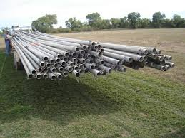
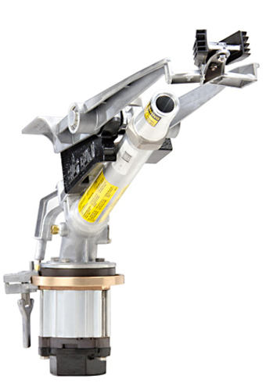
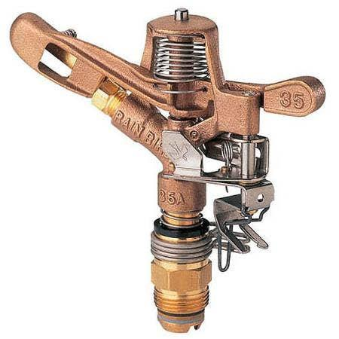
Aluminum pipe
Most expensive new increase 2x if you can get it
Least expensive used
Above ground use both large and small gun heads
High labor cost for setup and take down
Can use for frost control with small head
Not able to spray field for insect and disease control
Mostly used by smaller farms on limited acres

Slide 13
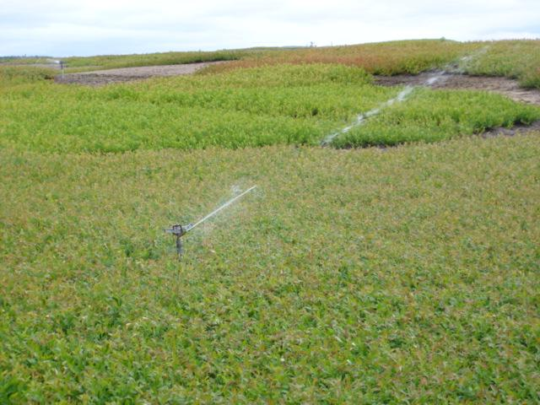
Small gun
In ground
More establishment
Costs
Less labor
than big gun as
all heads are
connected
Notes:
Same systems used in cranberry bogs

Slide 14
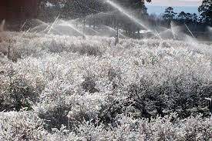
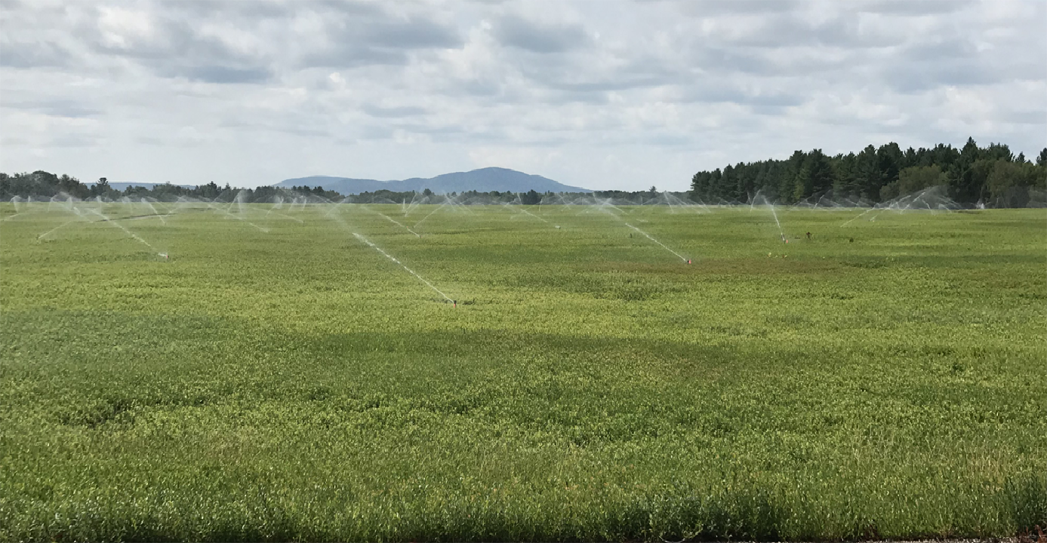
Small Gun
Best water
distribution
Frost protection
Notes:
For frost need adequate water since after ice is formed must be run until ice melted off from plant

Slide 15
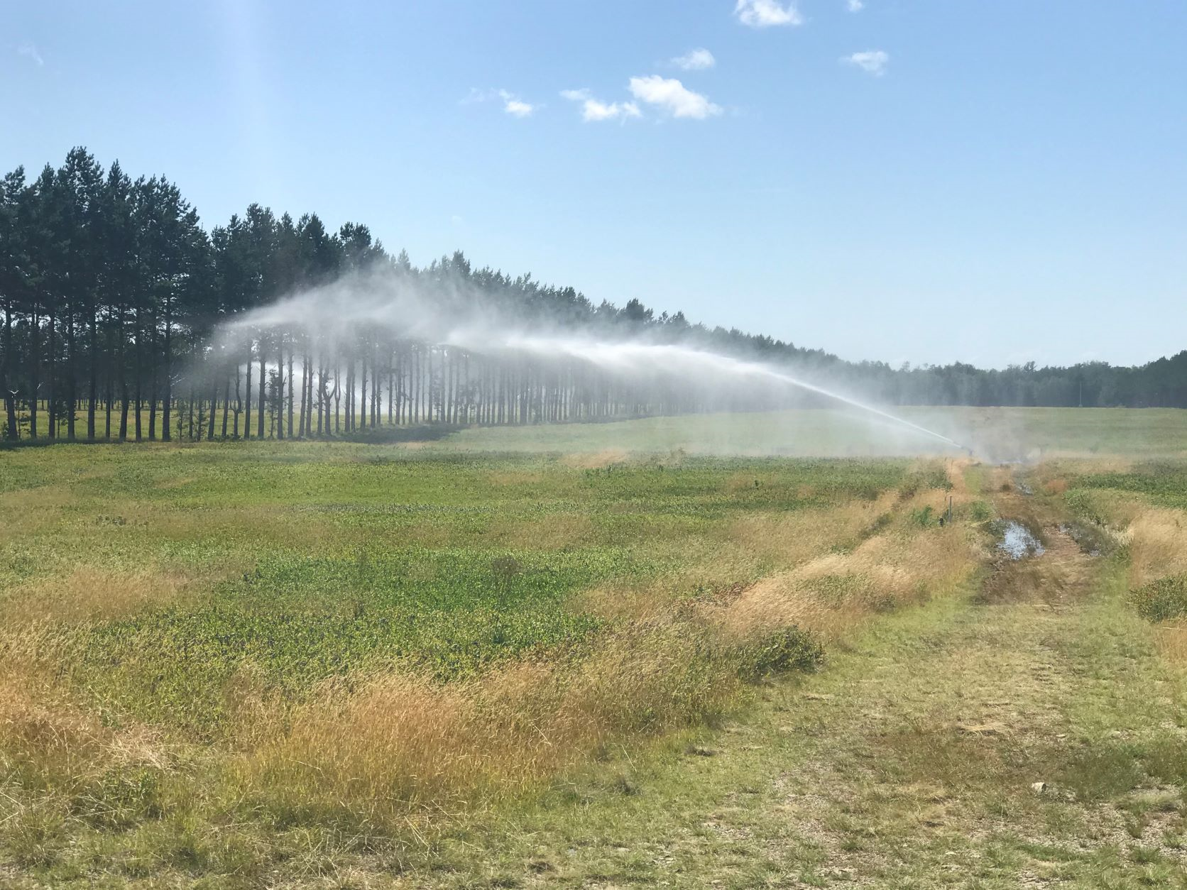
Large gun
In ground
Uneven coverage
PVC –more maintenance to drain
HDPE – more expensive no need to drain
Less establishment costs
More labor than small gun
Nelson 150 1 acre, Nelson 100 0.74 acre, head cost: $950-$1600 per head
Notes:
Heads have to be moved out but much less labor since pipes are in ground

Slide 16
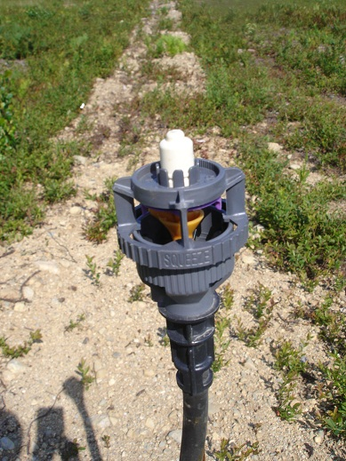
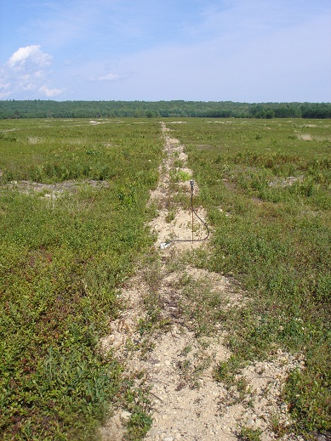
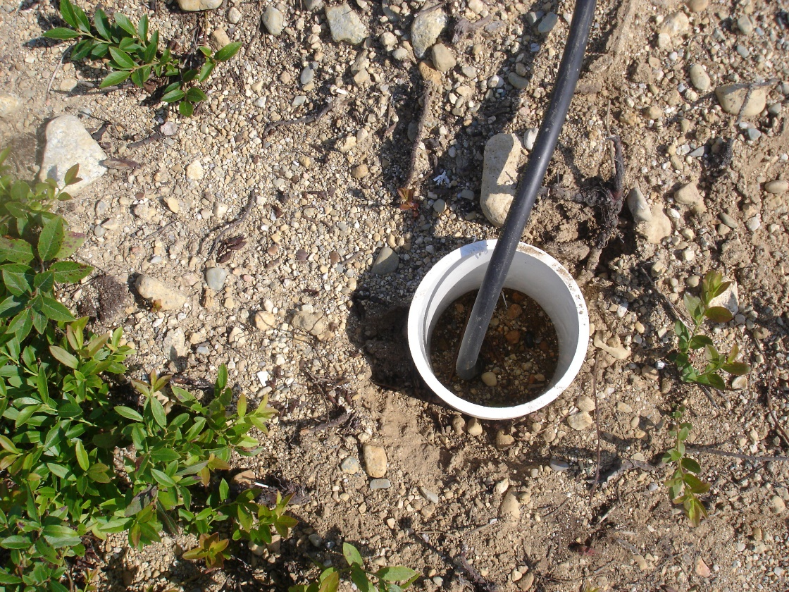
Low pressure small
In ground
Frost protection only
Notes:
Systems available that just provide frost protection use less pressure and water

Slide 17
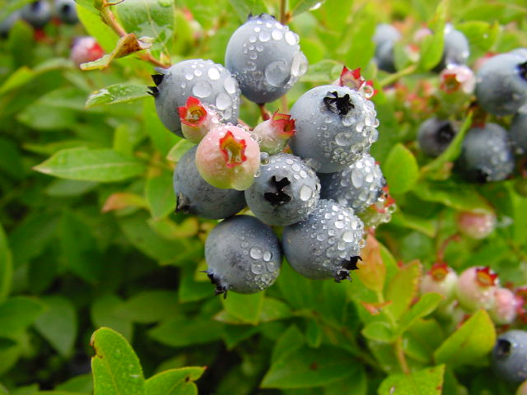
Wild blueberry irrigation in Maine
About 1/3 acres (14,000a) under irrigation
Mostly in Washington county on barrens
Mostly large gun systems on large farms
Aluminum pipe on small farms
NB only 2-3% (400-600a)
Notes:
Water improves fruit size and yield

Slide 18
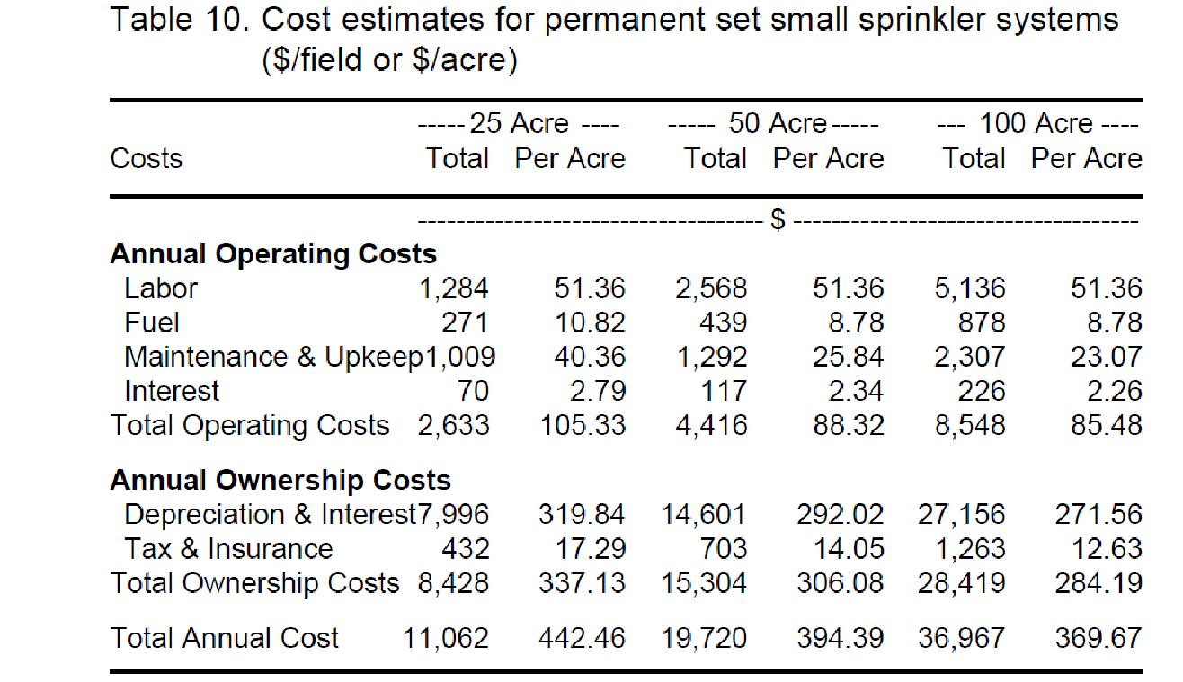
Operating and Fixed costs UMaine Tech Bull 183 2002 Dalton Files and Yarborough
747.75
Maine Blueberry barrens 2018 operating costs (labor&fuel) $100/a for in ground large gun
1966 J Burleigh Crane irrigation study $50/a operating cost & deprecation
=$462/a today dollars
Notes:
Systems costs are highly variable most recent cost study done in 2002 with current dollars in red but does not account for increase in fuel

Slide 19
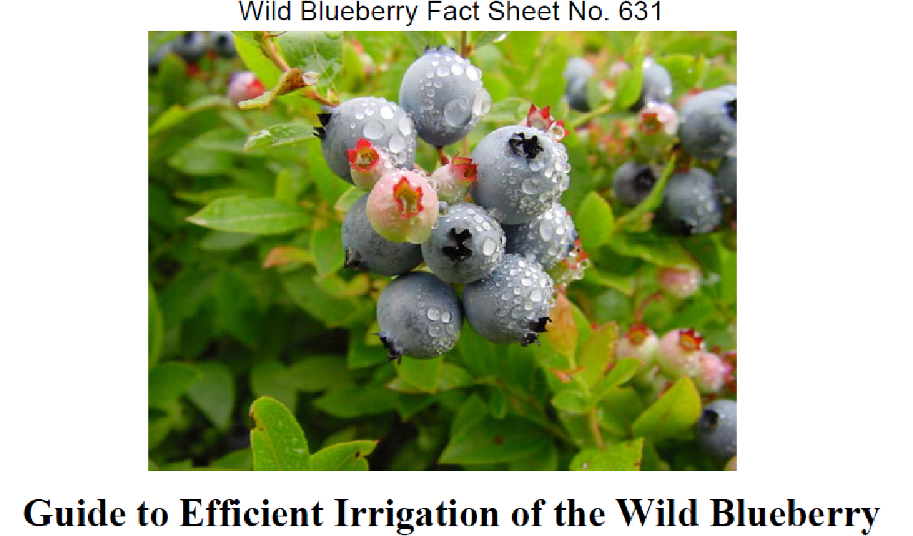
Hunt, Honeycutt and Yarborough 2009
Notes:
UM Extension Fact sheet summarizes our recommendations on irrigation in 2009

Slide 20
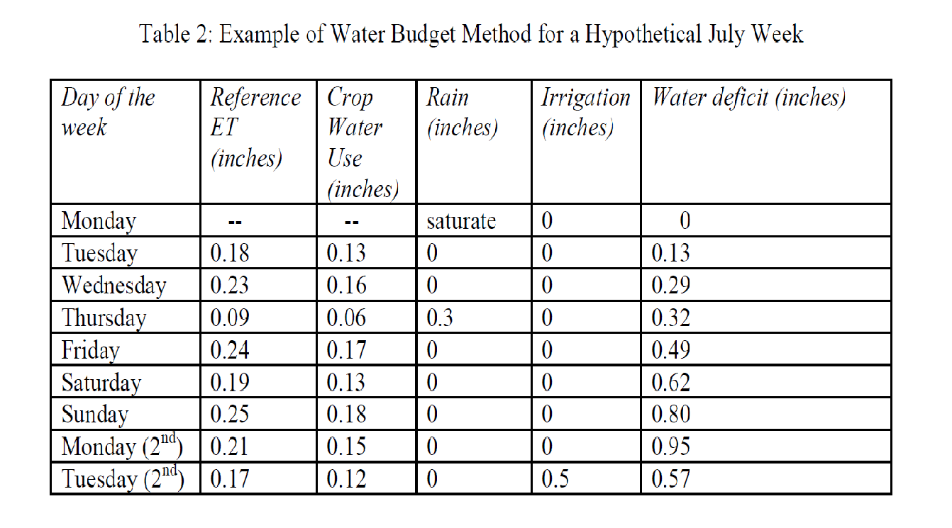
Estimating crop water use
Evapotranspiration (ET) – water evaporation and plant transpiration determine water use
or just add precipitation and irrigation total to 1 inch per week applied as ½ inch twice
Day of the Year (See chart) Worksheet included with Fact sheet or may be obtained from commercial weather stations for reference ET x 0.7 to get actual ET Reference ET x Kc = Actual ET
Latitude
Daily Minimum Relative Humidity (%)
Daily Maximum Relative Humidity (%)
Daily Average Relative Humidity (%)
Daily Average Air Temperature (F)
Daily Maximum Air Temp (F)
Daily Minimum Air Temp (F)
Daily Total Solar Flux (MJ/m^2)
Daily Average Wind Speed (mph)
Elevation above sea-level (ft)
Penman-Montieth Reference ET (inches)
NS weather stations use air temperature, relative humidity, average wind speed, and solar radiation data to estimate ET
It is calculated every hour and users can see daily and weekly ET totals

Slide 21
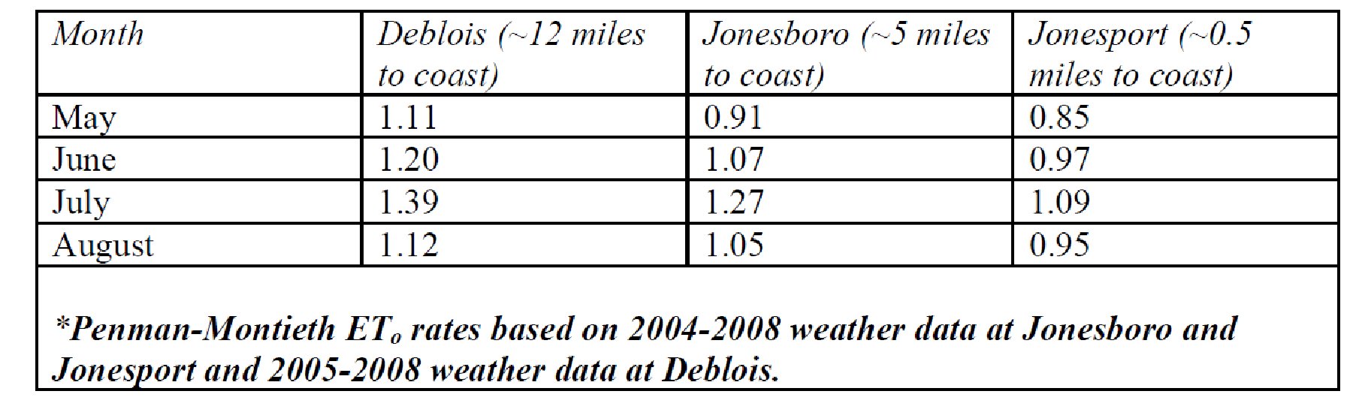
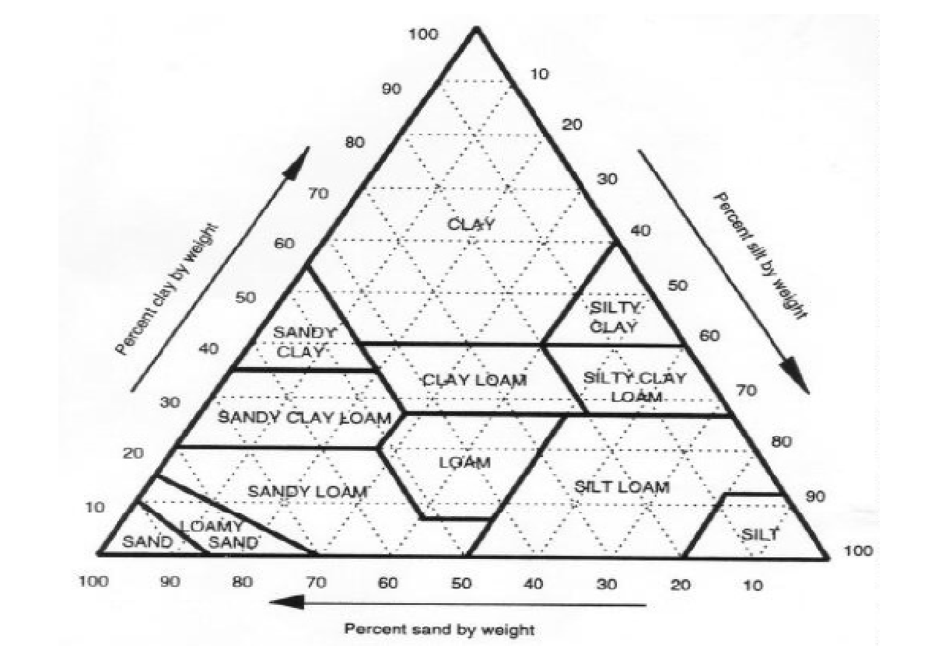
Effect of field location and texture
Coastal field require less water due to vapor deposition
Warmer temperatures increase ET and require more irrigation
Sandy loam soil only hold ¼ inch of water
Notes:
Research has revealed that costal fields get more moisture from vapor deposition and have less heat stress so require less irrigation

Slide 22
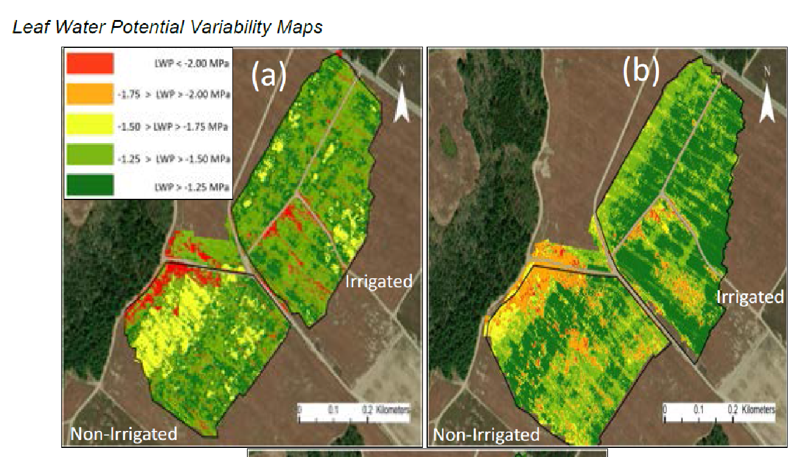
Barai and Zang Using UAV and thermal-based remote sensing to detect spatial variation in water stress of wild blueberries UMaine 2023
UAV-based thermal sensors and calculated Crop Water Stress Index (CWSI) can effectively monitor crop water status remotely.
By detecting the temporal-spatial heterogeneity of crop water status, irrigation can be intelligently controlled by adopting precision irrigation management systems to minimize crop water stress, maximize overall production, and save water use.
Notes:
New research shows promise of using UAV sensors to determine irrigation water needs but this has not yet been put into commercial practice

Slide 23
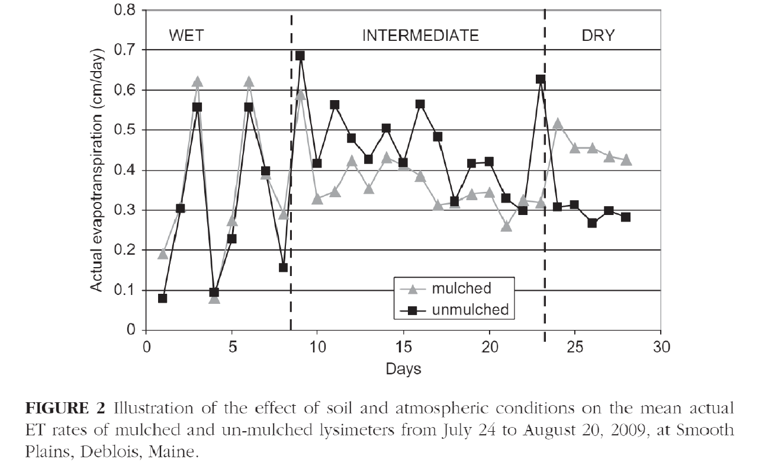
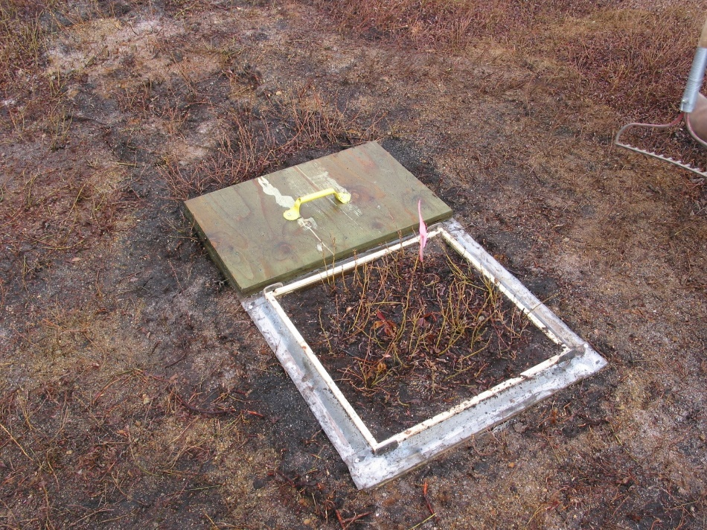
Mulch studies
Hunt, Honeycutt, Yarborough 2010 UMaine Effect of Pine bark Mulch on
Lowbush Blueberry water Demand
3”
Notes:
Mulch as been shown to limit ET when there is intermediate stress so it is available when it is dry by using weighing lysimeters to determine actual soil moisture

Slide 24
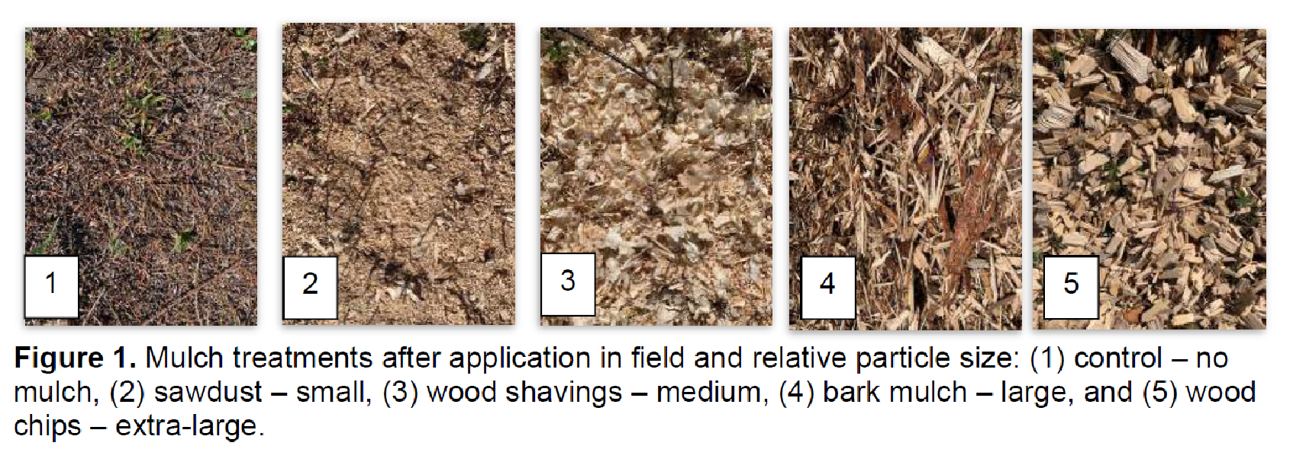
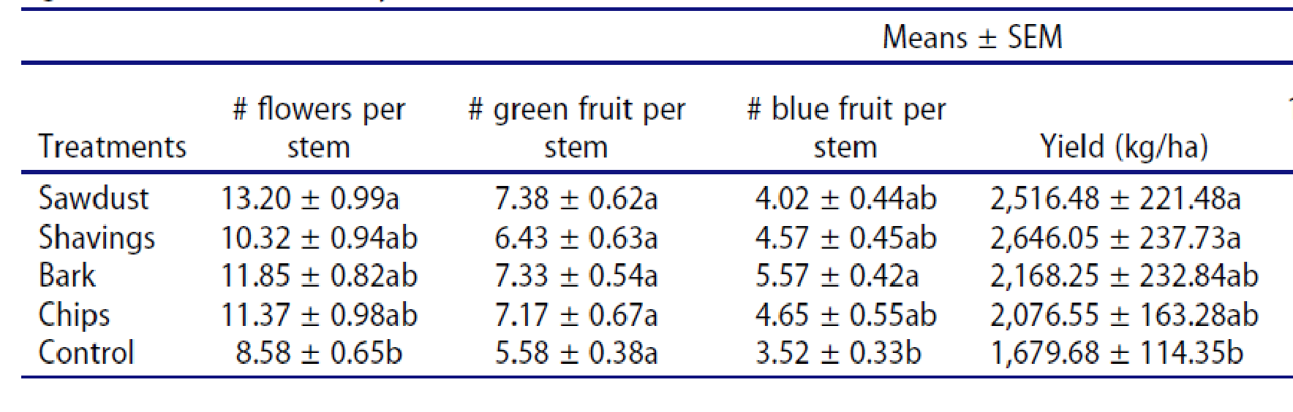
Mulch studies
Gumbrewicz, Calderwood 2022 UMaine Comparison of wood chip particle size for wild blueberry management …
Notes:
Recent mulch research indicated sawdust and shavings increased flowers per stem and yield

Slide 25
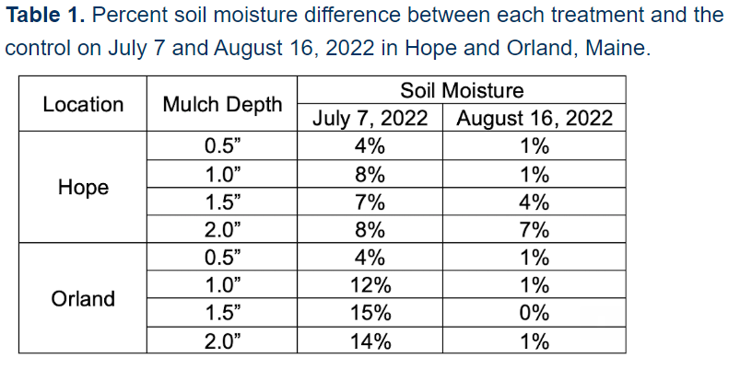
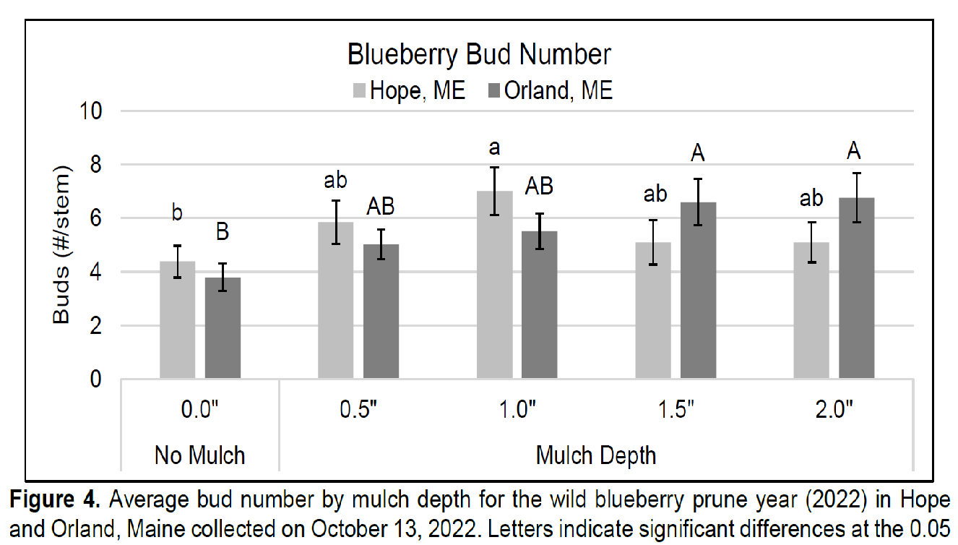
Mulch studies
Calderwood, Tooley, Scallon 2023 UMaine Whole field mulching for wild blueberry mulch management
Notes:
It also found increased soil moisture with increasing mulch depth with more buds at a depth of over an inch

Slide 26
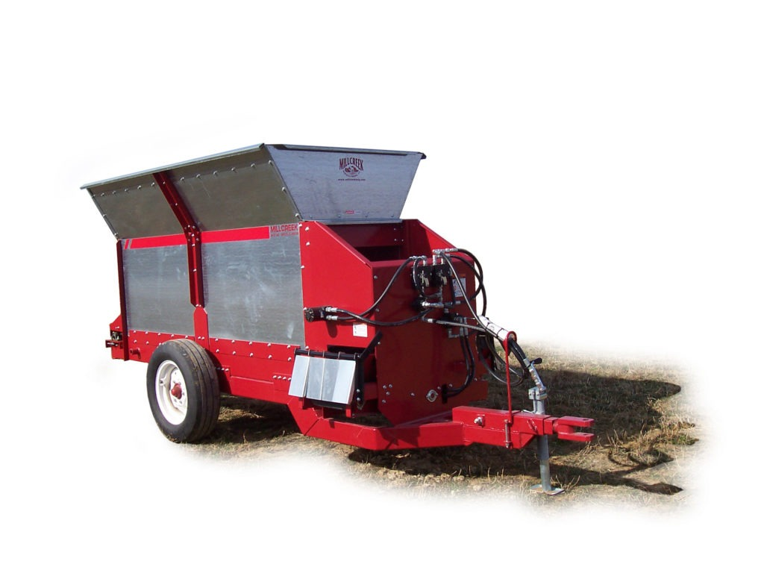
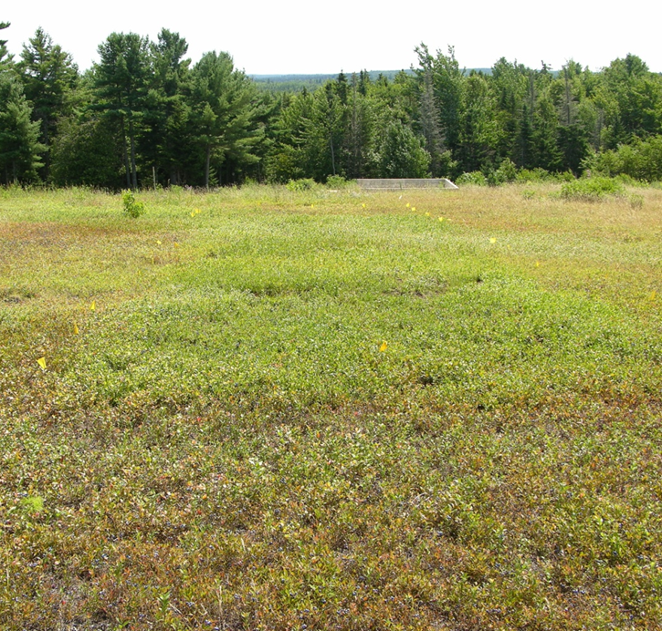
Mulch applications
Mill Creek row mulcher 4.4 yds 1”/acre = 135 cubic yards
Sunkaze Farm owner indicated the mulched part of the field was “like the field was irrigated”
Notes:
Some growers have invested in mulching and use commercial machines to reduce costs and improve efficiency of spreading mulch

Slide 27
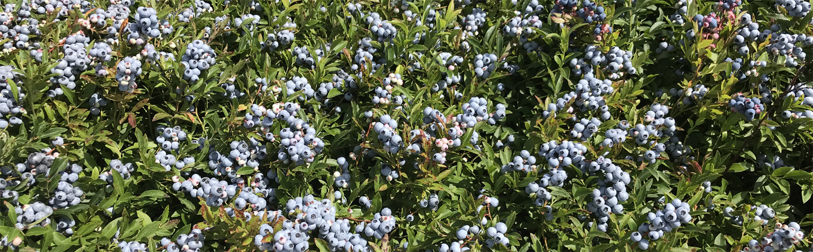
Considerations
Warmer temperatures uneven precipitation and frost will increasing limit yields
Irrigation can mitigate these effects and reduce crop variation
Locating adequate water source and permitting are barriers to adoption
High cost of irrigation systems and lack of government support prevent adoption
Need to have high yielding fields with full cover and inputs to support higher yields,
i.e. mulch, weed, fertilizer, pollination, disease and pest control optimized
Want to double 5,000 lb/a not 2,000 lb/a
Notes:
So should you invest in irrigation? Irrigation alone is not enough, need to optimize inputs to double a much larger yield

