Slide 1
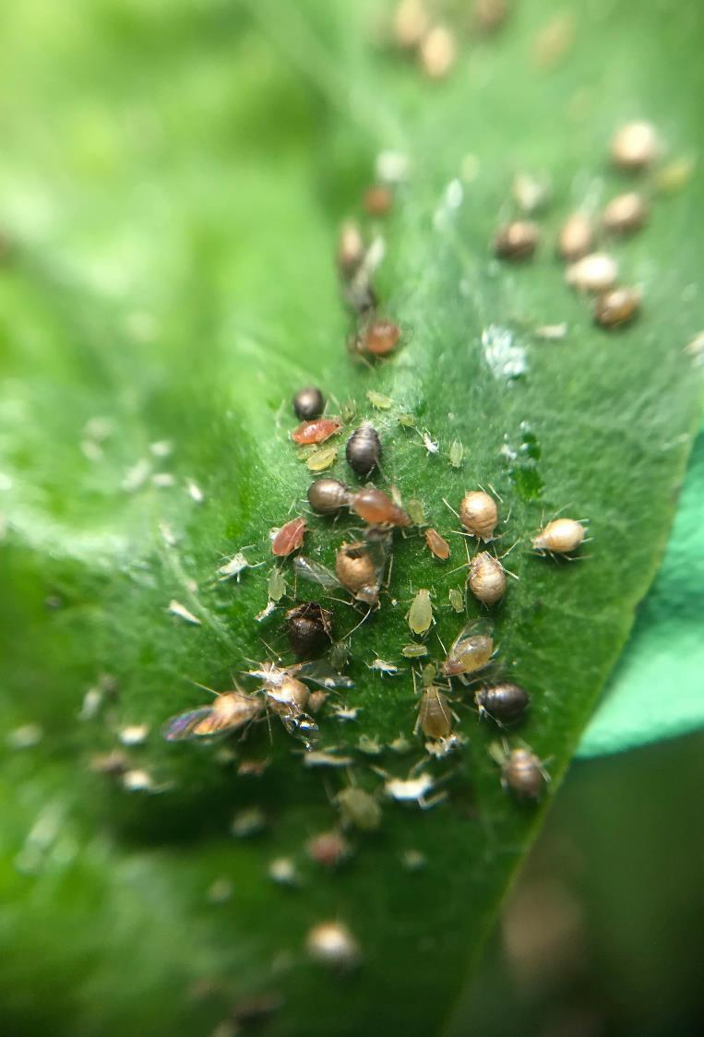

Common greenhouse pests and control options
Geneviève Labrie, Ph. D. Chercheure, CRAM
New Brunswick Hort Congress March 15th 2023

Slide 2

Outline of the presentation
Integrated pest management
Overview of vegetables greenhouses in Quebec
Survey of phytosanitary problems in greenhouses (2018-2019)
Réseau des Serres Sentinelles (monitoring network in Quebec)
Main pests and diseases observed in vegetables greenhouses
Control options

Slide 3
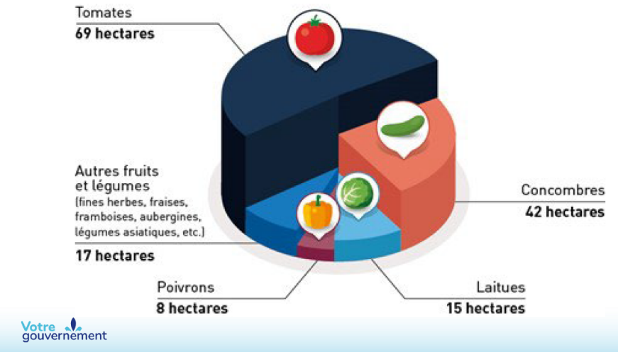
Overview of vegetables greenhouses in Quebec province
313 ha of greenhouses (151 ha in vegetables)
676 producers of vegetables and fruits in greenhouses
467 < 1000 m² (69% of producers) = 9% total greenhouses area
209 producers (31%) > 1000 m²
16% in organic production
  24 ha of tomato, cucumber, pepper, lettuce
  25 ha of diversified crops
Greenhouses provide 50% of fruit and vegetable consumption of the province
Leblanc, J. 2022. Colloque maraîcher en serre

Slide 4
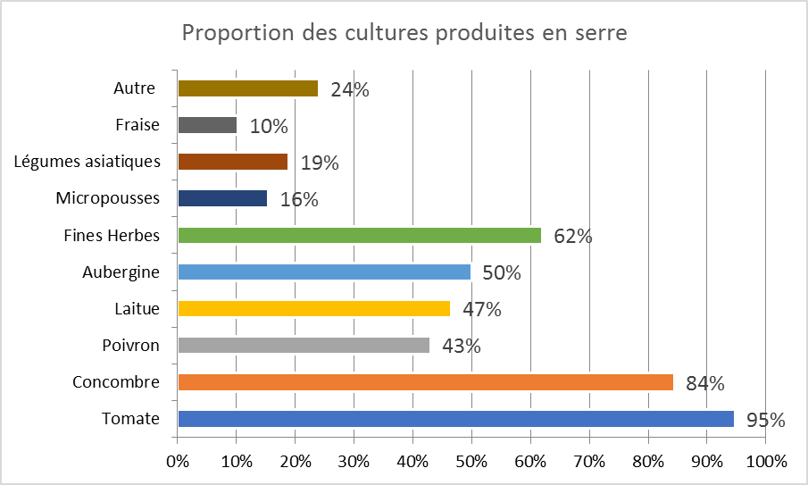
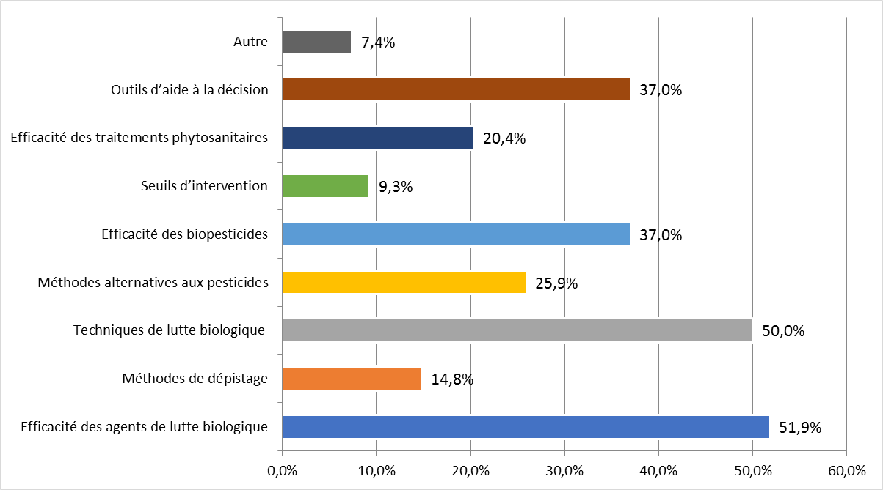
Survey of phytosanitary problems in vegetables greenhouses in 2018-2019
Research priorities
Questionnaire on pests and disease problems in vegetables in greenhouse sent to 314 producers in Quebec (58 responses)
Objective to identify the main problems and needs in research for producers
Priorities on disease management
Priorities in entomology
Spider mites
Powdery mildew
Striped cucumber beetle

Slide 5
Monitoring network in vegetables greenhouses in Quebec
Between 50 and 100 greenhouses monitored each year since 2020
> 20 crops monitored
27-30 pests/year; 22-25 diseases/year
Monitoring each week by agronomists (private, government, and CRAM)
Identifications of pests and disease confirmed by Laboratoire d’expertise et de diagnostic en phytoprotection – MAPAQ identification laboratory
Control options used by producers noted
Discussions between agronomists, producers, researchers

Slide 6
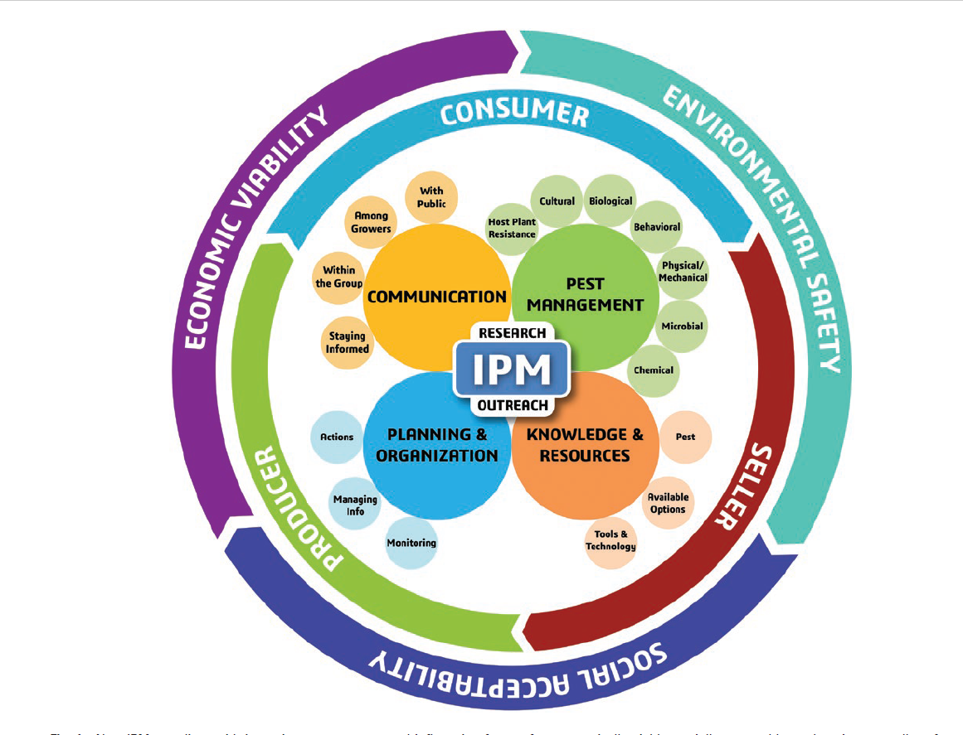
Integrated Pest Management
Monitoring
Knowledge of the pest or disease
Preventive methods
Curative methods (pesticides are the last choice in the IPM)
Communication
Dara, 2019

Slide 7
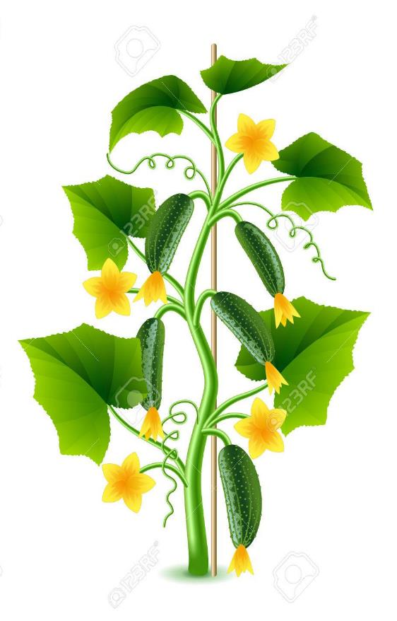

Optimal control with multiple control methods

Slide 8
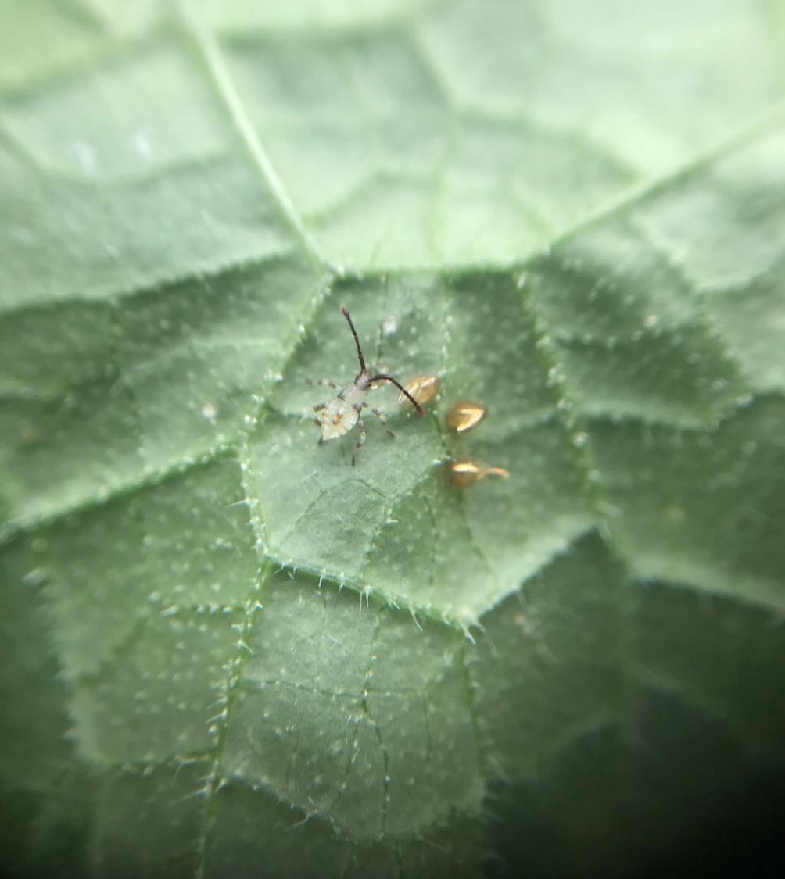
IPM – Monitoring
Very important to know exactly what is the pest species presents on your crop
Will influence the choice of control method

Slide 9
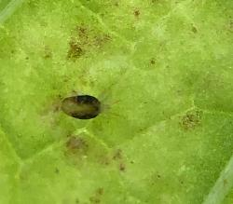
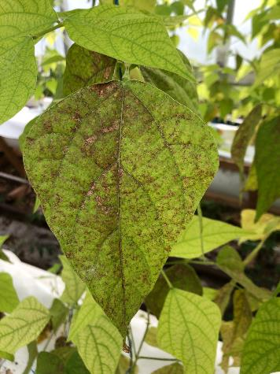
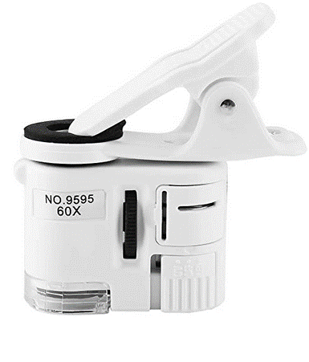
Monitoring and identification: key of success!
Where are the pests or damages?
Cell phone magnifying glass
C. Sylvestre, CRAM
Spider mites Tetranychus urticae
C. Sylvestre, CRAM

Slide 10
Monitoring and identification: key of success!
For a good diagnostic of diseases:
  Where are the symptoms? (bottom, middle, top; stem, leaves, fruits, roots)
  Always verify roots and collar
  Symptoms presents on all row, section, or just a few plants? On which varieties?
  Where in the greenhouse?

Slide 11
Prevention of infestation and infection
Remove all crop residues
Disinfection of material
Insects net
No insects at the end of the season
  Oil on structure, crop residues, floor covering
  Solarisation (greenhouse at 40°C, 24h/day, 2-3 consecutive days)
  Monitoring and trapping of insects (yellow sticky traps)
https://www.agrireseau.net/legumesdeserre/documents/102212/la-biosecurite-y-penser-pour-eviter-le-pire
https://www.agrireseau.net/documents/Document_96389.pdf

Slide 12
Prevention of infestation and infection
Choice of resistant or tolerant varieties
Seed treatment
  Hot water
  Natural products (organic acids, oils)
  Biological control (Trichoderma sp., Bacillus sp.)
  Chemical control (Kleengrow, Virkon, vinegar, bleach)
https://www.agrireseau.net/documents/Document_96389.pdf
https://www.agrireseau.net/legumesdeserre/documents/102212/la-biosecurite-y-penser-pour-eviter-le-pire

Slide 13
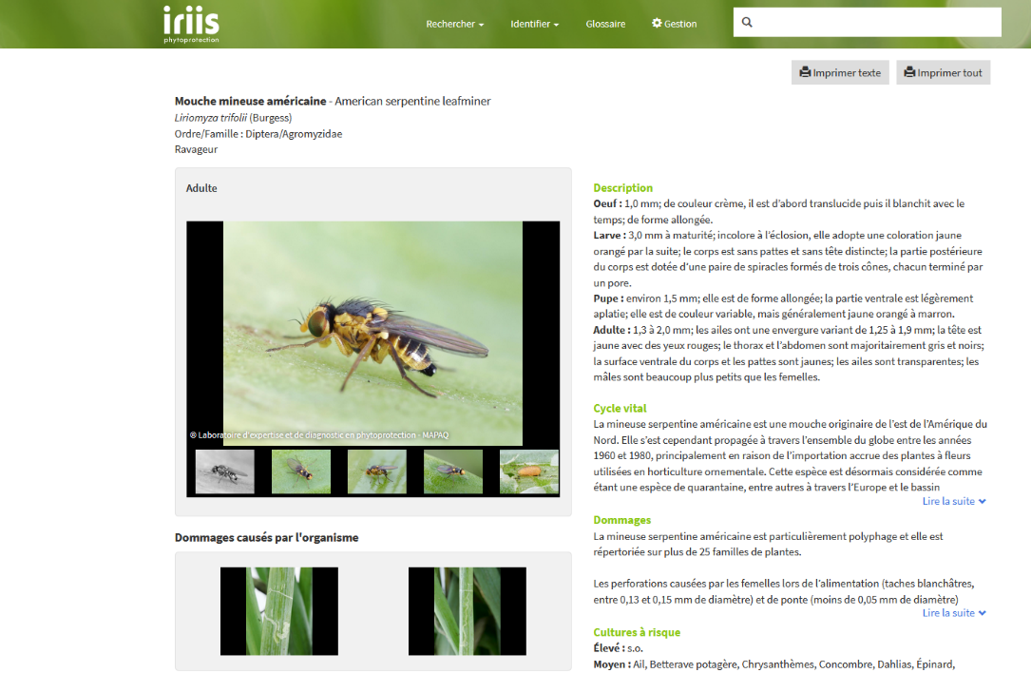
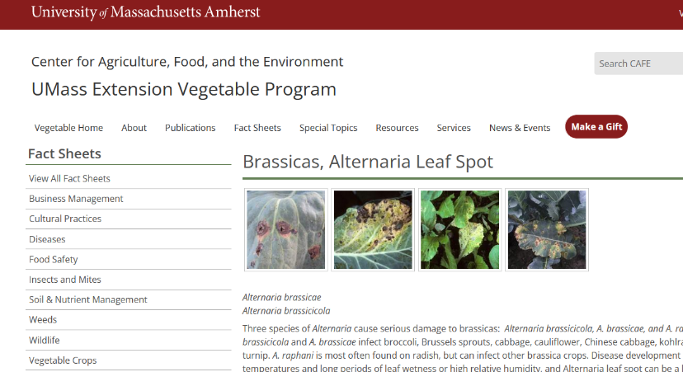
In the toolbox of the greenhouses producers
Websites for identification and factsheets for pests and disease (Examples – many more)
https://ag.umass.edu/vegetable/fact-sheets/brassicas-alternaria-leaf-spot
https://www.iriisphytoprotection.qc.ca

Slide 14
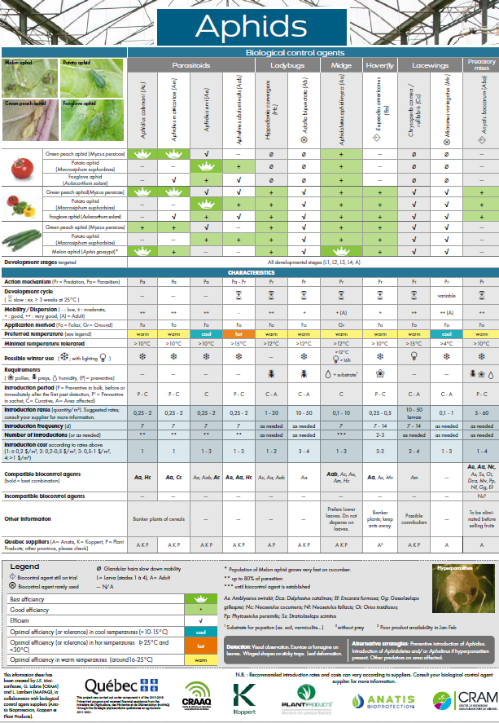
In the toolbox : Biological control agents information sheets
Aphids
Whiteflies
Spider mites
Thrips
Gnats
French version: https://www.cram-mirabel.com/wp-content/uploads/2023/03/affiches-ravageurs-FR-2022_final_web.pdf
English version: https://www.cram-mirabel.com/wp-content/uploads/2023/03/affiches-ravageurs-ANGL-2022_final_web.pdf
Will be presented in detail this afternoon

Slide 15
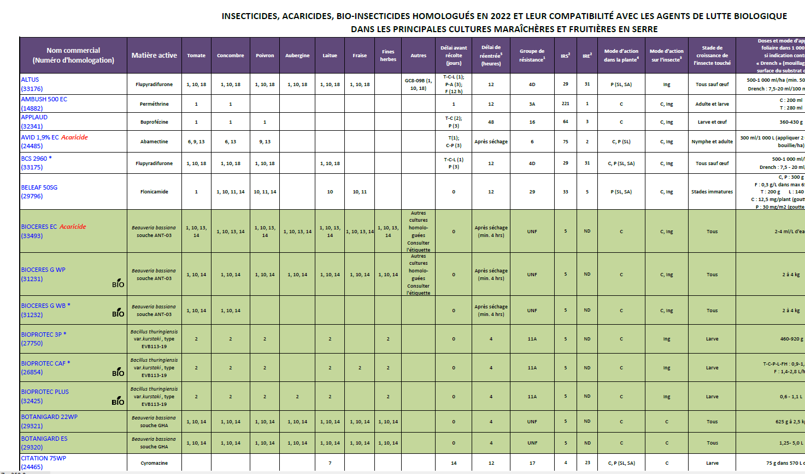
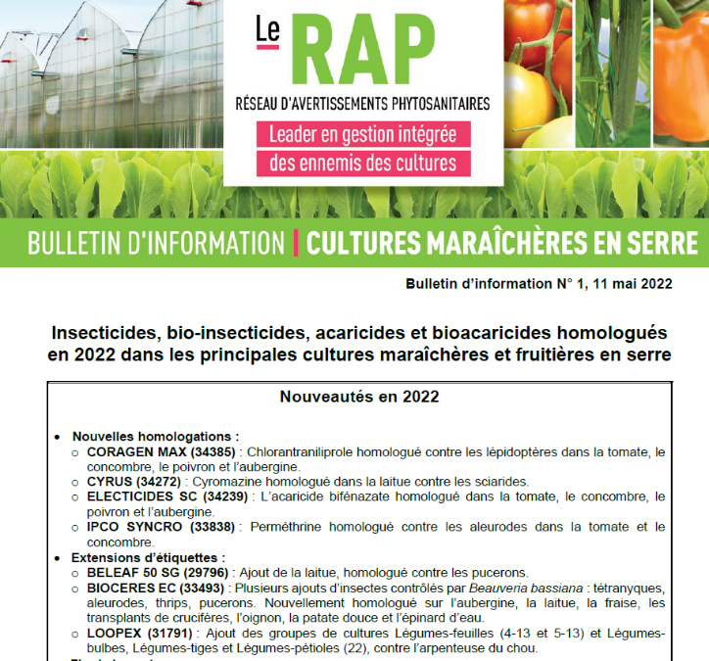
Insecticides and bio-insecticides registered in greenhouses
https://www.agrireseau.net/documents/Document_108942.pdf

Slide 16
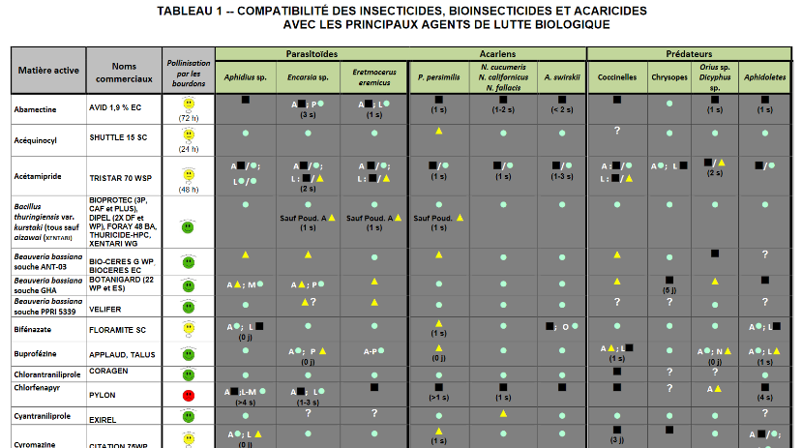
Insecticides and bio-insecticides registered in greenhouses
Compatibility with biocontrol agents
https://www.agrireseau.net/documents/Document_108942.pdf
https://www.sagepesticides.qc.ca/Recherche/RechercheTraitement

Slide 17
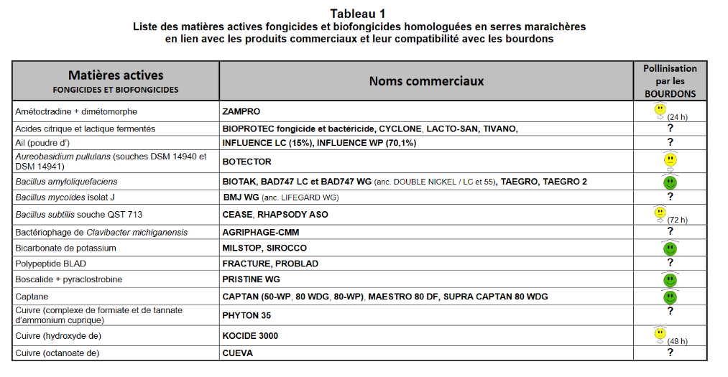
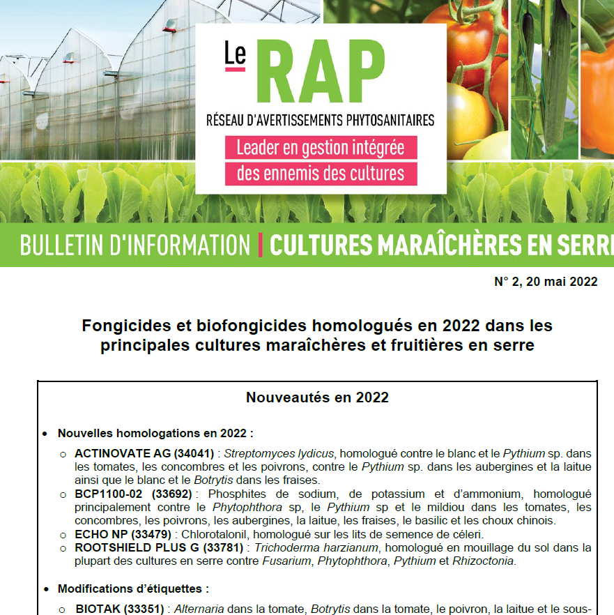
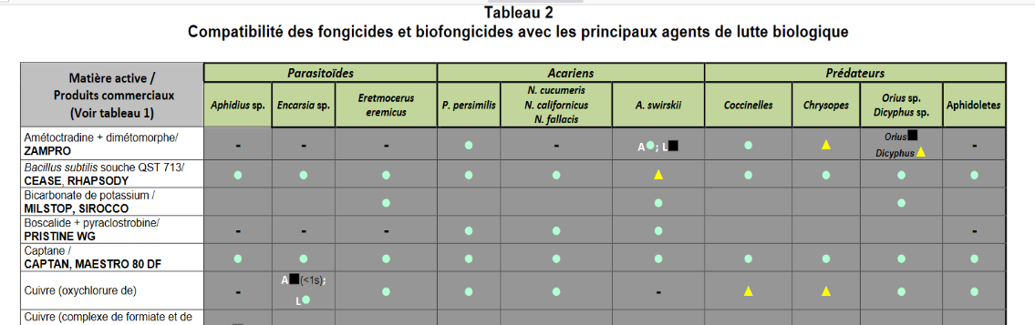
Fungicides and bio-fungicides registered in greenhouses
https://www.agrireseau.net/documents/Document_109030.pdf
https://www.sagepesticides.qc.ca/Recherche/RechercheTraitement

Slide 18
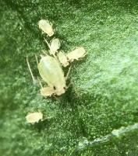
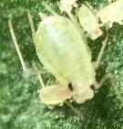
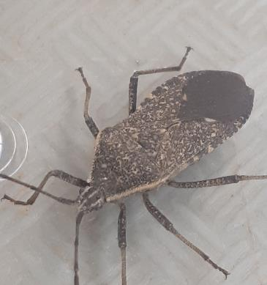
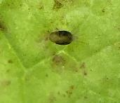
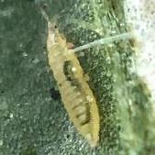
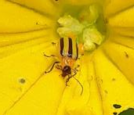
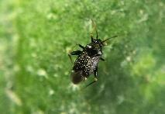
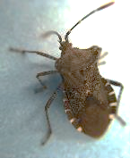

Slide 19
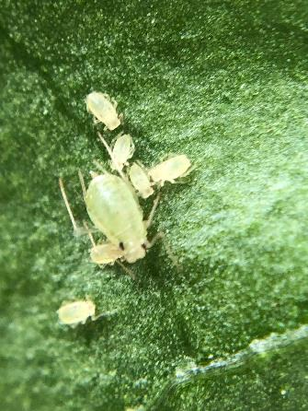
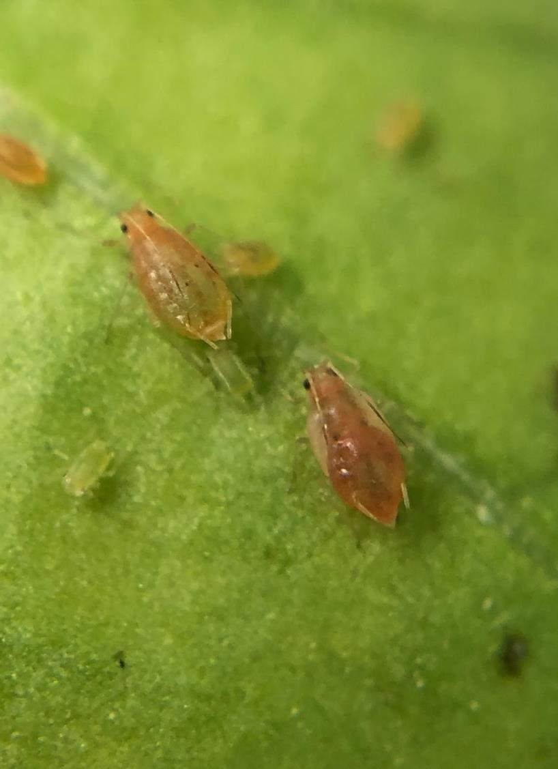
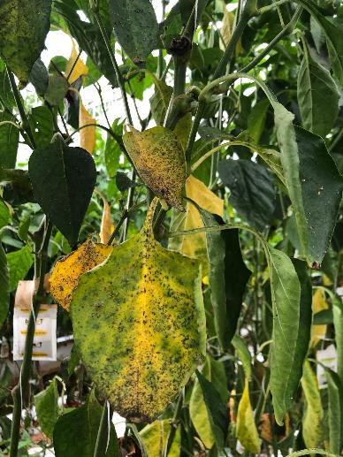
Aphids in vegetables greenhouses
Sooty mold
Green peach aphid, Myzus persicae
Tobacco aphid (Myzus persicae subsp nicotianae)
Different behavior compared to green peach aphid
Difficult to control with biocontrol agents
C. Sylvestre, CRAM

Slide 20
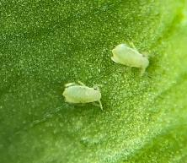
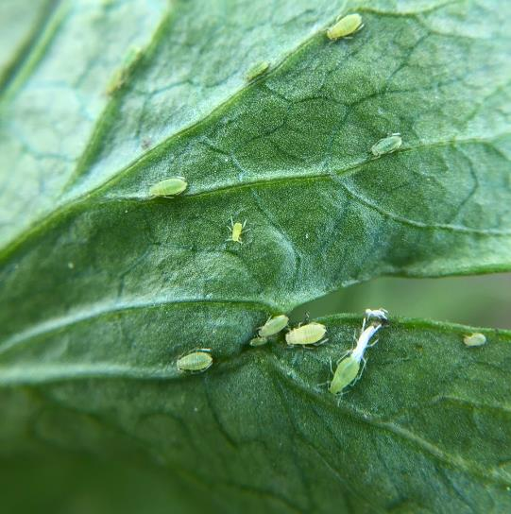
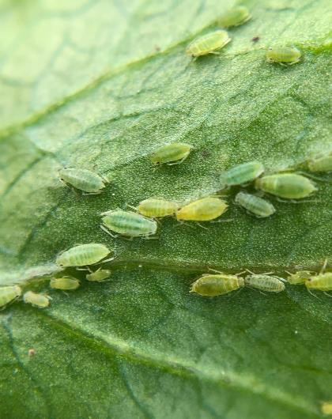
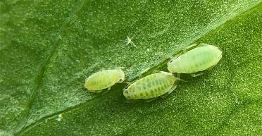
Willow- carrot aphid (Cavariella aegopodi) - celery

Slide 21


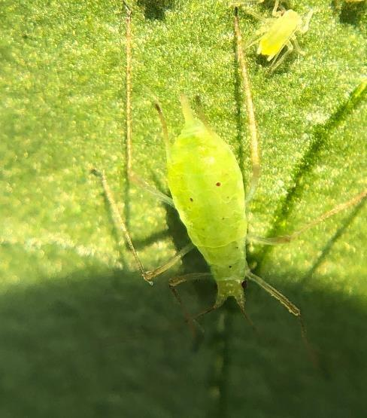
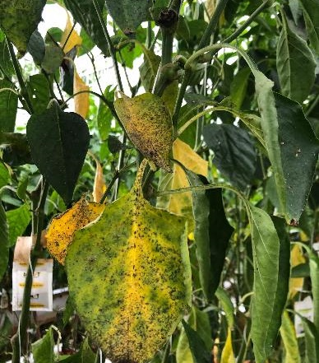
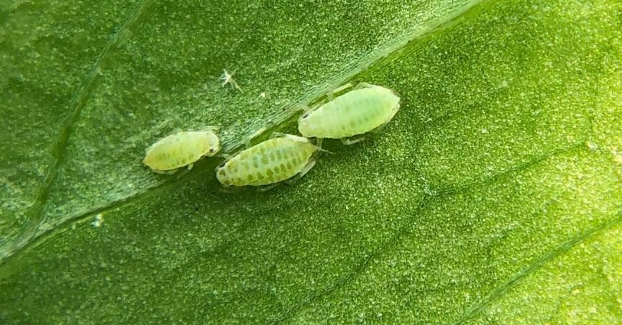
Green peach aphid
Tobacco aphid
Potato aphid
Sooty mold - pepper
Puceron de la pomme de terre
Willow-carrot aphid- Celery
What species of aphids do you have?
  Good choice of biocontrol agent
  Temperature and humidity conditions?
  Alternative resources (pollen, Ephestia eggs…) needed for the biocontrol agent?

Slide 22
Control methods used by producers*
* Mentioned by producers during summer 2021
Curative introduction which are successfull:
  4-5 Aphidius/m²
  Lacewings, ladybeetles or hoverflies in high density
E: eggplant; P: pepper; T: tomato; B: Bean; C: Cucumber; Ce: Celery

Slide 23
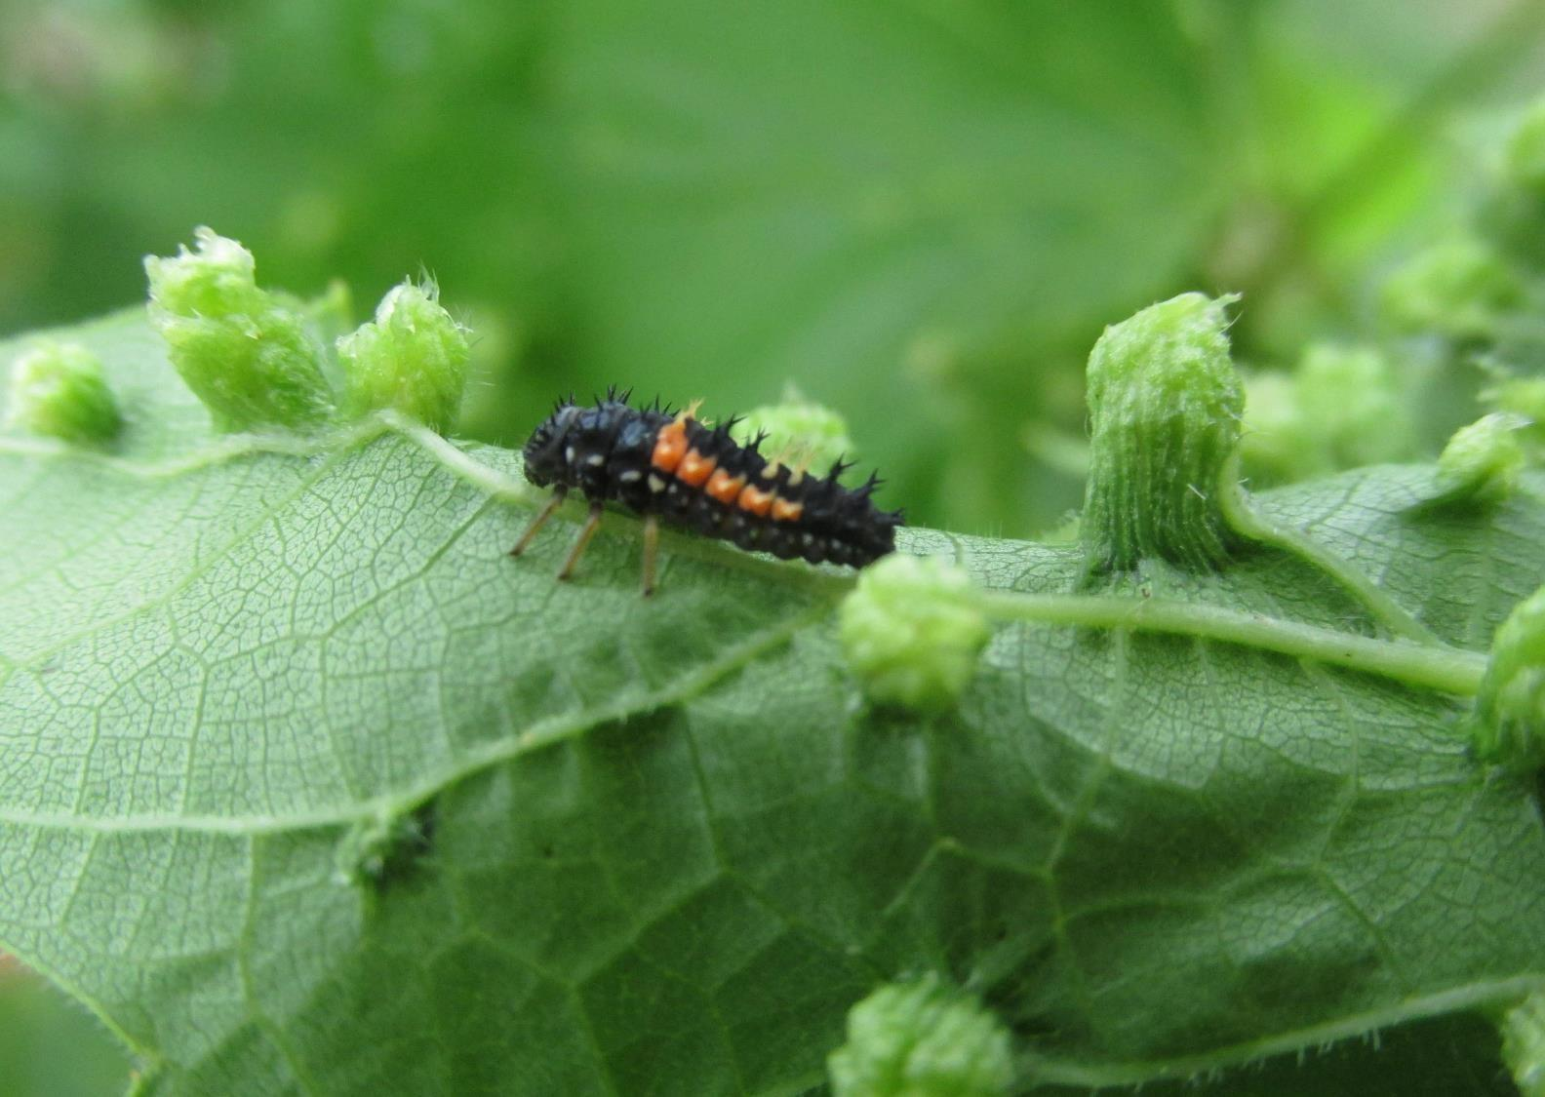
Ladybeetles from outside
Multicolored Asian ladybeetle overwinter inside house
Can be keep at 4°C all winter (in a fridge – not with food)
Can provide water with sugar (honey) or pollen before releasing them in greenhouse in Spring

Slide 24
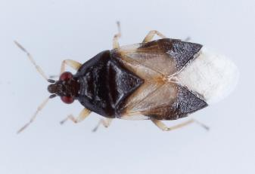
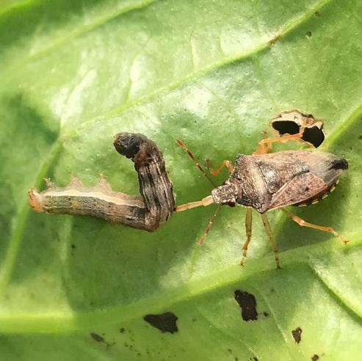
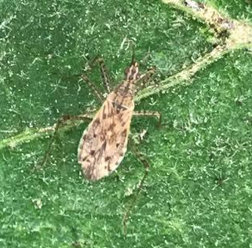
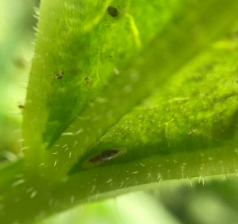
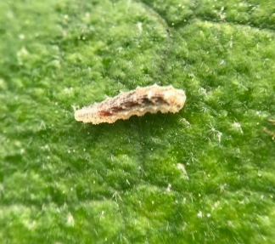
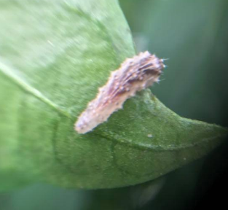
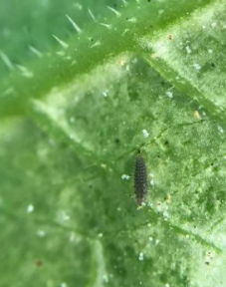
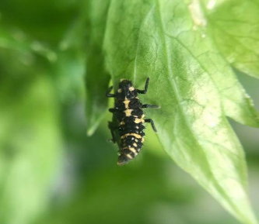
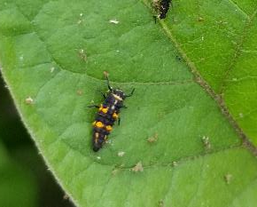
Preventive method: Attraction of natural enemies from outside greenhouse
Research project (2020-2023) demonstrated that many natural ennemies enter in greenhouses:
  Ladybeetles: Asian, 12-spotted, 14- spotted, 7-spotted, Adonis, 20-spotted, Stethorus punctum punctum
  Hoverflies
  Lacewings (green and brown)
  Orius
  Predatory bugs (nabids, pentatomids...)
Orius insidiosus
Nabis roseipennis
Predatory bugs
Use of attractive flowers (adults are often pollen feeders)
Hoverflies
Ladybeetles
Stethorus
maculée
14 points

Slide 25
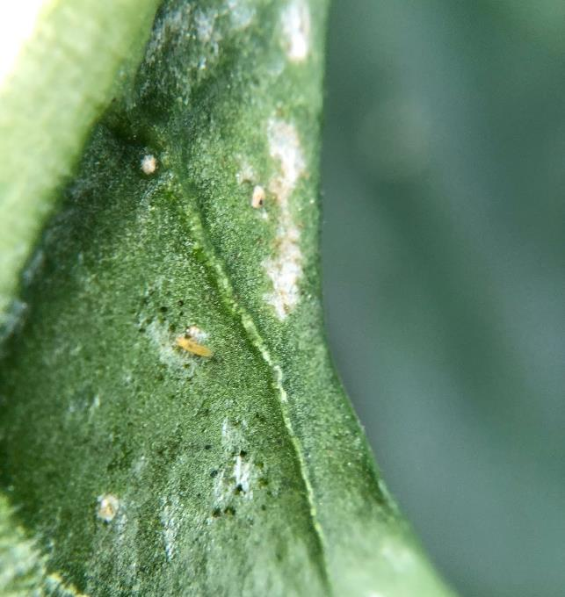
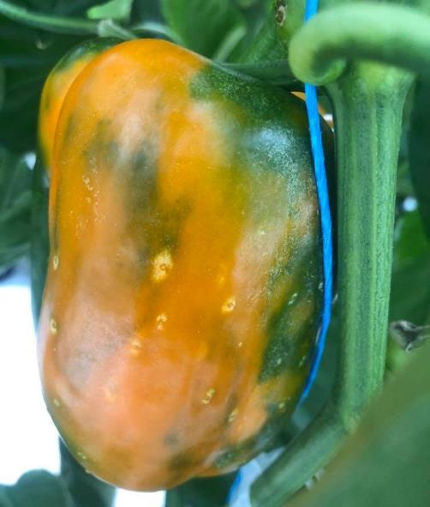

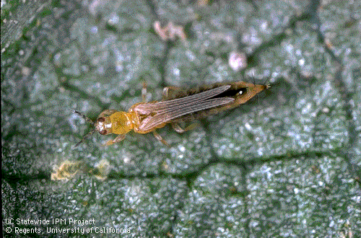
Thrips
Main species
  Western flower thrips
  Onion/tobacco thrips
Life cycle
  Eggs inside leaves or stem
  Larvae and adults on plants
  Pupae in soil
Damages:
  Silver shinny spots on leaves
  Feces in the form of small black dots
  Distorted fruits

Slide 26

Damages and feces of thrips in cucumber

Slide 27


Damages in basil

Slide 28


Research project: Identification of thrips species
134 thrips collected
13 greenhouses
10 crops
~ 12 different species (under DNA identification)
New species already identified:
Thrips fallaciosus
Hercinothrips femoralis
Hercinothrips femoralis
Thrips fallaciosus

Slide 29

Control options used by producers
* Will replace cucumeris with swirskii or californicus when temperature is rising in the greenhouse

Slide 30



Spider mites
Damages
  Small yellow dots at beggining;
  Decoloration of the leaves;
  Spider webs.
Preventive methods:
  Control the population at the end of summer before entering in diapause.
  Misting to maintain relative humidity of >70%.
  Preventive use of biocontrol agents

Slide 31




Spider mites (Tetranychus urticae)

Slide 32



Spider mites damages

Slide 33
Control methods used by producers *
* During summer 2020

Slide 34

Striped cucumber beetle
Important damages because of the transmission of the bacterial wilt
Research projects on push and pull strategy with attractives lures (mass trapping) - ↓ 12- 73% bacterial wilt on some sites
Repulsive products (kaolin – stop feeding, no oviposition)
More trials in 2023

Slide 35

Winning strategies against pests
Knowledge
  Right identification
  Understand its life cycle
Prevention of infestation
  Disinfection of the greenhouse between crop
  Attracts and retain natural enemies
  Preventive introductions of biocontrol agents
Use different control methods
(resistance, cultural, mecanical, physical, behavioural…)
Curative methods
  Massives introductions of biocontrol agents
  Use of pesticides or biopesticides (verify compatibility with biocontrol agents)

Slide 36
Main diseases in greenhouses in Québec
ToBRFV (tomato brown rugose fruit virus): survey in 2023

Slide 37




Powdery mildew in tomato and cucumber

Slide 38



Alternariose (Alternaria solani) - tomato

Slide 39





Alternariose (Alternaria alternata) - cucumber

Slide 40




Cladosporiose (Cladosporium ) - cucumber
Notes:
No pesticides registered

Slide 41
Winning strategies against diseases
* Disinfection of seeds recommended for some diseases
Question to producers in a research project on disease: Do you clean your greenhouse at the end of the season?
88% = NON

Slide 42

Conclusion
Right identification of the organism = most important for the right choice of control methods
Winning strategies = prevention of infestation with many control methods
Preventive methods by attracting natural enemies and introduction of biocontrol agents
Quick response when a pest arrives
Cleaning and disinfect the greenhouse each year

Slide 43


Acknowledgements
Philippe-Antoine Taillon, Geneviève Legault, Julie Marcoux, Isabelle Fréchette, Caroline Martineau, Jenny Leblanc, Mahmoud Ramadan, Liette Lambert, MAPAQ
Stéphanie Duranceau, Charlotte Giard-Laliberté, CETAB+
Caroline Vouligny, Josée Bonneville, ITA St-Hyacinthe
Collaborators of Serres sentinelles
Producers
Summer students
$ Québec and Canada
Laboratoire d’Expertise et de diagnostic en phytoprotection (LEDP)

Slide 44

Questions?

