Slide 1
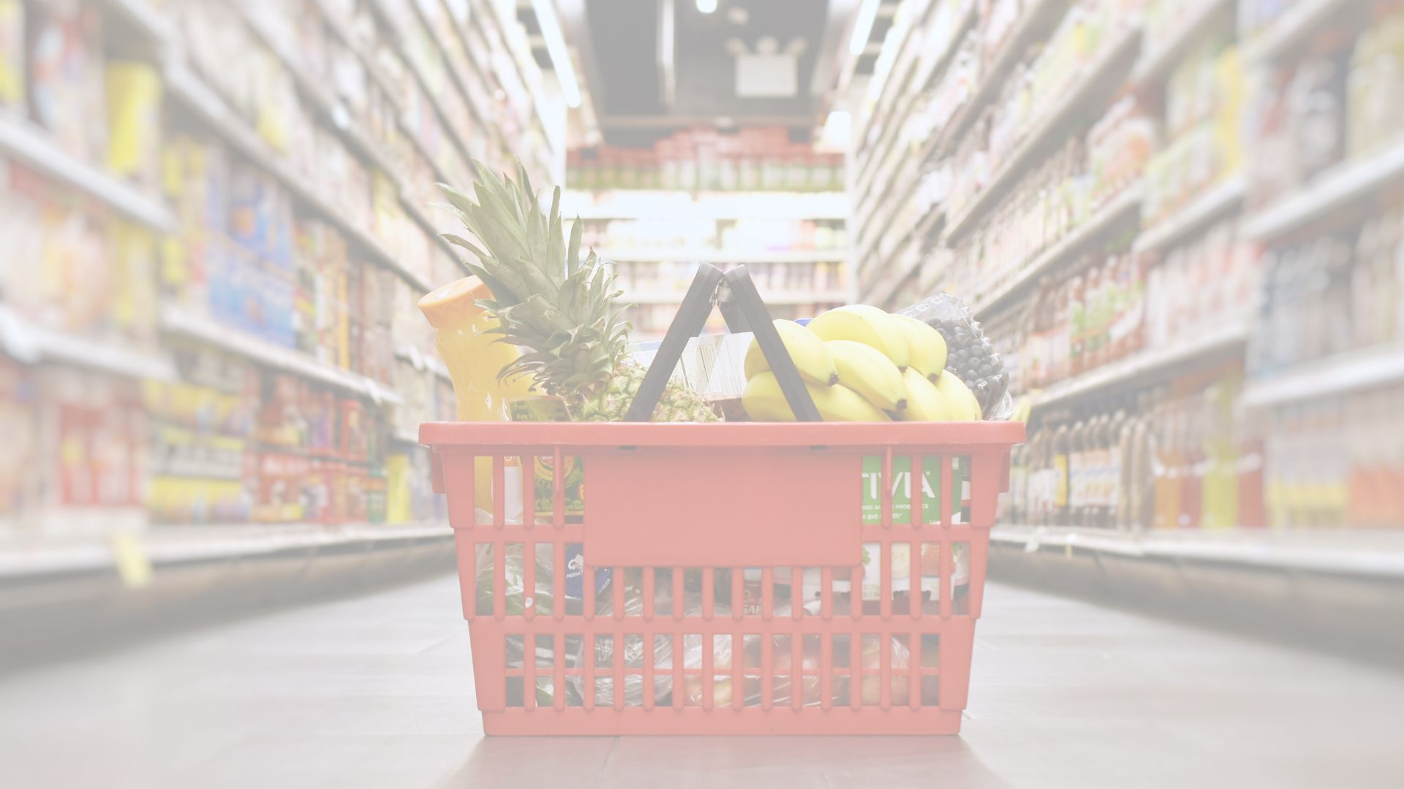
Changing the channel:
Guidelines on selling produce to conventional grocery retailers
NB Horticultural Congress March 2023

Slide 2





A LearnSphere Program
Funded by:
Notes:
REQUIRED – FUNDER ACKNOWLEDGEMENT
Speaking Notes:
Supply Chain 123 is a LearnSphere program.
For over 25 years, LearnSphere has helped businesses and organizations reach their full potential through the design and delivery of comprehensive, bilingual, evidence-based learning and development solutions.
The Supply Chain 123 program is funded by Employment and Social Development Canada. Specifically the Office of Skills for Success.

Slide 3
Background Basics
Total Food Sales in Canada:
  Away from Home - Food Service - 30%
  At Home- Purchased at Retail - 70%
    Canadian horticulture sector crops: field grown vegetables, potatoes, greenhouse vegetables, fruits, ornamental products (floriculture, nursery, Christmas trees, sod), honey and maple products….

Slide 4
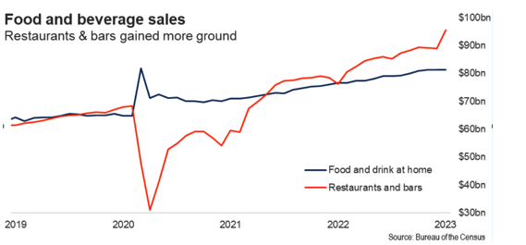

Slide 5
Crop Highlights ….2021
Potatoes : fifth largest primary agriculture crop in Canada (after wheat, canola, soybean, and corn),
Worth $1.5 billion in farm cash receipts in 2021
Field Vegetable's carrots, dry onions, tomatoes, cabbage, peppers, lettuce, sweet corn and broccoli comprised nearly 60% of the total value of field vegetable sales.
Worth $1.41 billion in farm cash receipts in 2021
Greenhouse vegetables and mushrooms contributed $2.7 billion in farm cash receipts in 2021
Notes:
An estimated two-thirds of all produce consumed in Canada is imported. U.S. fresh fruit exports are projected to remain steady, accounting for approximately 37% of Canada’s fresh fruit imports in 2021.

Slide 6
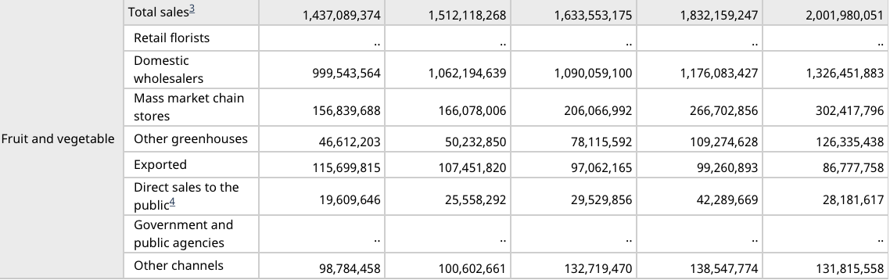
Channels of distribution for horticulture product sales and resales – Canada
2021
Domestic Wholesalers = 66%
Mass Market chain stores = 15%
Direct sales to public = 1%
Notes:
4 ….. Includes roadside stands and owner-operated retail outlets.
Farm gate value.
Canada’s retail market is mature and largely consolidated, with five retailers comprising more than 75% of the total retail grocery market. The remainder of the market is represented by smaller regional retail chains that include 6,800 independents and 27,000 small and independent convenience stores.

Slide 7
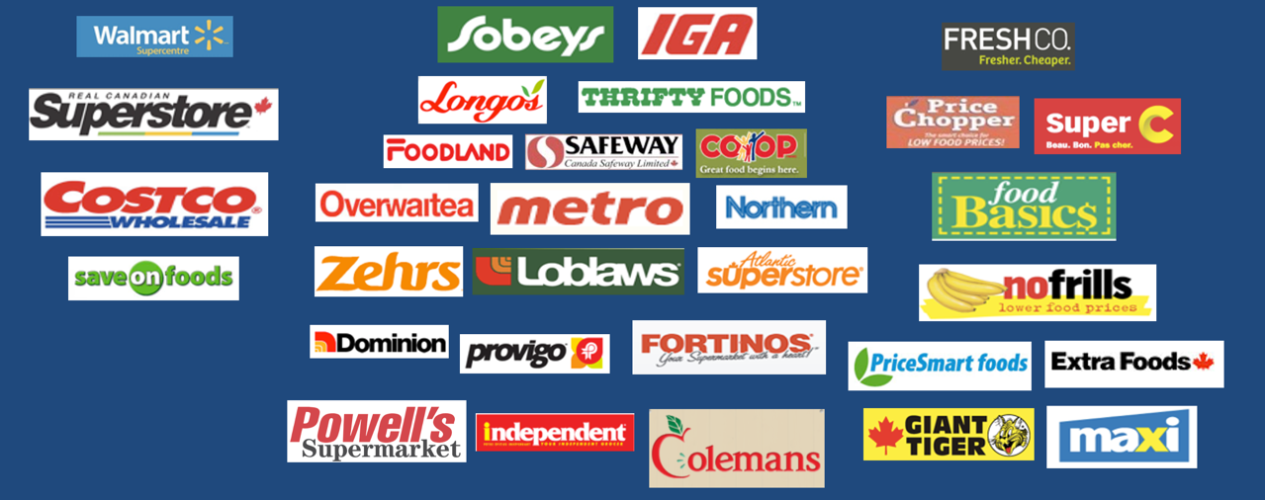
Large store Conventional Discount

Slide 8
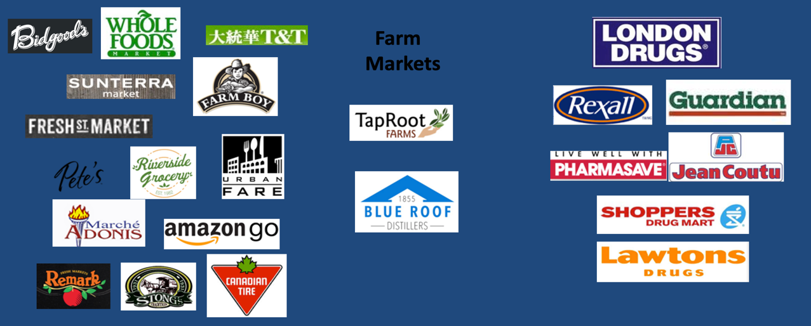
Specialty Direct Drug

Slide 9
Food & Beverage Customer Segmentation Model
Segment | Primary Positioning | Size of stores | Format | Margin expectation | Characteristics
Regional specialty | Local Specialized (e.g. butcher) | Small | Pete’s, Pusatieri’s, Sunterra, Noggin’s, Masstown Market, Free Range Store, Health food stores | High | Local, unique, gift items Locally managed, independent owners Small listing base, DSD, a lot of labour
National specialty | Market segments (Asian, Italian, convenience) | Small | T&T, M&M, Farm Boy, Longo’s, Simply for Life, Urban Fare, Fresh St Market, 7-11 | Medium-high | Mix of national and local, unique items Centrally managed
Discount | Lowest price | Small-Medium | No Frills FreshCo Food Basics Giant Tiger | Lowest | Low labour Minimal fixtures Lowest price guarantee, hot ads Limited listing base
Conventional | Best total shop for food Quality fresh | Medium-Large | Sobeys, Metro, Loblaws, Zehrs, Independent, Foodland, Co op, Fortinos, IGA, Atlantic Superstore | Medium-high | High low program Should be best fresh Broad listing base Service perishables
Super Centres | Value | Very large | Real Canadian Superstore, Walmart, Save On Foods | Low | Limited labour, Modified EDLP General Merchandise No membership
Warehouse | Unique sizes Value | Very large | Costco | Fixed | Paid membership Treasure hunt Predetermined sales targets
Drug | Functional Benefits | Small-medium | Shoppers Drug Mart, Lawtons, Jean Coutu, Rexall, London Drugs, Guardian, PharmaPrix | Medium-high | Broad listing base in health & beauty Traditionally convenience items in food Shifting to more food & beverage
Online marketplace | Selection Convenience Price |  | Well.ca, Amazon | Fixed | Delivery Unlimited listing base
Note: Not every retailer’s format fits into our market segments. These are intended to be a guide and you should look at each customer as a unique opportunity.

Slide 10

Key Trends…..

Slide 11
Key Trends at Retail for Fruit and Veg - 2023
“Buy Local“ Trends Accelerating
Food Inflation Impacts – Fresh vs Frozen Shifts, Trading Down impacts
Value Added developments in produce :
Some Cut, Bagged and Prepared- Volumes not there
No “Little Potato” type branding by Atl. producers
Innovation in Frozen formats (e.g cauliflower rice, veggie spirals)
  Private Label penetration continues in onion, potatoes and carrots
  Volumes require multiple vendors, packing compatibility
  Sustainability in Packaging:
    Carbon footprint concerns
    Less bulk buying
    Resealable, recyclable, compostable

Slide 12
Local Produce Sourcing Programs
of Atlantic Retailers – 2023
KEY CRITERIA : | SOBEYS | LOBLAWS | WALMART | COSTCO
No of Stores | 84 in Atl Canada + Foodland | 56 + 16 Dominions in NL + Independent | 26 Supercenters with full produce and 18 Division 1 with limited assortment | 5 (6 if you include St. John's)
Food Safety Requirement: | Little more lenient; not as strict on Canada GAP initially | Canada GAP | Canada GAP | Canada GAP +Addendum
Distribution Method | DSD | Via DC (Some DSD) | Via "new"DC - maybe require Nova Agri consolidation | DSD
Warehouse Location | Debert & Cornerbrook | Moncton & St Johns | Moncton | Ontario
Cat Mgr/Director Contact: | Travis McLeod (Stellarton) | Graham Smith (Brampton) | Dave Wood (Moncton) | Category Dependent(Ottawa)

Slide 13
Local Produce Sourcing Programs
of Atlantic Retailers – 2023
KEY CRITERIA : | SOBEYS | LOBLAWS | WALMART | COSTCO
EDI and Communications: | Yes if warehouse and no if DSD | Yes if warehouse and no if DSD | Yes | Yes
Willingness to Work with Small Grower ? | Yes - can take on fewer stores | Yes - can take on fewer stores | Yes - can take lower volume through consolidation center | Yes
Full Pallet Quantities Needed? | No | No | No | Yes
Promotional Spend Needed to Support Local Program | Yes | Yes -higher expectations here | EDLP | Limited
Special Labelling and Pack Requirements? | No | Possibly to support Local merchandising | No | Yes

Slide 14
Key requirements for selling grocery retail chains
Get into stores - see how your category is packaged and merchandised
Depends on chain, but not necessary to sell all stores
Canada GAP for food safety
$ to participate in “Locally Grown” promotions via retailer rebates
EDI capabilities for order communication
Need a responsive sales team and commitment to supply forecasting
May need DSD or participation with a consolidating supplier

Slide 15
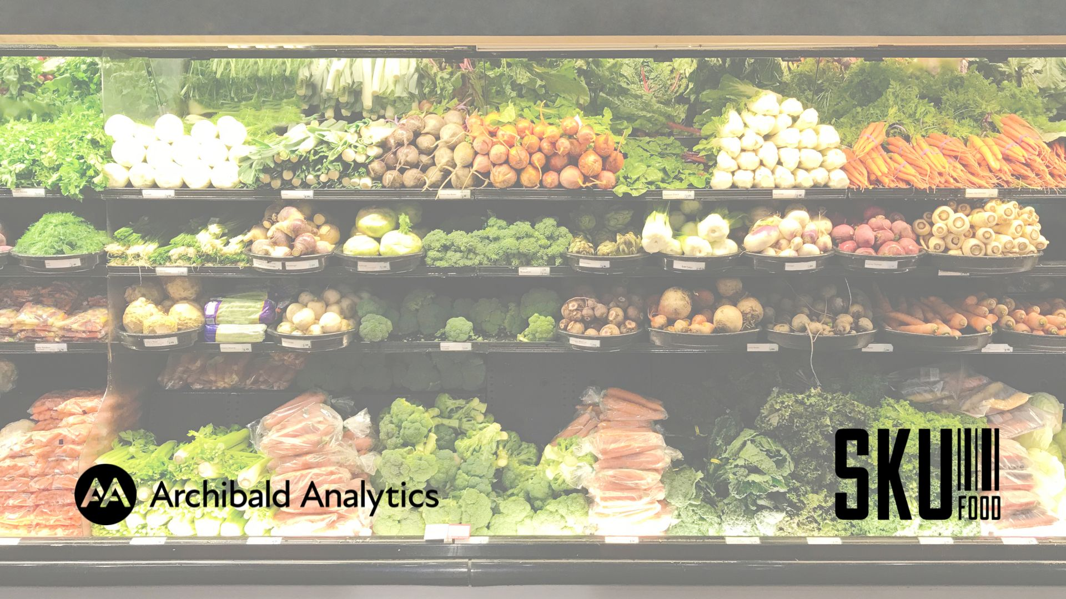
Question and Answer Time…
Notes:
830 intro & Welcome

