Slide 1
Common Health and Safety Gaps found in the Agricultural Sector
Lisa Waugh, Health and Safety Consultant
March 16, 2022

Slide 2
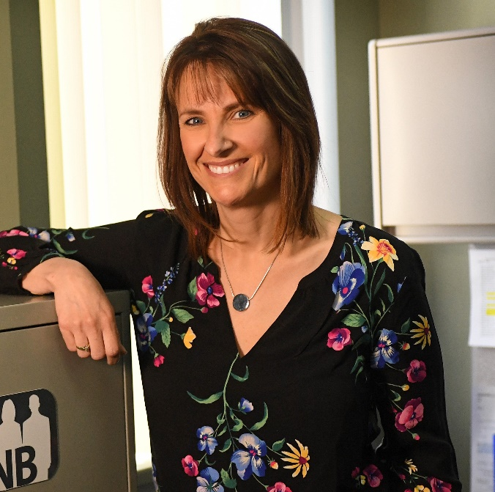
Background
15 Years Health and Safety Consulting with WorkSafeNB
Experience working with various agriculture sectors from
Potato farms
Maple Syrup Producers
Beef and Chicken farms
Several years organizing the Progressive Agriculture Safety Days in Northwestern New Brunswick exposing -/+ 4000 students to Ag. Safety.

Slide 3

Common Gaps identified in Agriculture Sector
Family farms being workplaces
Unaware of New Brunswick Occupational Health and Safety Legislation
Reporting of injuries
Ensuring employees receive health and safety orientation and training
Calling on WorkSafeNB for support

Slide 4

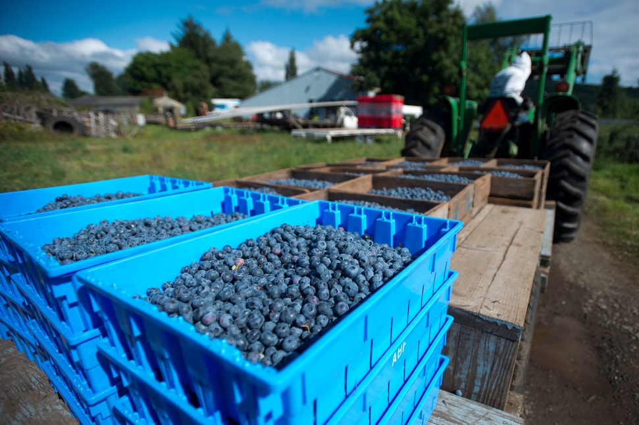
When does a family farm become a legislated workplace?
Employer – Employee relationship
  Compensation coverage <3 and >3

Slide 5
Occupational Health and Safety Legislation
Occupational Health and Safety Act
Employer Responsibilities
Take all measures to ensure health and safety of employees
Employee Rights and Responsibilities
3 legislated Rights
Work safely, follow rules/procedures
Report Hazards and incidents
Supervisor Responsibilities
Have the same responsibilities and rights as employees
Take every reasonable precaution to ensure health and safety of employees they supervise
Safe and healthy working conditions
Health and Safety training and orientation for employees
Lead by example
Outlines the Occupational Health and Safety responsibilities in the workplace
Provide safe and healthy working conditions
Provide health and safety training and orientation
Lead by example
Establish health and safety criteria:
Health and safety programs
JHSC
Orientation & training

Slide 6

Injury reporting under the OHS Act
Reporting to WorkSafeNB at 1-800-999-9775
A loss of consciousness
Amputations
Fractures (other than fingers or toes)
Burns requiring medical attention beyond first aid treatment
Loss of vision in one or both eyes
Deep lacerations requiring medical attention beyond first aid treatment
Worker admission to a hospital as an in-patient
Fatalities
Any accidental explosion or exposure to a biological, chemical or physical agent, whether or not a person is injured
Any catastrophic event or equipment failure that results, or could have resulted in an injury

Slide 7

Injury reporting under the Workers Compensation Act
What to do if there is an injury at work?
Report injury to supervisor
Seek medical attention
Report injury to WorkSafeNB within 3 days by completing the Application for Benefits
    www.worksafenb.ca/media/61299/application-for-workers-compensation-benefits.pdf

Slide 8
Preventing Injuries Starts With
Orientation
Health and safety orientation must take place before any employee begins work
Training
Must occur when employees are required to perform specific tasks that have associated hazards to prevent injury such as operating equipment

Slide 9

At your service
Health and Safety Officers
Health and Safety Consultants
1-800-999-9775
Prevention@ws-ts.nb.ca
www.worksafenb.ca

Slide 10
Questions & Feedback

