Slide 1
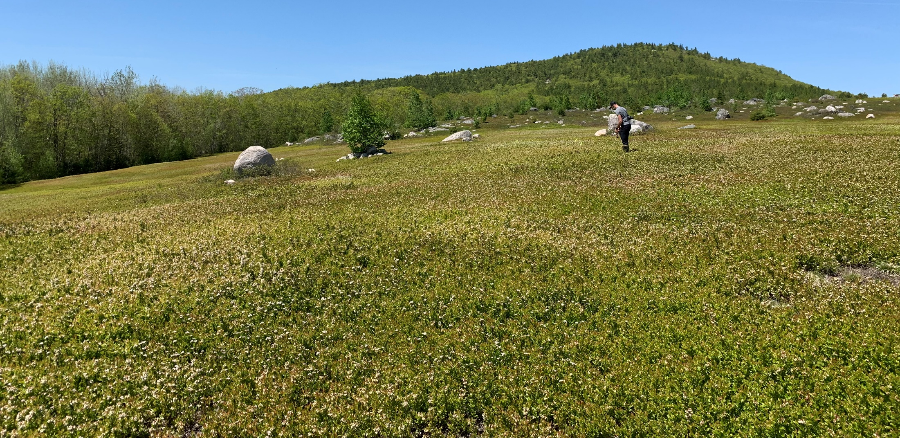
Wild Blueberry Disease Management
Seanna Annis Associate Professor, Associate Extension Professor, University of Maine
sannis@maine.edu, 207-581-2621

Slide 2




Acknowledgements
Research professionals: Margo Roberts, Jacob Schwab, Greg Kornelis, Rachael Martin, Caleb Slemmons
Graduate Students: Kristen McGovern, Laura Penman, Ashley Thompson, Tyler Case, Katie Ashley, Erika Lyon, Nghi Nyugen, Ian Leonard, Zoe Colwell
Numerous undergraduate students
Blueberry grower cooperators

Slide 3
Most lowbush blueberry diseases caused by fungi
Mummy berry
Exobasidium leaf and fruit spot
Red leaf
Botrytis blossom blight
Leaf spots
  Sphaerulina leaf spot
  Powdery mildew
  Valdensia leaf spot
  Probably leaf rust
Witches broom
Some stem blights?
Monilinia vaccinii-corymbosi (MVC)
Exobasidium maculosum
Exobasidium vaccinii
Botrytis cinerea
Sphaerulina vaccinii
Erysiphe vaccinii or minima
Valdensia heterodoxa
Thekopsora minima
Pucciniastrum goeppertianum
Phomopsis sp., Gondronia sp.

Slide 4
Management of diseases
MONITORING and SCOUTING!
Pruning
Mulching
Sanitation
Fungicides

Slide 5
Diseases that are consistently present most years (if they are in the field in the past)
Vegetative/Prune year
AND Fruiting/Crop year
ONLY Fruiting/Crop Year
Exobasidium leaf spot
Red leaf
Leaf spots
  Sphaerulina leaf spot
  Powdery mildew
  Valdensia leaf spot
  Probably leaf rust
Witches broom
Some stem blights?
Exobasidium fruit spot
Mummy berry
Disease that is not consistently present in fields
Botrytis blossom blight

Slide 6
Disease whose organisms overwinter in the field
Mummy berry
Exobasidium leaf and fruit spot
Powdery mildew
Sphaerulina leaf spot
Valdensia leaf spot
Leaf rust
Red leaf
Witches broom

Slide 7
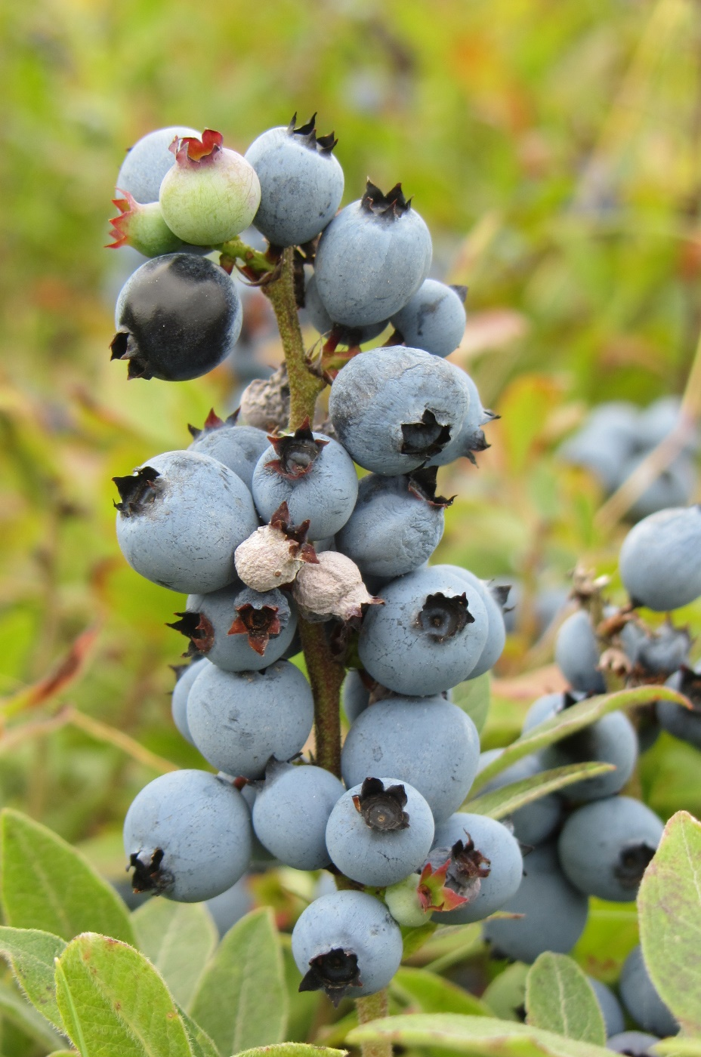
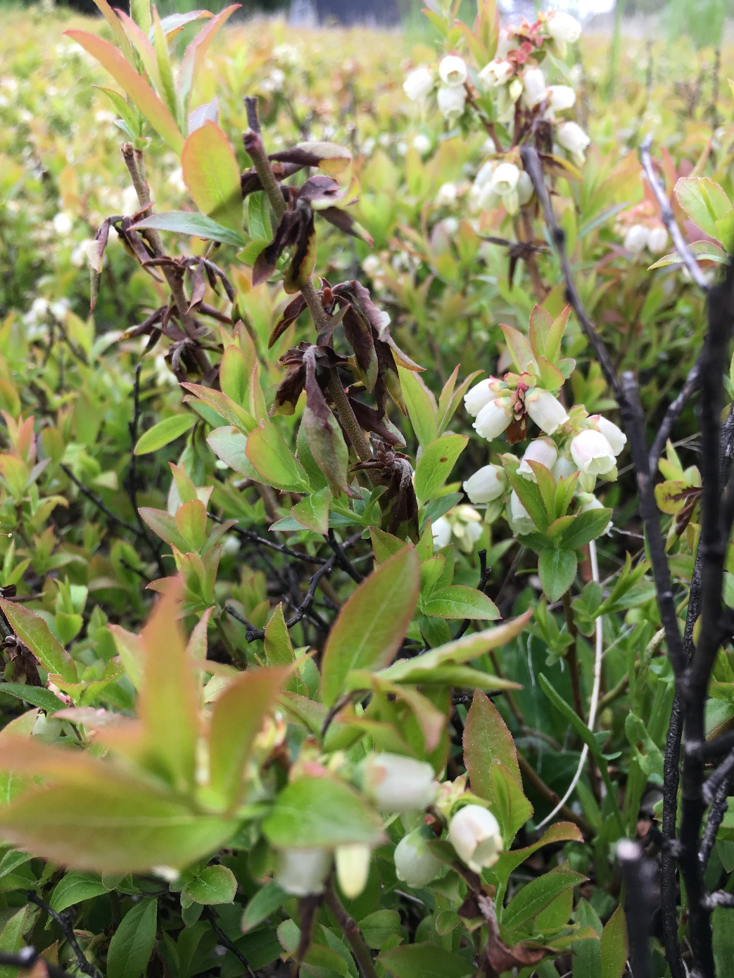
Mummy berry caused by Monilinia vaccinii-corymbosi

Slide 8
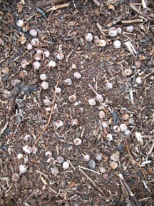
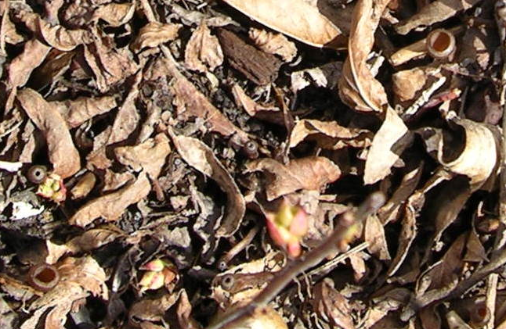
Overwinters as pseudosclerotia (mummy berries) for one to two maybe three years
Spores dispersed by wind in spring
Notes:
This is a 2 inch by 3 inch patch with about 50 mummy berries before they were covered with a thin layer of dirt and pressed into the soil.
In the spring a week before bud break is when you should start monitoring your patches. I would suggest checking twice a week to see how the cups are developing.

Slide 9
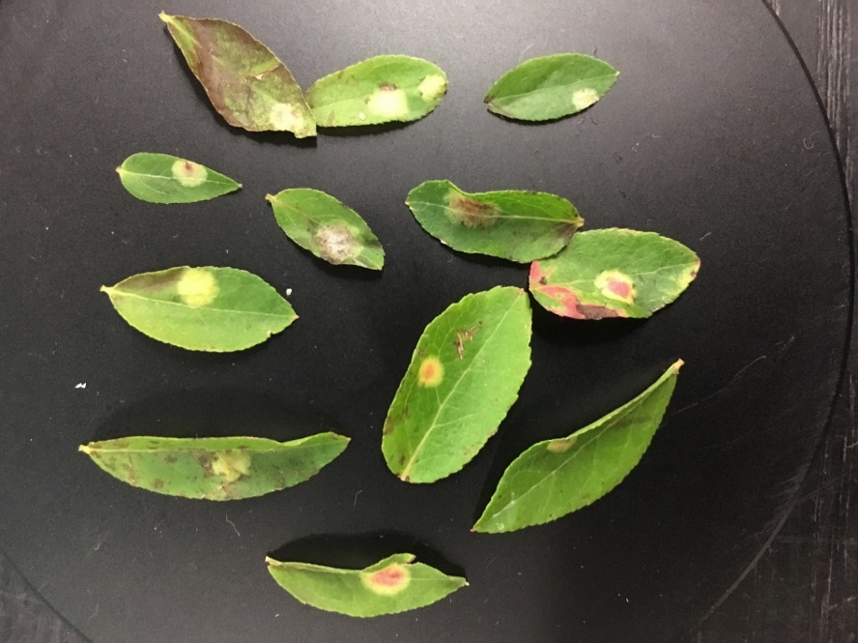
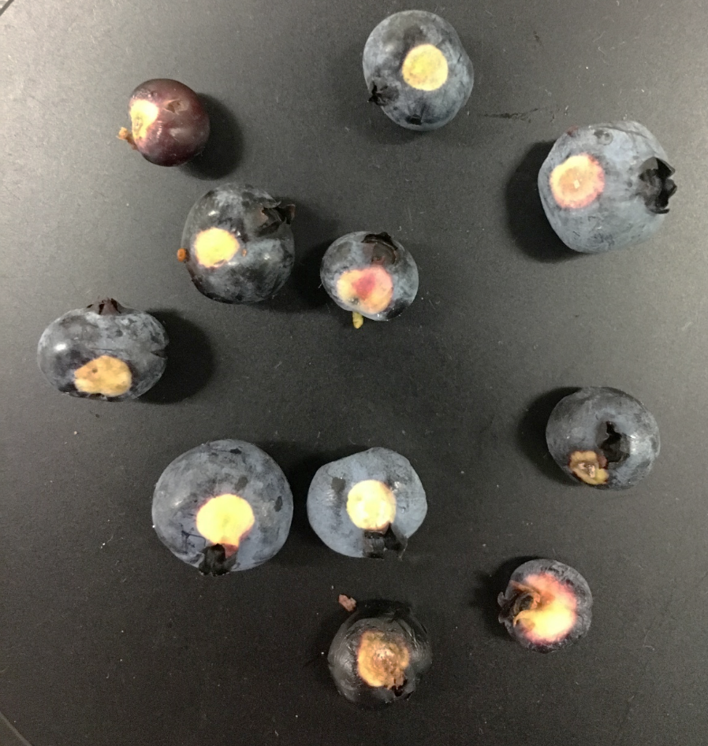
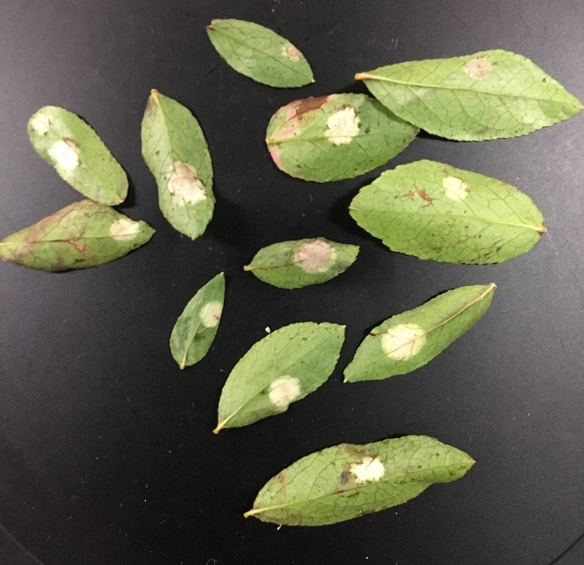
Exobasidium leaf and fruit spot (Exobasidium maculosum)
infections typically on lower leaves and on fruit
Spores dispersed by water? And wind?

Slide 10
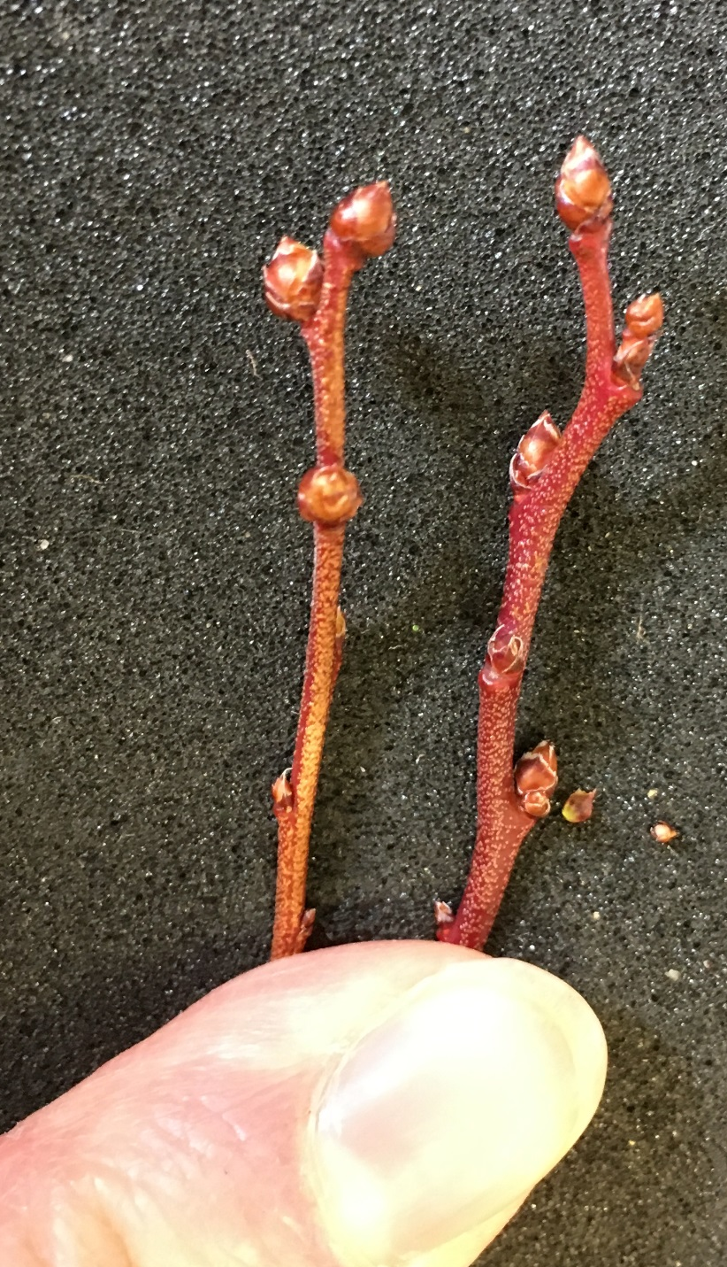
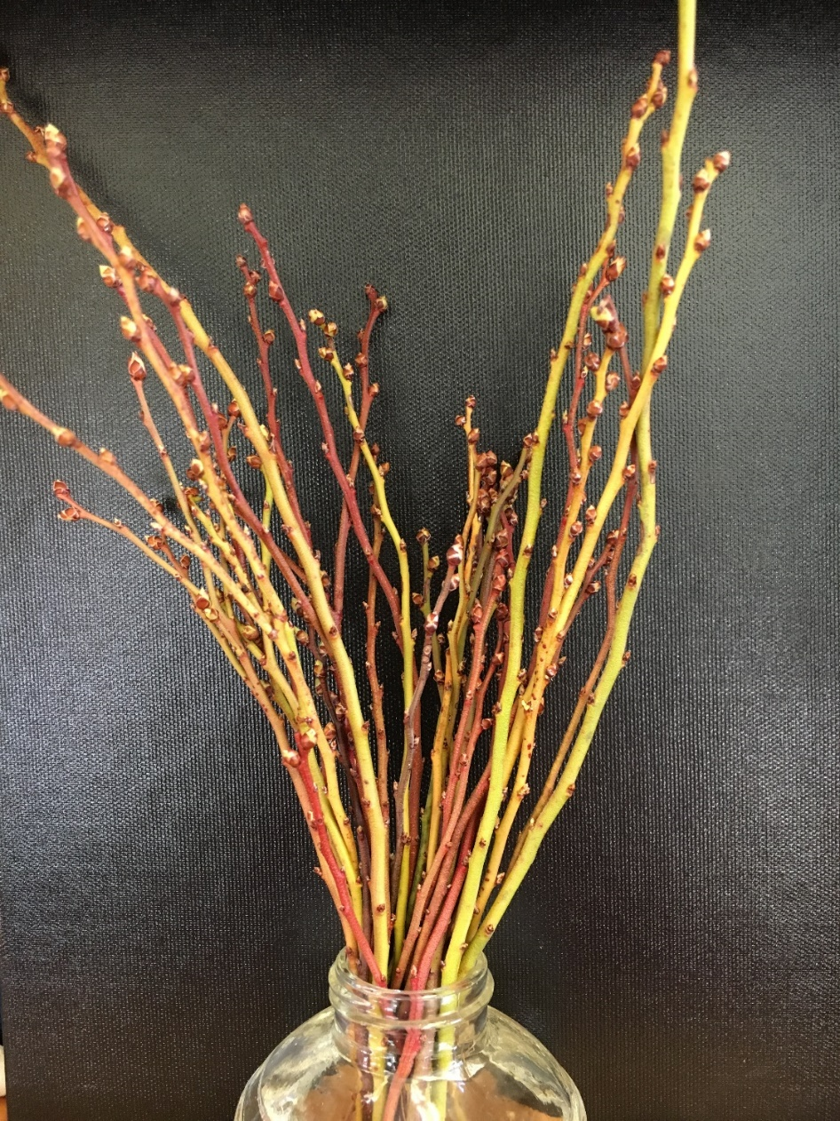
Exobasidium seems to overwinter on the outside of the stem, particularly the buds

Slide 11
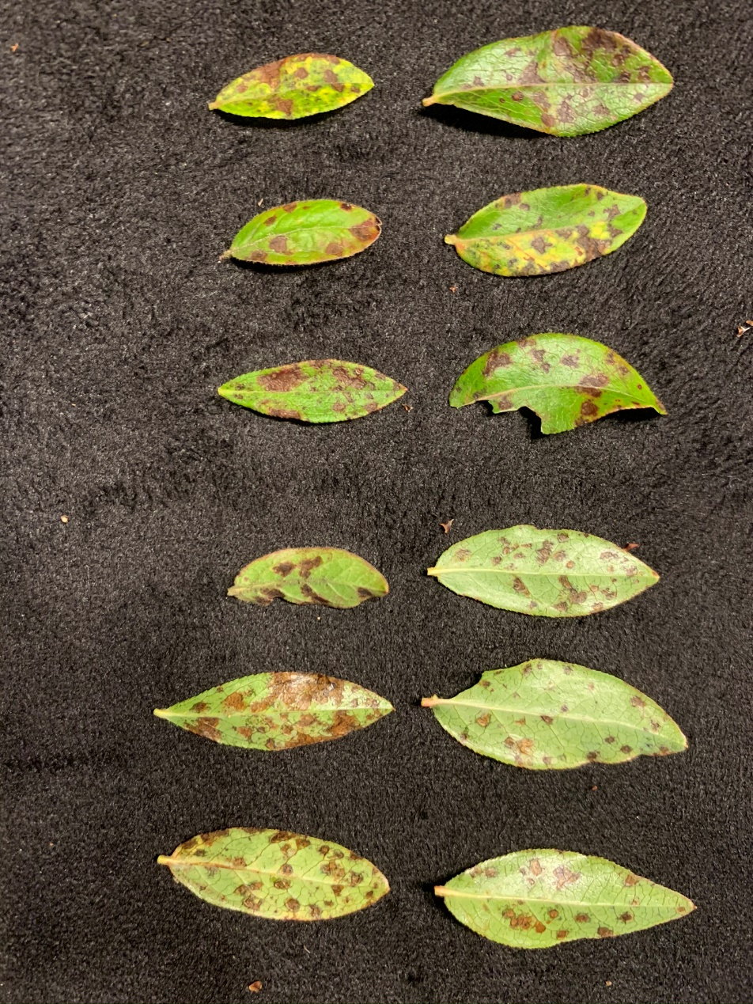
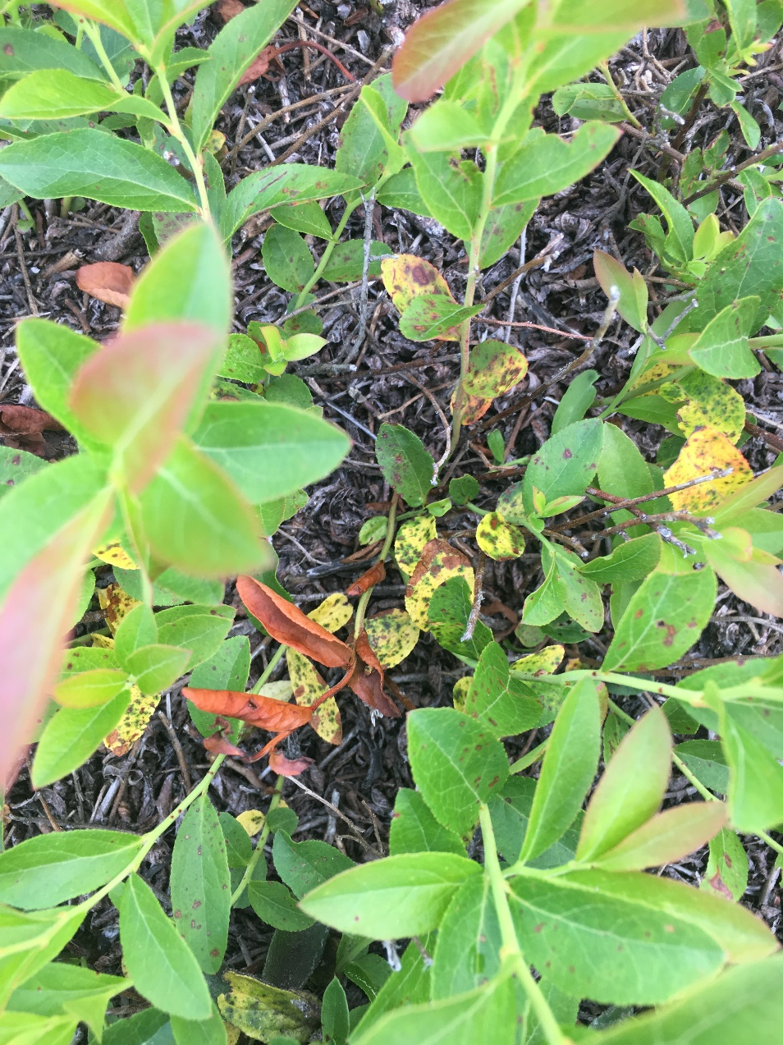
Sphaerulina leaf spot (Septoria old name)

Slide 12
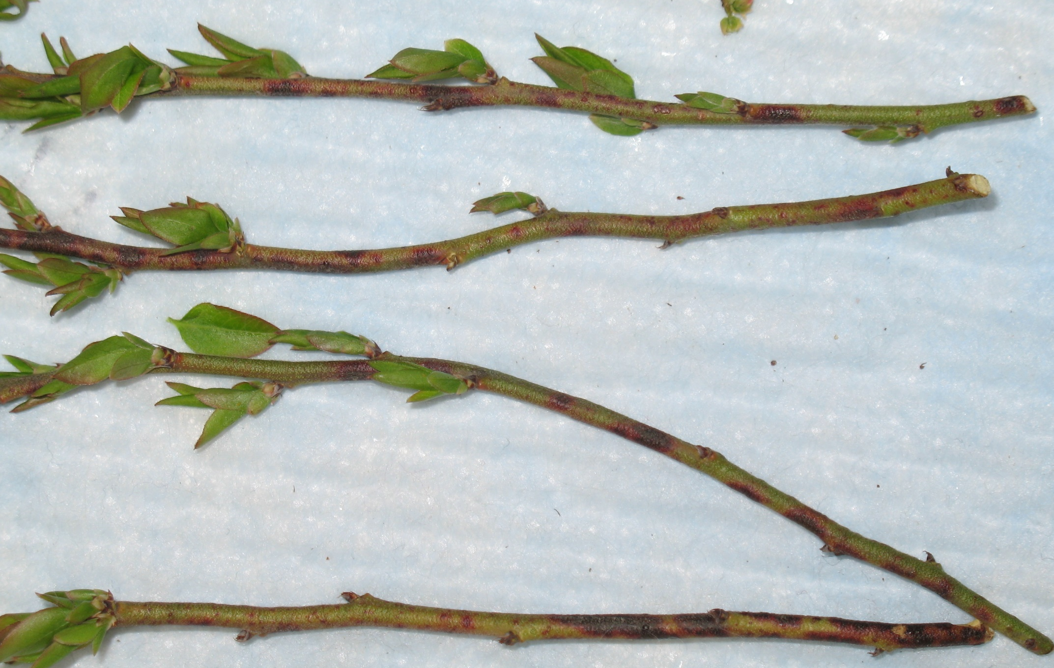
Overwinter in infection dead leaves and stems or as lesions in living stems, splash dispersed by water

Slide 13
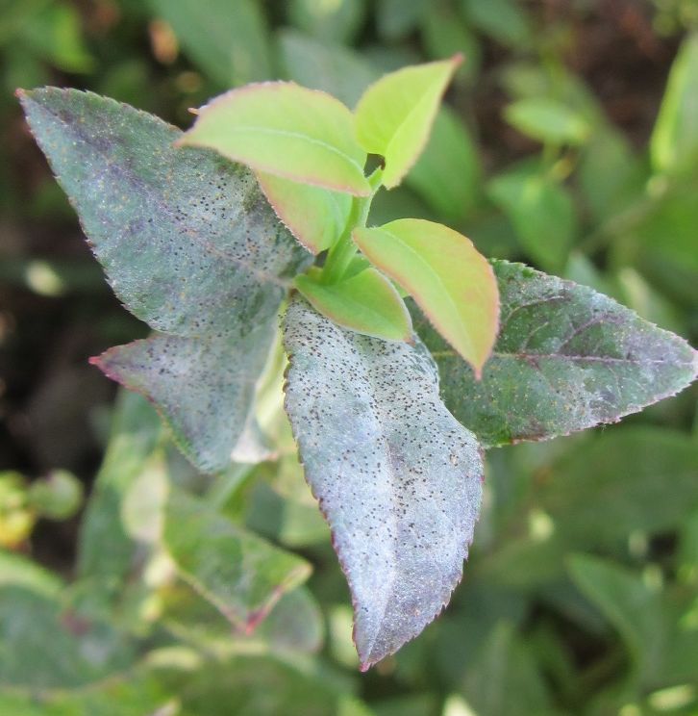
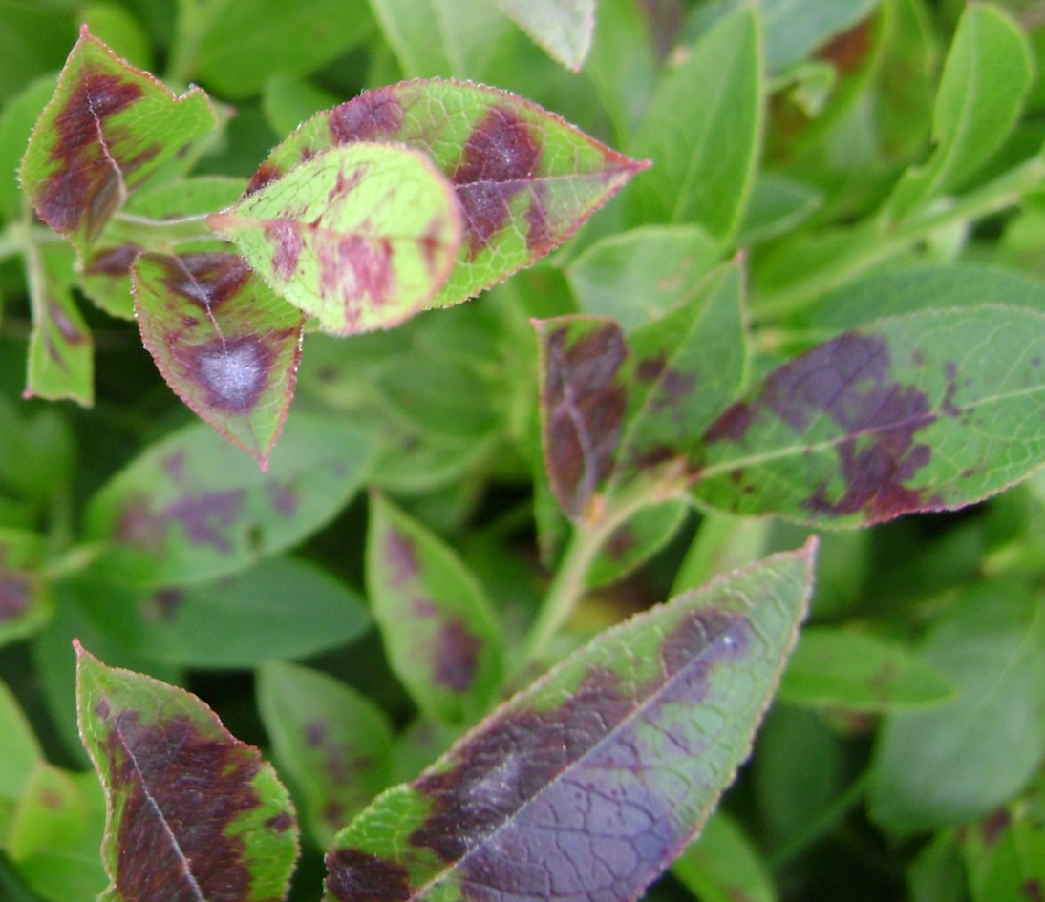
Powdery Mildew- Microsphaera vaccinii

Slide 14
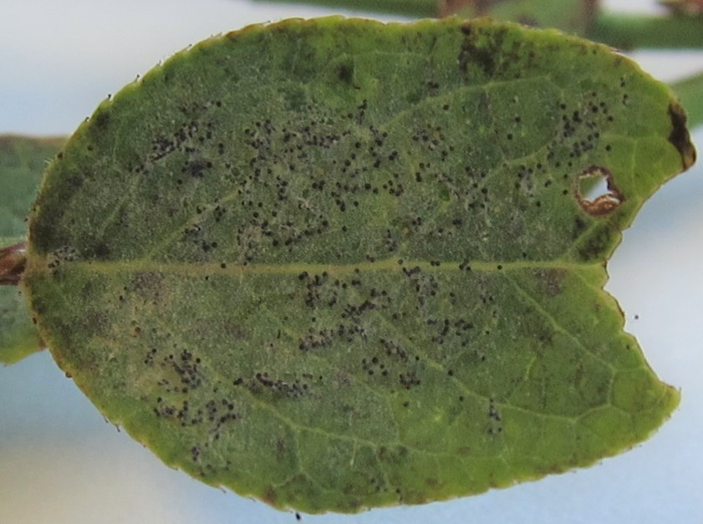
Powdery mildew overwinters on dead leaves and stems - spores dispersed by wind

Slide 15
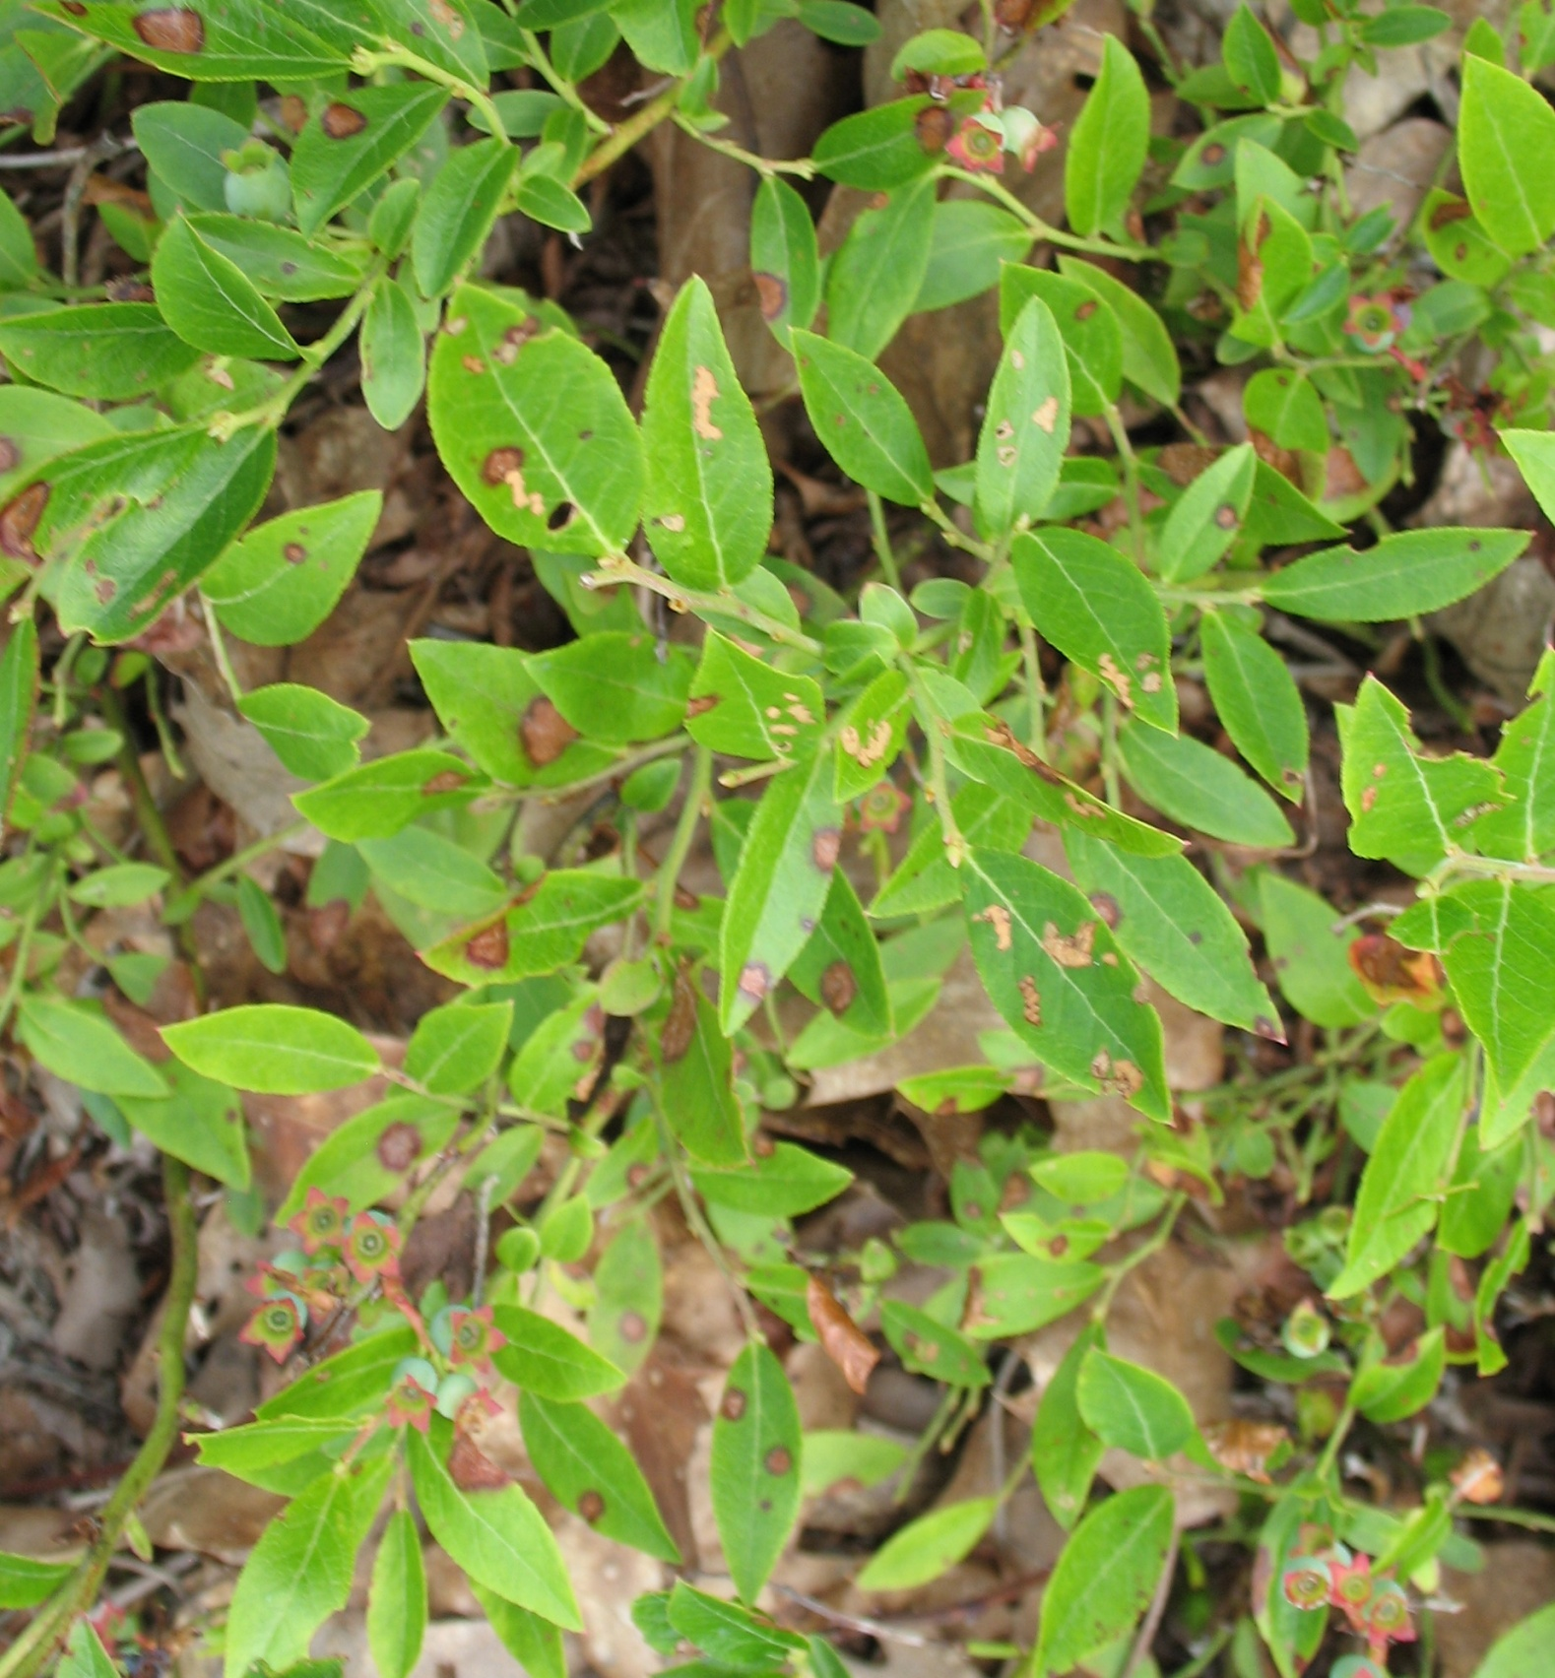
Valdensia leaf spot
Notes:
The next disease I would like to talk to you about is Valdensinia leaf spot which I consider the next most damaging disease after mummy berry blight to Maine wild blueberries. The Valdensinia fungus causes leaf spots in both crop and prune fields and can cause complete defoliation with severe infections.

Slide 16
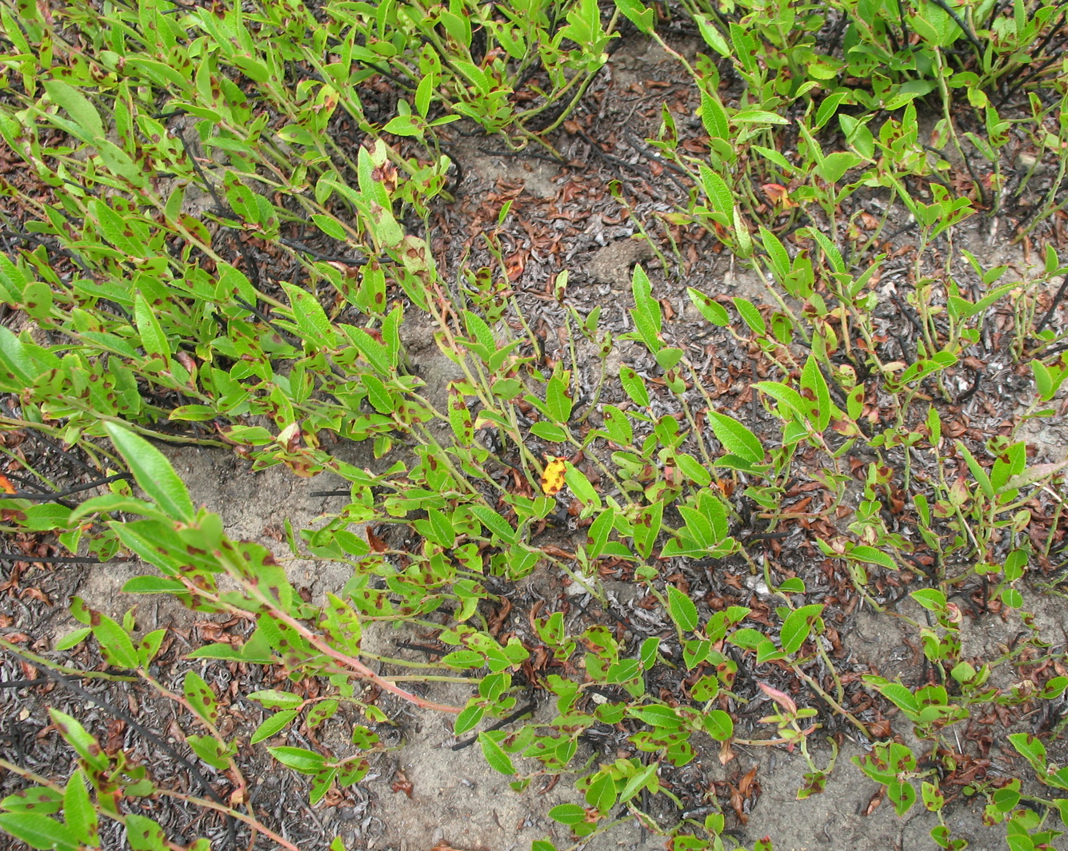
Prune field - early July 2010
Notes:
Stems with severe infections will lose most or all of their leaves. This picture shows prune stems with lower leaf loss.

Slide 17
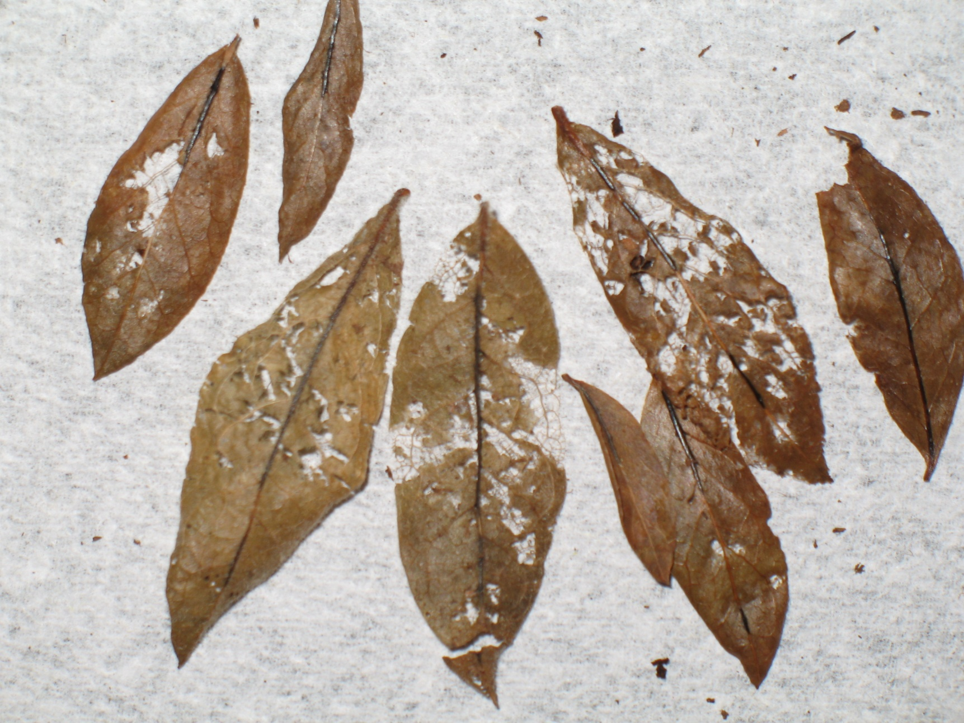
Fungus overwinters in sclerotia in infected leaves
- Spores actively shot off and spores too heavy to disperse by wind or water

Slide 18
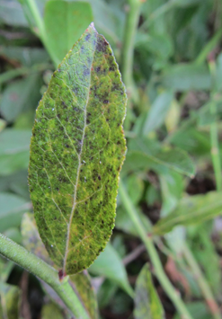
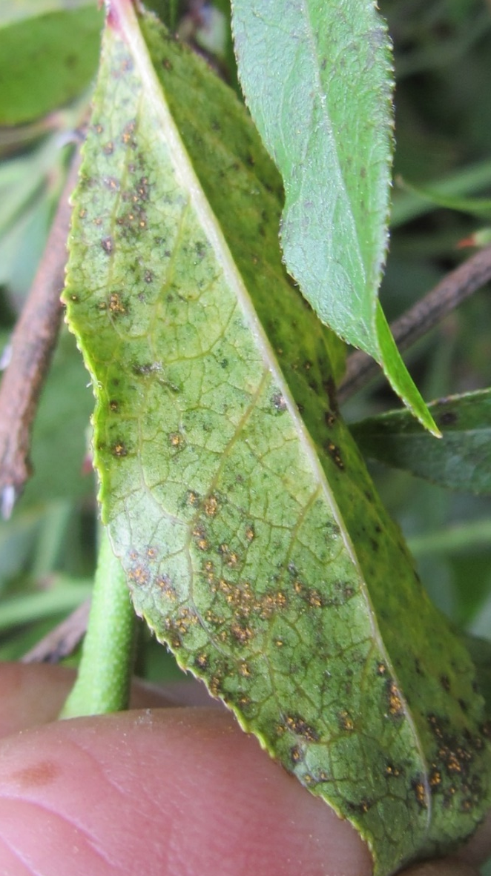
Leaf Rust - Thekopsora minima
Overwinters as spores on blueberry and early spring infects hemlock and then later spring spores infect blueberry

Slide 19
Disease whose organisms overwinter in the field
Mummy berry
Exobasidium leaf and fruit spot
Powdery mildew
Sphaerulina leaf spot
Valdensia leaf spot
Leaf rust
Red leaf
Witches broom
Overwinter INSIDE living blueberry plants

Slide 20
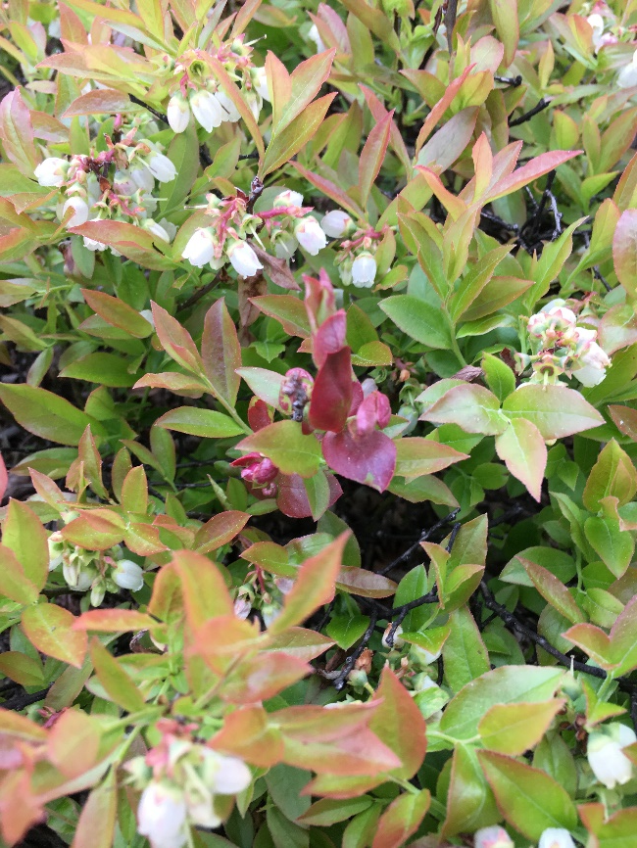
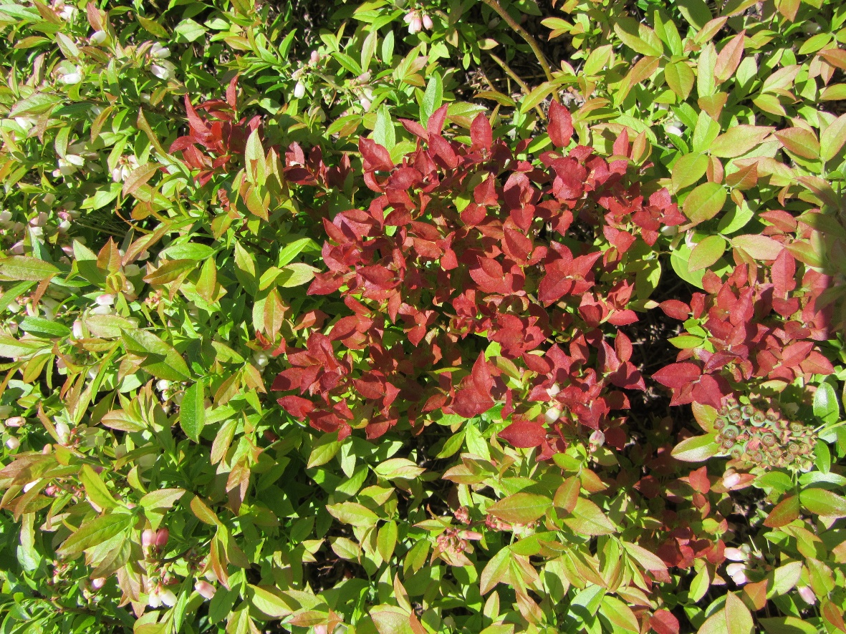
Red leaf fungus persists inside rhizome and stem
Overwinters inside of plant

Slide 21
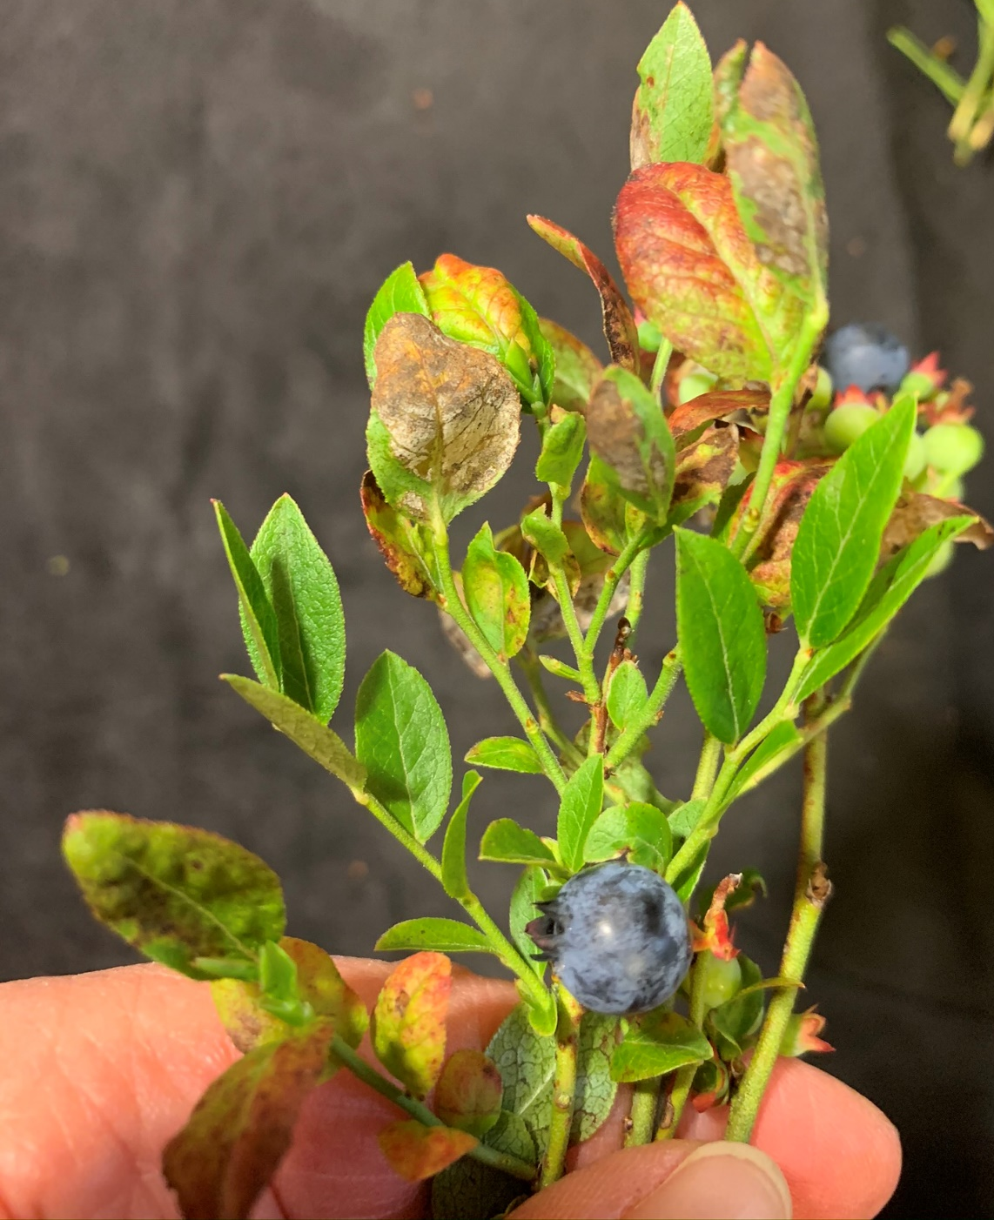
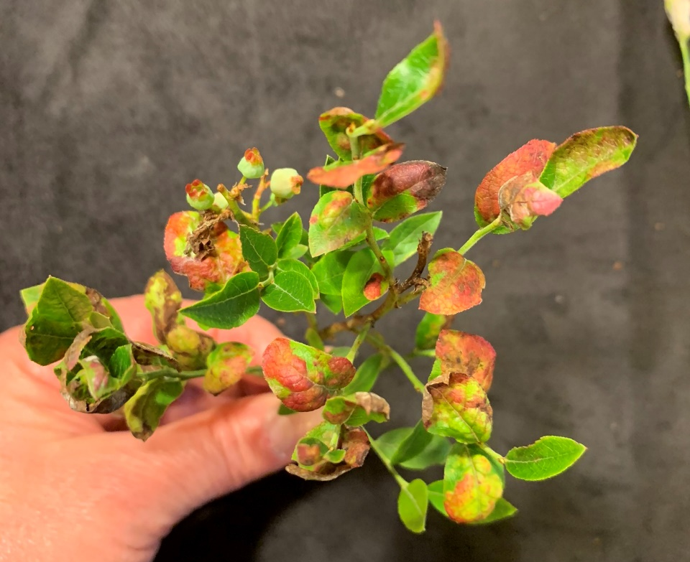
Fungus produces spores late July
Does not spread well by spores (air dispersal)

Slide 22
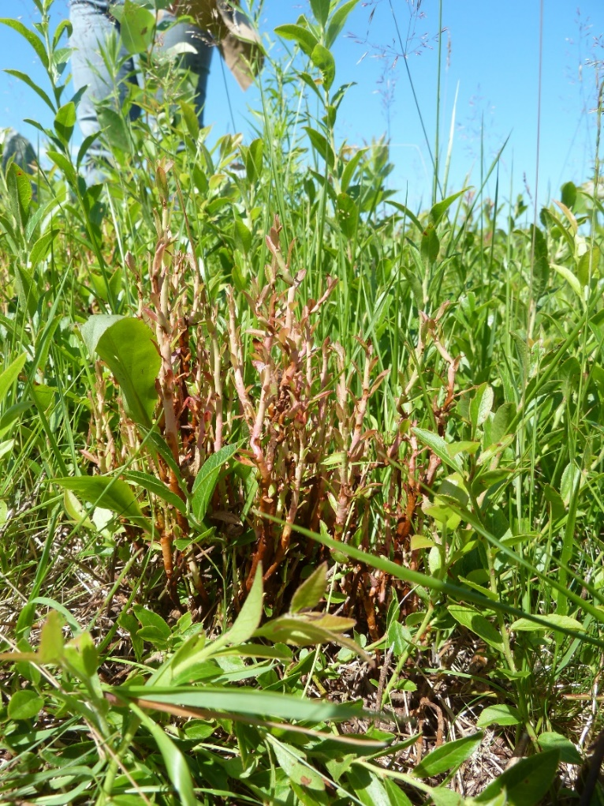
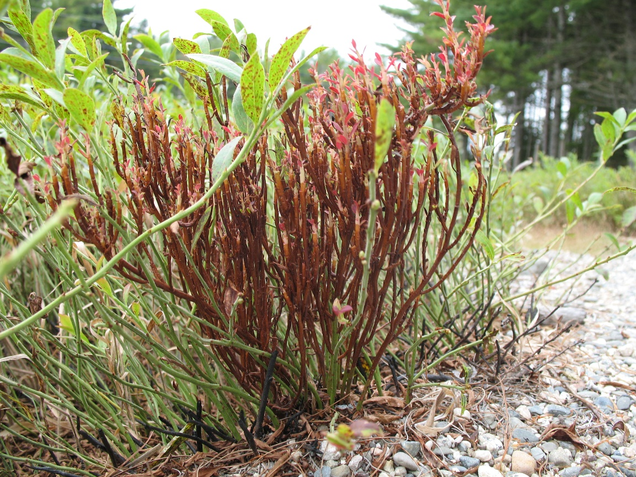
Witches broom – rust fungus
- overwinters in blueberry stems under bark from year one to year two. Can survive for years
- part of life cycle is spent on balsam fir spores dispersed by wind

Slide 23
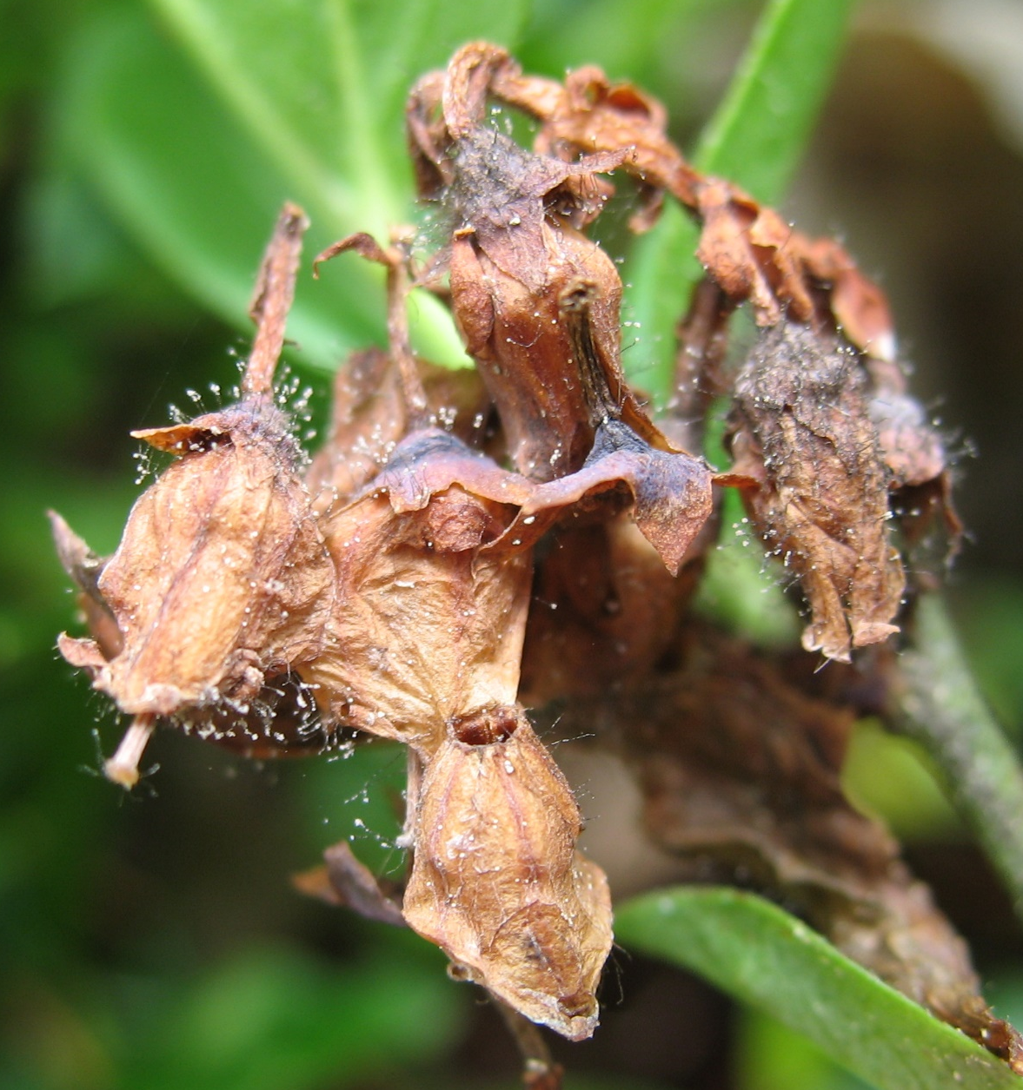
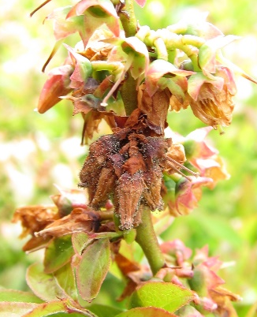
Botyris Blossom Blight comes in initially from outside of the field
Botrytis blossom blight

Slide 24
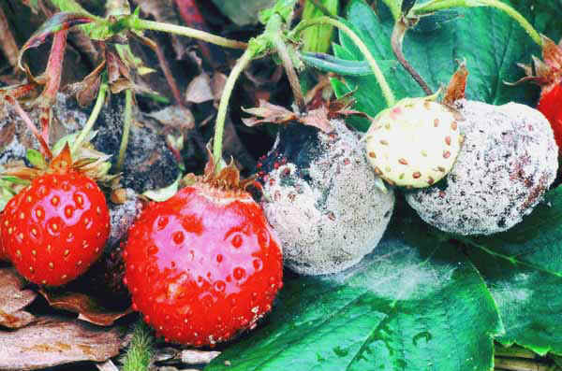
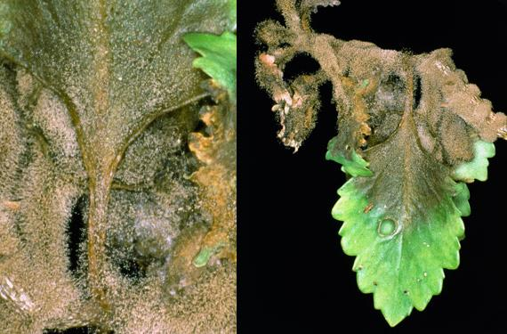
Botrytis – generalist that attacks leaves, flowers and fruit of 1000s of plants
Spores spread by air, blow in from infected plants around field

Slide 25
Effective control involves knowing which disease you have AND its disease cycle
  What stage of plant does it infect?
  When does pathogen produce infective stages?
  What the weather conditions for the fungus to infect the plants?
  Which stages in disease cycle are best for managing disease?
host
pathogen
time
environment

Slide 26
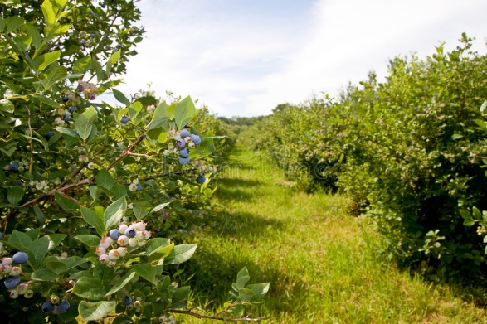
Highbush blueberries

Slide 27
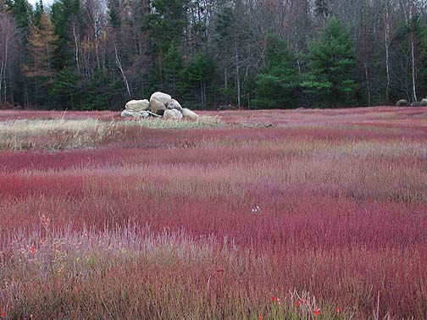
Genetic diversity in lowbush blueberries
Genotypes vary in timing of development AND susceptibility to diseases
Most fungal pathogens have co-evolved with plants
Notes:
Once you know when the fungus is producing spores, the next step is to determine if your field has enough susceptible tissue to warrant fungicide applications. Previous research has found that it is not cost effective to apply fungicides to control this disease until at least 40% of the stems have susceptible tissue.
Because wild blueberry fields are a patchwork of clones, it is often hard to tell by just looking at the field when 40% of the buds are susceptible. By taking a random sample of stems across a field, you can get an accurate idea of how the plant development is progressing.

Slide 28
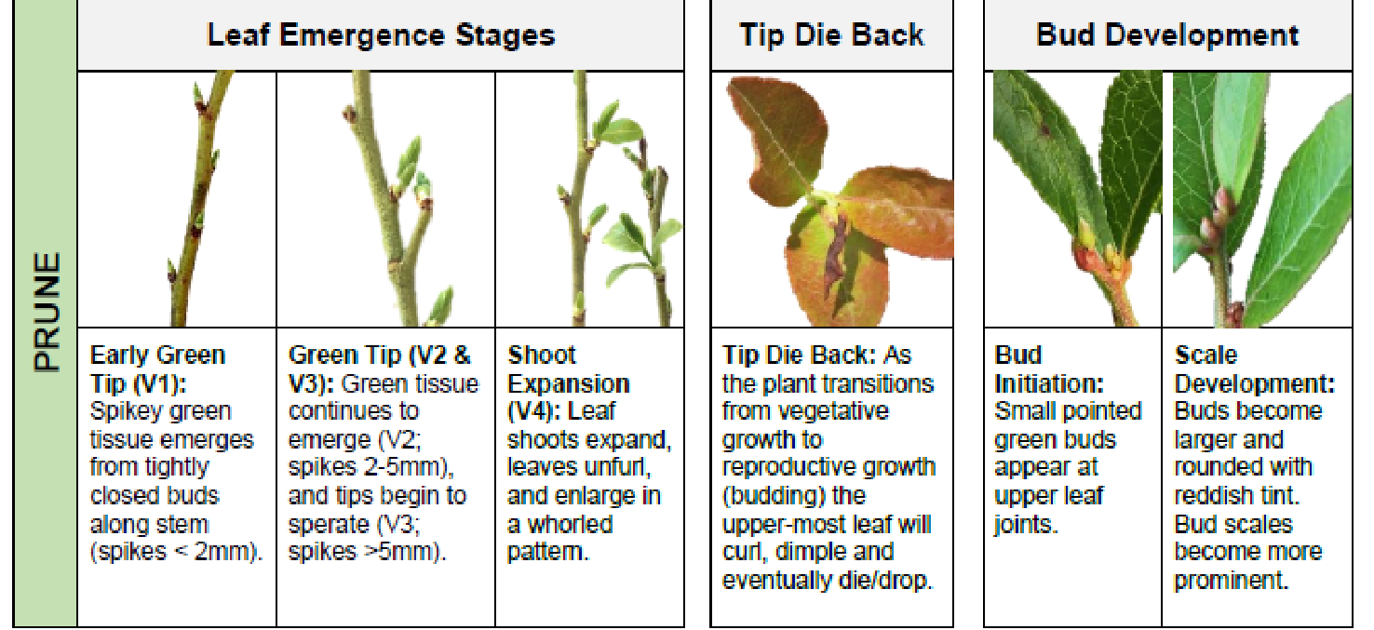
Different stages of development can vary in their susceptibility

Slide 29
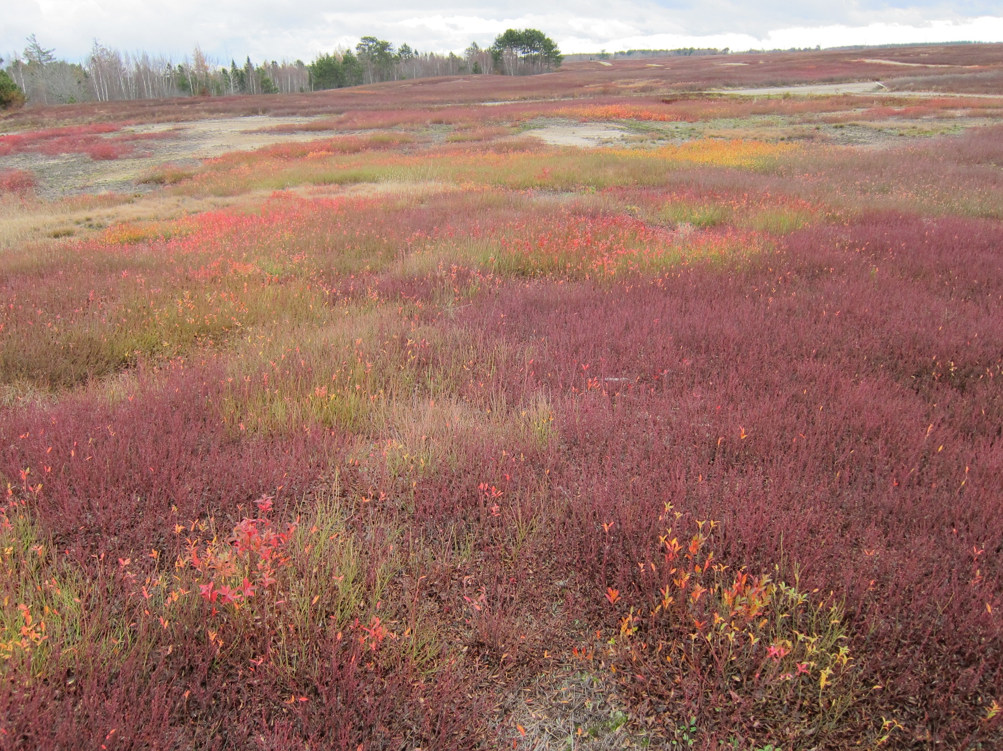
Late September to October, crop year

Slide 30
Pruning
Decreases living infected plant material – disrupting build up of inoculum
Increases chances of pathogen dying overwinter by killing host tissue (eg. Sphaerulina) or decay of plant material
Disrupts pathogen lifecycle by changing plant development stage available when spores are produced (eg. mummy berry)
Increases plant debris layer and may bury some inoculum
UNFORTUNATELY many pathogens can survive in dead plant material

Slide 31
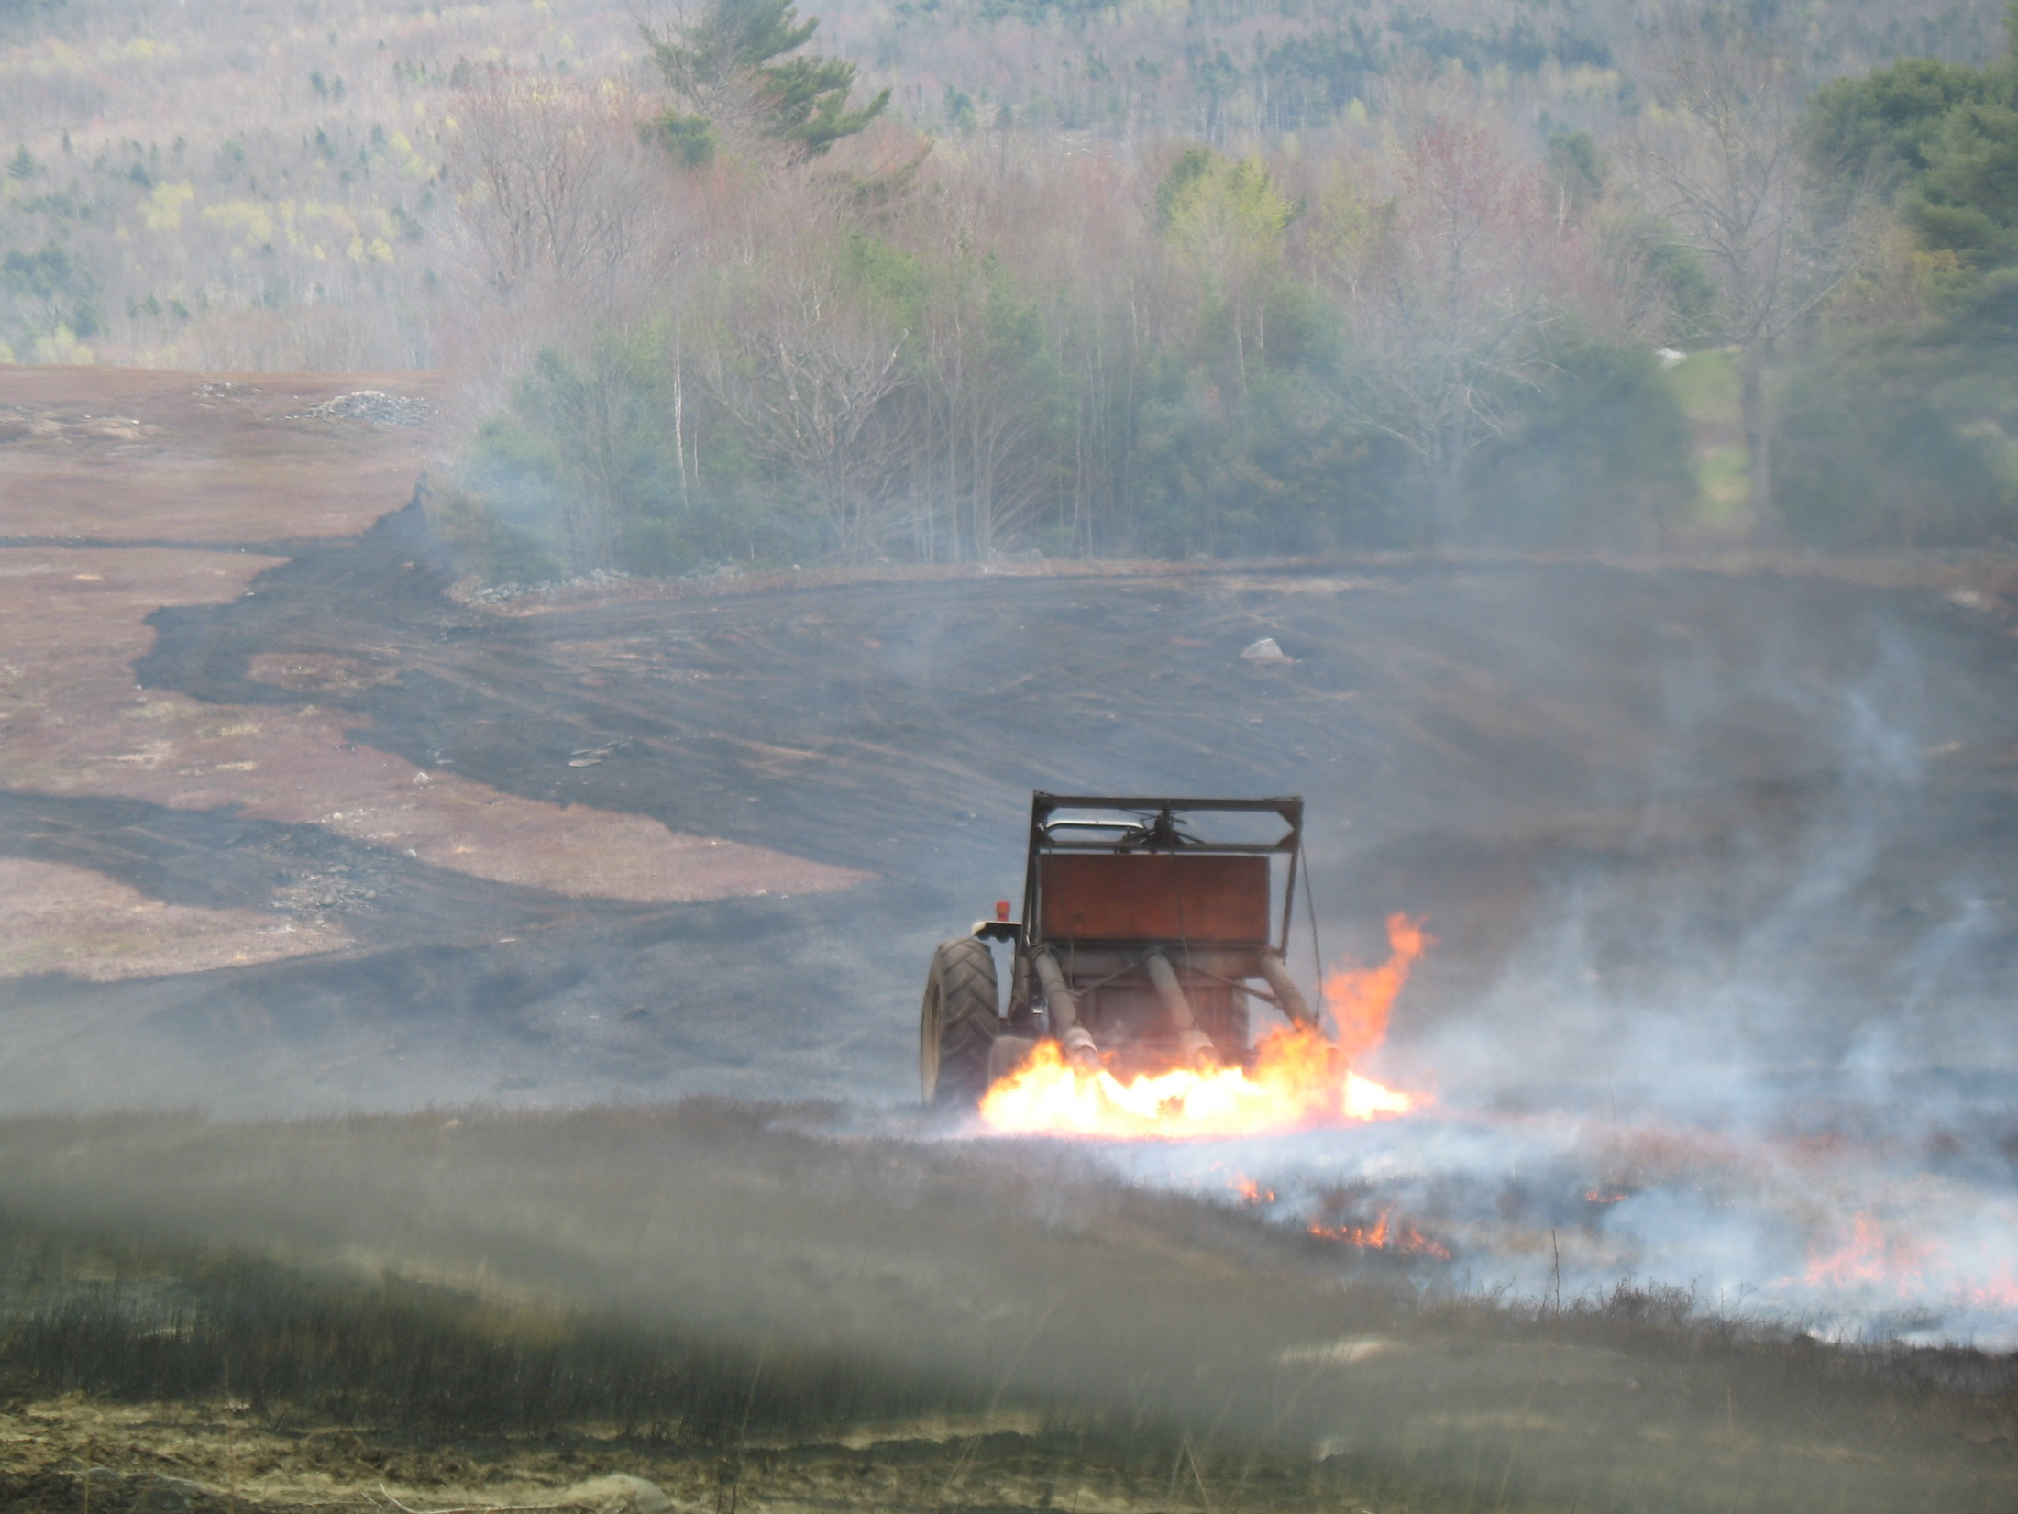
Burn pruning – helps destroy infected plant material and pathogen structures

Slide 32
Effect of pruning method on mummy berry
Pruning method | Number of crop cycles | Mummy berry (infected stems/m²)
Remained mowed | 1 crop cycle (1987) | 19.8
 | 2 crop cycles (1989) | 45
Switched to burn for one cycle after 2 cycles of mow | 1 crop cycle after switch (1987) | 5.66
 | 2 crop cycles after switch (1989) | 6.35
(Lambert D., 1990)

Slide 33
Burning also may have an effect on:
Sphaerulina leaf spot – infected stems and leaves
Valdensia leaf spot – infected leaves
Powdery mildew? no effect seen by Lambert (1990)
Leaf rust?
Witches broom?
Stem blights?

Slide 34
Mulching after pruning – late fall or very early spring
- Need to have mulch spread at least 1 inch thick before cups emerge
Kristen McGovern, MS, 2007

Slide 35
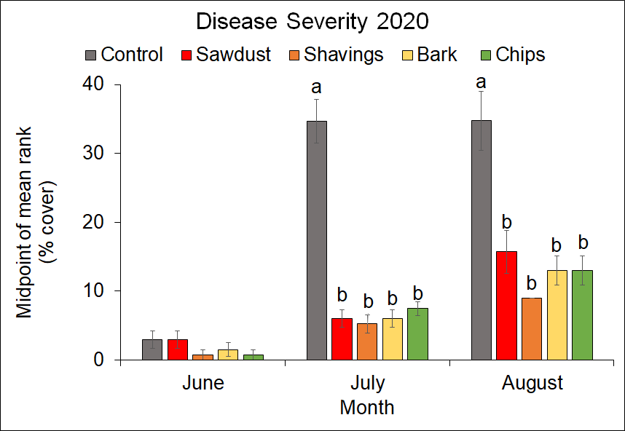
Mulch can decrease leaf spot symptoms
Rebecca M. Gumbrewicz. MS, 2021

Slide 36
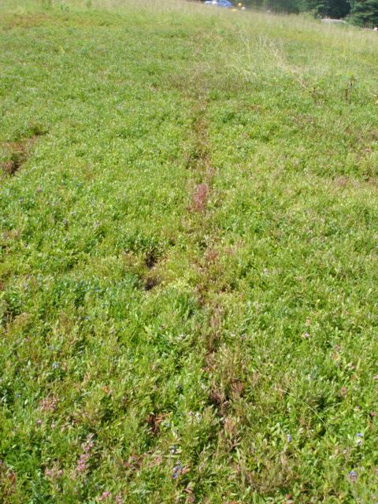
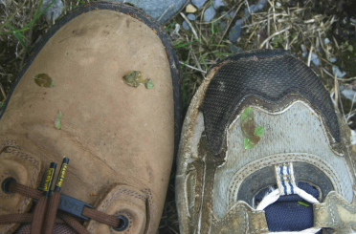
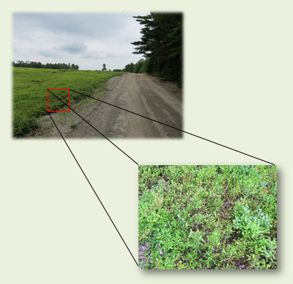
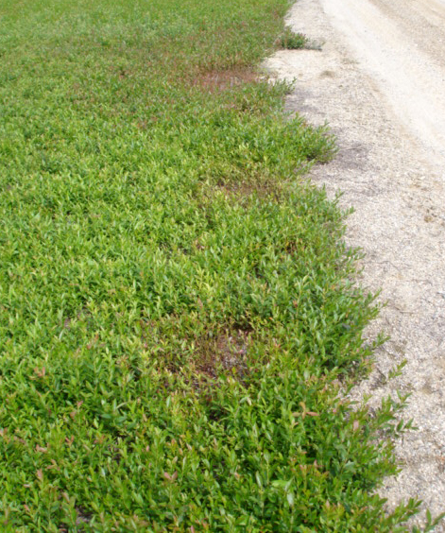
Sanitation: footwear, vehicles, and equipment
can move diseased tissue
Example:
Valdensia leaf
spot
Paul Hildebrand
Erika Lyon
Notes:
Hypothesis: V. heterodoxa is brought into fields via human transport along road networks, and suitable microclimates facilitate reproduction and localized spread of the fungus. Therefore, pathogen sites in LBB fields will on average be closer to roads and certain habitats than random

Slide 37

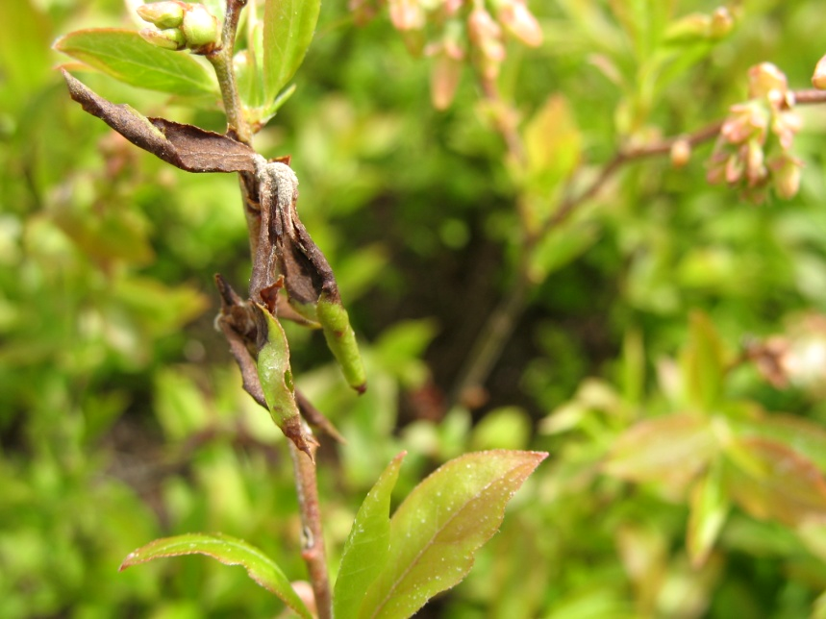
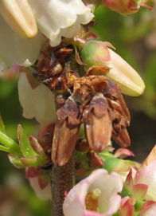
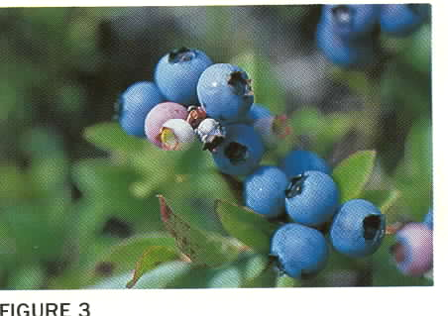
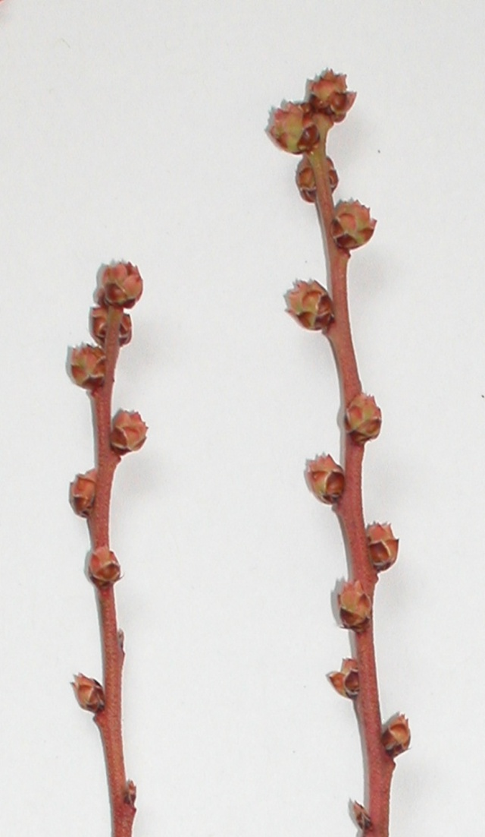
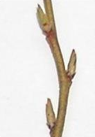
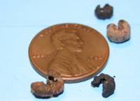
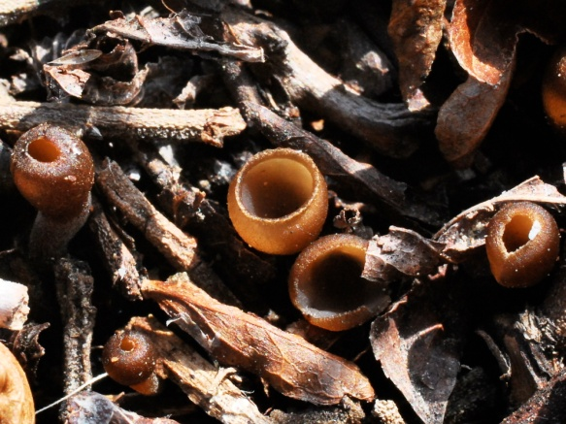
Spores produced on infected flowers and leaves infect healthy flowers
Infected flowers produce mummy berries
Mummy berry
Monilinia vaccinii-corymbosi
April: mummy berries germinate and produce cups with ascospores
Mummy berries overwinter in soil
Ascospores infect open leaf and flower buds with leaf wetness
Notes:
I will start with the mummy berries which are the fruit that has been colonized by the fungus Monilinia vaccinii-corymbosi that causes mummy berry disease.
The mummy berries overwinter in the top layers of the soil and germinate in April and May. When they germinate they grow a cup structure that produce sexual spores, ascospores, that are actively shot off into the air.
The ascospores are carried by wind to land on leaf and flower buds. Cups are usually present BEFORE bud break so spores are being produced as the buds are opening and becoming susceptible. Flower buds are susceptible to the fungus once the bud scales are open enough that the bud looks like a crown with points. The leaf buds are susceptible once they have green tissue exposed from their bud scales. Leaf and flower buds are susceptible through out their development to mature leaves and flowers.
There needs to be a long enough period of wetness on the plant for the spores to germinate and penetrate into the plant. The length of time for the spores to penetrate depends upon the temperature. This is the key stage of the plant to protect from the fungus to avoid crop losses.
Once the fungus has penetrated into the plant, it grows through the leaf and flower bud tissue as they continue to develop. The infection shows no visible symptoms until eight to nine days after penetration when it kills the bud tissue and produces a second type of asexual spore on the dead surface of the tissue.
These spores do NOT cause infections that kill leaves and flowers. These spores are picked up by and carried by insects, possibly pollinators, to healthy open flowers.
The spores penetrate into the flower’s ovaries and the fungus replaces the fruit as it grows. At harvest the mummy berries are smaller, gray and easy to see compared to the ripe fruit.
The mummy berries fall to the ground and overwinter to repeat the life cycle.

Slide 38


For example: infection by fungus (MVC) that causes Mummy Berry requires:
2) Susceptible
Leaf and flower buds
1) Mummy berry cups producing infective spores
¼”
3) Rain or Fog period
Notes:
To get mummy berry disease you need three things to occur at the same time. You need mummy berry cups producing spores, susceptible leaf and flower buds, and a long enough rain or fog period for the fungal spores to germinate and penetrate into the plant.
To control the disease, we cannot affect the weather, but we can decrease the number of mummy berry cups and protect the developing leaf and flower buds with fungicides.
Two ways to decrease the number of mummy berries producing cups is by burn pruning and mulching.

Slide 39
Monilinia Apothecia Presence – 2009 to 2022
2019
2021
2022
Notes:
These are approx. dates due to moving rectangles over the years.

Slide 40
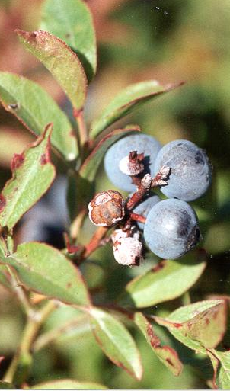
Making mummy berry plots
1. At harvest, collect about 30 to 50 mummies per plot
2. In a field that will be crop the next year, find small bare area among the plants (3” X 3”) and clear off leaves
3. Place mummies on ground and cover with ¼ inch of soil
4. firmly press mummies into dirt (step on them), replace leaves
5. Mark plot with stakes/flags
Notes:
If you make a mummy berry patch, you will know what is happening with the cups in your field, instead of them germinating and producing cups were you cannot easily find them and know what they are doing. You do not need to put mummy berry patches in every field you manage. Mummy berry patches in the earliest and latest developing fields is a good idea to get the range of development of the mummy berries. How you make a mummy berry patch is very easy.
During harvest, collect about 40 to 50 mummy berries for each patch you want to put out. We suggest putting out 3 patches in a field since often one will not work due to the mummy berries washing away or being lost due to frost heaves.
Soon after collecting the mummy berries place them in a field that will be in crop the next year, and in an area that you have easy access to. Find a slight hollow 2 to 3 inches across.
Brush aside the leaf litter and place your mummy berries in the cleared area. Cover the mummies with 1.4 inch of soil.
Firmly press the mummies into the dirt by stepping on them
And the last very important step, mark the patch by putting flags and/or stakes beside it.

Slide 41
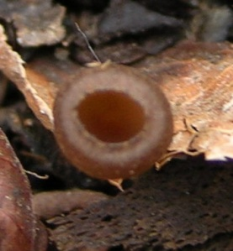

When is fungus producing infective spores?
- Fungi have their own development stages and timing during the year
Apothecia producing infective spores

Slide 42




When is plants susceptible?
Field susceptible to MVC when 30 to 40% or more of plants have susceptible flower buds
Susceptible to MVC
F0 F1
F2 F3

Slide 43
What weather conditions required for fungus to infect the plant?
Delbridge and Hildebrand method based on Hildebrand and Braun, 1999

Slide 44


When is best time to manage disease?
This is too late for mummy berry!

Slide 45



Fungus infects plant at early bud stages and grows in plant while plant grows
7 to up to 21? days
later

Slide 46
Fungicides
Most are protectants and must be applied before infection
Last 7 to 14 days depending upon material and weather
Need to be applied at a suitable stage
Applied to early or late – waste of time, material and money

Slide 47

Data 2014
Blue rectangle when mummy berry cups are present
Black bars indicate possible infection periods
?
9

Slide 48
Disease control
Identify disease and pathogen
When does inoculum appear in the crop cycle?
What plant stages does pathogen infect?
What weather conditions aid in infection (if known)?
What are possible points in pathogen’s life cycle that can be disrupted?
What are the best methods to manage pathogen?

Slide 49
Acknowledgements
Research professionals: Margo Roberts, Jacob Schwab, Greg Kornelis, Rachael Martin, Caleb Slemmons
Graduate Students: Kristen McGovern, Laura Penman, Tyler Case, Katie Ashley, Erika Lyon, Nghi Nyugen, Ian Leonard, Zoe Colwell
Numerous undergraduate students
Blueberry grower cooperators

