Slide 2
Why a play book?

Slide 3
2020 Berry Grower Survey:
In a “normal year”, what pests are the greatest threat to your strawberry production?
Weed 73.3 %

Slide 4
2020 Grower Survey:
How many applications for herbicides in one year?
0,2,3,4
Once at end of season
None except between plastic rows

Slide 5
Largest Limiting factor in Berry Production from the Survey:
Labour!!!!
Your labour is too valuable to be pulling weeds and cultivating

Slide 6
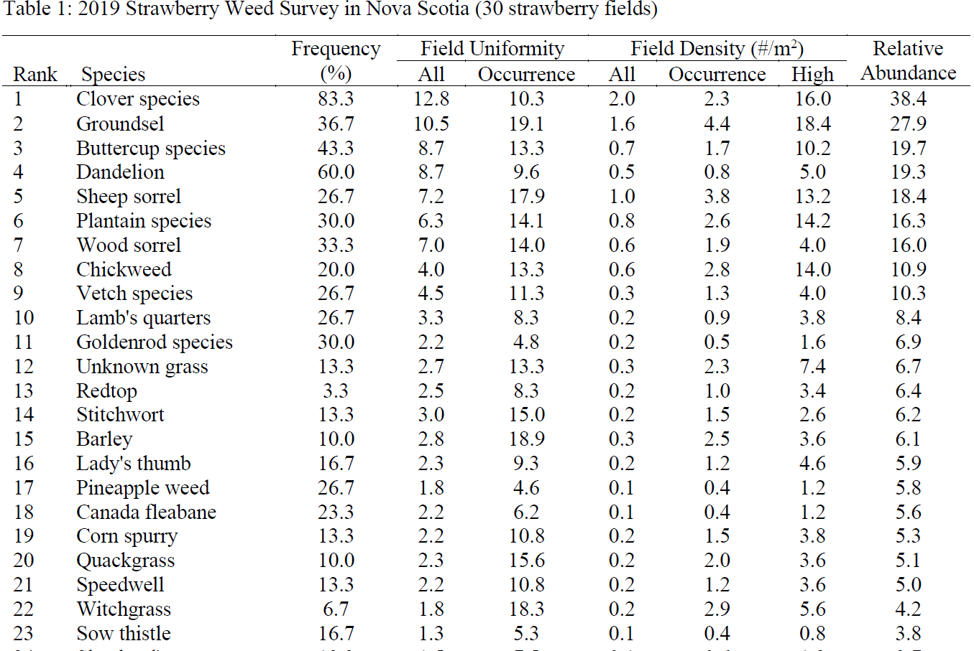
Initiated by Angela Gourd, completed by Laura Anderson of NSDA

Slide 7
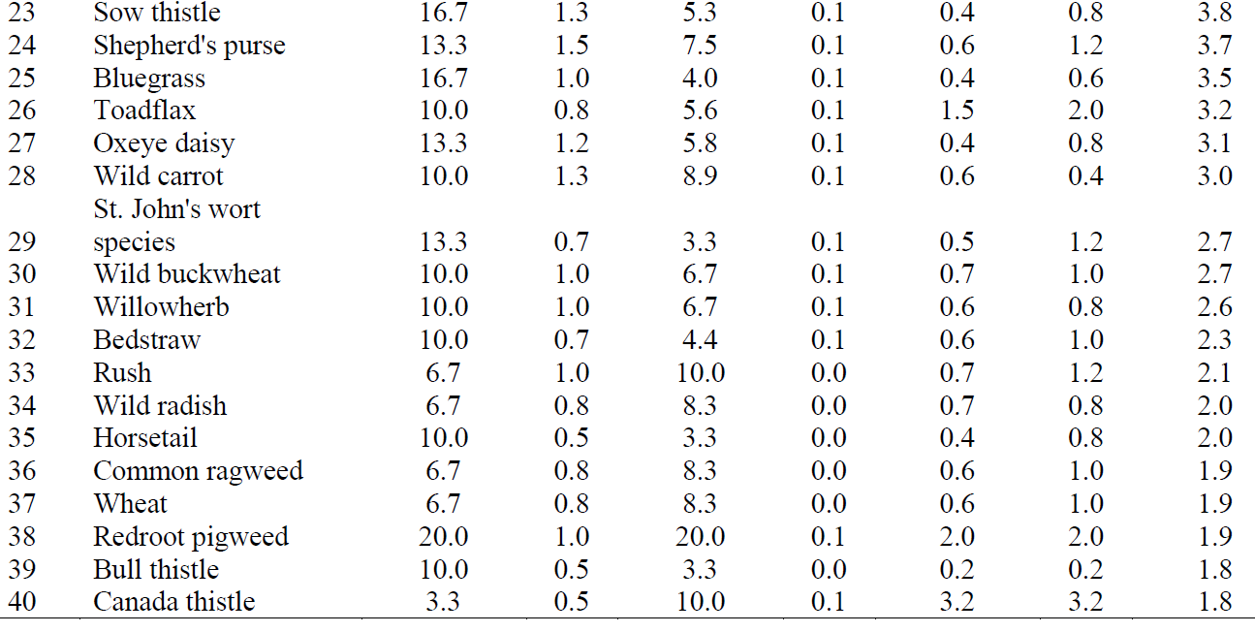

Slide 8
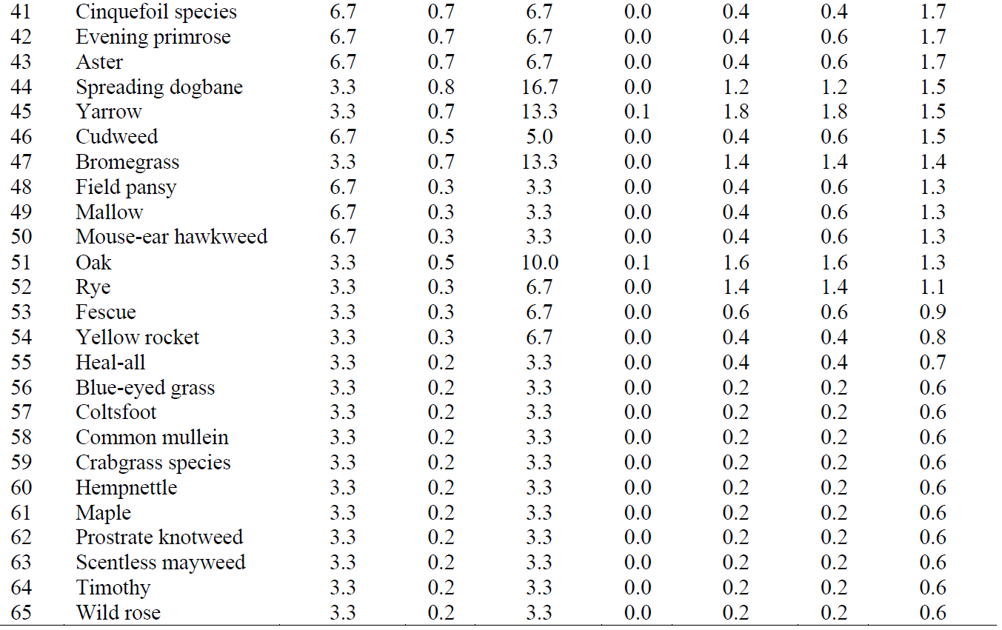

Slide 9
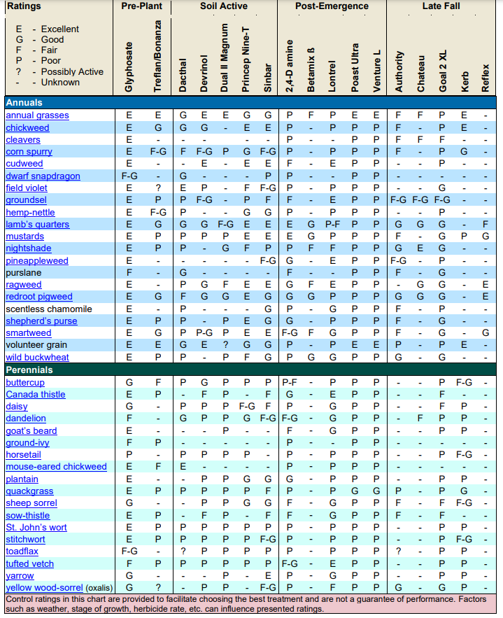

Slide 10
Perennial weeds:
Wood Sorrel, Golden Rod, Clovers, Quack Grass, Vetch
  Proper burn down and field prep
  Start a year out, burn down, plant cover crops (two cycles), burn down again
  Never use Roundup alone for burndown

Slide 11
Start clean and keep it clean
We have very good soil active and pre emergent products
We have poorer post emergent products therefore we need to be PREVENTATIVE

Slide 12
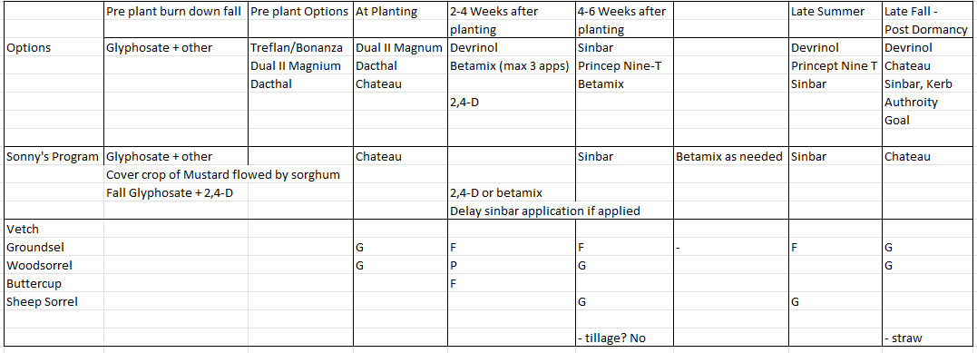
Planting year program

Slide 13
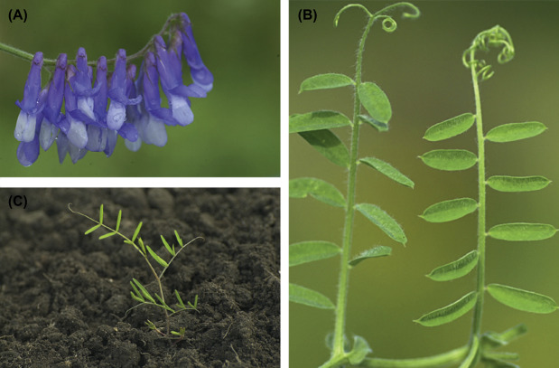
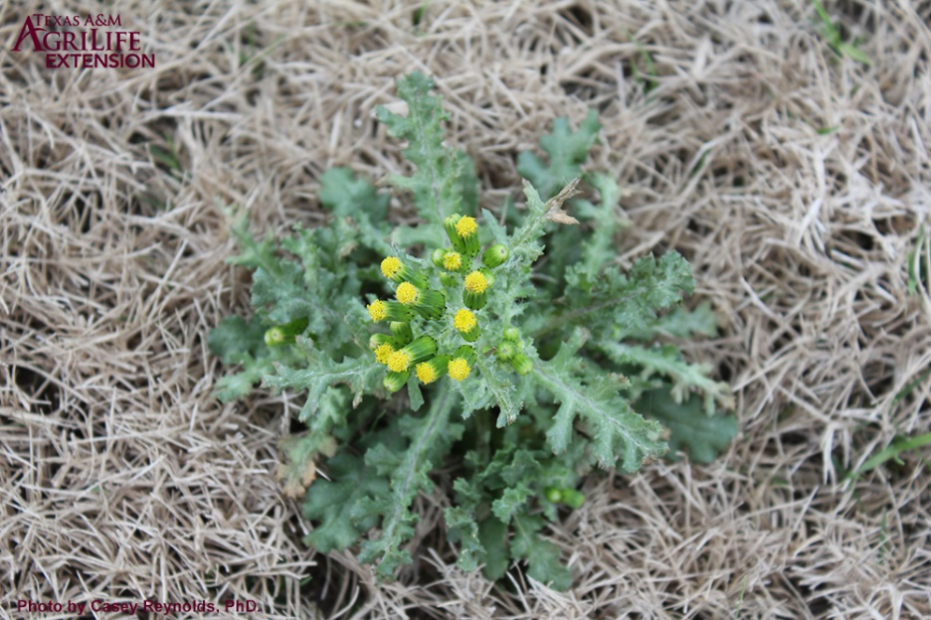
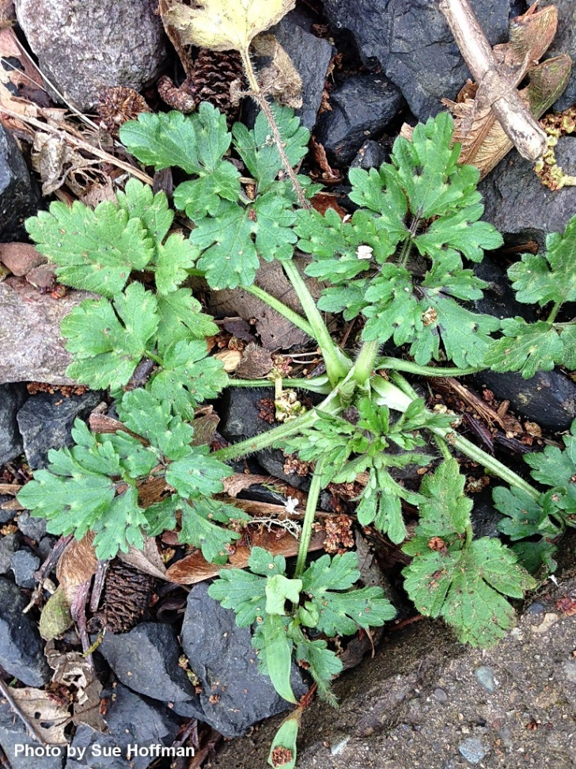
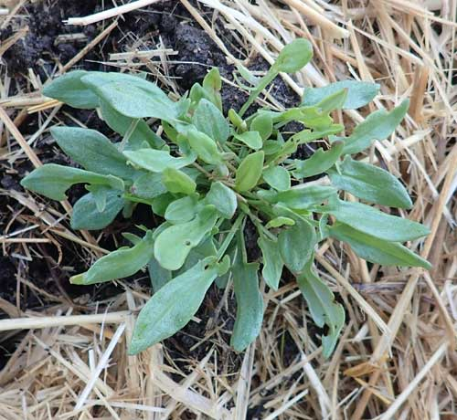
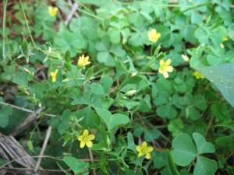

Slide 14
Planting year program

Slide 15
NO TILLAGE IN-CROP ESTABLISHMENT YEAR!
Tillage dilutes your residual herbicide, brings up more weed seeds which begets more tillage

Slide 16
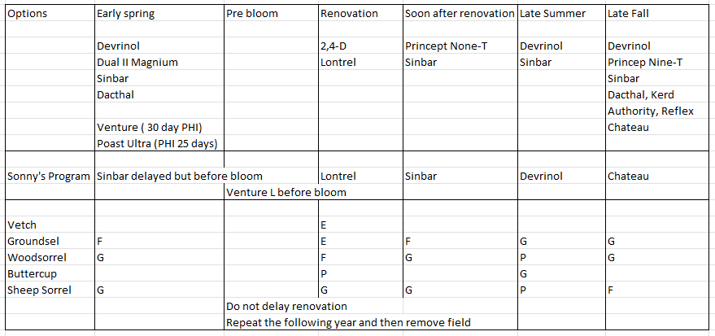
Harvest year program
- allow 10-14 days between sinbar and venture

Slide 17
Must break up Renovation
Early Varieties
    Take out before weeds go to seed
    Do we need a spring herbicide on early maturing varieties
    Problems are only going to magnify in these areas as the season progresses if we don’t renovate early
    Maximize time for regrowth and set fruit buds
Mid/late Varieties
    Hopefully are picking up less disease and insects from spent fields
    Yes you may have to clean out your sprayer….or have two sprayers

Slide 18
Harvest year program

Slide 19
Cautions:
These programs assume
    Good drainage
    Irrigation/rainfall when needed after application
    Healthy vigorous plants
    Good fertility
    Dormant applications when plants are dormant, soil is not frozen, no heavy rainfall directly after application

Slide 20
Ok, what about a fungicide program

Slide 21
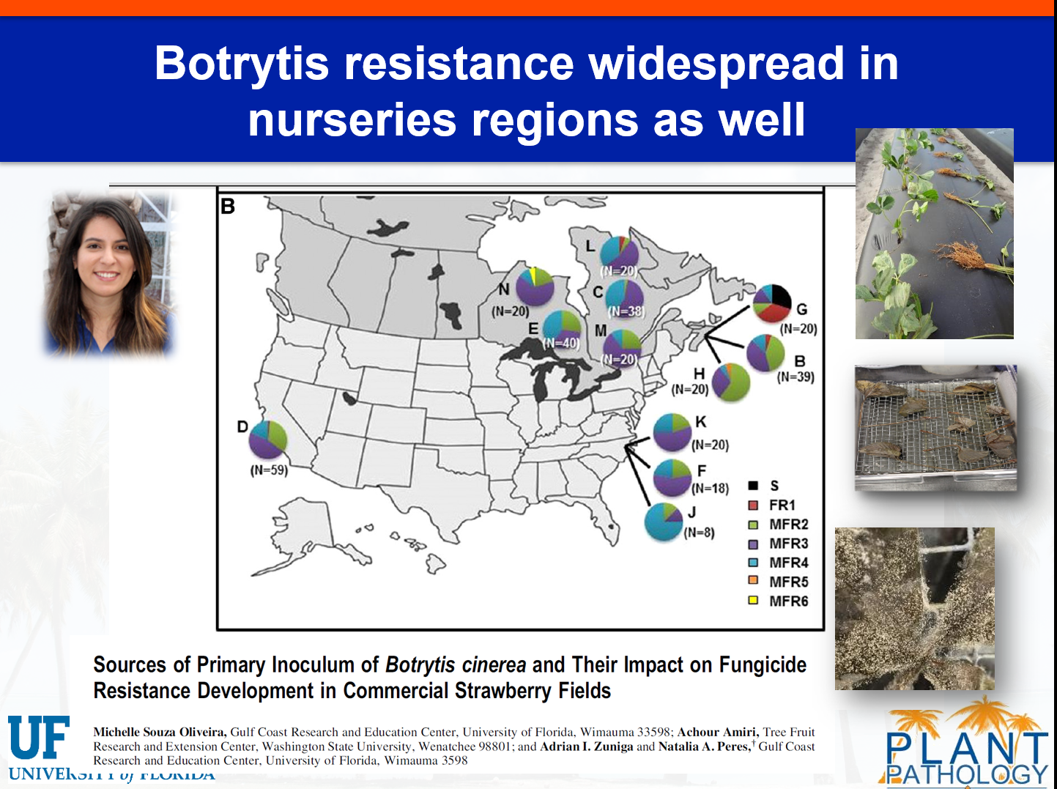

Slide 22
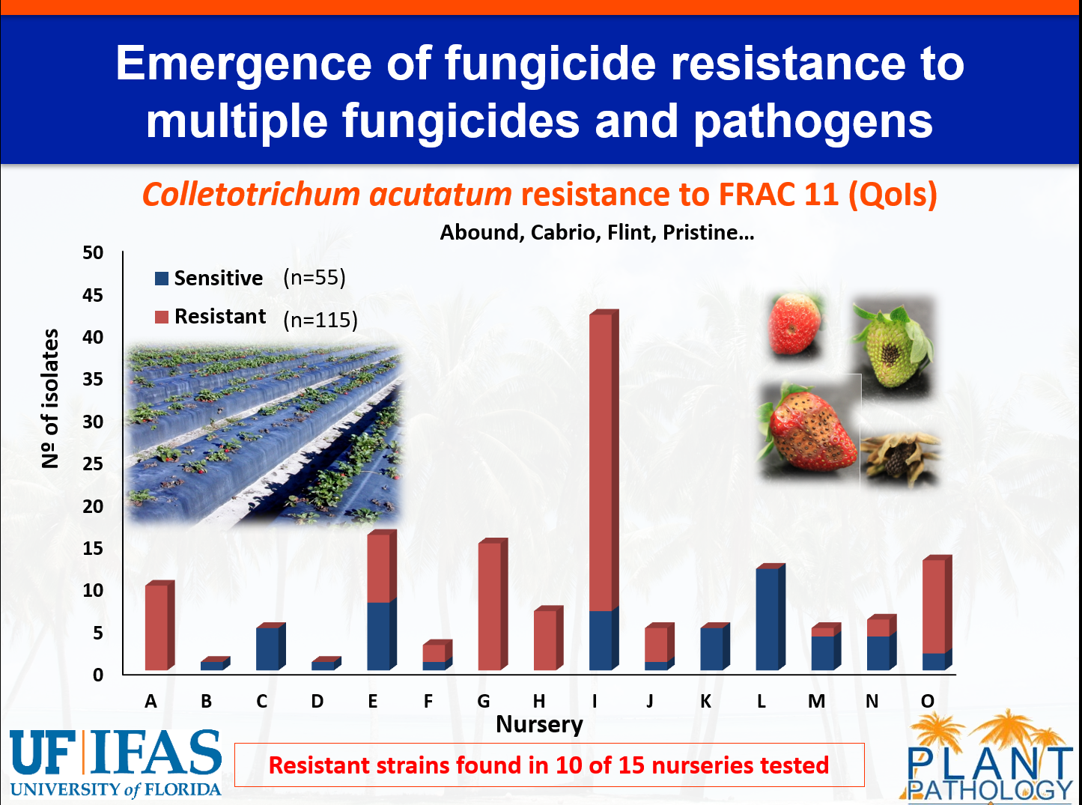

Slide 23
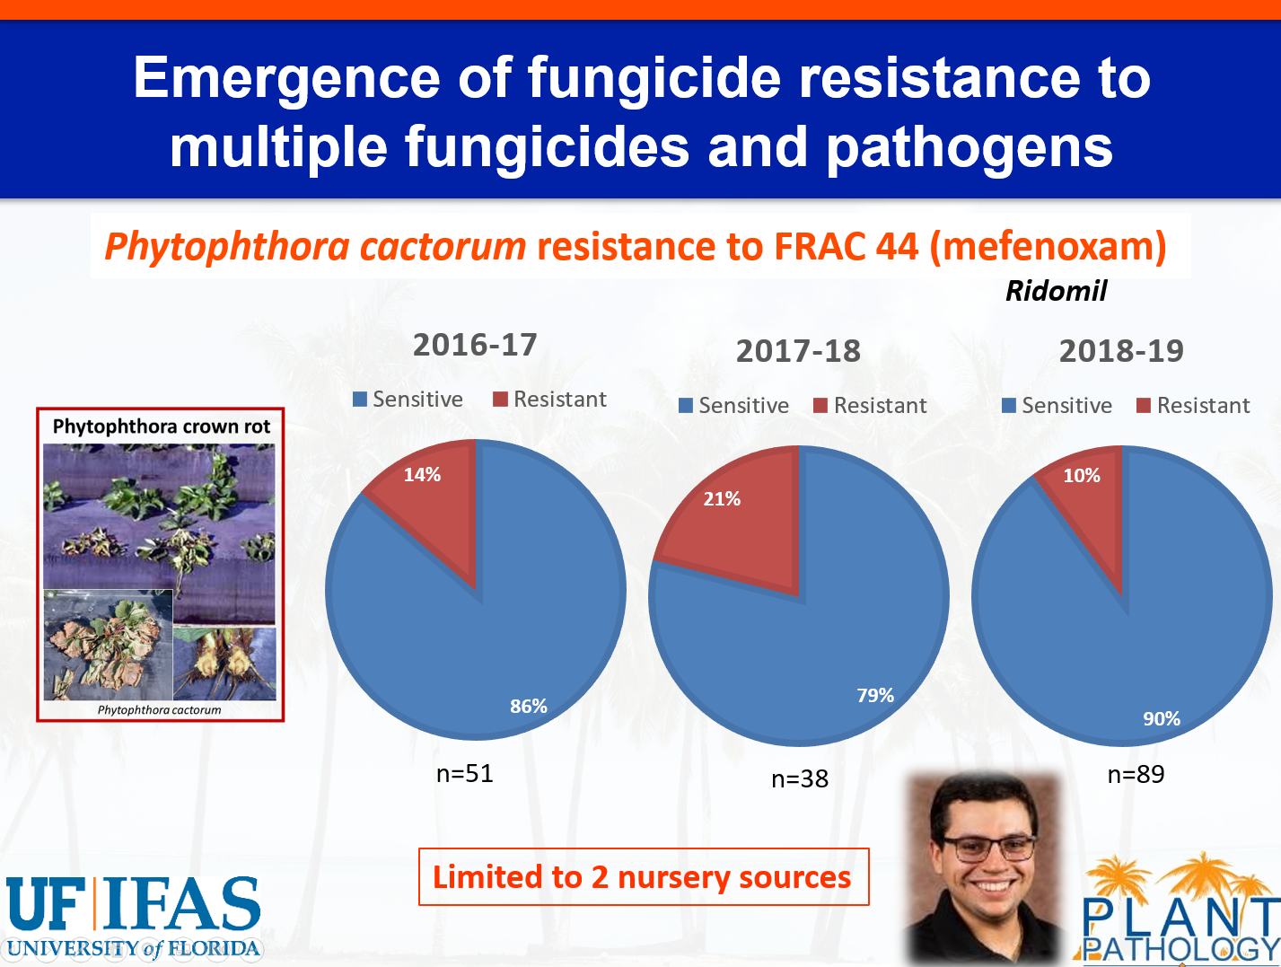

Slide 24
We must fight tooth and nail to keep the fungicides we have
$800 million to bring a new pesticide molecule to market
…….they aren’t coming
What is coming? Beneficials, Biologicals, PHP, botanical extracts, summer oils, neem oils

Slide 25
Ok, what about a fungicide program
Establishment year
Harvest year
    Anthracnose in Nova Scotia is our most damaging disease

Slide 26
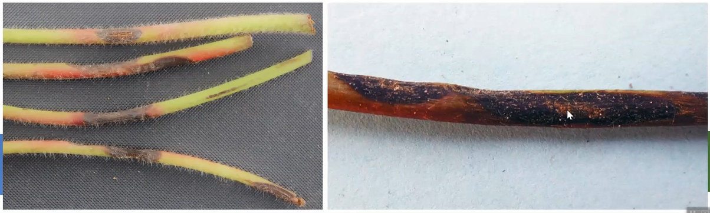
Anthracnose symptoms of petioles and runners
Begin as red streak, develops into dark, sunken firm elongated lesion
Lesions encircle the petiole causing leaf wilting
When lesions girdle runners, daughter plants are either not formed or die off
Younger runners and petioles are more susceptible

Slide 27
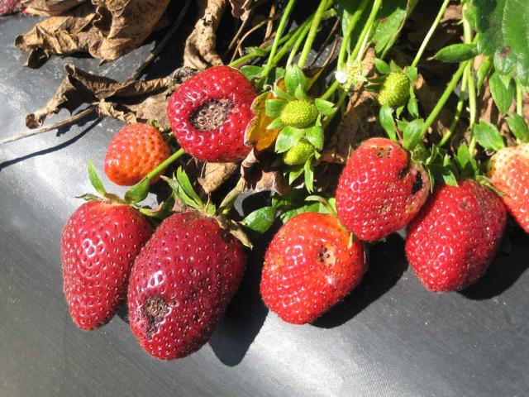
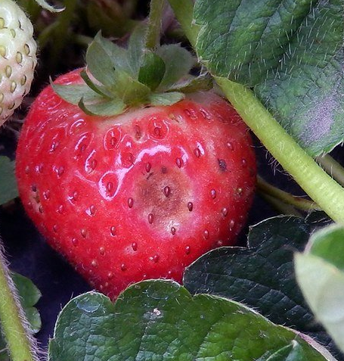
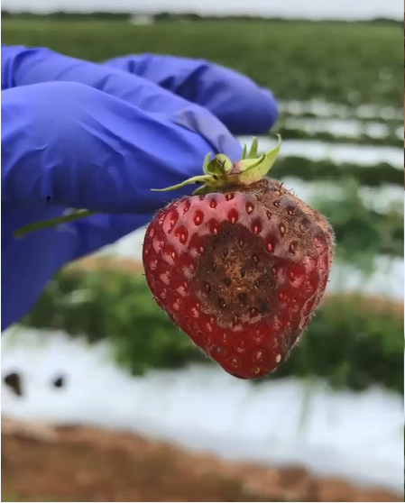
Symptoms on fruit

Slide 28
Symptoms on fruit
Start as sunken white water soaked lesion
Quickly turn dark brown, sunken and dry
These lesions are covered in orangish sticky spore masses
Under very wet conditions the lesion may be surrounded by white mycelium

Slide 29
Slow the spread
Good mulches to decrease splashing
Removal of infect fruit from field
Install drip irrigation over sprinkler irrigation
Refrain from working in fields when wet
Work from newer cleaner fields to older fields
Tight picking schedule

Slide 30
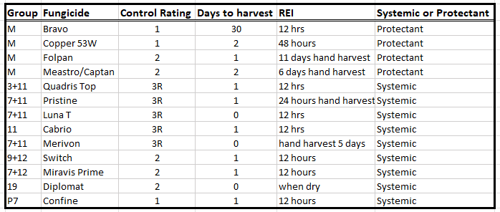
Control Products
Suspected resistance of group 11 therefore mix with Captan/Maestro

Slide 31
Proposed spray program for Junebearing Strawberries
Pre-Bloom: 2 applications of Bravo (M) (max apps 3/year) primarily for botrytis
Bloom: Captan (M) or Folpan (M)(max apps 6/year), Miravis Prime (7+12) (max apps 3/year)
Through harvest rotate through Miravis, Switch and Diplomat
          Pay particular attention to Annapolis, Cavendish, Kent and Mira

Slide 32
Proposed Everbearing Strawberry
Pre-bloom: same as June bearing
Through harvest rotate through Miravis, Switch, group 11 with Captan/Maestro and Diplomat
          Keep in mind Diplomat will need another product with it for powdery mildew and botrytis control
During the summer rest period rely on Captan/Maestro
          Watch all everbearing varieties while Albion is less susceptible

Slide 33
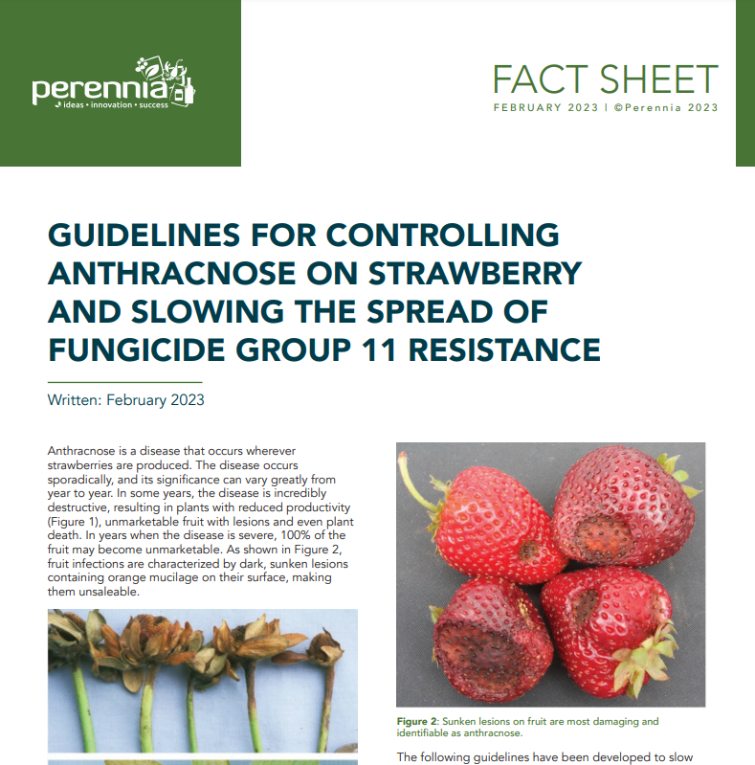

Slide 34
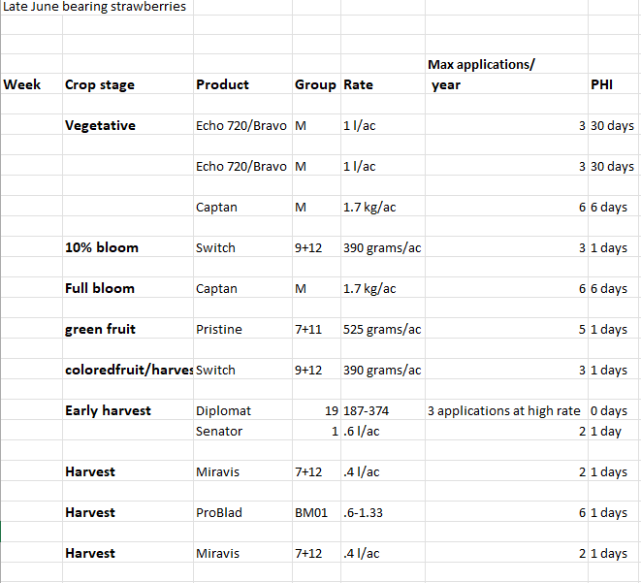

Slide 35
Post Harvest Fungicide
Anthracnose?
Powdery mildew?

Slide 36
Insecticide?
Aphids
Strawberry clipper weevil
Thrips
Tarnish Plant bug
Strawberry root weevil

Slide 37
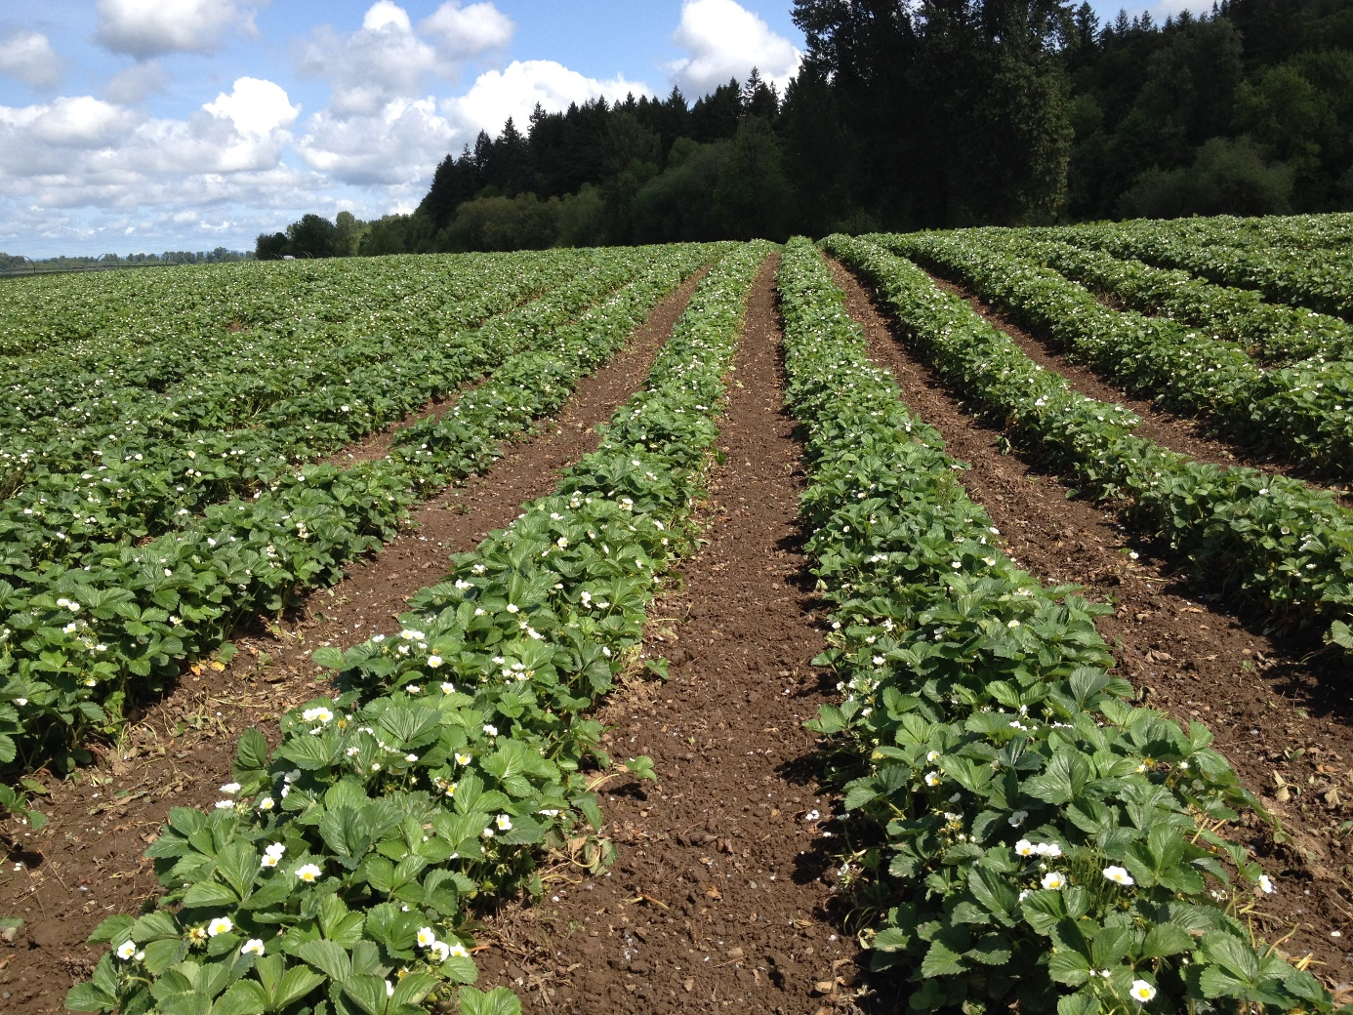

Sonny Murray: Smurray@perennia.ca

