Slide 2
Cover Crops in Perennial or Short Term Perennial Systems
Goal?
    repair soil, decrease compaction, build organic matter
Prepare for the next planting
    Control nematodes and diseases

Slide 3
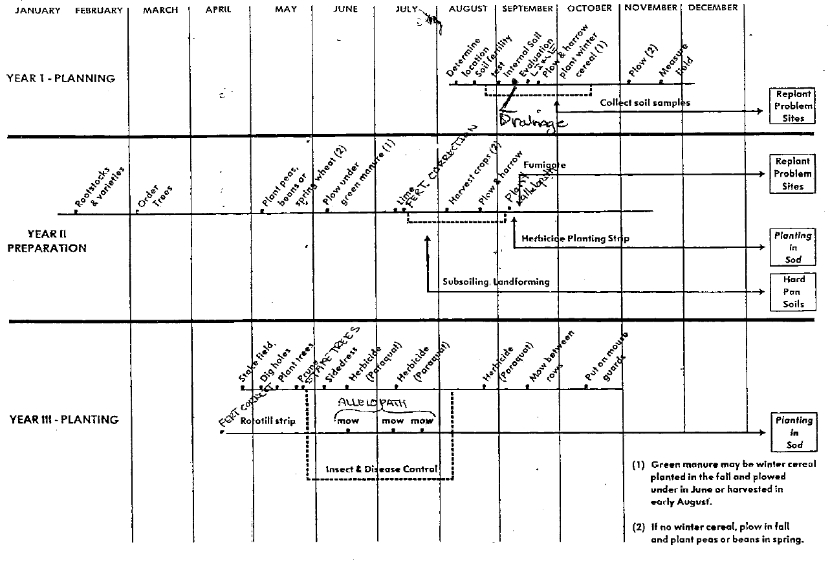

Slide 4
Start now to prepare for the establishment year
Cover crop sequence: Fall oats-Spring Mustard-Summer Sorghum Sudan Grass
Fall planted oats, Mustard planted followed up with a mix of Sorghum-Sudan Grass or Pearl Millet mixed with Daikon Radish
Keep tillage to a Minimum

Slide 5
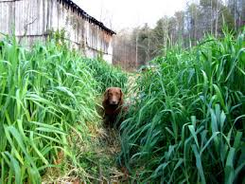
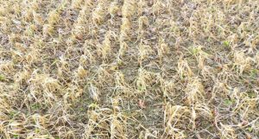
Fall planted: Oats
Winter kill
Not a extreme amount of residue to contend with in spring
Seeding rate: depending on planting time 40-100 lbs/ac
Add tillage radish. Depending on the plant timing

Slide 6
Early Spring Mustards
Bio-fumigation for disease control
Can be planted at 5 c
In spring long days 40 days can get you to flower
Nematodes are at peak populations in the upper soil layers in June

Slide 7
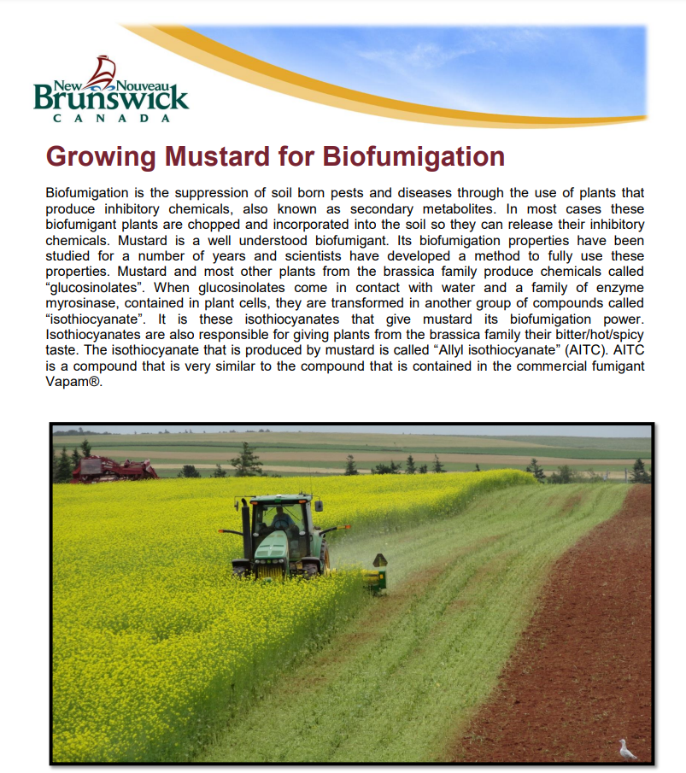
Early Spring Mustards
Fertilize with AS
Do we need to wait to
plant the next crop?

Slide 8
Sorghum Sudan Grass or Pearl Millet
Soil temperature for planting SSG 15 C
Soil temperature for PM 23 C!
Herbicide? For weed control?
Seed into moisture
Add Daikon Radish 2-3 lbs/ac
Seeding rates: SSG 40-50 lbs/ac
PM 15-20 lbs/ac

Slide 9
Sorghum Sudan Grass
or Pearl Millet
Both love nitrogen
Mow at 27 inches
    Root structure
    Tillers
Will die at the first frost but radish will keep going

Slide 10
Spring of planting year
Strip-till strawberries? Why not?
As strip-till corn becomes more popular I think we will see a lot of adoption of strip till vegetables
Ontario most of the sugar beets are strip-till
Many of the processing tomatoes are strip-till

Slide 11
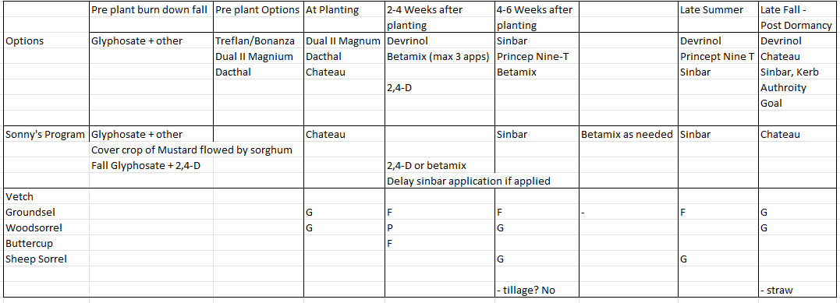
Why are we doing tillage pre- plant in Strawberries?

Slide 12
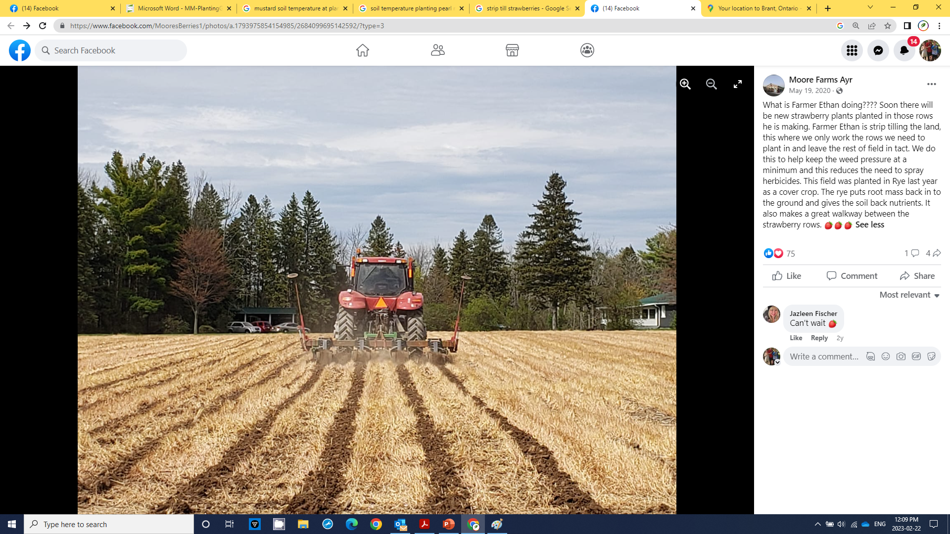

Slide 13
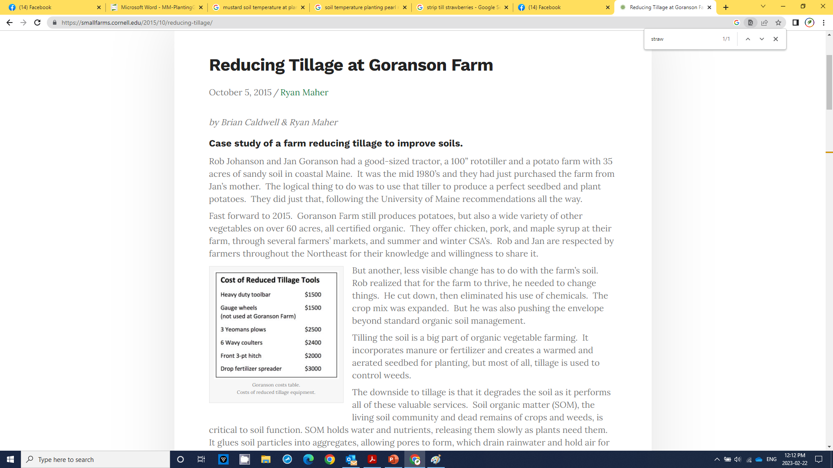

Slide 14
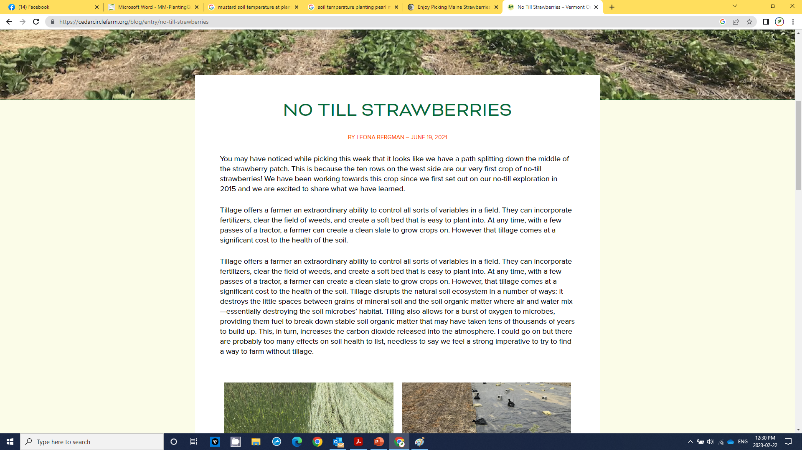

Slide 15
Cut the tillage
Enough of the madness
Breaks down organic matter, decimates soil structure and internal drainage
Negates your residual herbicide and brings more weed seeds to the surface

Slide 16
Cut the tillage
“ Excessive cultivation will destroy soil structure and also lead to compaction and poor internal drainage…….ultimately leading to an increase in BRR”
Marvin Pritts

Slide 17
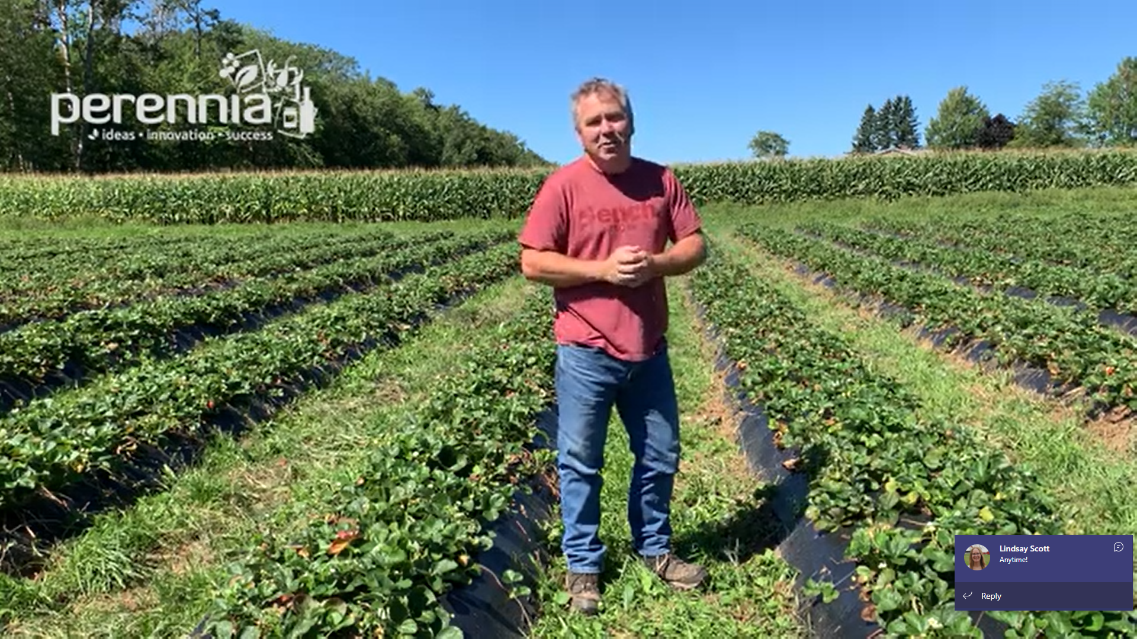

Slide 18
How to do it?
Come up with a list of goals – keep them short
    Scavenge nitrogen
    Reduce compaction
    Build organic matter
    Build soil aggregates
Come up with a plan
    Stick to the plan

Slide 19
After early season vegetable harvest
Goal: Compaction/hang onto nitrogen
“Give me 21 days I’ll grow you a cover crop”
  Buckwheat 3-5 day emergence ……flowers at 28 days
When do your early veggies start to come out?

Slide 20
Sucessive plantings of early veggies into an overwintered cover crop:
  Plow a strip every two weeks and plant – leave the rest of the clover/ryegrass to grow
Last plowing, ryegrass was headed out, clover and rye was thick and up to your knees (first week of June)

Slide 21
Mid summer cover crop
Challenges
    Hot and dry
          Plan around moisture in July
    Too busy
    Days are getting shorter time is of the essence
    Use a drill even if it is an old piece of junk
    Plant to moisture

Slide 22
Parting thoughts
Look at the whole rotation
Make a plan…work the plan but look for opportunities
Order your seed and have it on site

Slide 23
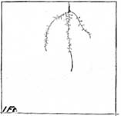
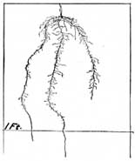
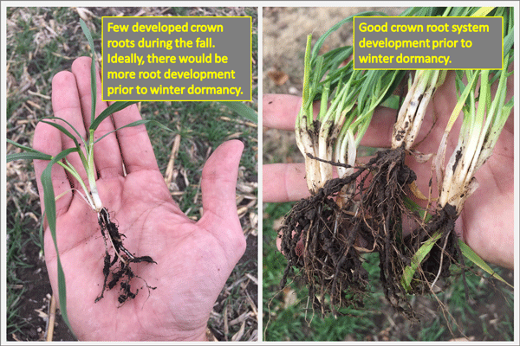
Winter wheat, 10 days – second leaf half grown
Winter wheat, 20 days – one tiller
Winter wheat, 30 days – four tillers

Slide 24
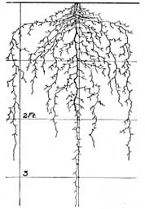
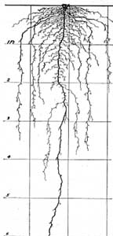
Red Clover
6-8”
1-1.5’
Root system of red clover about 2.5 months old.
Plant is 12”
Soilandhealth.org
Mature root system of red clover.
Notes:
http://soilandhealth.org/wp-content/uploads/01aglibrary/010139fieldcroproots/010139ch14.html

Slide 25
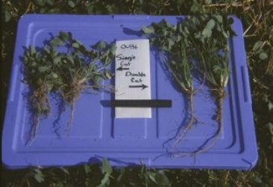
From OMAFRA
Notes:
http://www.omafra.gov.on.ca/english/crops/facts/cover_crops01/redclover.htm

Slide 26
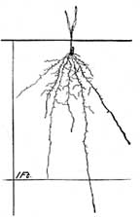
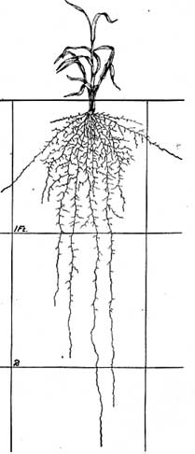
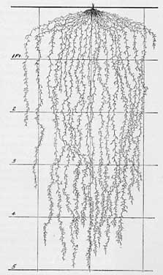
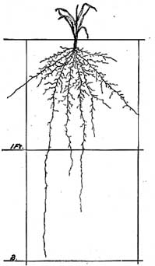
Spring wheat, 31 days
Winter/Fall rye
Root system can extend down
often as tall as the plant grows
Spring wheat, 60 days
Soilandhealth.org
Spring wheat, 45 days
Notes:
http://soilandhealth.org/wp-content/uploads/01aglibrary/010139fieldcroproots/010139ch6.html

Slide 27
Get the seed purchased
Get it in your shed
Have the drill calibrated and ready
Try some low hanging fruit to get a feel for it
Commit, have a plan, have a parachute

