Slide 1
Major cranberry diseases in NB
NB Hort Congress, 2023
Michael Tesfaendrias and Jennifer McDonald
NB Department of Agriculture, Aquaculture and Fisheries
Michael Tesfaendrias , Ph.D., P. Ag.
IPM Specialist (Plant Pathologist)
(506) 453 3478
Michael.tesfaendrias@gnb.ca

Slide 2
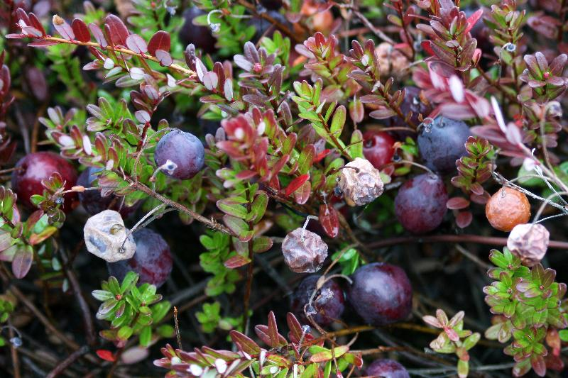
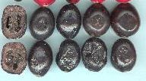
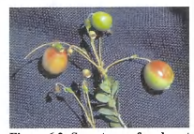
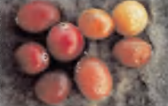
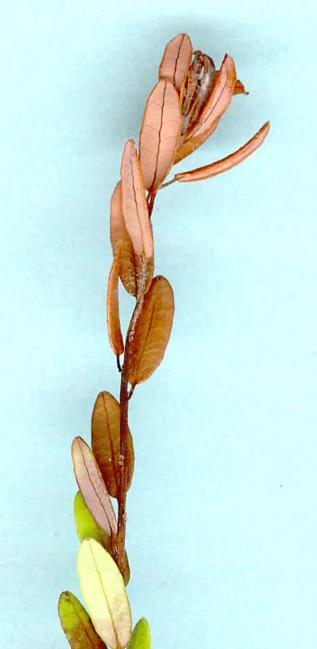
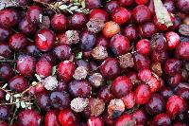
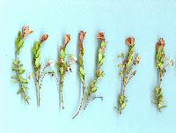
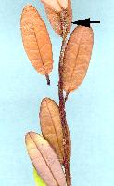
Major cranberry diseases in NB
Fruit rots
Cottonball (Monilinia oxycocci)
Upright Dieback (Phomopsis vaccinii)

Slide 3
Cranberry diseases
Cranberry diseases a limiting factor in production
Cause leaf discolouration and leaf drop, stem/twig infection
Reduced fruit bud production
Infect fruit - fruit rots
Lower yield

Slide 4
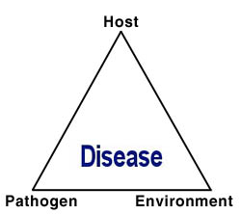
Plant disease development
Conducive Environment
The Plant Disease Triangle
Disease
Susceptible Host
Pathogen

Slide 5
Upright dieback
A disease complex: Caused by a combination of different fungi and environmental conditions
The main pathogen is Phomopsis vaccinii/Diaporthe vaccinii
P. vaccinii also causes viscid rot (mostly a post harvest disease)
Uprights are infected as they resume growth in the spring
Fruit are infected during bloom
Symptoms usually appear in late summer.
High incidence when vines are under stress due to periods of hot and dry weather.

Slide 6
Upright dieback
NBDAAF
NBDAAF
NBDAAF
Eastern Canada cranberry IPM manual
Notes:
NBDAAF

Slide 7
Upright dieback management
Proper irrigation/minimize heat and drought stress
Encourage plant vigour (sanding and flooding)
Reduce picking damage
For new planting, use vines from a source with little or no history of upright dieback or viscid rot.
Fungicide: Apply in the spring between bud break and bud elongation (when shoots have 1cm of new growth).
NBDAAF
NBDAAF

Slide 8
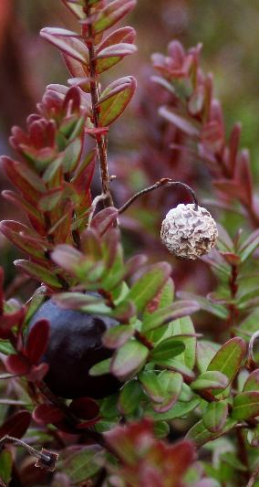
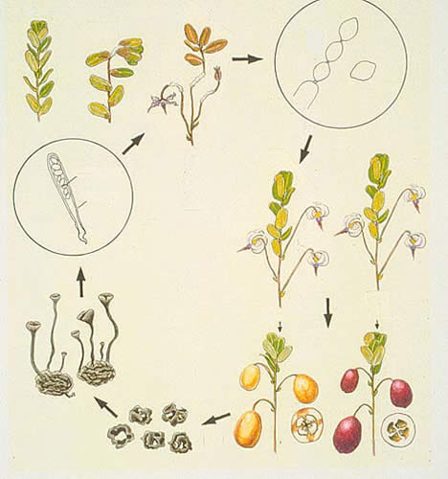
Cottonball
Caused by the fungus Monilinia oxycocci
Two stages of the diseases
  Primary infection (tip blight)
  secondary infection (fruit rot)
Tip blight
Cottonball (Fruit rot)
Eastern Canada cranberry IPM manual
NBDAAF
Notes:
Cottonball (Fruit rot)

Slide 9
Cottonball disease cycle
Healthy
1st symptom
Primary infection
secondary infection
Early spring
Infected fruit
Healthy fruit
Sclerotia
(Mummified berries)
Eastern Canada cranberry IPM manual
Notes:
early spring

Slide 10
Cottonball management
Plant pathogen-free vines
Resistant cultivars (e.g Stevens and McFarlin)
Remove floating debris at harvest.
Reflooding beds, along with removal of floating plant debris, also reduces inoculum.
Good drainage (avoid having areas of saturated sand in the spring), moss control
Fungicide application
  Spray when buds break dormancy and again 1 to 2 weeks later and again during bloom.
  Under low disease pressure: bloom sprays may be sufficient alone

Slide 11
Fruit Rots
Caused by at least 15 fungal pathogens
Most attack the fruit, causing them to rot
Some also infect the flowers, stems and leaves.
Most common fruit rots
Early rot (Phyllosticta vaccinii)
  Infects the flowers, stems, leaves and fruit.
  Causes leaf spots, premature leaf drop, and fruit rot
  Damage to fruit in storage is economically important
  The pathogen grows at high temperatures (~28⁰C)
Eastern Canada cranberry IPM manual

Slide 12
Fruit Rots
Early rot management
  Sanding, good drainage, remove floating debris at harvest, refrigerate stored fruit
  Refrigerate harvested cranberries
End rot (Godronia cassandrae f. vaccinii)
  Can cause twig blight, leaf spot and fruit rot
  Fruit rot is economically important.
End rot management
  Sanding, good drainage, remove floating debris at harvest, avoid excessive N fertilizer, avoid prolonged periods of flooding
Notes:
Eastern Canada cranberry IPM mannual

Slide 13
Fruit Rots
Viscid Rot (Phomopsis vaccinii)
  A field rot, but most of the rotting occurs in storage.
  Disease favoured by high temperatures and when vines are under stress.
Viscid Rot management
  Promote plant growth, minimize heat and drought stress
Eastern Canada cranberry IPM manual

Slide 14
Fruit rot management
Promote vigorous plant growth: Adequate fertilization and irrigation
Good drainage
Sanitation (remove debris floating in the water after harvest)
Minimize heat and drought stress
Sanding: to promote vigorous vine growth and reduce plant pathogens
Fungicide applications (Early rot and Viscid rot)

Slide 15
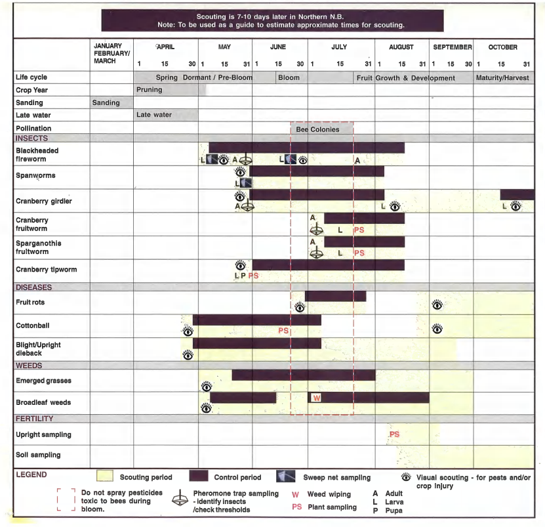
Crop scouting calendar (Southern NB)

Slide 16
Re-evaluation Decision RVD2018-11, Chlorothalonil and Its Associated End-use Products for Agricultural and Turf Uses
Pest Management Regulatory Agency, 10 May 2018
Regulatory Decision for Chlorothalonil
The PMRA has completed the re-evaluation of chlorothalonil. Under the authority of the Pest Control Products Act, the PMRA has determined that continued registration of products containing chlorothalonil is acceptable. An evaluation of available scientific information found that most uses of chlorothalonil products meet current standards for protection of human health or the environment when used according to the conditions of registration, which include required amendments to label directions.

Slide 17
Latest: Consultation on the special review of Chlorothalonil and its associated end-use products, Proposed Special Review Decision PSRD2022-01 (10 February 2022)
Consultation period is closed now.
Aspects of concern considered in this special review are:
Human Health
Environment
Proposed special review decision for chlorothalonil
Health Canada is proposing:
-Continued registration of greenhouse ornamental uses.
-All other uses of chlorothalonil are proposed for cancellation.
Next steps: -Health Canada will consider all comments received from the public.
A science-based approach will be applied in making a final decision on chlorothalonil.
Health Canada will then publish a special review decision document.

Slide 18
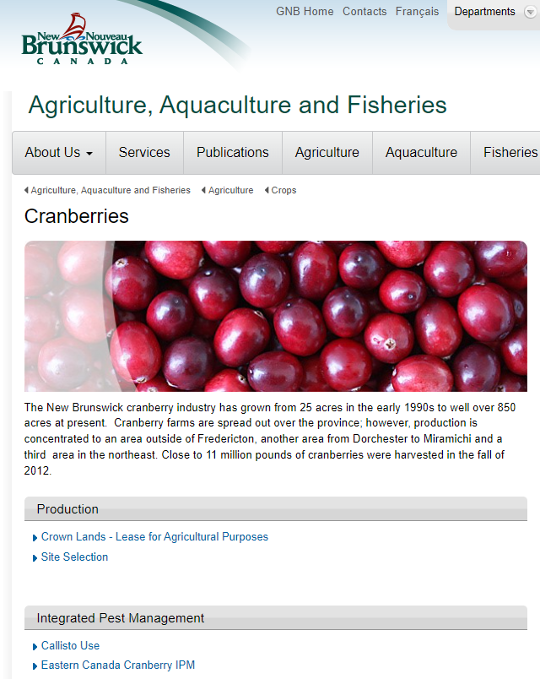
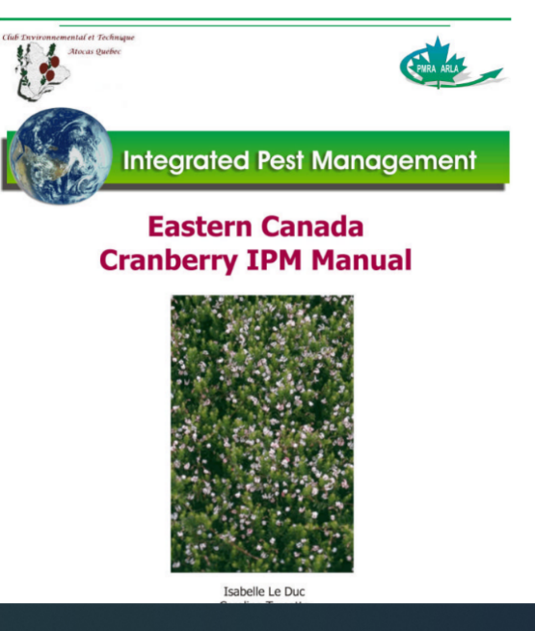
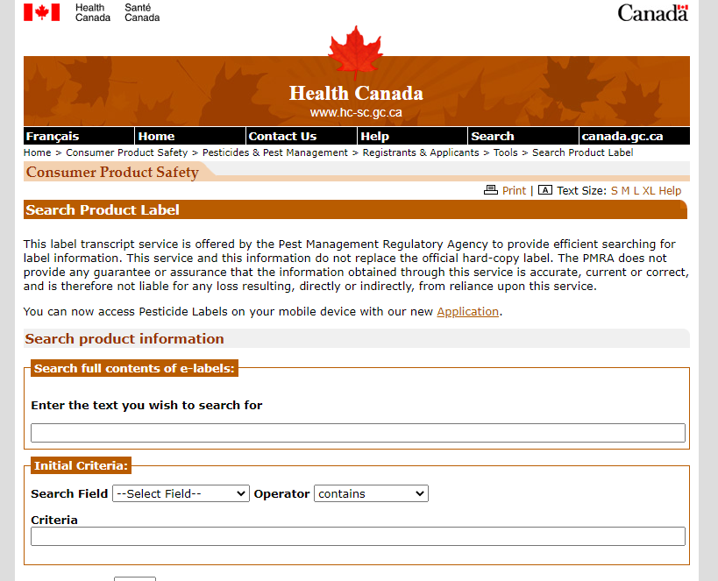
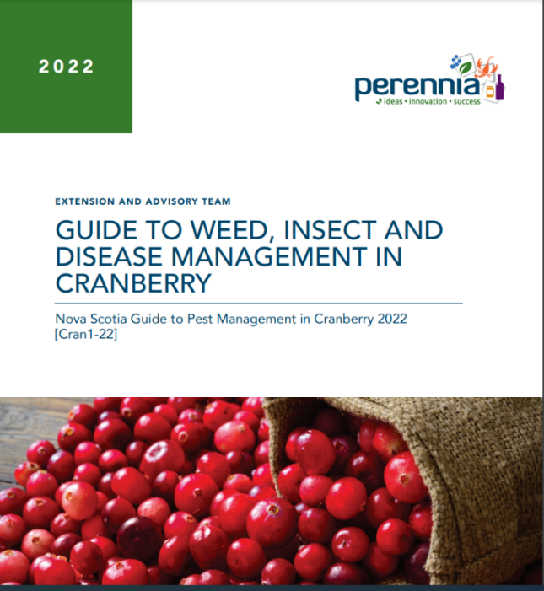
Resources
http://hc-sc.gc.ca/cps-spc/pest
https://www.perennia.ca
Always read the label carefully before using a pesticide.
Always check with your processor or buyer to see what products are allowed for their markets.
Notes:
Resources

Slide 19
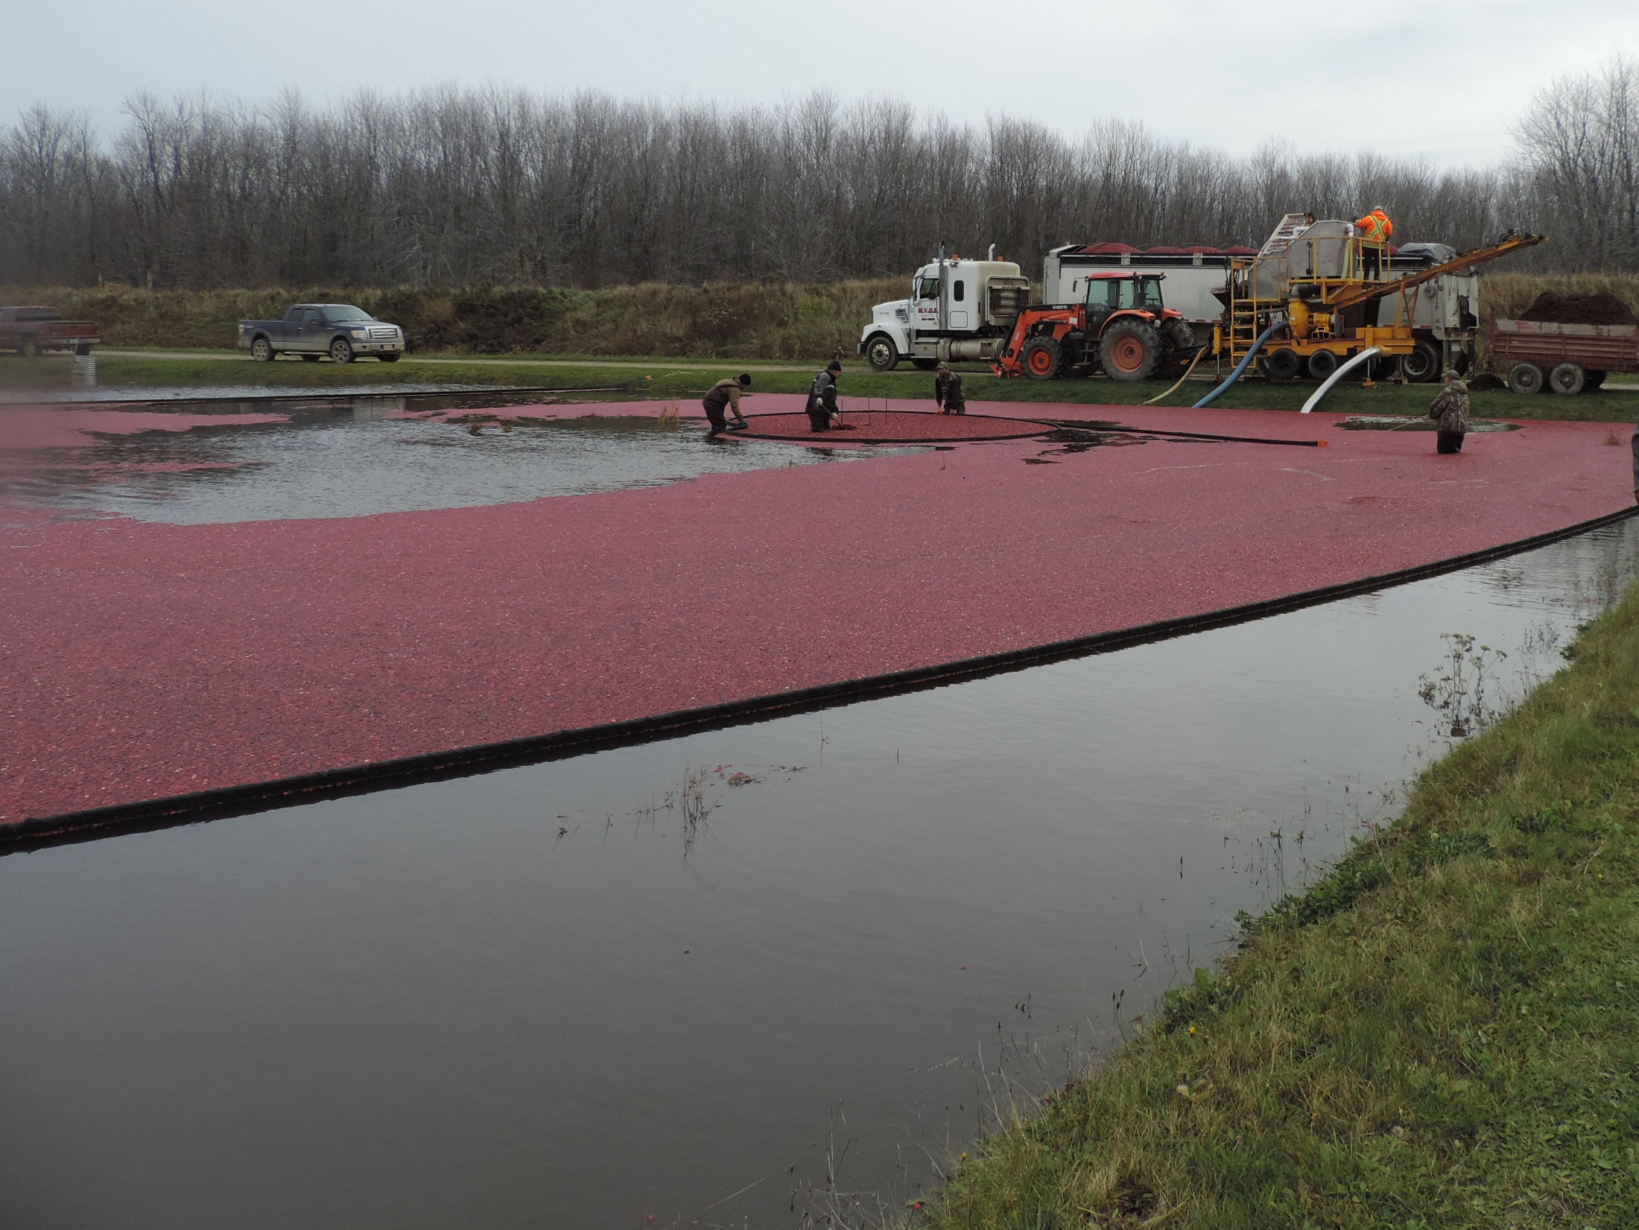
Thank You
Merci

