Slide 1
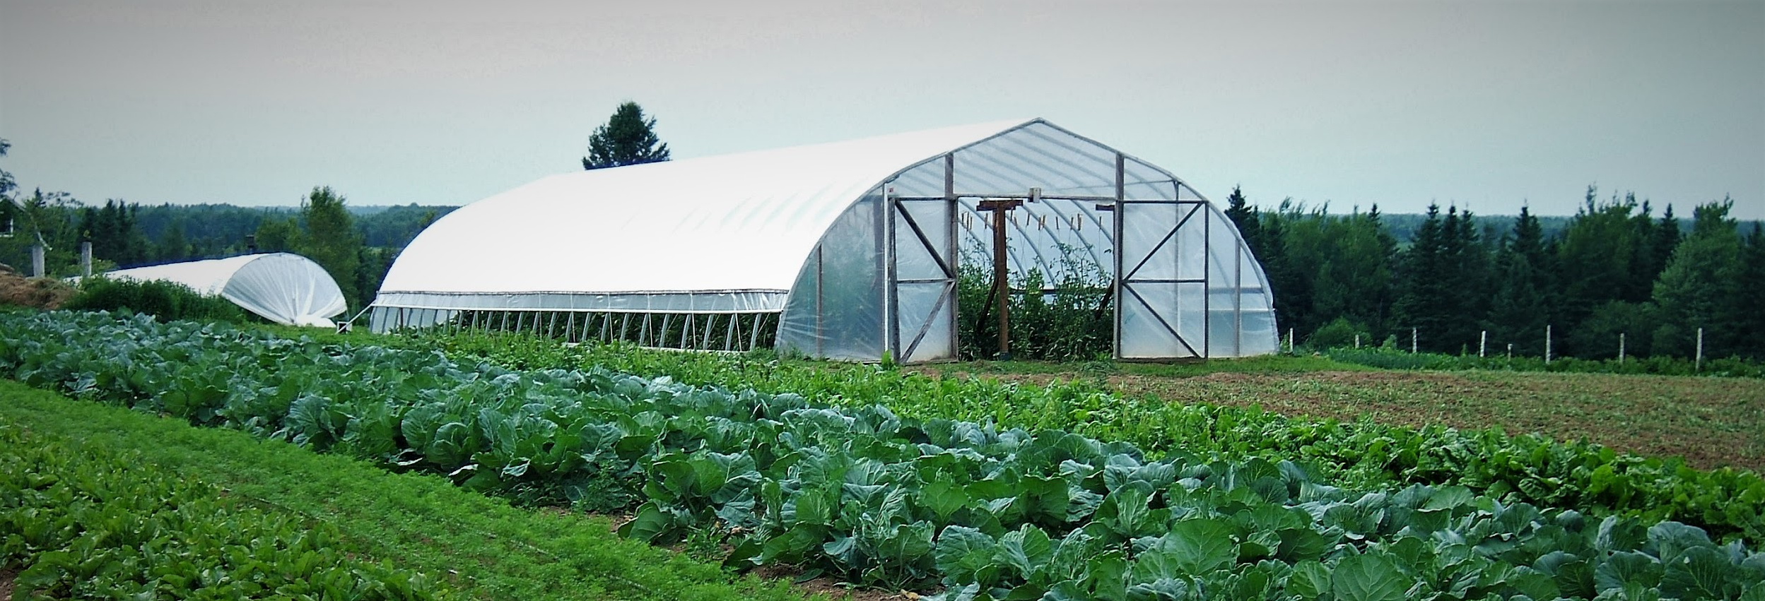
Building Knowledge in NB Greenhouse Vegetable Production
Presented by: Pauline Richard & Venessa Allain
NB DAAF

Slide 2
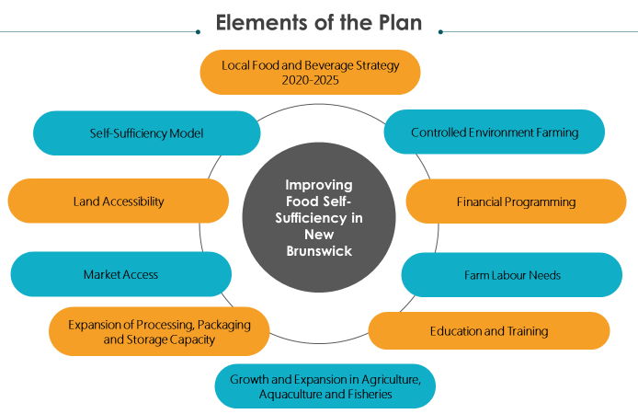
New Brunswick Department of Agriculture, Aquaculture and Fisheries Action Plan : Improving Food Self-Sufficiency in New Brunswick

Slide 3
NBDAAF – Self-Sufficiency Action Plan
Goals
  Double the Controlled Environment Agriculture area in five years (2021 to 2026)
  Optimize growing conditions to maximize yields and profitability with current infrastructure
  Build knowledge and leadership within producers and Department of Agriculture, Aquaculture and Fisheries staff

Slide 4
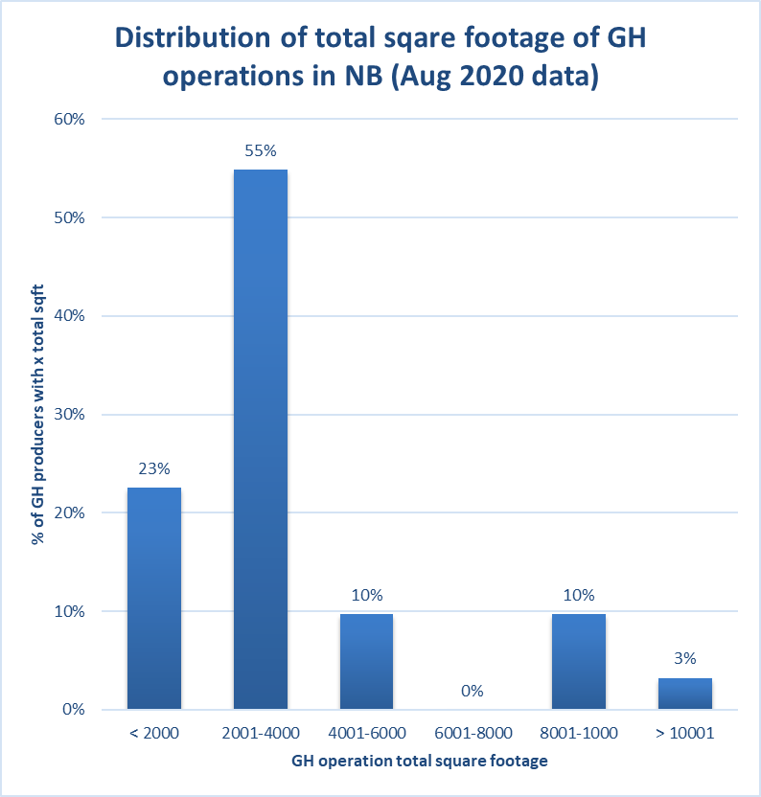
NB Greenhouse Vegetable and Fruit production Overview – Pre FVID program
Roughly 49 vegetable greenhouse operators in the province
  Mostly diversified growers with smaller GH operations
Average size of NB greenhouse for vegetable production is 3,600sqft (range from 1,200sqft to 18,200sqft).
100% of greenhouse/warehouse vegetable growers sell directly to consumers
  41% of these also sell into the local retail grocer market (direct to stores, no brokers).
78%
<4,000 sqft

Slide 5
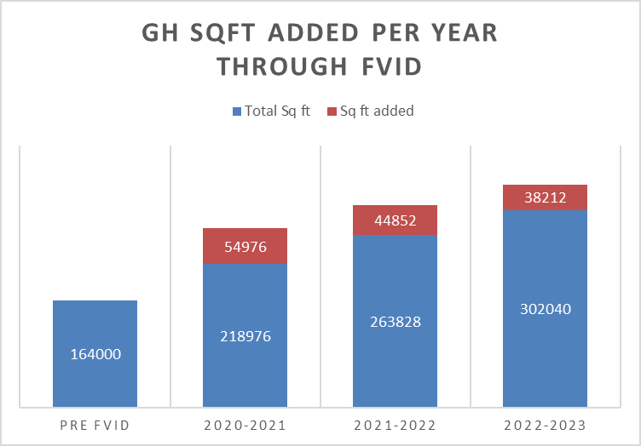
FVID Program impact on GH industry in NB
From 2020 – 2023:
  138,040 sqft of new Greenhouse area in NB
2020: 164,000 sqft
3.8 acres
2023: 302,040 sqft
7 acres
84% increase

Slide 6

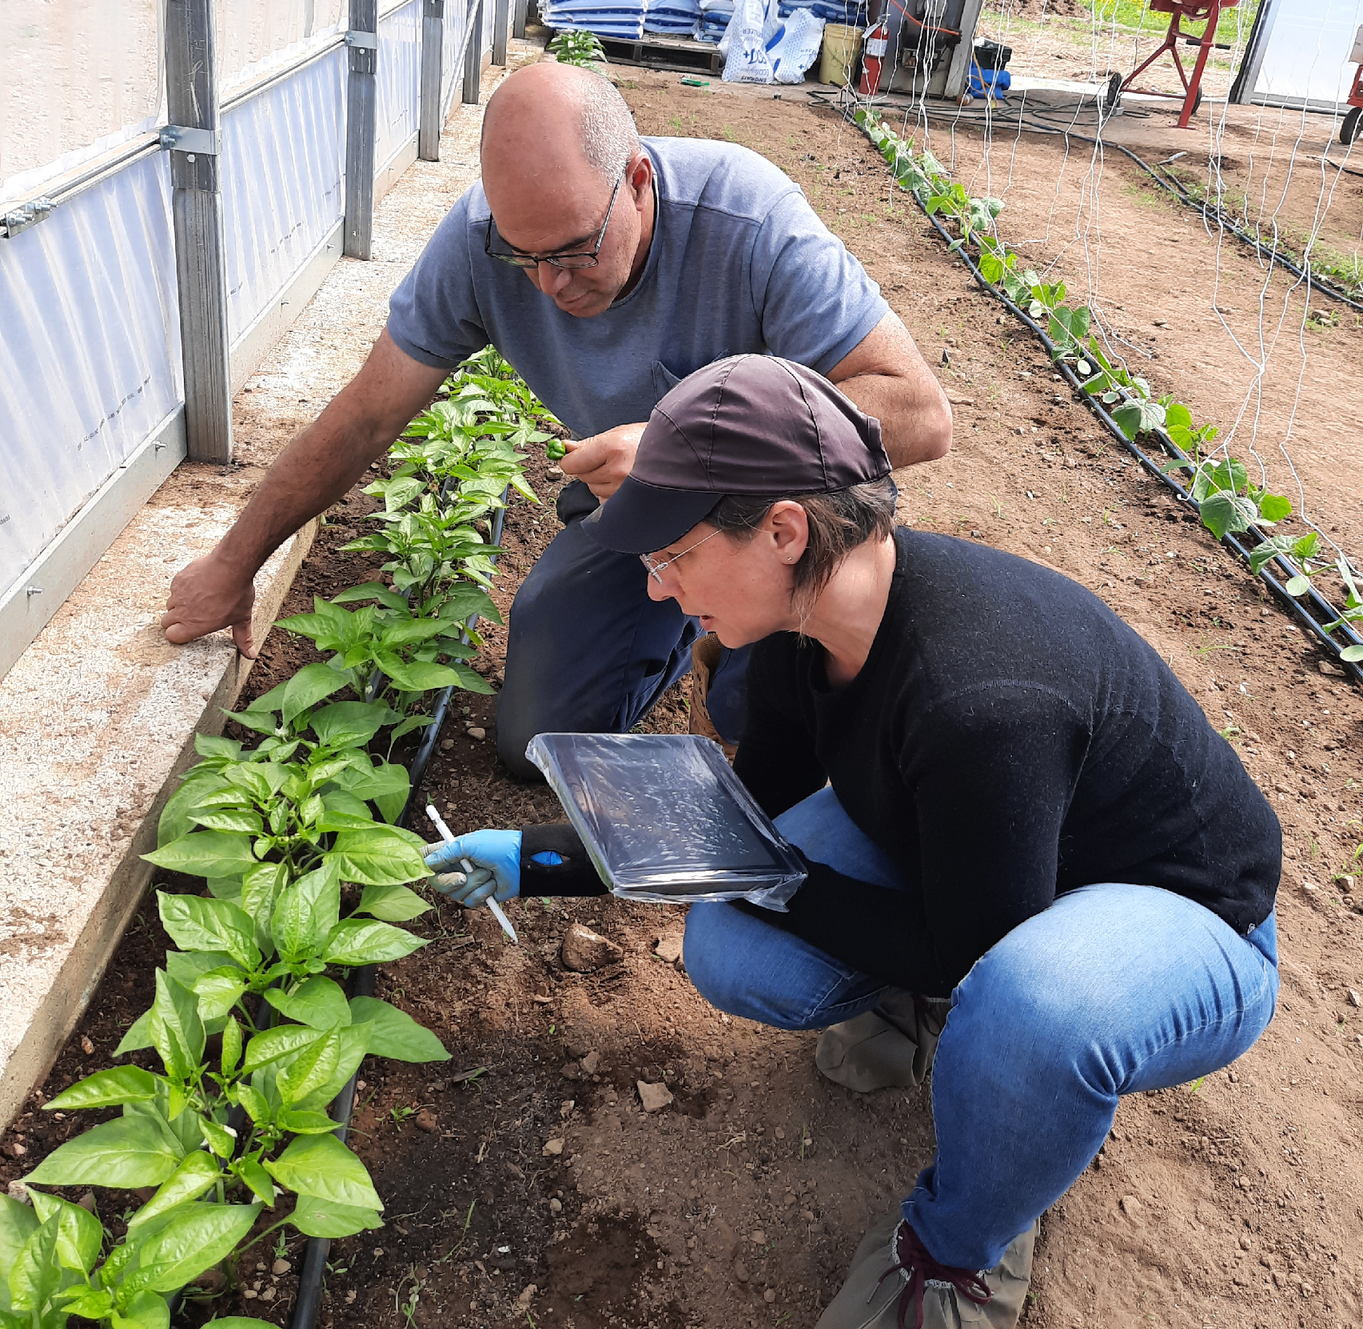
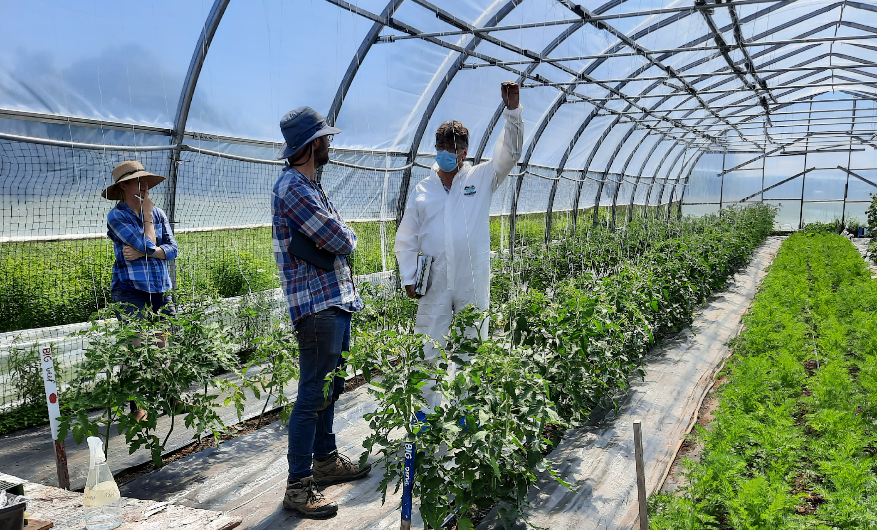

Slide 7

2021/2022
  15 farms
  4 Webinars presentations
  1 field day
2022/2023
  24 farms 4 times throughout the season
  2 webinars presentations
  1 field day

Slide 8
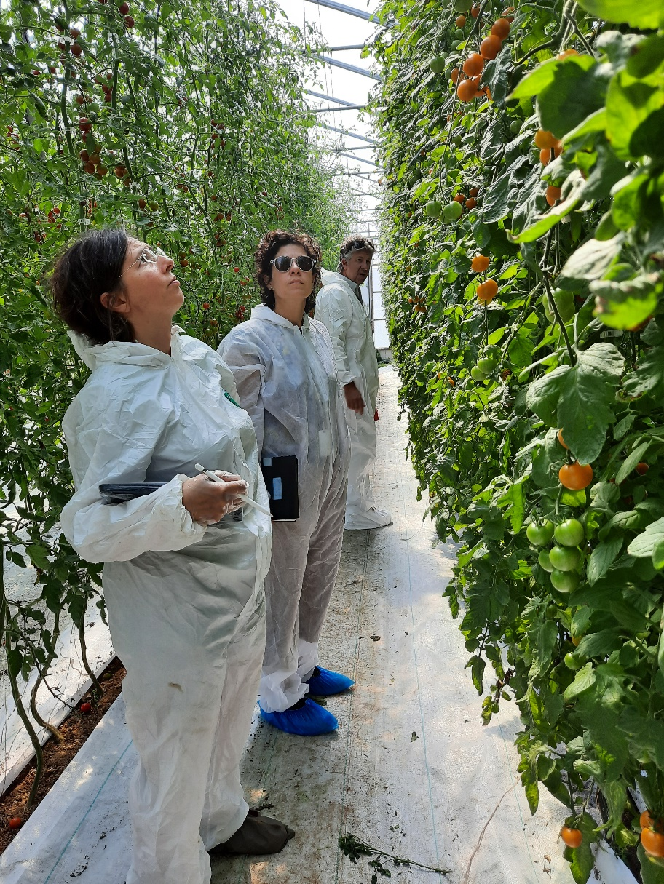
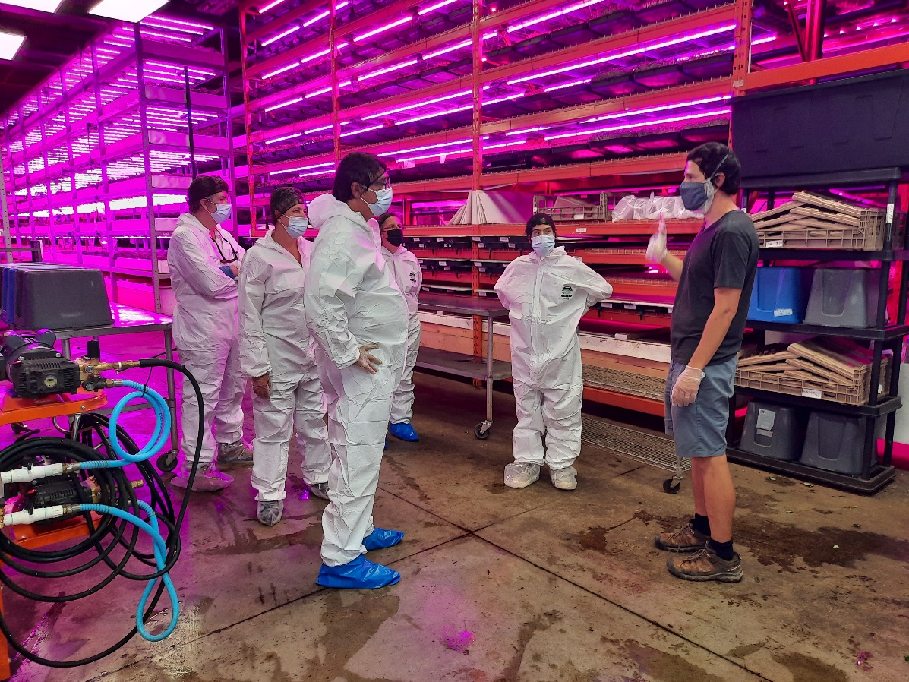
Learning!

Slide 9
Potential Yields
Vegetable | Structure Type | Yield | Harvest Period
Beef Tomato – Indeterminant | Caterpillar tunnel | 8-15 kg/m² | Late July to late September
 | Tunnel or cold greenhouse | 10-20 kg/m² | 3rd week of July to late September
 | 3-Season greenhouse | 20-30 kg/m² | Early June to early November
Colored Peppers | Caterpillar tunnel | 4.8-6 kg/m² | Mid-August to early October
 | Tunnel and cold greenhouse | 5.5-6.8 kg/m² | Early August to early October
 | 3-Season greenhouse | 7-10 kg/m² | 3rd week of June to early November
Translated from Guide de production – Poivron et tomate biologiques sous abris

Slide 10
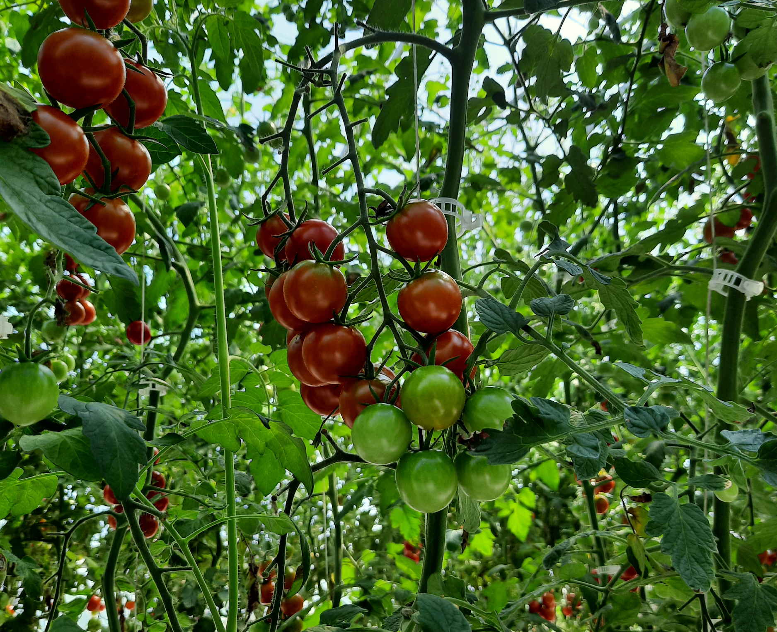
What do those yields look like?

Slide 11
Cold Greenhouse – production from 3rd week of July to the end of September (11 weeks)
Average size of an unheated greenhouse in NB is 30ft x 100ft =
  3000ft² = 278.7 m²
  Possible yield range = 20kg/m² of beef tomatoes
5,574 kg = 12,288 lbs
Practical calculation for mixed vegetable growers:
  100 ft bed, 90 ft actually in production.
  Assuming 160cm wide bed = 43.89 m²
  878 kg = 1936 lbs
  weekly production = 79.8 kg/week or 176 lbs/week

Slide 12
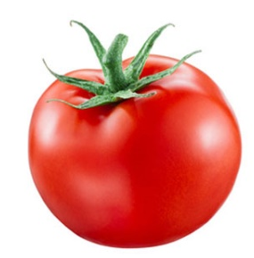
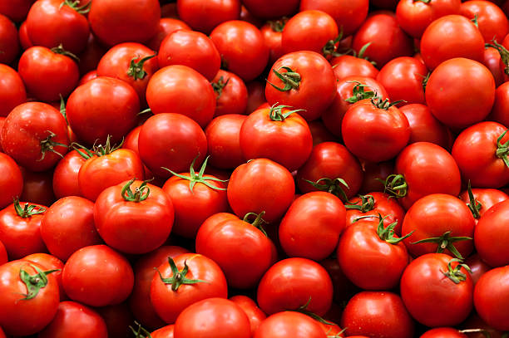
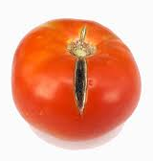
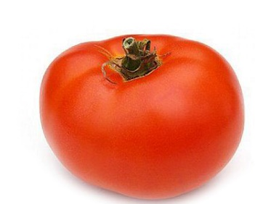
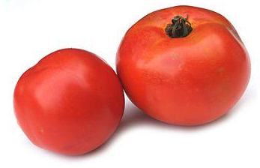

Where do you stand?
What are my yields?

Slide 13
Key Observations of Knowledge building project
Some of the Ah ha moments!

Slide 14
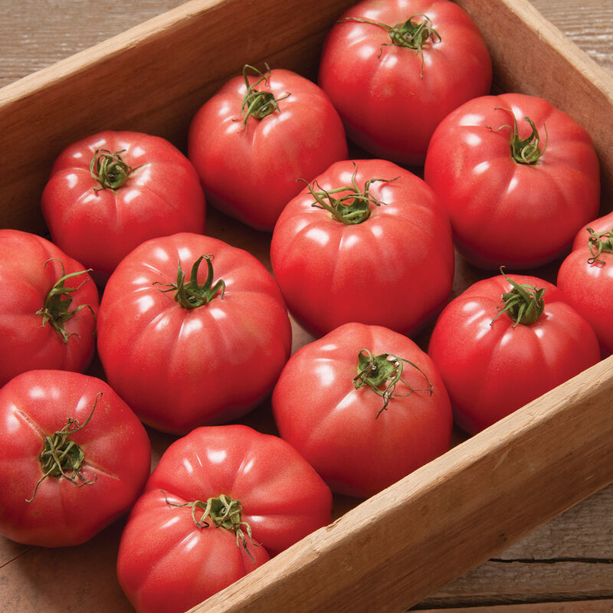
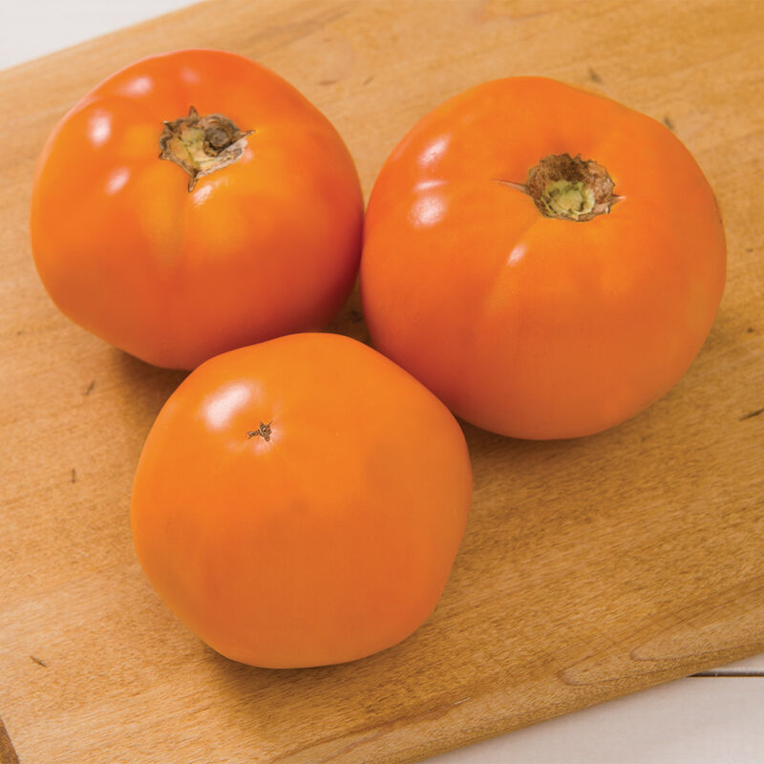
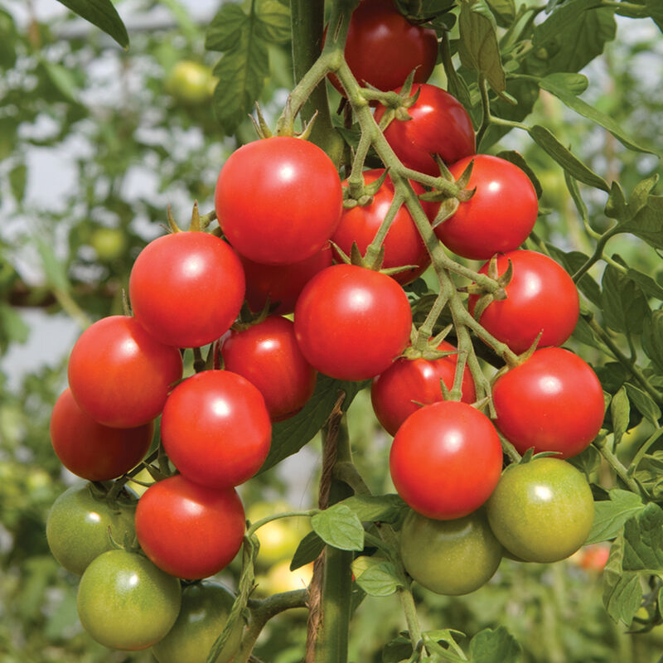
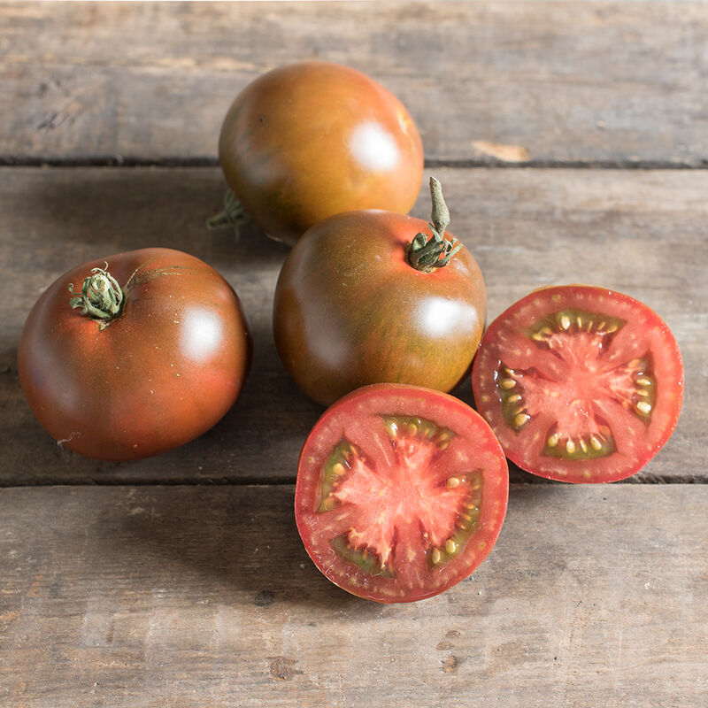
Planning – Variety Selection
Selecting varieties:
  The obvious reasons:
    Flavour,
    Shape & Type,
    Yield,
  The sometimes overlooked:
    Disease resistance
      (soil born & foliar diseases)

Slide 15
Variety selection - Disease Resistance
Greenhouse Tomato varieties:
  ToMV 0-2, - Tomato mosaic virus
  Ff: A-E (LM), - Leaf mold race A and E
  Fol:1-2, - Fussarium Crown and root rot
  For – Fussarium wilt
Greenhouse tomato rootstock:
  ToMV:0-2 – Tomato mosaic virus
  Fol:0,1 – Fussarium crown and root rot
  For – Fussarium wilt
  Pl (CRR) – Corky root
  Vad - Verticilium a & d
  N ma/mi/mj – Nematodes (Meloidogyne arenaria, incognita and javanica

Slide 16
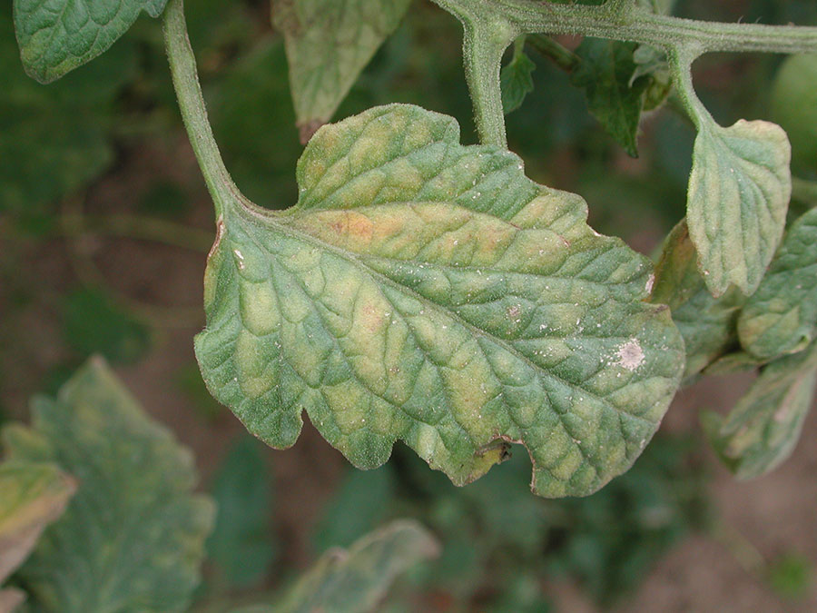
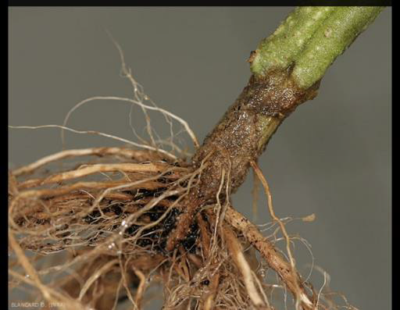
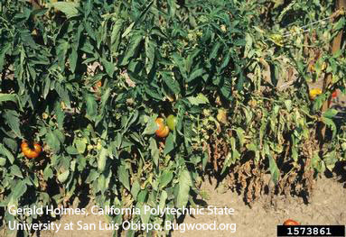
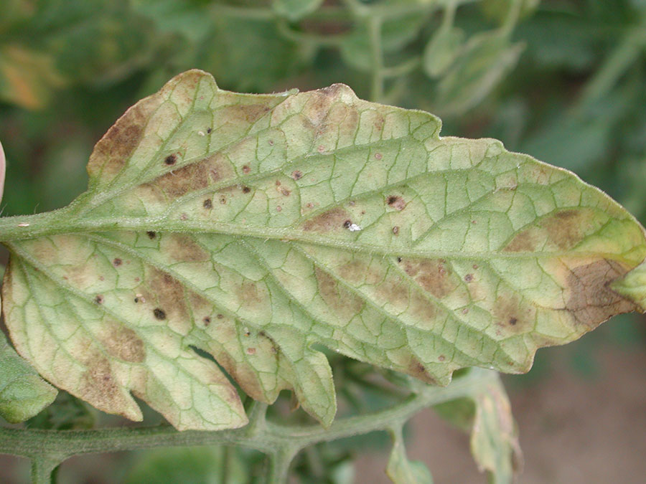
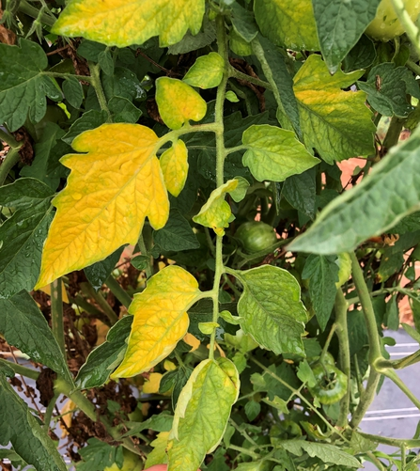
Leaf Mold - top of leaf
Fusarium Crown and Root Rot
Verticilium Wilt
Image credit: OMAFRA
Image credit: OMAFRA
Leaf Mold - underside
Fusarium Wilt
DAAF diagnostic services
Samples can be either brought to your local DAAF office or mailed in directly.
Image credit: OMAFRA
Image credit: NC Sate extension

Slide 17
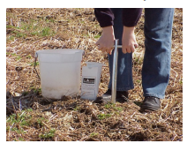
Planning – Soil Fertility
Soil analysis: the season before
  OM: raise OM % if needed with compost or other OM additions.
    You MUST know your compost before adding large amounts.
  pH: adjust pH to desired level, BUT keep in mind that certain inputs (compost, crab meal) might affect pH.
  Salinity: without precipitations to leach out salts, NEED to watch the salt levels.
DAAF website has factsheet on sampling if you’ve never done this

Slide 18
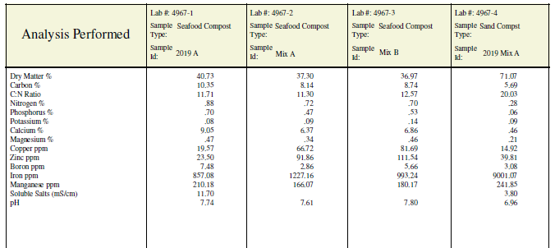
Perennia’s Factsheet is a very usefull ressource on Compost analysis:
‘’How to Interpret a Compost Analysis Report’’
C:N ratio: under 20
pH : should be close to neutral
Soluble Salts: > 10ms/cm considered high, for GH we should be even more carefull
PEI Lab Compost Analysis package: Ask for Soluble Salts

Slide 19
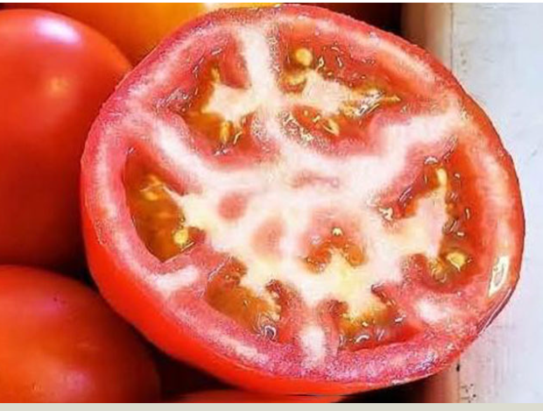
Planning the fertility program
Fertilize based on kg of tomato expected not on per acre basis
  Field N recommendation: 135kgN/ha, but in 3 season GH this could be as high as 600kgN/ha
Very important to not limit N & K as they will affect the yield and quality of the fruit.
  Split fertilizer applications
White core: fertilizer can be among the causes

Slide 20
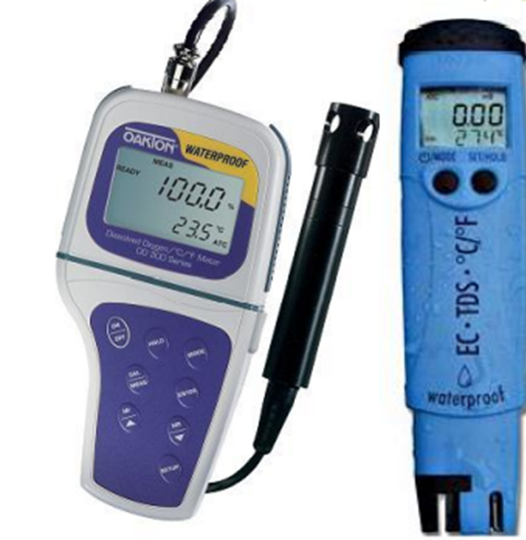
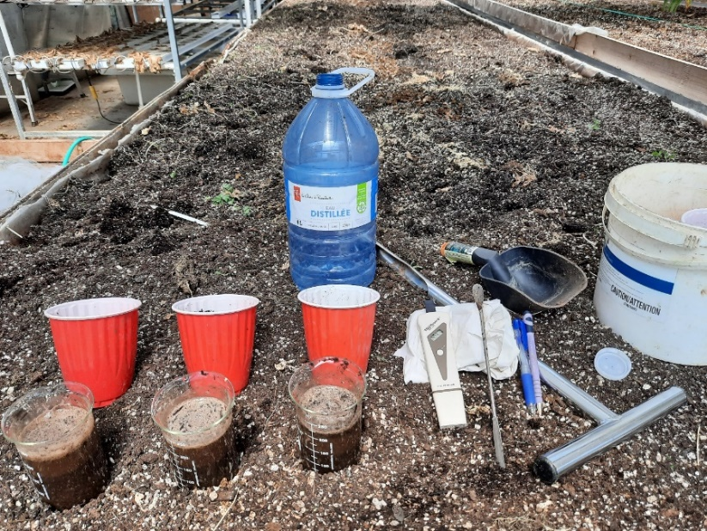
Electrical Conductivity
Ideal EC levels by crop and growth stage (mS)
Crop | Pre-emergence | Post-emergence | In pot | Entering Greenhouse | At transplant | Mature Crop - Spring | Mature Crop - Summer | Mature Crop – Fall
Tomato | 0.5 | 1 – 1.5 | 2.5 – 3 | 3.5 - 6 | 4.5 – 6.5 | 3.5 – 4 | 3.0 3.5 | 3.5 – 4
Cucumber | 0.5 - 1 | 1.5 – 1.8 | 2 – 2.5 | 2.5 | 2.5 - 3 | 2.2 – 2.7 | 2.0 – 2.5 | 2.2 – 2.7
Peppers | 0.5 | 0.5 | 1 – 1.5 | 1.5 | 1.5 | 2.7 – 3.2 | 2.2 -2.7 | 2.7 – 3.2

Slide 21
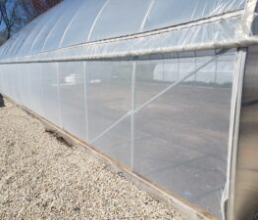
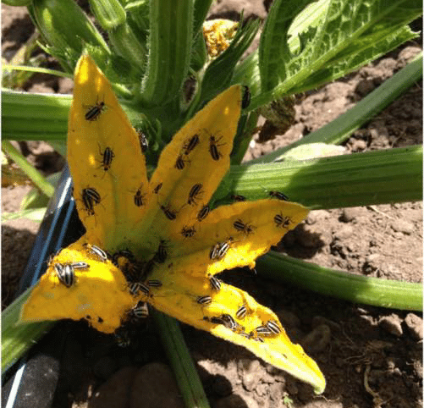
Plan for your enemies
Physical barriers such as Insect netting:
  A must if growing cucumbers
Biocontrols – introduction of beneficial insects
  Make a plan! Contact your supplier ahead of the season
Have a strategy to deal with outbreaks
  Controls (have them on hand).
Have your pesticide applicator licence

Slide 22
Planning the GH Space - Light
Even light distribution and adequate space to work
  Guidelines for plants/m² are based on light distribution
  Appropriate amount of light helps keep plants in balance.

Slide 23
Planning the GH Space - Light
Need to consider the type of structure you have and the amount of light available.
    Older plastic vs newer
    Condensation (anti-condensation film)
    Type of structure (rib spacing, size of ribs, wooden vs metal)
If light is limited, you should reduce the plants/m² a bit to reflect this limitation.

Slide 24
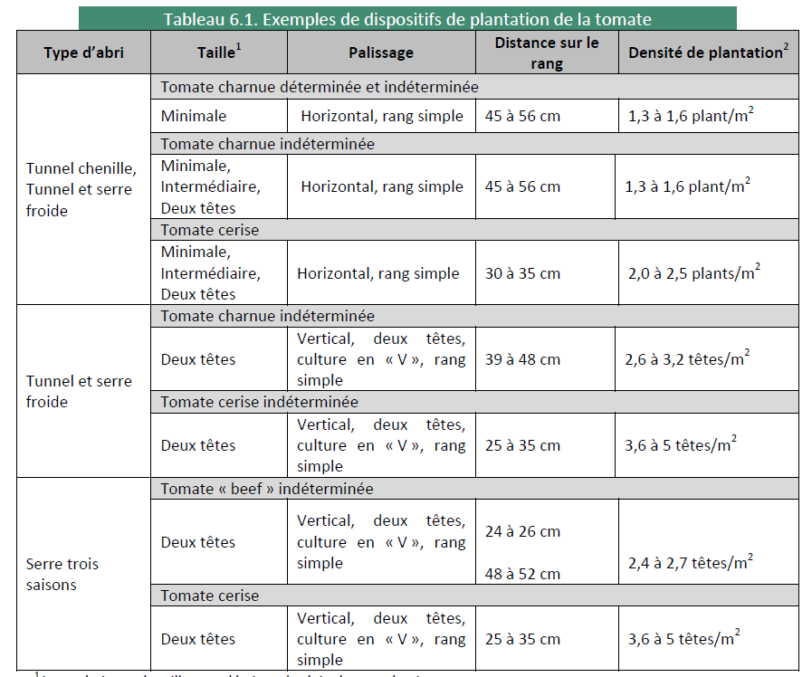
OMAFRA’s
publication 836 gives the
general
recommendation
of:
2.4 -2.7 plants /m2
For example: Consider reducing to 2.1 or less if light is limited in your GH

Slide 25
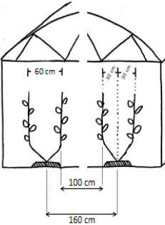
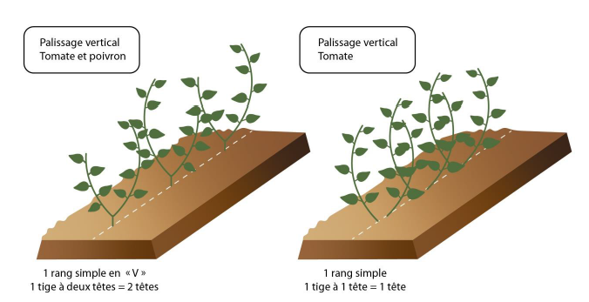
Planning the GH Space - Configuration
1 row configuration (either 1 or 2 heads per plant) allows you to place your ground cloth at base of plants
Space your wires accordingly
Spacing important for light to reach the plants
Don't be afraid to really give enough loose in the string to deepen the ‘’V’’
  More of a “U” shape.
Vertical trellis
Vertical trellis
Both images taken from:
Guide de Production Poivron et Tomate Biologiques Sous Abris
1 row
2 heads/plant
1 row
1 head/plant

Slide 26
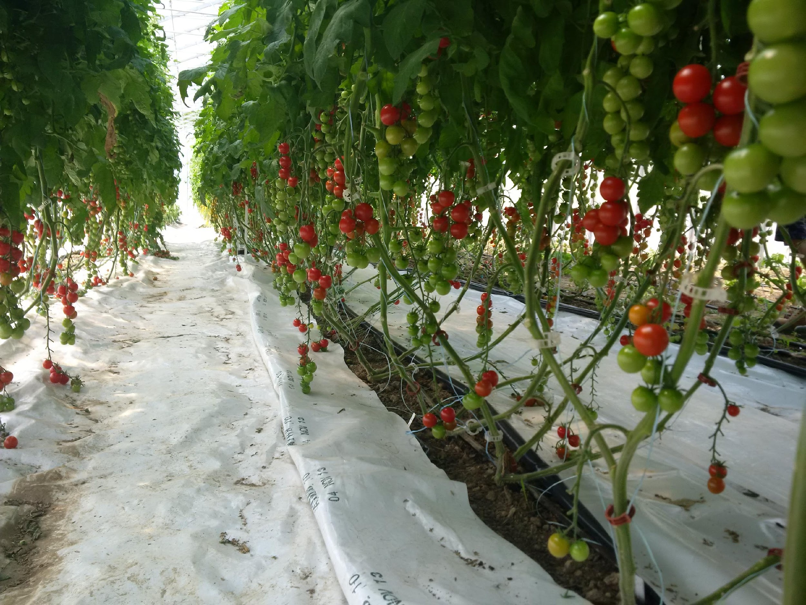
1 row
2 heads/plant
configuration

Slide 27
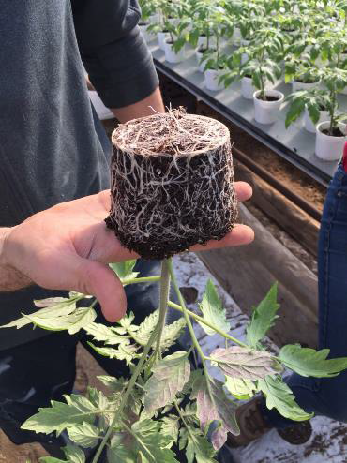
Grow Strong Seedlings
A+
A good strong seedling:
  Healthy white roots,
  Seedling can be lifted without breaking the plug,
  Sturdy stem, not stretched (stocky),
  Good foliage color,
  First flower cluster open on 50% of plants or 8-10 true leaves
Hit the ground running:
  Roots at the edge of the pot, ready to contact soil ASAP,
  Enough fertility,
  If seedling not ready, might as well delay TP day.
Photo credit: Climax Conseil

Slide 28
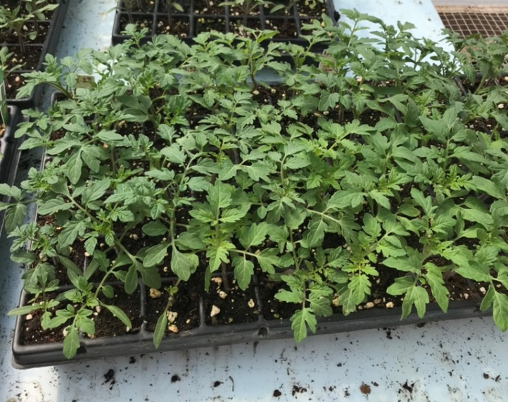
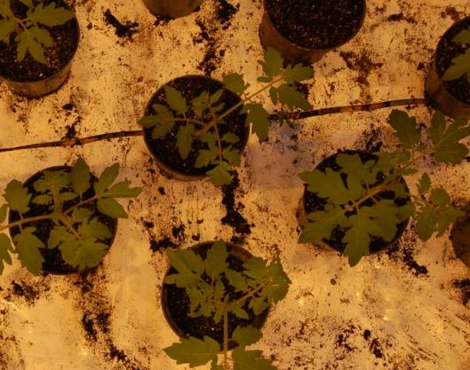
Grow Strong Seedlings
Temperature
Fertility
Space
  Plants should not touch,
  Seed in every two cells (seedling trays).
Light: If using grow lights, ensure enough light so plants don't stretch
  The lights can be lowered.
  Have enough lights for sqft of seedlings
Water and air (for roots to expand and fill plug)
  Water is important, but don’t overdo it
  Lift the plug out of the cell to confirm watering
Too tight
Enough space to grow
Photo credit: Climax Conseil

Slide 29
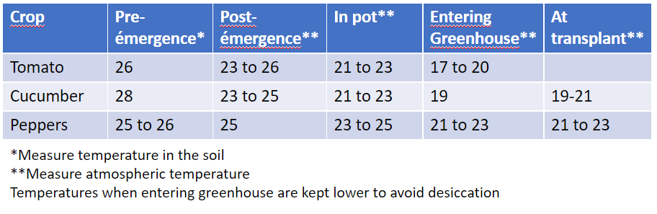
Seedling Temperature Targets

Slide 30
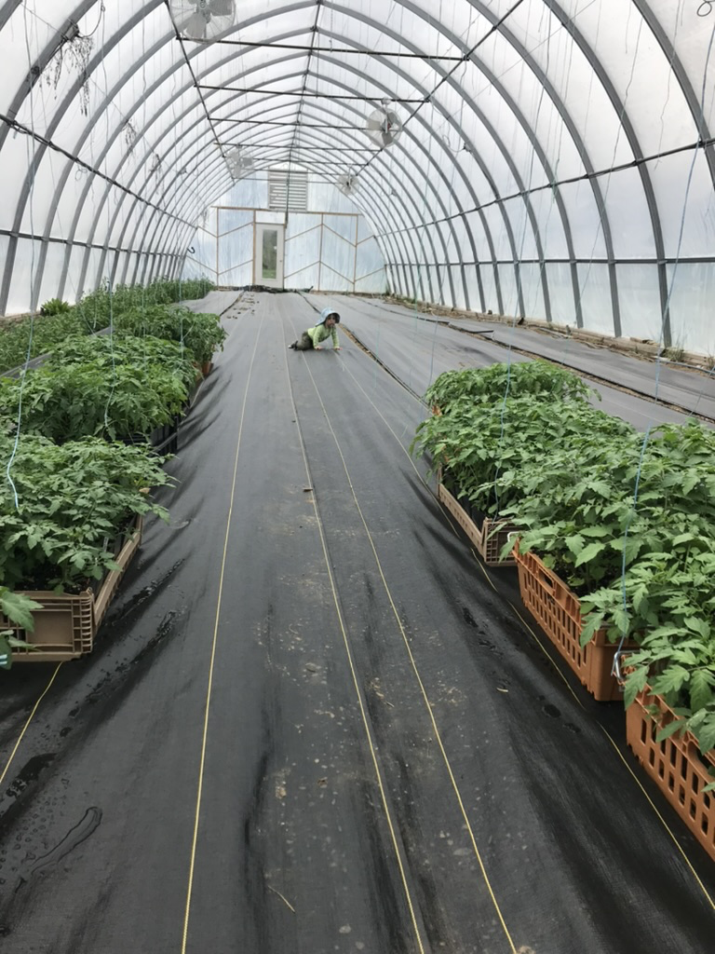
Preparing the GH for Transplanting
Fertilize seedlings with 1tbsp pelletized chicken manure per pot 1 week before TP
  Will provide fertility before plants make contact with soil.
Fertilise soil the week before the transplants go in
  Elements should be available when the roots get there.

Slide 31
Preparing the GH for Transplanting
Get the soil moist in order to start mineralisation.
Place drip tape and soil covers
Strings and hooks can be placed ahead of time
On TP day, all you have to do is TP!

Slide 32
Notice the mound in middle of tray?
Space between plants was probably not adequate!

Slide 33
Irrigation Management – Timing and Amounts
Treat irrigation like the plants are in a marathon
Watering cycles start 3 hours after sunrise and end 6 hours before sunset
  Let the soil dry to ensure proper oxygenation
Irrigation amounts according to sun
  If it’s a cloudy day, the plants will need less water than if it’s a sunny day
Soil type determines how many intervals and their length

Slide 34
Irrigation Intervals Based on soil texture and sunlight amounts
Soil Texture | Sunny | Partly Cloudy | Cloudy
Sand | 8-12 | 6-8 | 4
Loam | 6 | 4 | 2
Clay | 4 | 2 | 0-1
Volume of water depends on the amount of sun and the size of the plant
0.67 x Solar Radiation x plastic type coefficient x crop type coefficient / 251 Joules/cm³

Slide 35
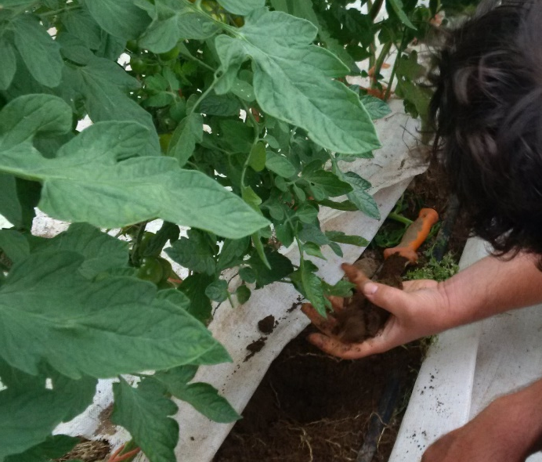
Getting a feel for it
  Feel the soil every morning before the first irrigation
  Touch the leaf to see if it’s cool
Time of day | Hand Feel
Before first watering | Humid, but does not dirty hand
Wetting | Humid, leaves hand dirty
Maintenance (between 11h and 16h) | Drops of water form when squeezing a ball of soil

Slide 36
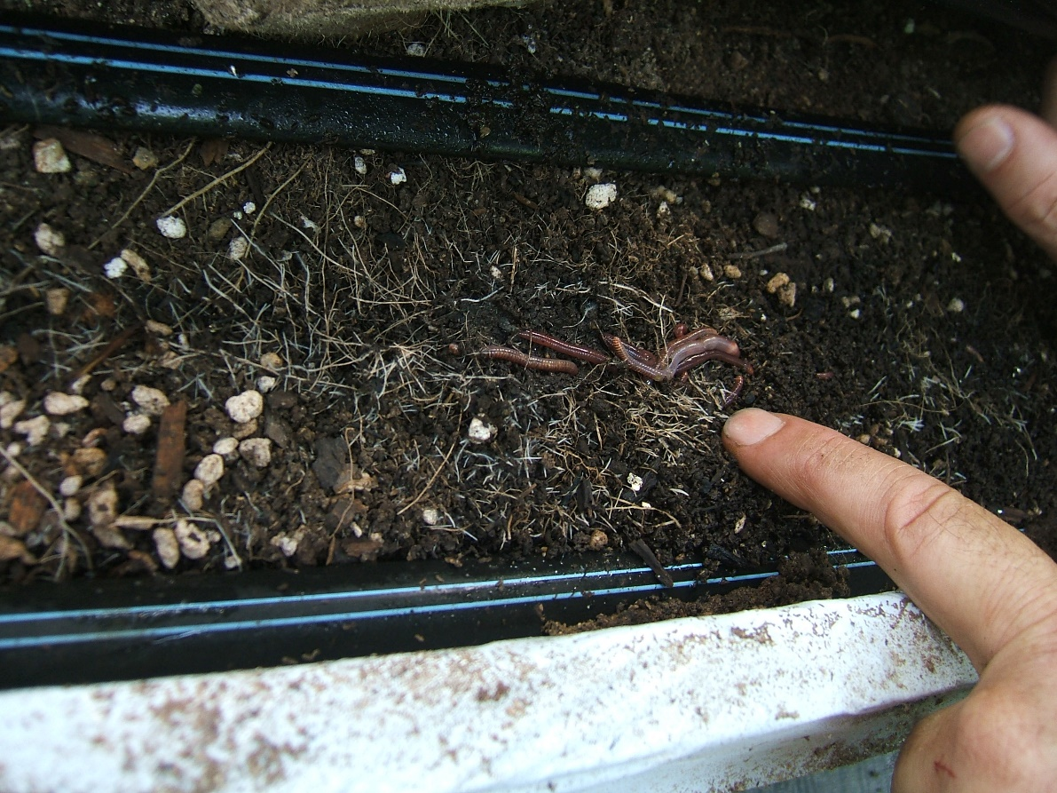
Irrigation Management
Mineralization only happens in a humid soil

Slide 37
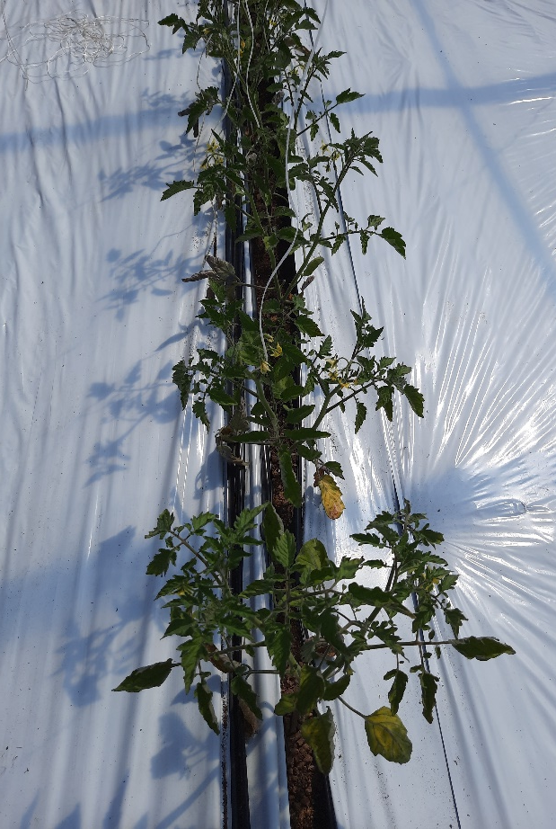
Irrigation Management
When transplanting, placing drip lines over plug
  Remember dry soil acts like a sponge
Use new drip tape! The risk of loss in production outweighs the cost of new drip tape
Plastic cover to keep humidity

Slide 38
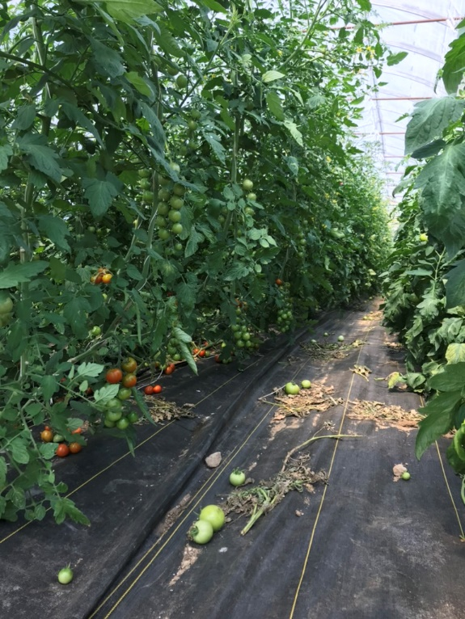
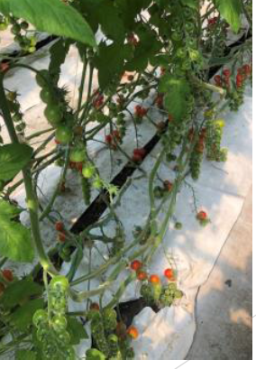
Soil Covers
OK!
Black woven.
Keep clean, sweep debris!
Soil Covers: ideally white on black non-woven
  Keep soil moist
    Less evaporation (especially with non-woven)
  Help mineralize fertilizer
  Minimize the need for weeding
  Allows for easier cleaning of the space
    reduce the spread of disease
Better!
White on black non-woven

Slide 39
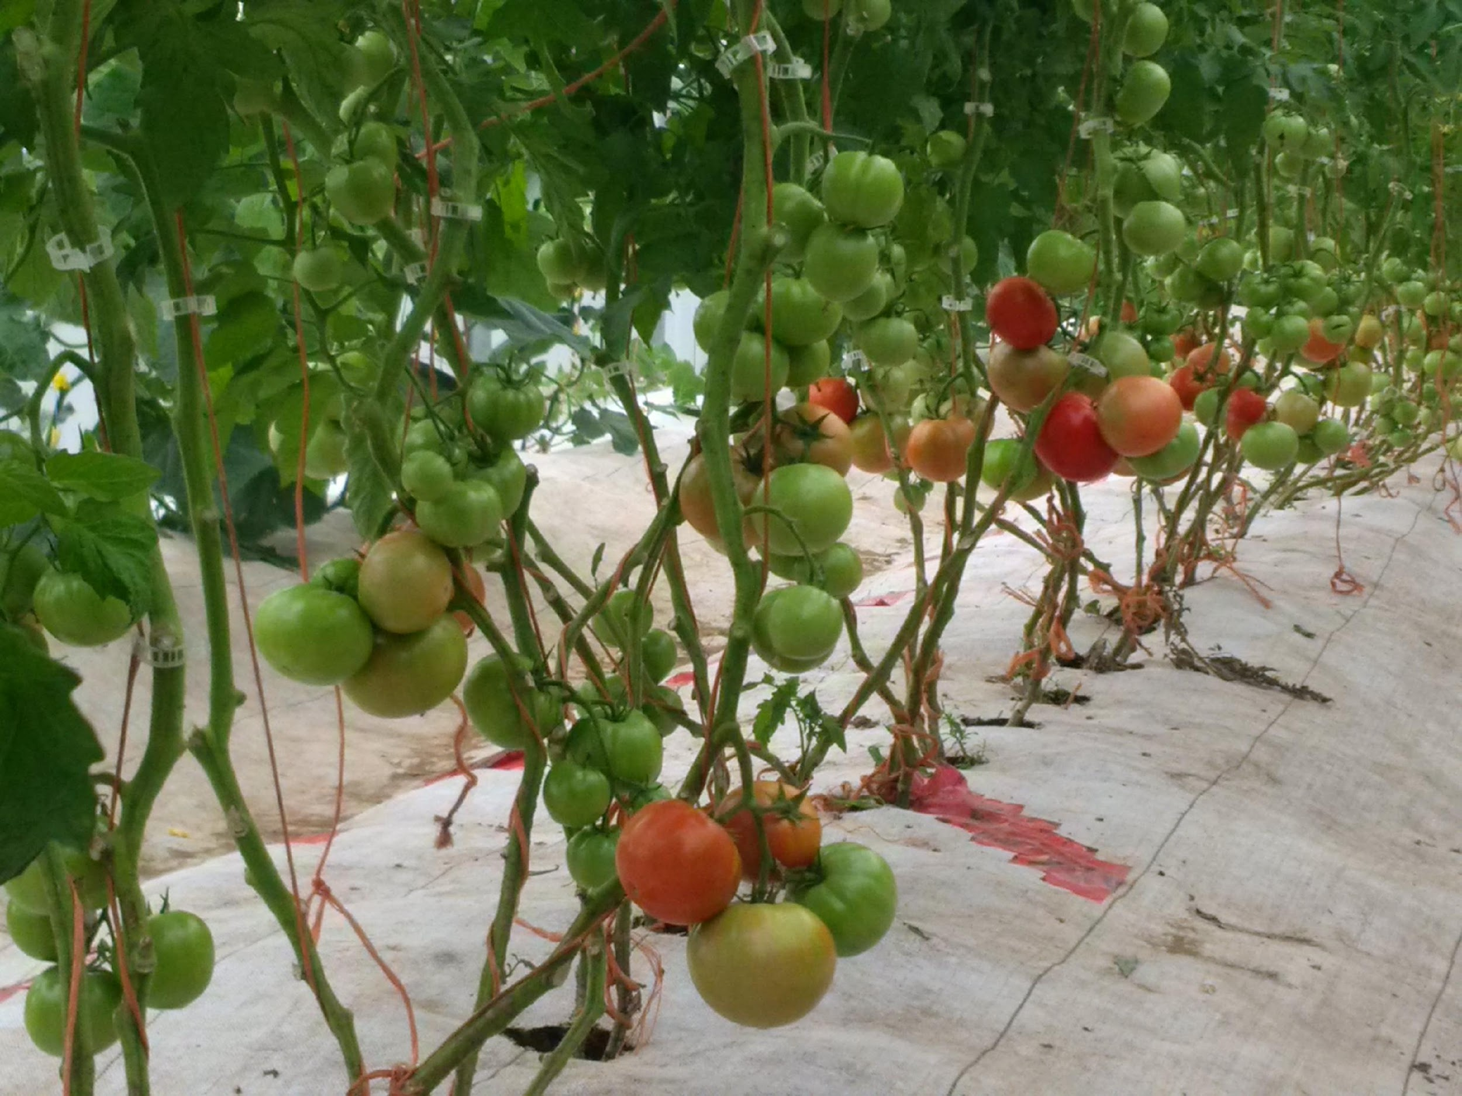

Easier to lift plastic to fertilize

Slide 40
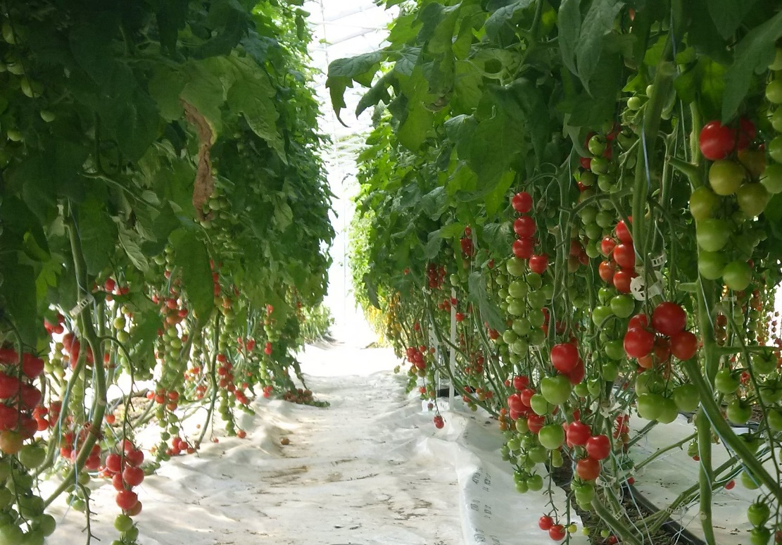
Temperature
Relationship between light and temperature
  “Il fait beau, il fait chaud. Il fait laite, il fait frête.”
If the plants are too hot, the stomates will close, preventing photosynthesis

Slide 41
Temperature - Night
Nighttime needs heat for the sugars produced during the day to be translocated to where they are needed
  If not, there is no room for new sugars to be formed in the leaves
Day and night differential affect plant growth
  0 ºC = vegetative
  2 - 3 ºC = balanced
  4 - 6 ºC = generative

Slide 42
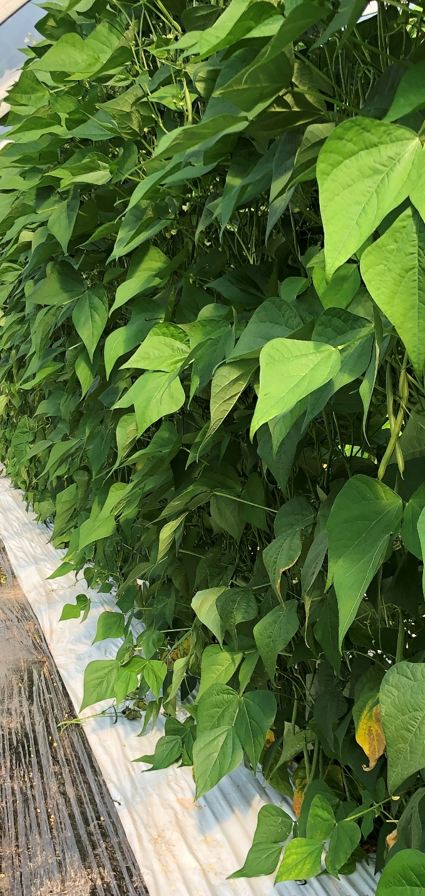
Temperature
Observations this summer:
  Overall leaf density in the greenhouse is your first tool to reduce temperature
  Hot and dry nurseries, dries up transplants too quickly (wet the floor)
  If your plants are long and reaching for the light, reduce the heat
  If they are purple, increase the heat

Slide 43
Humidity Control
Humidity in the morning – make sure it’s not too high so that plant can transpire (if not, no photosynthesis)
Disease prevention

Slide 44
The Right Conditions
Temperature, (heat and ventilation), humidity level
Should you heat your GH?
Lots of things to consider before adding heat.
    Know your yields
    Have you mastered the production
    Cost of heating
    Price you can obtain if you do produce in shoulder season
    If you are going to heat, hit the temperature targets, otherwise you might as well delay. Go Big or Go Home!!
Climate control system might be good investment if heat will be added.

Slide 45
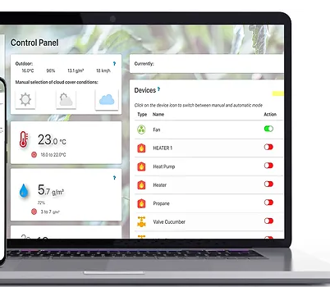
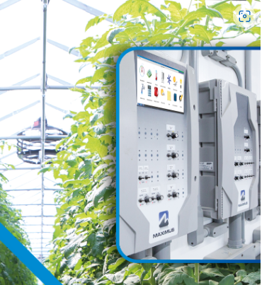
Climate Control Technologies
Climate control technologies
  Many suppliers available
  Might be more accessible than you think
  Potential to control irrigation, heat, ventilation, roll ups
  DAAF programs to help with costs (?)
With optimal conditions, potential for higher and earlier yields.
  Can technology help?

Slide 46
Leaves – Source of Energy
Leaf surface is the plant’s source of energy
Ideal number of leaves can be calculated based on leaf area related to the amount of sun available
Rough estimation in tomatoes:
  Beef tomatoes should have 20 leaves, 45 cm long
  Cherry Tomatoes should have 17 leaves, 45 cm long
  Before plant maturity, consider 2.5 leaves / cluster
If there are too many leaves, these act as an energy sink
In tomato production - A common occurrence was not enough leaf surface – solution: Flag leaf

Slide 47
Pruning Flowers
  Cherry tomatoes – prune to 16 flowers until fruit production starts
  Larger tomatoes – depends on the desired size,
    Keep upcoming heat waves in mind
  English cucumbers – prune first 6-8 flowers, then every 2nd flower – this prevents waves of fruit abortion
  Peppers – prune all flowers below the 3rd node (V)

Slide 48
Light
Fertility
Temperature
Yield
Balance
Flavour
Irrigation

Slide 49
It's All
Connected
Light
Fertility
Temperature
Yield
Balance
Flavour
Irrigation

Slide 50
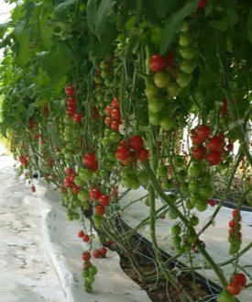
Balanced Growth
Balanced growth distribution of energy between head, fruit and flower
Spend time in the greenhouse reading your plants

Slide 51

Tables found in “Managing Crop Balance” 2021-2022 Educational Presentation on GNB CEA Webpage

Slide 52
Available Resources and Programs
DAAF staff to help you plan out your next greenhouse project
Hire consultants to help plan out projects
  DAAF programs to help with costs (?)
Don't be afraid to ask for help!!
DAAF CEA Resources page
Guide de Production Poivrons et Tomates Biologiques Sous Abris
OMAFRA Publication 836: Growing Greenhouse Vegetables in Ontario

Slide 53


Slide 54


Slide 55


Slide 56

DAAF CEA Ressources
Educational Sessions:
Lot’s of very valuable information here.
Climax Conseil webinars are all available.
Good end of winter viewing!

Slide 57
Continuing the Knowledge Building
Continue knowledge building to bring NB greenhouse production to optimal levels
Climax Conseil project for 2023-2024 season
Still lots to learn for everyone!

Slide 58


