Slide 1
Common and Emerging Pests in Vegetables
- insects
New Brunswick Hort Congress
March 15-16, 2023
Fredericton, NB
Chris Maund chris.maund@gnb.ca
506-453-3477
Integrated Pest Management Specialist
(Entomologist) and Provincial Apiarist
NB Department of Agriculture, Aquaculture and Fisheries

Slide 2
Insect pests / insectes nuisibles
Cabbage maggot / mouche du chou
Cabbage looper / fausse arpenteuse du chou
Imported cabbageworm / piéride du chou
Diamondback moth caterpillars / fausse teigne des crucifères
Flea beetles / altises
Aphids / pucerons
Swede midge / cécidomyie du chou-fleur
Cutworms / vers-gris (larves de Noctuelles)
Leek moth / teigne du poireau

Slide 3
Scouting methods: 5 X 5 method
Choose a V pattern in the field
Pick 5 points and examine 5 plants at each point
Change placement of V each time you scout the field

Slide 4

Cabbage maggot / mouche du chou
Crops: cabbage, cauliflower, broccoli, turnip, rutabaga, radish, related crucifer crops.
Monitoring: Seedlings most susceptible. 4 broods: Ap/Ma (yellow rocket); Ju/Jl (Daylily); Au (Canada Thistle); fall (New England Aster flowers)
Control: Pesticide at planting (post planting to 2023).
- After 2023: pesticide at planting.
No present pesticide alternative for rutabaga.
- Other options: Crop rotation; fences; nets.
8 mm

Slide 5
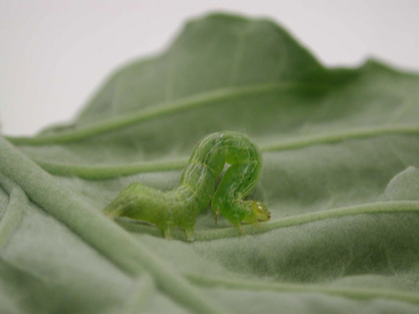

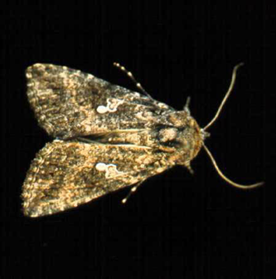
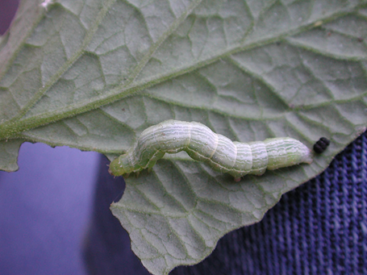
Cabbage looper / fausse arpenteuse du chou
Crops: broccoli, kale, cabbage, cauliflower. Also: turnip, radish, rutabaga, tomato.
Adults: July / August
Monitoring: holes in leaves.
Threshold: Cabbage: 0.3 larval units / plant;
Cauliflower or broccoli; 0.2 to 0.3 larval units / plant

Slide 6
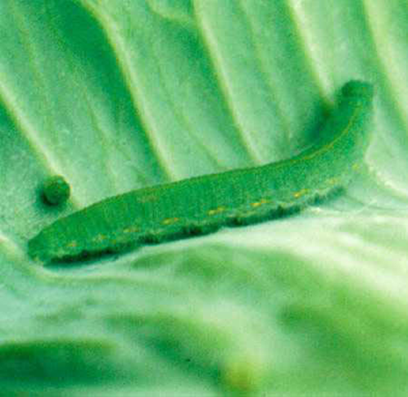
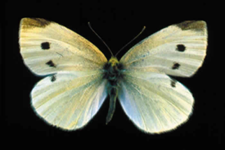
Imported Cabbageworm / piéride du chou
Crops: broccoli, Brussels sprouts,
kale, cabbage, cauliflower. Also: canola
Adults: May, onwards
Monitoring: 5 plants at each of 5 sites
Cabbage looper equivalents: Cabbage looper (1 unit); Imported cabbageworm (1/ unit); diamondback moth caterpillars (1/5 unit).
Threshold: Cabbage: 0.3 larval units / plant;
Cauliflower or broccoli; 0.2 to 0.3 larval units / plant

Slide 7

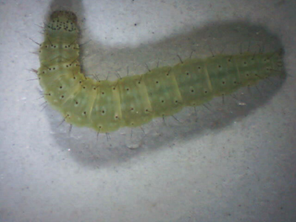
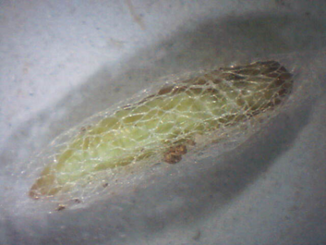
Diamondback moth caterpillars / fausse teigne des crucifères
Crops: broccoli, canola, Brussels sprouts, kale, cabbage, cauliflower
Adults: May/June, 2 to 4 generations / year
Damage: “window-pane” chewing damage (Middle layer of leaf not chewed.)
Monitoring: 5 X 5 method.
Cabbage looper equivalents (1/5).

Slide 8
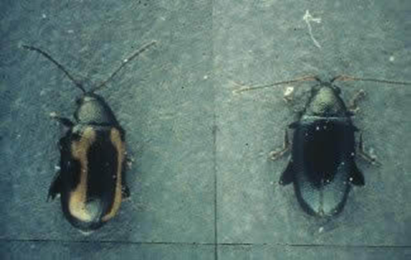
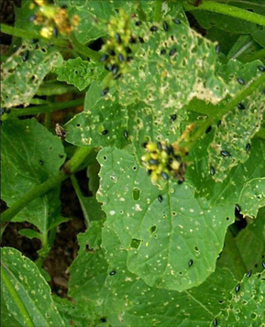
Flea beetles / altises
Crops: cruciferous crops
Adults: Name: Flea beetles (JUMP)
(2 to 3 mm long) mid-May
Damage:
Adults: Shot-hole feeding damage
(1 to 5 mm holes)
adults on seedlings / larvae in roots
Monitoring: 25 plants
Threshold: 1 beetle / plant (seedlings) to 6 leaf stage.
Also: marketability
10% 90%

Slide 9
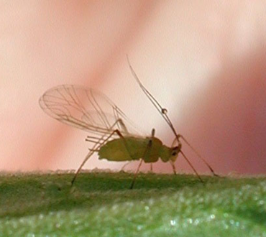
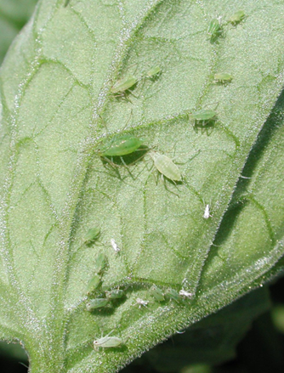
Aphids / pucerons
Crops: Numerous Aphids: winged or wingless
Damage: suck sap on leaves: leaf stunting, yellowing.
Aphids secrete fluid: honeydew and mould on plants. Aphids may transmit viruses / depends on crop.
Monitoring: 10 sets of 10 plants; inspect stems and undersides of leaves.
Threshold: not determined on many crops
Populations can increase rapidly.

Slide 10
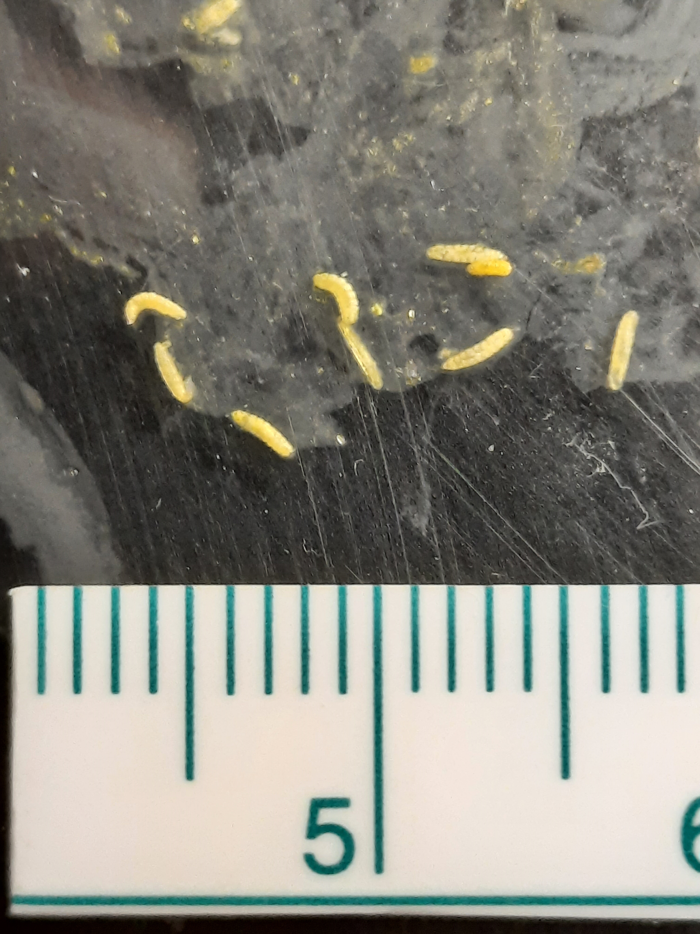
Swede midge / cécidomyie du chou-fleur (1)
Crops and weeds: broccoli, cabbage, cauliflower, Brussels sprouts, kale, collards, rutabaga, radish, horseradish, turnip, canola. Wild mustard, shepherd’s purse, stinkweed, field peppergrass, yellow rocket.
Adults: 1.5 to 2 mm long
Larvae: pale yellowish white
Damage: seedlings twisted and or brown scarring damage
Older plant: distortion (often growing points)
Do not confuse with: plant bolting, genetic disorder, soil nutrient deficiency
Monitoring: Inspect plants. Pheromone traps - adults. Rear larvae / adults from distorted plant in sealed plastic bag / container.
Scale millimetres

Slide 11
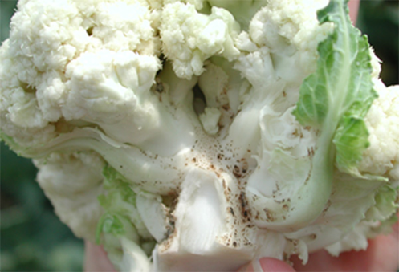
Swede midge / cécidomyie du chou-fleur (2)
Further notes:
Generations: 4 – 5 / year (mid-May; mid-June, etc.)
Almost impossible to eradicate
Crop rotation:
- non-crucifer crops; non crucifer weeds
Pupae in soil for two years
Wind: Adults - a few hundred metres.
Physical controls: specific netting (non-infested area).
Bury pupae below 50 mm (2 inches) for 2 years.

Slide 12
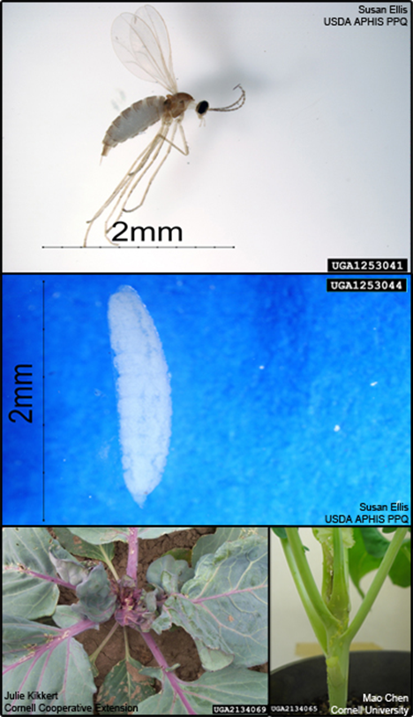
Swede midge / cécidomyie du chou-fleur (3)
Pesticides:
Ontario study: Cabbage crop and pheromone traps
Threshold: 5 males / trap / day
and a minimum 7 day spray interval
Economic benefit
Need a trained person to identify adults
USA: greenhouse study: systemic neonicotinoids (seed treatment) controlled Swede midge for various weeks.

Slide 13
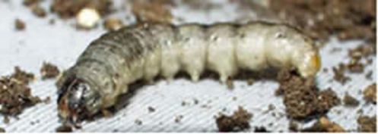
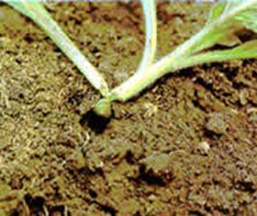
Cutworms / vers-gris (larves de Noctuelles)
Numerous species on crops and weeds: numerous
Cutworm moths: Attracted to wetter / weedy areas / lush vegetation.
Cutworm: Large robust. Shiny / greasy. Roll up. Active at night.
Monitor: Middle of day: plants wilted / fallen over. Inspect for damage.
Threshold: 5% damaged plants

Slide 14
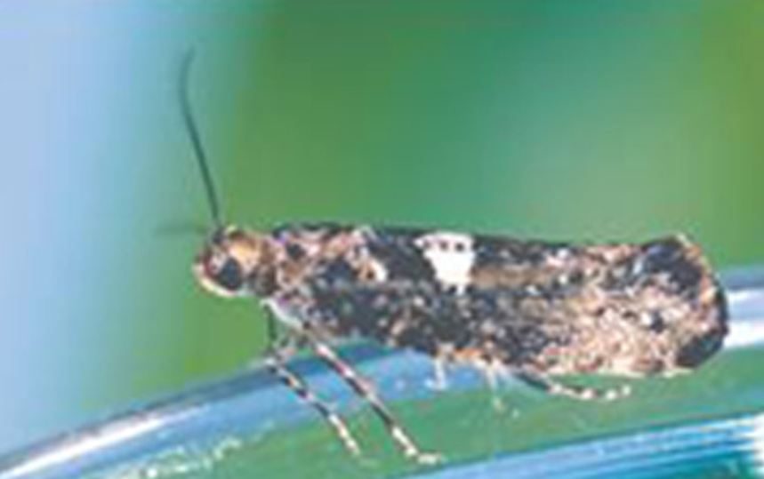
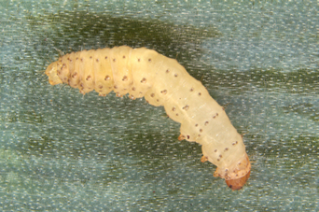
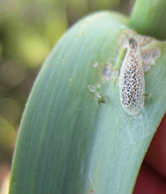
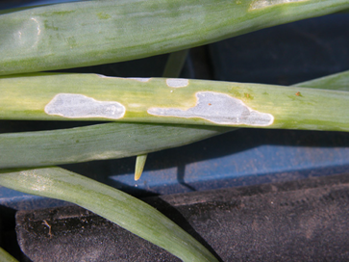
Leek moth / teigne du poireau
Crops: leek, garlic, chives, French shallot, dry onion, green onion
Adult: 9.5 ⁰ C (southern QC)
1st (May); 2nd (late June - July) or later
3rd (early Aug - early Sep)
Damage: “window-pane” (not completely chewed through) / tunnelling.
Monitor: Pheromone traps
(Insecticide 7 to 10 days after peak flight.)
Threshold (QC): 5% damaged plants/25

Slide 15
Leek moth / teigne du poireau
Cultural controls:
Crop rotation; Delayed planting; Remove old, infested leaves
Destroy caterpillars / pupae
Early harvest
Place susceptible crop away from infested areas
Destroy plant debris after harvest
Germany: cover leeks with netting prior to female moths.
ON: Lightweight floating row covers. Can be removed in day (weeding) and reassembled prior to dusk. (Moths fly at night.)

Slide 16
Thank you / Merci

