Slide 1
Common diseases of vegetable crops in New Brunswick
NB Hort Congress, 2023
Michael Tesfaendrias, Ph.D., P. Ag.
NBDAAF
IPM Specialist (Plant Pathologist)
(506) 453 3478
Michael.tesfaendrias@gnb.ca

Slide 2
Plant Disease
Infectious (biotic)
  Fungi (early blight)
  Bacteria (soft rot)
  Nematode (stem and bulb nematode)
  Protozoa (club root)
  Phytoplasma (aster yellows)
  Virus (iris yellow spot)
Non-infectious (abiotic)
  Too low or too high Temp.
  Drought or excessive moisture
  Lack or excess light
  Air pollution
  Nutrient deficiency, mineral toxicity, soil pH
  Pesticide toxicity
  Improper cultural practices

Slide 3
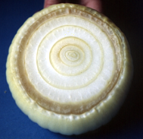
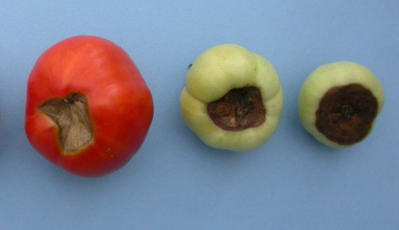
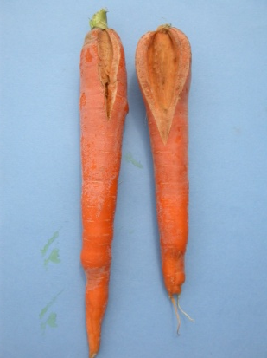
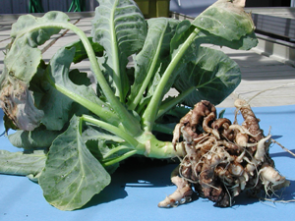
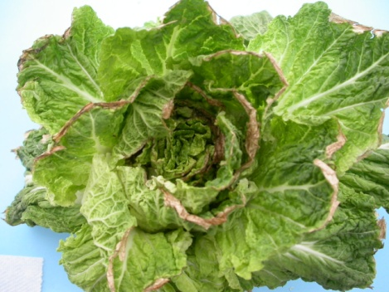
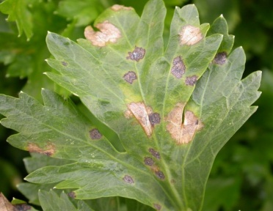
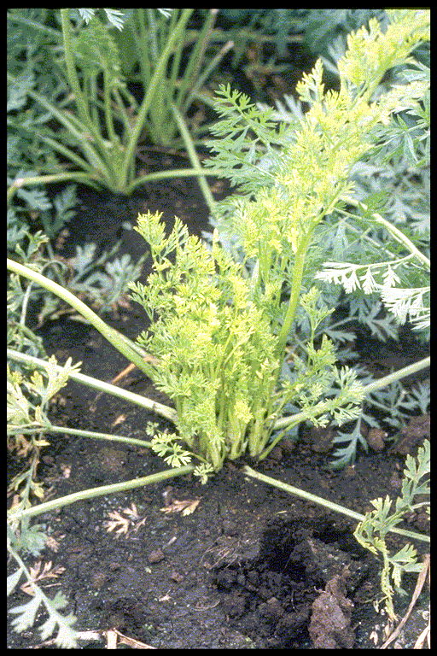
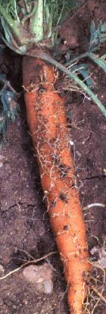
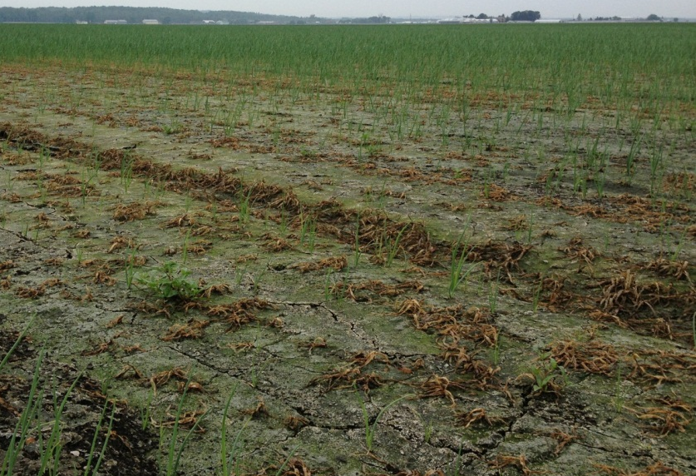
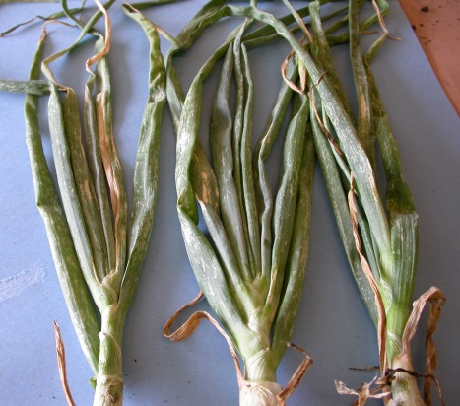
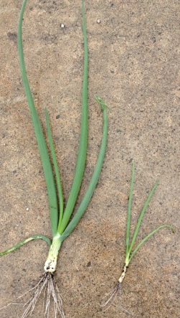
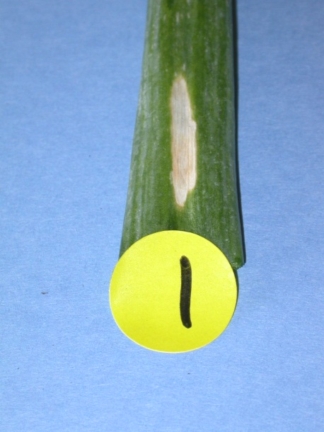
Infectious (biotic)
Noninfectious (abiotic)

Slide 4
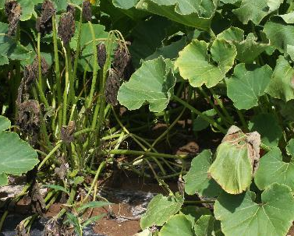
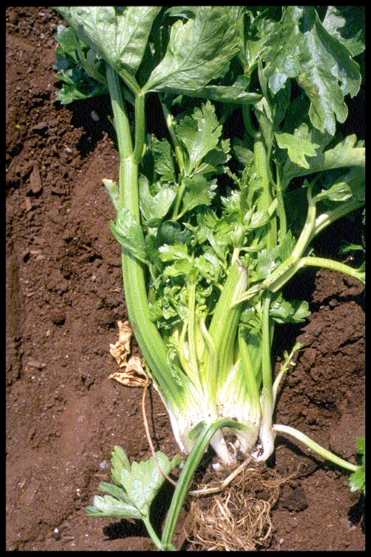
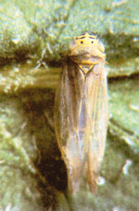
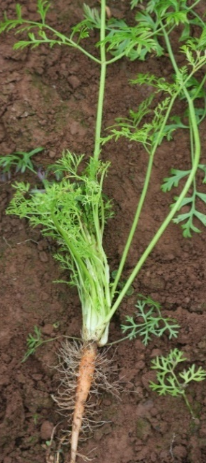
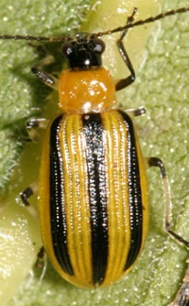
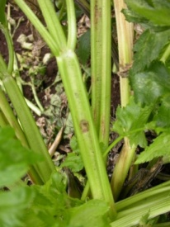
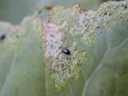
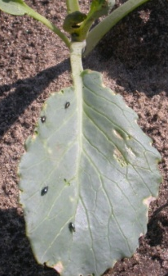
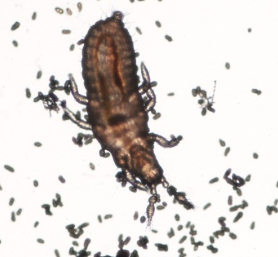
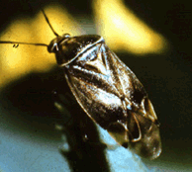
Role of insects in plant diseases
Insects can transmit diseases (virus, bacteria, phytoplasma)
Bacterial wilt
Aster leafhopper
Striped cucumber beetle
Aster yellows
- Wounds caused by insects provide an entrance for pathogens to invade/infect plants
Flea beetle
Fungal spores
Tarnished
plant bug

Slide 5
Vegetable disease management
Integrated Pest Management (IPM): an approach to managing pests that uses all available strategies to reduce pest populations below an economic injury level.
  Monitoring: weather conditions, plant health, disease symptoms
  Cultural methods: site selection, crop rotation, resistant/tolerant cultivar, disease free seed/planting material, sanitation, remove alternate host, optimize plant health
  Biological/chemical control methods
  Holistic approach

Slide 6
Common diseases of tomato
Late blight (Phytophthora infestans)
  Infects Solanaceae plants
  High moisture, high RH and moderate temp. (10-21 ºC)
  Sever defoliation and fruit rot
  Can be introduced in a field:
    On infected tomato transplants, infected seed potatoes, volunteer plants, cull piles
    Produce millions of spores wind-borne and spread into nearby fields

Slide 7
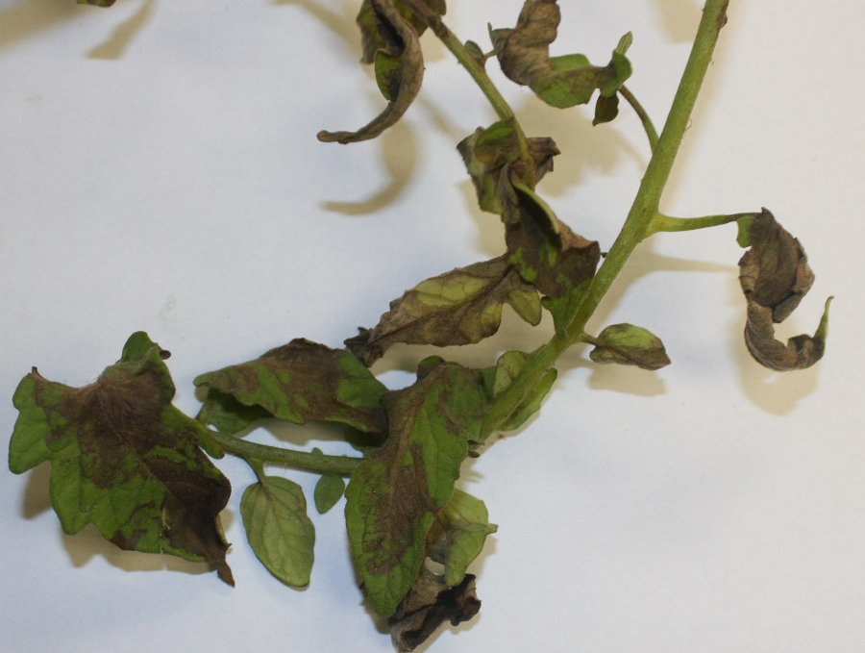
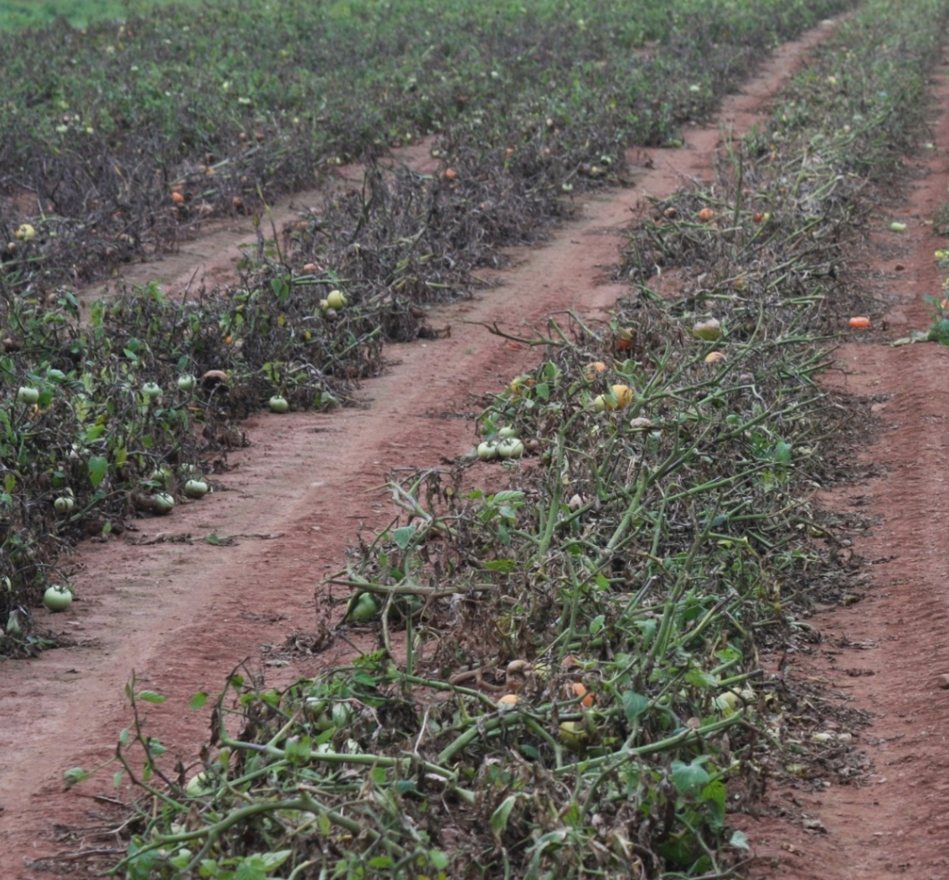
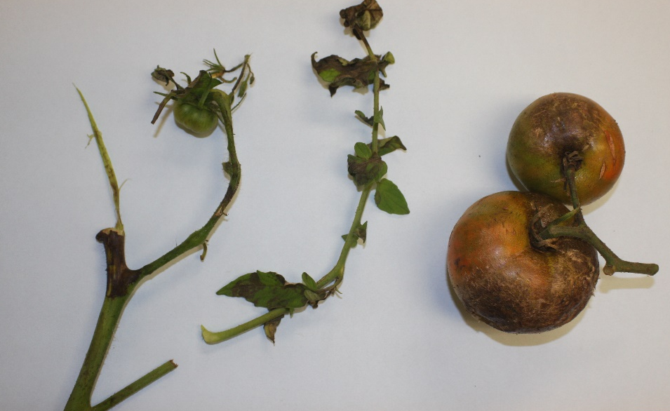
Late blight

Slide 8
Late blight management
Select resistant varieties
Remove volunteer tomato, potato plants and nightshades.
Make sure transplants are disease free
Keep leaves as dry as possible
Remove or plough tomato plants at the end of the season to eliminate a winter reservoir for the pathogen
Fungicide spray

Slide 9

Late blight resistant tomato cultivars?
Notes:
Late blight resistant tomato cultivars?

Slide 10
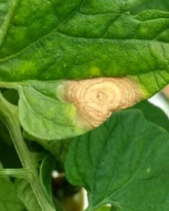
Early blight (Alternaria solani)
  Infects leaves and fruit
  Reduces plant vigor
  Defoliated plants are subject to sunscald
  Infection:17-24ºC and extended leaf wetness
  Spore dispersal: water, wind, insects, and machinery

Slide 11
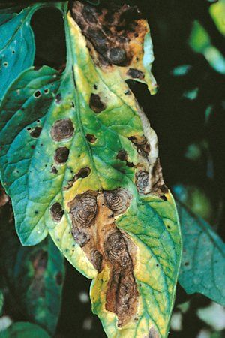
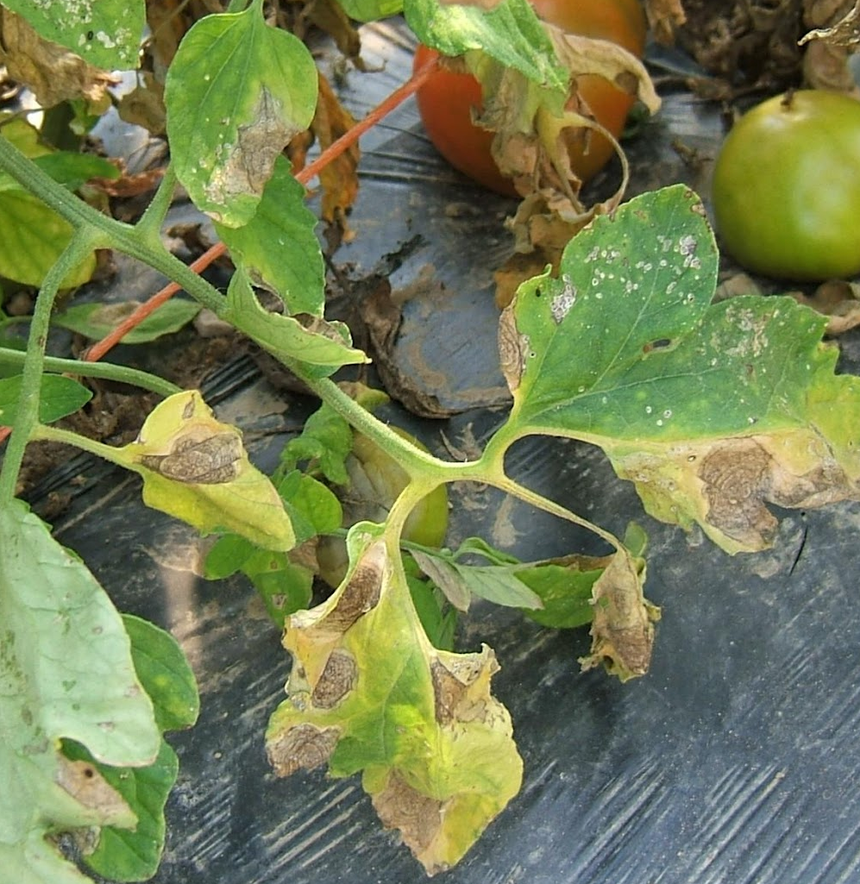
Early blight
Courtesy APS
Notes:
Early blight

Slide 12
Early blight management
Remove and destroy crop residue or plow residue into the soil
Crop rotation (3-4 years)
Control volunteers and susceptible weeds
Good air circulation
Proper nutrient management
Minimize plant injury
Use resistant or tolerant varieties
Chemical/biological control

Slide 13
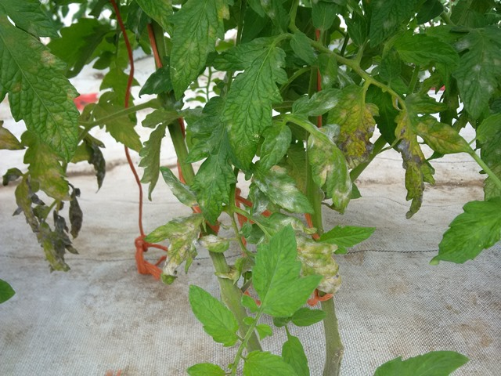
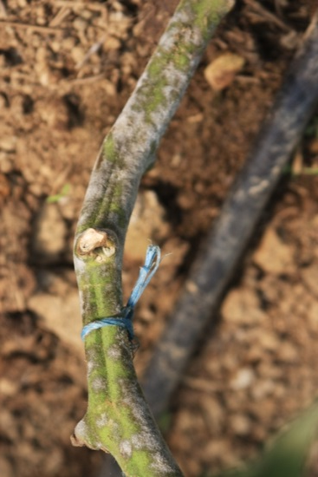
Powdery mildew (Oidium neolycopersici,
Erysiphe lycopersici, Leveillula taurica)
Infection: warm, humid and fields under water stress
Most common in high tunnel than in field tomato

Slide 14
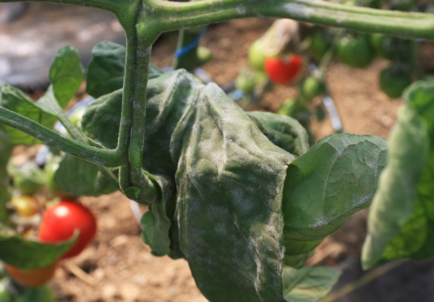
Powdery mildew management
The best management is prevention
Select resistant varieties
Fungicide/biocontrol
  Timing: no later than the first sign of disease
  good coverage

Slide 15
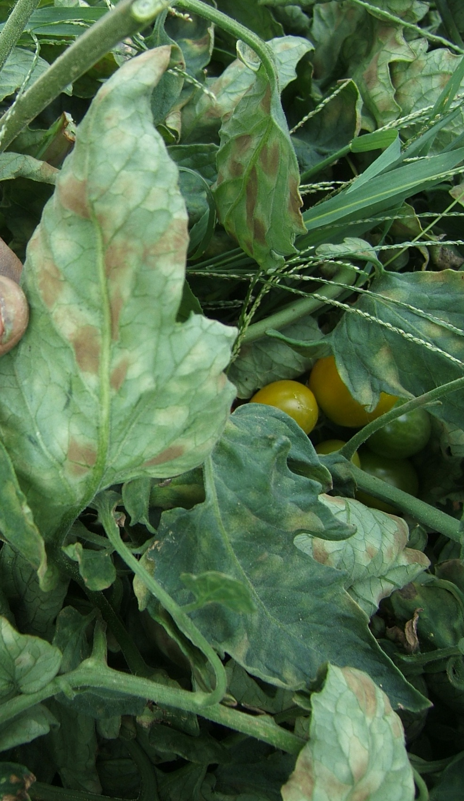
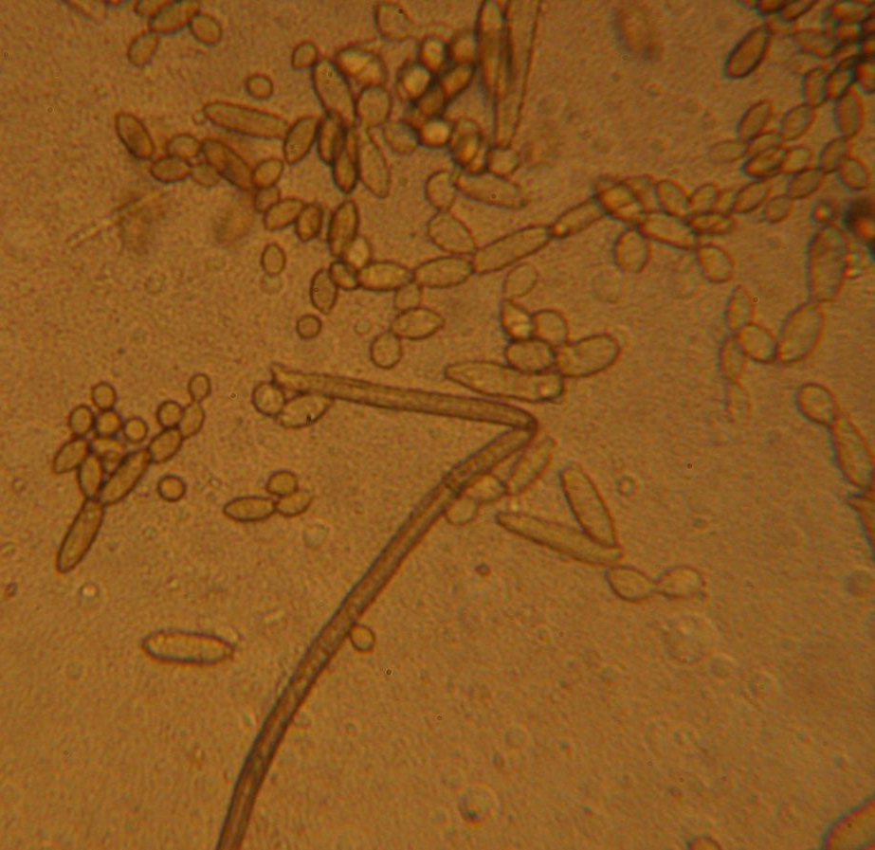
Leaf mold (Fulvia fulva)

Slide 16
Leaf mold (Fulvia fulva)
  Primarily a problem in greenhouses
  Can affect field tomatoes
  Most destructive (GH) during the fall, early winter, spring when relative humidity is high and heating is not continuous
  High relative humidity: fungus develops rapidly
    (RH ≥ 85%; 4º - 34ºC)
  If not controlled, results leaf death yield loss

Slide 17
Leaf mold management
Keep the RH <85%, reduce leaf moisture period
  Provide good air circulation
  Warmer night temperatures
  Avoid wetting the leaves
  Maintain temperatures 16º to 18ºC
  Adequate plant and row spacing (prevents excessive shading)
Select resistant cultivars
Reduce primary inoculum (e.g. sanitation)
  Carefully remove all plant debris

Slide 18
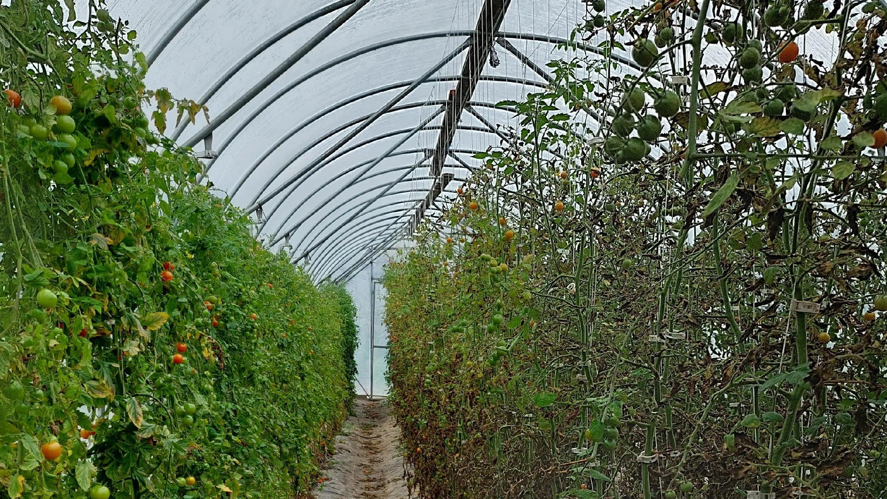
Leaf mold

Slide 19
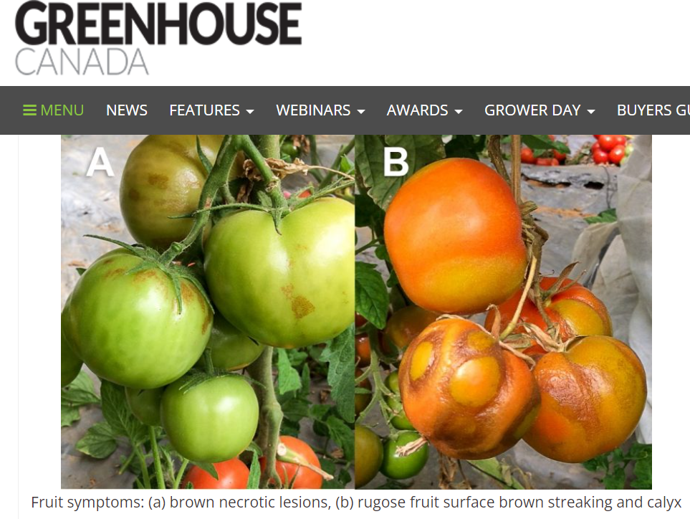
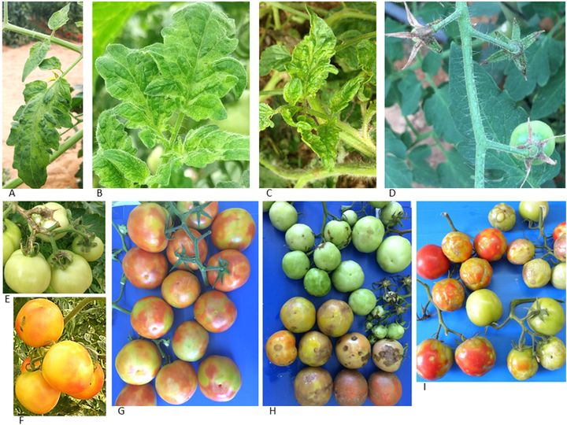
Pest alert: Tomato Brown Rugose Fruit Virus (ToBRFV),
A viral disease mainly impacts tomato plants and pepper
Spreads easily and persists in the environment
Mainly affects greenhouse tomatoes and peppers
Infected fruit are unmarketable
OMAFRA
Notes:
OMAFRA

Slide 20
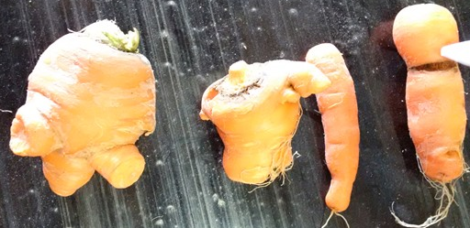
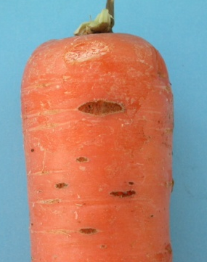
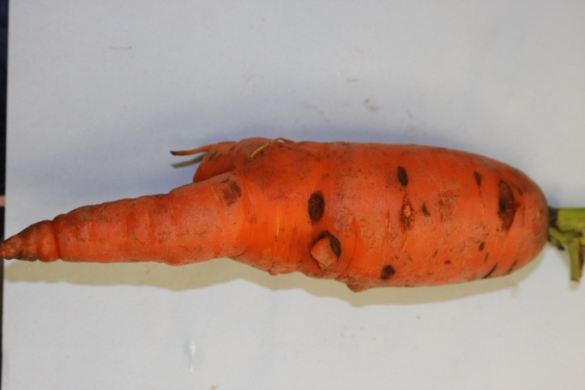
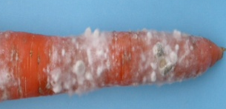
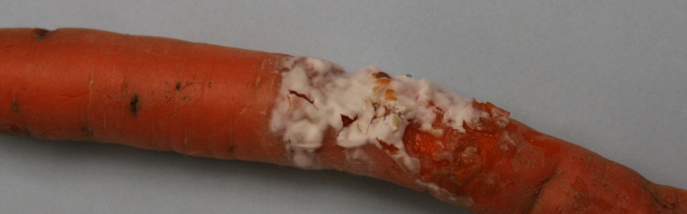
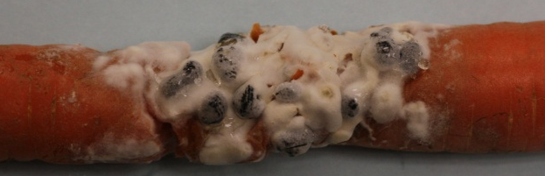
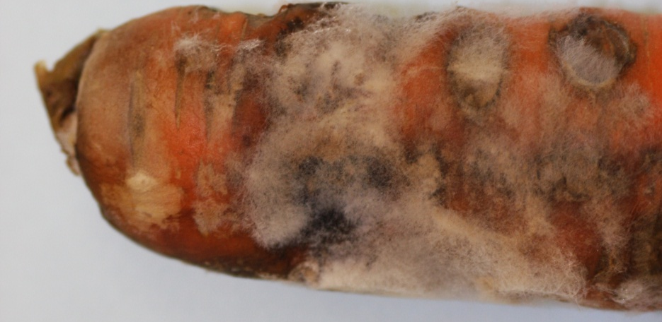
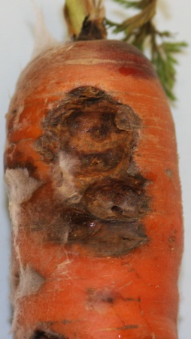
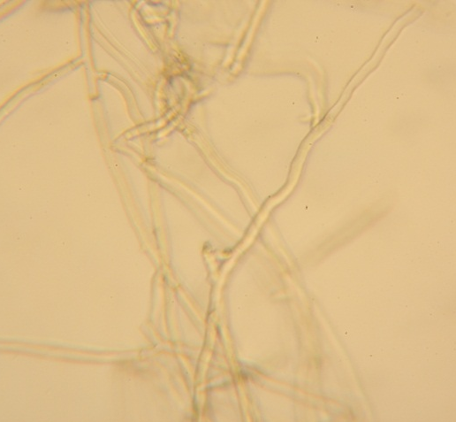
Carrot Diseases
Cavity spot and pythium root dieback(Pythium spp.)
Sclerotinia rot (Sclerotinia sclerotiorum)
Crater rot; Crown rot (Rhizoctonia)

Slide 21

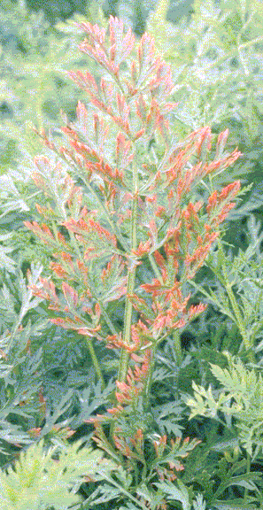
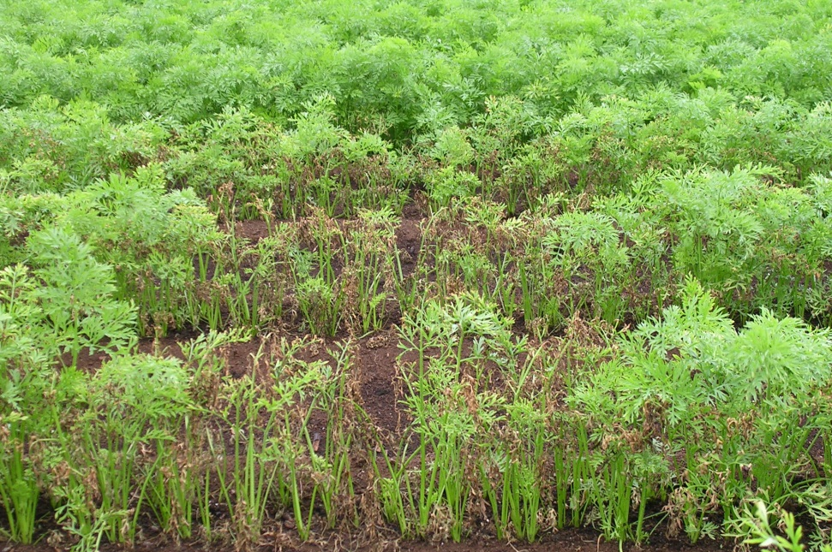
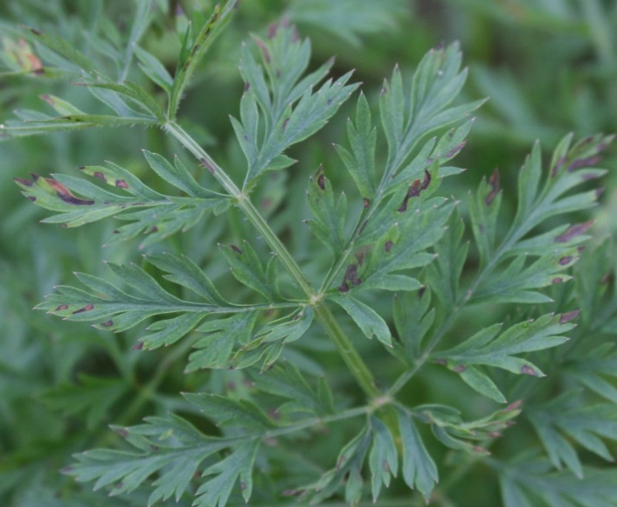
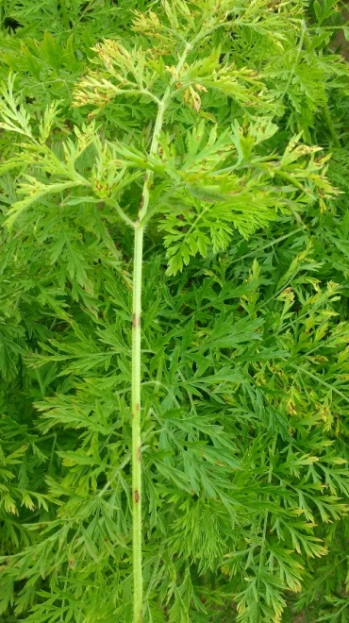
Carrot Diseases
Aster yellows (Phytoplasma)
Leaf blight (Alternaria dauci and Cercospora carotae)

Slide 22
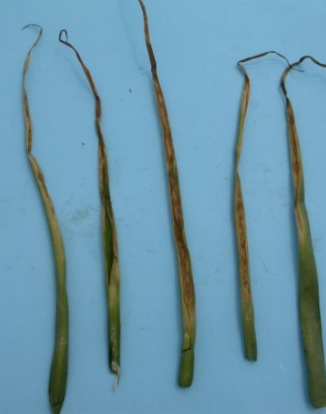






Allium Diseases
Stemphylium leaf blight
(S. vesicarium)
Botrytis neck rot
(Botrytis spp.)
Purple blotch
(Alternaria porri)
Botrytis leaf blight (Botrytis squamosa)
Notes:
Bacterial rot

Slide 23





Allium Diseases
Sour skin (Burkholderia formerly Pseudomonas)
Soft rot (Pectobacterium carotovorum)
Notes:
Sour skin

Slide 24



Allium Diseases
Bulb and stem nematode (Ditylenchus dipsaci)
Fusarium basal rot (Fusarium oxysporum f.sp. Cepae)
-Use clean seed (free of nematodes)
-Crop rotation
Notes:
Crop rotation

Slide 25



Downy mildew (Peronospora destructor)
August 2014
Notes:
August 2014

Slide 26



Swiss chard, beets and spinach: Cercospora leaf spot (Cercospora beticola)
  One of the most important diseases affecting the Chenopodium group.
  High temperatures, humid and long leaf wetness periods at night favour the disease.
    Management
  Start with disease-free seed.
  Minimize leaf wetness period
  Sanitation (bury infected residues, destroy volunteer plants and weed hosts)
  Crop rotation 2-3 years with non-host crops
  Fungicide/biocontrol spray

Slide 27
Pathogens with wide host range
Botrytis cinerea
Sclerotinia sclerotiorum
Damping off and root rot (Pythium spp., Fusarium spp.)

Slide 28



Gray mould (Botrytis cinerea)
  Wide range (>100: trees, vegetables, ornamentals, weeds)
  Cool and humid conditions
  Infects damaged tissues
  Field lettuce: most serious in early spring and late fall

Slide 29





Botrytis gray mould (Botrytis cinerea)
Notes:
Botrytis gray mould (Botrytis cinerea)

Slide 30
Gray mould management
Cultural practices
  Space plant adequately to provide good ventilation
  Proper fertilization (e.g. N and Ca levels)
  Sanitation: remove (eliminate) plant debris/cull piles
  Proper irrigation/watering
  GH: provide sufficient heat at night to prevent dew formation
  Chemical/biological control

Slide 31




Sclerotinia sclerotiorum
Fungal plant pathogen
World wide distribution
>400 plant host species
Causes losses in the field and postharvest

Slide 32








Sclerotinia sclerotiorum
White mould, sclerotinia rot, pink rot, cottony soft rot, drop, sclerotinia stem rot

Slide 33





White mould

Slide 34





Sclerotinia sclerotiorum
Soilborne or airborne pathogen
Survival structure: sclerotia
Germination of sclerotium
  Myceliogenic (hyphal emergence)
    Infection by mycelium at or beneath the soil-line
  Carpogenic germination - produces apothecia with ascospores
    Above ground infection
  Both Myceliogenic and Carpogenic
Notes:
J.

Slide 35
S. sclerotiorum (white mould) management
Reduce viable sclerotia
  rotation (≥ 3yr) with non-host crops
  keep field free of weed
  discard infected plants from the field
  deep plowing to keep the sclerotia from soil surface
During and after harvest
  do not mix infected with healthy crop (e.g. tomato)
  store harvested produce into clean bins
  proper storage temperature and ventilation
Fungicides/Biological control

Slide 36
Damping-off and Root rots
Pythium, Phytophthora, Rhizoctonia, Fusarium
Seedlings affected at ground level and topple over
Symptoms: seed decay, rotting roots and cankers on the stem or lower petioles
Damping-off: usually during the seedling stage
  Cool and wet springs
  Conditions that slow emergence and delay development
Root rots: can affect at any growth stage
  Mostly warm, wet conditions

Slide 37
Damping-off management
Use sterile soil-less mixture to grow seedlings
Use clean/disease free seed
Care not to crack or shatter seeds
Plant when soil and weather conditions are favourable for vigorous crop development
As soon as damping-off is detected, stop watering for a while
  allow the soil to dry, but not completely dry
  Chemical/bio-control (e.g. seed treatment, drench application)

Slide 38





Resources
PMRA http://hc-sc.gc.ca/cps-spc/pest
Notes:
Resources

Slide 39

Thank You
Merci

