Slide 1
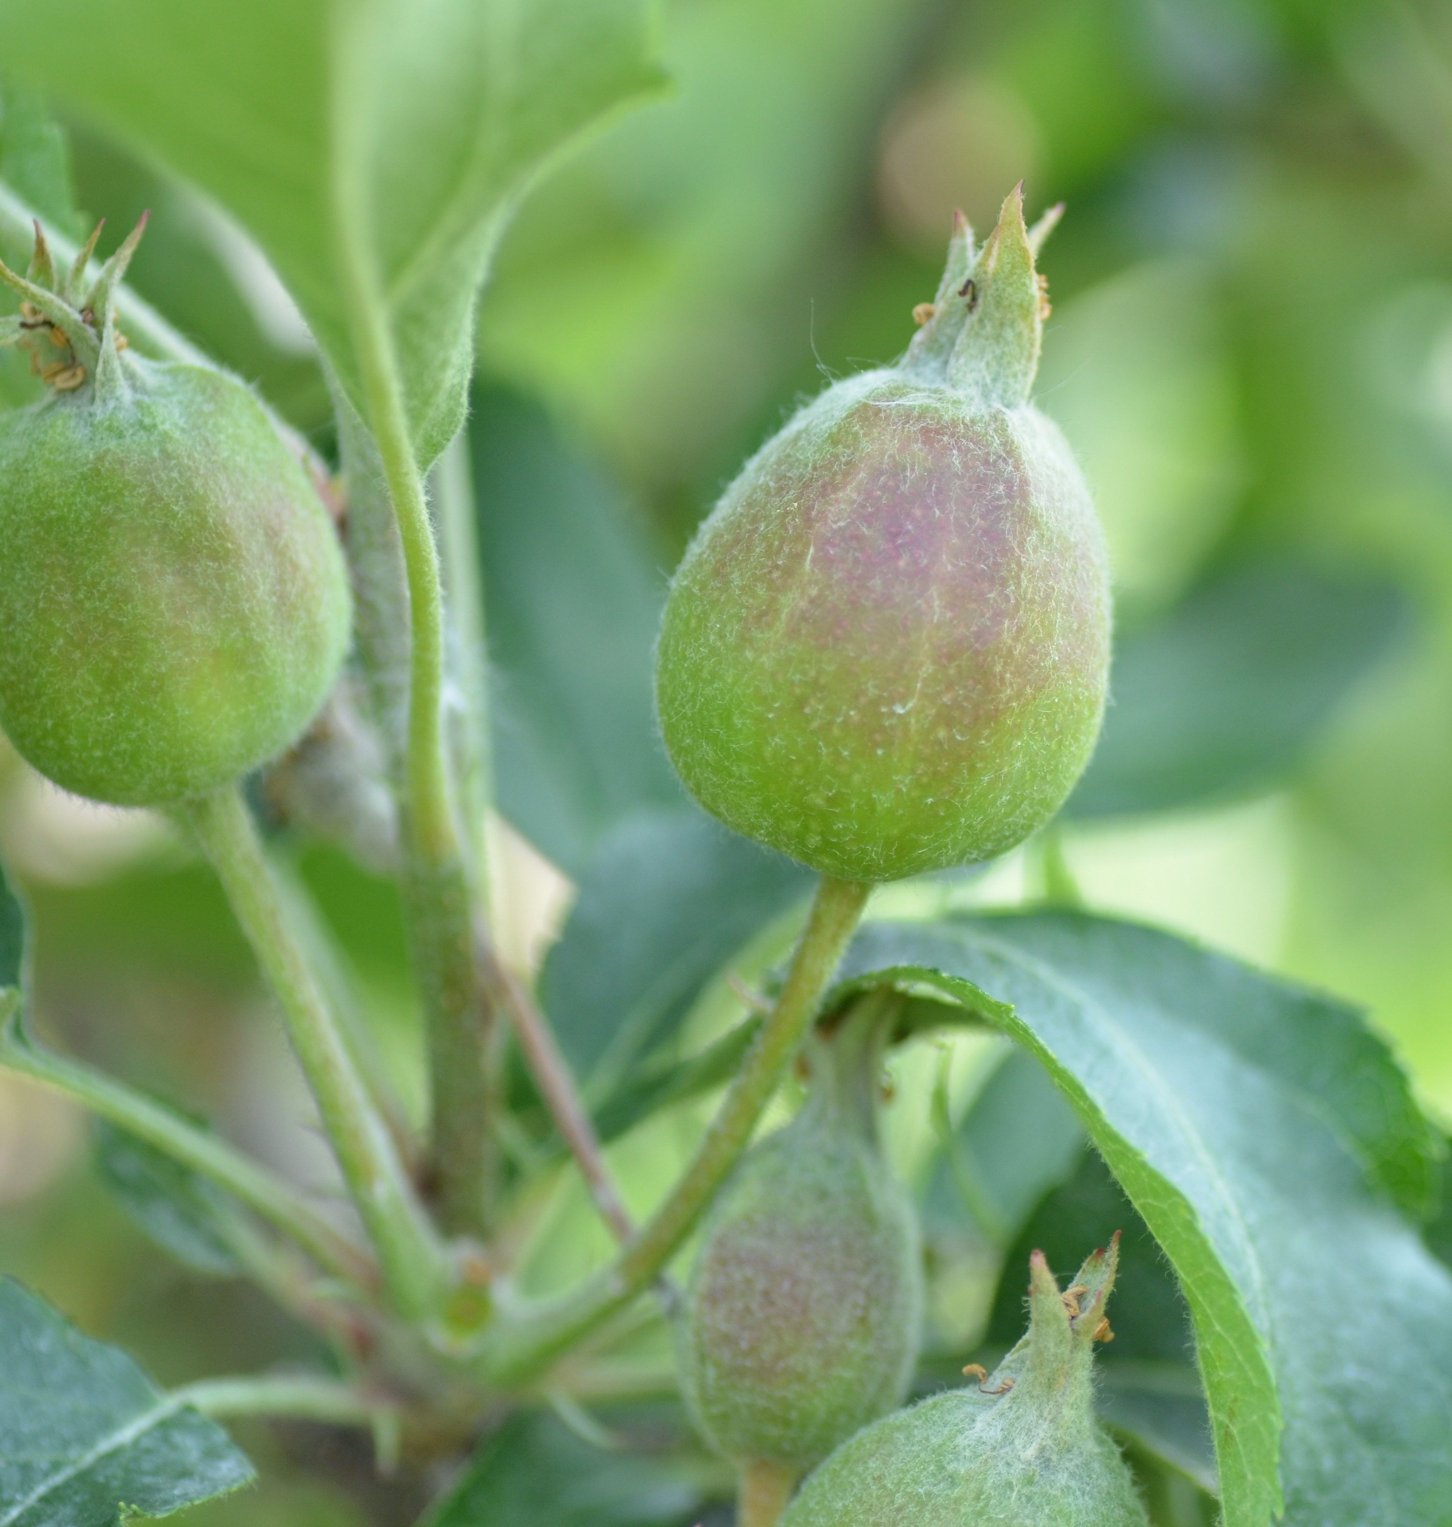
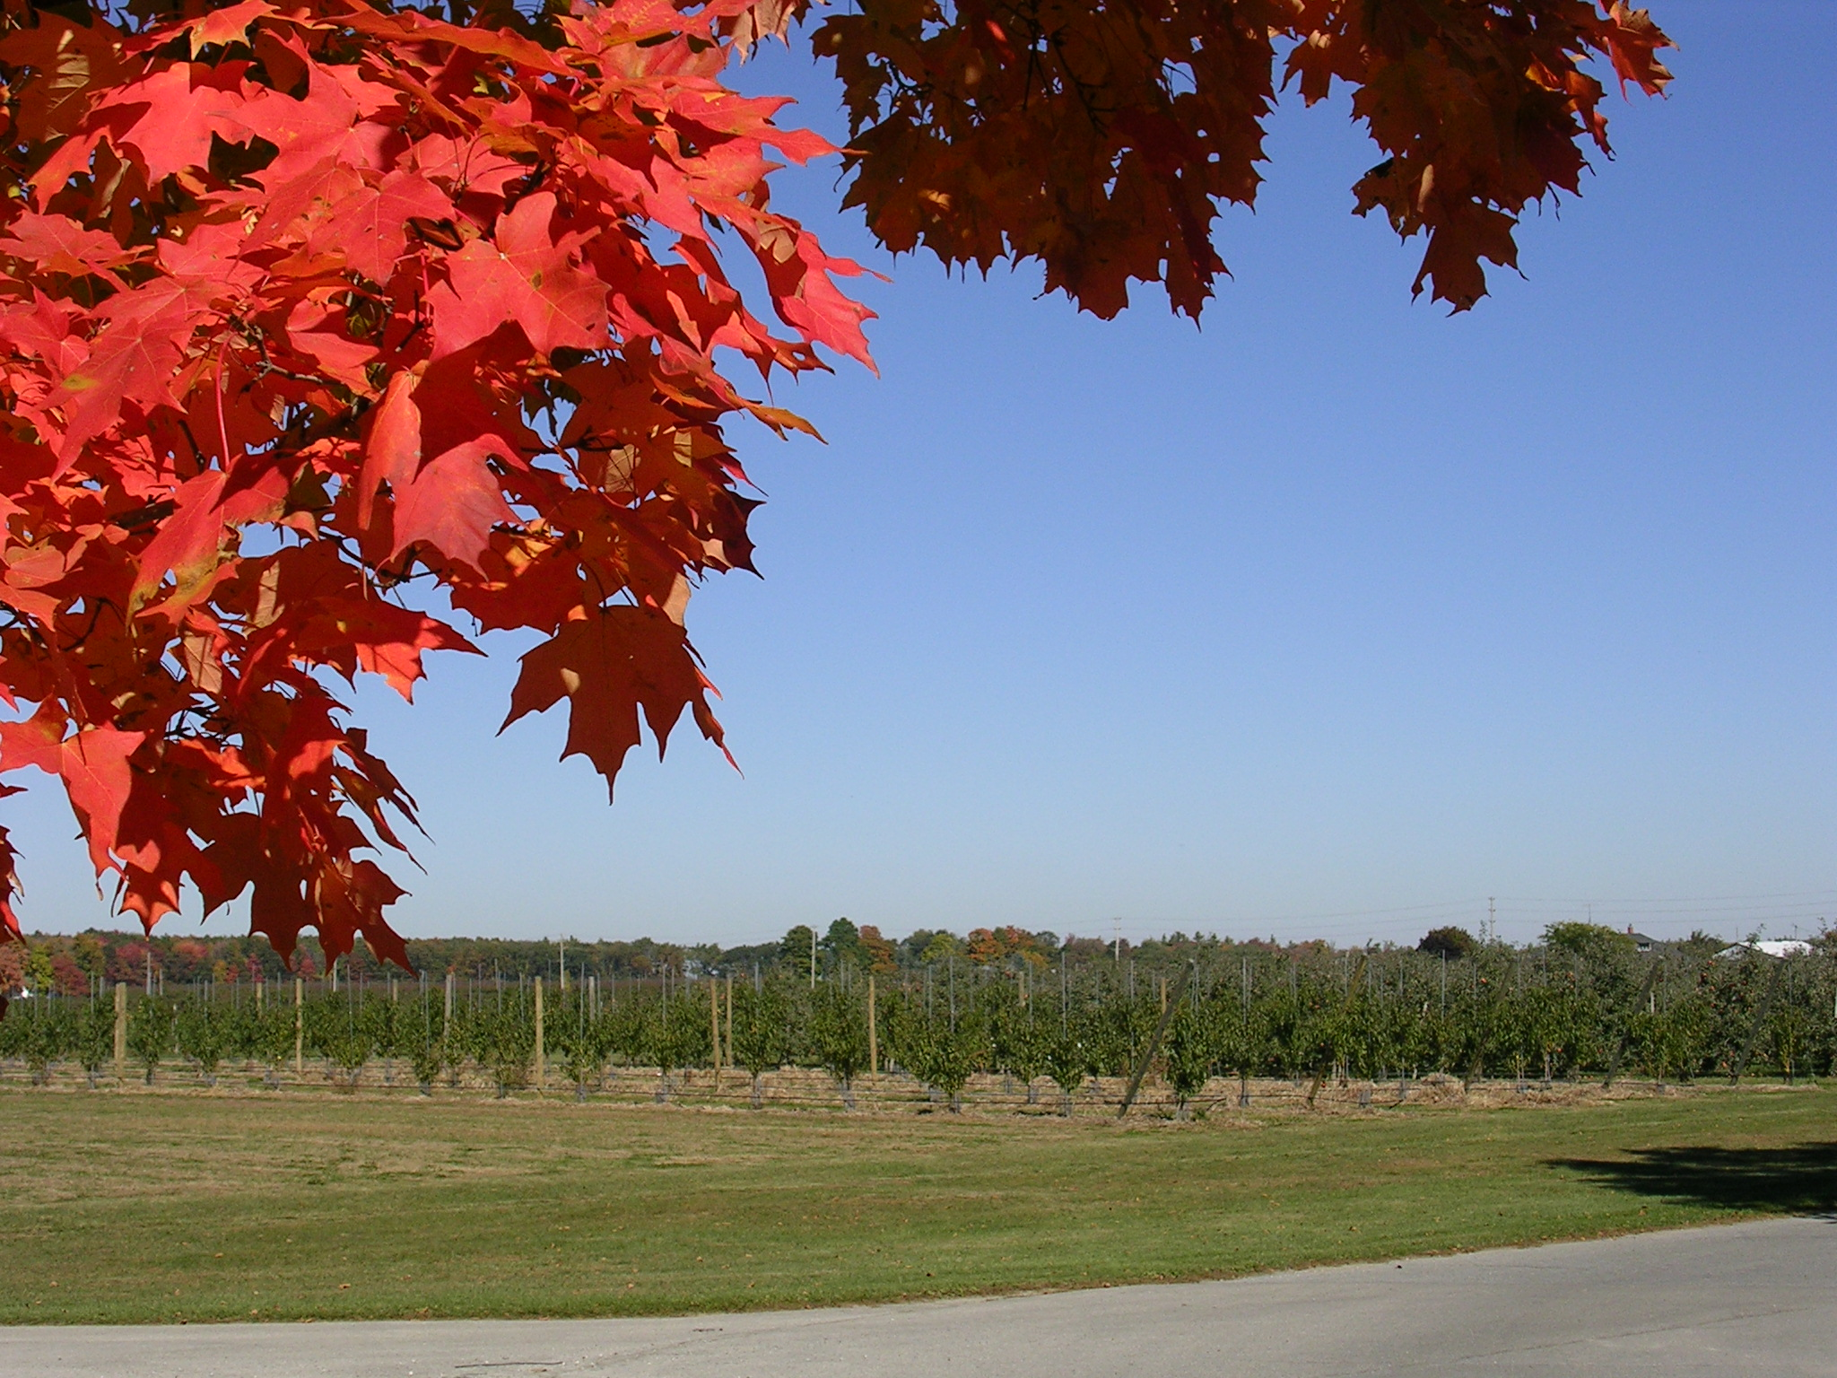
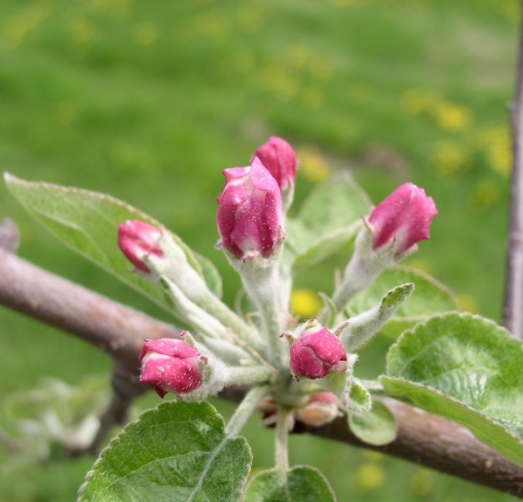
Apple Crop Load Management
John Cline, Tree Fruit Pomologist, University of Guelph

Slide 2
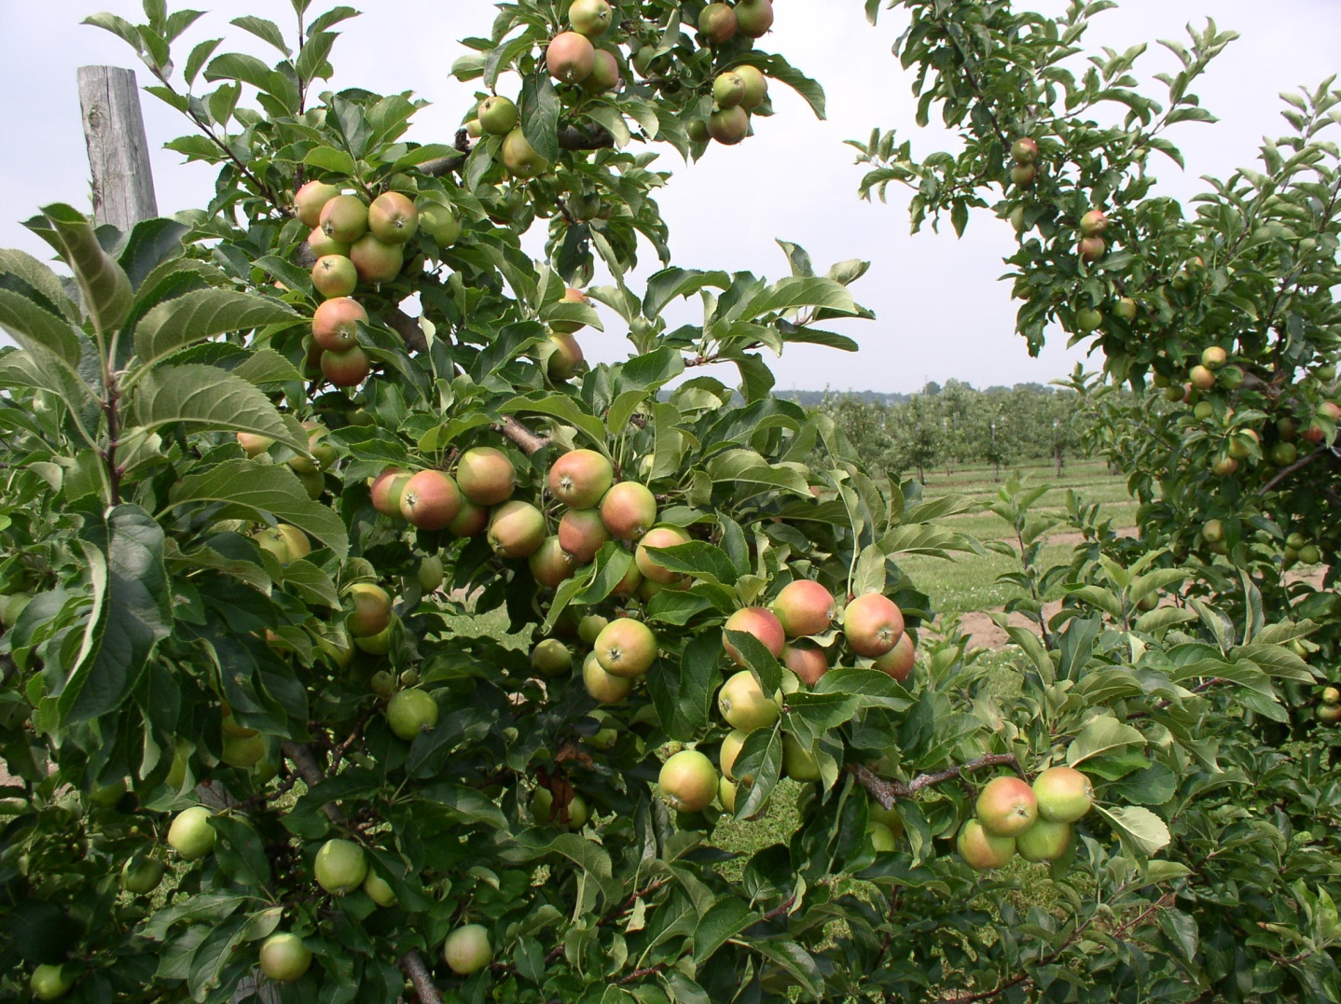
What is Crop Load Management?
The process of reducing the fruit number to an acceptable level (thinning)
Builds upon the natural process that occurs in the tree
Jonagold trees with excessive fruit

Slide 3
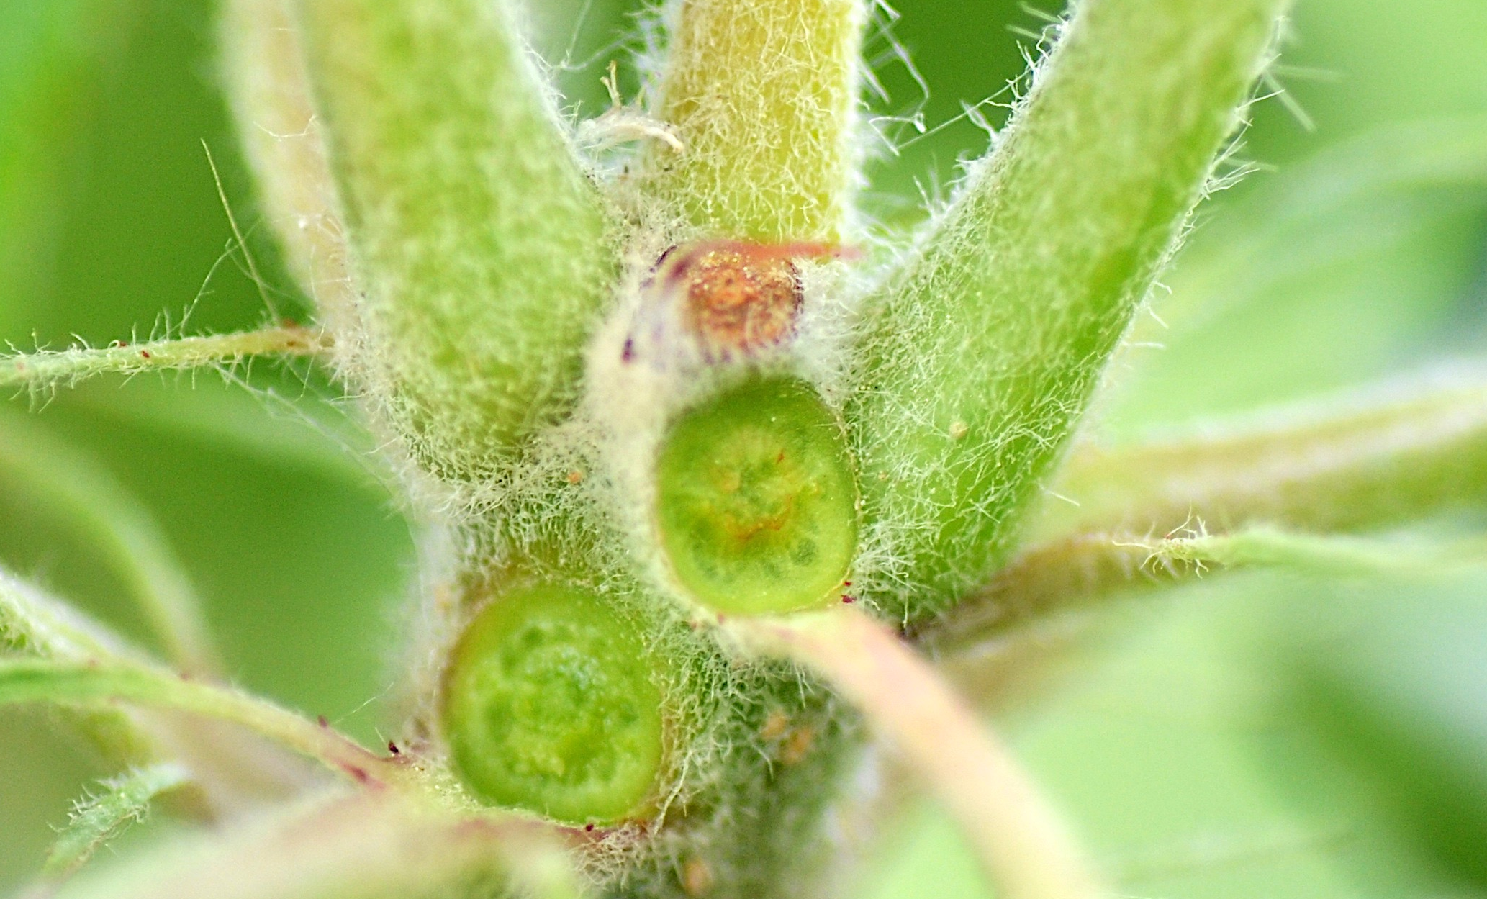
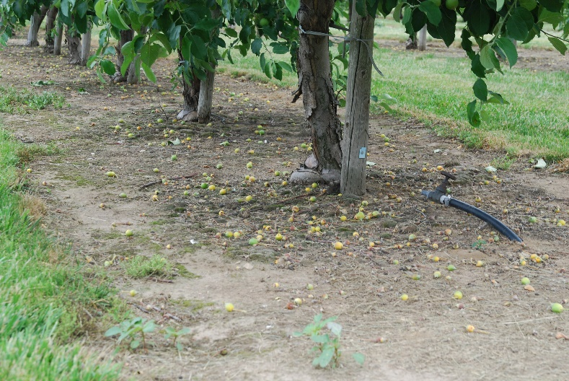
Underlying physiology of fruitlet abscission
abscission zone
Natural Fruit Abscission
'June drop' represents the period of natural abscission (shedding of fruits)
Abscission is an internal mechanism regulated by the tree
Fruitlet thinners
Enhance earlier fruit drop -> augmenting the natural process

Slide 4
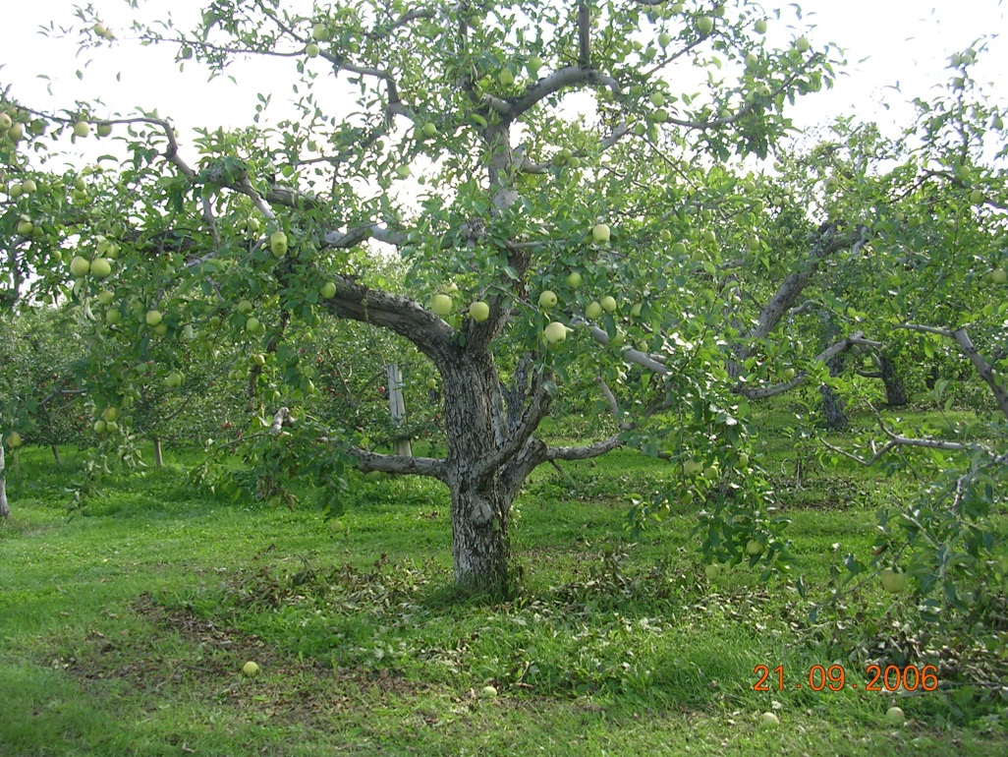
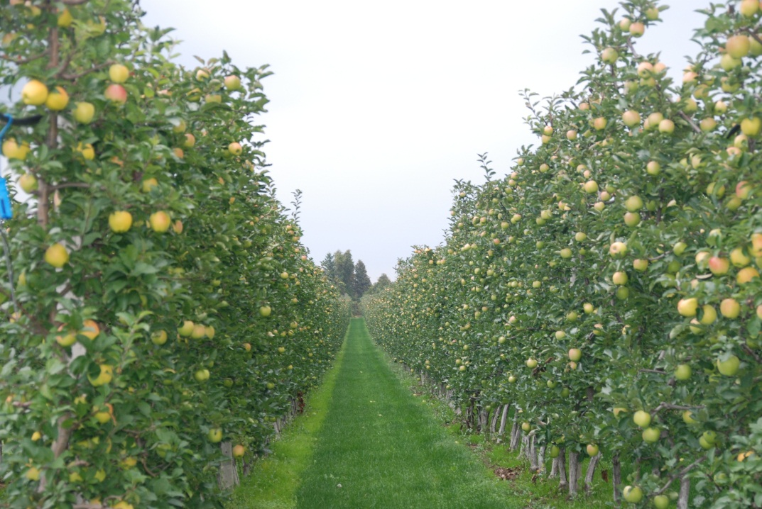
The shift toward hedgerow orchard systems provides new crop load management opportunities
Free-standing low density, globular
Higher density spindle, narrow canopy widths

Slide 5
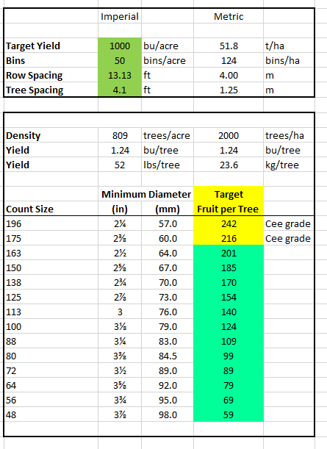
Target fruit size calculator

Slide 6
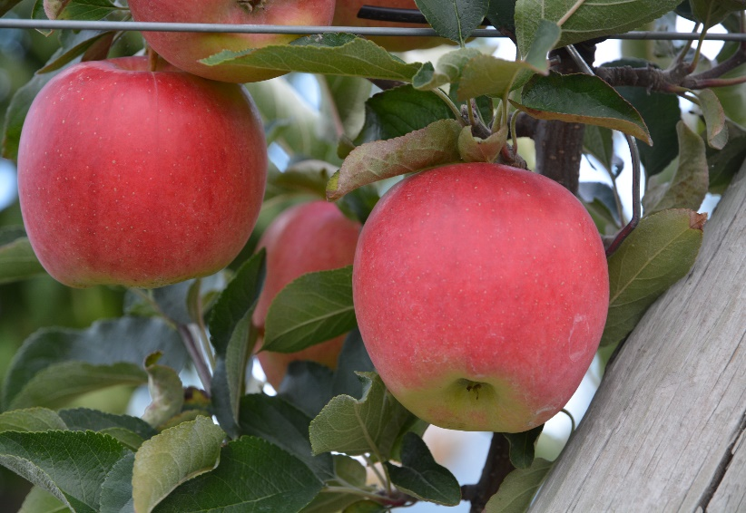
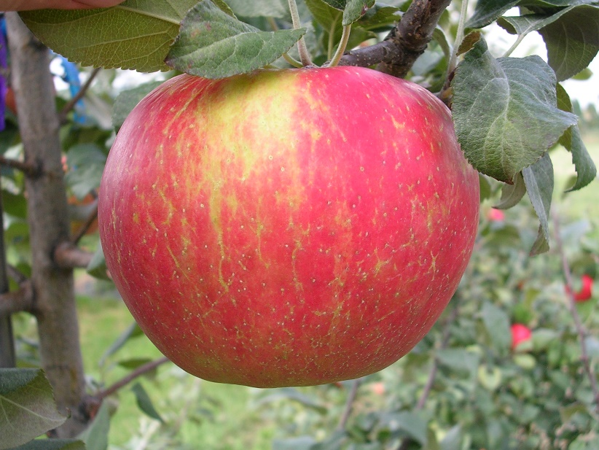
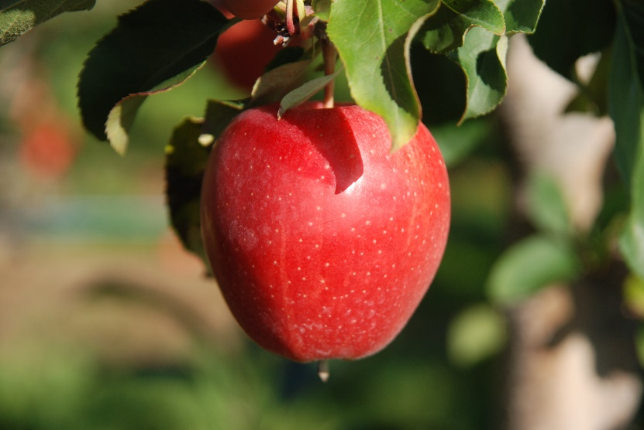
Why is Crop Load Management Important
Apples trees bear an overabundance of flowers
Thinning (reducing crop load) is necessary to enhance fruit size and quality at harvest
Early chemical thinning is important to reduce labour costs of hand thinning and optimize fruit quality
Labour availability and cost are significant growing concerns
Ambrosia
Honeycrisp
Honeycrisp
Gala

Slide 7
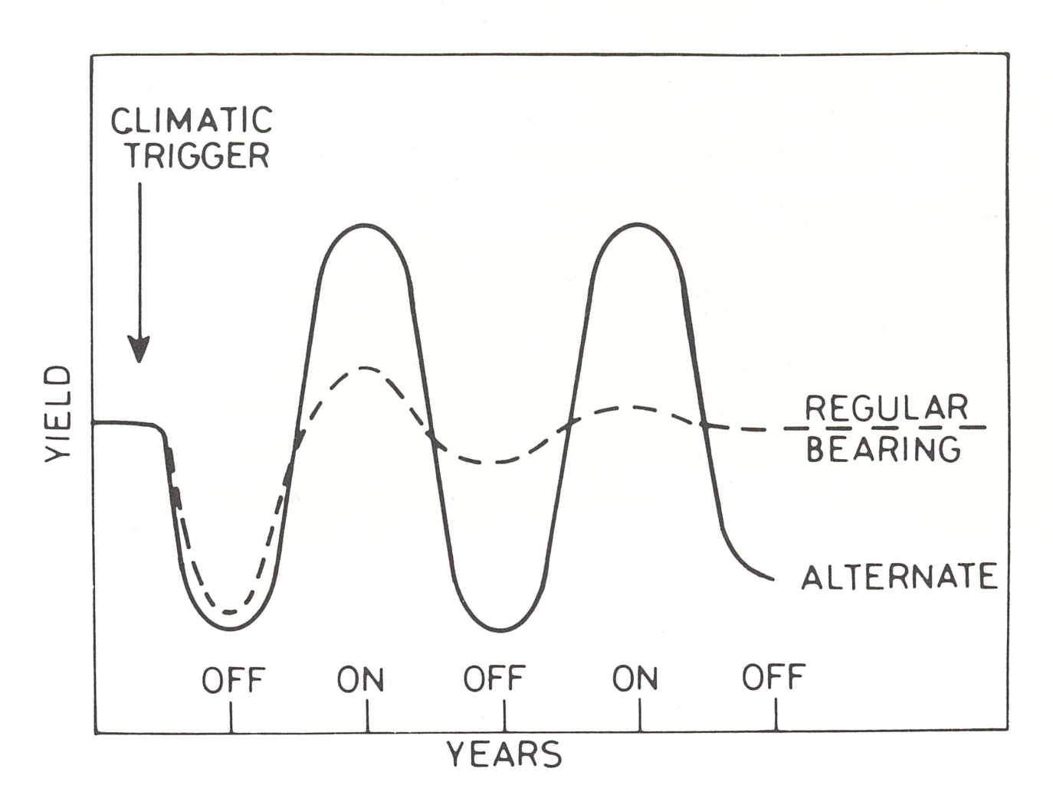
Biennial Bearing- justification alone for thinning
Biennial Bearing
Honeycrisp
Fuji
Northern Spy
Annual Bearing
Gala
Empire
Schematic diagram showing differences in cropping on a regular and alternating cropping year. The off year can be caused by a climatic trigger such as frost, poor pollination, or hormonal imbalance the previous year. After Monselise and Goldschmidt, 1982.

Slide 8
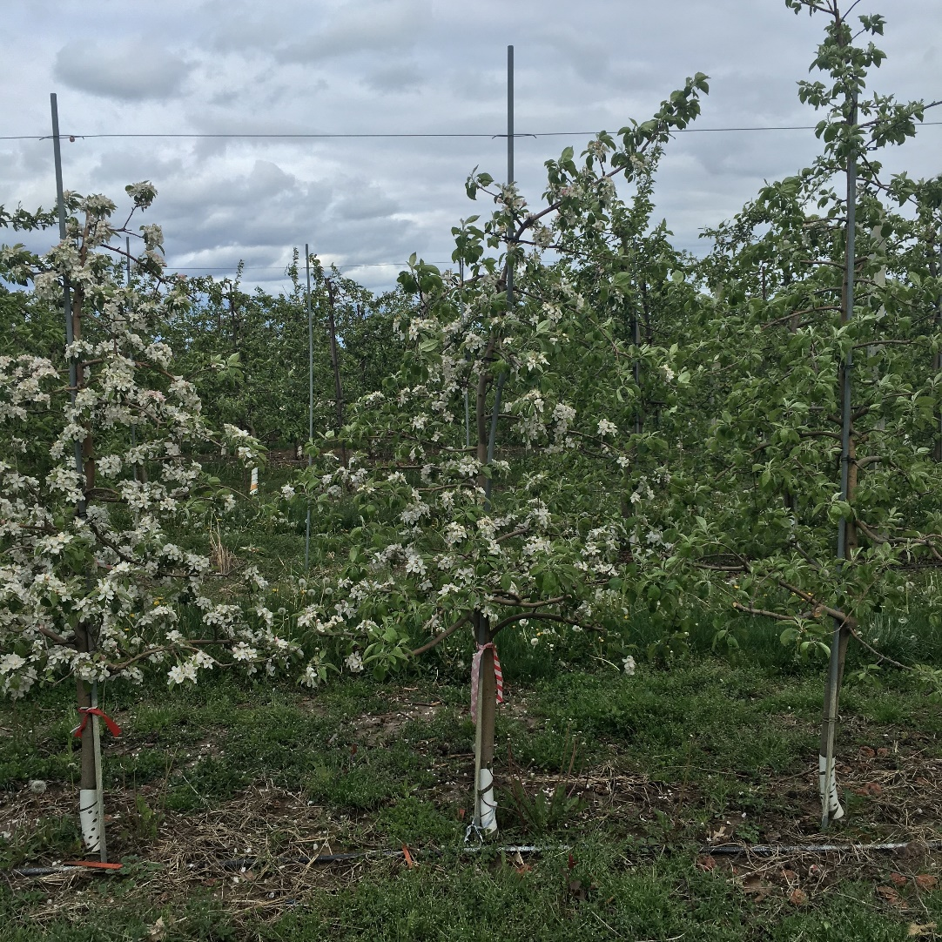
Benefits of a successful thinning program
Reduced Biennial Bearing
For biennial bearing cultivars:
-reduce the crop load early to avoid less bloom the following year
ON
ON
OFF

Slide 9
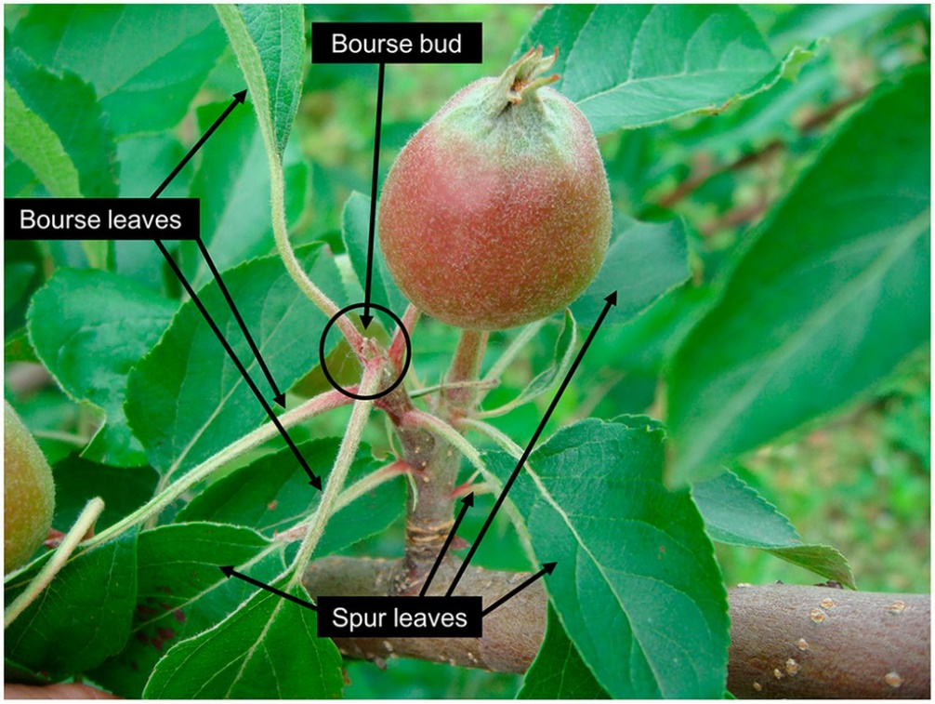
Why thin early?
Flowers begin to develop (FBI) one year prior to bloom (June)
Many factors within the trees determine if the bud will become floral or remain vegetative

Slide 10
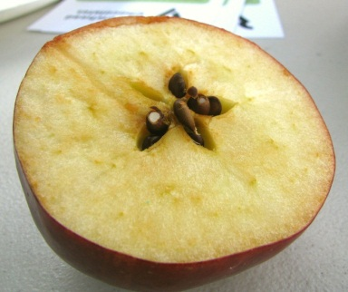
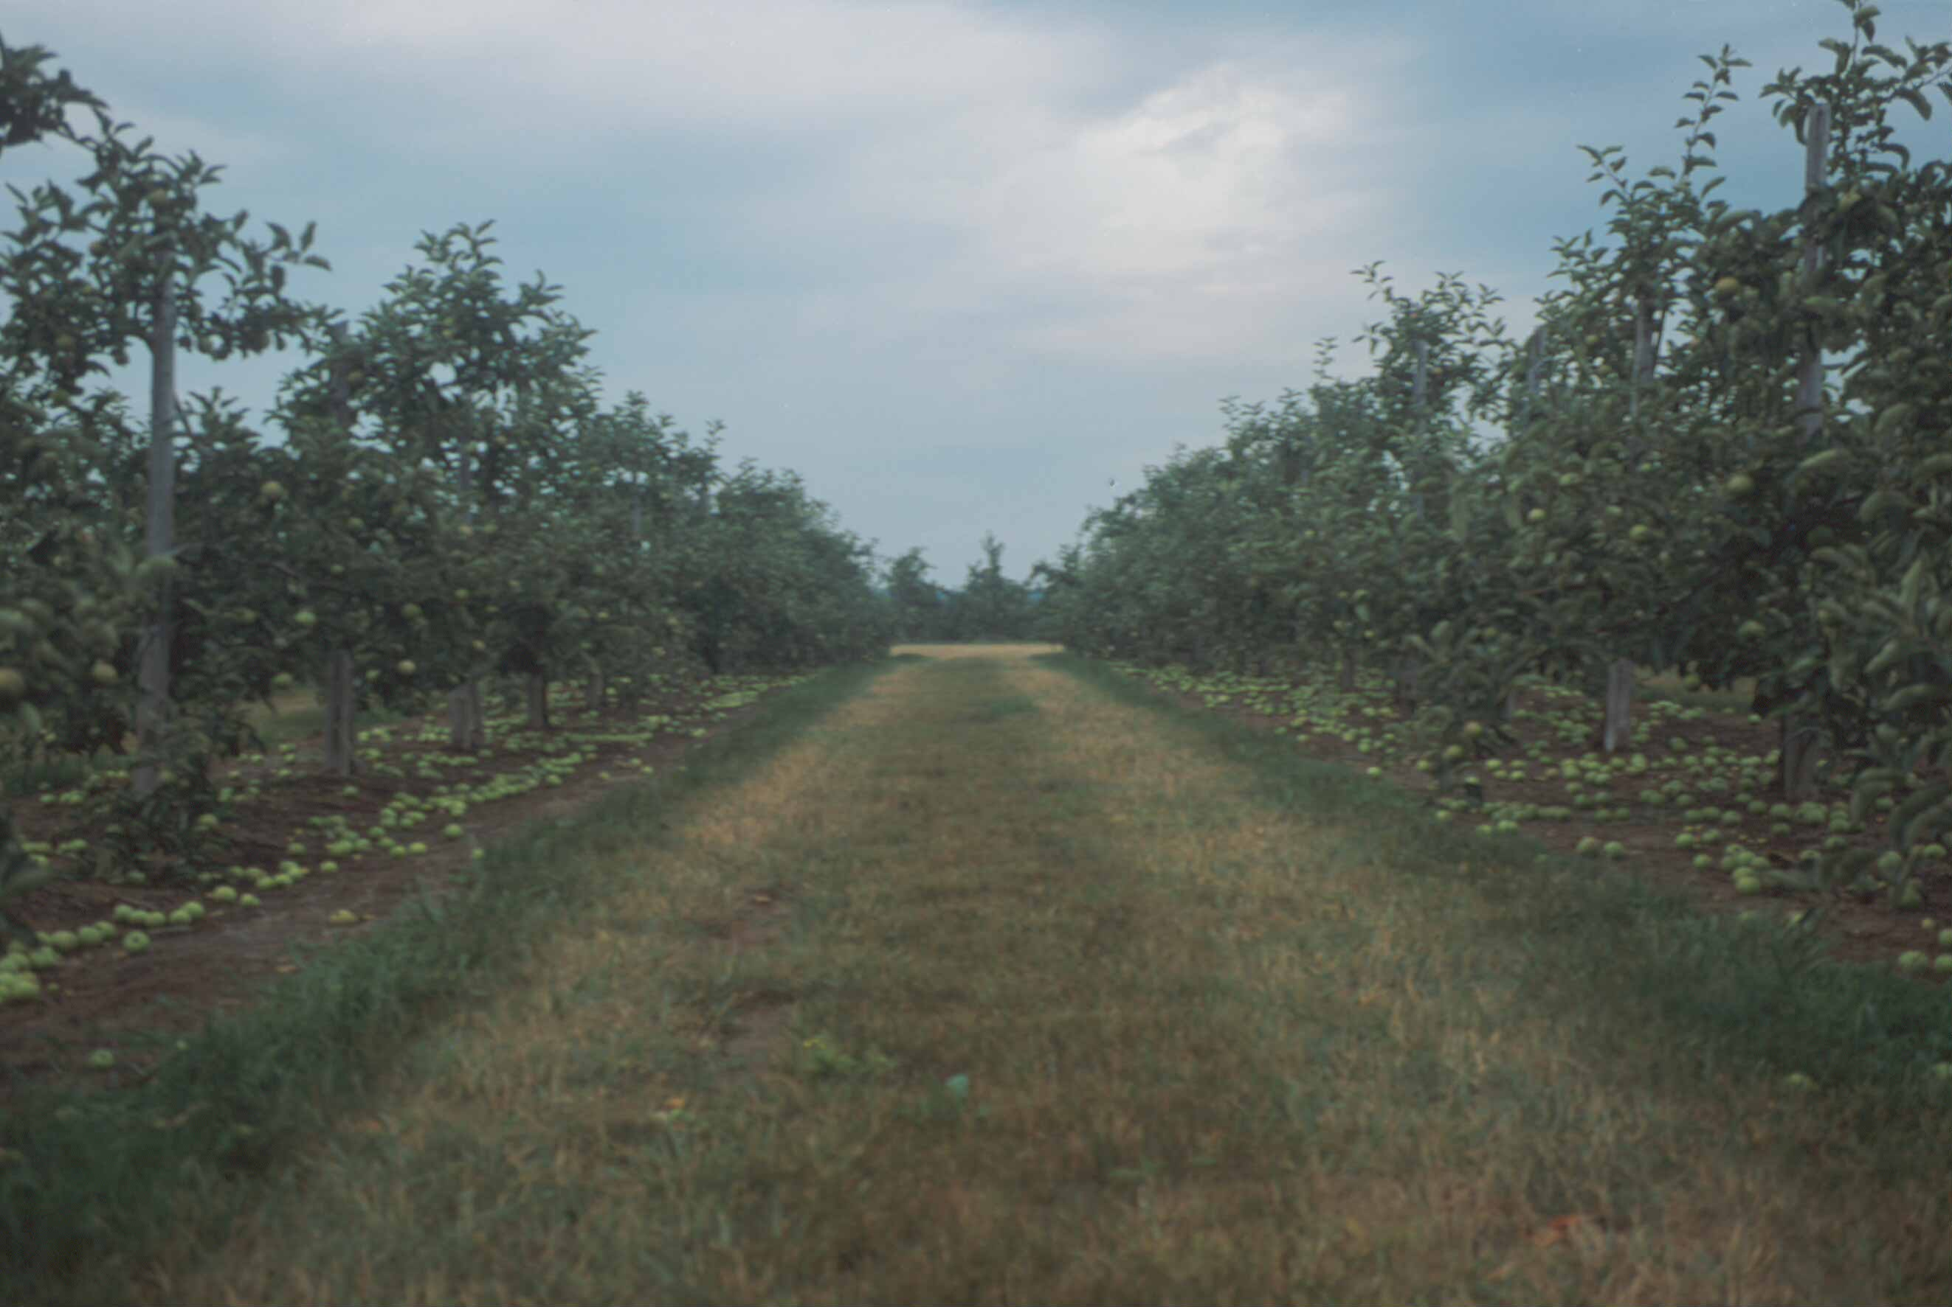

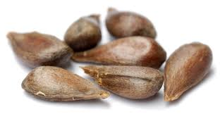
Hand Thinning – Least Desirable
Also least effective for return bloom and final fruit size at harvest

Slide 11
Precision thinning
Pruning – remove flower buds
Blossom thinning
Lime sulphur
Petal Fall (5 mm ø
NAA
Late 15-25 mm fruitlet diameter
(1-ACC)
String thinner
Early 8-15 mm ø diameter
6-BA
Hand thinning
Target Fruit size
Carbaryl
NAA
(Metamitron)
(1-ACC)
(Metamitron)
(Ethephon)
ATS
Precision thinning is the orchard management process of using multiple strategies to reach a target crop load with minimal need for hand-thinning

Slide 12
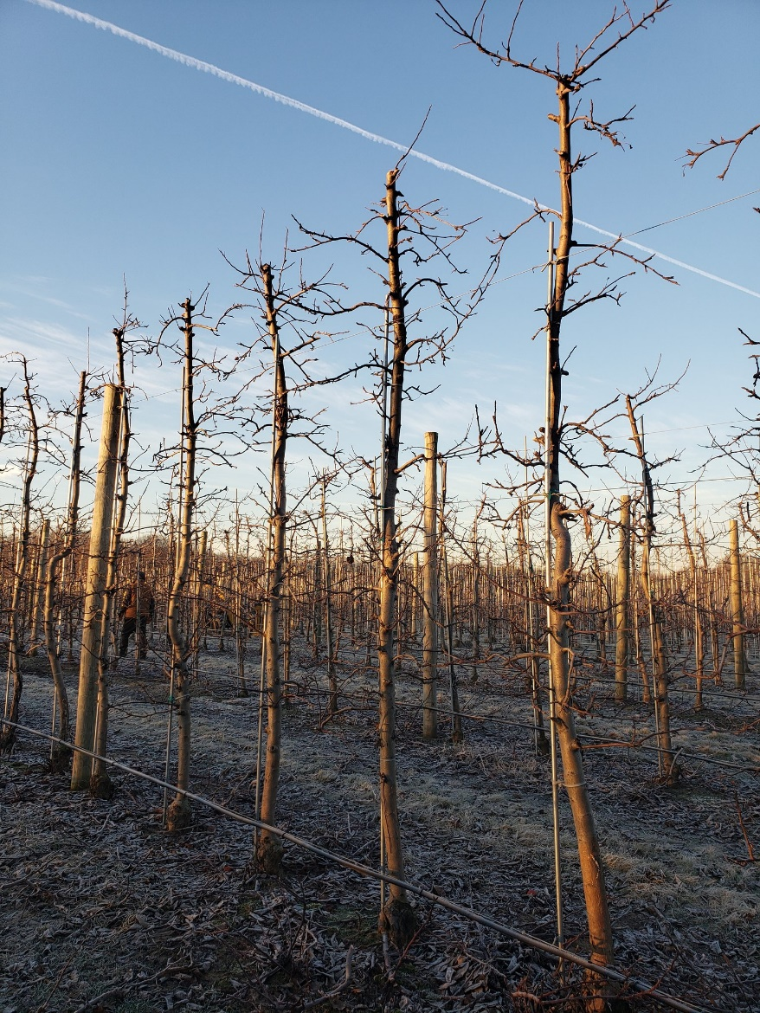
Precision Pruning
Reduce the bud load to 1.5-2.0 times the target number of fruit per tree

Slide 13
Precision Crop Load Management
Blossom and fruitlet thinning
-Apply sequential chemical thinning sprays and assess response after each spray (full bloom – 20 mm fruit diameter)
Hand thinning
-reduce final fruit number to the target fruit number

Slide 14
Steps in Precision Thinning (after Robinson)
Prediction Models | Initial Flower Load | Timing
Pollen Tube Growth Model | 1.Blossom Thinning | 60% full bloom
Carbohydrate model, fruit growth rate model | 2. Petal Fall | 6-7 mm
Carbohydrate model, fruit growth rate model,(BreviSmart) | 3. 10-15 mm | 10-15
Carbohydrate model | 4. 16-20 mm | 16-20 mm
 | 5. Hand thinning | After June drop (25-30 mm)

Slide 15
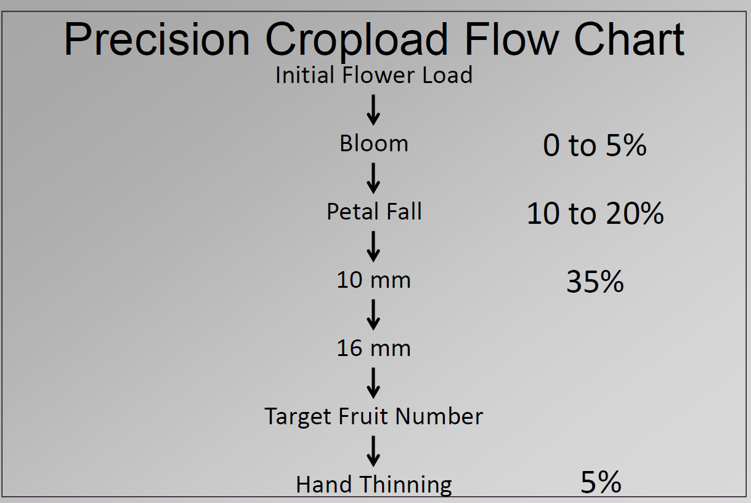

Slide 16
Action Steps for Precision Crop Load Management
Set a target crop load (number of fruit) per tree
Dormant prune to 1.5-2.0 bud load
Start blossom and chemical thinning early
Use models to predict fruit set
Repeat chemical fruitlet thinning sprays as needed
Hand thin

Slide 17
Cornell Carbohydrate Model
Web-based (newa.cornell.edu) and mobile version (MaluSim.org) are available in the USA
The model uses sunlight and temperature to estimate carbohydrate availability for fruit growth
Thinning efficacy for any given spray uses a carbohydrate balance 2 days before and 4 days after the spray
Output: Provides a recommendation on:
i) whether to thin
ii) adjustment in chemical thinning rate +/- 30%

Slide 18
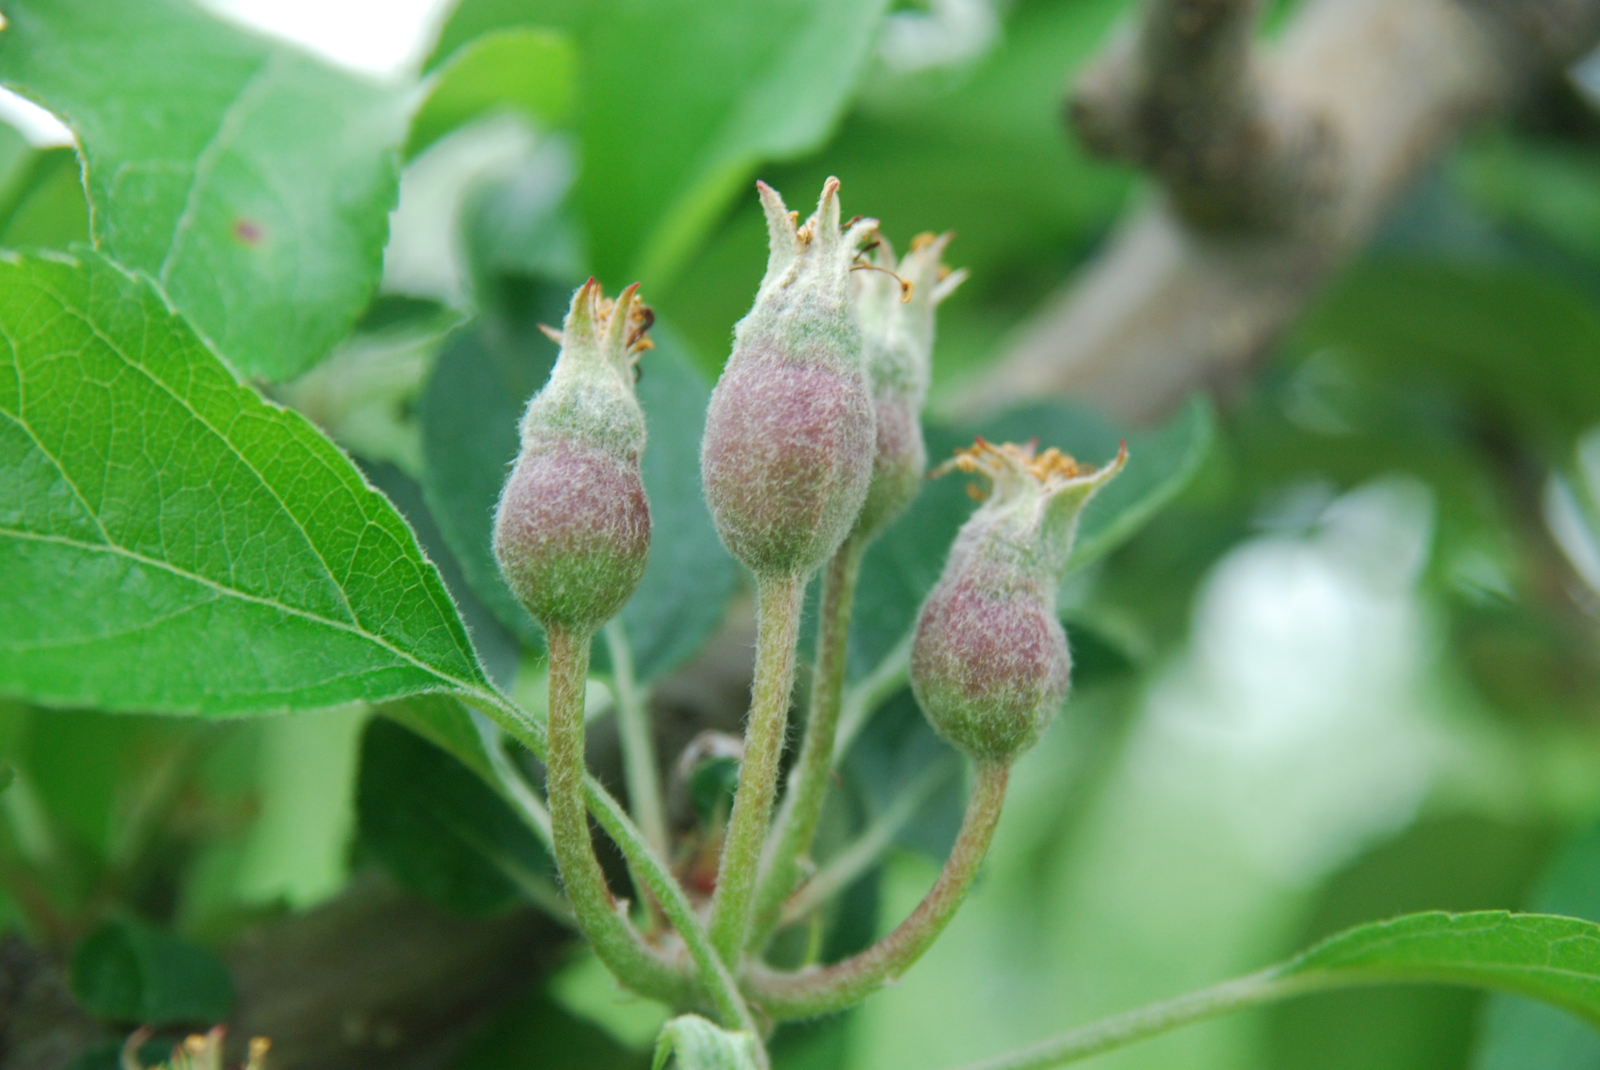
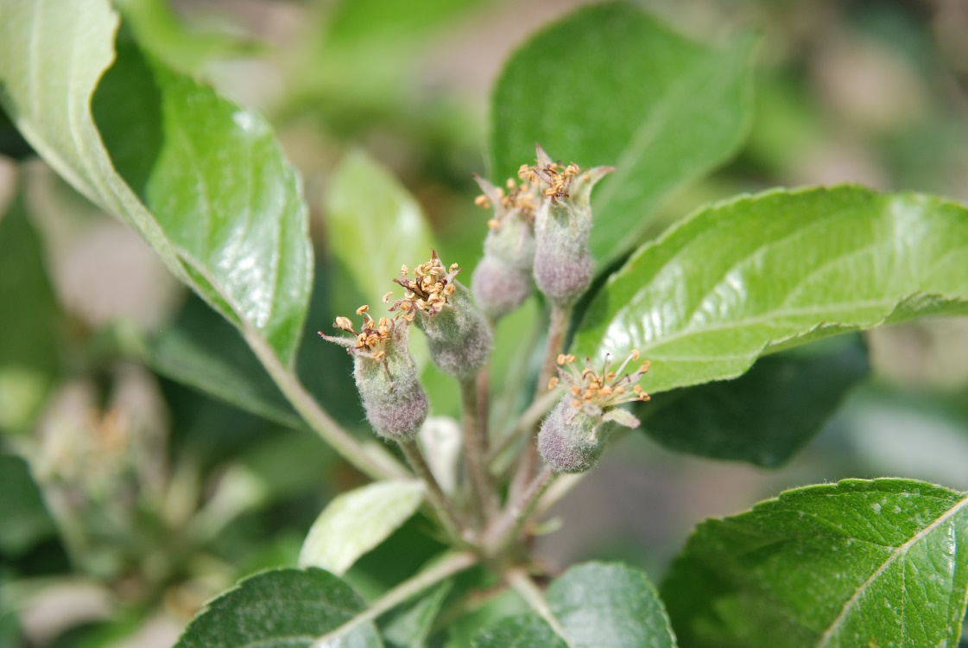
Apple fruitlets developing from a cluster – about 10-15 days after bloom

Slide 19
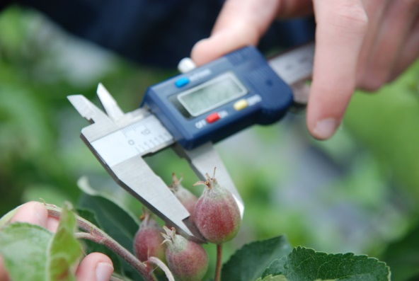
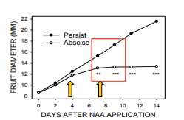
Fruit Growth Rate Model
Basic assumption/hypothesis
Fruitlet fate | Prediction
Persist | A fruit is predicted to persist if the growth rate over the measurement period was at least 50% or greater of the fastest growing fruit.
Abscise (drop) | A fruit is predicted to abscise if the growth rate of the fruit slowed to 50% or less of the growth rate of the fastest growing fruit.
https://www.canr.msu.edu/uploads/files/PredictingFruitset1-21-14.pdf
Abscising fruit slow down growth in 3-4 days days and stop growth within a 4-6 days following a thinning application.
This slowing of growth is temperature dependent
Two measurements usually will suffice to predict set.
The first diameter measurement should be performed three days after the time of a thinning application and no earlier than the 6 mm stage.
The second diameter measurement should be performed three to four days later as indicated above

Slide 20
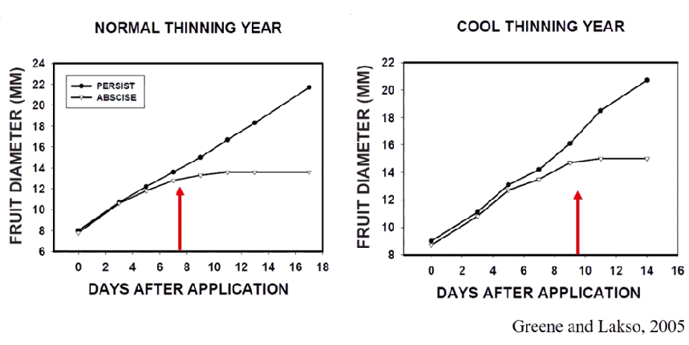
Fruit set prediction based on actual data
(Greene and Lakso, 2005)
Slowing of fruit growth (the precedes abscission) can be detect 7 to 10 days after thinner application (weather dependent)
Thinner applied
Thinner applied

Slide 21
Chemical Thinners
Blossom | Fruitlet | Future Availability
Lime-Sulphur (Oligo-S, Axter Agroscience, Mont-St-Hilaire, QC) (tanked mixed with) Mineral Oil: Purespray Green Spray Oil 13E, Intelligro, Mississauga, ON | Carbaryl - Sevin XLR (carbamate insecticide) | Metamitron (Brevis)
Ammonium thiosulphate (12-0-0-26S Norwich Fertilizer, Norwich, ON) | 6-BA (MaxCel, Cilis Plus) – Cytokinin | 1-ACC (Accede)
NAD- Amid-Thin (no longer registered in Canada) NAA - Fruitone | NAA – (Fruitone-N/L, Maintain)

Slide 22
Physiology
Stress within the fruit
Increased sensitivity of the abscission zone to ethylene
Activation of the fruit abscission zone
Cloudy weather (shading)
High night temperature
Drought
Excessive crop load
6-BA, NAA, Carbaryl, Metamitron
Promotion of ethylene
6-BA, NAA, Ethrel, 1-ACC
Notes:
The diagram represents a very simplified overview of a very complex process occurring within the tree and within developing apple fruits
1. Based on observation and research, we have learned that several conditions lead to the development of stress within the fruit (state these stressed)
2. Concurrently, the fruit abscission zone shortly after bloom becomes more sensitive to forming and is sensitive to ethylene specifically during this time (approx. 5-20 mm)
3. We also know that ethylene and ethylene promoting compounds trigger the activation of the abscission zone.
This is more specific to fruit as the leaf abscission zone is not nearly as responsive at this time.

Slide 23
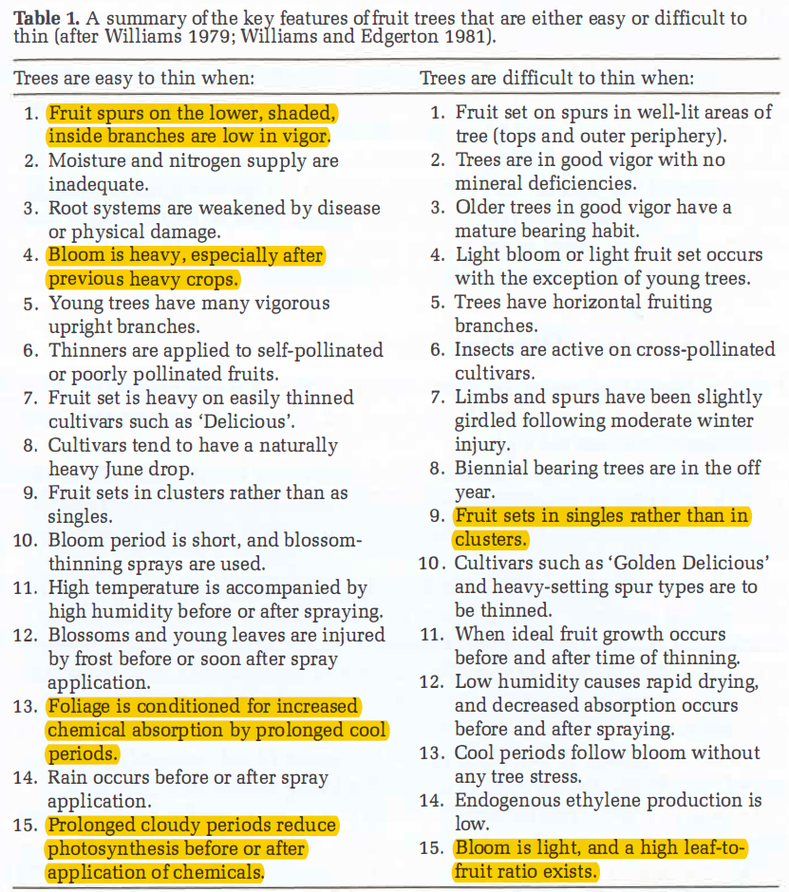

Weather is a key component (temperatures, rain, solar radiation)

Slide 24
Important factors that promote and supress the response to chemical thinners
Promoters
Lower light conditions
Heavy bloom
Cuticles of leaves formed under cooler periods are lead to greater absorption of chemicals
Higher night temperatures
Fruit set in clusters rather than singles
Suppressors
Lower temperatures reduced plant metabolism and activity
Light bloom
Highly tree vigour leading to maximal fruit growth before and after thinner application
Biennial bearing trees in their ‘off’ year
Less differentiation in size between the central fruit (king) and lateral fruit

Slide 25
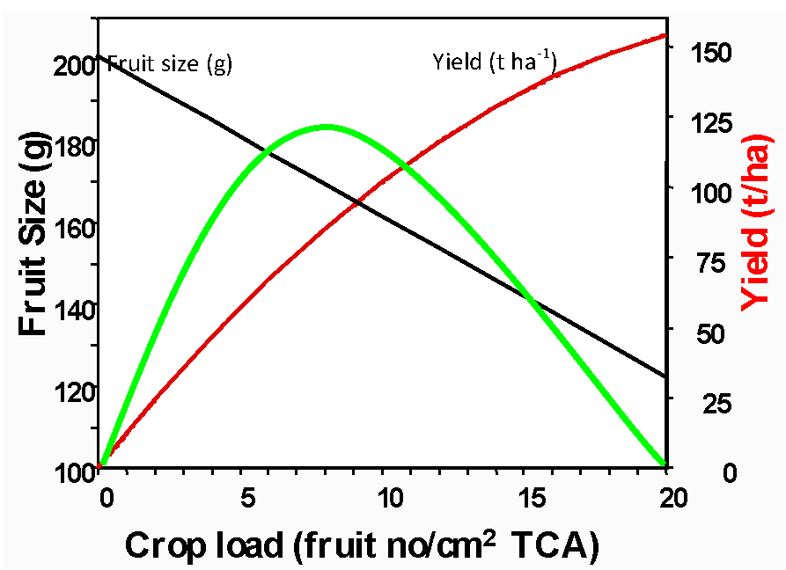
Optimizing Crop Value
Gala
The number of fruit that remain on the tree directly affects:
yield
fruit size
Colour
Fruit quality
Return bloom
Calculations of crop value at various crop load levels have shown that at very high crop loads, yield is very high
but fruit size and crop value are low (Robinson, 2013)
When crop load is reduced to more moderate levels through thinning, then crop value rises dramatically even though
yield is lower because fruit size is larger and has greater value.
At some point crop value peaks when yield and fruit size are balanced and then with further reductions in crop load, crop value declines due to the lower yield not being fully compensated by larger fruit size
Managing crop load is a balancing act between reducing crop load (yield) sufficiently to achieve optimum fruit size and adequate return bloom without reducing yield excessively (Robinson et al., 2014).
Crop Value
Robinson et al. 2016

Slide 26
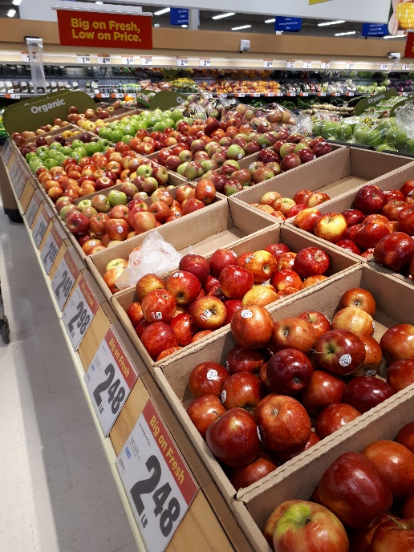
Details of net returns are required to determine target fruit size
Example of $/lb in relation to fruit size

Slide 27
Thinning Models/Tools
Model/Tool | Input | Output | Comments
Fruit Growth Model (Greene) | Fruit diameter | A predication of the final number of fruit that will remain after thinning | Very accurate Time consuming Difficult to implement with large acreage
Carbohydrate Model (Malusim) (Laskso and Robinson) | Amount of bloom, temperature, solar radiation | Timing and Efficacy of thinners – adjustment in the rate of chemical thinner | Requires local weather and weather forecasts Not available in Canada
Pollen Tube Growth Model (Yoder and Peck) | Style length, temperature | Best time to apply blossom thinners | Requires local weather Not available in Canada
BreviSmart (Adama) | Temperature, fruit diameter, cultivar, past and forecasted weather | Timing and efficacy of Brevis - adjustment in the rate of chemical thinner | Requires local weather and weather forecasts (which Not available in Canada

Slide 28
New Fruitlet Thinners for Canada
Product | Company | Mode | Ideal Timing | Status
Brevis (metamitron) | Adama Agricultural Solutions | Photosynthesis inhibitor | Petal fall – 20 or 25 mm | Product launch 2024 Currently registered in other countries (Australia, Israel, New Zealand, Chile, Argentina, parts Europe, S. Africa)
1-ACC (Accede) | Valent BioSciences | Stimulates ethylene | Petal fall – 20 or 25 mm | Registration has been submitted in Canada Valent is conducting larger grower trials in Canada without crop destruct

Slide 29
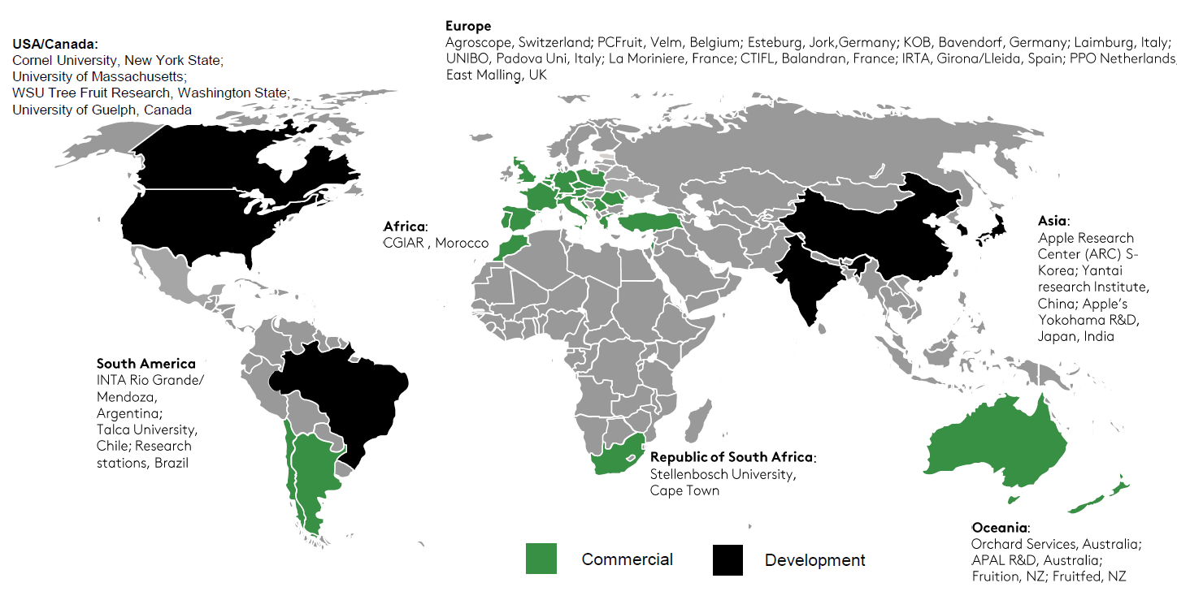
Brevis status globally (2021)
Source: Ton Bresseling

Slide 30
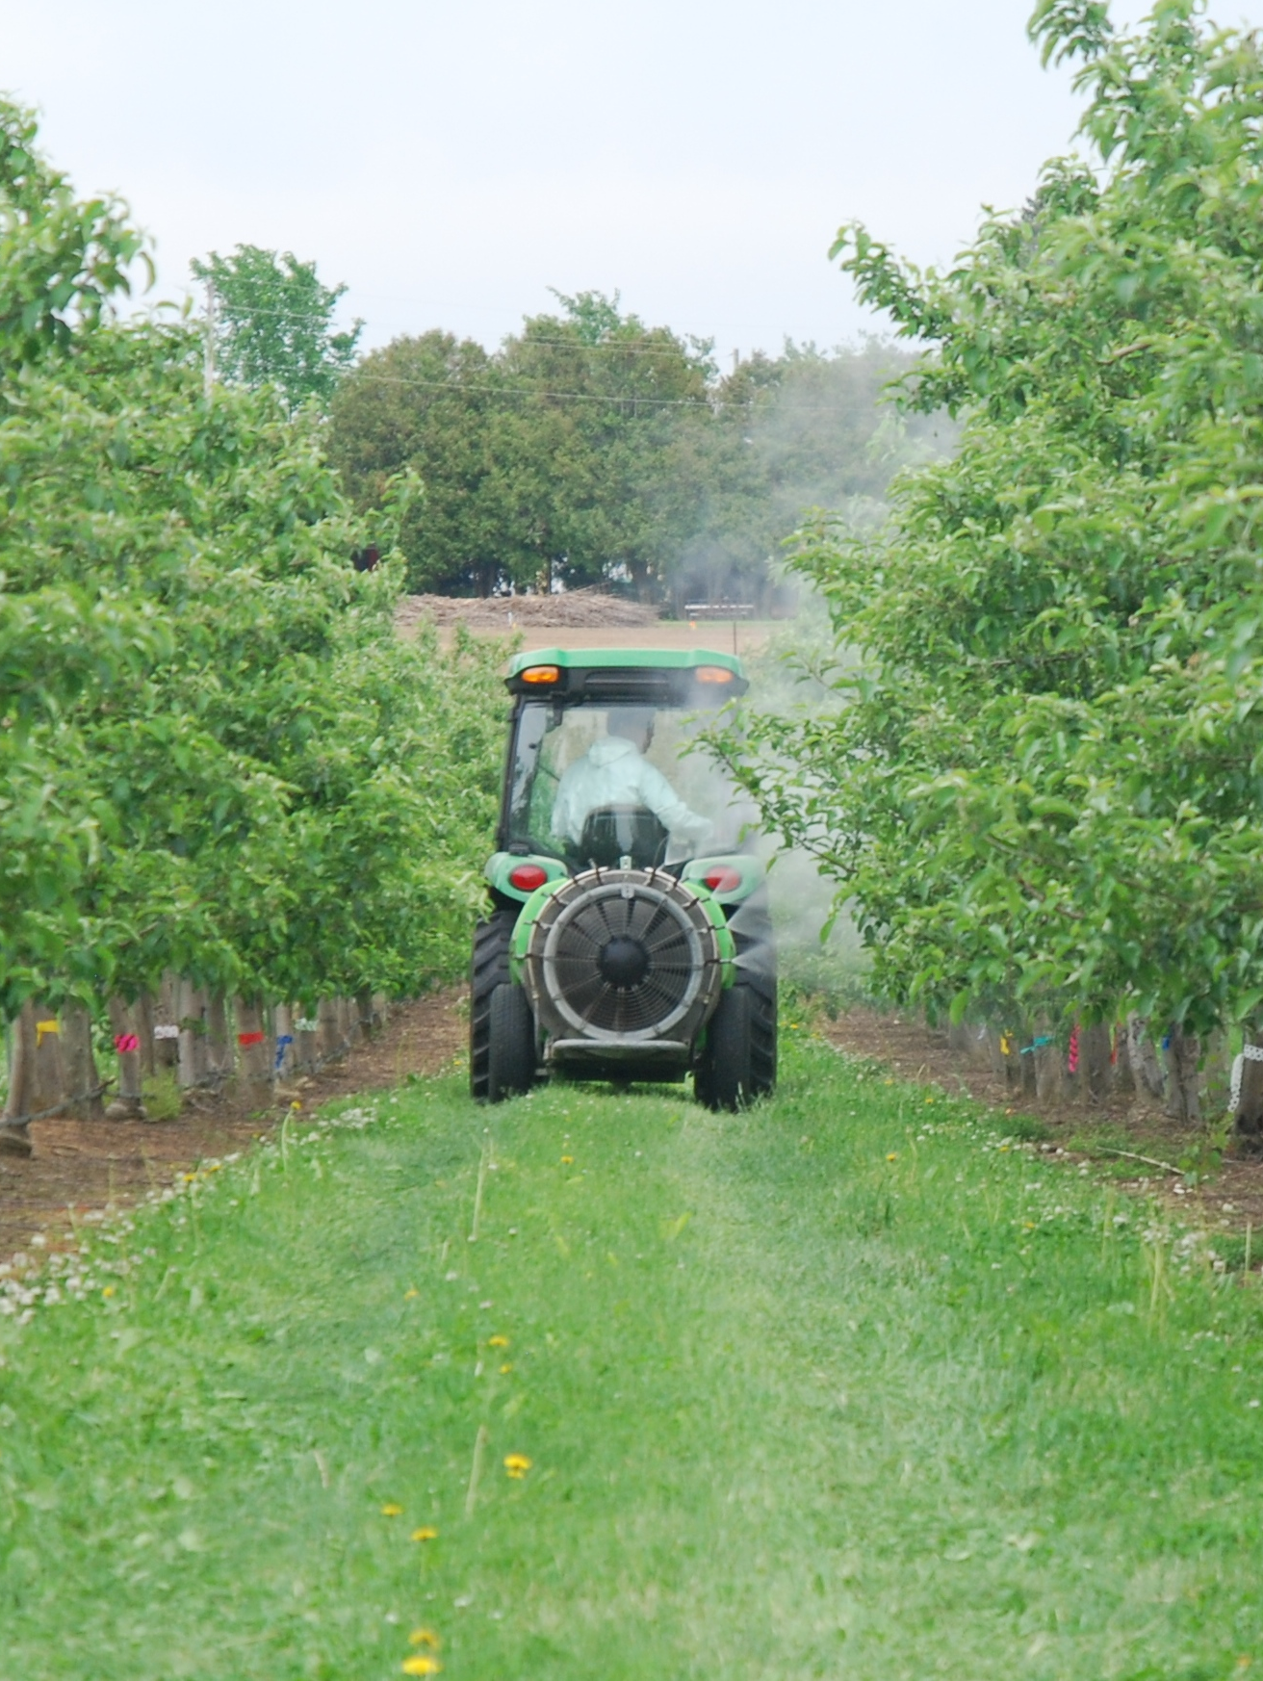
Steps for Successful Thinning – What I’ve learned over the years
Apply tree row volume dilute
Use the appropriate product and rate (check grower recommendation guides)
Spray upper 2/3 of the tree if fruit set is poor in the lower canopy
Use a non ionic surfactant such as Agral 90 (0.05-0.10% by volume)
When hand thinning, leave only one fruit per flower cluster
50% of the spurs need to be resting (no fruit) to have good return flowering
Fruit are most sensitive to chemical thinners when 8-15 mm fruitlet diameter
Its better to slightly over-thin than to under-thin.

Slide 31
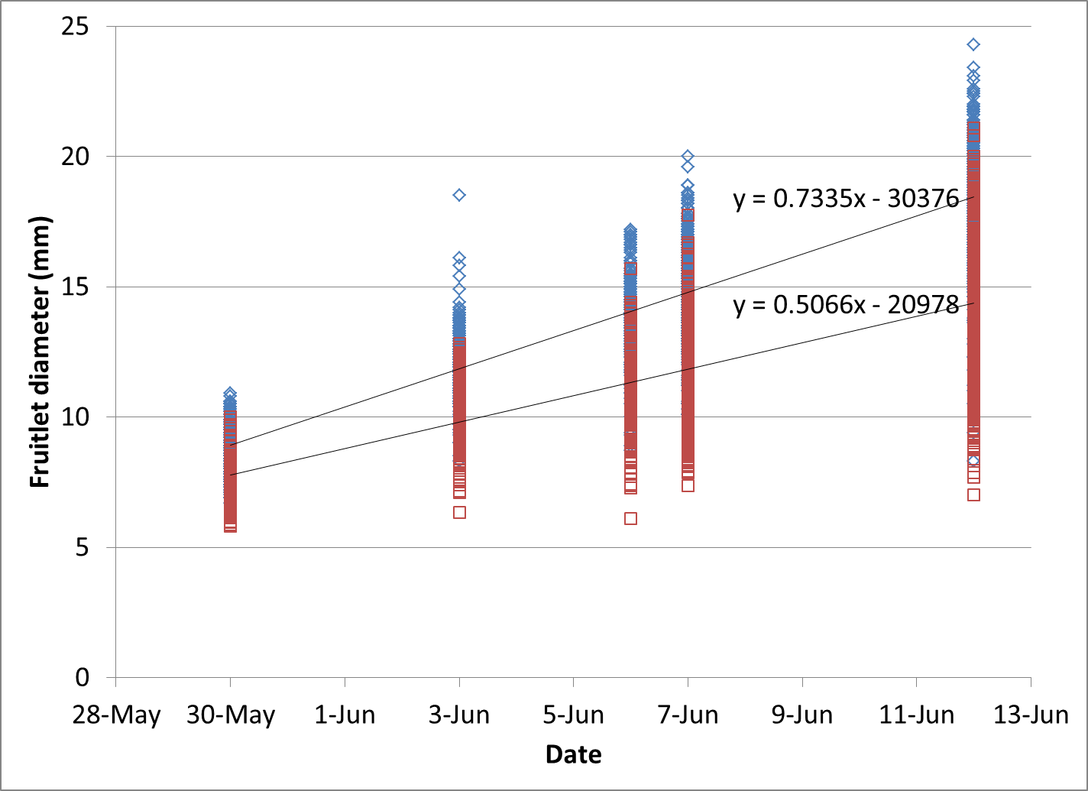
Gala king and lateral fruitlet growth (2013)
King fruitlets ~ 0.75 mm/day
Lateral fruitlets ~ 0.50 mm/day

Slide 32
2022 Ambrosia Fruit Growth Rates
Simcoe, ON
Growth rates
King fruitlets: 0.75-1 mm/day
Lateral fruits: slightly low rate
Thinning window 5 (PF)-15 mm
King fruit mm/day | Days
0.75 | 13
0.85 | 12
1.0 | 10

Slide 33
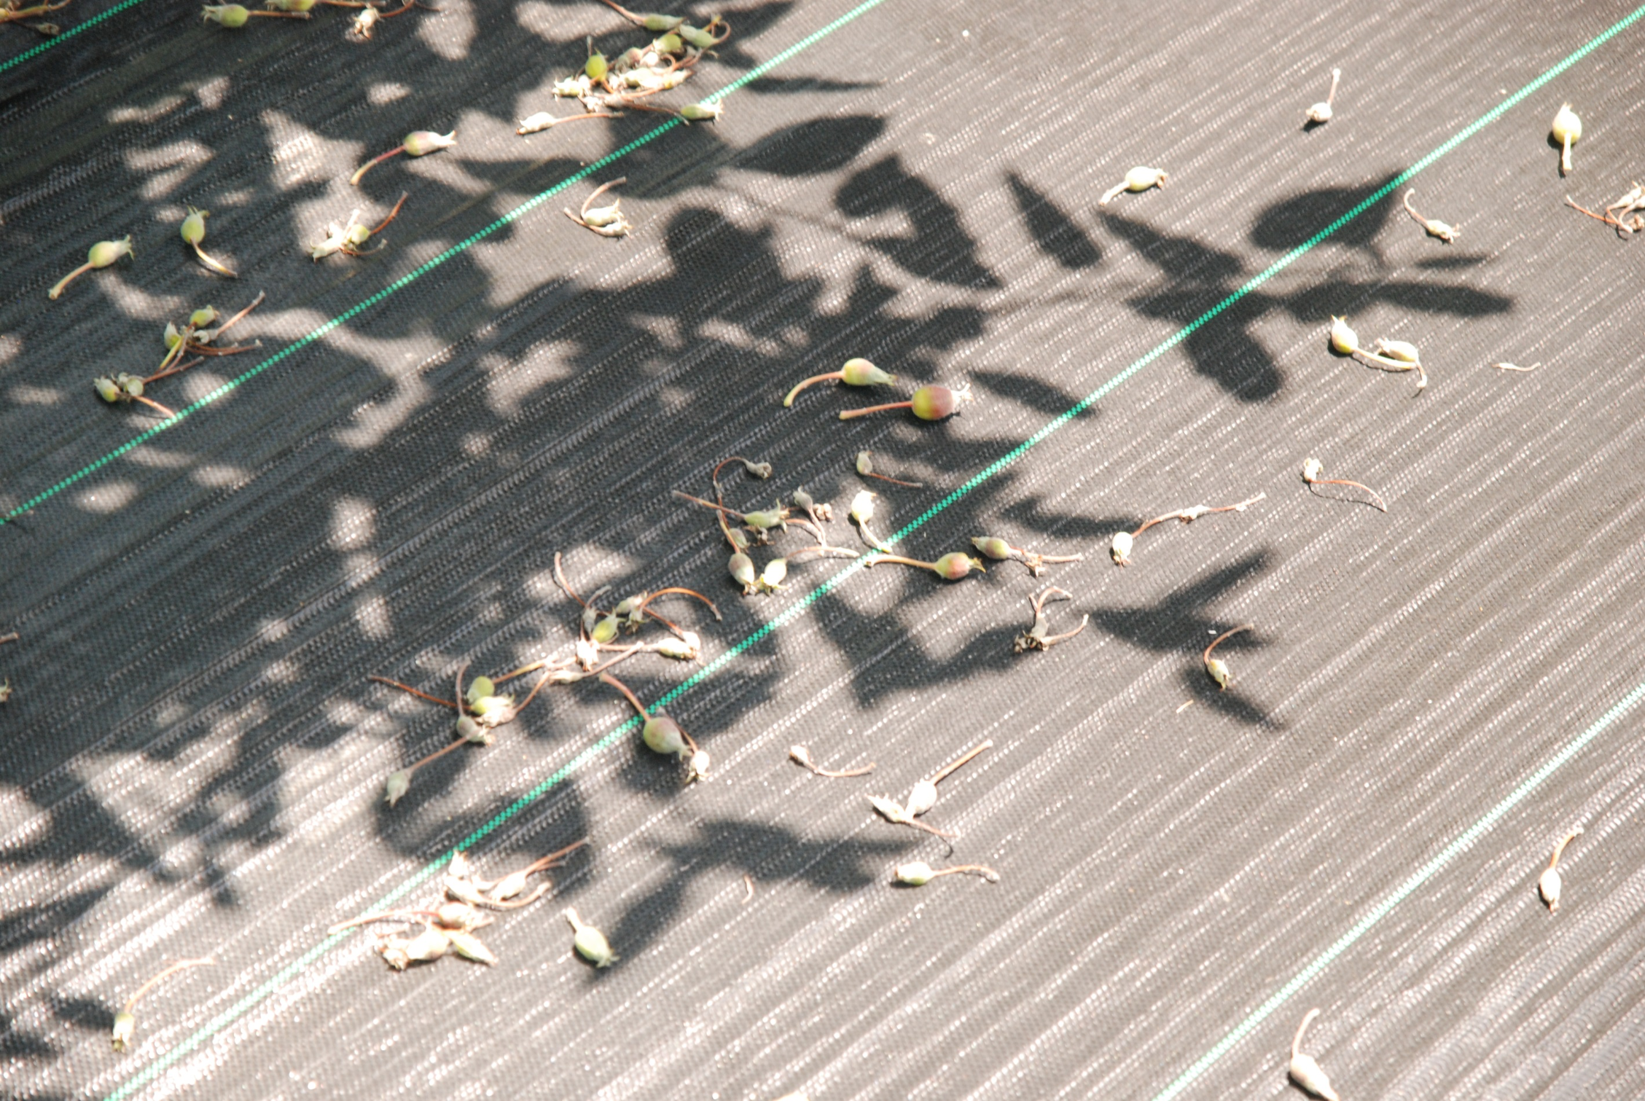
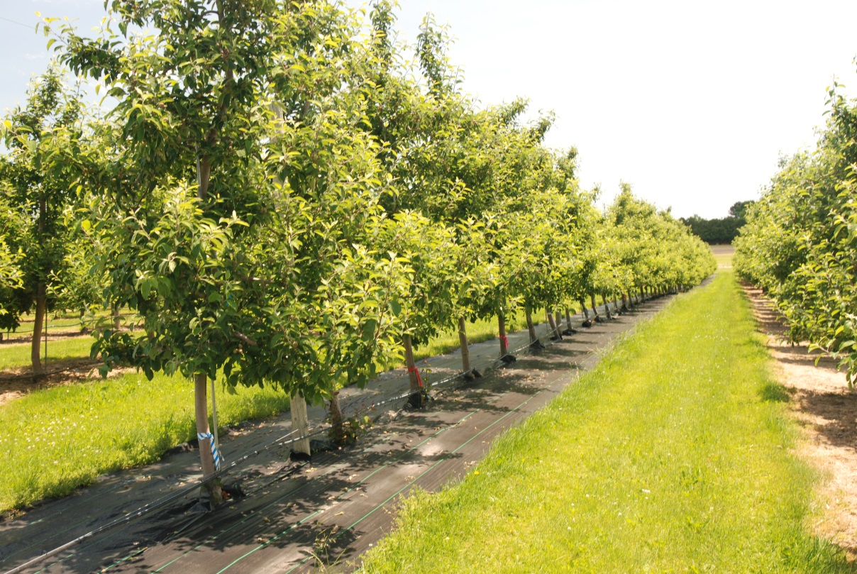
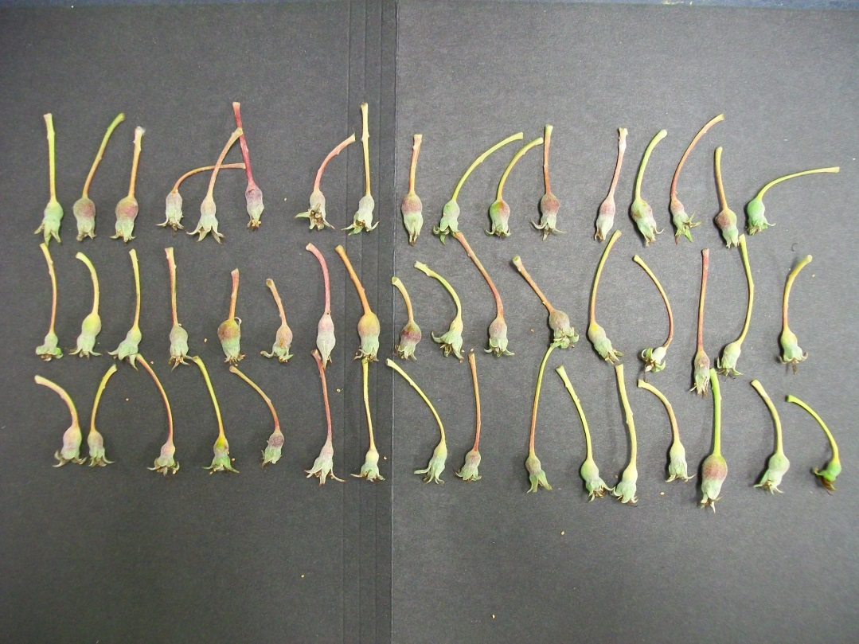
It takes 12-14 days to visually see fruit drop after applying a chemical thinner

Slide 34
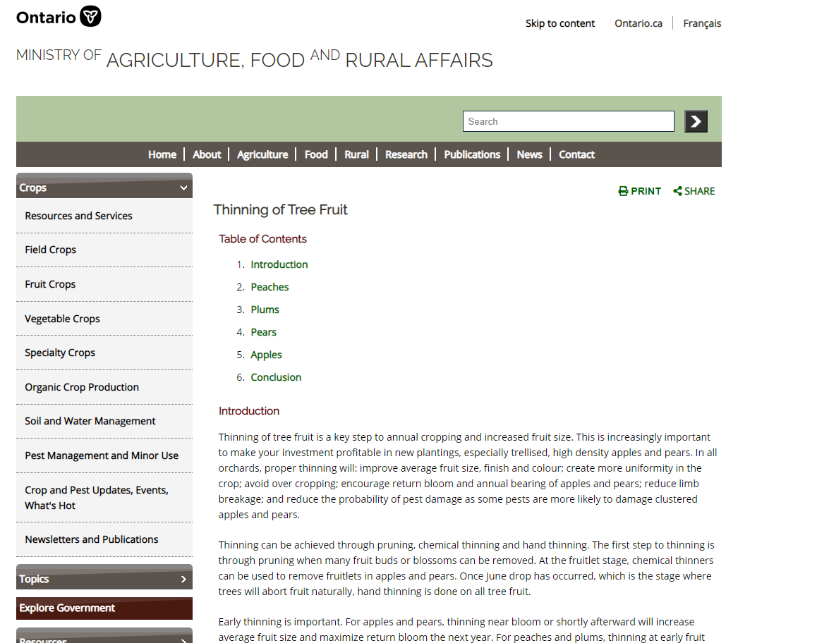
Where to obtain more information - OMAFRA thinning guidelines
http://www.omafra.gov.on.ca/english/crops/hort/thinning.htm

Slide 35
Cultivar Sensitivity to Chemical Fruitlet Thinners
Easy | Moderate | Difficult
Ambrosia non-spur Red Delicious Idared Mutsu/Crispin Jonagold strains Jerseymac Honeycrisp Gingergold Silken Creston Cameo Golden Supreme | Empire McIntosh Northern Spy Cortland | Golden Delicious Paulared Gala strains Fuji Goldrush Spartan Wealthy spur-type McIntosh spur-type Red Delicious.
Source: http://www.omafra.gov.on.ca/english/crops/hort/thinning.htm#apples

Slide 36
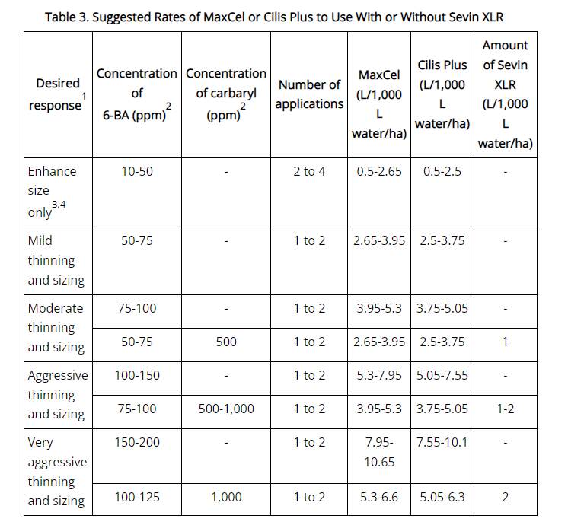
Thinning with 6-BA and Carbaryl
http://omafra.gov.on.ca/english/crops/hort/thinning.htm#apples

Slide 37
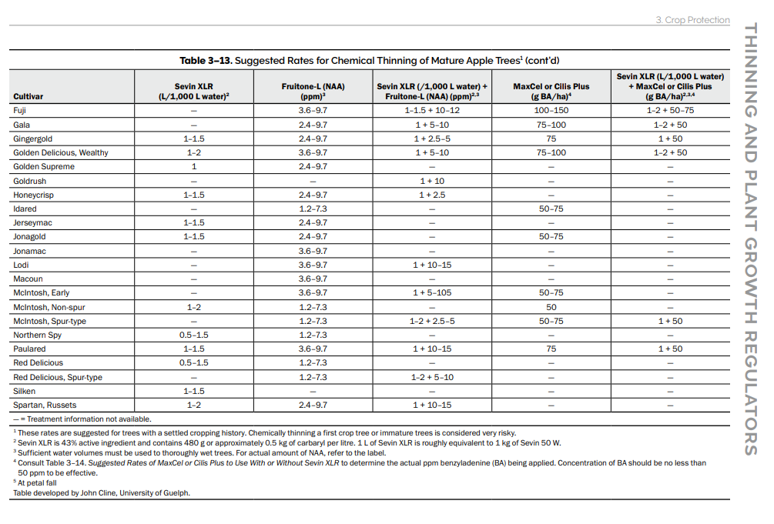
Thinning recommendations by cultivar
http://omafra.gov.on.ca/english/crops/pub360/pub360A.pdf

Slide 38
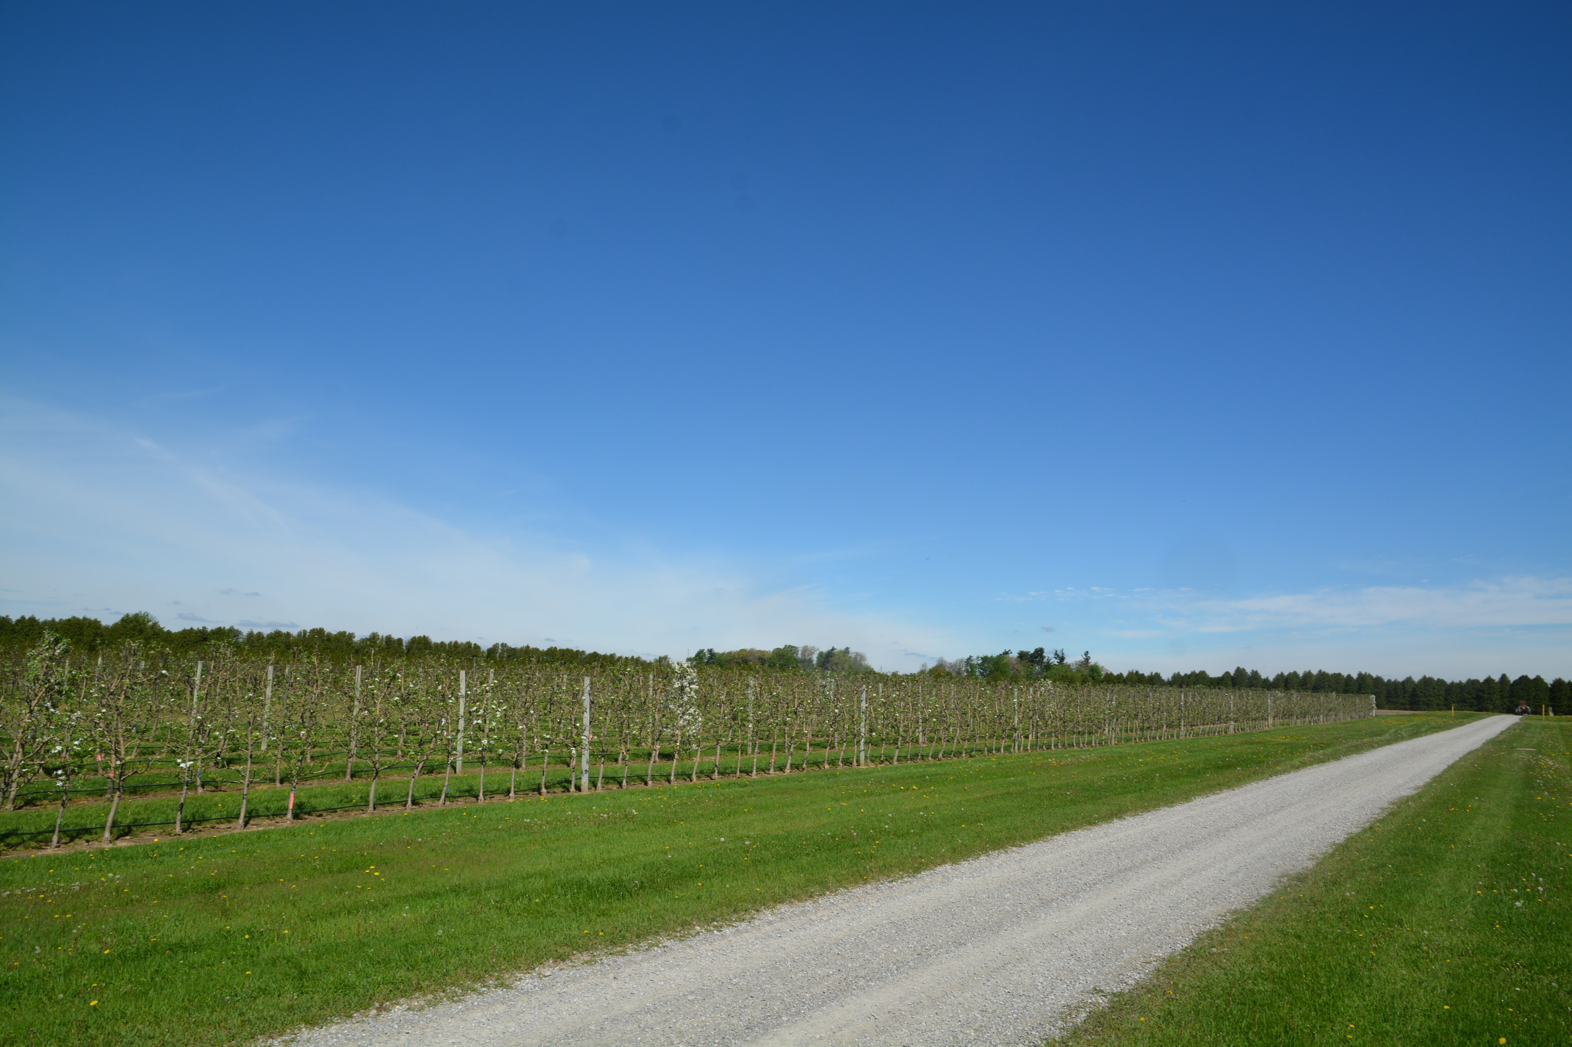
Further Reading
Clements, J., Cowgill, W. 2021. Precision Crop-load Management of Honeycrisp: Flower Bud Identification and Precision Pruning. FruitNotes 86:8-10
Clements, J. 2022. Fruit Growth ‘Apple Fruit Set Predictor’ app. FruitNotes 88:7-9
Clements, J. N.D. Predicting fruit set using the fruitlet growth rate model. [online]. https://ag.umass.edu/fruit/fact-sheets/hrt-recipe-predicting-fruit-set-using-fruitlet-growth-rate-model (accessed Feb 28, 2023)
Cline, J. 2020. Blossom Thinning Apples with ATS and Lime Sulphur. Orchard Network 24(2):6-8 https://onfruit.ca/wp-content/uploads/2021/01/2020_02_Apr.pdf
Cline, J. 2021. Preliminary Results of Blossom Thinning with Lime Sulphur and ATS 25(2):10-14 https://onfruit.ca/wp-content/uploads/2021/05/2021_02_Apr.pdf
Greene, D.W., Lakso, A.N., Robinson, T.L. and Schwallier, P., 2013. Development of a fruitlet growth model to predict thinner response on apples. HortScience, 48(5):584-587.
Hillmann, L., L. Gonzalez Nieto, T. Kon, S. Musacchi, T. Robinson, S. Serra, and T. Einhorn. 2022. A modified apple fruit set prediction model to guide repeat thinner applications. New York Fruit Quarterly 30(2): 4-6
Miranda Sazo, M and Robinson, T. 2023. Intentional Delay of Dormant Pruning for ‘Honeycrisp’ & Other Important Biennial Cultivars (Fuji). [online]. https://blogs.cornell.edu/enychp/tree-fruit/apples/tree-fruit-blog-intentional-delay-of-dormant-pruning-for-honeycrisp-other-important-biennial-cultivars-fuji/ (accessed March 3, 2023)

Slide 39
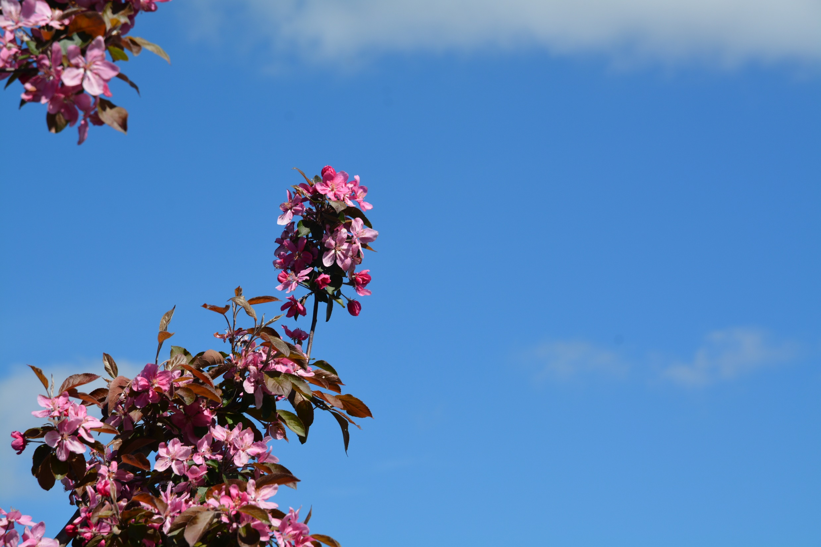


Acknowledgements
Cathy Baker, Research Technician
Mandy Beneff, Research Technician
Graduate Students
Ontario Apple Growers
Ontario Agri-Food Innovation Alliance Research Program

Slide 40
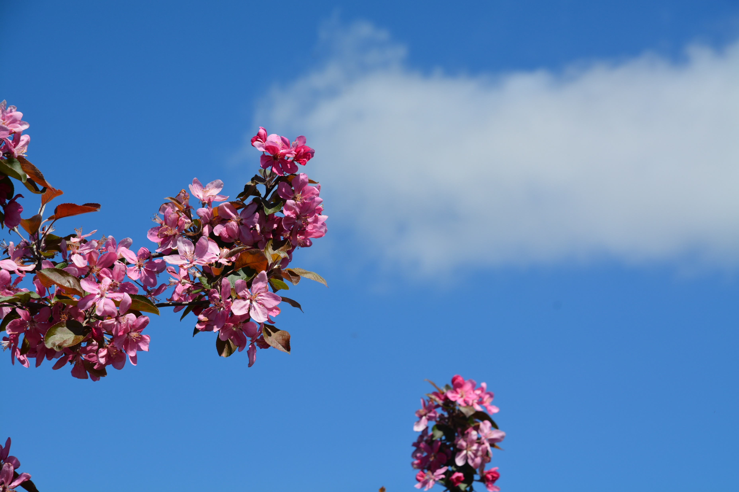
John Cline
University of Guelph
Horticultural Crops Research Simcoe – Simcoe
Email: jcline@uoguelph.ca

Slide 41
Extra Slides

Slide 42
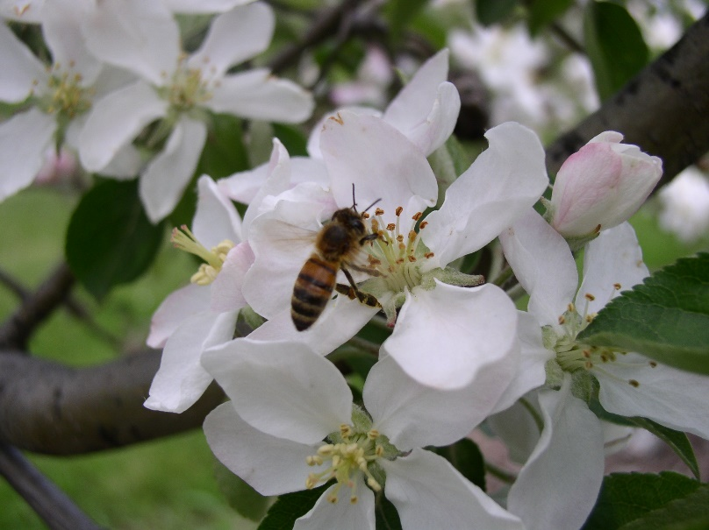
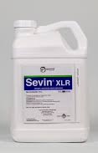
Issues with Carbaryl
Benefits
Carbaryl is commonly a used carbamate insecticide to thin apples.
low cost and effectiveness, particularly when combined with other thinners, it is often preferred over 6-BA and NAA
Issues/Concerns
Carbaryl is toxic to bees
Human health concern
Banned from use in Europe
The same fate may become of Carbaryl in Canada
Producers require reliable alternatives to Carbaryl. Experiments will investigate 1-aminocyclopropane-1-carboxylic acid (ACC) and metamitron for thinning of Honeycrisp, Ambrosia and Gala.

Slide 43
Gala treatments - Examples
A random complete block (RCBD) , 7 replications
Eight treatments, single tree plots
17-yr-old ‘Gala’/Bud.9 spacing of 2.5 m x 4.5 m (889 trees ha⁻¹)
Two Timings:
  8.7 mm King fruitlet
  ~12 mm King fruitlet)
untreated control
hand-thinned control (single cluster, space ~10 cm apart)
1500 mg/L Carbaryl tank mixed with 75 mg/L 6-BA
165 mg/L (1.1 L/ha) metamitron (Brevis 46701, Adama Canada)
247.5 mg/L (1.65 L/ha)metamitron
330 mg/L (2.2 L/ha) metamitron
412.5 mg/L (2.75 L/ha) metamitron
480 mg/L (3.2 L/ha) metamitron

Slide 44
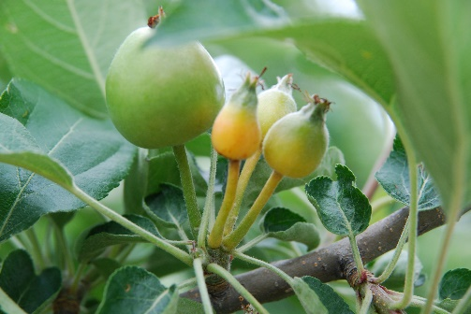
Gala – fruit set
The untreated control had the greatest fruit set while trees treated with the tank mix of 1500 mg/L carbaryl and 75 mg/L 6-BA and 3.2 L/ha Metamitron had the lowest fruit set.
Trees that were left un-thinned and treated with 1.1 and 1.65 L/ha metamitron had fruit set values less than the hand-thinned control
Trees treated with 2.2 L/ha metramitron or greater, had fruit set values similar to the hand thinned controls.
Fruit set decreased in an inverse linear relationship (P<0.001) with metamitron concentration.

