Slide 1

Let’s Talk Local Food Distribution

Slide 2
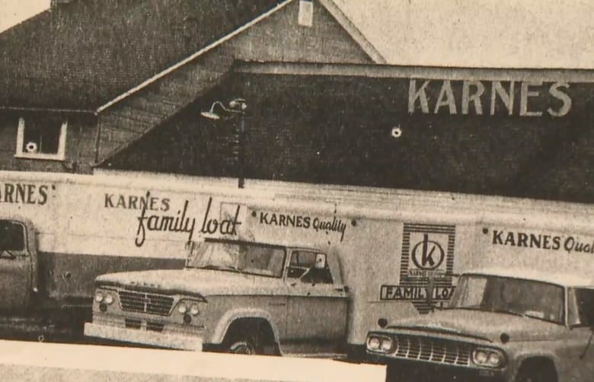




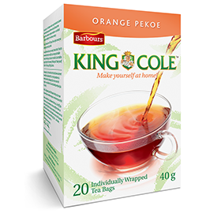

Blair Hyslop – 30 Years in the Food Business
– almost all of it from New Brunswick

Slide 3
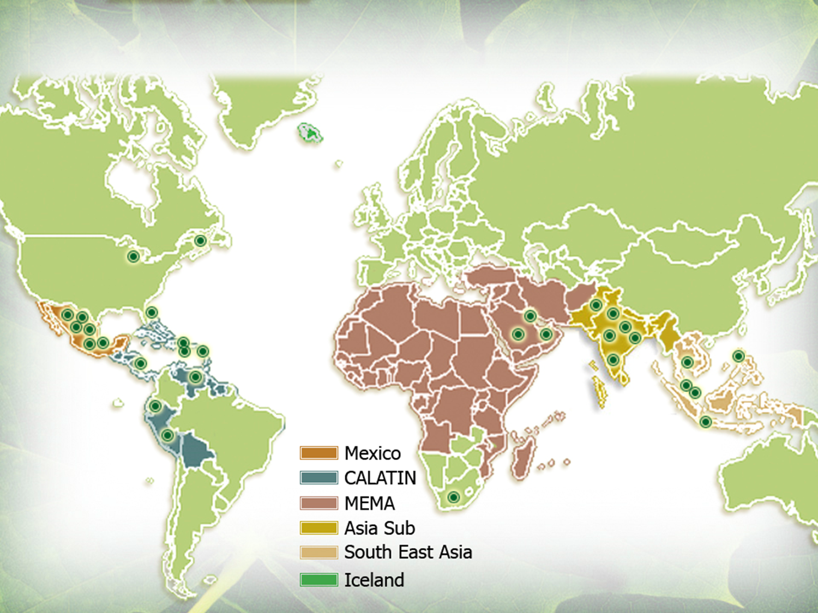

Slide 4






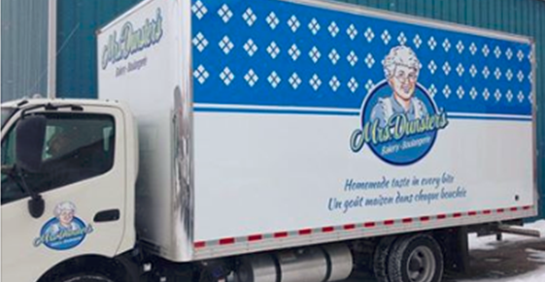


Extensive Fresh Direct to Store Service
Mrs. Dunster’s
Strong Local Brand
Your regional bakery:
2 bakeries
  NEW Bread, Rolls , Pizza Shells - Moncton
  Donuts / Sweet Goods - Sussex.
4 Retail Stores of our own, including Kredl’s
250 Employees
Mrs. Dunster’s delivers fresh to over 600 stores & 200 Restaurants fresh 1 or 2 X per week.
Price Edward Island
NEW
BRUNSWICK
Nova Scotia
MAINE
Bakeries – Moncton, Sussex
Retail Stores – Sussex, Moncton (2)
Delivery Routes

Slide 5
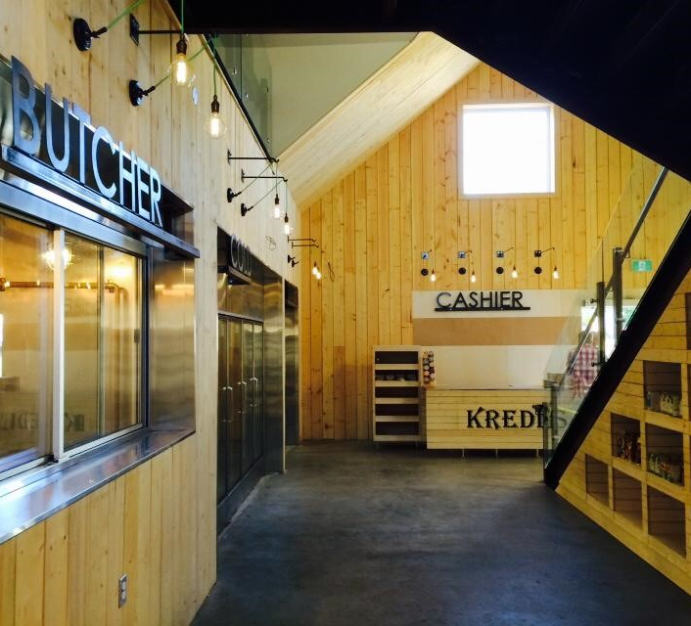

In 2017 we purchased Kredl’s
Established more than 40 years ago as roadside stand.
Today is more than 10,000 sq. feet store including;
  butcher shop,
  bakery,
  garden center,
  ice cream,
  cookhouse,
  market,
  LOCAL Agency Store License
  Refrigerated wholesale distribution
  large wholesale commercial kitchen.

Slide 6
When we purchased Kredl’s in 2017 we set out to amplify it’s focus on local.
We asked the question how do we buy our inventory today?
Ontario
Quebec
Nova Scotia
New Brunswick
Why is it easier and cheaper to buy NB & PEI potatoes from the produce market in Montreal than it is to buy them locally?
Why? – No Local Supply Chain

Slide 7
In just two generations we have gone from more than 75% of the food consumed in Atlantic Canada being grown, raised or produced here to less than 6% today
New Brunswick is one of the few provinces in Canada that does not have a central distribution Hub for fresh local food at Kredl’s Corner Market we are committed to fixing this problem

Slide 8
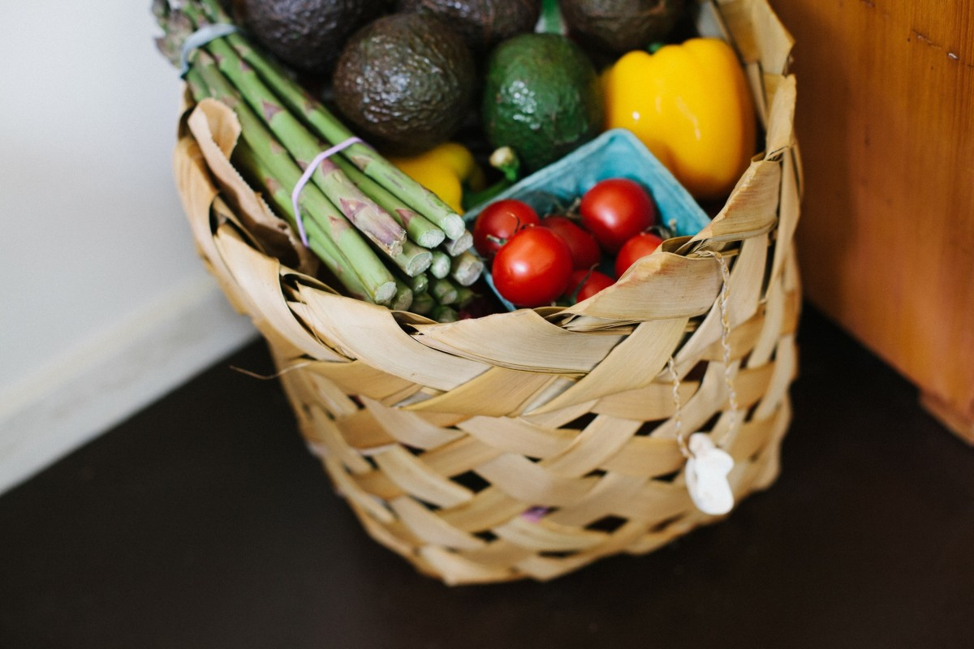


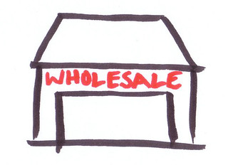

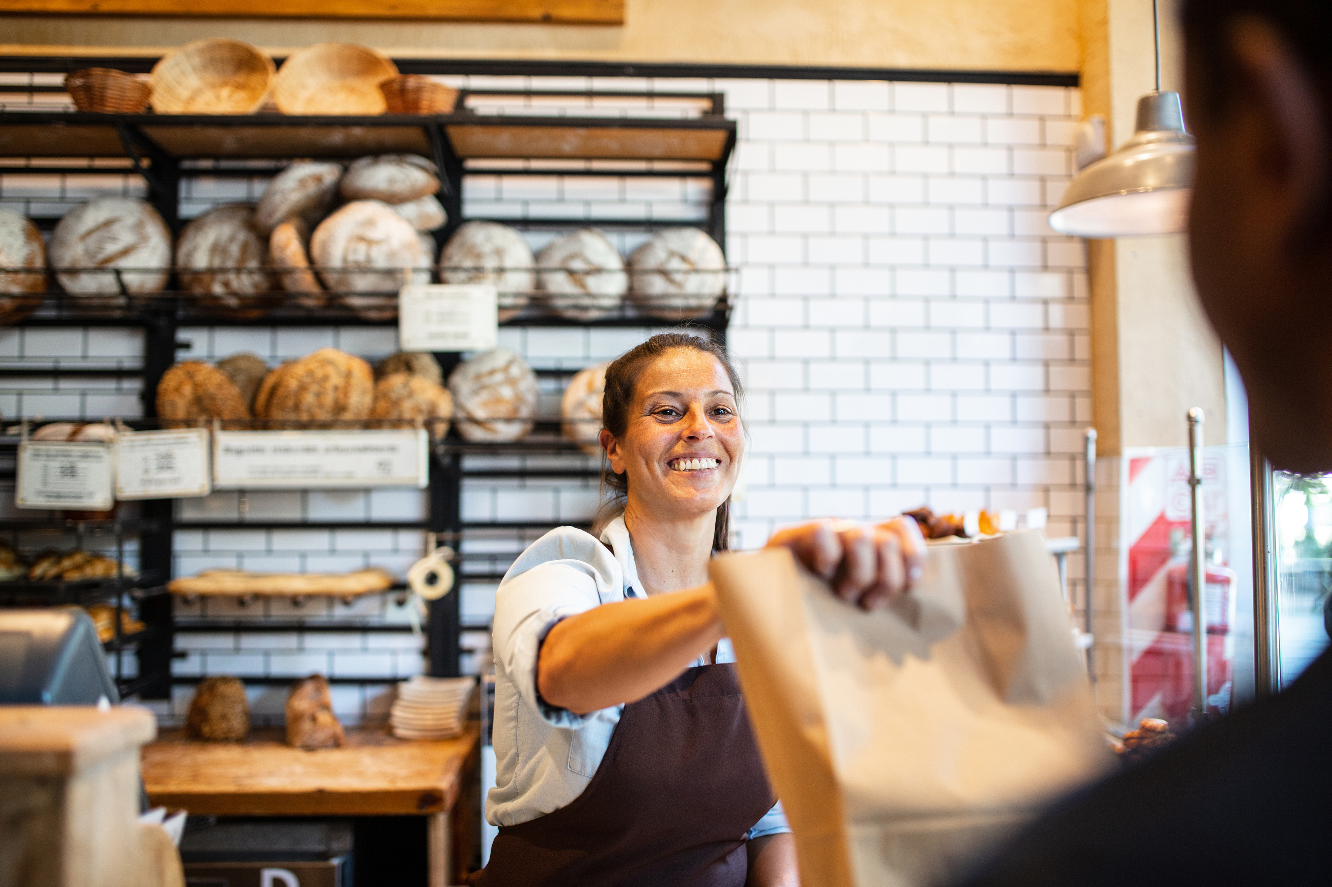
We have a supply chain problem in New Brunswick – How Most Provinces Do it
Food
Manufacturer
Wholesaler
Consolidate inventory
Warehousing
Logistics
Consolidate logistics
Retailer / Restaurant
Consumer
Food
Want 15 different things?
Place 1 order
Manufacturer
This Photo by Unknown Author is licensed under CC BY-SA

Slide 9
We have a supply chain problem in New Brunswick – How We do it
Logistics
Retailer / Restaurant
Consumer
Food
Manufacturer
Logistics
Retailer / Restaurant
Consumer
Want 15 different things?
Place 15 orders
Food
Logistics
Retailer / Restaurant
Consumer
Manufacturer
Logistics
Retailer / Restaurant
Consumer

Slide 10

The Plan
Spring 2023 in Partnership with the Province of New Brunswick we ar e launching Our Local food Supply chain Initiative
Supply Side – Purchasing Manager ; focus on sourcing and buying local supply, mapping what's grown, raised, manufactured, where and by whom.
Demand Side – Business Development Manager; responsible for finding customers for local food.
Kredl’s Kitchen – Responsible for identifying value added opportunities ie; turkey pot pie, pizza , soups …
Kredl’s wholesale & warehouse – Logistics

Slide 11
Thank you

Slide 12
