Slide 1
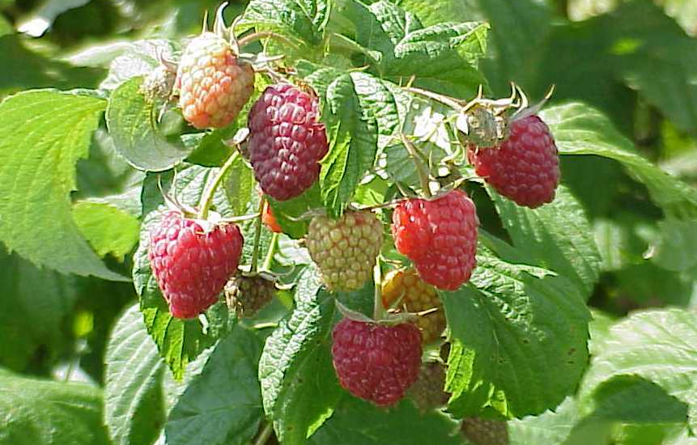
The Raspberry Plant

Slide 2
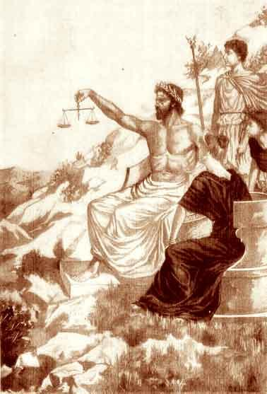
Raspberries: History
Rubus idaeus
Genealogy is confusing
Mix of American, European and Asian heritage
Likely cultivated by the Romans
Heavy commercial production in Europe in the 19th century with 20+ bred varieties
Imported for use and breeding in the U.S.

Slide 3
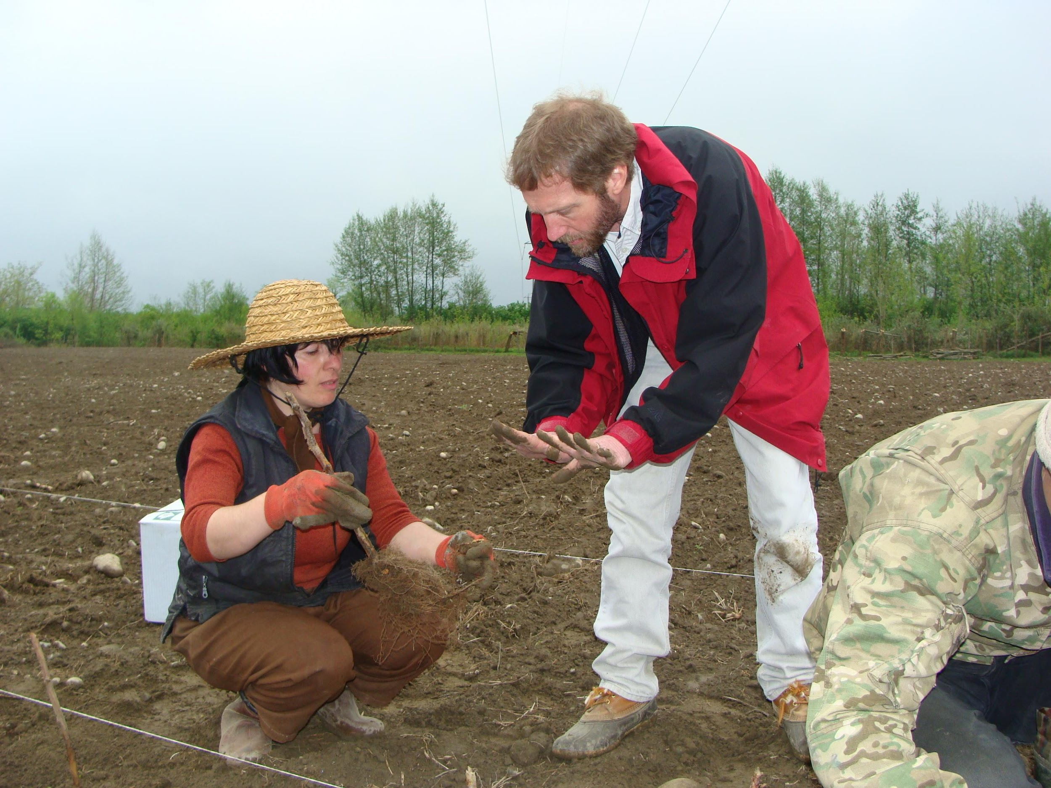
Raspberries: Worldwide
Major production regions:
Russia
Europe
  Poland, Hungary, Serbia, Germany, U.K.
North America
  Pacific Northwest
Up & Coming:
  Mexico, Chile, New Zealand, Australia

Slide 4
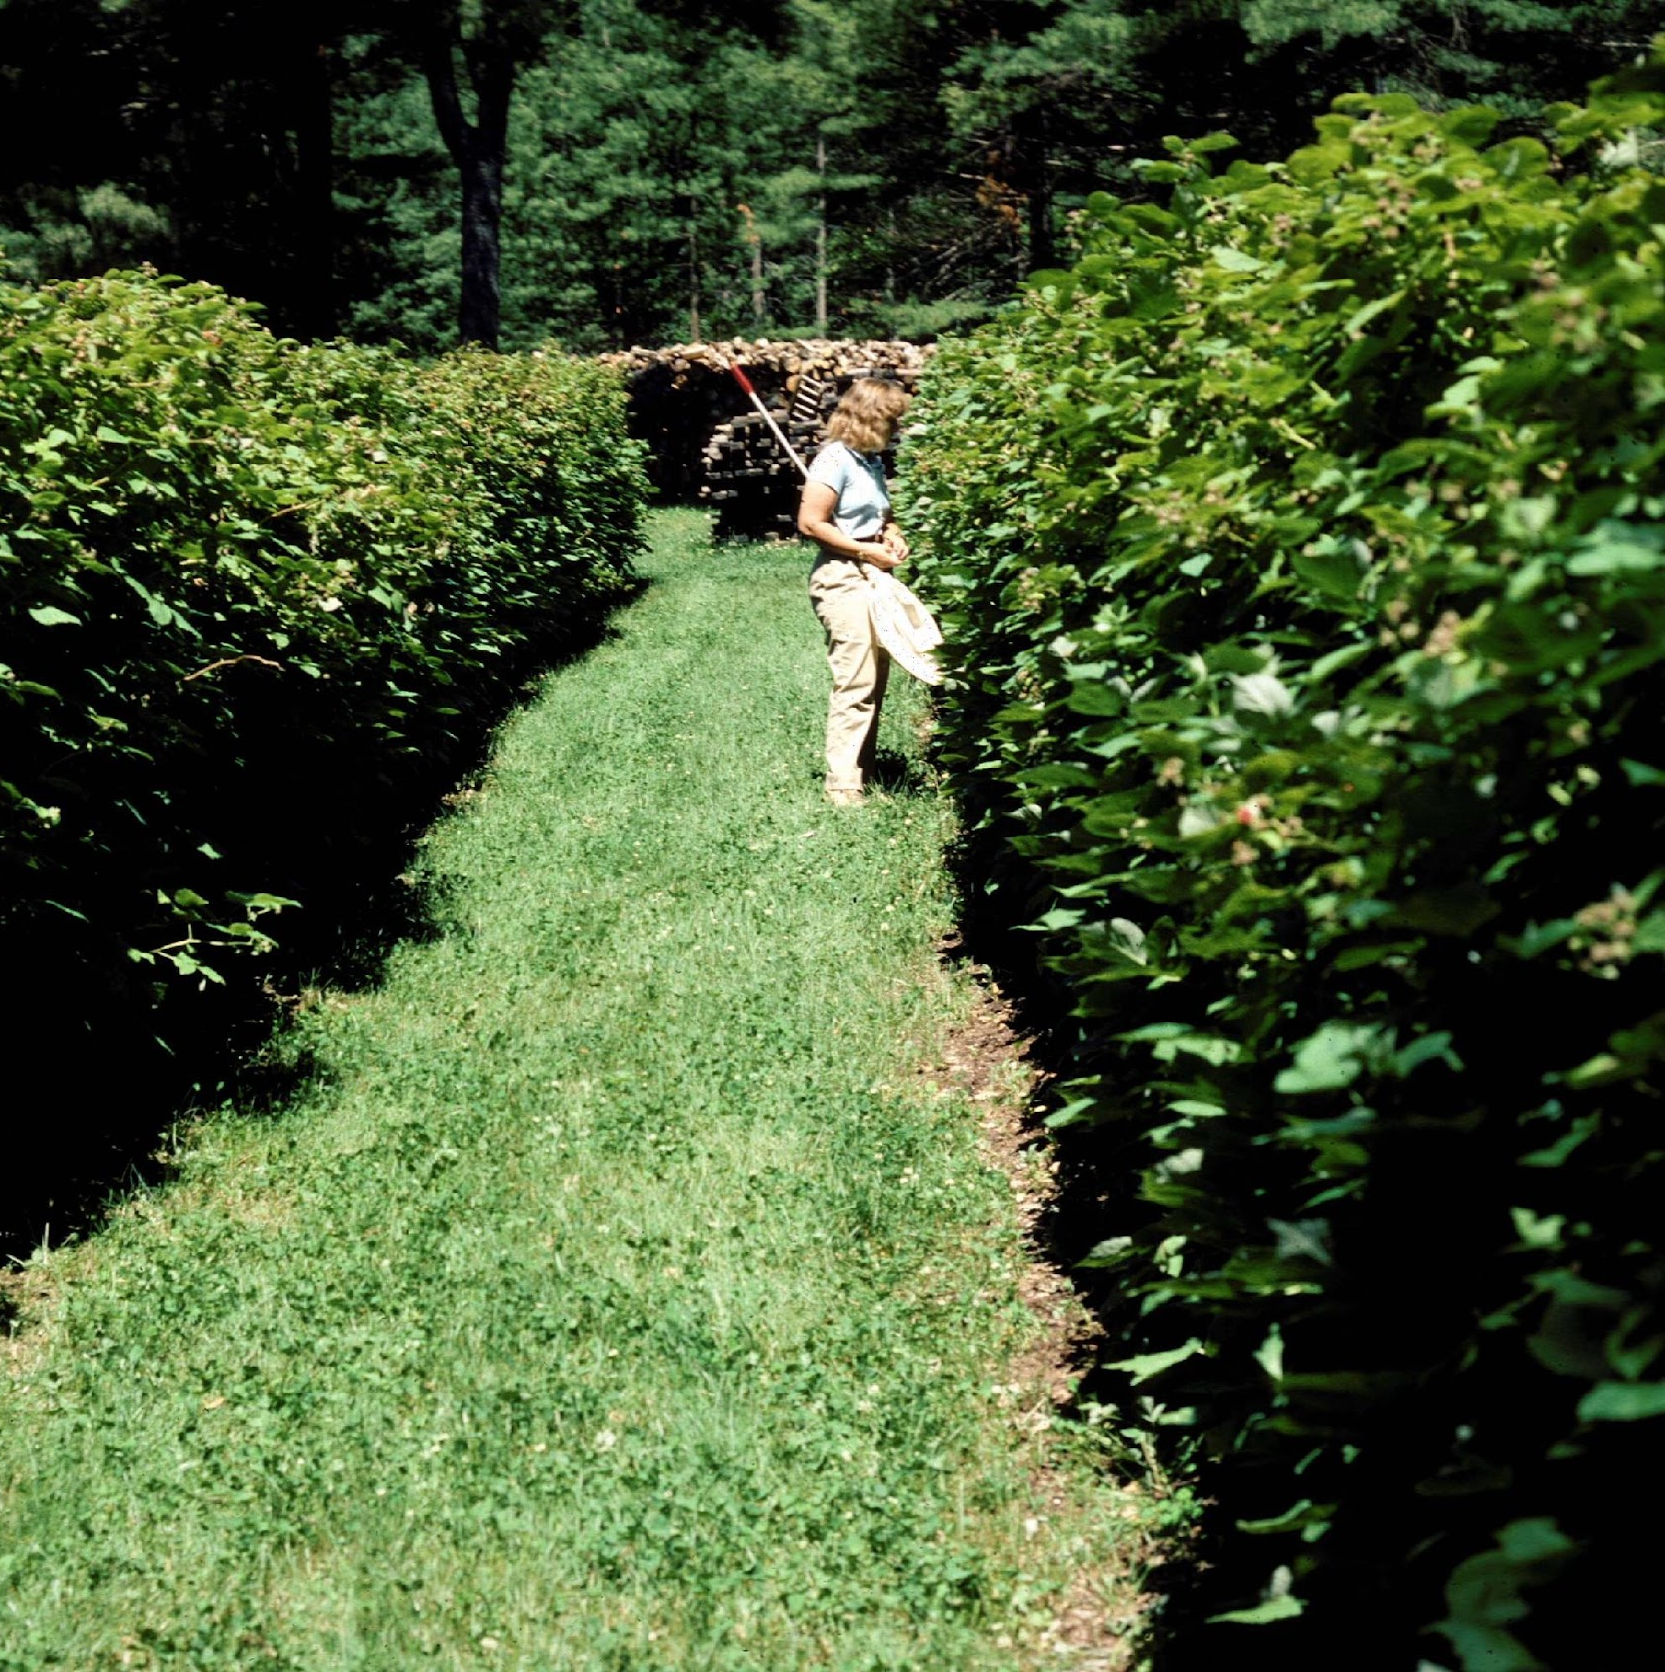
Raspberries: Maine
Approximately 100 acres
Approximately 200 farms
Nearly all red varieties
Mostly summer-bearing

Slide 5
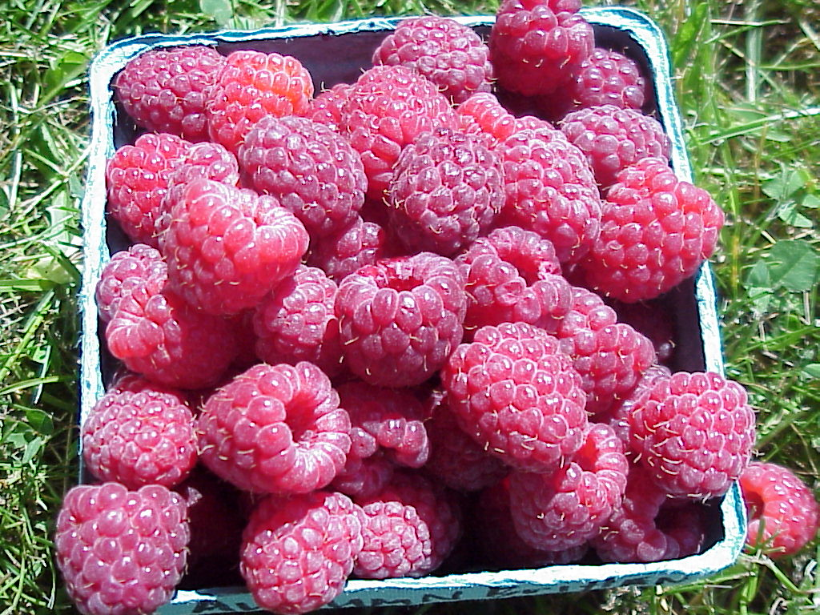
Raspberries: Maine
About 50% Marketed PYO
  Low PYO popularity
    Harvest timing
    Harvest difficulty
    Cost
Remaining is pre-pricked
  Farm stands, markets, restaurants, schools, etc.
Demand is high!
  But who’s going to pick them?

Slide 6
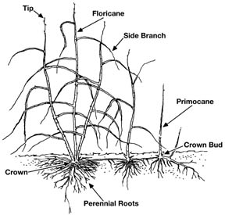
The Raspberry Plant
Roots
perennial
  adventitious buds
      new shoots (canes)
Crowns
  perennial
  many growing points
Canes (biennial shoots)
  axillary buds
    lateral shoots
    fruit buds

Slide 7
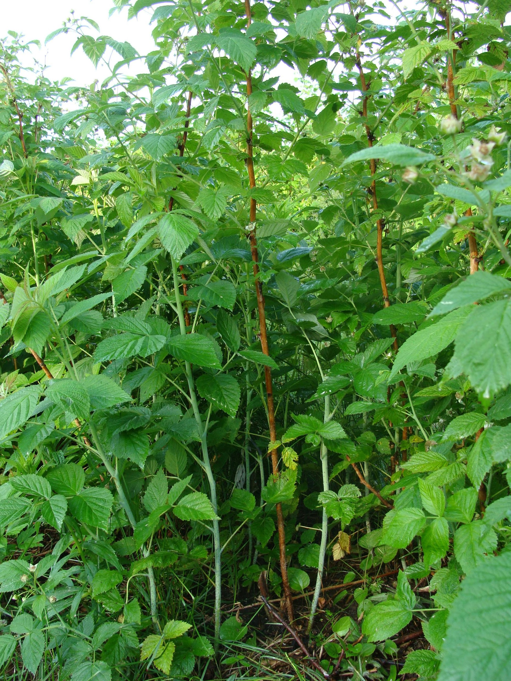
The Raspberry Plant
Roots
  Perennial
  Adventitious buds
    shoots (canes)
Crowns
  Perennial
  Many growing points
Canes (biennial shoots)
  Leaves
  Axillary buds
    Lateral shoots
      Fruit buds

Slide 8
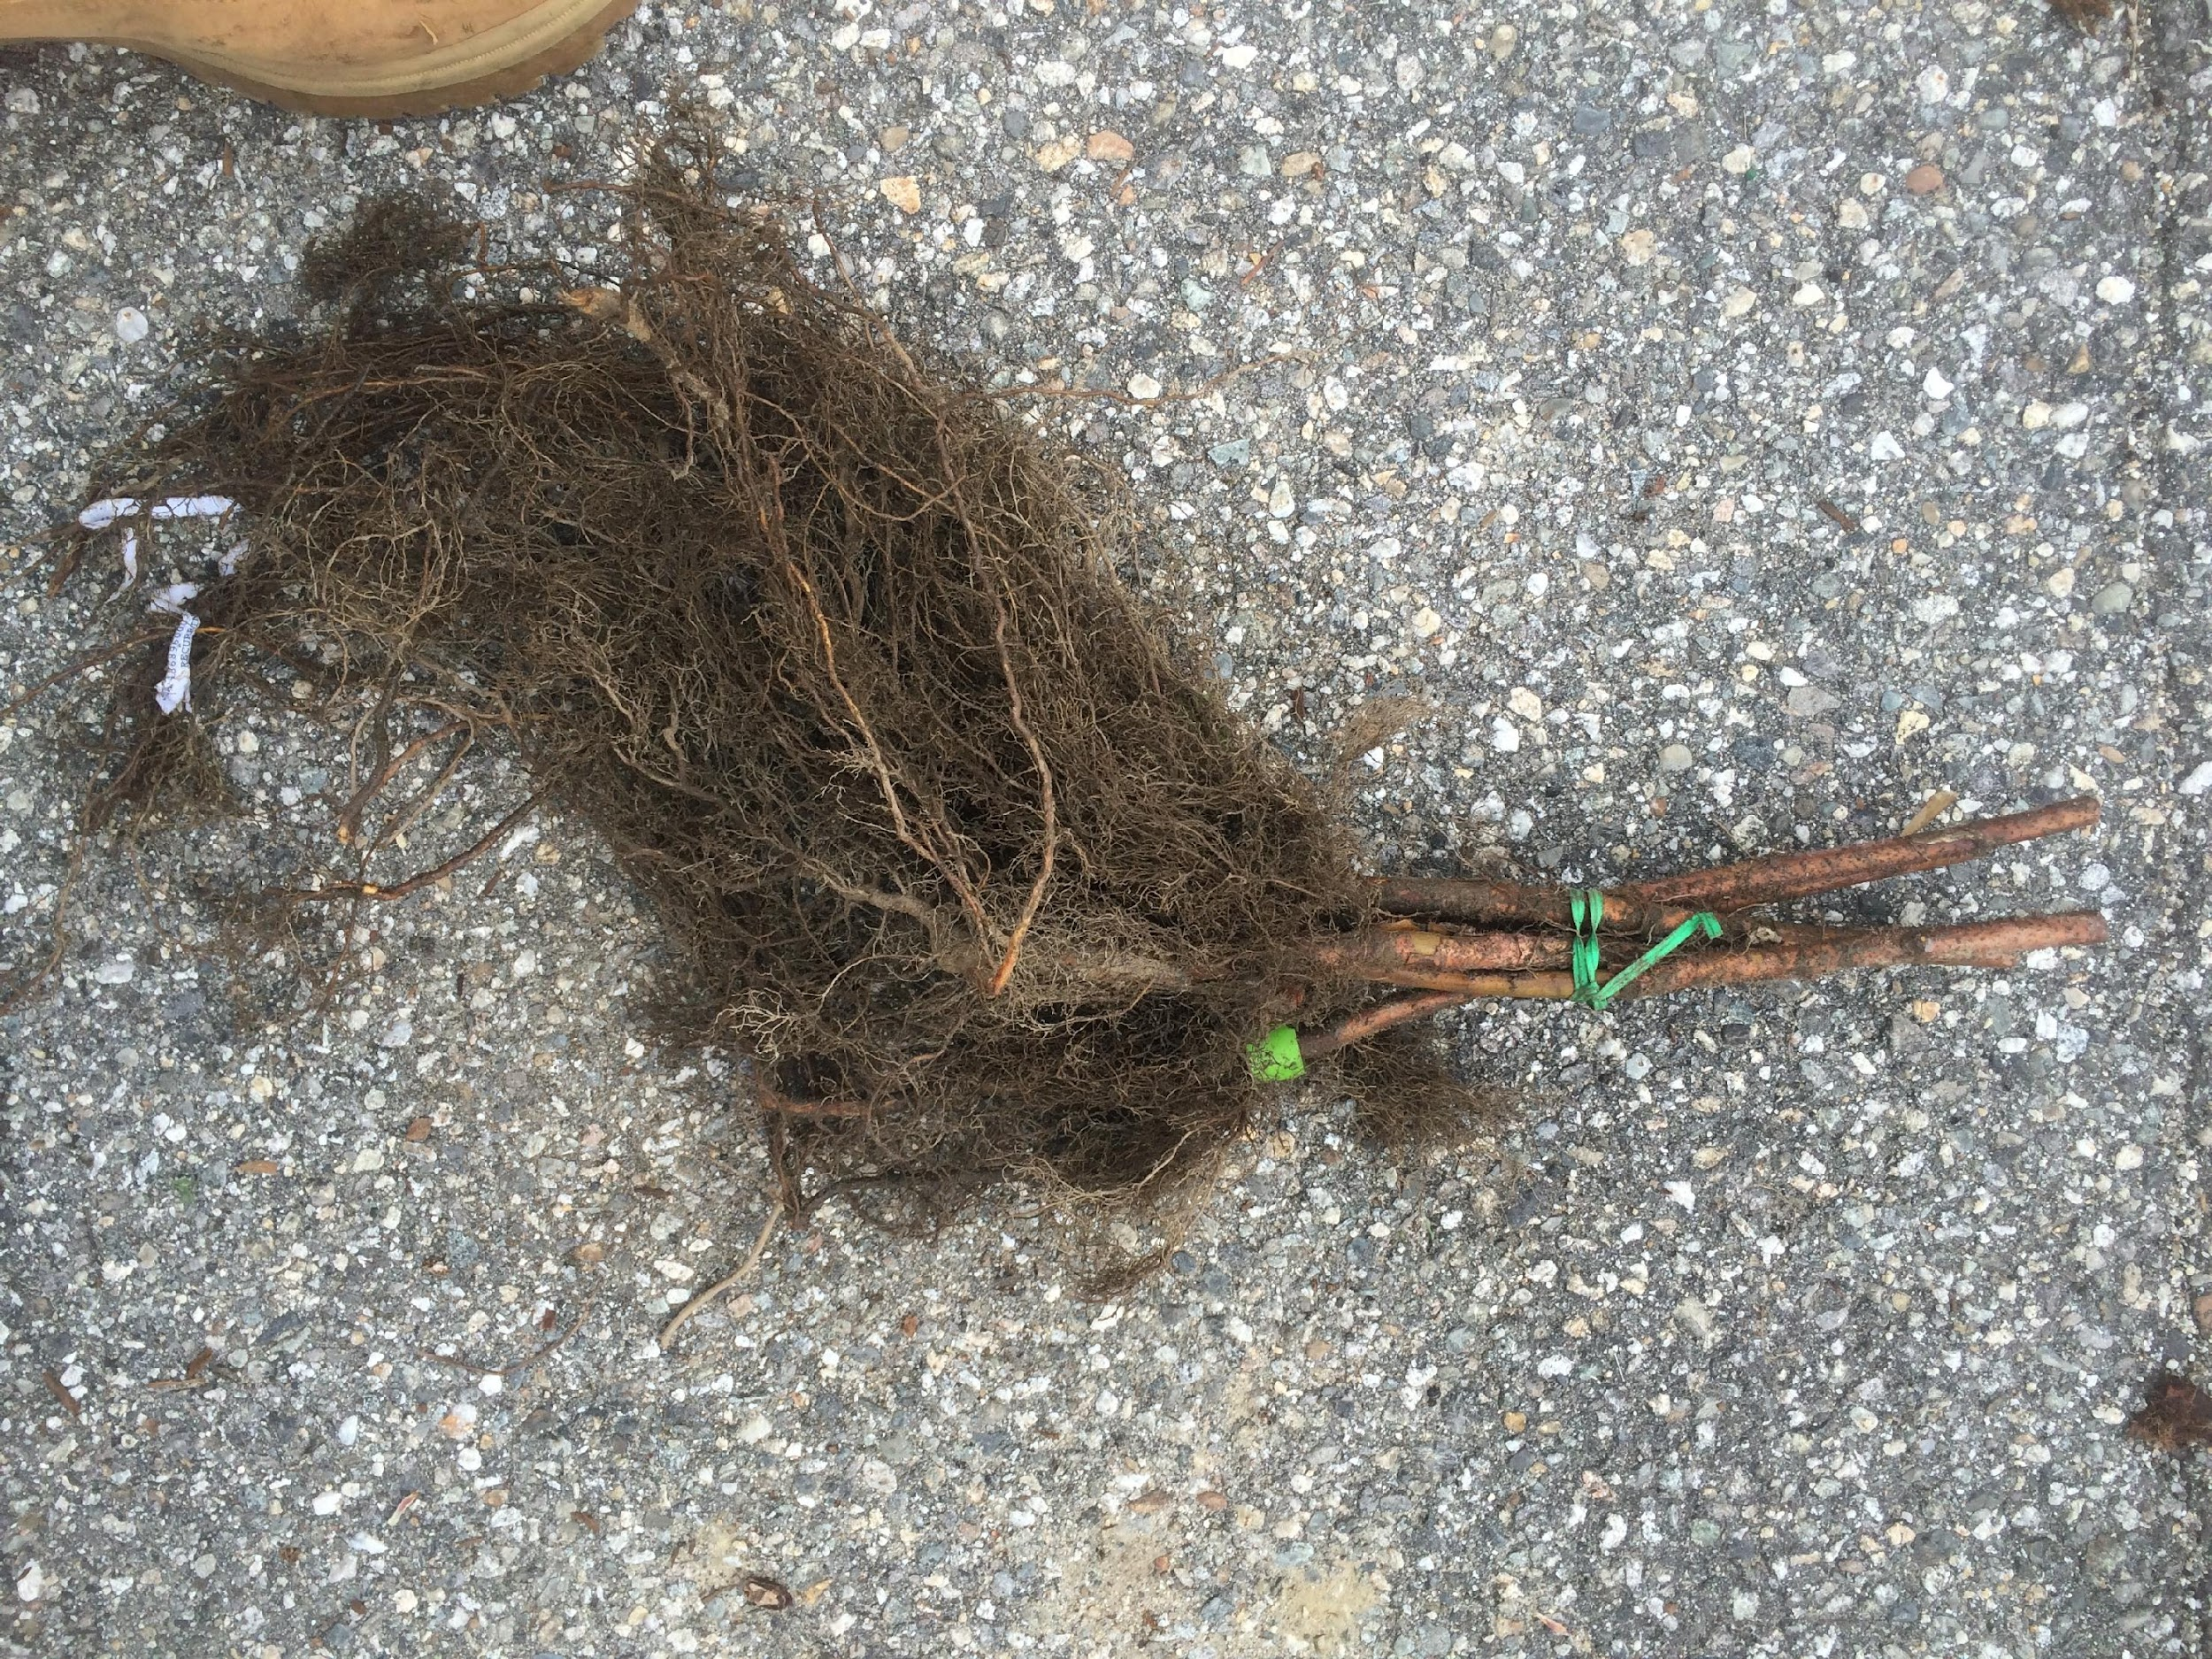
The Raspberry Plant
Roots
Perennial
Fibrous
70% w/in 10” of soil surface
Extend far beyond the crown
Adventitious buds
  Form shoots (canes)
Not competitive
Not wet-tolerant

Slide 9
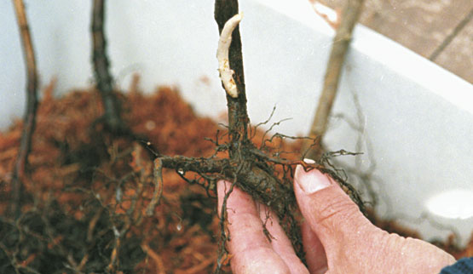
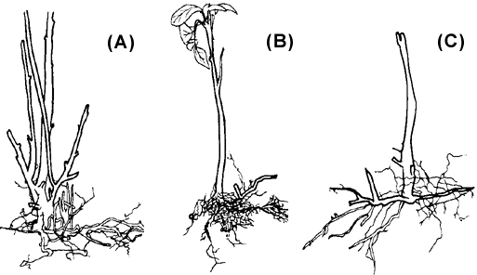
The Raspberry Plant
Crown
Perennial
Adventitious buds
    Form shoots (canes)
Sink for carbohydrates, nutrients

Slide 10
The Raspberry Plant
Canes (shoots)
From crown and root buds
  stimulated by chilling
Biennial
  1st year: Primocane
    form axillary buds
  2nd Year: Floricane
    fruiting laterals
      bear fruit buds
    Senescence follows fruiting

Slide 11
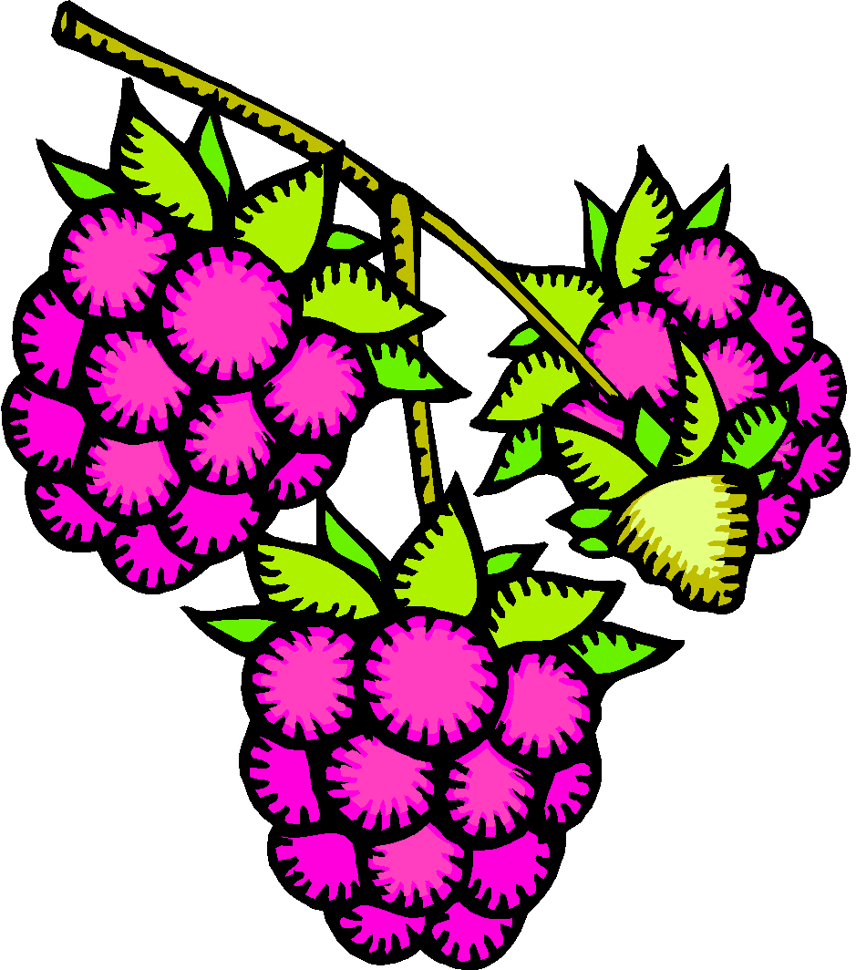

Raspberry Canes - Summer Fruiting
Fruiting laterals
Axillary buds
Primocane
1st year - vegetative
Floricane
2nd year - fruiting

Slide 12





Raspberry Canes - Everbearing
Fruiting laterals
Axillary buds
Fruiting laterals
Primocane
1st year – fruit on topmost buds
Floricane
2nd year – fruit on lower buds

Slide 13
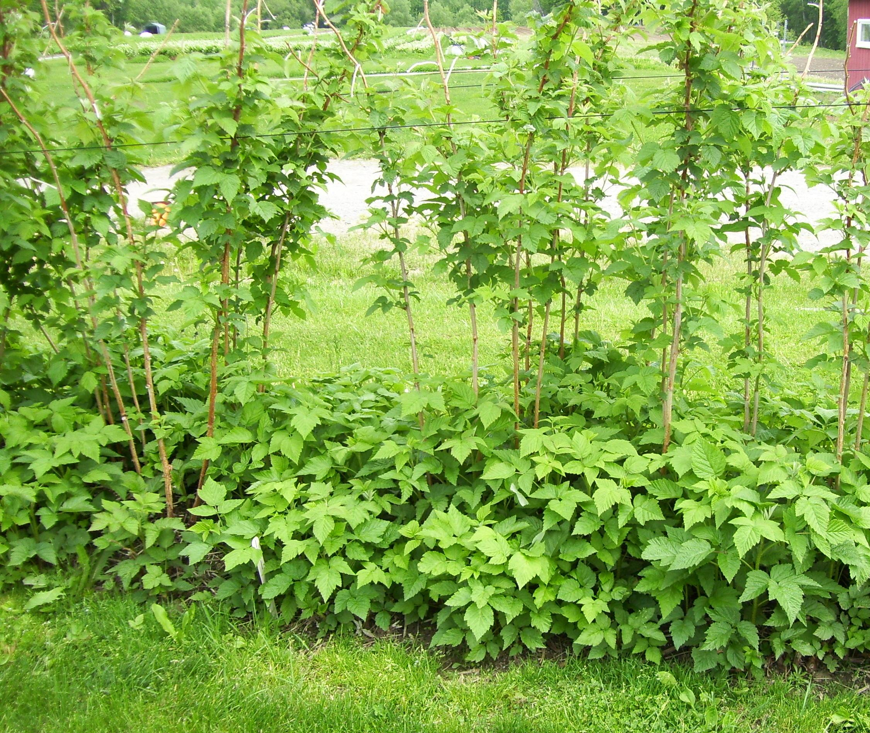
The Raspberry Plant
Biennial canes
Primocane 1st year
Floricane 2nd year

Slide 14
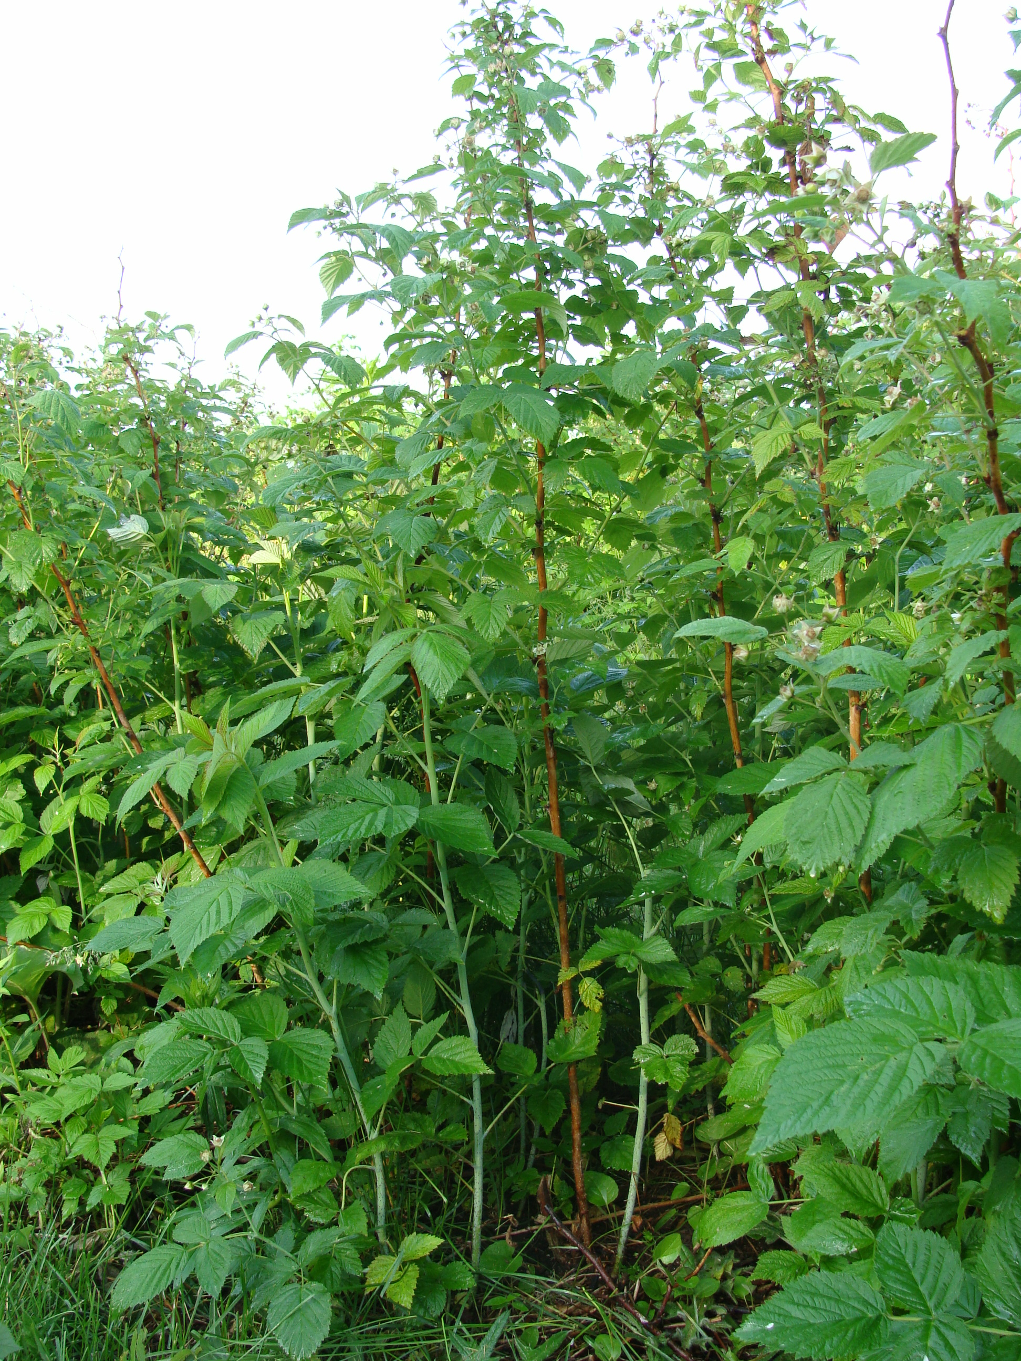
The Raspberry Plant
Biennial canes

Slide 15
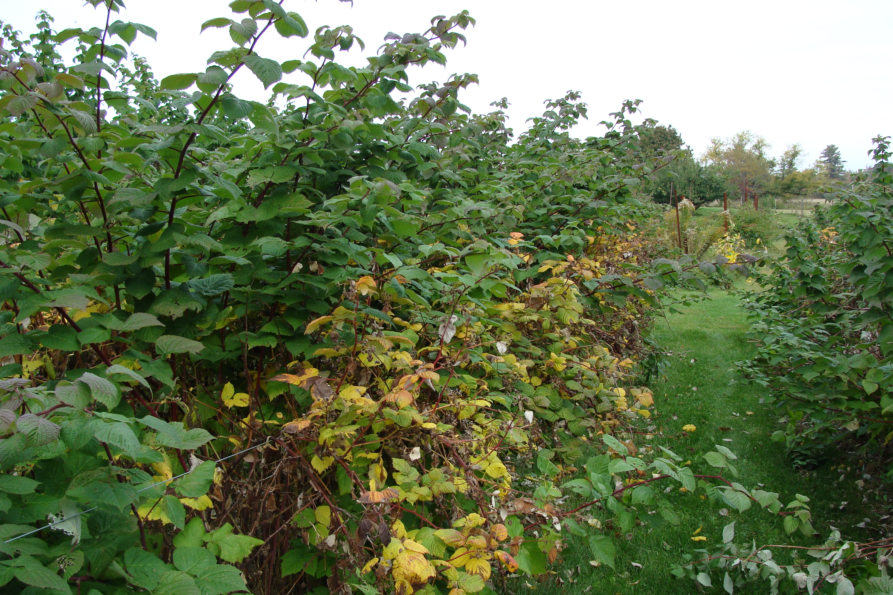
The Raspberry Plant
Biennial canes

Slide 16
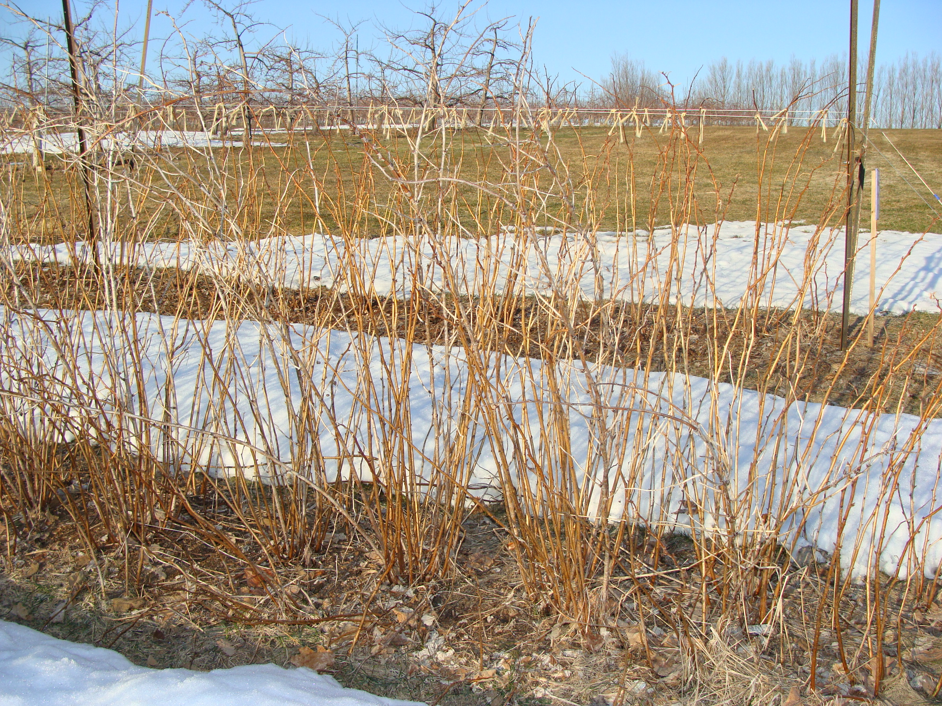
The Raspberry Plant
Biennial canes

Slide 17
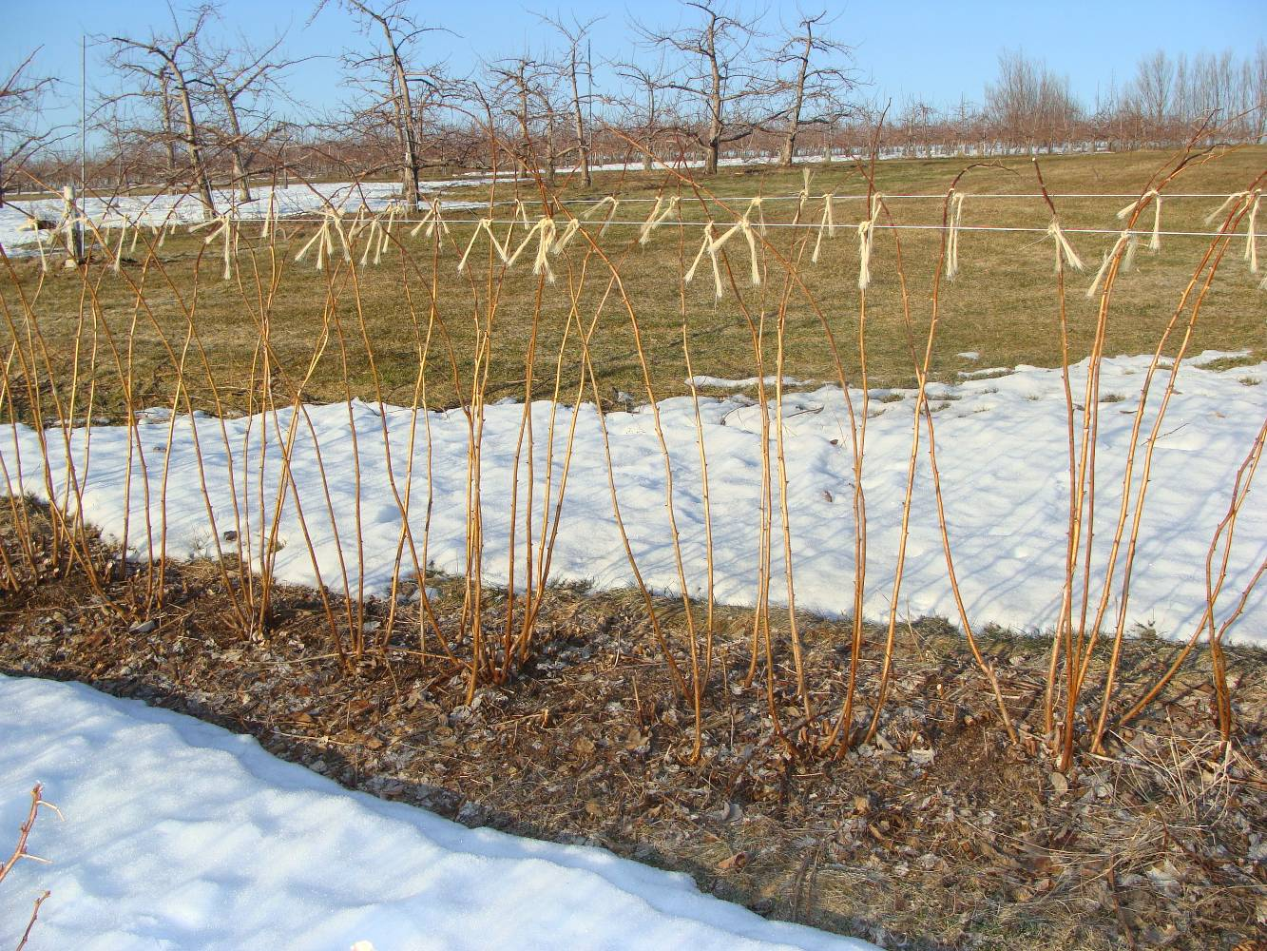
Pruning Raspberries
Biennial canes

Slide 18
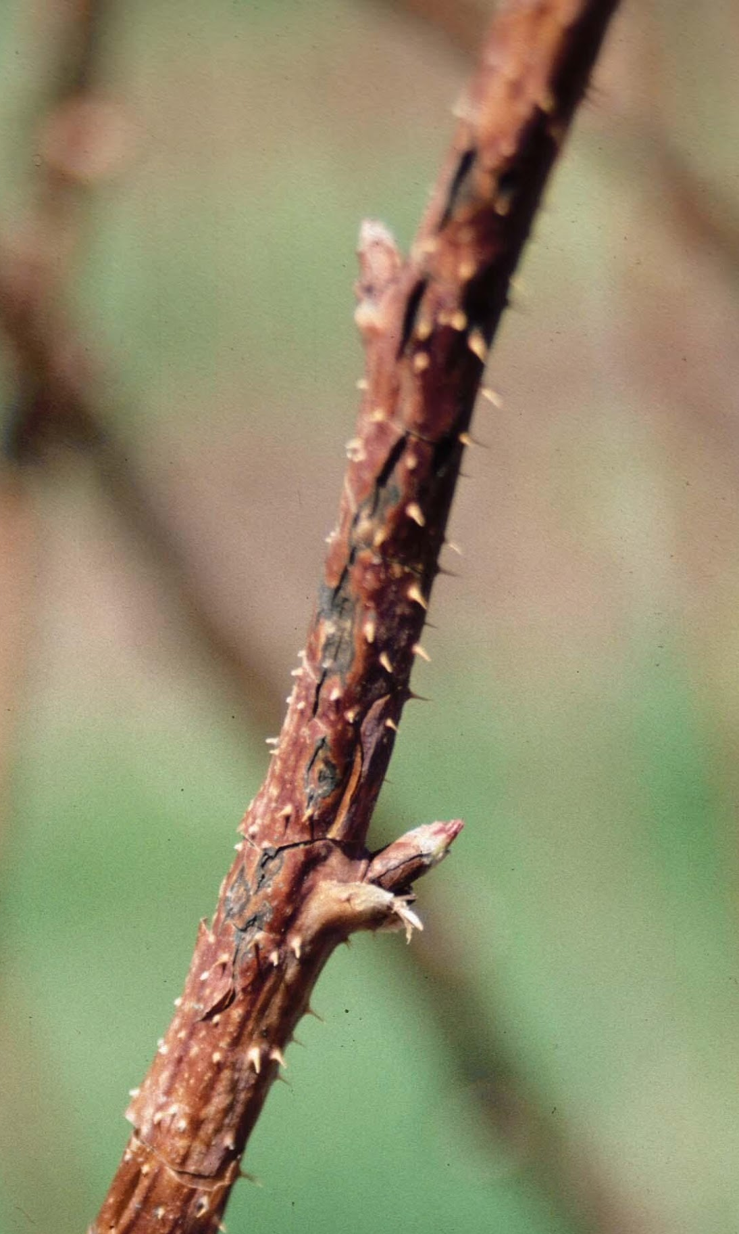
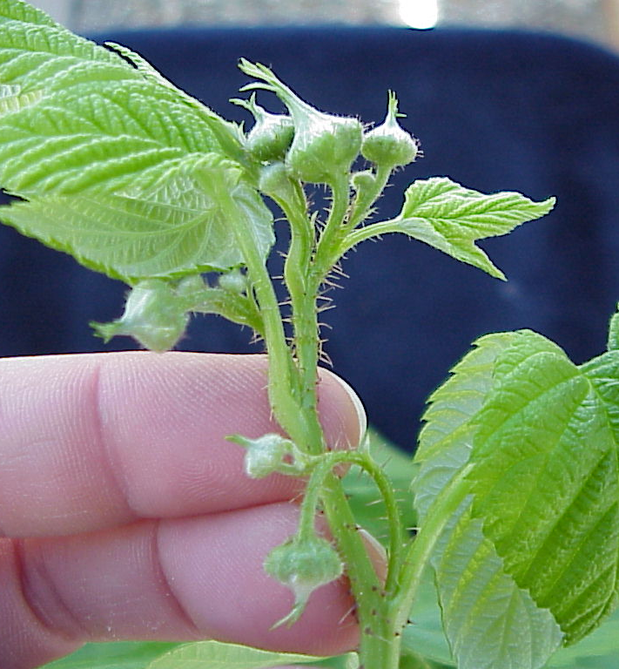
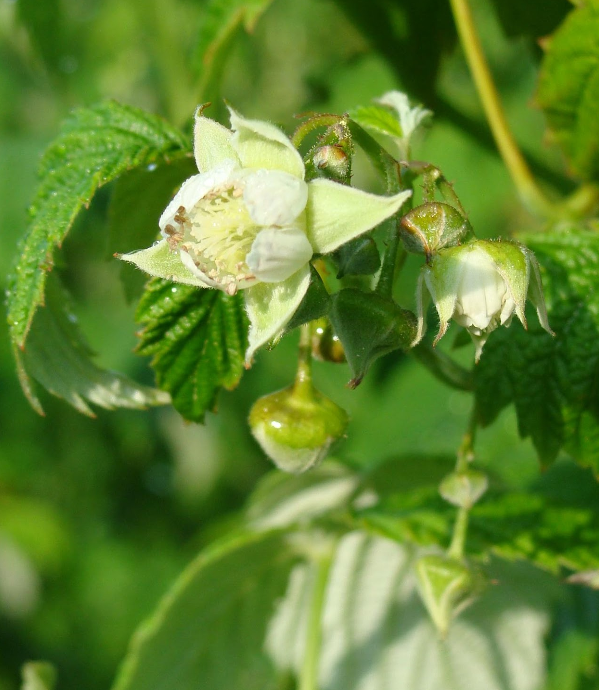
The Raspberry Plant
Flowers
Buds form on fruiting laterals
Stimulated by short days (fall)
Bud break stimulated by chilling (winter)
Most productive:
  Middle 3/5ths of cane

Slide 19
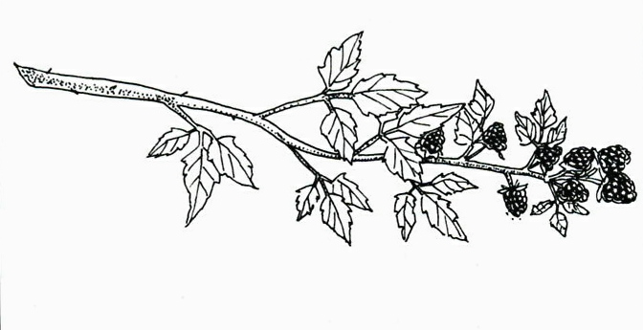
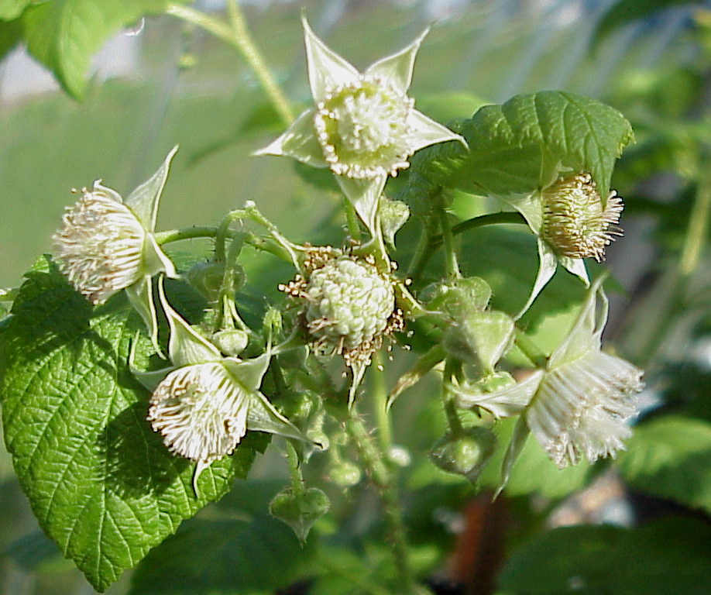
The Raspberry Plant
Flowers
In clusters at tip of shoot
Singles in leaf axils
5 sepals
5 petals
Rings of stamens
Many pistils inserted on receptacle

Slide 20
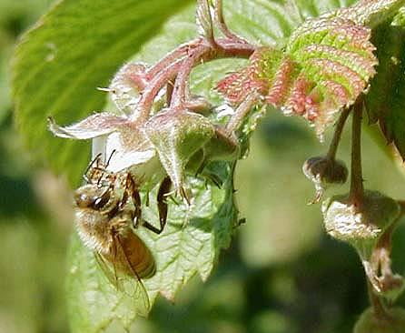
The Raspberry Plant
Pollination
Raspberries are self-fertile
  No cross pollination required
Very attractive to pollinators
  No managed pollination needed
    Except high tunnels?
Photo: M. Longstroth (MSU)

Slide 21
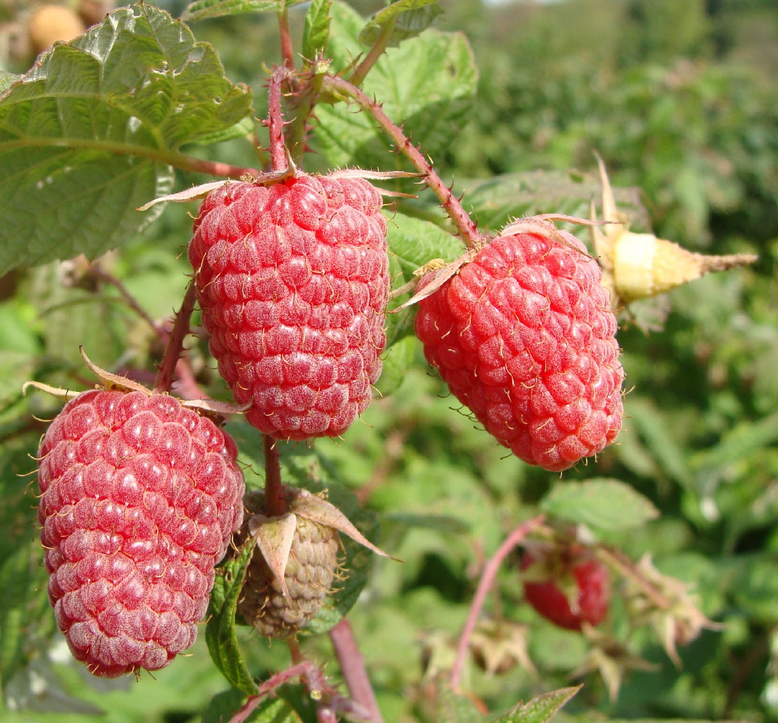
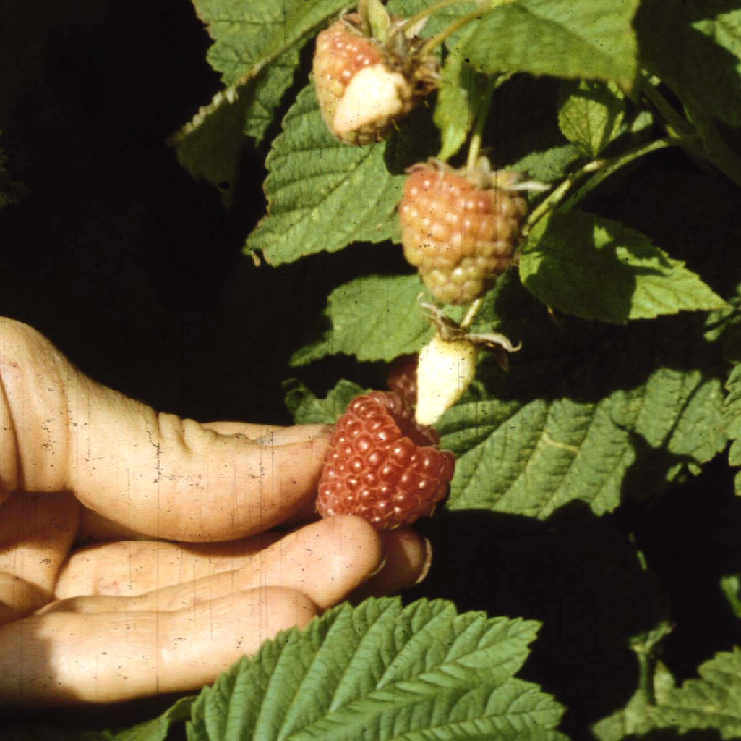
The Raspberry Plant
Fruit
75-125 druplets
  Held together by hairs
  2 ovules/pistil
    Form seed, flesh
  True fruit (drupe)
Loosely attached
Surround receptacle
  Torus
  Mature when separate easily
    Not blackberries

Slide 22
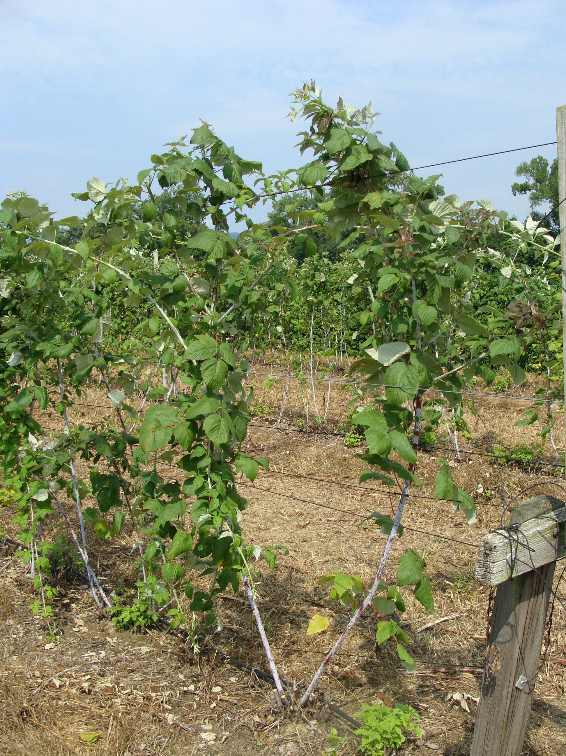
Black Raspberries
Trailing growth habit
Tips will root
New cane growth from crown

Slide 23
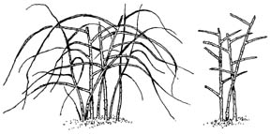
Blackberries
Primocane lateral branches
”extra” growth stage
Most fruit buds form on lateral
Thin, leaving thickest canes
Final density = 6 - 8 canes/hill
Shorten laterals to 12 - 16”

Slide 24
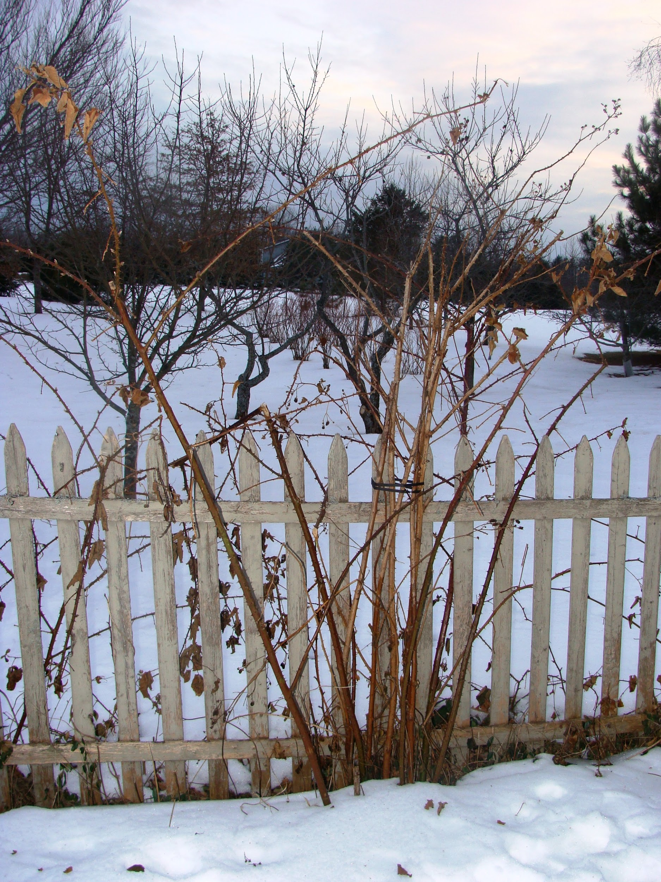
Blackberries

Slide 25
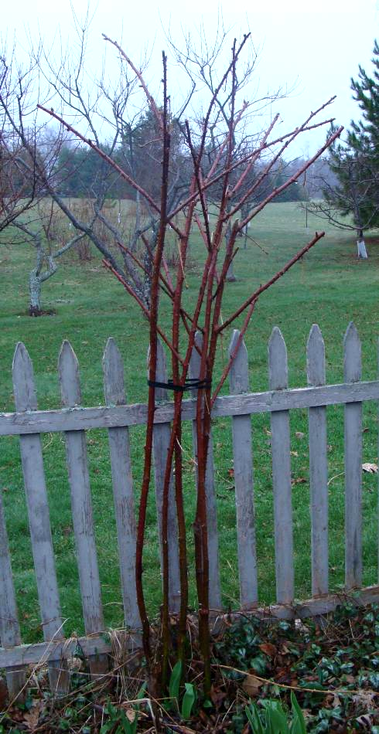
Blackberries

Slide 26
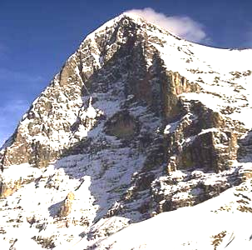
Site Selection: Where to Plant
Site Selection: Where to Plant
Berries need:
Well-drained soil with good organic matter
Good light exposure
Source of water nearby
Soil pH: 6.0 to 6.5
No weed competition
Trellis support
X
Notes:
Site Selection
Well-drained soil with good organic matter
Good light exposure
Gentle slope, elevation
Source of water nearby
Soil pH: 5.8 to 6.5
Eliminate weeds
Avoid nightshades
carry Verticillium

Slide 27
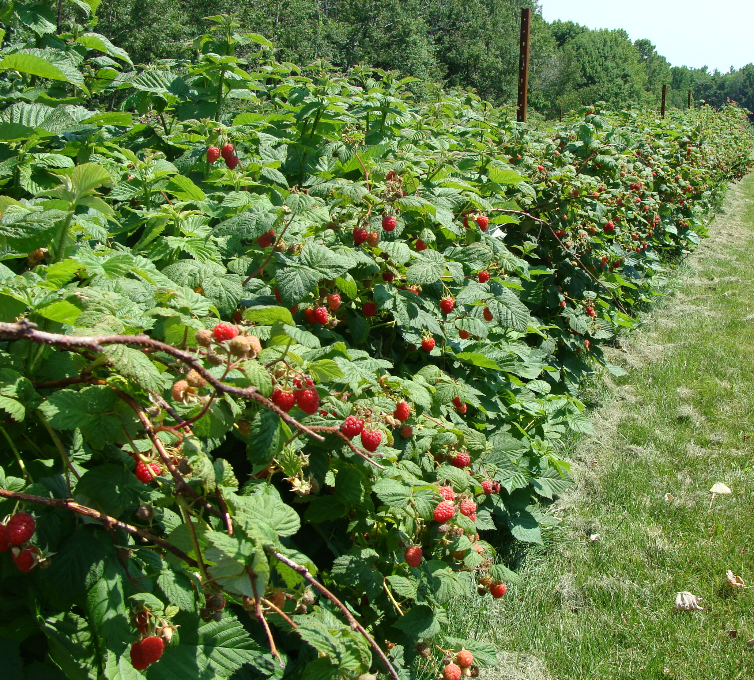
Questions?

