Slide 1
Plasticulture for Vegetable Production
Mark Hutton
University of Maine
Highmoor Farm
Monmouth, Maine
mark.hutton@maine.edu

Slide 2
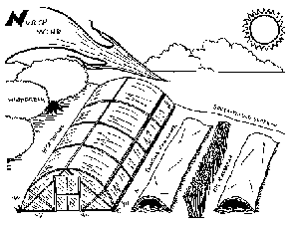
Air Drainage and Frost Pockets
Choose southern facing slopes
A 5º slope in our latitude is equal to the same location 300 miles to the south

Slide 3
Wind Breaks
Two zones of protection
Dependent on
Height
Density
Wind
10x height
1 – 3x height

Slide 4
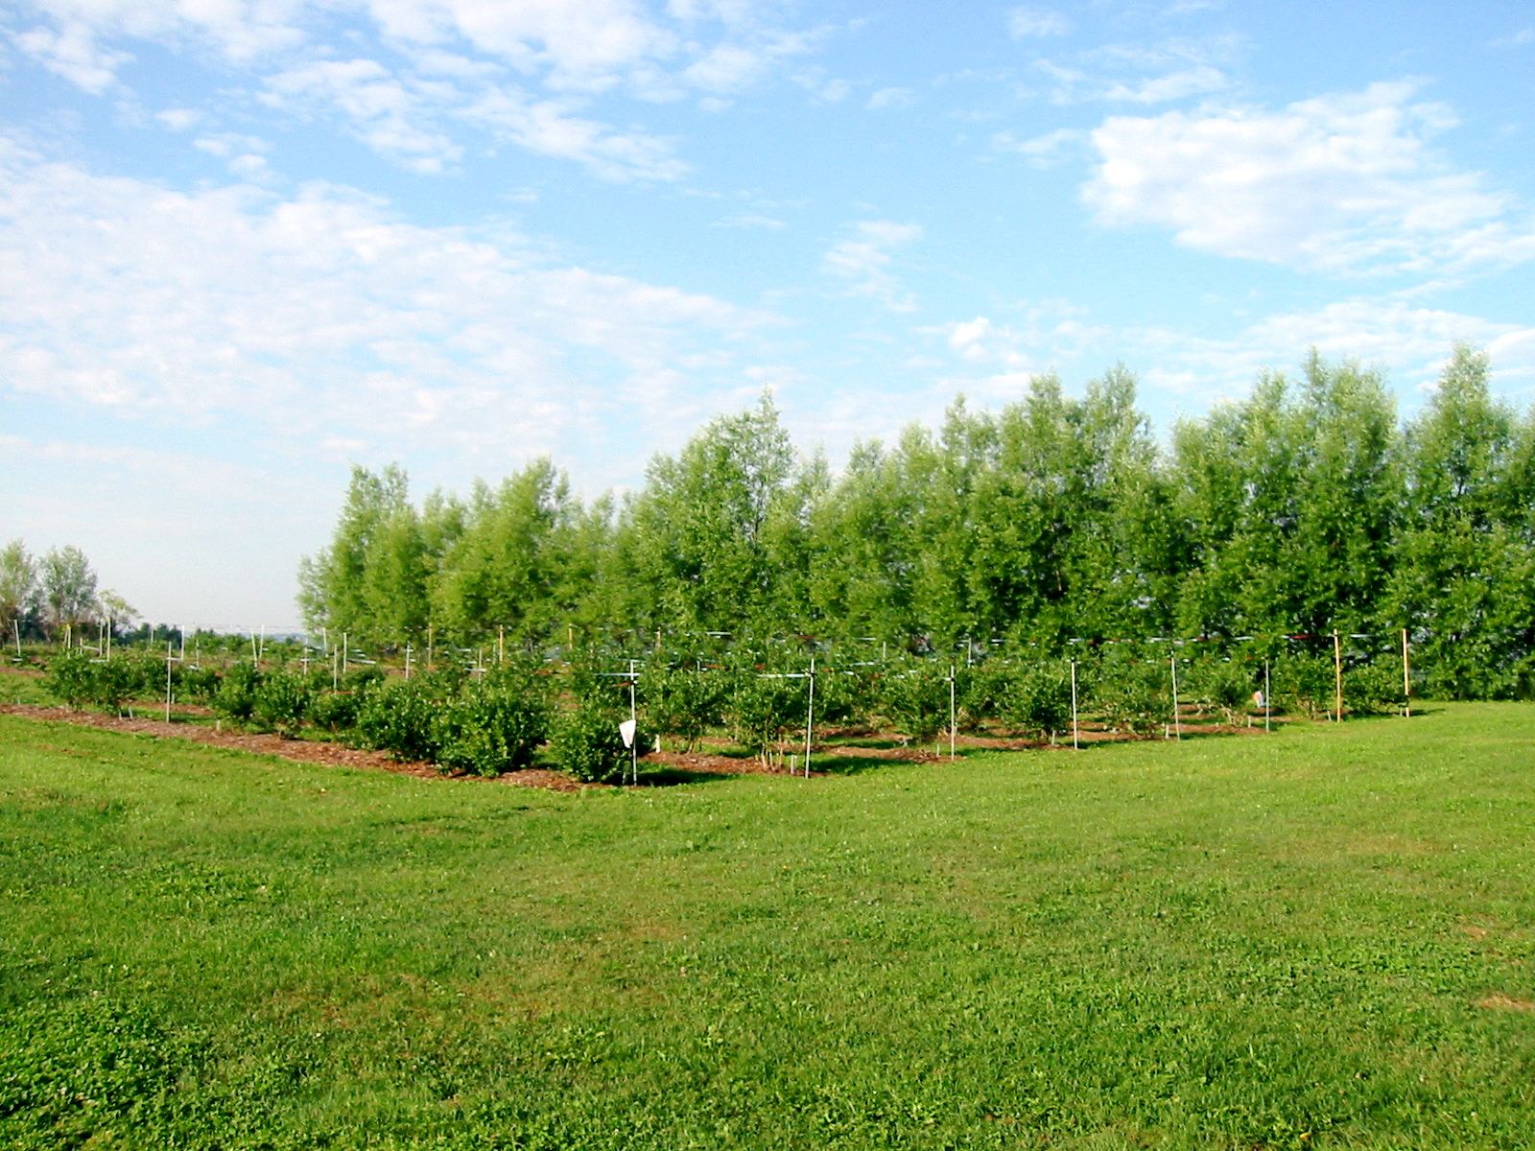
Types of Wind Breaks
Walls
Buildings
Snow fence
Hedge rows

Slide 5
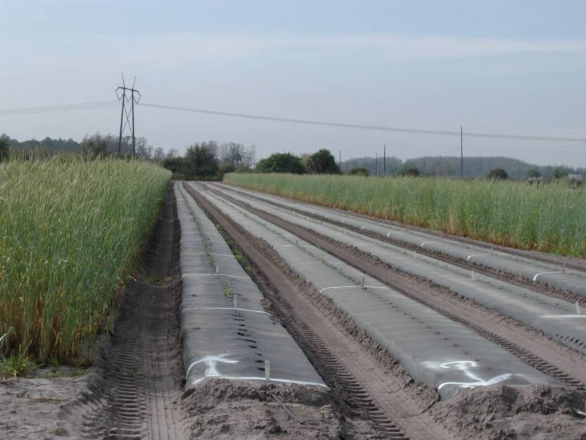
Benefits of Wind Breaks
Micro-climate modification
1-2ºC increase in air temp
Extend season by 10 days
Reduces soil erosion
Conserves water
Influences distribution of crop pests and their natural enemies
1m tall rye = 10 m protected zone

Slide 6
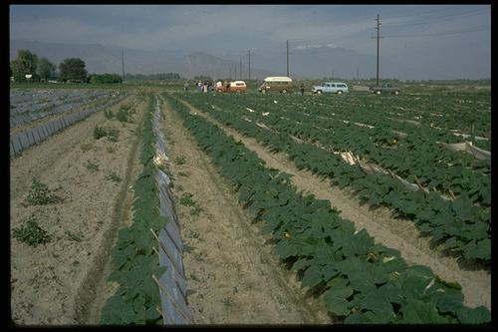
Paper Wind Breaks

Slide 7
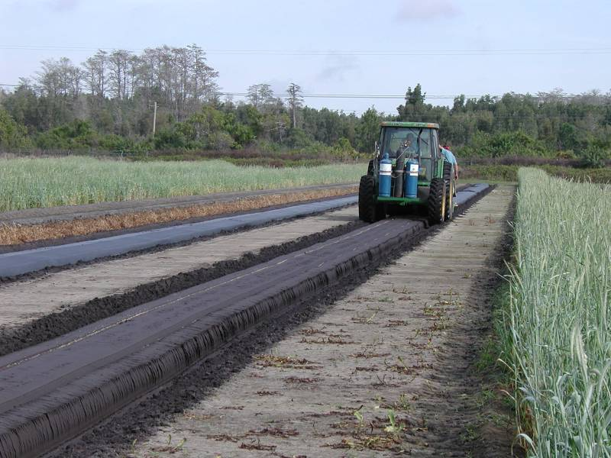
Raised Beds
Improves earliness
Increases soil warming
Better water management
Beds should have a crown shape

Slide 8
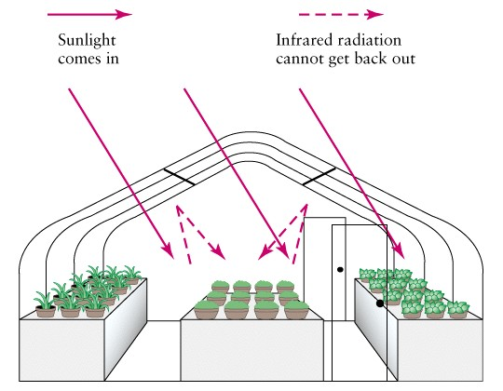
Greenhouse Effect
The principle of the greenhouse effect. Light energy from the Sun consists of short wavelengths in the visible range of the electromagnetic spectrum that pass through the glass of a greenhouse. Reflected energy from plants and the interior of the greenhouse has longer wavelengths (in the infrared range) that do not pass through the glass but reflect back causing heating.

Slide 9
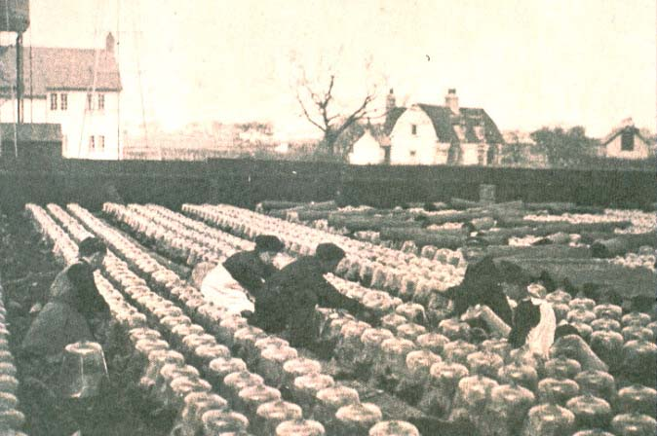
Cloches, Tunnels, and Row Covers
Season Extension is not a new idea . . .
Cloches were originally bell shaped glass jars

Slide 10
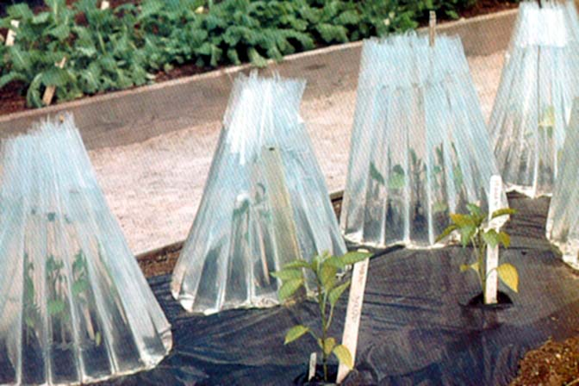
Wall of Water
Moderate day and night time temperature
May require venting on hot days
2.5% bleach in water to prevent algae
In Neb. Study 10.7 days earlier
Yield increases about equal to low tunnels

Slide 11
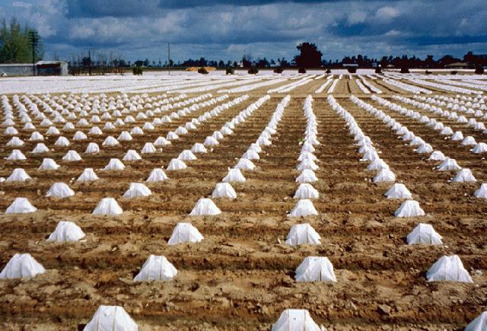
Waxed Paper Hot Caps
Easy to install
Less frost protection vs. other hot caps
Highest daytime temperatures but retain less heat at night

Slide 12
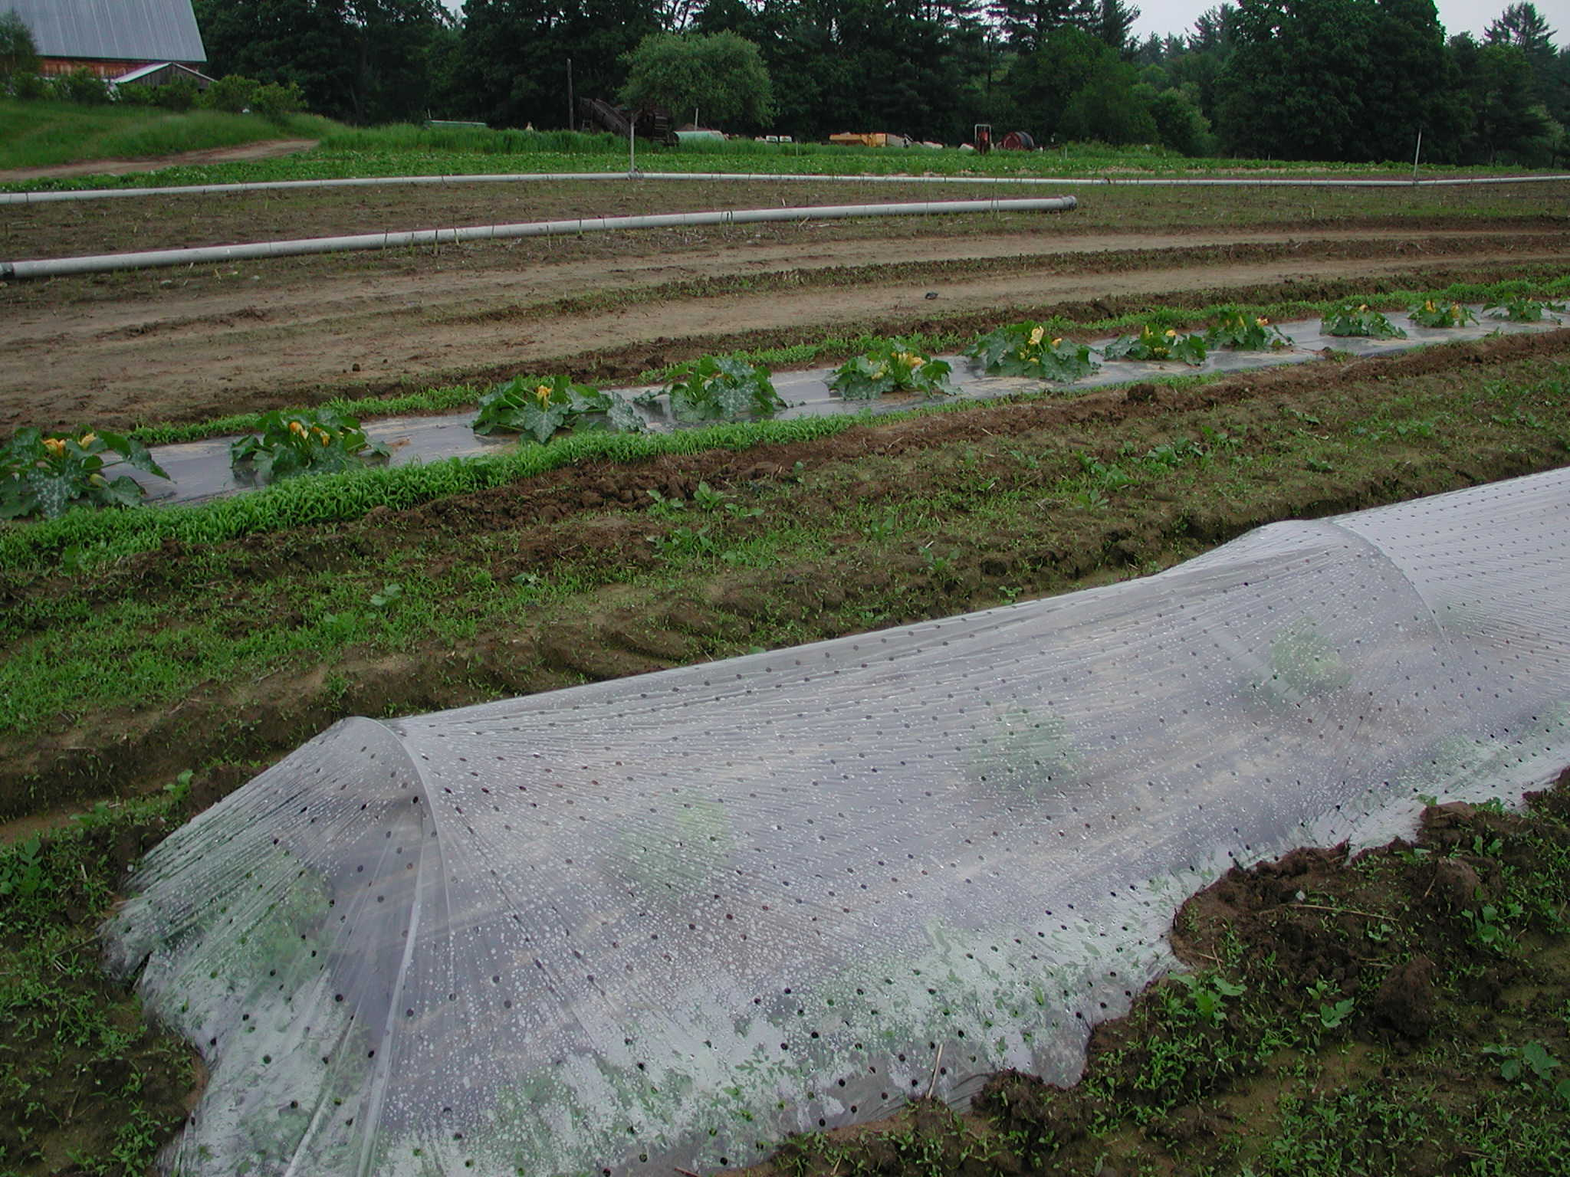
Low Plastic Tunnels
Covers single row
Requires support
Used in early season
Slitted or perforated to vent excess heat
Typically removed by mid-June

Slide 13
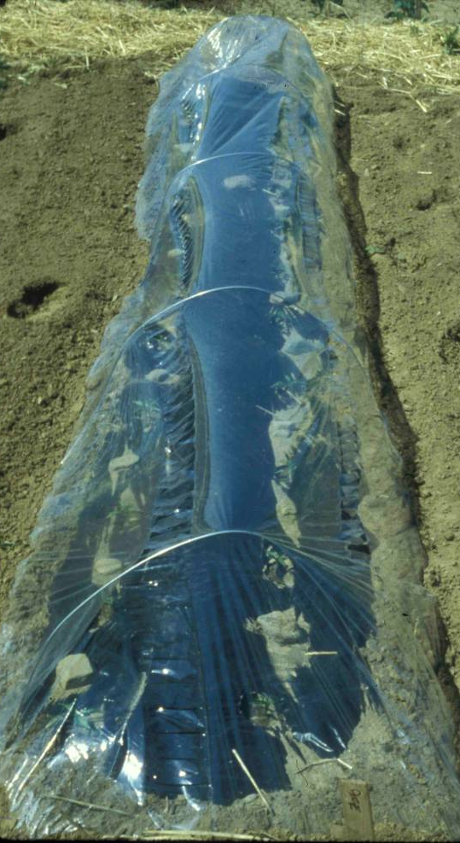
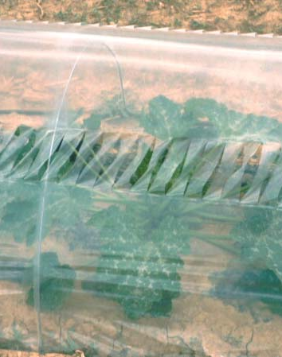
Low Plastic Tunnels
Slits become flexible as temperature increases – opening

Slide 14
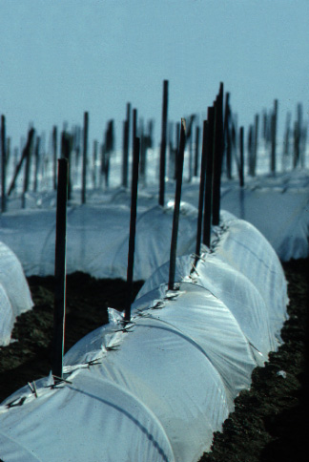
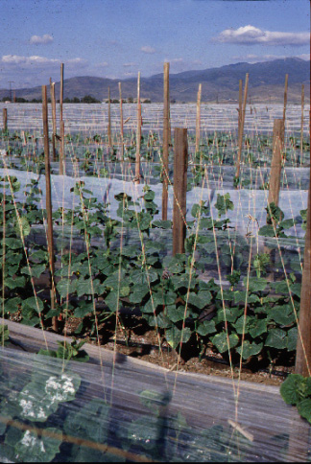
Zip-houses

Slide 15
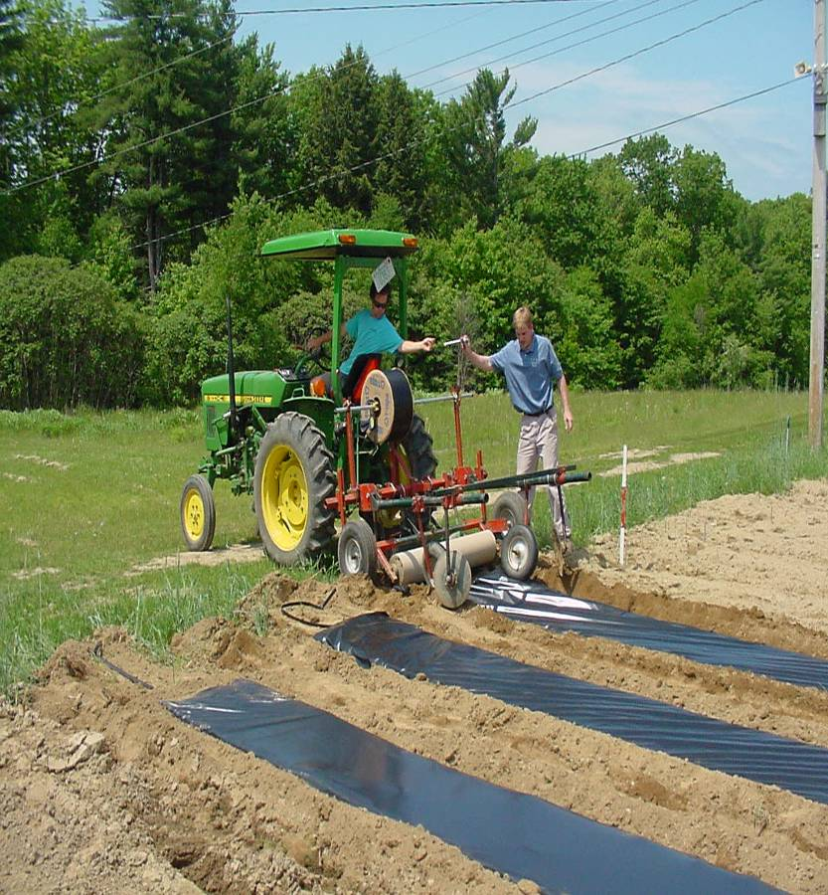
Mulch Benefits
Retains soil moisture
Prevents nutrient leaching from rainfall
Prevents weed growth
Prevents soil compaction
Provides barrier between fruit and ground, keeping fruit clean
Absorbs incoming solar radiation & transfers heat to soil by conduction

Slide 16
Light colored films reflect light
Dark colored films conduct heat to the soil
Clear films all solar energy to directly warm the soil

Slide 17
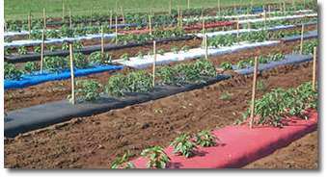
Different Types of Plastics
Clear
IRT Infrared transmitting
Black
Reflective
Mulch colors
  Red
  Blue
  Yellow

Slide 18
Clear Mulch
Transmits 85-95% of solar radiation
Temperatures warmer than bare soil
  4-8ºC at 5 cm
  3-5ºC at 10cm

Slide 19
IRT Mulch
Green or brown color
Allows IR through to soil but not PAR
Temperatures warmer than bare soil
  3-6ºC at 5 cm
  2ºC at 10cm

Slide 20
Black Mulch
Prevents weed growth
Temperatures warmer than bare soil
  2.8ºC at 5 cm
  1.7ºC at 10cm

Slide 21
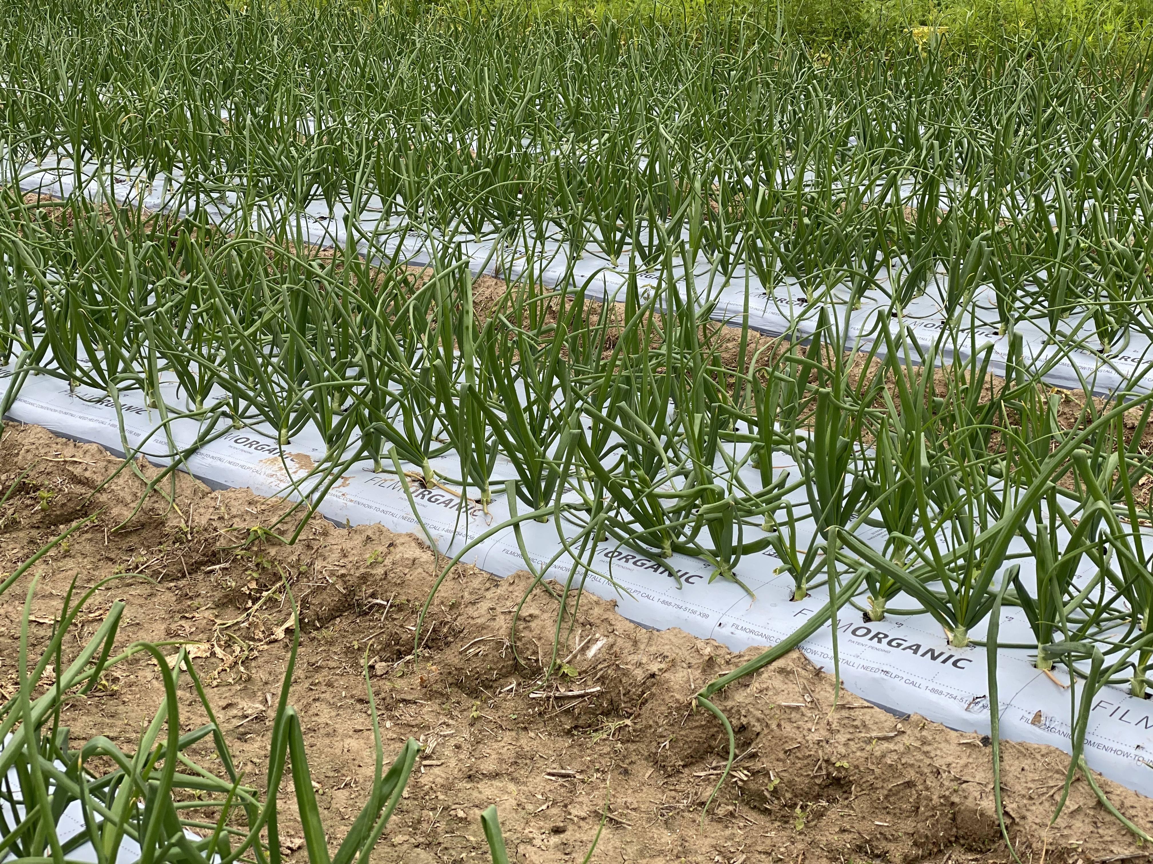
White Mulch
Prevents weed growth
Temperatures like bare soil during the day, but warmer at night
Soil temperature cooler than mulched with black
  5ºC at 5 cm

Slide 22
Degradable Plastic Mulches
Black
White
White on Black
Longevity varies by manufacturer and thickness
Typically, more expensive
Eliminates retrieval and disposal costs
Not allowed by many organic certifiers

Slide 23
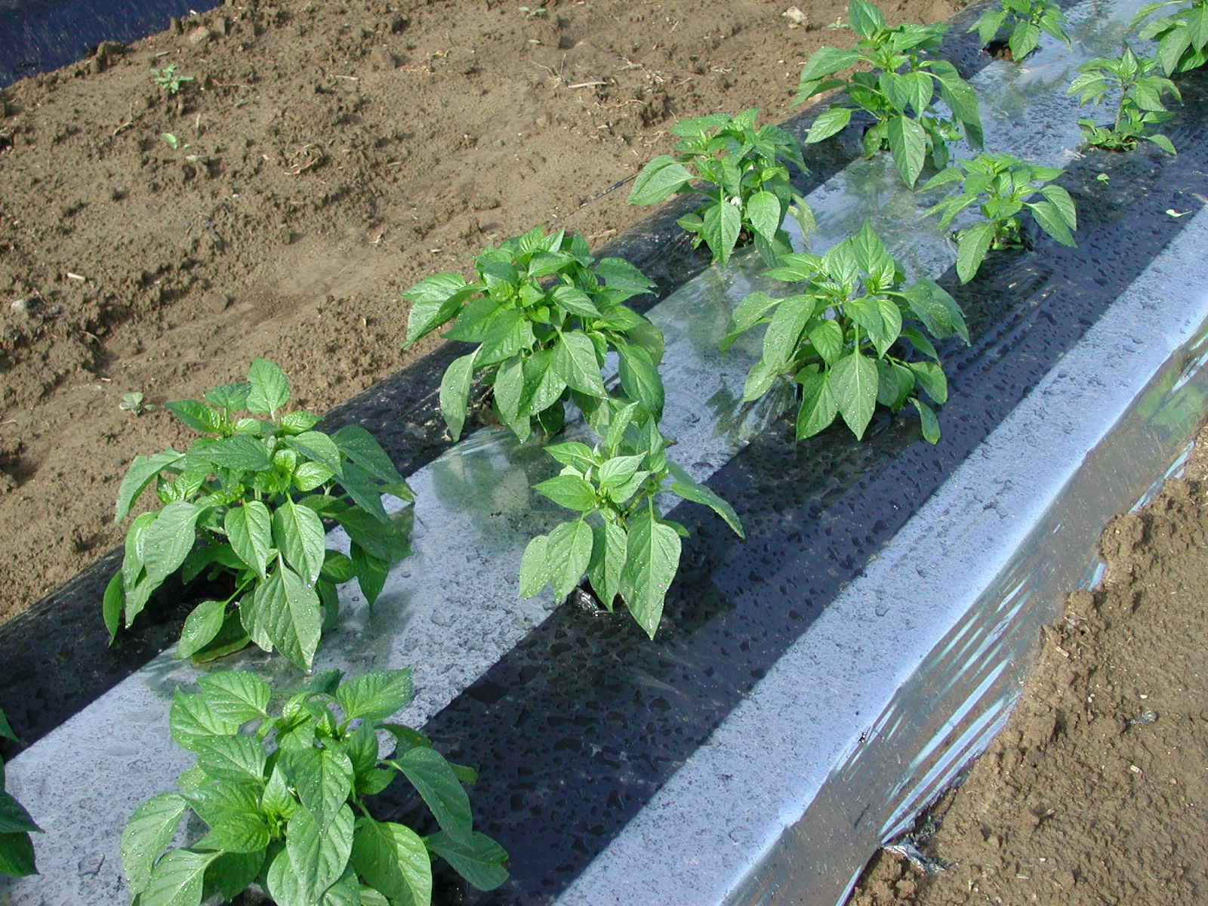
Reflective Mulch
Prevents weed growth
Temperatures cooler than bare soil during the day, but warmer at night
Soil temperature cooler than mulched with black
  8 ºC at 5 cm

Slide 24
Colored Mulch
Red
Can increase yield tomato yield up to 20% vs black mulch
Poor weed control
Cost much more $62 more for 600’ roll
Dark Blue
Can increase yield of some cucurbits
Difficult to find
Attracts Thrips

Slide 25
Coolest
Warmest
White
Black
Clear
IRT
Highly Reflective
Weed Free
Weedy
Black
White
Clear
IRT
Highly Reflective

Slide 26
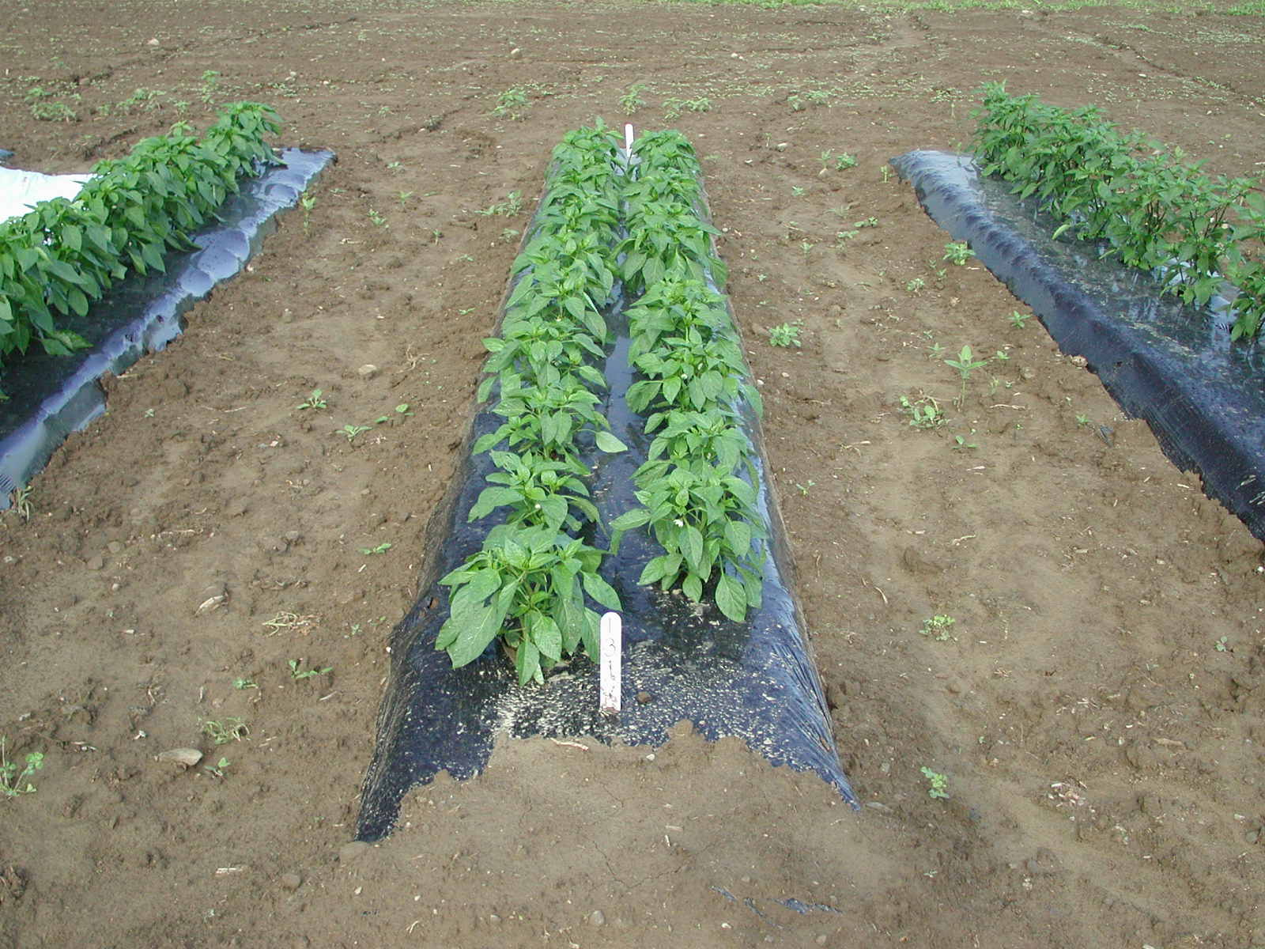
Black Plastic

Slide 27
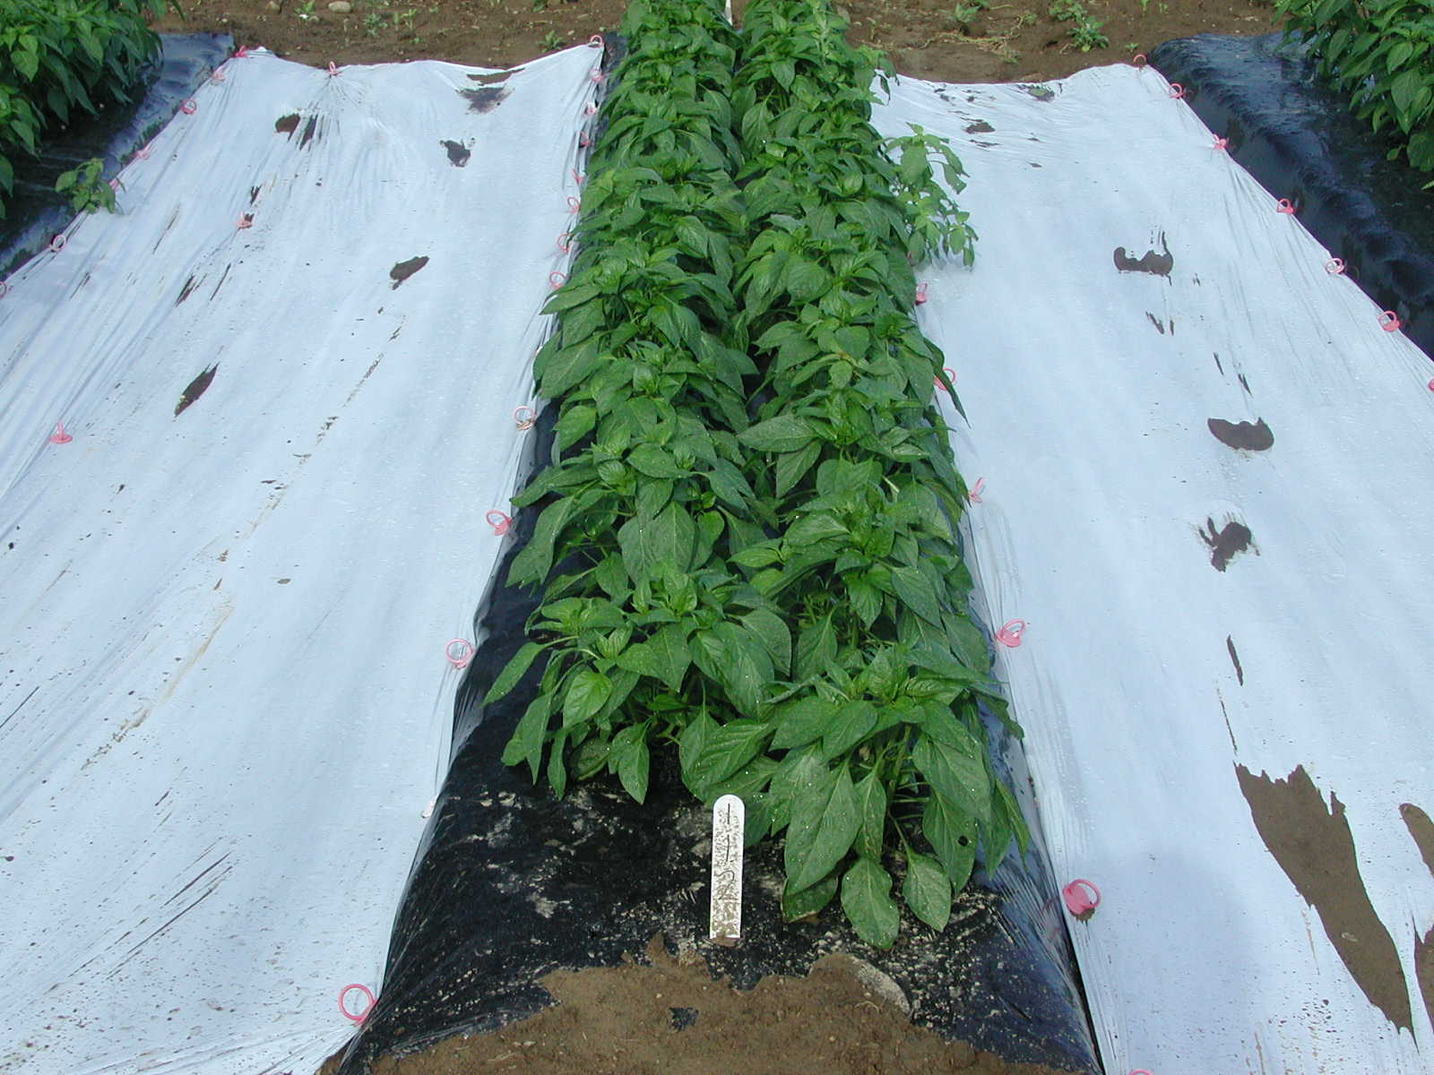
Black Plastic and White Inter-row Mulch

Slide 28
Reflective Mulch

Slide 29
Mulching Techniques to Improve Pepper Yield

Slide 30
Pepper Yield From Different Mulch Treatments
A
A
B

Slide 31
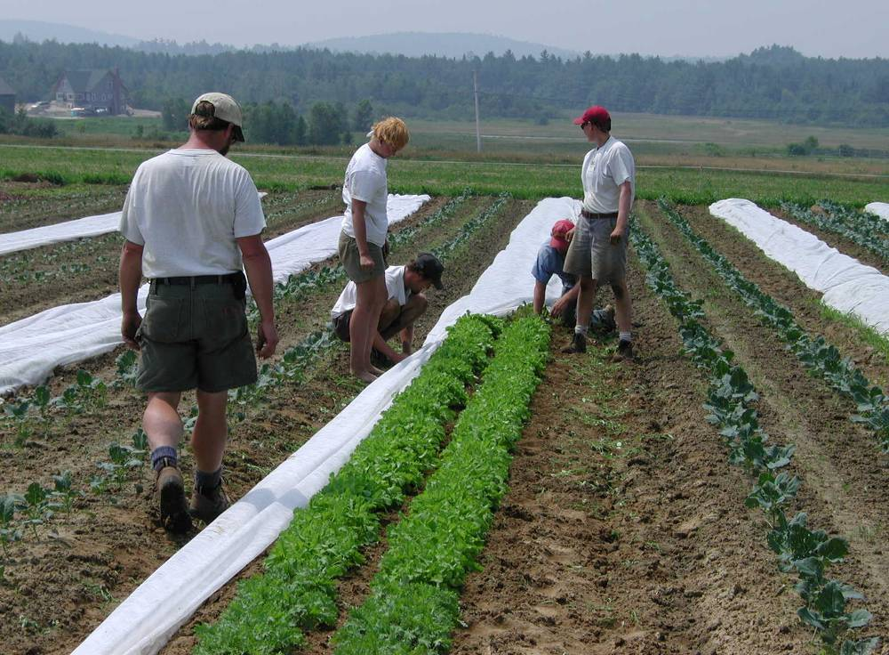
Floating Row Covers
Increase temperature in crop environment
Increase yields and earliness
Can be used to reduce insect attack

Slide 32
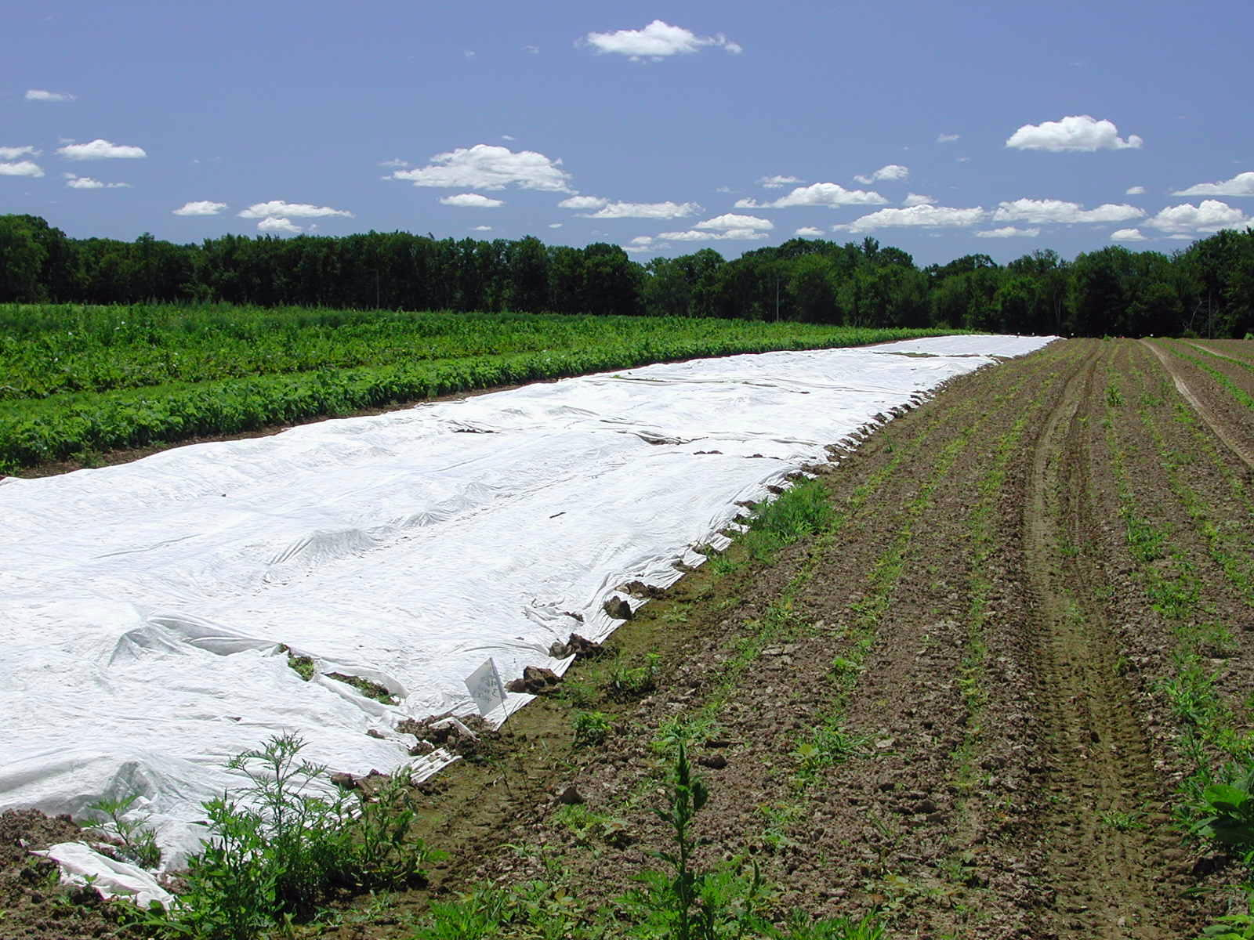
Floating Row Covers
Cover more than one row
With care can be used 3-5 years
Available in different weights
Frost protection to ~28ºF with heavier materials (0.3 to 2 oz. Per yard)

Slide 33
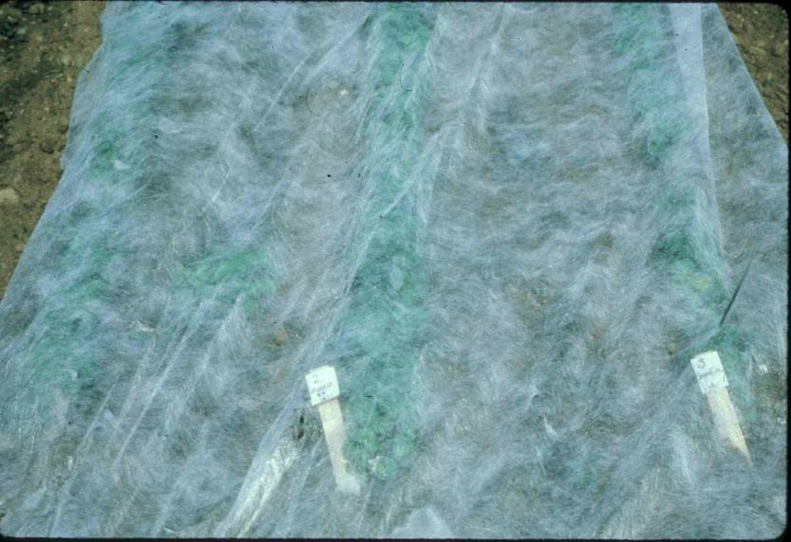
Floating Row Covers
Allow 70-80% transmission of available light
Remove when temperatures in the 80’s
Don’t work as well for tomatoes & peppers

Slide 34
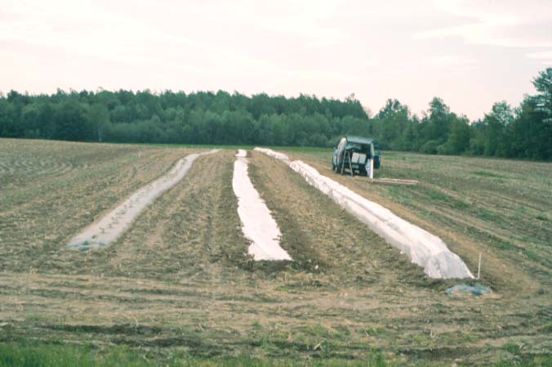

Slide 35
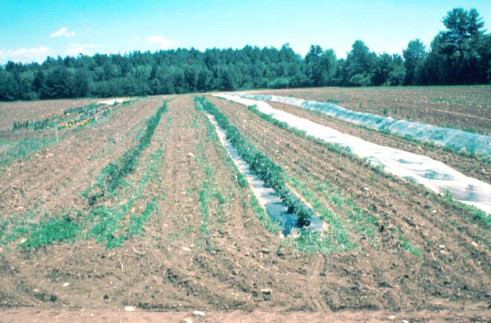

Slide 36
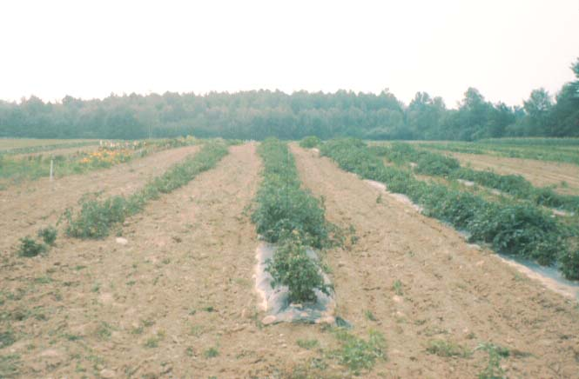

Slide 37
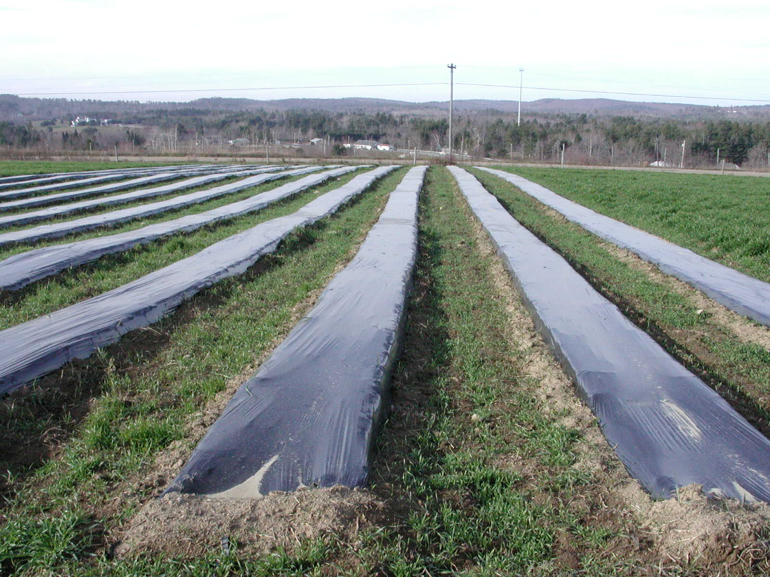
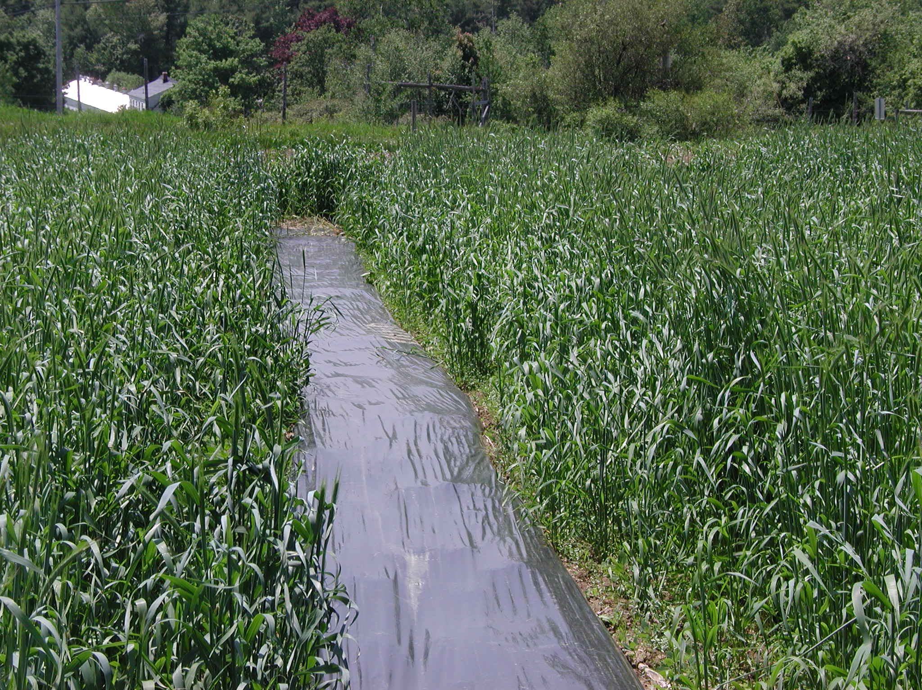
Fall Made Beds
Establish beds between late August until early October
Need to have time for rye cover crop to establish
Kill cover crop in spring
  Mowing
  Herbicide prior to planting

Slide 38
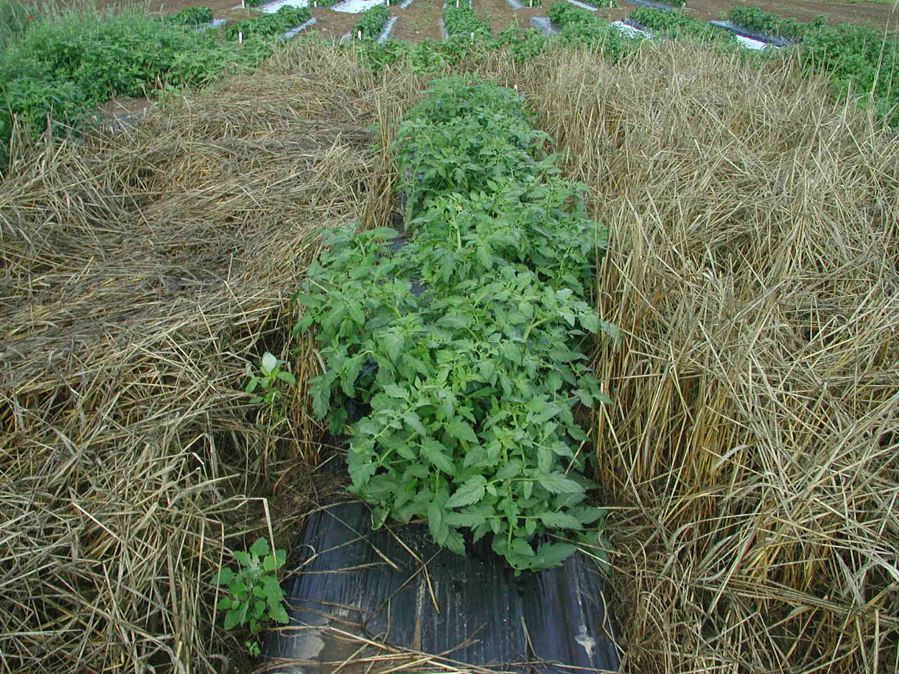
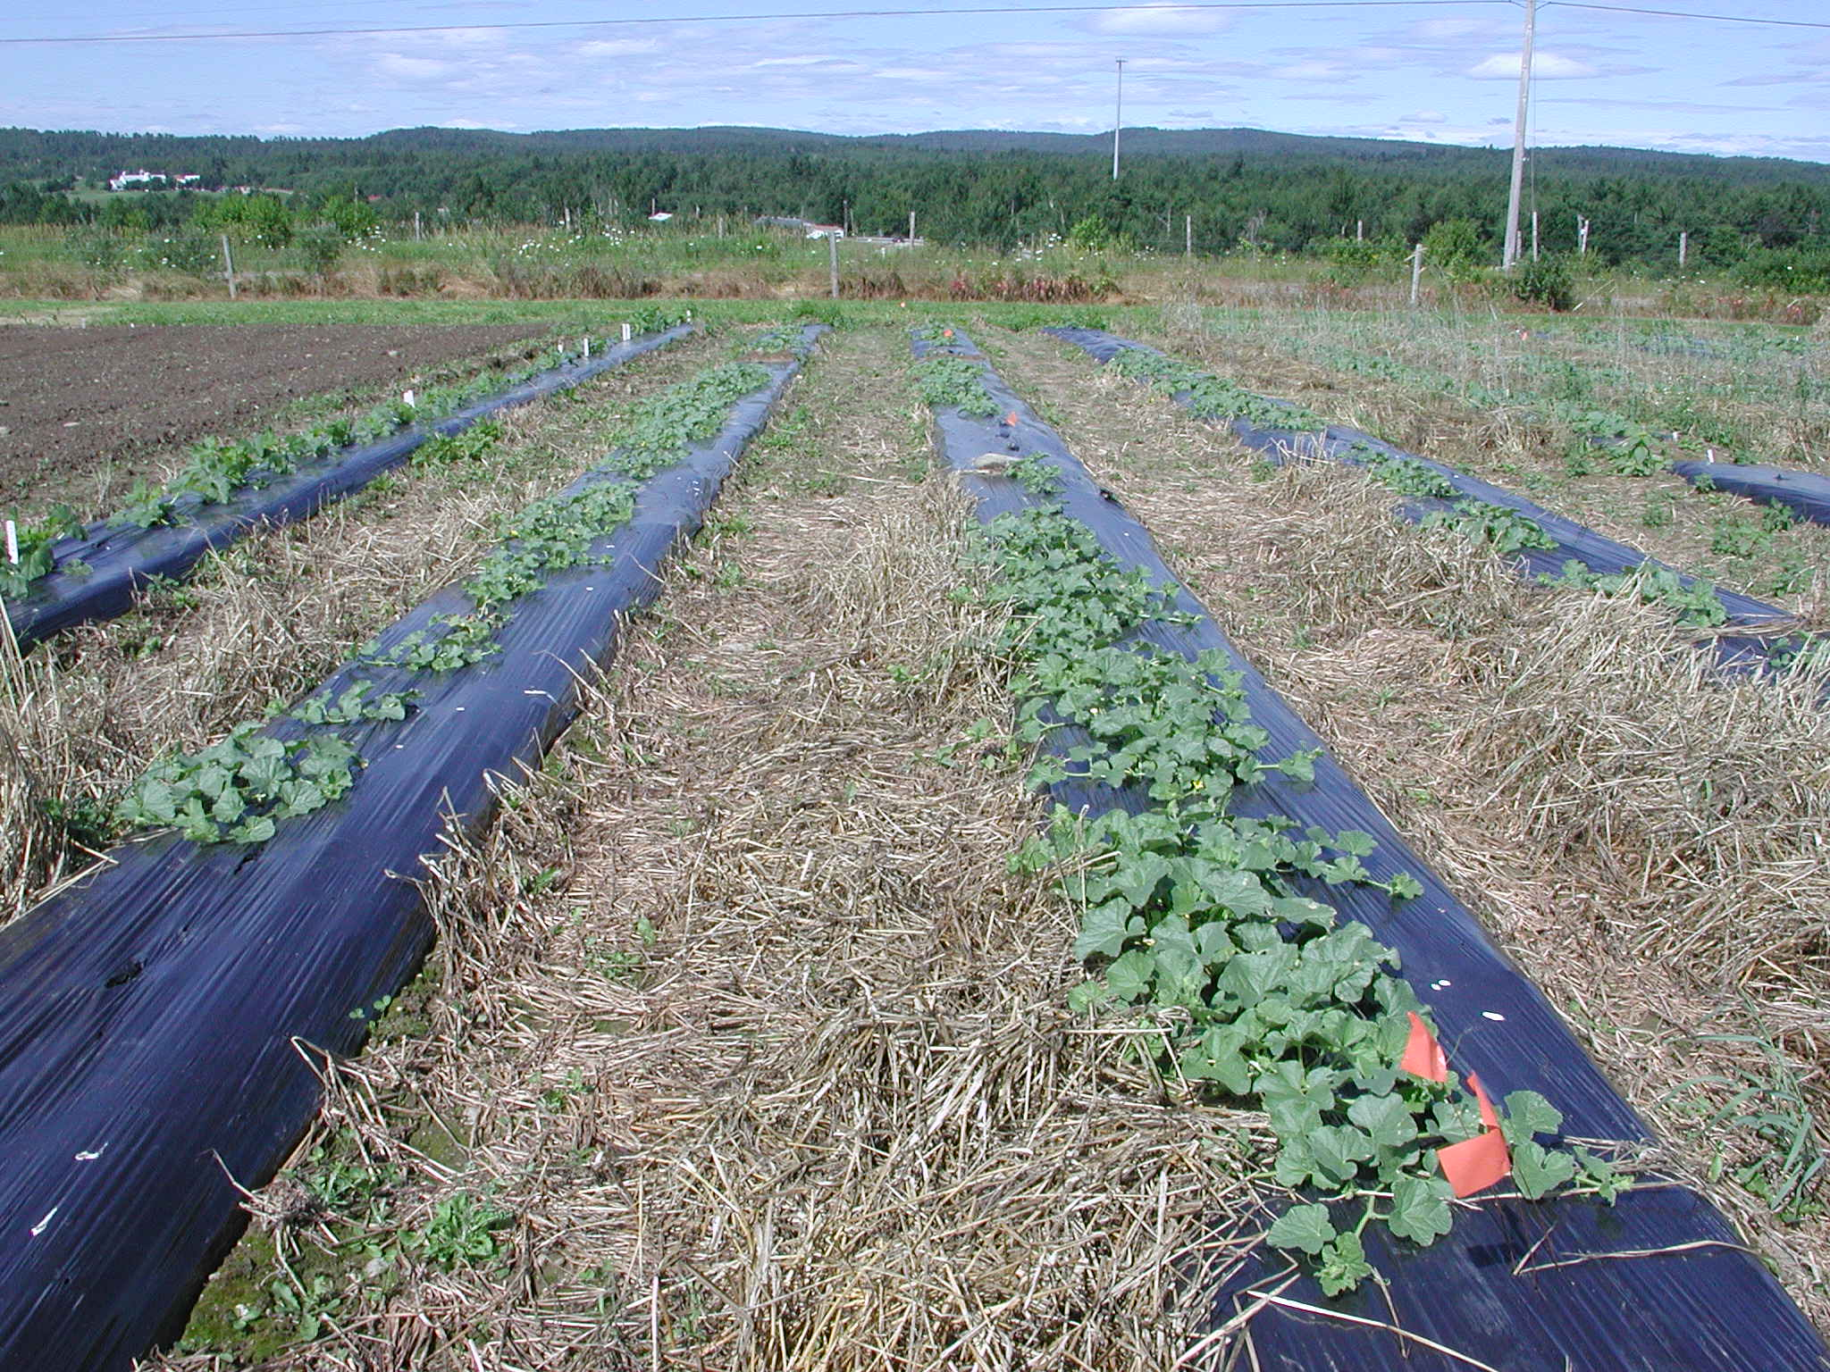
Fall Made Beds
Advantages
  Weed management
  Weed seed reductions
  Wind breaks in early season enhance earliness and yield
  Allows for earlier spring planting
  In some years double the yields with tomato
Disadvantages
  Time and land constraints in fall
  Damage to plastic over the winter
  Some plastic will need replacing

Slide 39
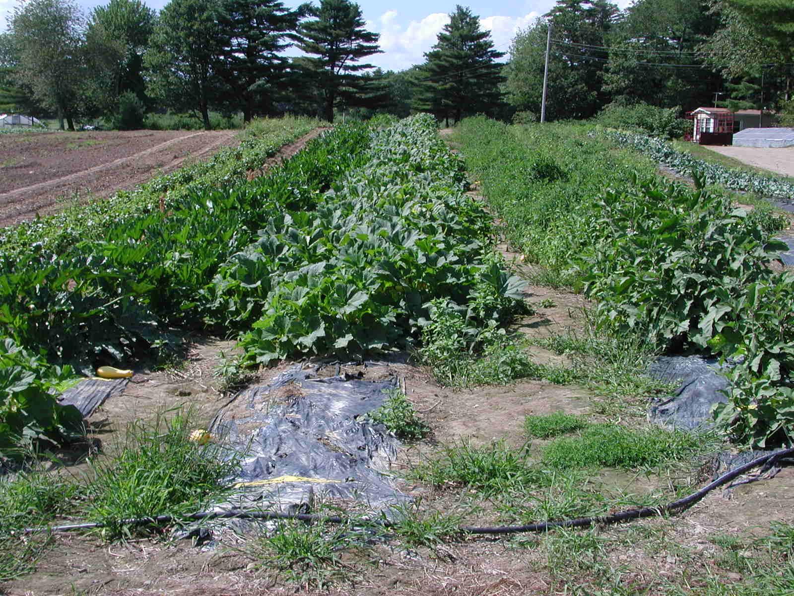
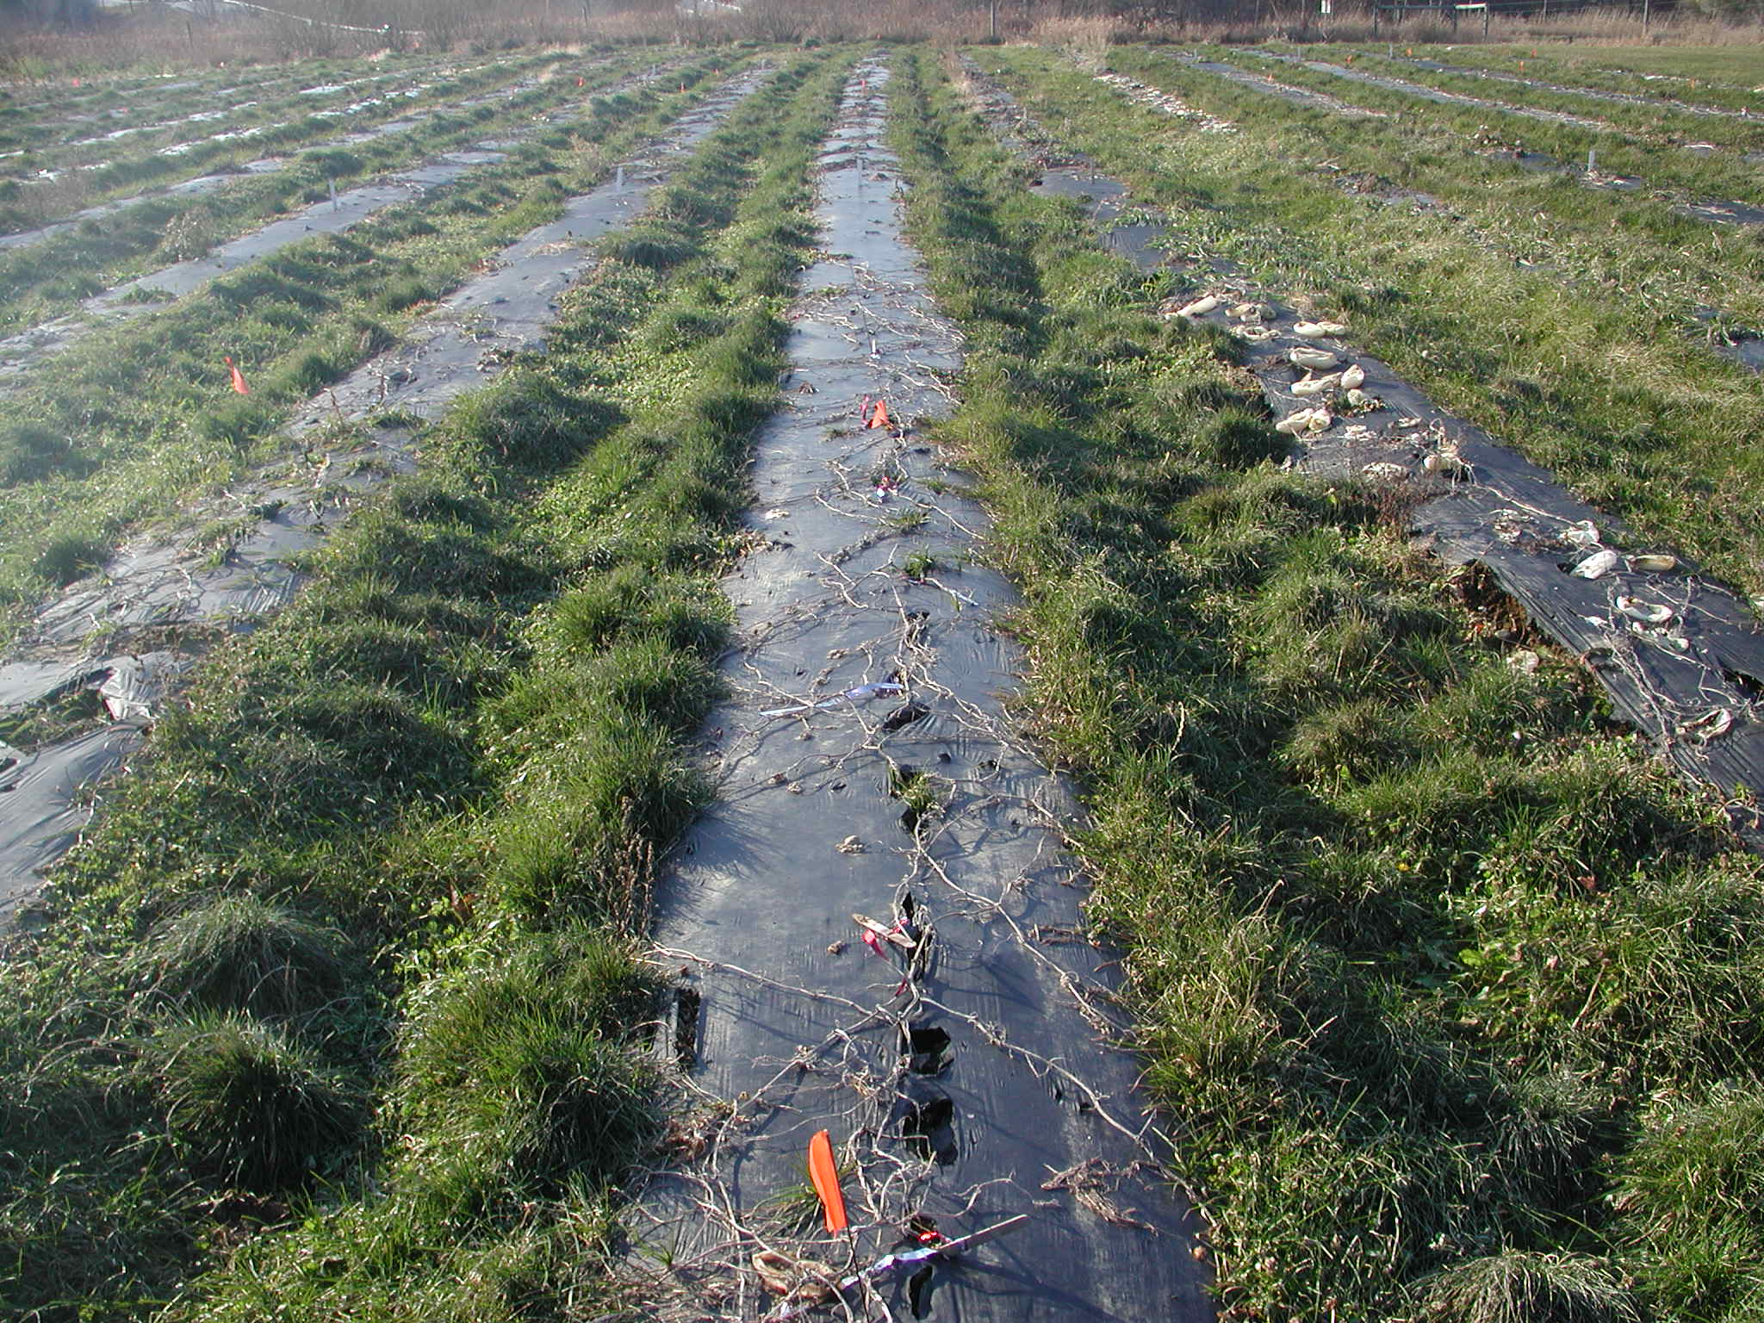
Why Hybrid Mulching
Seeking to combine the benefits of ‘No-till’ with plasticulture
Seeking to make better use of the plastic by cropping multiple years – reduces amount of waste disposal
Seeking to improve soil health
Seeking to reduce weed population
Seeking to maximize economic returns

Slide 40
Hybrid Mulch Study
Experiments initiated in Fall of 2004 and 2005
  Applied ~50 yd³ compost per acre
  Form beds and lay plastic
    Pliant plastic 1.5 mil
      18 month Micro embossed
      18 month Taffeta embossed
      24 month extended life
  Three crop rotations compared to each other and to conventional spring made beds
    T-C-P
    C-T-P
  No supplemental irrigation
  No additional fertility aside from starter at transplanting
  Tracked
    harvest yields and quality
    time required for all operations

Slide 41
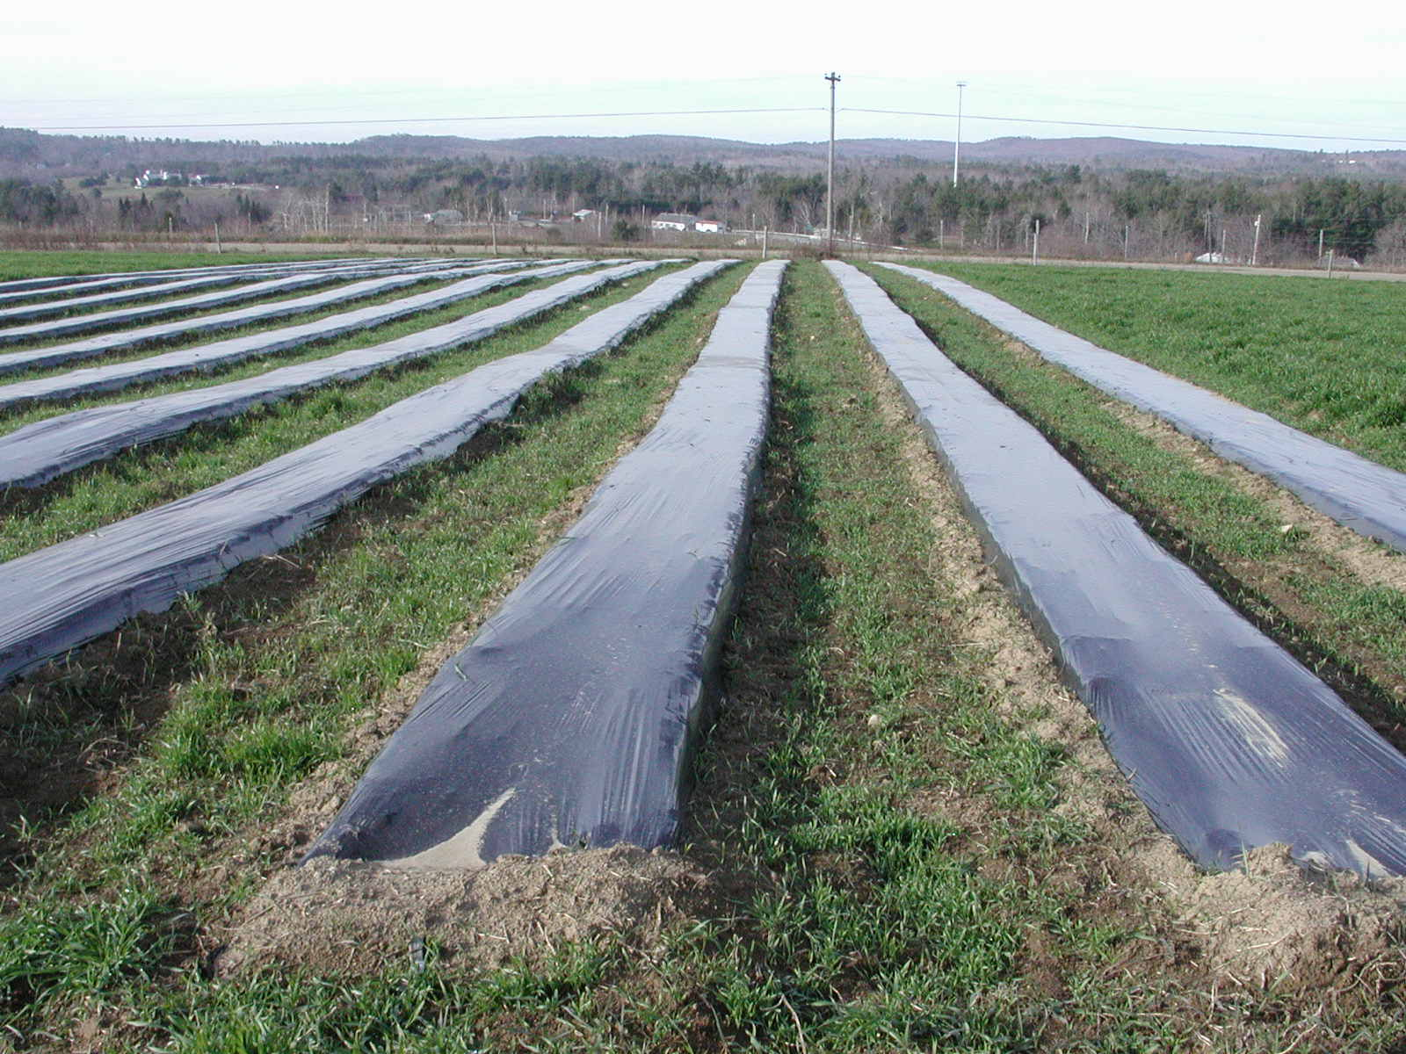
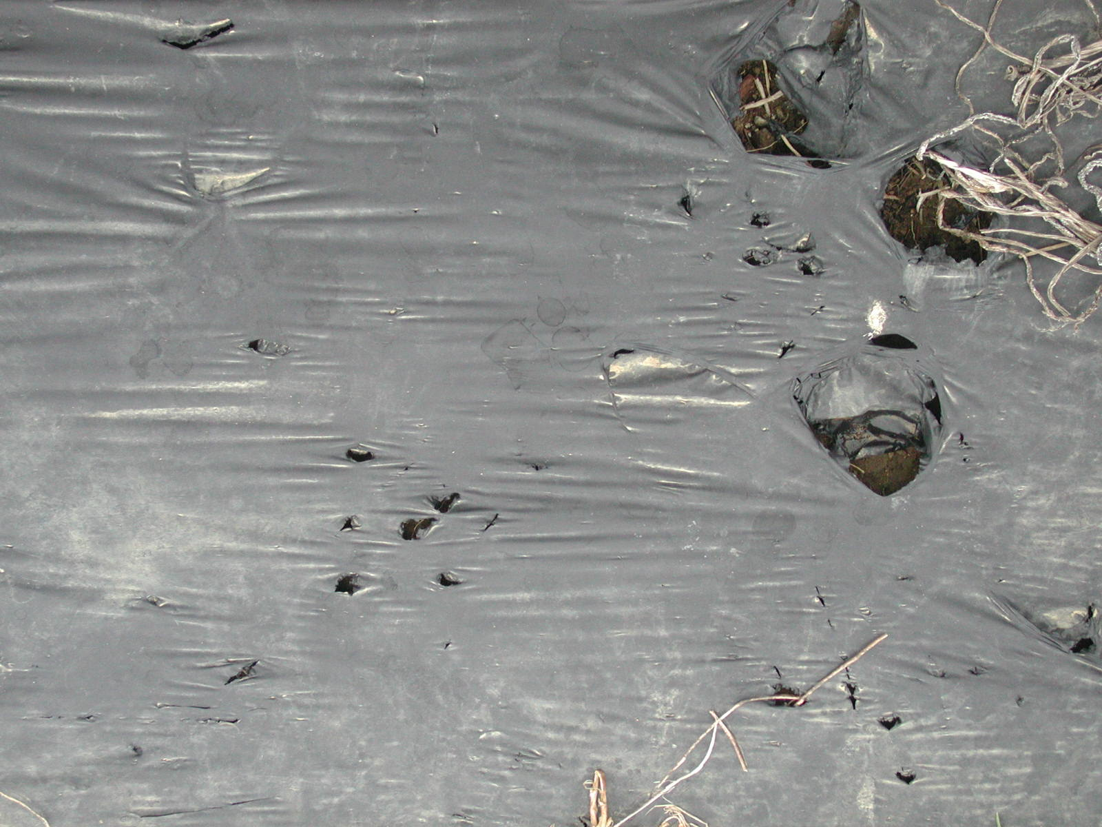
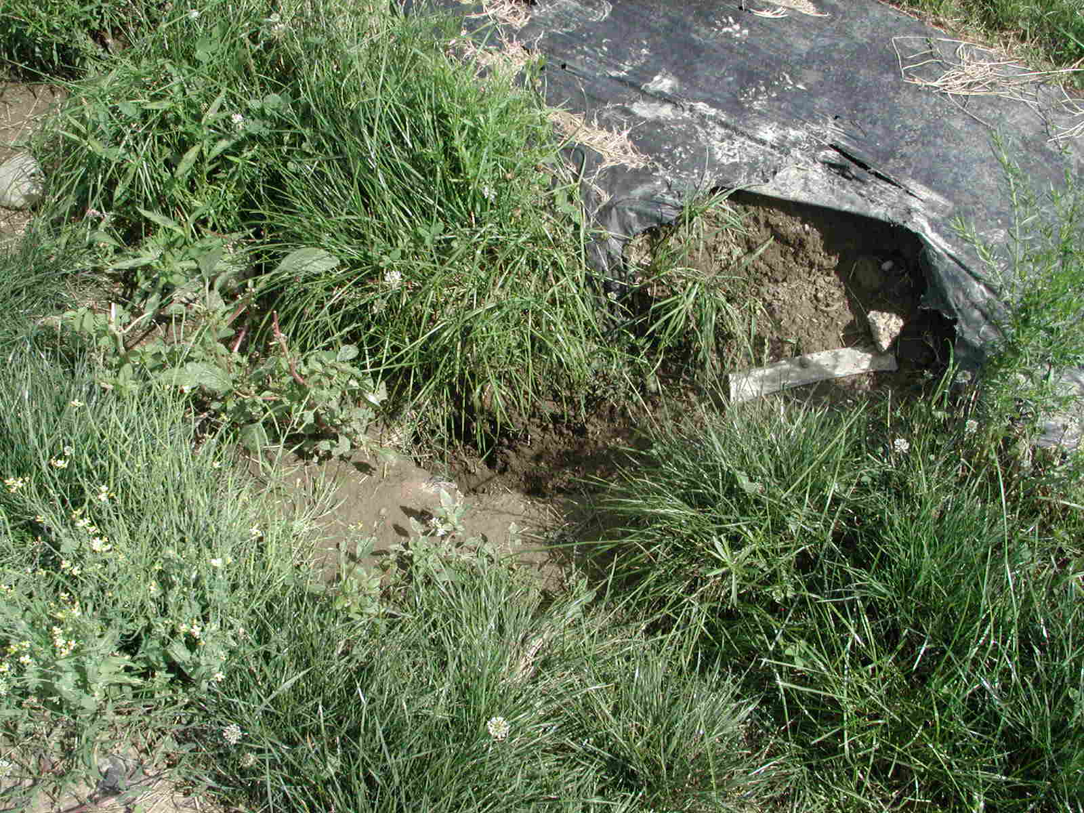
Results
Plastic Mulch Performance
All 3 types of plastic performed equally well over 3 cropping seasons
Major damage came from vertebrates which led to weed pressure
Wind damage

Slide 42
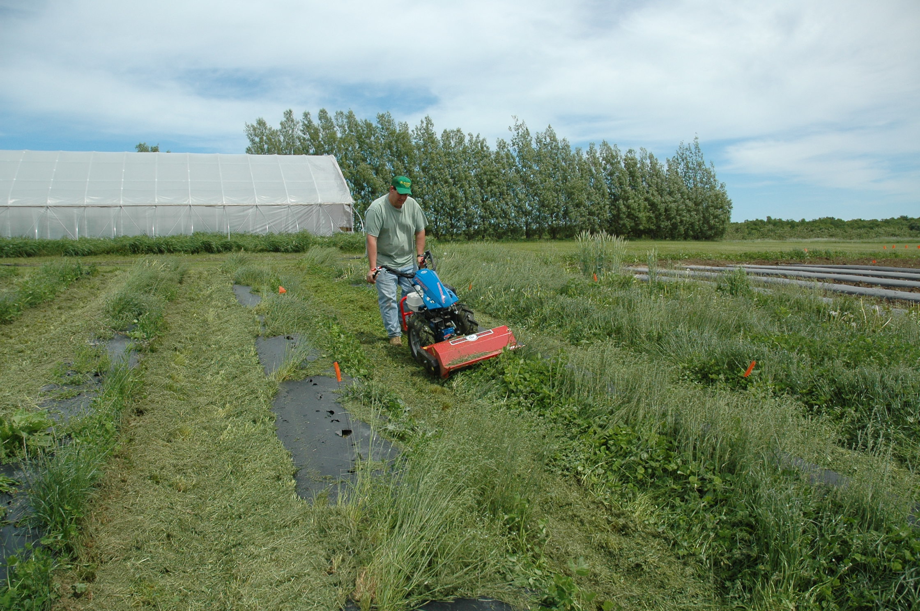
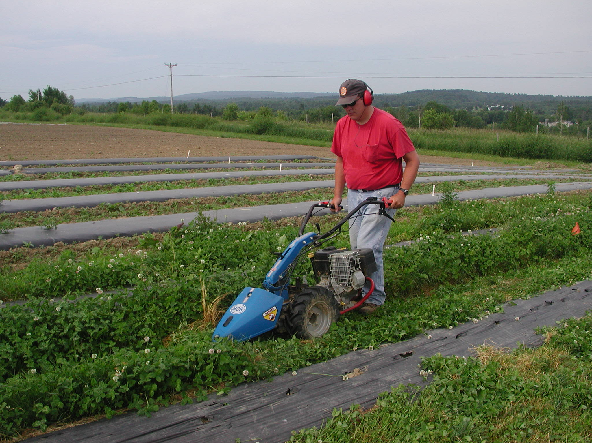
Considerations for Perennial Beds
Availability of irrigation / fertigation
Amount of ‘front loading’ of nutrients – composts or manures
Multiple mowings compared to fewer cultivations

Slide 43
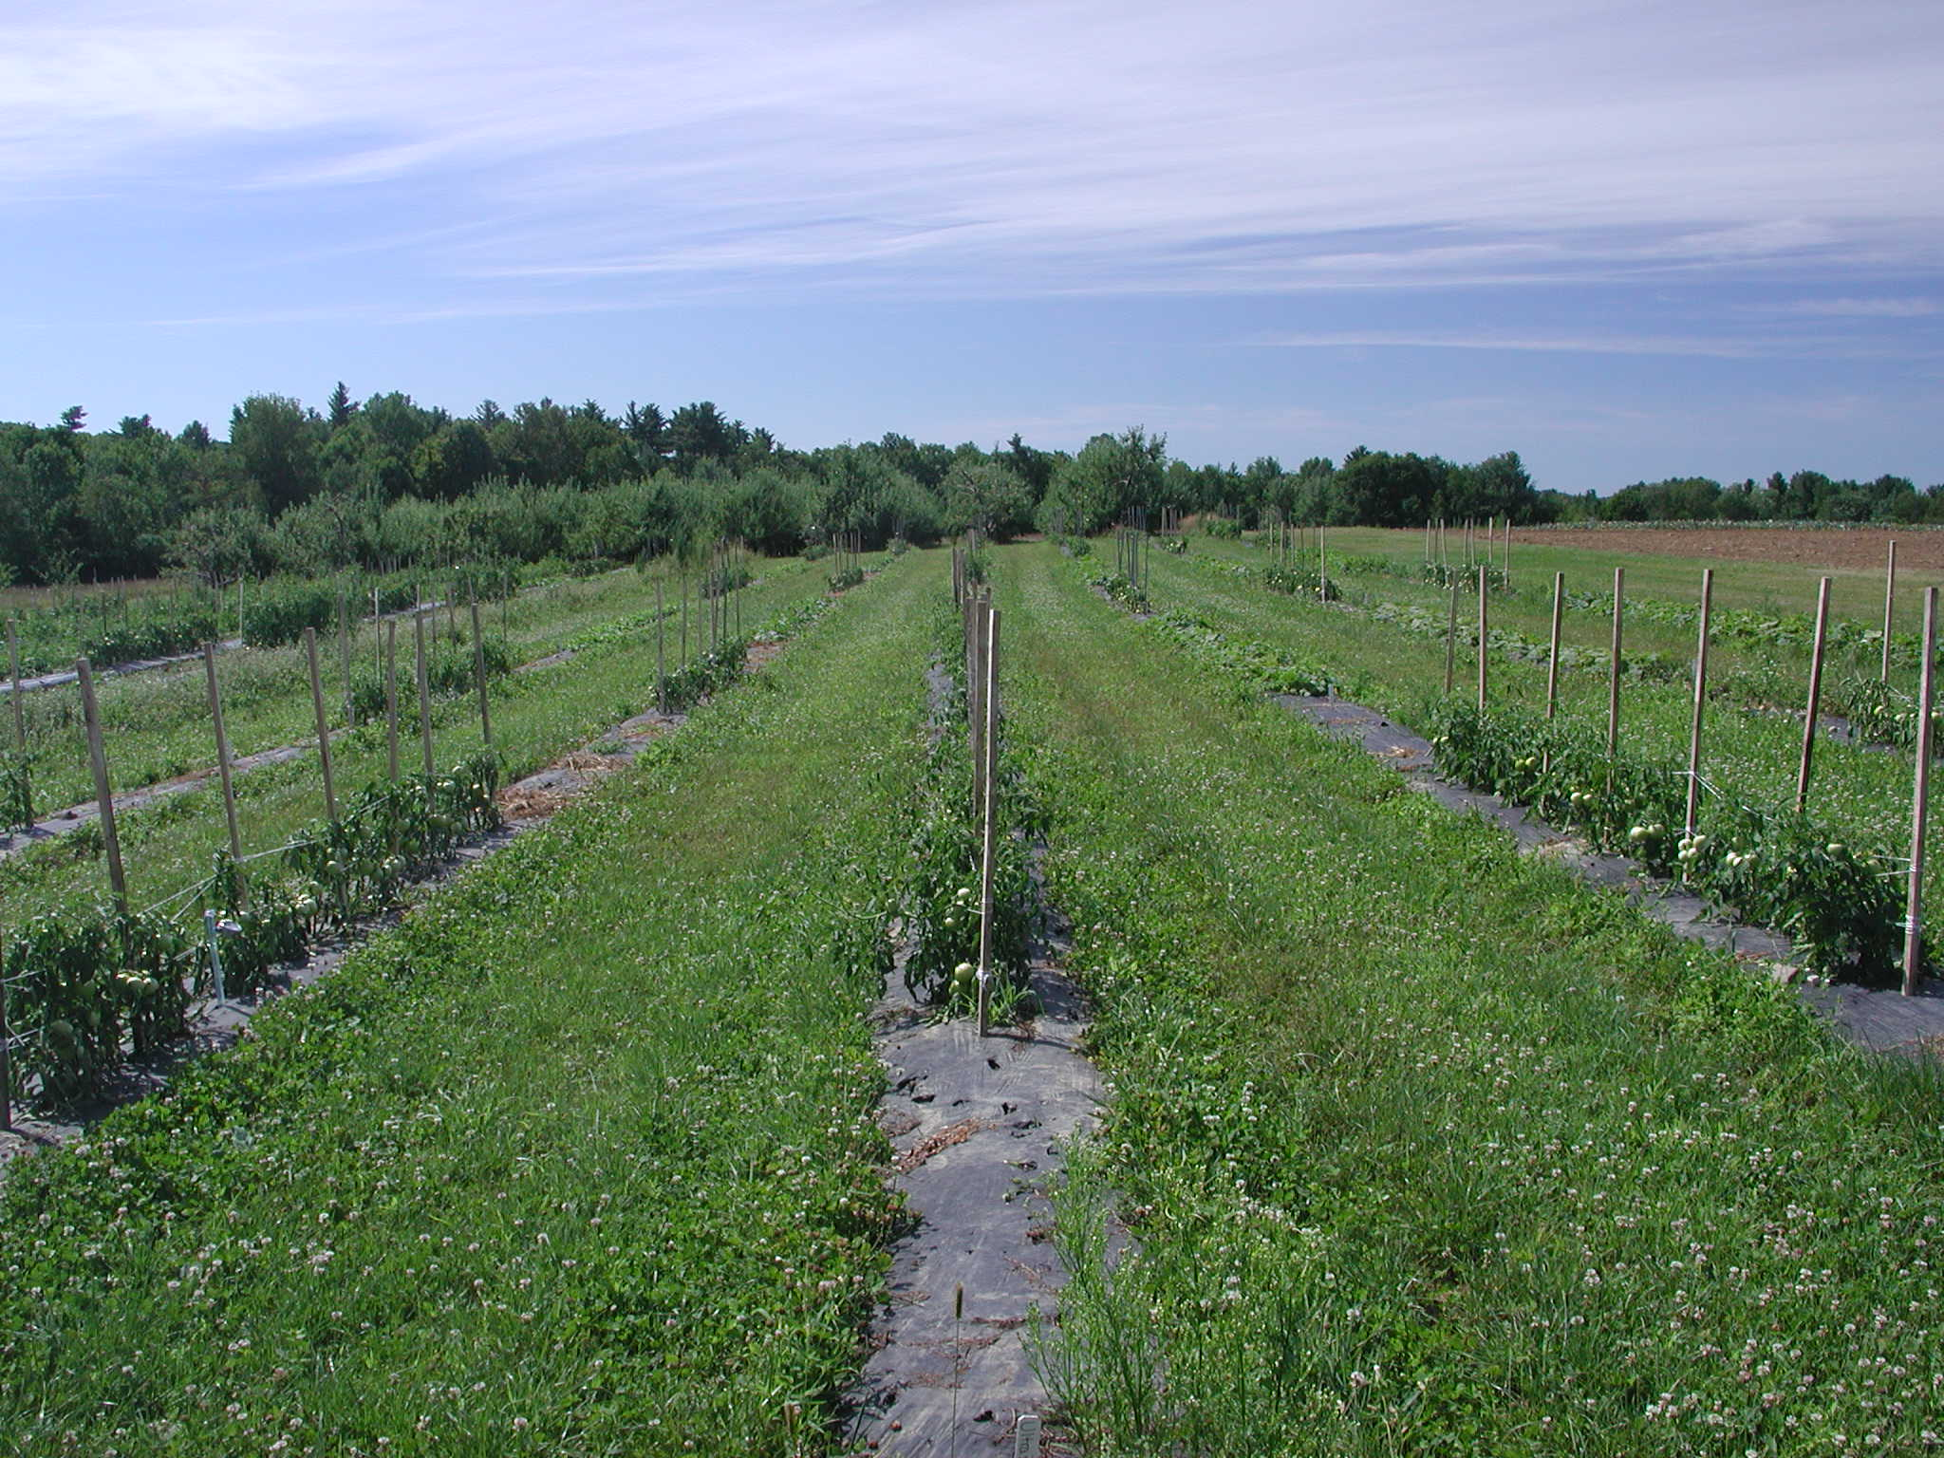
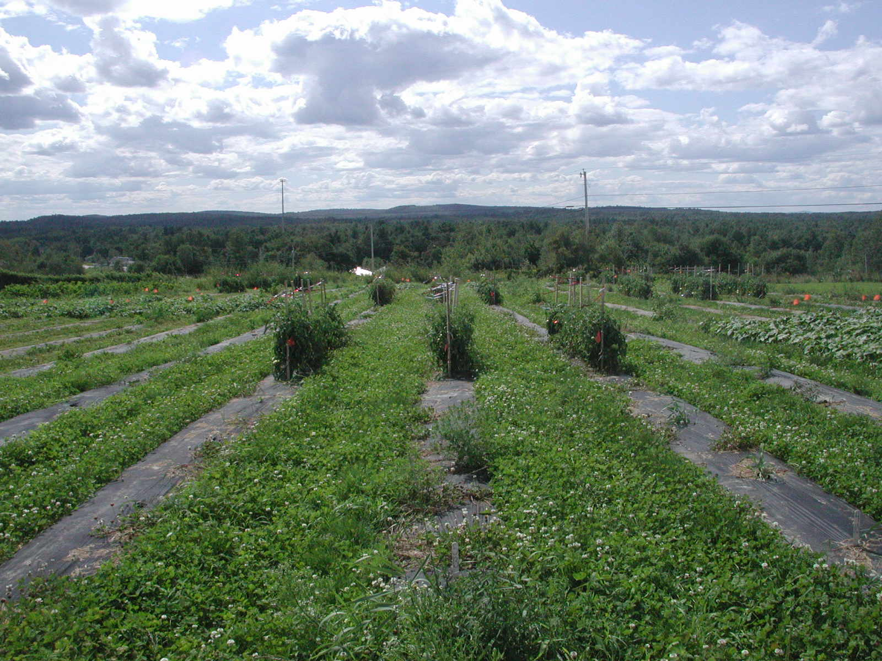

Slide 44
Results
Yields from 2005 to 2007- Rotation TCP

Slide 45
Results
Yields from 2005 to 2007 - Rotation CTP

Slide 46
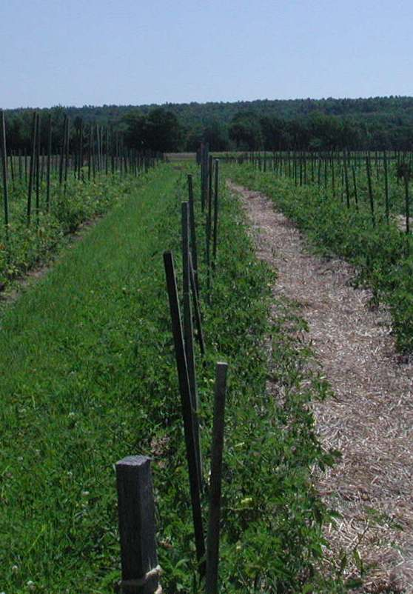
Grower Experiences
Earlier planting
Earlier harvest
Smaller plant size
Yields may have been reduced
Mowing was difficult to schedule

Slide 47
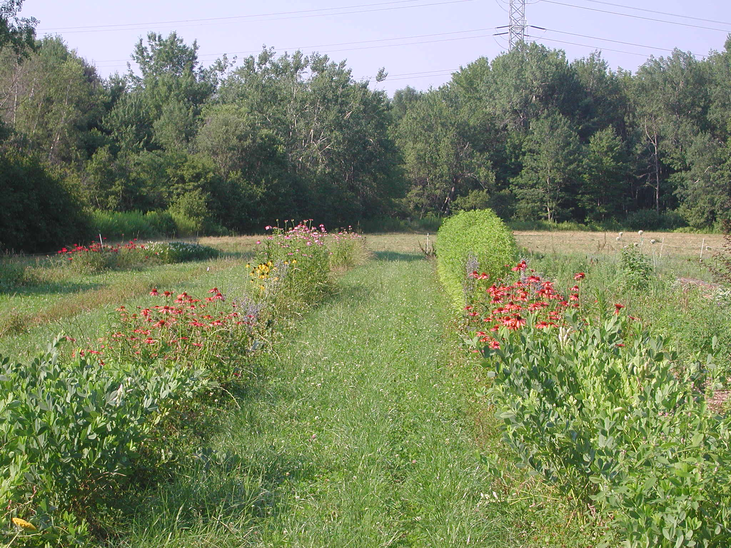
Grower Experiences
Mixture of annual and perennial flowers
Light soil
More frequent irrigation
Yield and quality acceptable
Earlier harvest

Slide 48
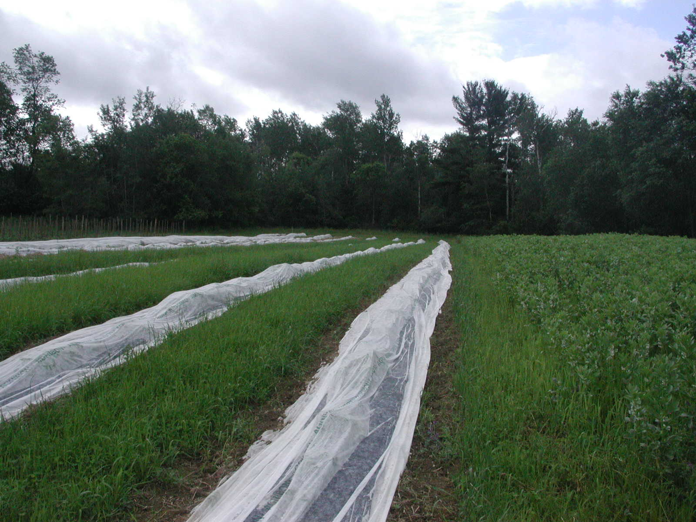
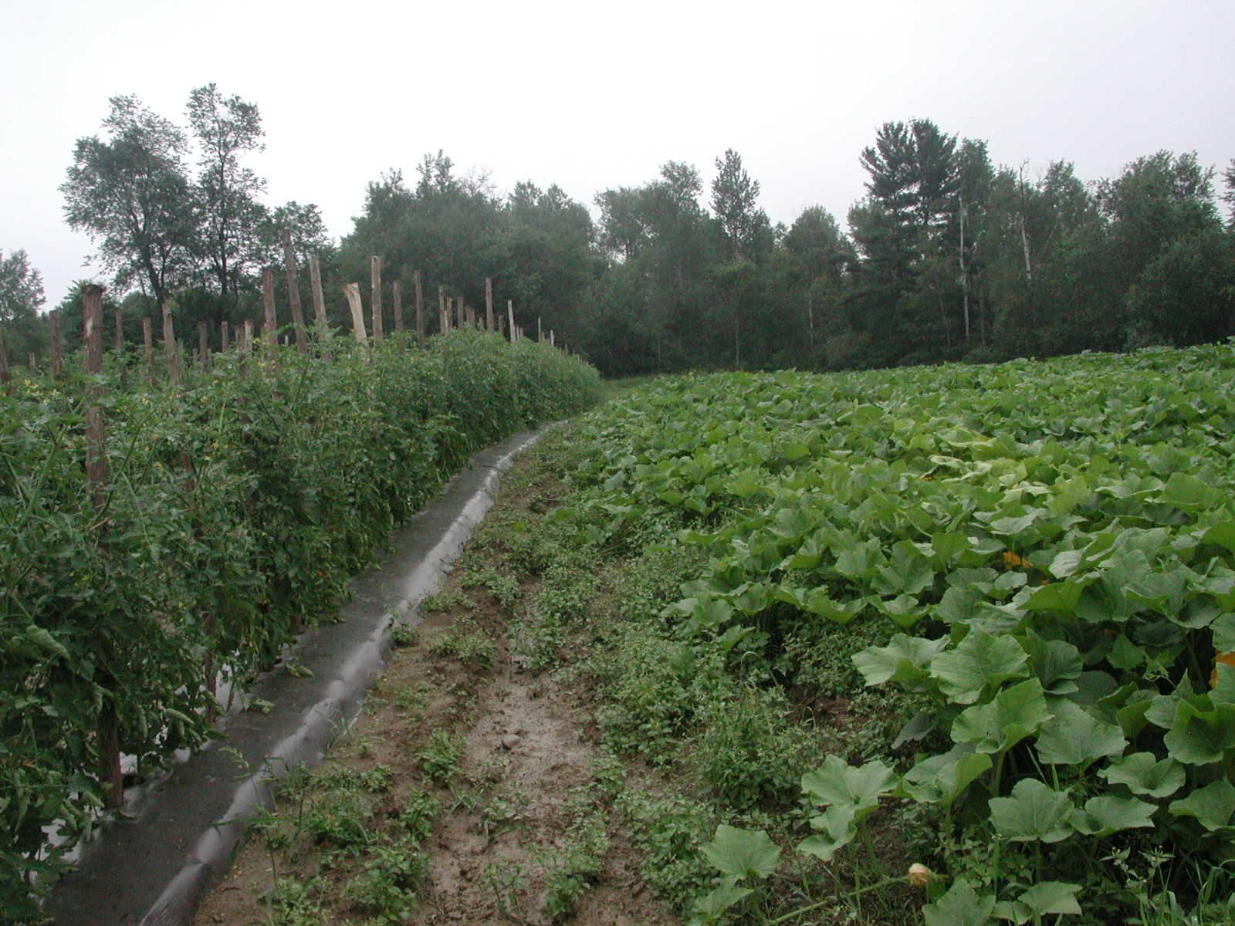
Grower Experiences
Possible to combine inter-row mulch with row covers (melons)
  Melon fruit size and yield reduced but earlier
Worked well with winter squash and pumpkins

Slide 49
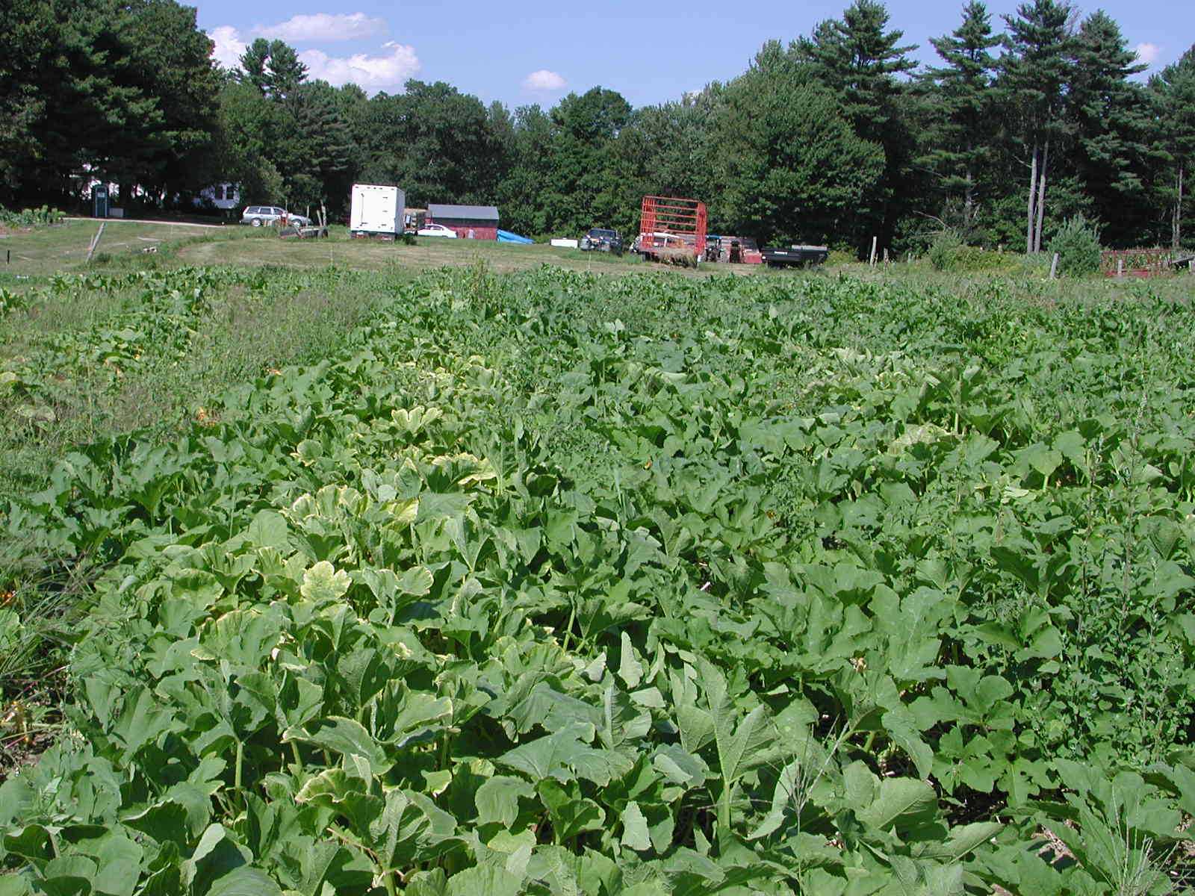
Grower Experiences
Tomato followed by pumpkins or squash
Pumpkin/cucumber followed by tomato
No inter-row mulch
  Herbicides used to manage weeds
Ability to fertigate
Earlier planting possible
Decision to keep plastic made in Fall

