Slide 1
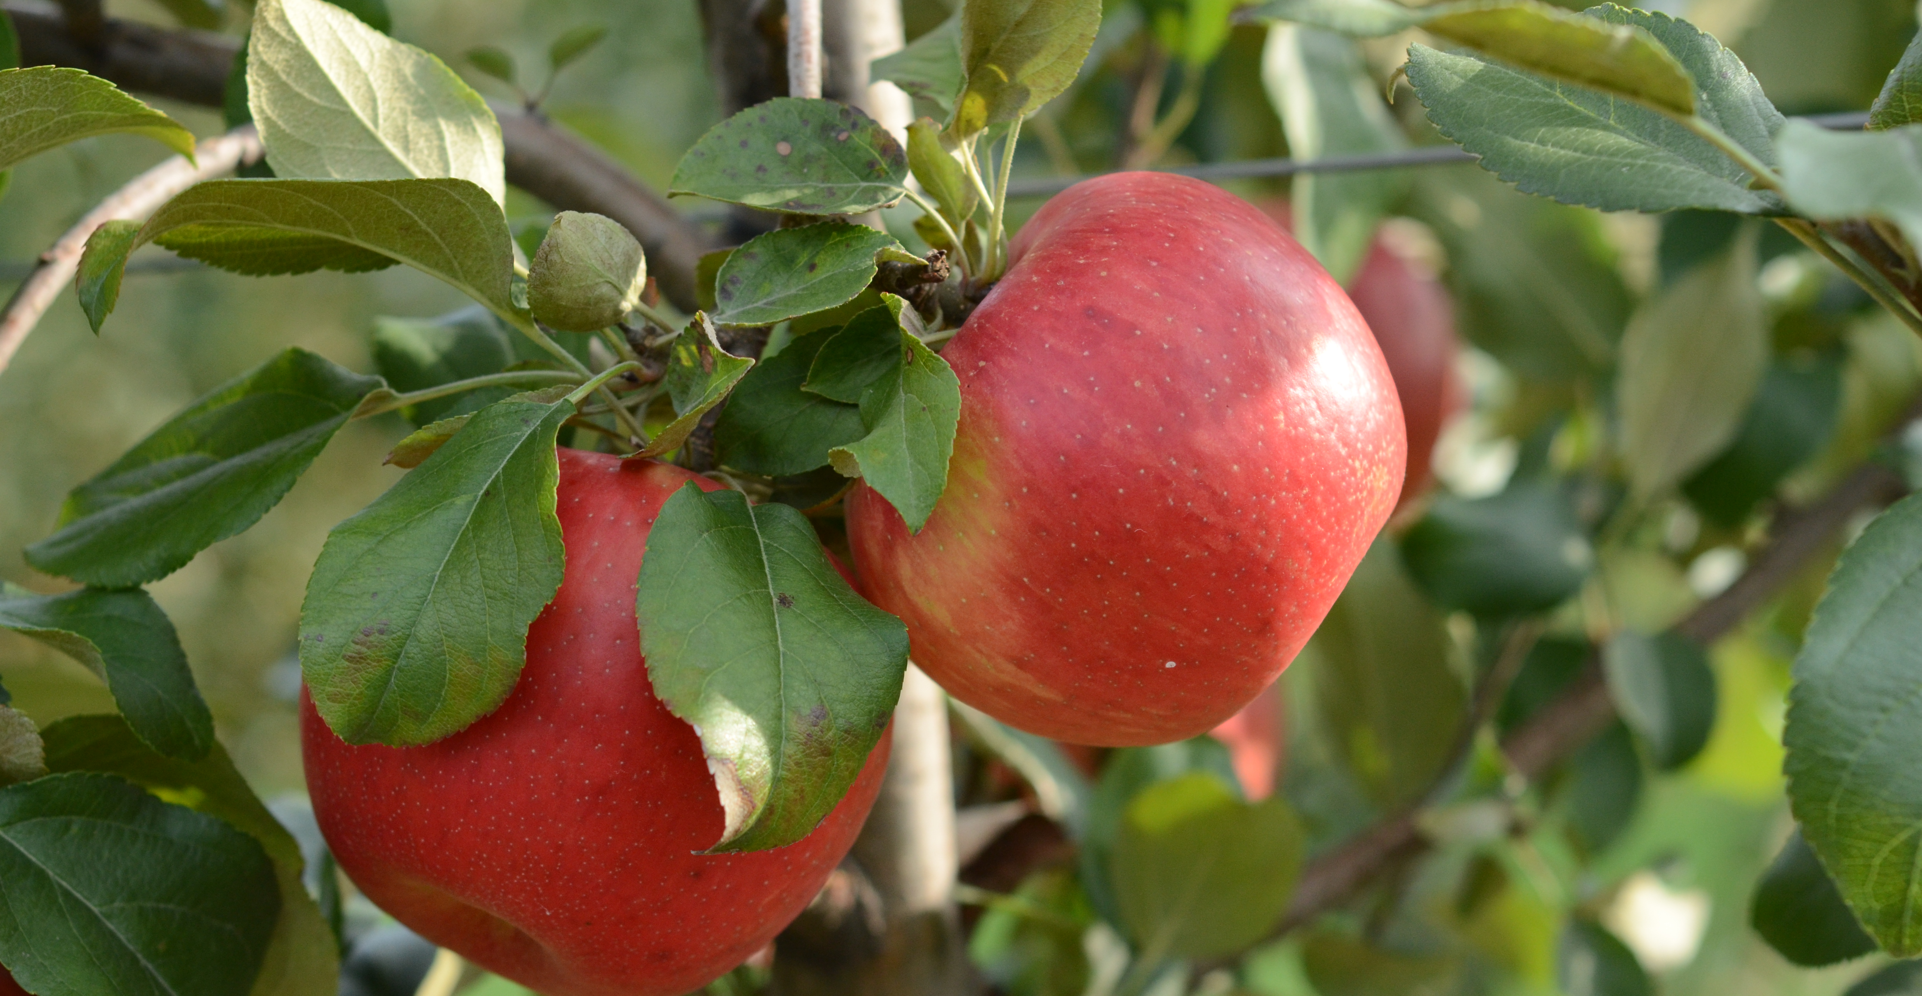
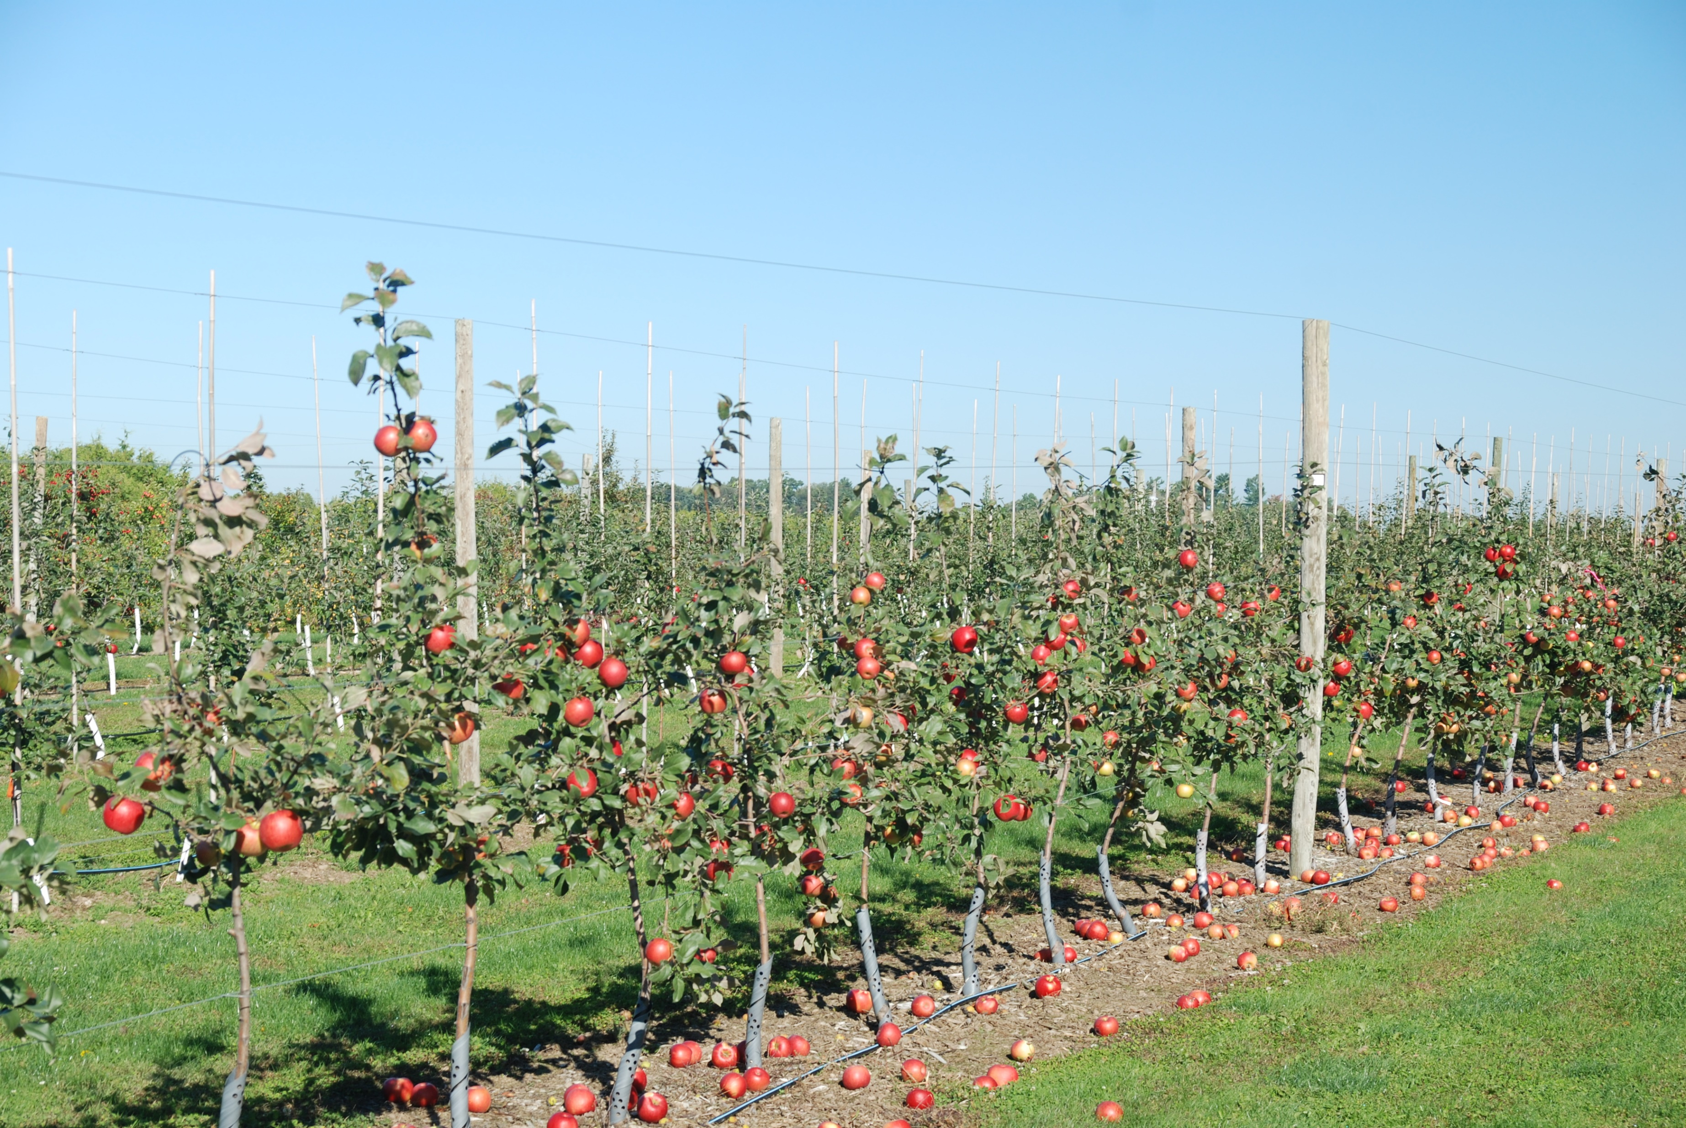



Plant Growth Regulators for Preharvest Management
John A. Cline, Tree Fruit Physiology, Ontario Agricultural College, University of Guelph

Slide 2
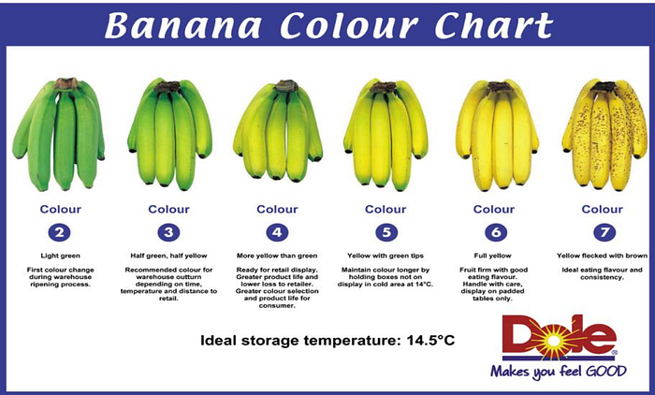
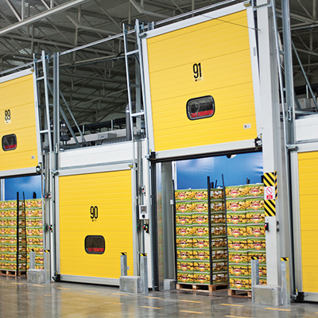
Introduction – Fruit maturity and Ripening
Fruit Maturity
A fruit it considered mature when it is ready for harvest – “horticultural maturity”
Fruit has fully developed in size but may not be ready for immediate consumption.
Ripening
follows or overlaps maturation
Rendering the fruit edible and acceptable to consume

Slide 3
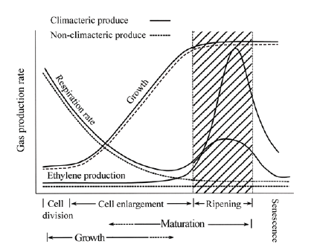
Introduction – Fruit maturity and Ripening
Climacteric Fruit
Associated with an increase in respiration and ethylene with fruit ripening during fruit ripening
Willis and Golding, 2016

Slide 4
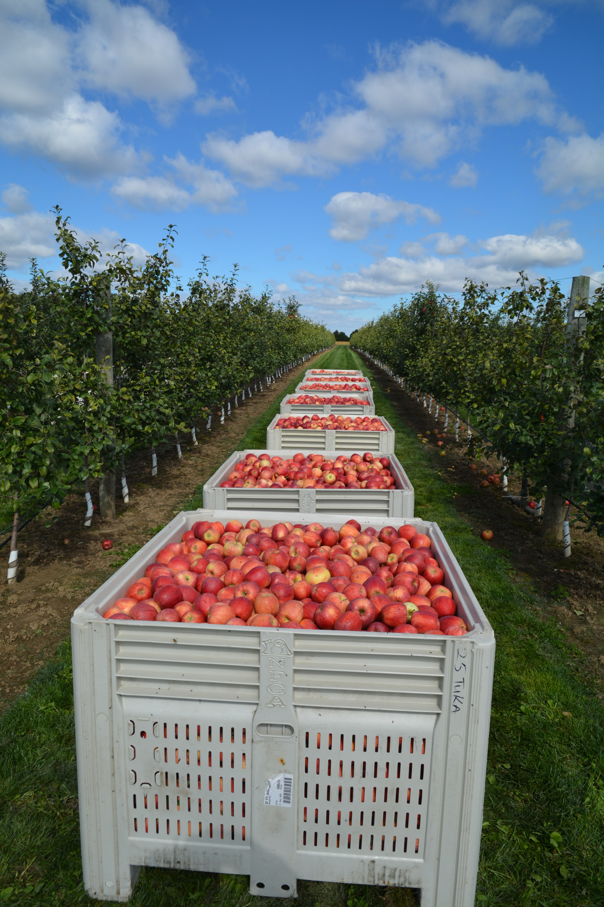
Apple Harvest Management
Pre-harvest fruit drop (PFD)
  Reduce losses in yield
Delay fruit maturity and ripening
  Improve fruit quality
Managing harvest
  labour
  maintaining fruit quality over extended harvest

Slide 5
Available PGR products
ReTain (AVG)
Harvista (1-MCP)
NAA (Fruitone, Maintain)
Foliar magnesium sprays (magnesium sulfate - Epsom)

Slide 6
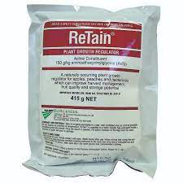
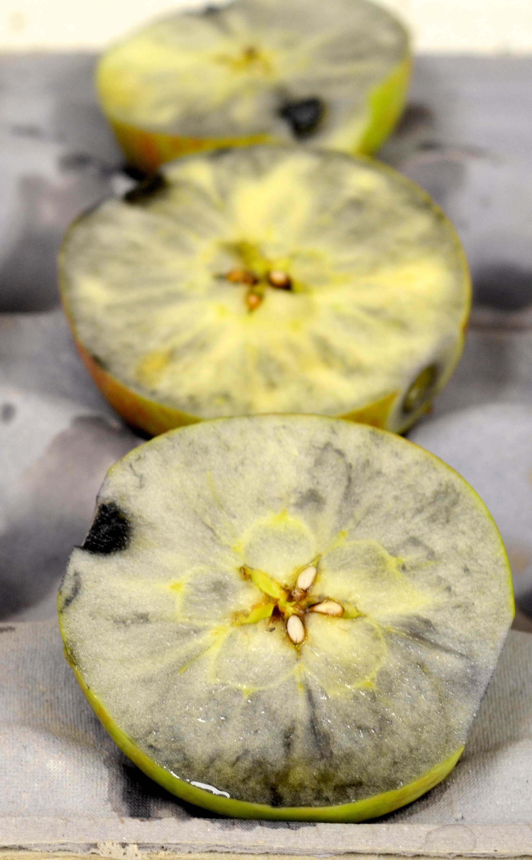
ReTain, Valent BioSciences
What is ReTain?
Aminoethoxyglycine (AVG)
Temporarily inhibits the production of ethylene (inhibitor)
Slows the fruit maturation process
Benefits
Delays fruit maturation
Aids in harvest management
Reduces preharvest fruit drop
Provides additional time for fruit to increase in size/wt on the tree
Optimizes fruit size and enhances fruit quality
Improves packout and storage potential by reducing physiological disorders at harvest and in storage (e.g., reduced incidence and/or severity of watercore and stem bowl cracking)

Slide 7
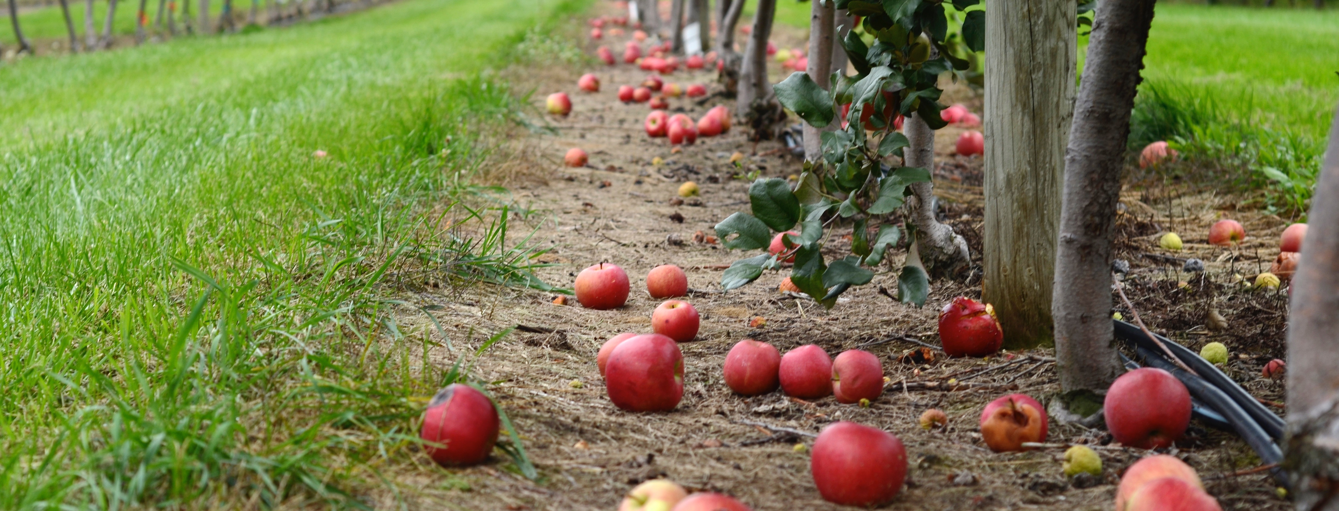
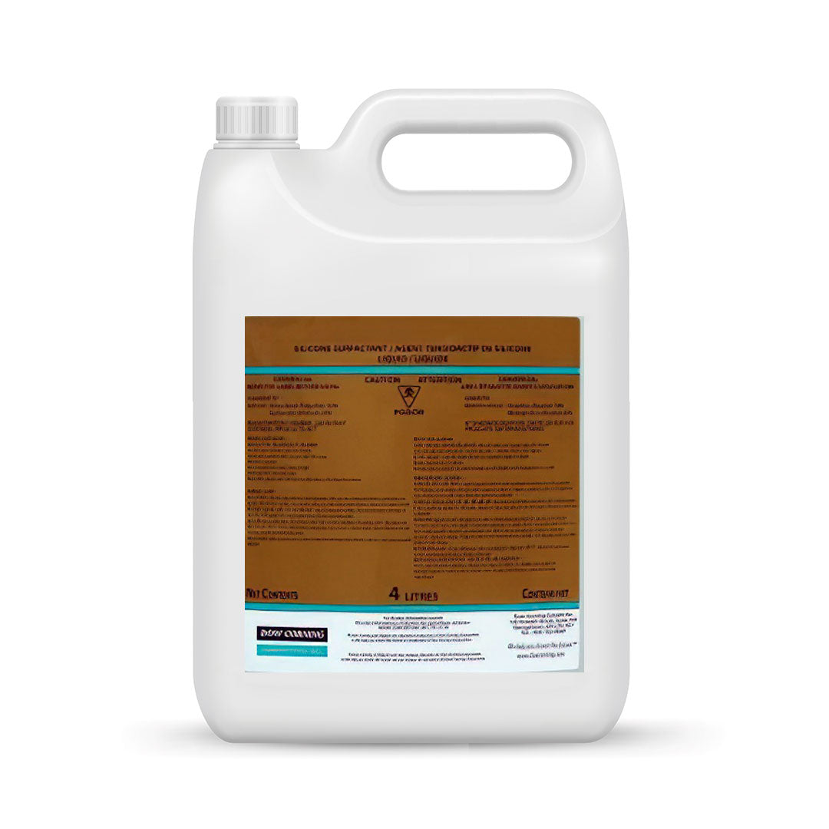
ReTain
When is applied?
Single pick cultivars: 3 to 4 weeks before harvest (to delay harvest 7-10 days)
Multi-pick cultivars: 1 to 2 weeks before harvest (will not delay harvest, but will slow ripening of later picks)
ReTain has a 7-day preharvest interval (PHI) for apple.
Rates
Use 1 pouch (50 grams AVG., which is 333 g product) of ReTain™ per 0.40 ha (1 acre) Cost $447 (Mar-6-23)
Caution: use lower rates on colour sensitive cultivars (Gala, Honeycrisp, e.g.)
Include 0.5-1.0 liters Xiameter OFX-0309 (organosilicone surfactant) per 1000 liters of water
Apply dilute (1000 L/ha)

Slide 8
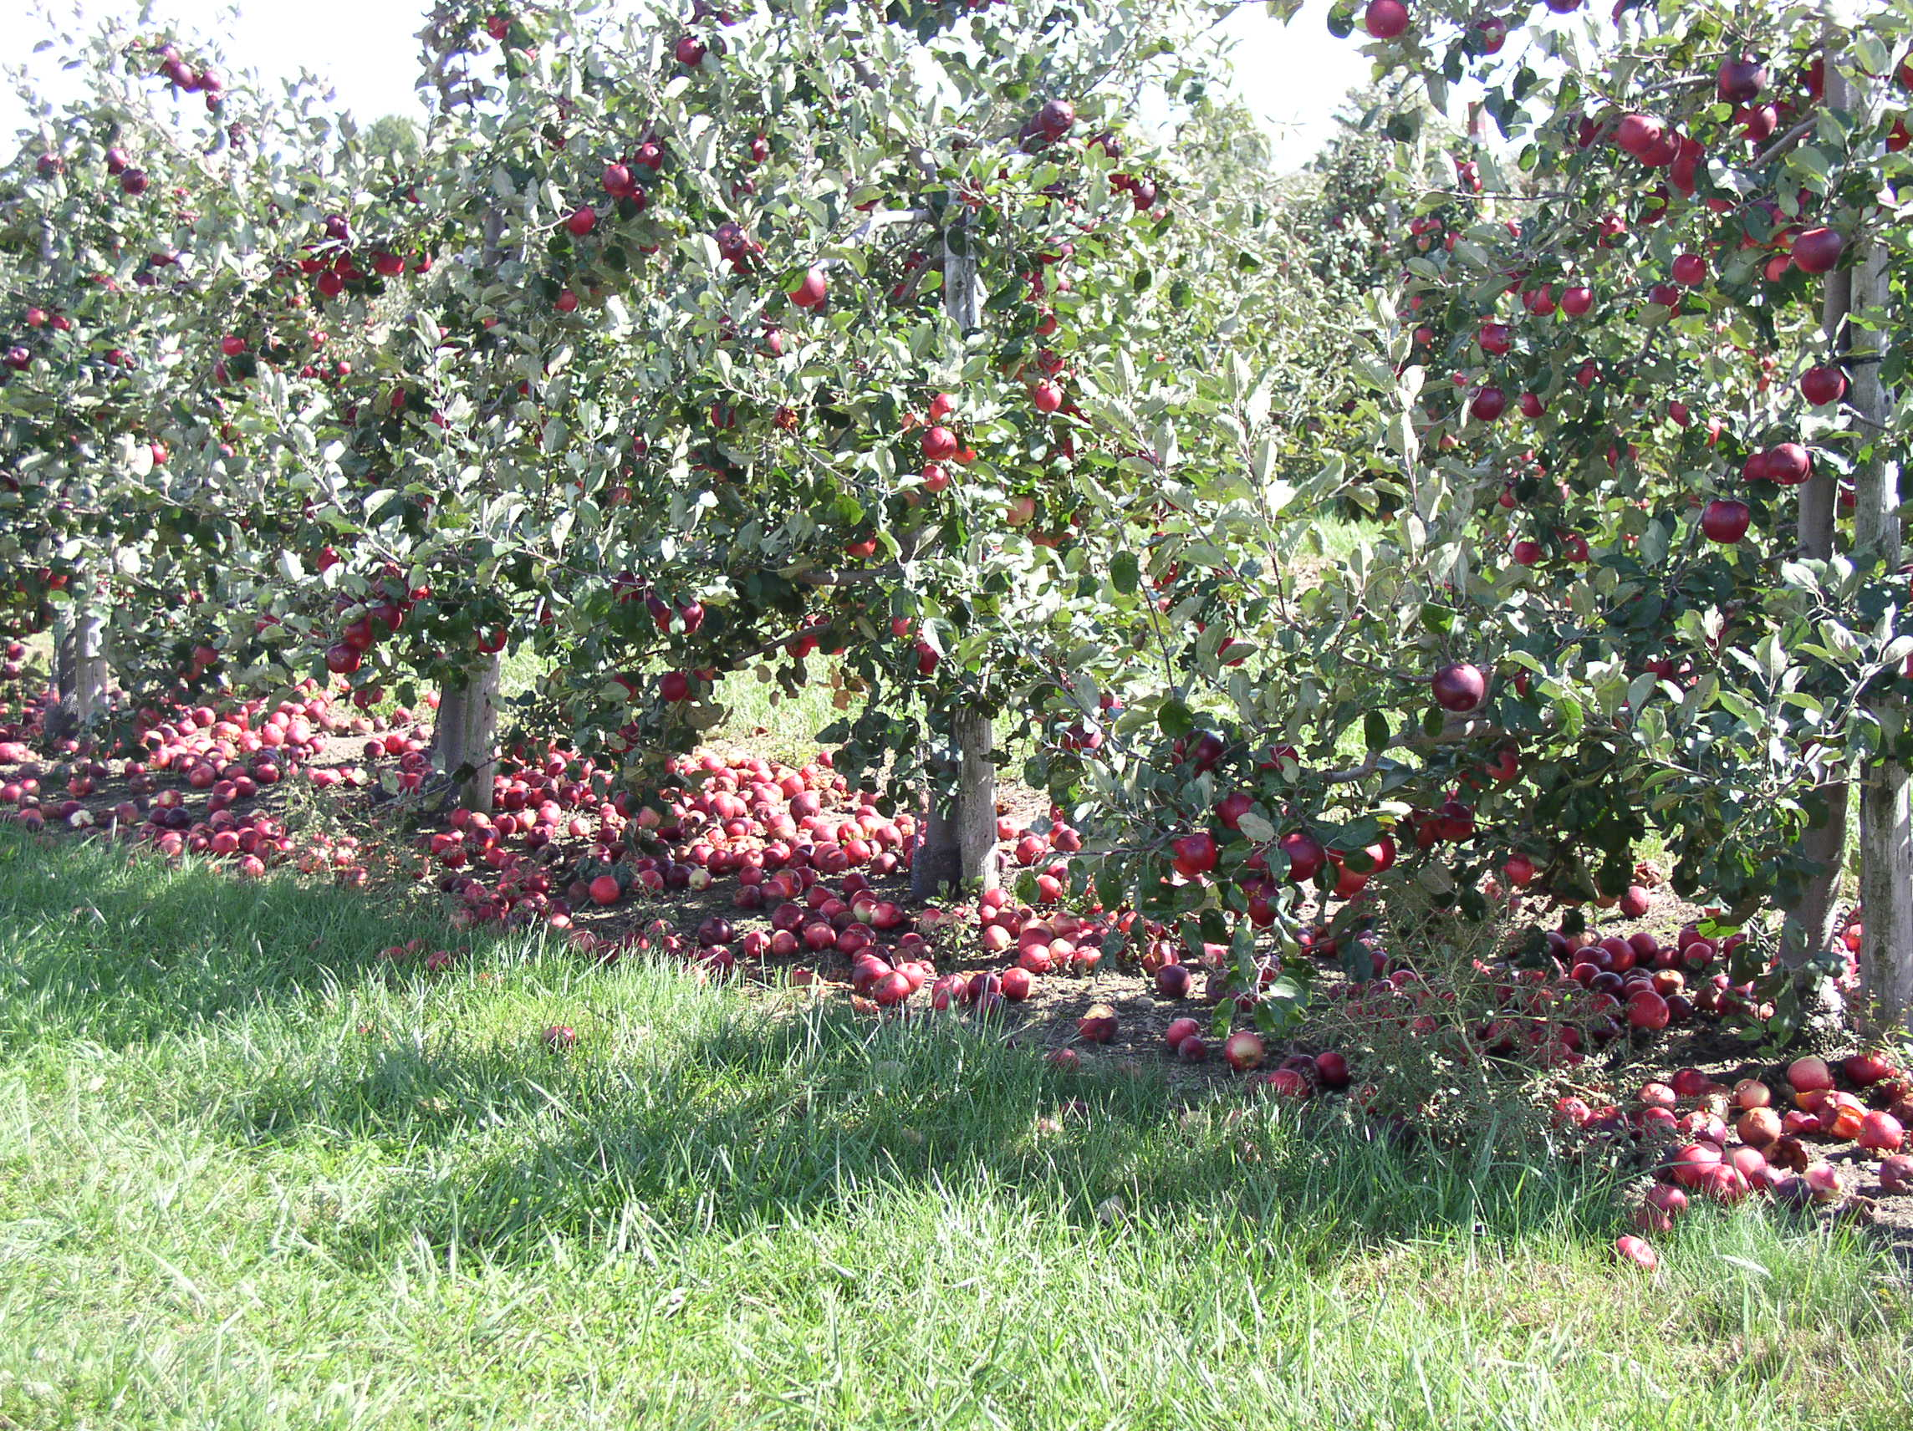
ReTain – Preharvest Fruit Drop
Very effective for PFD for McIntosh, Honeycrisp, Cortland
Can be combined with NAA
Caution: NAA alone will advance maturity and can reduce storage potential

Slide 9
Low fruit drop using ReTain and NAA (Michelle Corten’s Research on Honeycrisp, Univ. of Guelph)
Treatments
untreated control
125 mg/L AVG applied four weeks before the anticipated harvest (BAH)
20 mg/L NAA applied two weeks BAH
125 mg/L AVG tank mixed with 20 mg∙L-1 NAA applied two weeks BAH
200 mg/L Boron (Solubor 20.5%) 4 applications applied at two week intervals starting early July
2000 mg/L Mg (Epsom salt 10%) 4 applications applied at two week intervals starting early July
Notes:
Number of dropped fruit expressed as a percentage of the total number of fruit on a tree
Point out harvest first

Slide 10
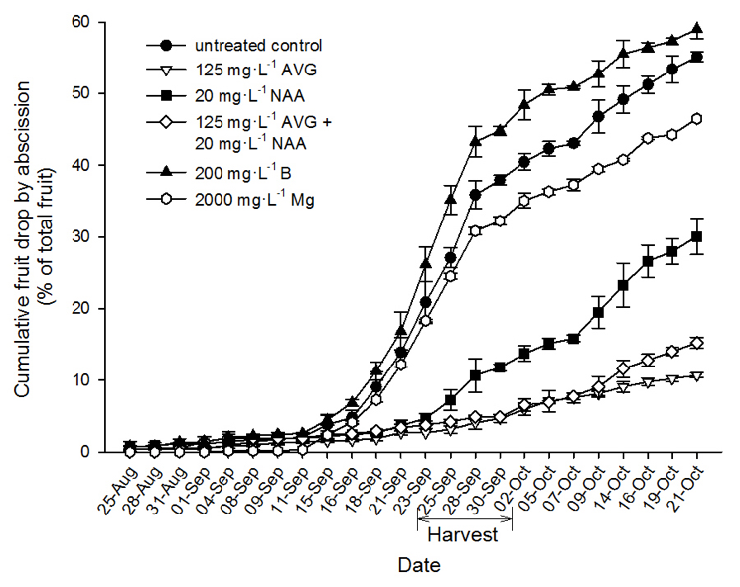
Low fruit drop using ReTain and NAA (Michelle Corten’s Research on Honeycrisp, Univ. of Guelph)
Pre-harvest fruit drop Retain
NAA
ReTain + NAA reduced PFD
Marketable Yield
ReTain: +44%
NAA: +48%
greater than control
Fruit Drop 2015 - Honeycrisp
Boron
Control
Magnesium
Total = 43%
Auxin
~20-27% less
Combination
~24-35% less
Ethylene inhibitor
25 Aug
4 Sept
15 Sept
23 Sept
2 Oct
14 Oct
21 Oct
HARVEST
Date
Notes:
Number of dropped fruit expressed as a percentage of the total number of fruit on a tree
Point out harvest first

Slide 11
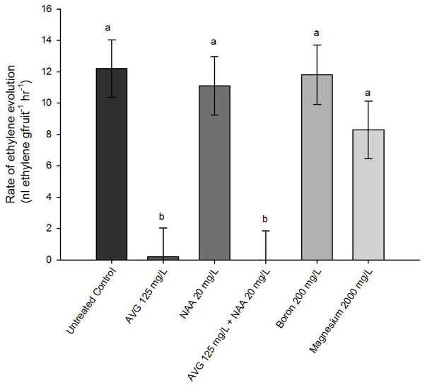
Results: ReTain and ReTain plus NAA on had a low rate of ethylene evolution
Rate of Ethylene Evolution
    ReTain and ReTain + NAA had very low ethylene production at harvest
    NAA alone - no effect on ethylene compared to the untreated control
2015
Not detectible
Auxin
Boron
Combination
Magnesium
Ethylene inhibitor
Untreated control

Slide 12
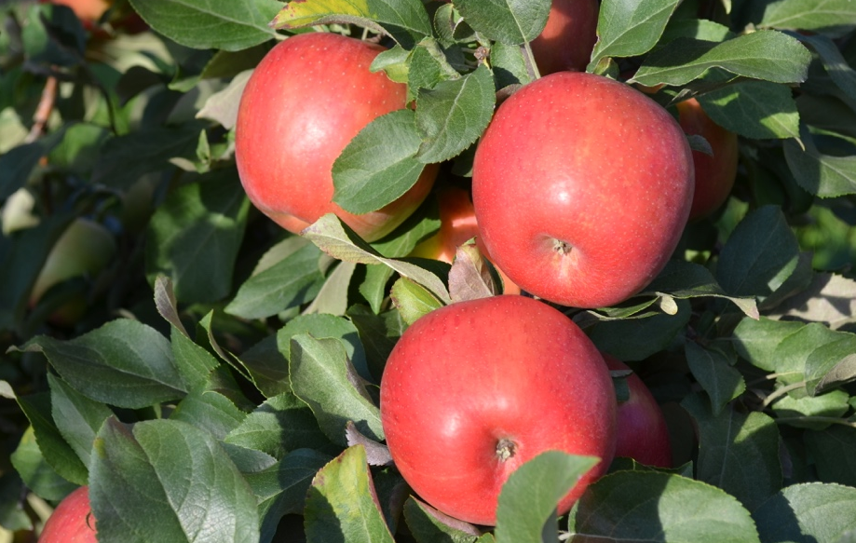
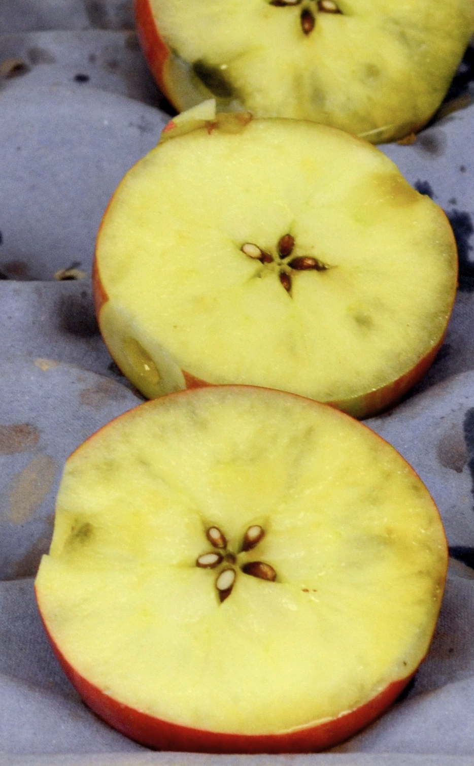
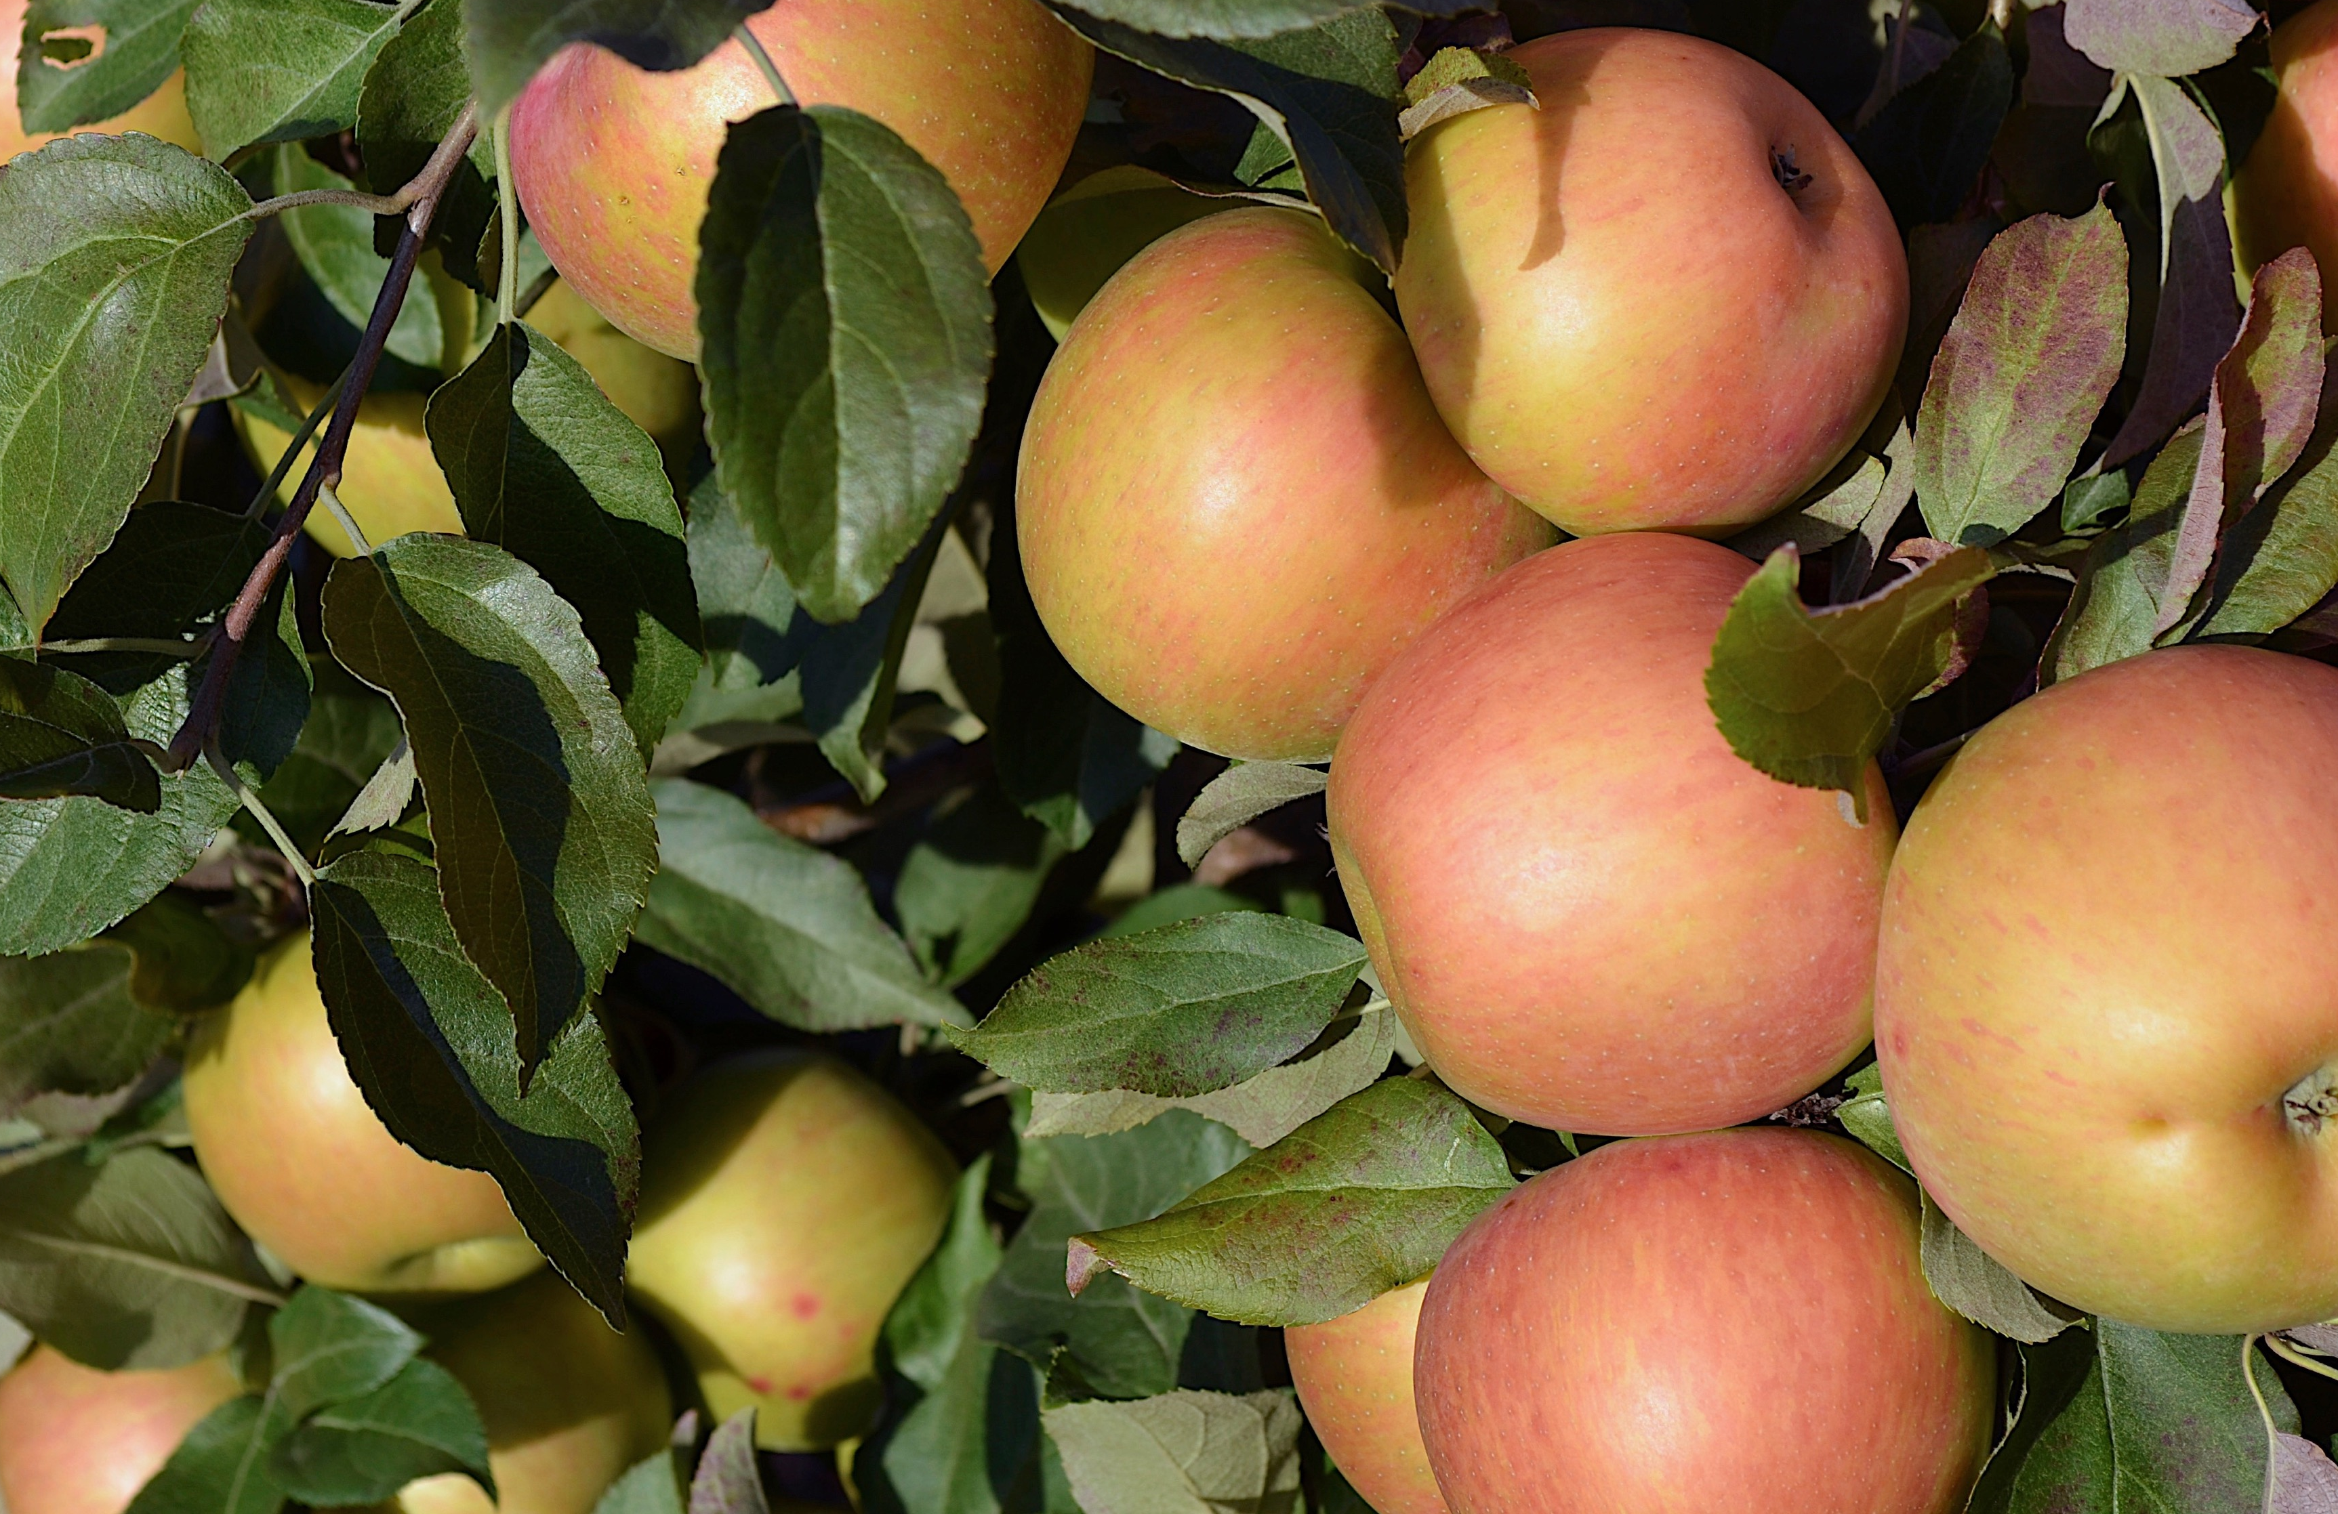
Results: ReTain and combination with NAA delayed maturity
Starch Index and Colour
    ReTain and ReTain+NAA delayed starch degradation and colour development
Untreated: Red
M. Arseneault
ReTain: Reduced colour
M. Arseneault
M. Arseneault
Control
ReTain
M. Arseneault

Slide 13
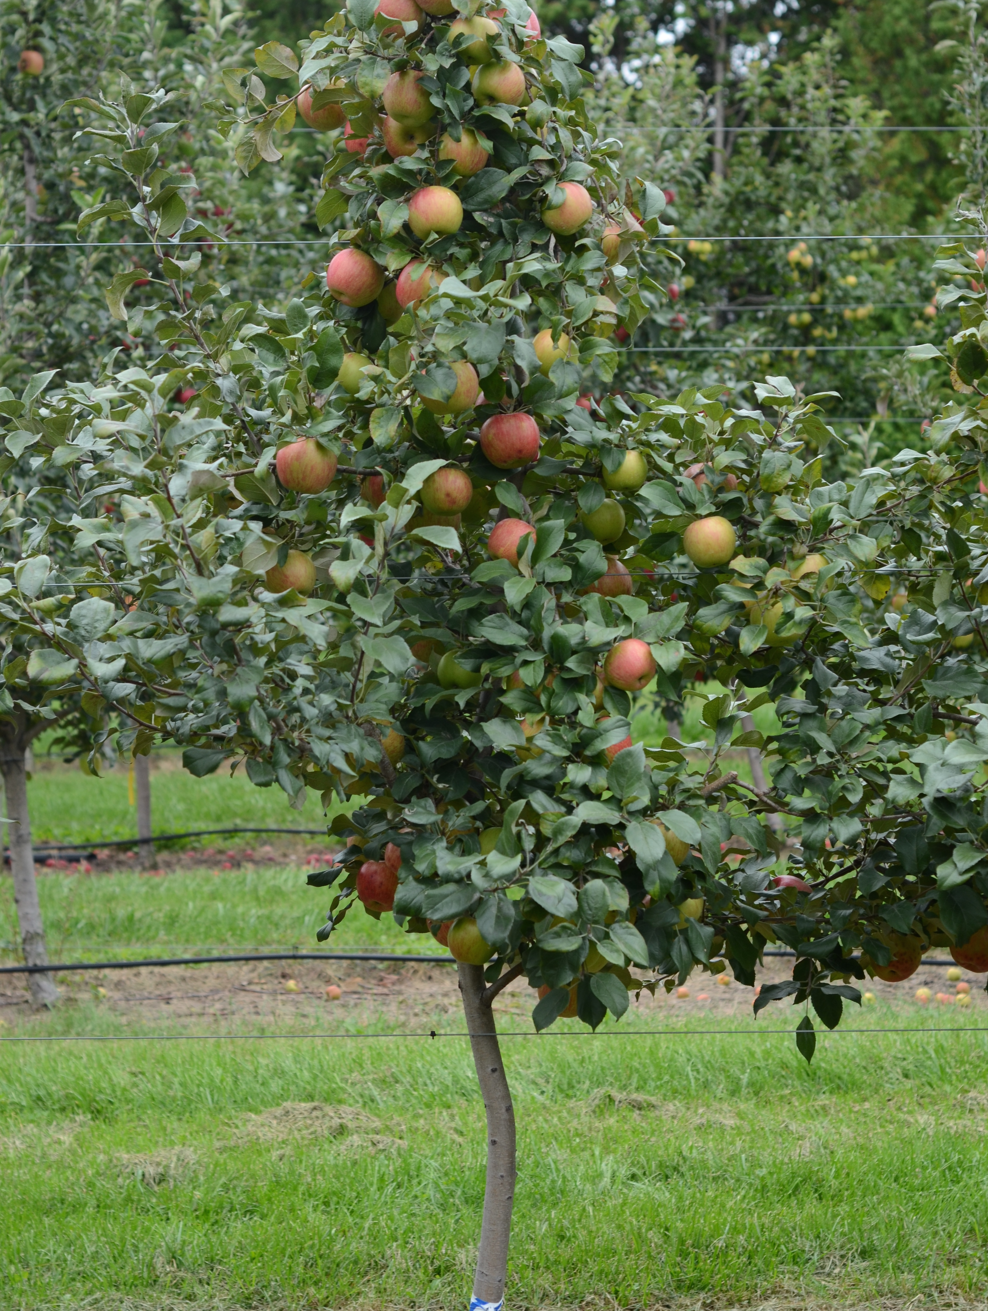
Discussion: Low fruit drop and delay of maturity is consistent with previous research
Bioregulators and Nutrients
    ReTain – consistent with other research
    ReTain plus NAA – response similar to ReTain alone, not additive on ‘Honeycrisp’
    Minor reduction by Mg
    More drop by B, mature fruit more likely to drop
Variable Fruit Drop
    Ranged from 20 to 75%
Quality
    ReTain delayed fruit maturity - consistent
(Li and Yuan, 2008; Marini et al., 1993; Poapst et al., 1959; Robinson et al., 2010; Schupp and Greene, 2004; Wójcik et al., 1999; Yuan and Carbaugh, 2007; Yuan and Li, 2008)

Slide 14
Other Research on ReTain (AVG)
Ethylene is essential for fruit maturation and ripening, but needs to be managed to improve maintain fruit quality prior to harvest or to slow the rate of fruit quality decline during harvest and in storage
ReTain is typically applied 2 or 4 weeks prior to anticipated harvest
A large number of published work has evaluated the response of apple trees and other temperate climacteric fruits to AVG
Responses vary based on cultivar, environmental conditions, time of application, and tree stress levels caused by insects or drought.
Its important to remember that once ethylene production in the fruit has started it will have less benefit.

Slide 15
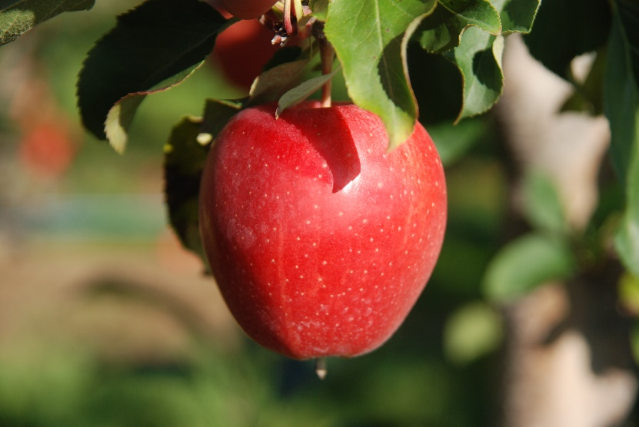
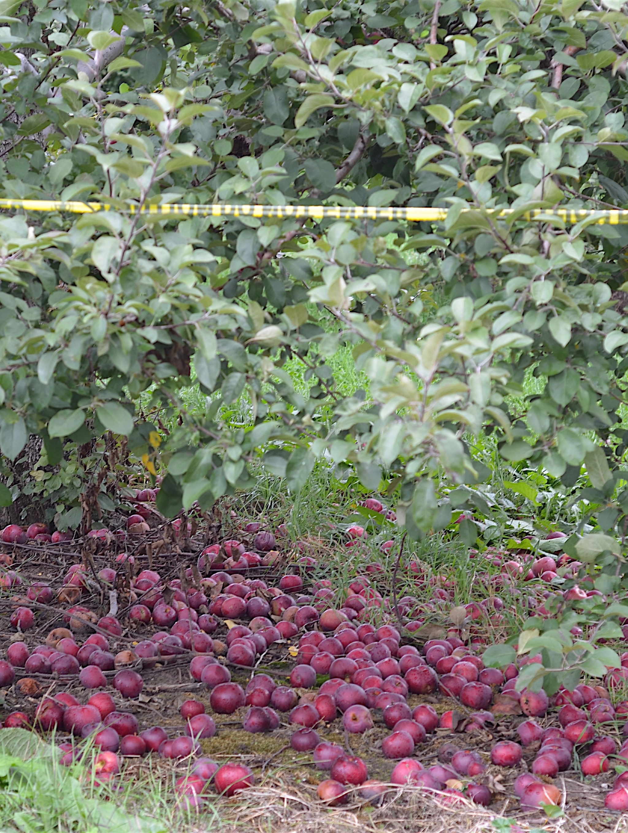
Conclusions
Commercially Acceptable
    ReTain is an effective tool to reduce fruit drop of ‘Honeycrisp’
    Delayed fruit maturity
    Has been effective on Gala for reducing stem-end cracking, and delaying fruit maturity
    Effective for reducing PFD of McIntosh
    Very useful for pick-your-own operators
    Concerns
    Can retard colour development, so reduced rates are suggested
M. Arseneault
M. Arseneault

Slide 16

Function of Pre-harvest PGRS
Harvista ™ - Agrofresh
What is Harvista?
1-MCP is the active ingredient
Blocks ethylene receptors and fruit response to ethylene
Benefits
Delays fruit maturation (up to 2 weeks)
Aids in harvest management
Reduced preharvest fruit drop
Additional time for fruit to increase in size/wt
Optimizes fruit size and enhances fruit quality
Improved packout
Ambrosia
Honeycrisp
Gala

Slide 17
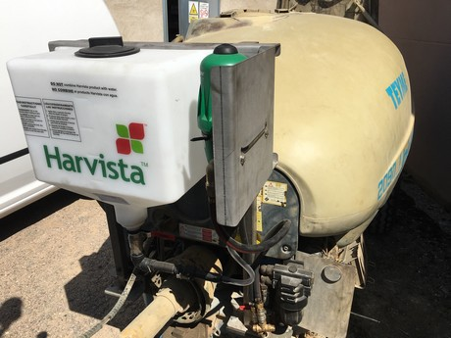
Harvista ™
Requires special application equipment installed on your airblast sprayer by N M Bartlett (~$3000)
Needs to be injected into the sprayer at the boom (ineffective when mixed with water in the tank)

Slide 18
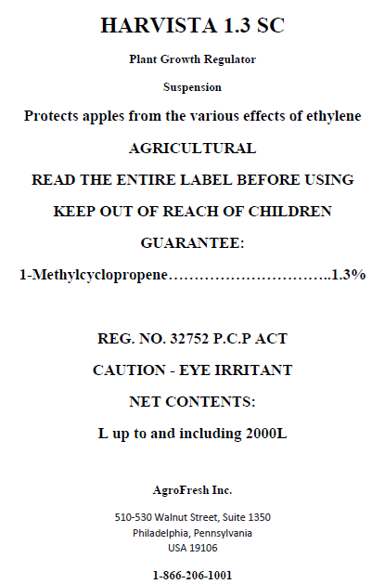
Harvista ™
Rates
Range (100 – 300 ppm)
Typical rate: 11.35 L/ha ~$1440)
3 days PHI
0.05% (v/v) Xiameter OFX-0309 silicone surfactant recommended
Timing
3-21 days before anticipated harvest
Most studies in the literature are applied 1 week before harvest

Slide 19
Anecdotal evidence
Harvista ™ - Literature
Very effective for maintaining fruit quality in CA storage
Works extremely well in pick your own operations – delaying harvest and delaying PFD
Timing: many studies report applying Harvista 1 week before harvest
Delayed ethylene production, starch conversion in Empire but McIntosh less responsive (Doerflinger et al, 2019).
In Gala, AVG decreased colour when Harvista did not (Liu Jian Yang et al, 2022)
AVG was more more effective in preventing stem-end splitting in Gala than Harvista (Liu Jian Yang et al, 2022).

Slide 20
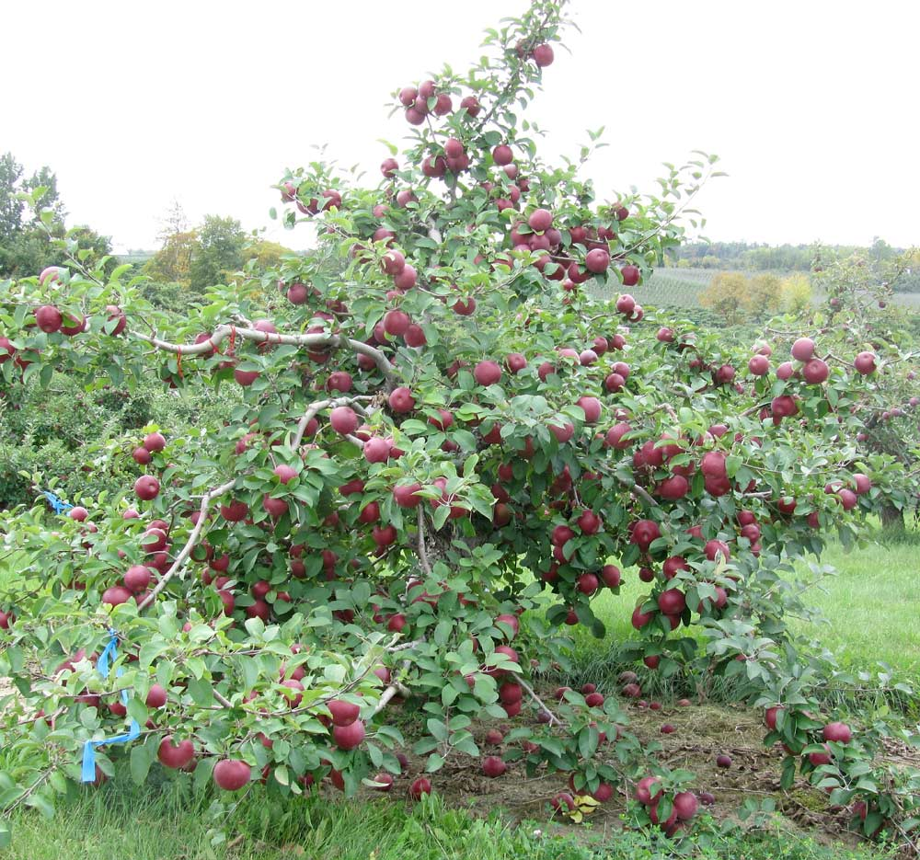
Anecdotal evidence
Harvista ™ - Literature
Works well on McIntosh b/c fruit produce 10- to 20-fold more ethylene than most apple varieties
It is challenging to get red colour on McIntosh, so delayed harvest and preventing pre-harvest fruit drop is a large benefit of 1-MCP (DeEll)
In a Brazilian study on Cripps Pink, 1-MCP applied 7 days before harvest delayed maturity 6-28 days (depending on concentration). The AVG treatment delayed ethylene production and skin red color development at harvest more markedly than the highest concentration of 1-MCP at 300 mg/L. (do Amarante, et al., 2022)

Slide 21
Anecdotal evidence
Harvista ™ - Summary
Harvista (1-MCP) and ReTain (AVG) are excellent pre-harvest management tools to reduced pre-harvest fruit drop, delay maturation, decrease some post-harvest disorders and improve storage potential
An in-line chemical injector system for air-blast sprayers is required for application
Rates:
Use higher rates for fruit that are at a more advanced stage of maturity
Consider lower rates when colour might be impaired (e.g., bi-coloured apples including McIntosh, Honeycrisp, Gala, Jonagold etc.)
Response will vary by cultivar, product rate, and time of application
The effects of Harvista on quality factors such as firmness can be maintained during air and controlled atmosphere storage, but the persistence of these effects are related to harvest maturity

Slide 22

Where to obtain more information
Distributor
M N Bartlett
Steve McDow: 902-680-8697
smcdow@bartlett.ca
www.agrofresh.com/solutions/harvista/
www.bartlett.ca

Slide 23
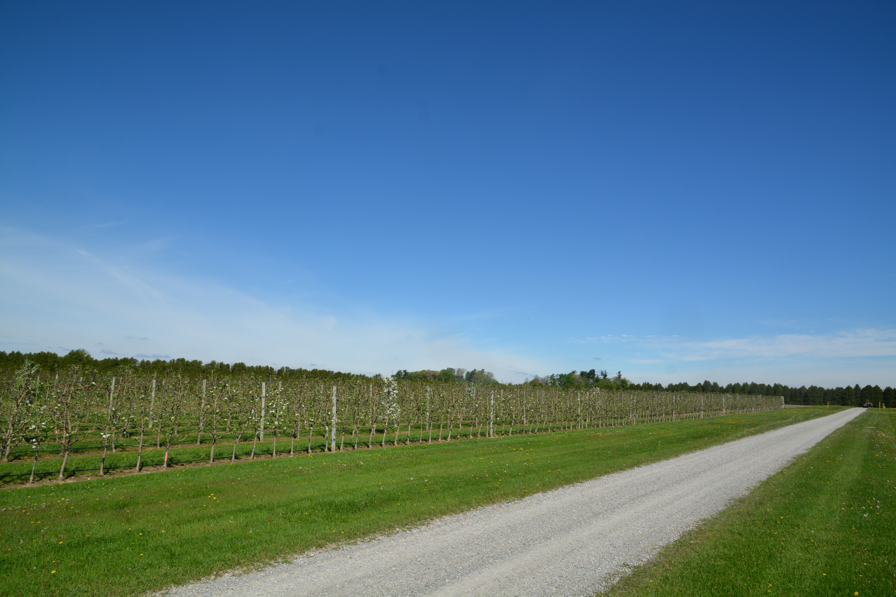
Select references for further reading
Doerflinger, F.C., Nock, J.F., Miller, W.B. and Watkins, C.B., 2019. Preharvest aminoethoxyvinylglycine (AVG) and 1-methylcyclopropene (1-MCP) effects on ethylene and starch concentrations of ‘Empire’ and ‘McIntosh’ apples. Scientia Horticulturae (244):134-140.
do Amarante, C.V.T., Argenta, L.C., de Freitas, S.T. and Steffens, C.A., 2022. Efficiency of pre-harvest application of 1-MCP (Harvista™ 1.3 SC) to delay maturation of ‘Cripps Pink’ apple fruit. Scientia Horticulturae(293) p.110715.
Elfving, D.C., Drake, S.R., Reed, A.N. and Visser, D.B., 2007. Preharvest applications of sprayable 1-methylcyclopropene in the orchard for management of apple harvest and postharvest condition. HortScience 42(5):1192-1199.
Liu, Jianyang, Md Tabibul Islam, and Sherif M. Sherif. 2022. Effects of Aminoethoxyvinylglycine (AVG) and 1-Methylcyclopropene (1-MCP) on the Pre-Harvest Drop Rate, Fruit Quality, and Stem-End Splitting in ‘Gala’ Apples. Horticulturae 8 (12):1100. https://doi.org/10.3390/horticulturae8121100
Nock, J.F., Watkins, C.B., James, H., Reed, N. and Oakes, R.L., 2009. April. Preharvest application of 1-methylcyclopropene (1-MCP) to control fruit drop of apples, and its effects on postharvest quality. Acta Hort. 877:365-374.
Watkins, C.B. 2008 Overview of 1-methylcyclopropene trials and uses for edible horticultural crops HortScience 43 86 94

Slide 24
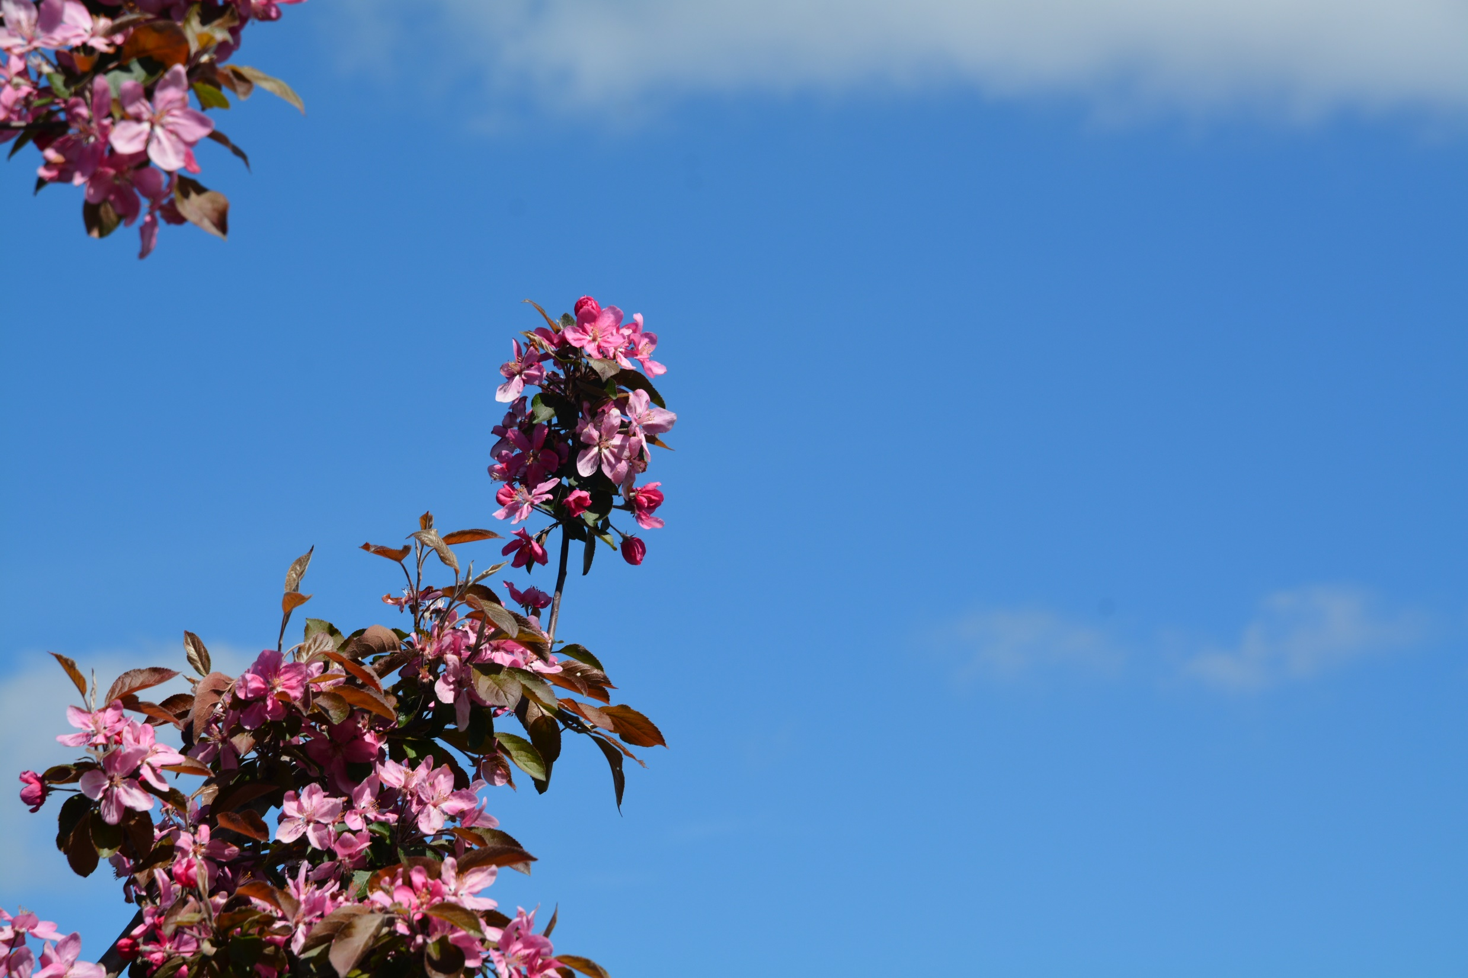


Acknowledgements
Michelle Cortens, M.Sc.
Ontario Apple Growers
Ontario Agri-Food Innovation Alliance Research Program

Slide 25
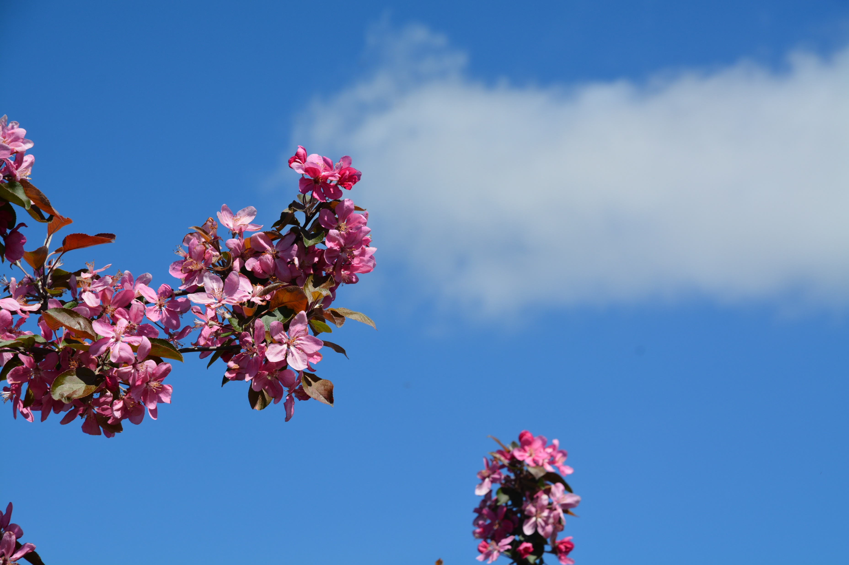
Contact Information
John A. Cline, Ph.D.
University of Guelph
Horticultural Crops Research Simcoe – Simcoe
Email: jcline@uoguelph.ca

