Slide 1
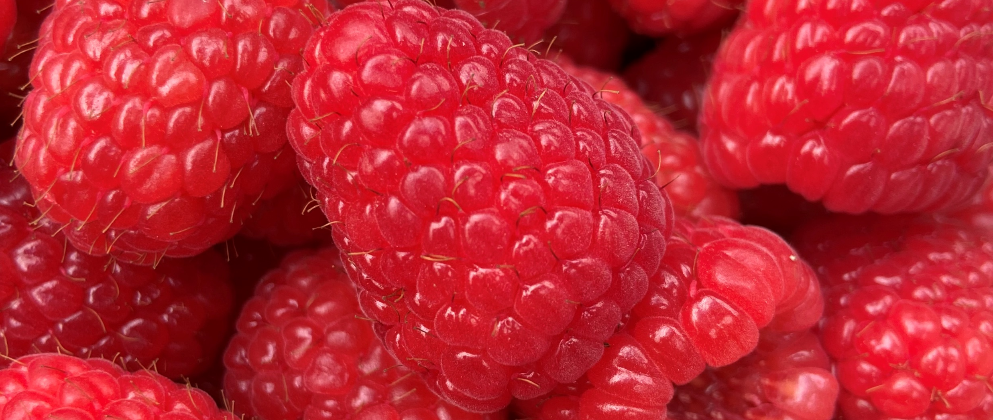
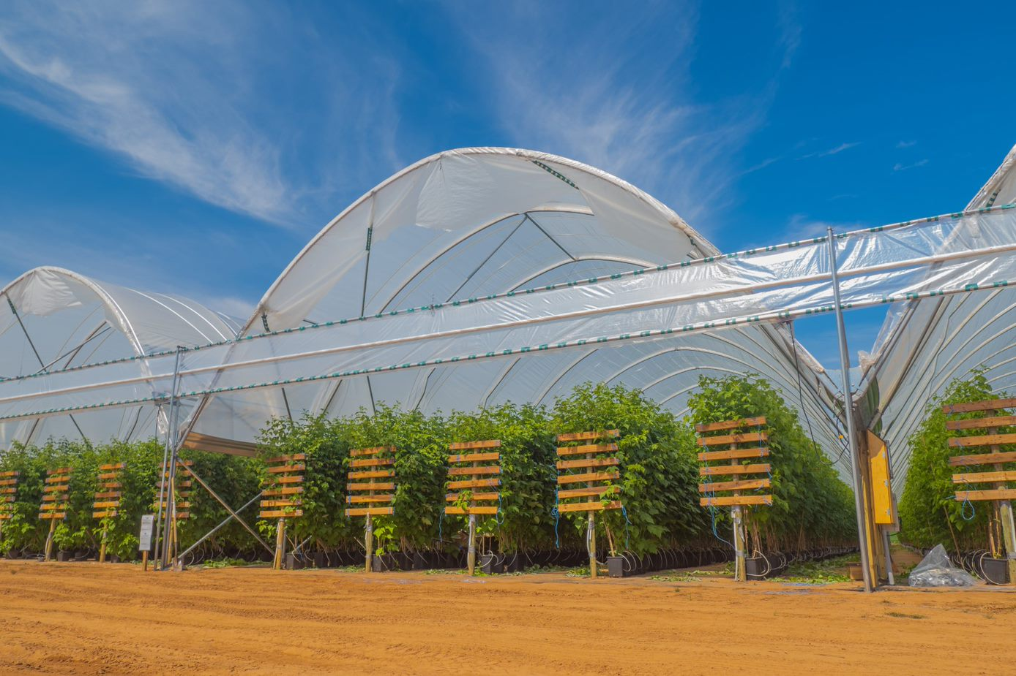
Long Cane Raspberry in Nova Scotia
A production overview from the pilot program launched in 2020
Notes:
Hi folks, my name is Talia Plaskett and I am the protected crop specialist at Perennia.
I’m here to talk about the long cane raspberry pilot program launched late in 2020, and will be coming to a close in March 2023. We’ve had two growing seasons under our belts with this program, and I’m going to talk present a basic outline on the fundamentals surrounding long cane production.

Slide 2
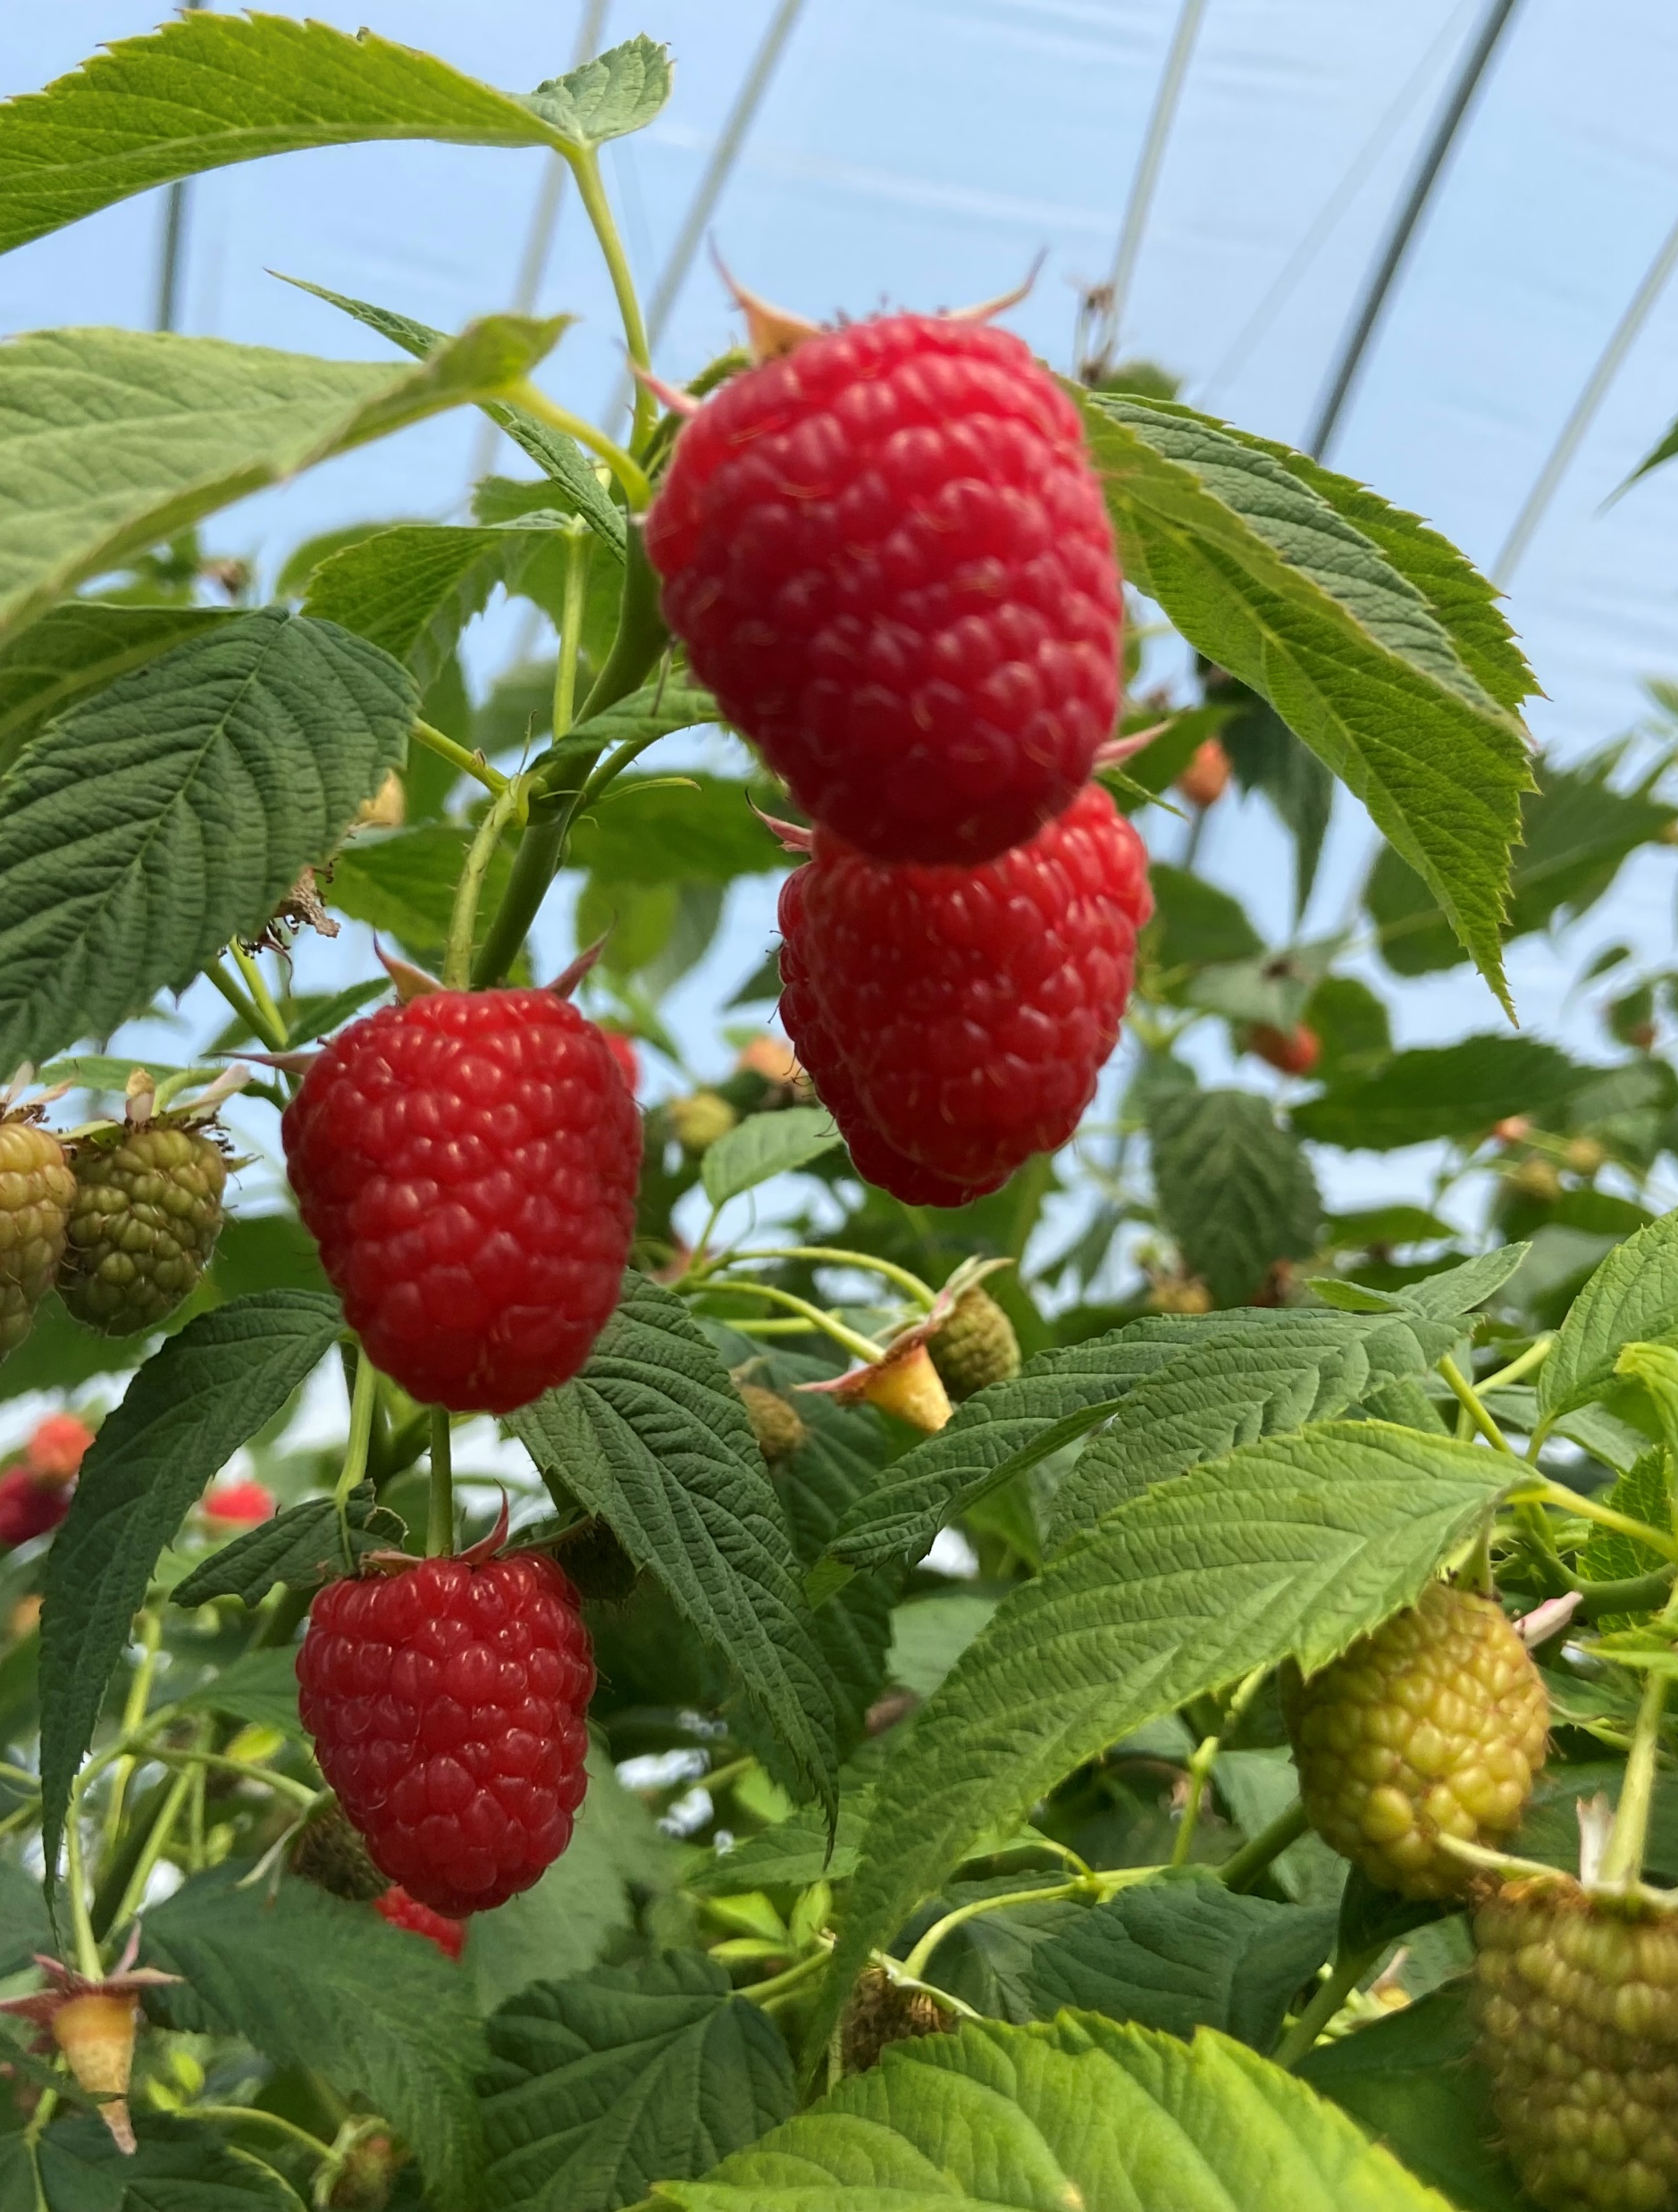
Presentation Overview
1. Program Overview and Partners
2. Site Preparation
3. Irrigation Management
4. Pests and Disease
5. Fruiting Production
Notes:
We’ll start out with a quick review the program itself and the partners that were involved, and then we are going to dive into all things production. Starting with site preparation, then transition to fruiting production and varieties, disease and pest pressure as well as irrigation management.
Obviously 25 minutes is not going to be enough to cover the full scope of what we have been working on over the last few years, so consider this presentation a teaser! As a result of the pilot program, we are putting together a long cane raspberry production guide which will be available for anyone who wants a copy. We are hoping to release this in March of this year, so keep your eyes peeled to our social media channels for the official release date and details on how to access it.

Slide 3
Program Overview
  Objective: Create a high-quality supply of Canadian-grown berries for off-season retail markets, displacing imports and creating new economic opportunities for NS berry growers
Partners
Nova Scotia Department of Agriculture
Collaborates with project team to monitor project progress & deliverables of contribution agreements
Provides funding through contribution agreements with participating producers and Horticulture Nova Scotia that allows for support from Perennia and training resources (Delphy consulting retainer)
Horticulture Nova Scotia – Administrative Lead
Manages and tracks project timelines and deliverables
Disperse project funds, manage finances, project inquiries and administrative tasks
Confirms producer co-operators, formalizes agreements for participation as well as any consultants
Perennia – Technical Lead and Co-operator Advisory Support
Create and facilitate field monitoring program to assess cane health and variety comparisons
Organize regular updates and advisory meetings between participating growers and a third-party consultant
Provide production support through the growing seasons
Participating farms – Webster Farms, Vital Berry Farms
Provide labour for day-to-day operations, crop management, harvesting, planting and take-down
Install all infrastructure required for implementation of this novel cropping system
Track relevant production data relating to cost of production
Notes:
Before we dive in to production overview, I want to briefly talk about the project itself and the partners involved. I’m not going to spend too much time talking about the individual roles for each of the listed partners, but they are listed here if you want to get a more in-depth breakdown.
This pilot program was put together with the hopes of creating a high quality supply of Canadian-grown berries for off-season retail markets. In doing so, this will displace our reliance on imports as well as create new opportunities for Nova Scotia berry growers.
This program was hosted by the Nova Scotia Department of Agriculture, and saw the involvement of Horticulture Nova Scotia, Perennia, Websters Farms and Vital Berry Farms for the the implementation of the project.

Slide 4

Source Water is Crucial!
During periods of peak crop water demand and hot low humidity days LCR can demand 9 l/pot/day, so it is important that the source be able to provide this volume of water.
3981-5308 pots per acre x 9 l/pot =
35,000-47,000 l/day!
Tremendous need for water
Notes:
One thing that deserves honourable mention here is the absolute necessity to understand your raw water source when considering hydroponic production!! This means ensuring there is enough volume to be able to sustain the crop, as well as have limited numbers of salts and minerals in it to begin with. Peak daily volume, including 25% drainage, for a raspberry crop planted in a 7.5L pot, with 3x 1.5L/h drippers, is going to need up to 9L, distributed throughout the day.
When it comes to production, water can range in quality, and in a system where we are solely relying on that water to carry our fertilizer solution to the plants, we need to make sure that the water is going to be able to do so. The three main variables we want to look at here are going to be alkalinity, EC, and the levels of trace salts. These things are going to determine how hard, or how easy, it will be to get that water up to where it needs to be to support a healthy, high yielding crop.
For those who have high EC in their source water, substrate production can still be done, its just going to be a bit more work with regular flushes to maintain a substrate that supports healthy plant growth. Any added components to your fertilizer solution is going to contribute to EC, which will impact the plants ability to take up water and can results in small fruits when this is in excess. An example of something that can readily contribute to EC is sulphates – we see this a lot for producers using sulfuric acid in their stock tanks, and really your just driving up the EC of your solution without supplementing any additional nutrients like a nitric acid would.
TALK ABOUT SLIDE VALUES

Slide 5
Source Water is Crucial!
Ideal source water has a very low EC
Na and Cl requirements in raspberries are quite low: levels above 1 mmol/L can result in tip burn, calcium deficiency, reduced fruit size
Sulphates are not readily used by the crop and can easily accumulate in the substrate.
    Levels above 2.5 mmol/L can be toxic on some primocane varieties
Bicarbonate levels become problematic above 4.5 mmol/L
    Acidification of this to <0.5mmol/L will prevent blockages in the irrigation lining
Notes:
One thing that deserves honourable mention here is the absolute necessity to understand your raw water source when considering hydroponic production!! This means ensuring there is enough volume to be able to sustain the crop, as well as have limited numbers of salts and minerals in it to begin with. Peak daily volume, including 25% drainage, for a raspberry crop planted in a 7.5L pot, with 3x 1.5L/h drippers, is going to need up to 9L, distributed throughout the day.
When it comes to production, water can range in quality, and in a system where we are solely relying on that water to carry our fertilizer solution to the plants, we need to make sure that the water is going to be able to do so. The three main variables we want to look at here are going to be alkalinity, EC, and the levels of trace salts. These things are going to determine how hard, or how easy, it will be to get that water up to where it needs to be to support a healthy, high yielding crop.
For those who have high EC in their source water, substrate production can still be done, its just going to be a bit more work with regular flushes to maintain a substrate that supports healthy plant growth. Any added components to your fertilizer solution is going to contribute to EC, which will impact the plants ability to take up water and can results in small fruits when this is in excess. An example of something that can readily contribute to EC is sulphates – we see this a lot for producers using sulfuric acid in their stock tanks, and really your just driving up the EC of your solution without supplementing any additional nutrients like a nitric acid would.
TALK ABOUT SLIDE VALUES

Slide 6
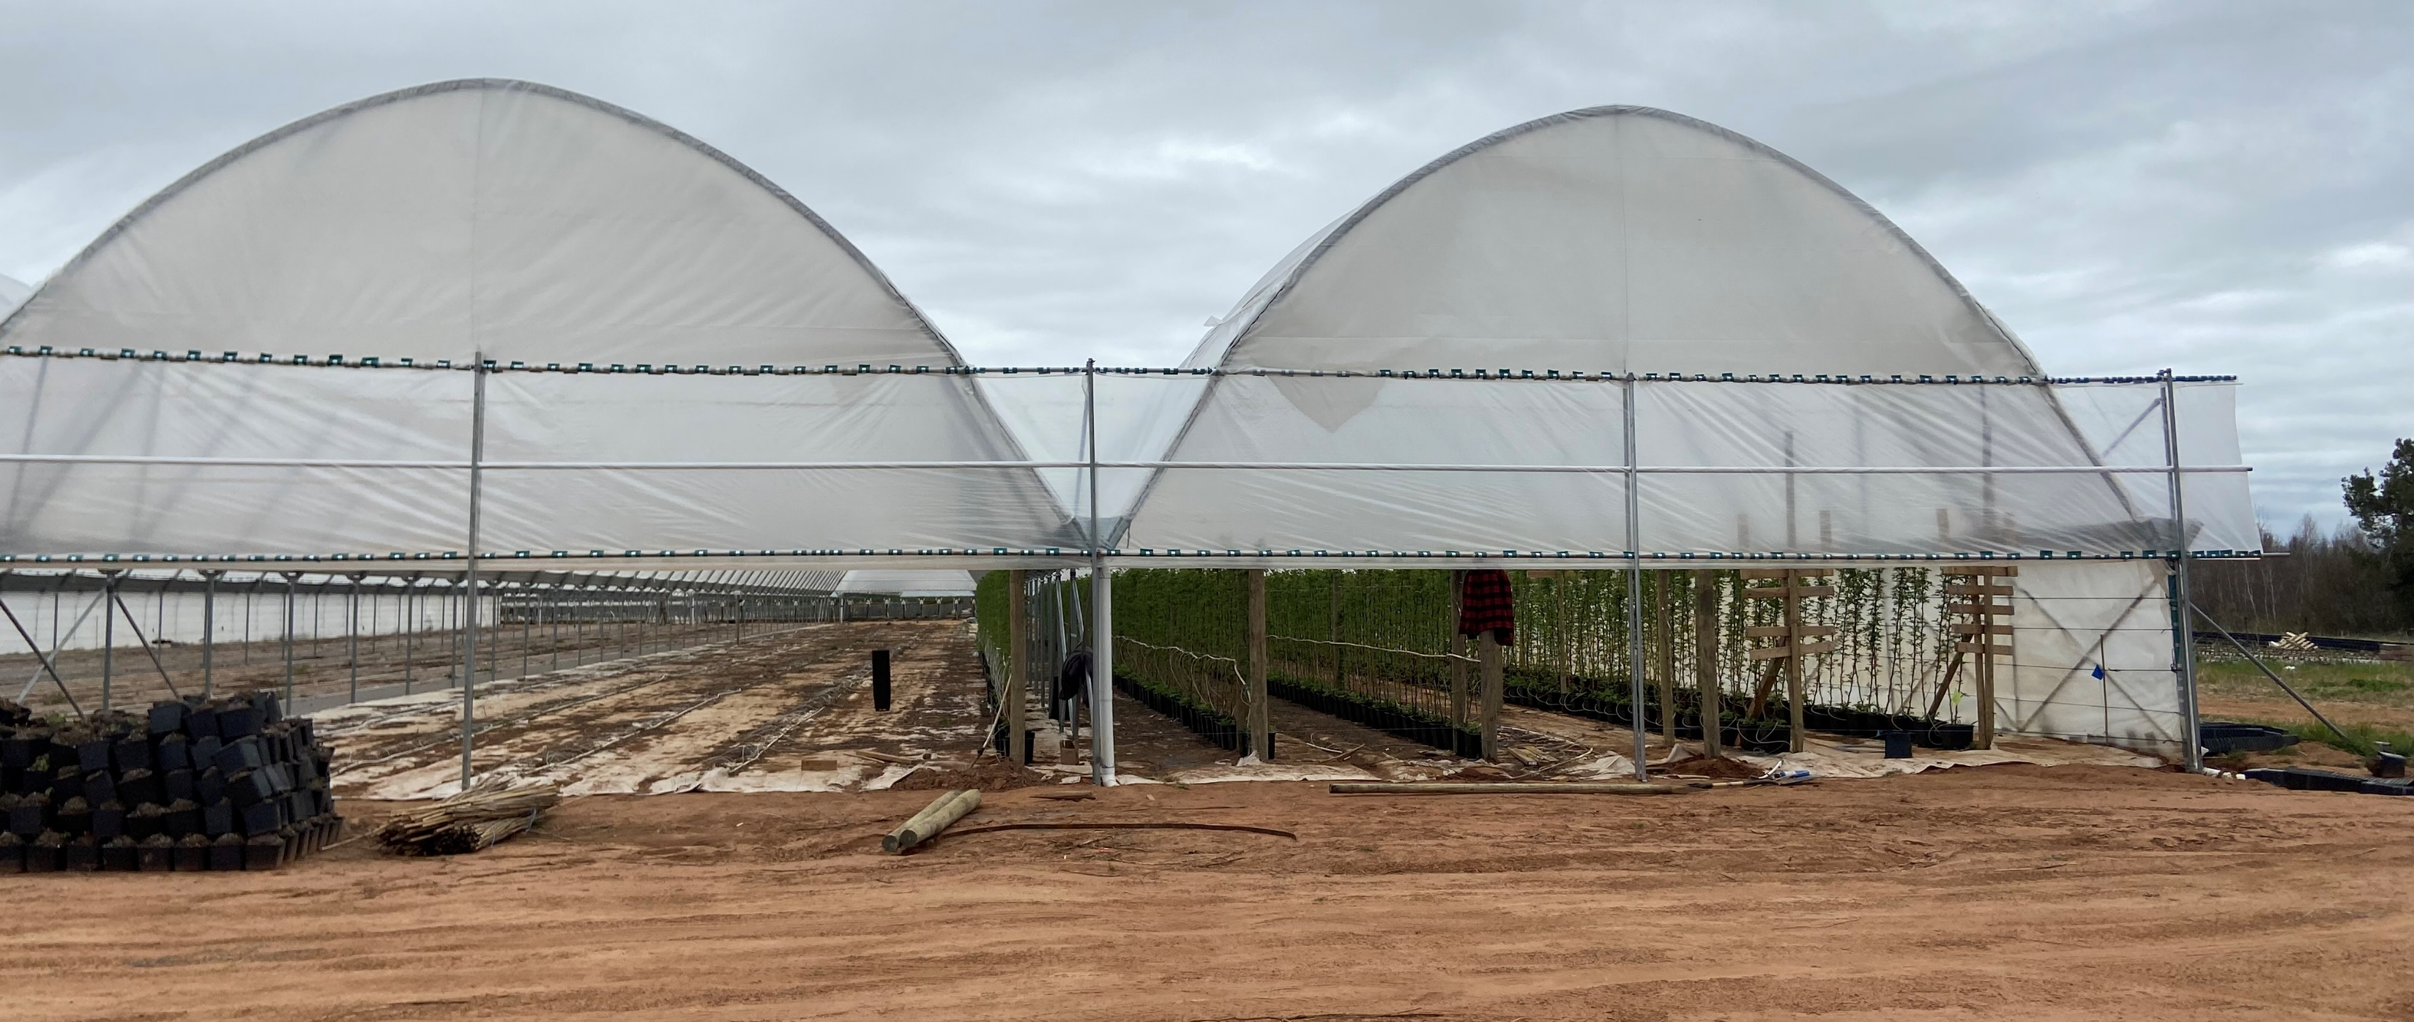
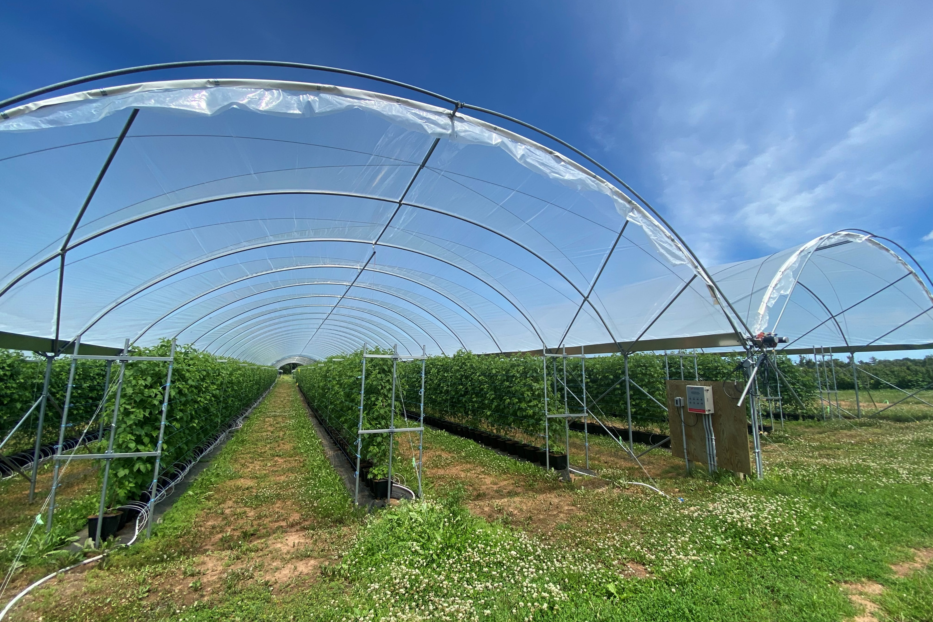
Site Preparation
Site Setup:
Before fruiting production can begin, the growing space needs to be prepared
  Land prep, leveling, drainage assessment
  Irrigation setup
  Tunnel selection and construction
  Addition of ground cover
  Trellis installation
Notes:
Before we can think about fruiting production, we have to think about preparing the grow space. These preparations are going to look different depending on the state of the land pre-production, and I’ve listed some of the things that need to be done here.
Outside of preparing the land, making a decision around what sort of tunnel you want to use can be a time-consuming process. Classic high tunnels are typically 30ft wide, and can vary when it comes to height, length and features. The types of features necessary are going to depend on the growing season and the area you are growing in – a highly protected site may not need as sturdy of a structure compared to one with a high level of exposure. A producer who is aiming to target the shoulder seasons for fruit production might want to consider a structure like the one on top here, where you are able to fully roll down the ends to try and retain a bit more heat. The other piece to the puzzle is obviously going to be cost, and the amount of overhead that you are able to take on to make the project happen. These are just some of the things to think about when coming up plans for a new production space.

Slide 7
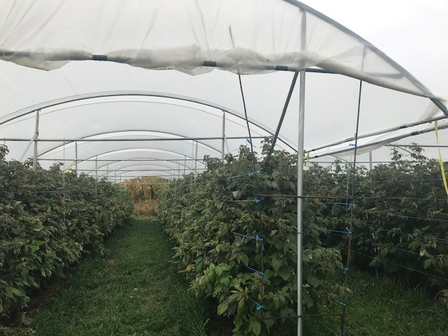
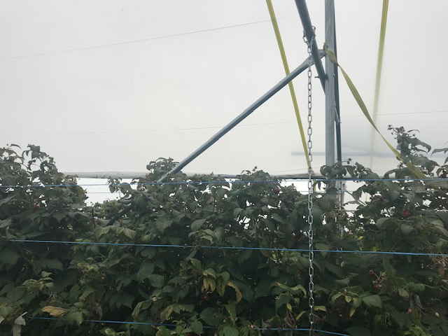
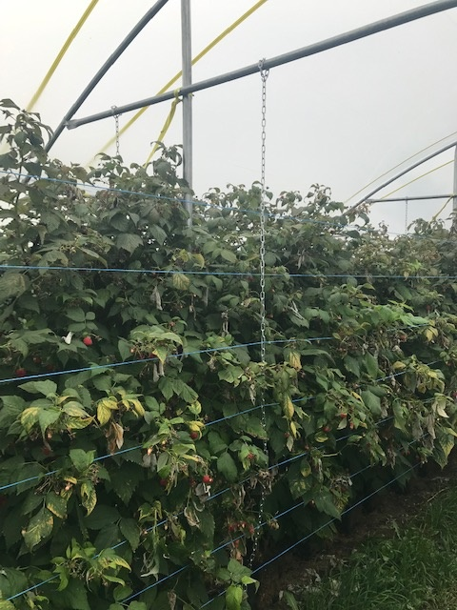
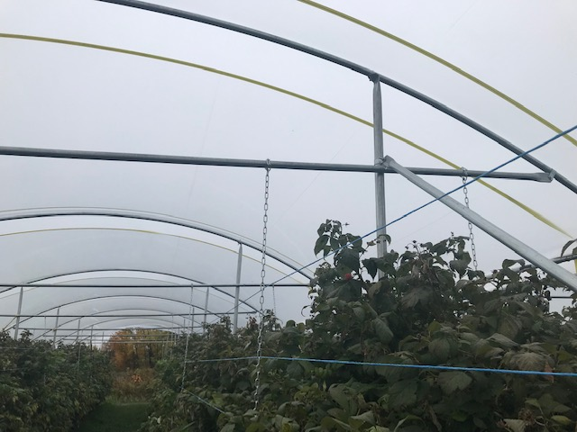
Umbrella Type Structure

Slide 8
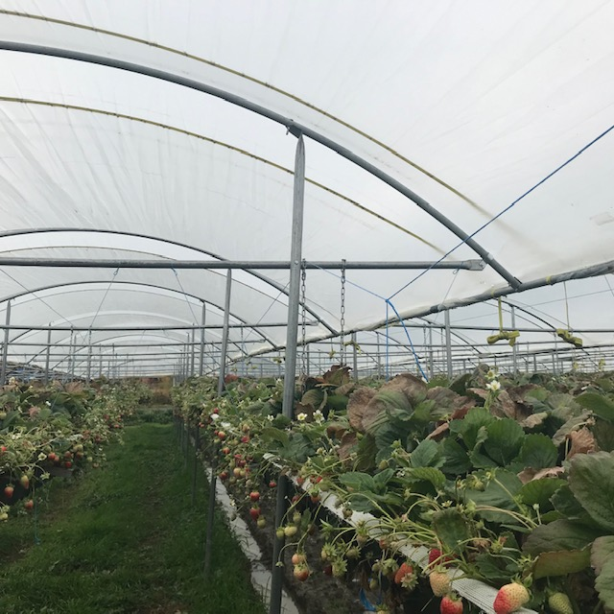
Umbrella Type Structure

Slide 9
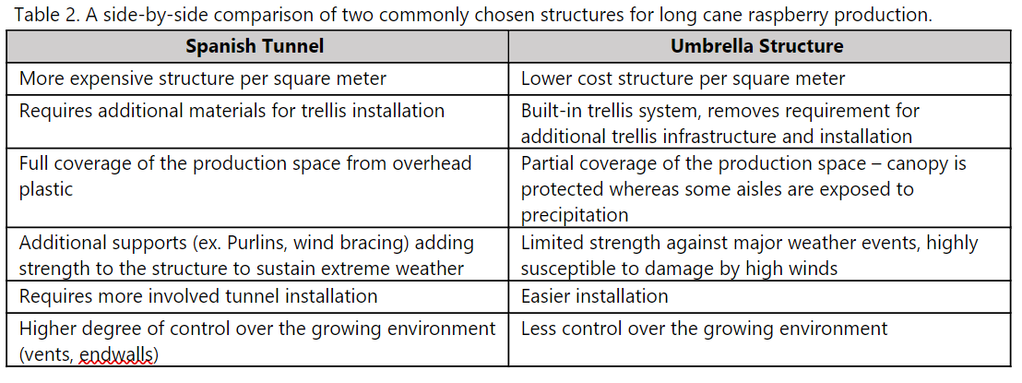
Umbrella Type Structure

Slide 10
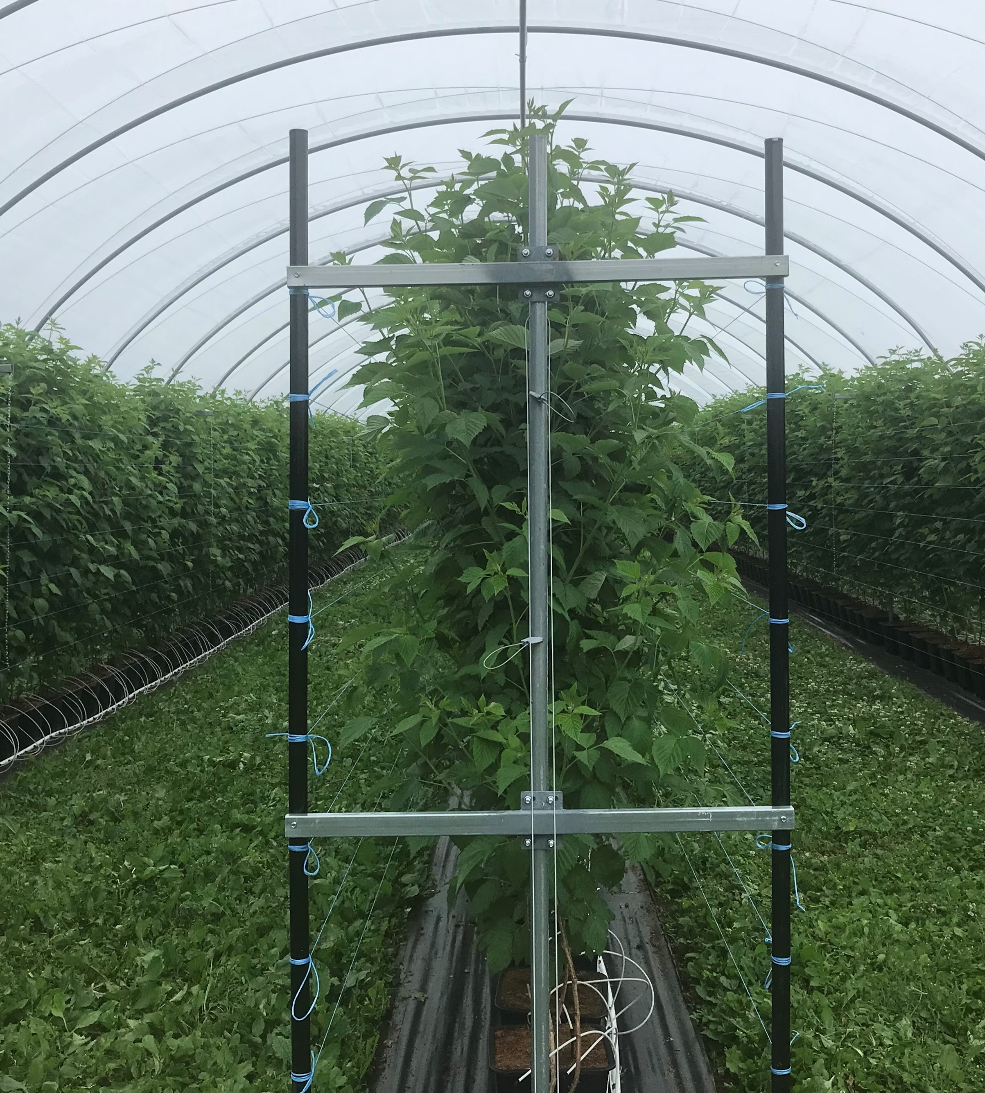
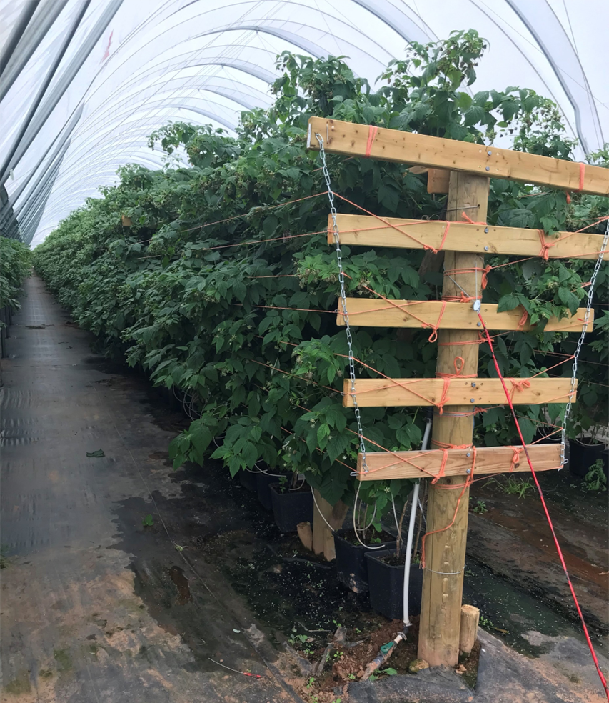
Site Preparation
Trellis:
Aisle widths are 10 ft, allowing plenty of room for the canopy to expand while still allowing passage of pickers and sprayers
Support strings running up the height of the canopy begin 1ft above the ground, and continue up to the top of the cane
Perpendicular support beams should extend out 40-50 cm on either side of the central support post
Trellis system needs to be well supported to withstand substantial weight during the harvest period
Notes:
The other site setup feature I want to delve into a little bit deeper is trellis setup, which is an important component for any crop that requires additional support.
In an ideal scenario, aisle widths will be about 10ft wide, from centre post to centre post, to allow for lateral expansion while maintaining space for pickers and spray equipment. It might not be super clear in this photo as to what is happening so I’ll do my best to point those things out here. We have a series of orange strings coming off this end trellis post. It is recommended to use about 8-10 of these lateral support strings across the height of the canopy which start about 1 ft from the bottom of the crop, and continue up until the top of the cane. This should be sufficient in supporting all of the laterals that will come off the main nursery cane. The use of this metal chain, suspended from the top anchor, provide additional support to those strings as it runs through the crop, to ensure the full weight of the laterals can be supported and minimizing the amount of dipping happening along that string.
While the majority of the trellis installation should happen before planting, the addition of these strings, which are orange in the first photo and blue in the second, is typically done once the canes have been brought in to facilitate easy planting.

Slide 11
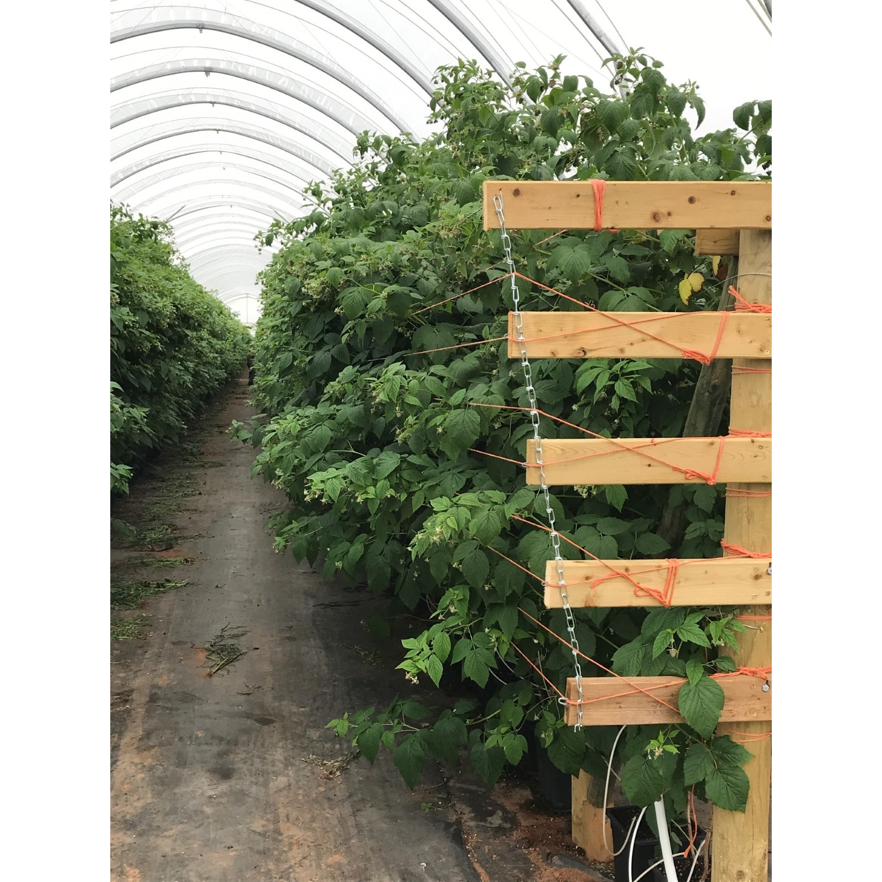
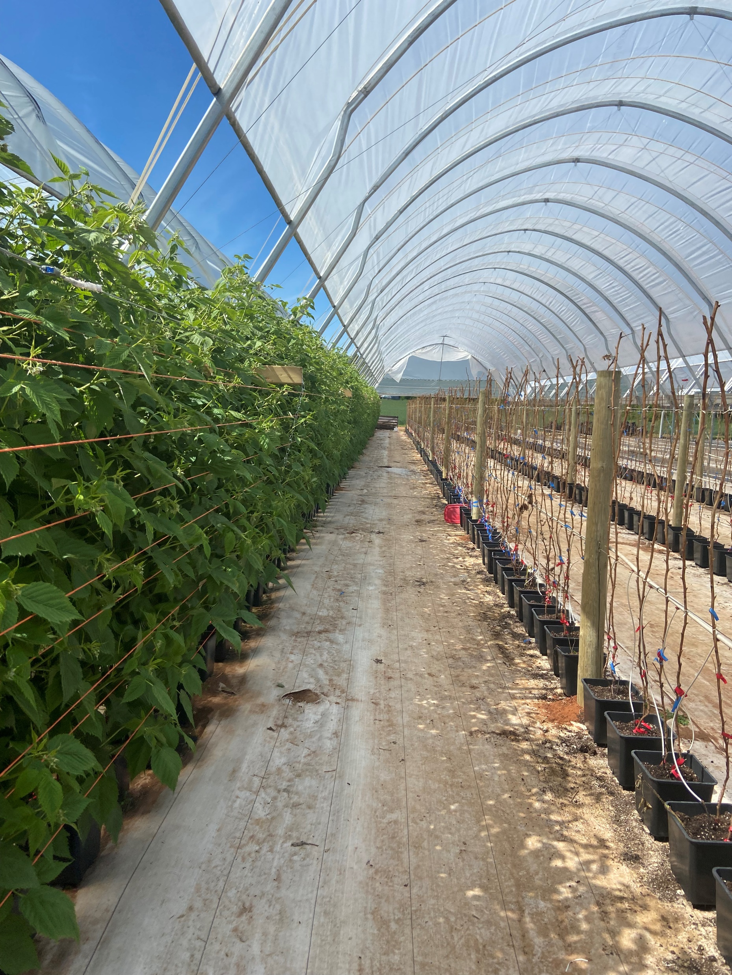
Ground cover

Slide 12
Long Cane Raspberry Production
Planting Dates
One of the advantages to containerized long cane raspberry production is the ability to select planting dates.
One singular planting, or staggered plantings, can be used to extend the season for local raspberry production by targeting times where field raspberries are not actively harvested
The use of Growing Degree Hours is a useful tool in planning out next seasons crop
Notes:
Now that we have our site set up, we can start thinking about when we want to plant. One of the advantages to containerized long cane raspberry production is the ability to select planting dates, whereas perennial raspberry budbreak is at the mercy of the weather. Selecting planting dates allows producers to decide, to some extent, when they want to be harvesting these plants. This can be done to target shoulder seasons before or after field raspberries have been harvested, to address shortages or gaps in activities for on-farm labour, or to allow for a continuous harvest through the growing season to be able to supply retailers for a longer window of time.

Slide 13
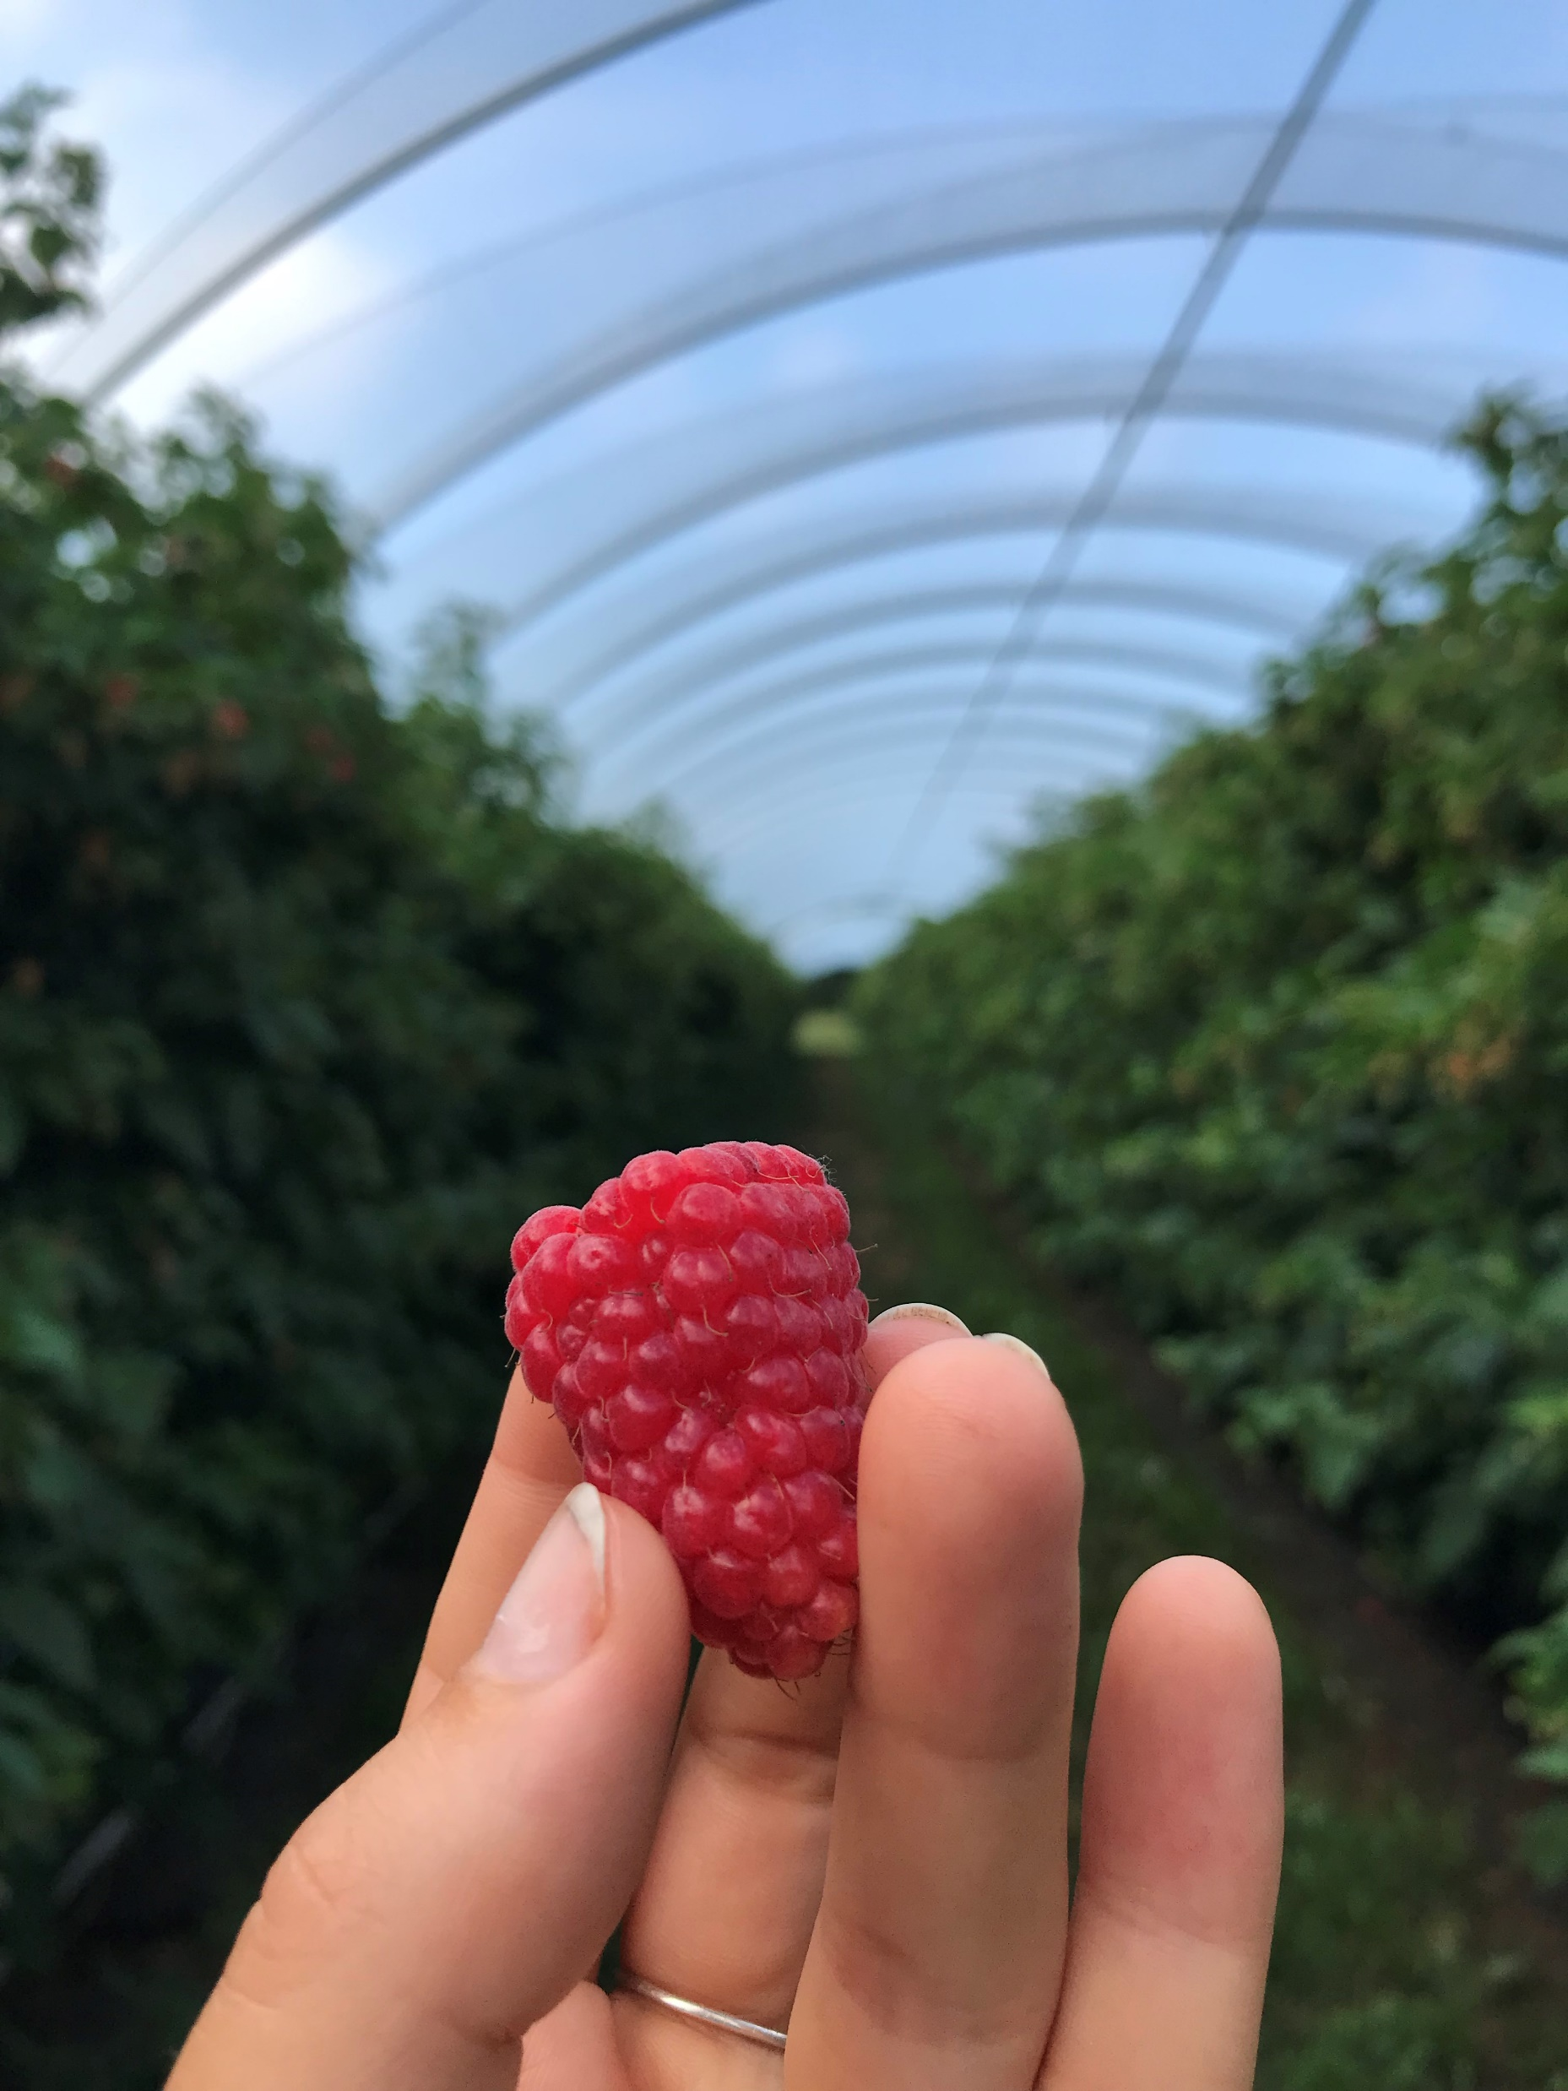
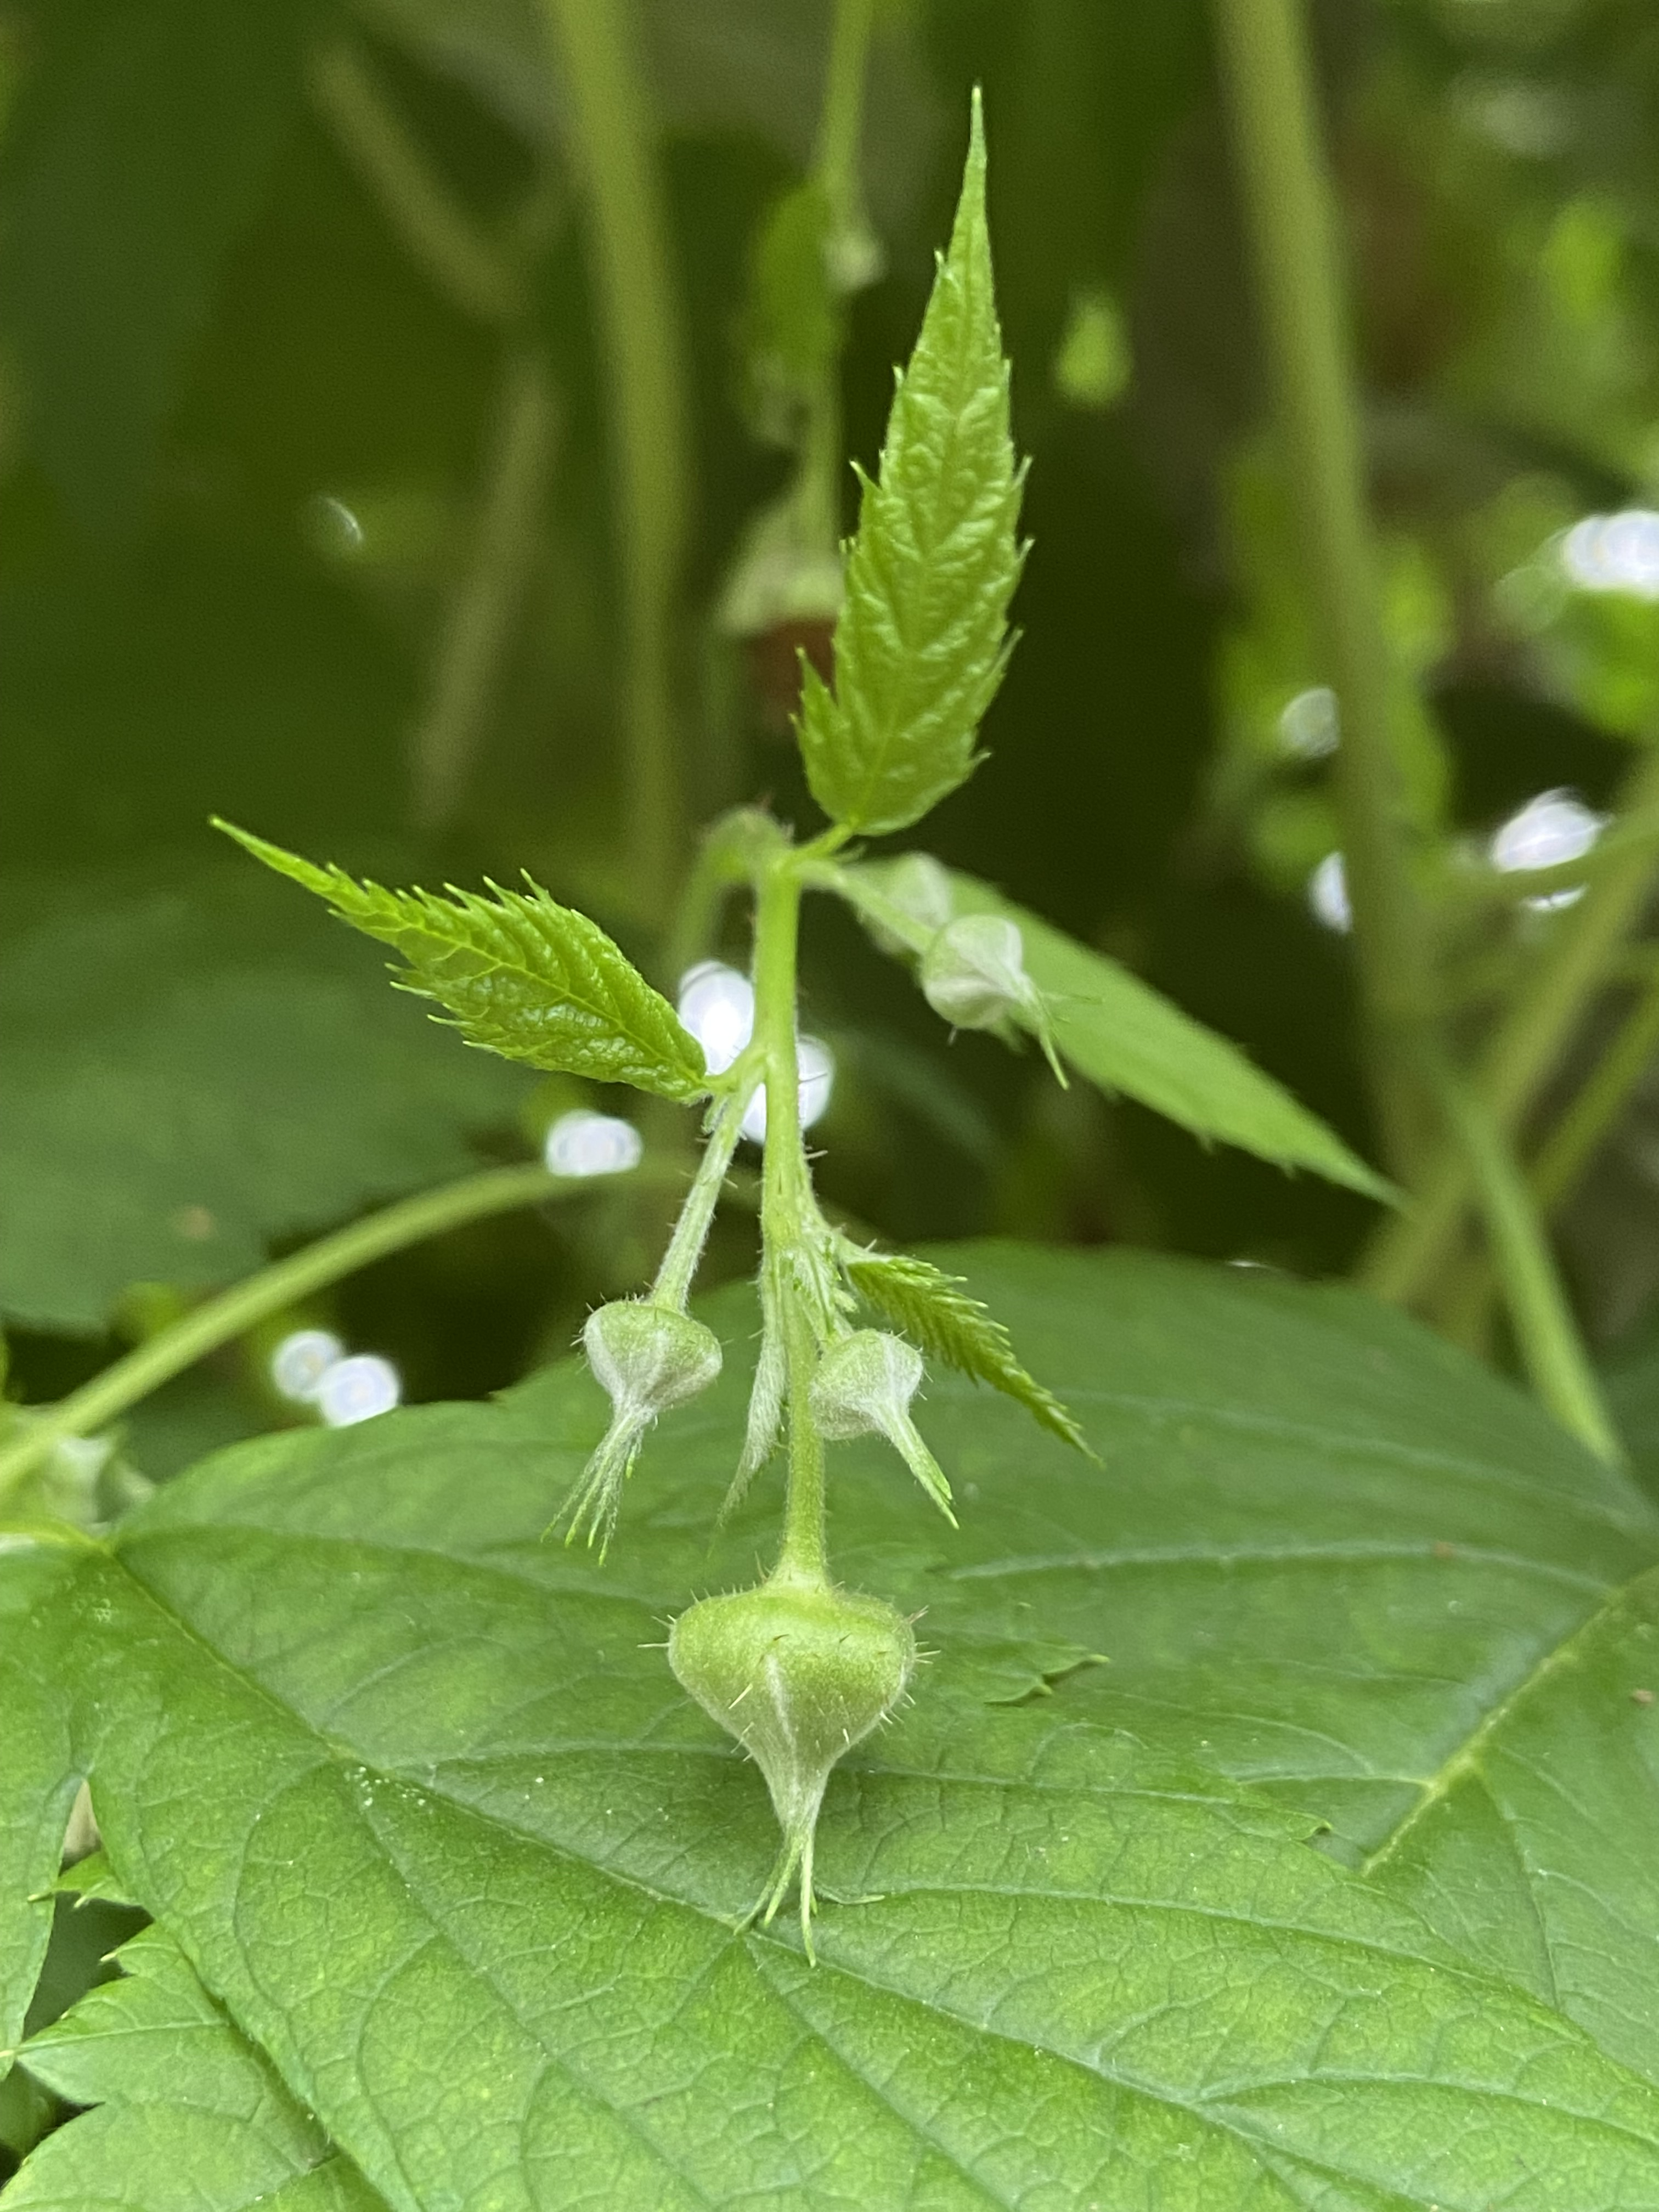
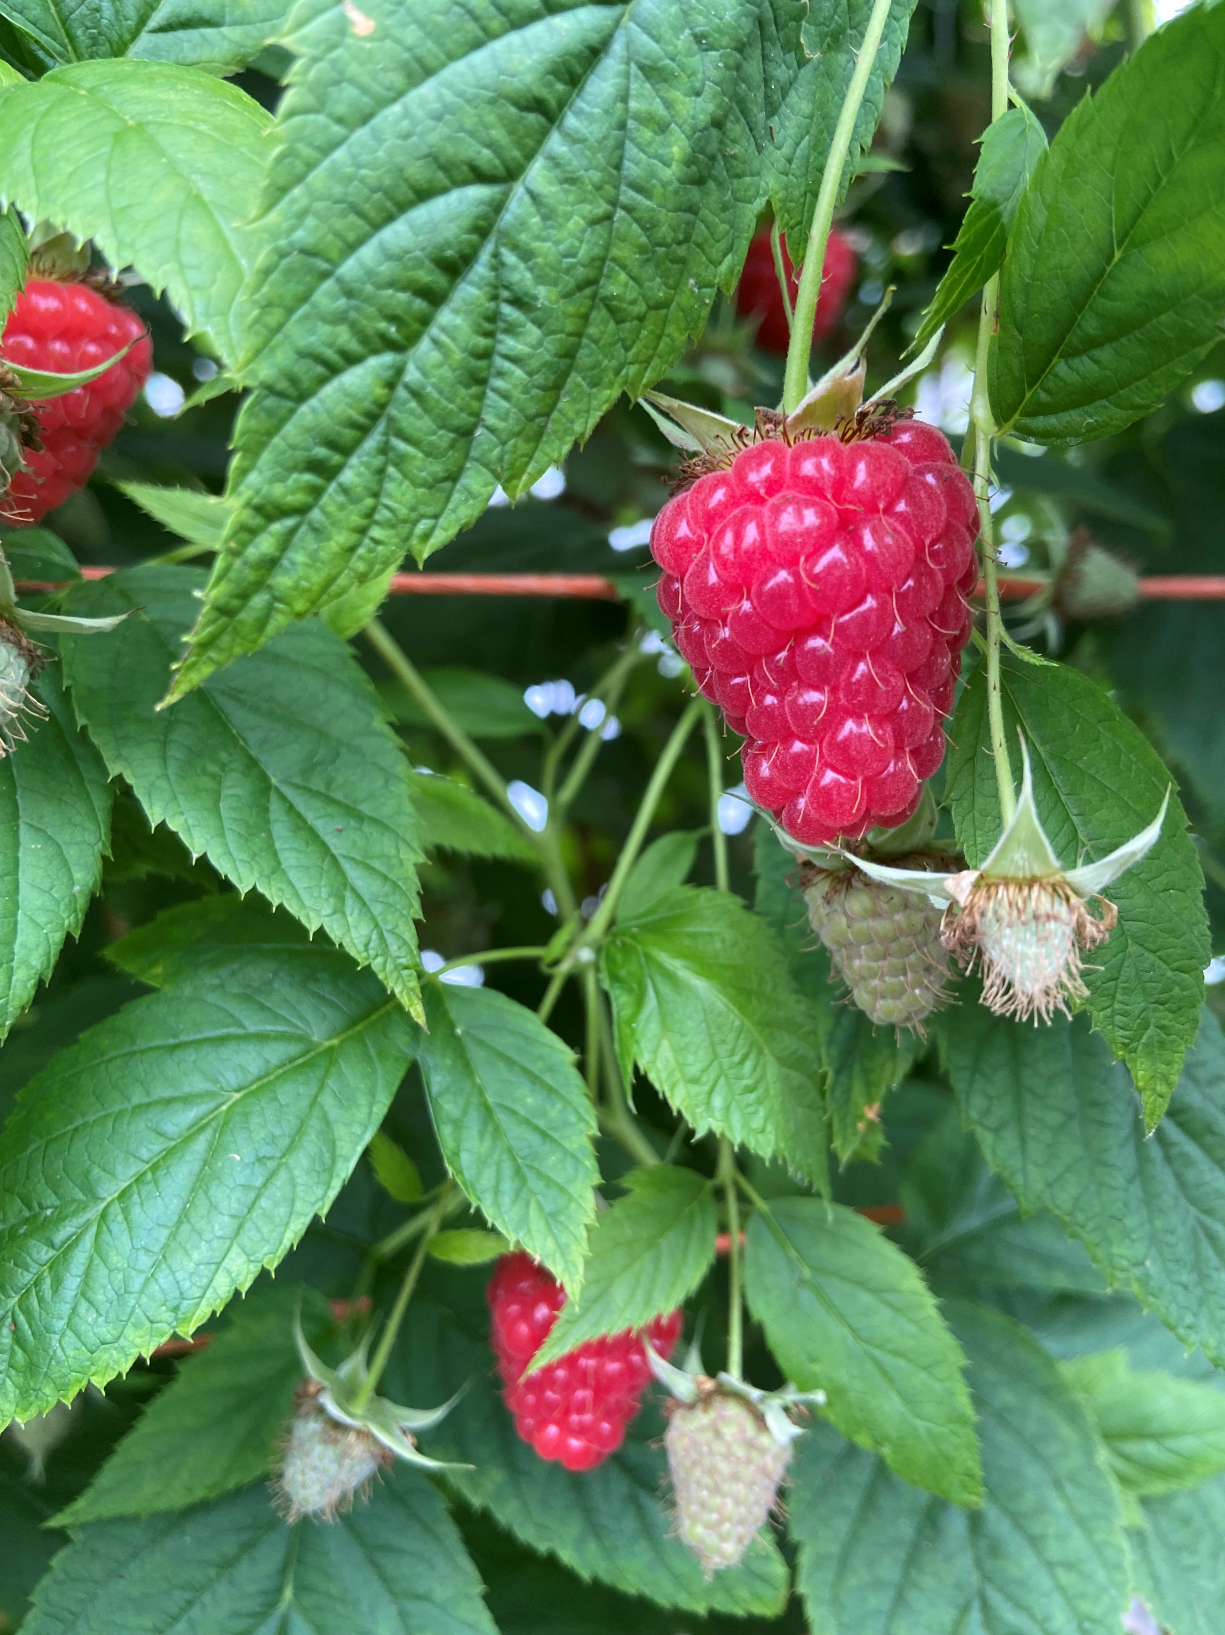
Long Cane Raspberry Production
Scheduling Planting Dates
Growing degree hours is a measure of heat accumulation using 4.5ºC as the baseline for long cane
This measurement allows for accurate forecasting of when the first flowers will open, when harvest will begin, and when the crop will be finished
Using this, one project participant was able to pre-plan and realize four full months of harvest in 2022
Accumulated GDH and Associated Growth Stages
 | First Flower | First Pick | End of Harvest
Delphy Benchmarks | 10,000 - 11,000 | 21,000 – 22,000 | 42,000
Nova Scotia Benchmarks | 16,000 – 18,000 | 27,000 – 28,000 | 37,000
Notes:
This flexibility in planting dates requires a metric that will account for the very different growing conditions these nursery canes experience depending on their planting dates (April vs May vs July). The UK relies on growing degree hours, which takes into account the plant activity that happens above the 4.5C base temperature. Major crop milestones such as first flower, first harvest and crop completion are logged against these growing degree hours so that we get a better idea of what is happening when. This can go one step further and be applied to the ripening process as well – how long to transition to small green fruit to white-ish fruit to red fruit, and how long from red fruit until harvest.
One of the interesting things we found throughout the pilot program was a differentiation in these GDH benchmarks compared to what Delphy has observed in the UK. You can see here in the chart, that first flower requires about 5k more growing degree hours compared to what is required in the UK, but we also see a much shorter harvest window. This is definitely something we are hoping to continue to ground-truth here in Nova Scotia to aid our ability to predict planting.
For those who are just starting out and interested in accessing local data, we have a reference table of GDH by week in the production guide that can be used to help plan planting dates until hyper localized data is available. This was collected across two farms in the Annapolis valley, so some other regions are going to have to use caution when looking at these numbers.

Slide 14
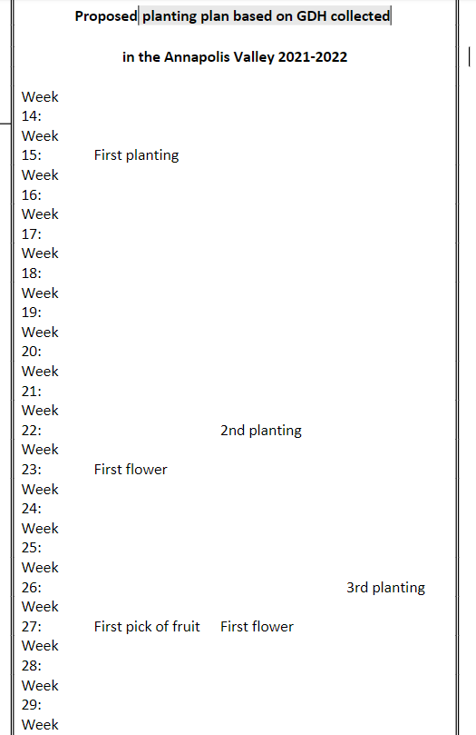
Predict planting times
Notes:
Week 15 = April 9th
Week 27 = July 2 first harvest

Slide 15
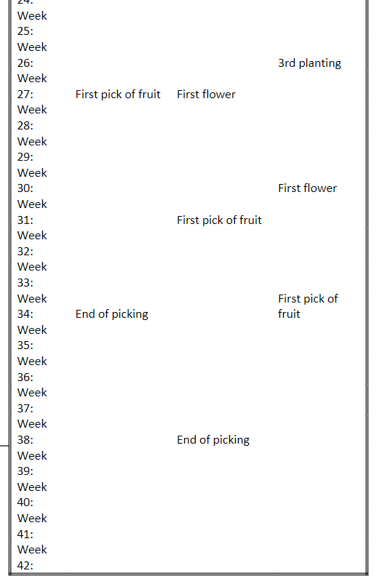
Predict harvest times
-16 weeks of harvest from three plantings starting Week 28
Ending week 44
Notes:
Last planting picking starts august 20th
Ends of October

Slide 16
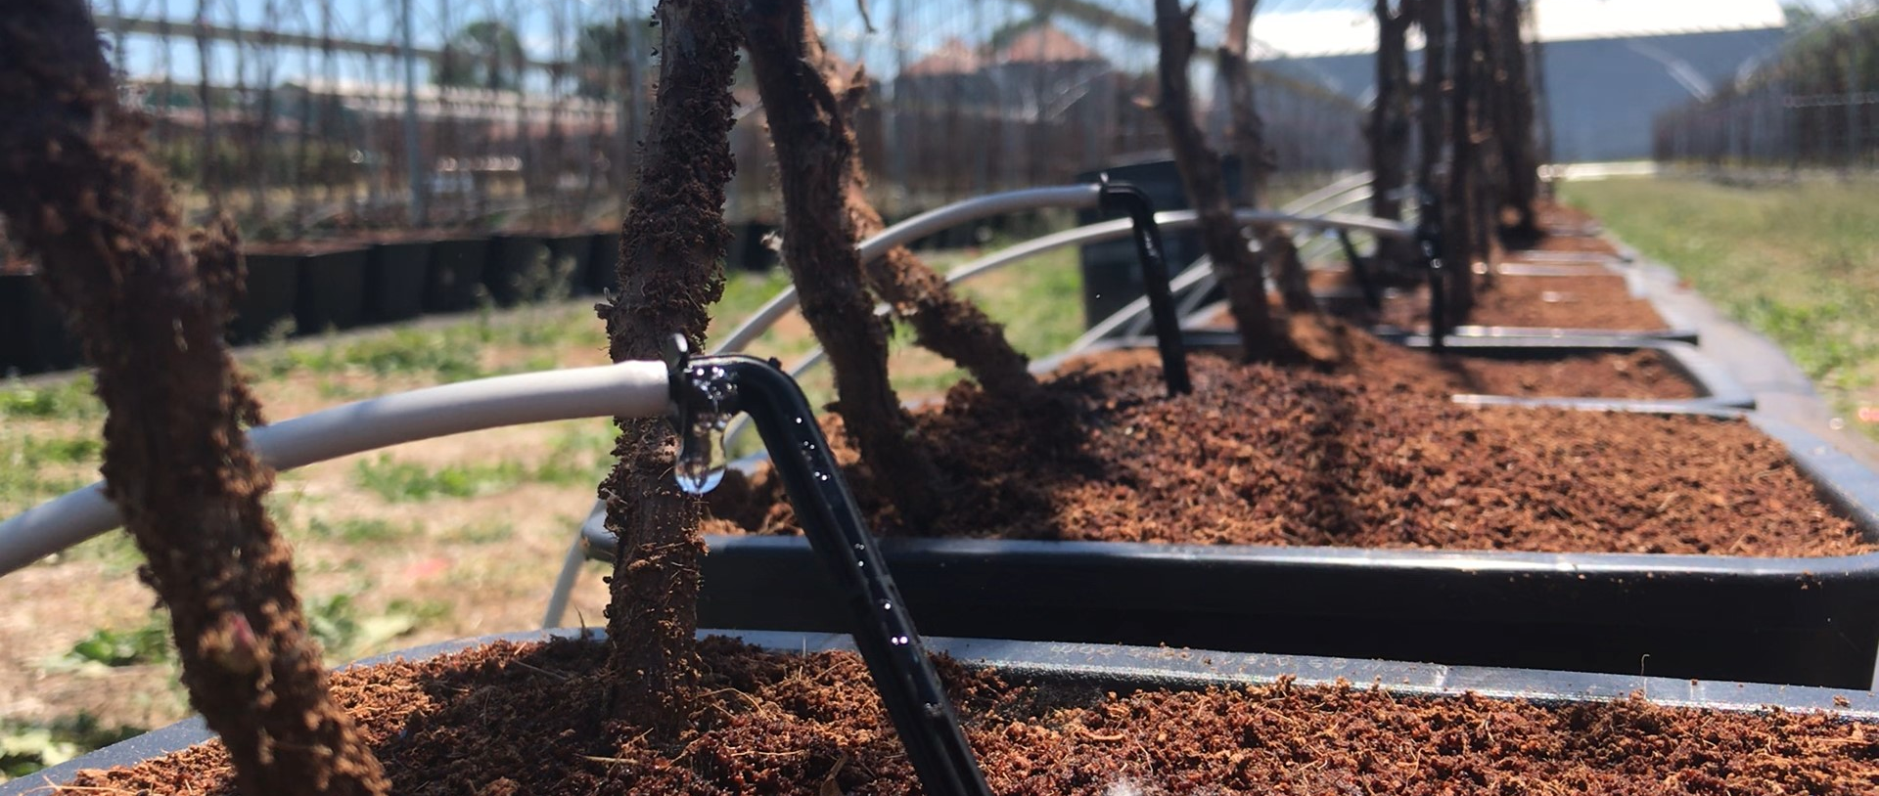
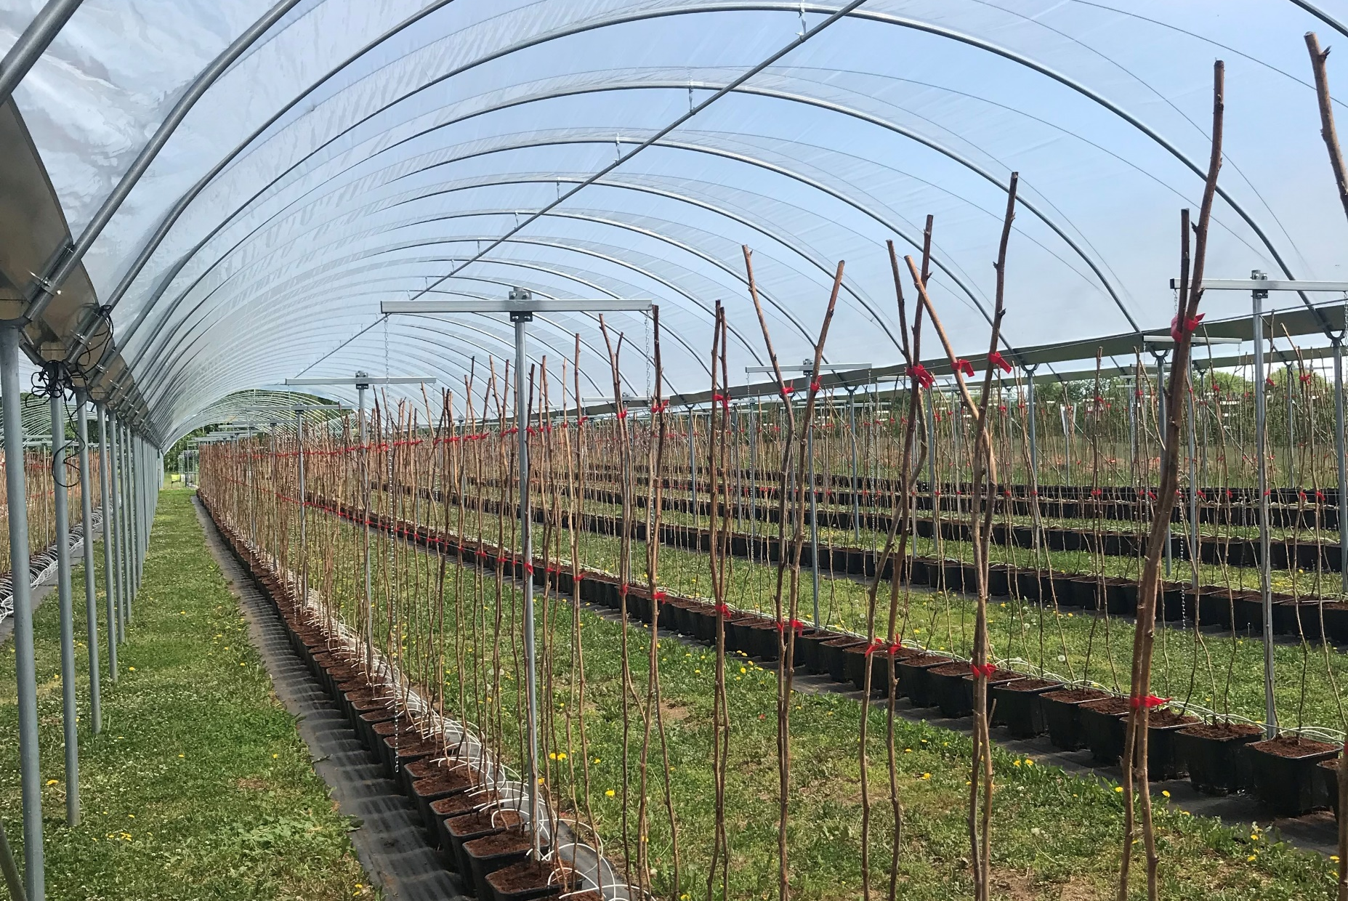
Long Cane Raspberry Production
From the beginning:
Nursery stock is held dormant in cold storage until it is time for planting
Canes are transplanted out of the 1.7L nursery pot into a larger container for fruiting production
  4.5L, 7L and 10L are the most common container sizes
Lateral growth will begin quite quickly once the canes have been pulled out of dormancy
Notes:
Now that the site has been adequately prepared and planting dates established, its time to start growing plants. The growing season for long cane raspberry begins once nursery stock is pulled from cold storage. These canes are then transplanted out of the nursery pots and into a larger container, and moved into the production space for the remainder of the growing season.
Quickly after transplanting, we recommend fastening the canes to the central wires on the trellis to keep them from blowing over. This is also a nice timepoint to add the string into the trellis setup. Lateral growth is going to happen quickly after you pull the canes out of dormancy, so its worth investing the time in the crop early on so that you aren’t caught off guard.
Drippers can also be stuck into pots immediately following installment into the tunnel. Managing the irrigation schedule starts right from day 1, and there will be a few chapters in the production guide dedicated to coming up with an irrigation schedule that will support crop needs.

Slide 17
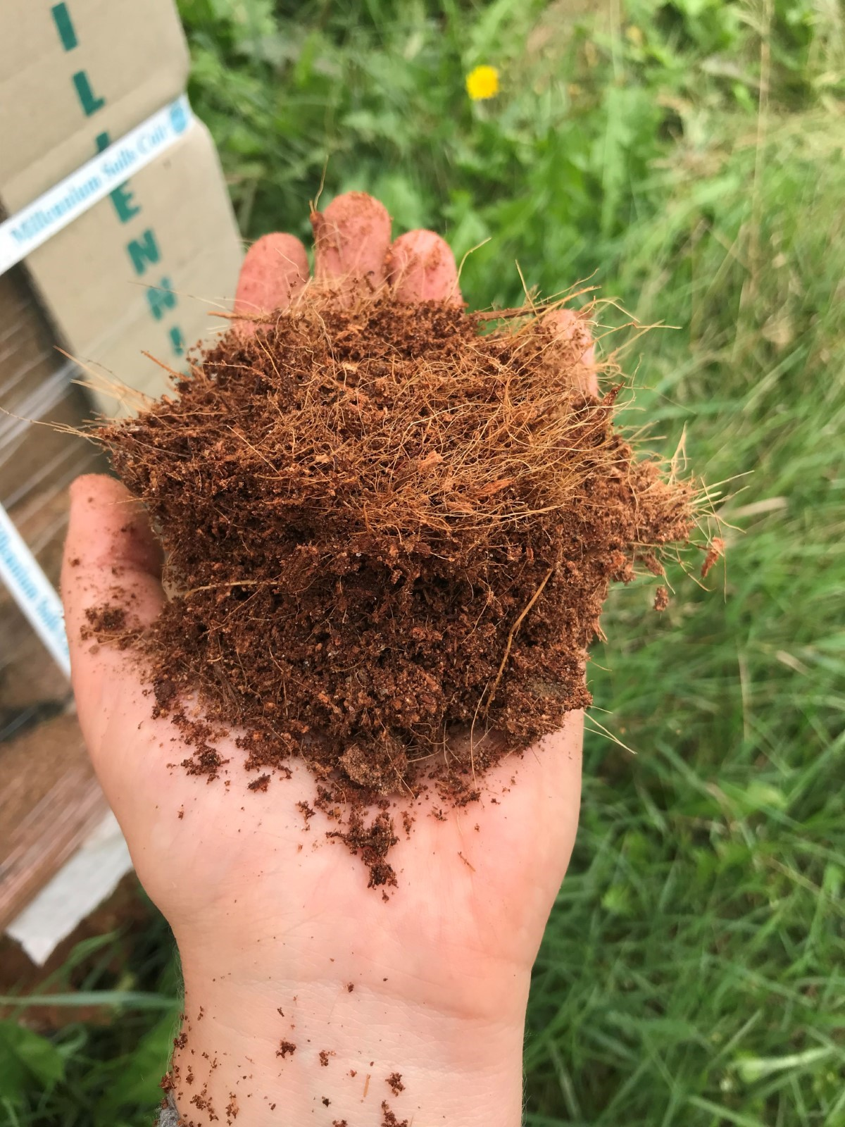
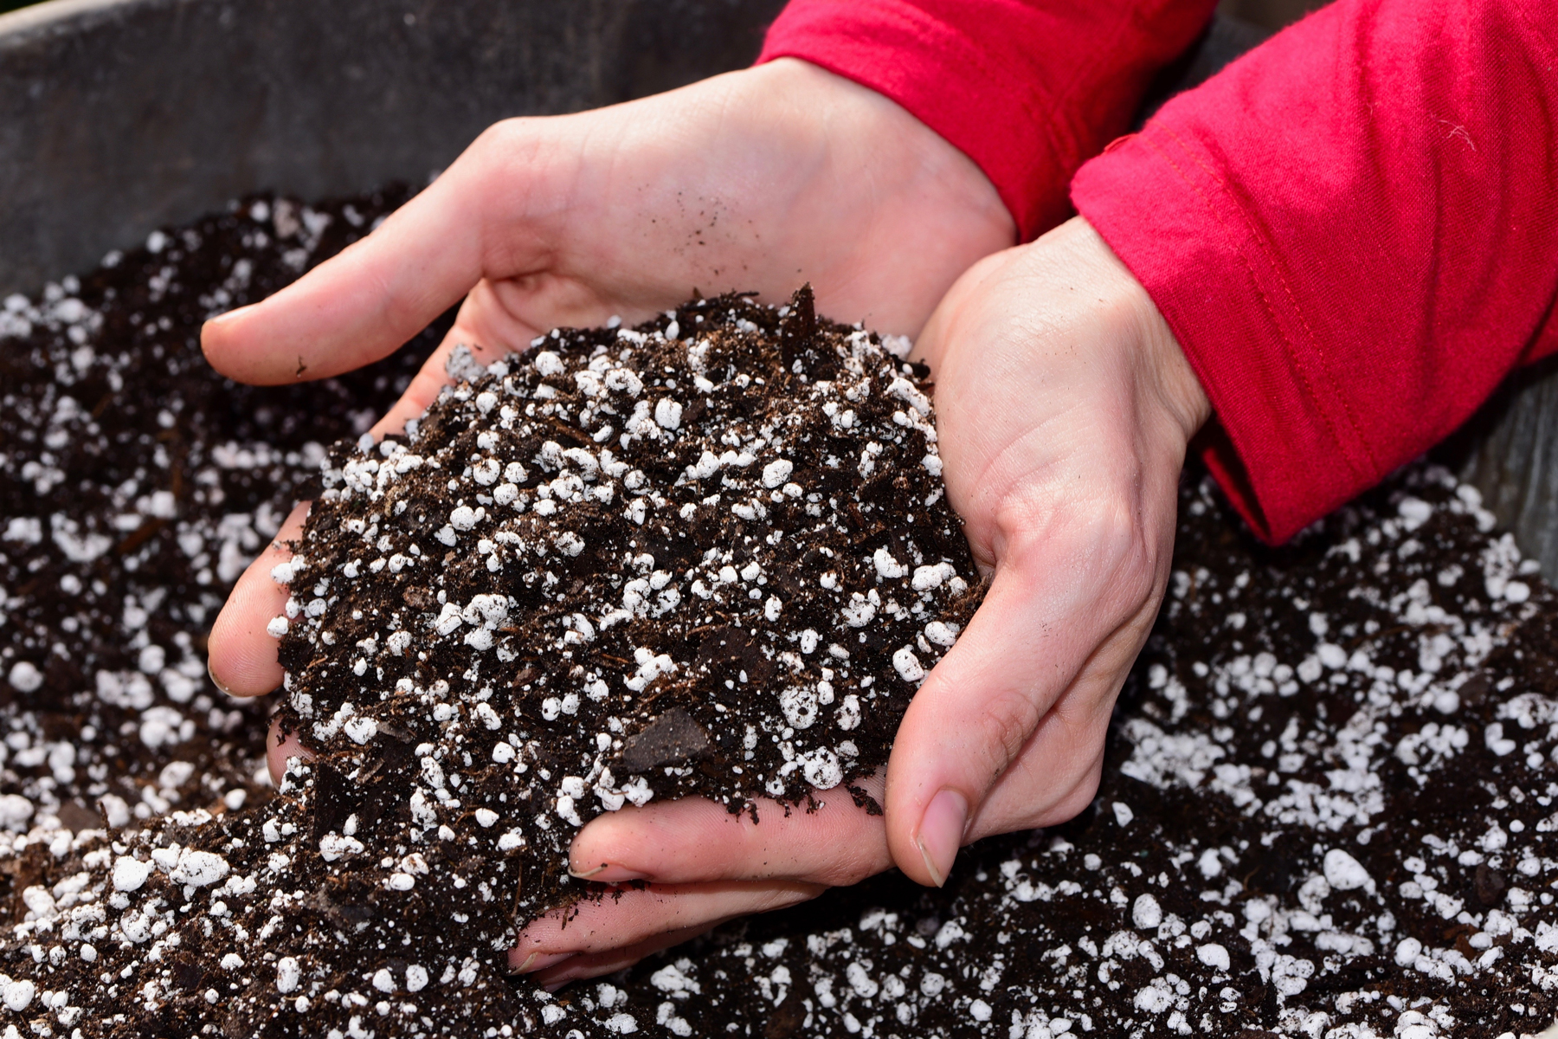
Selection of Substrate
Coir
Perlite/Peat

Slide 18
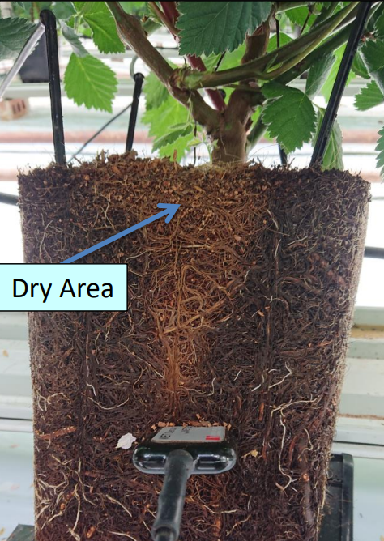
Pot size and Number of Drippers
Pot Size and Number of Drippers
Dripper requirement based on pot size:
  4.5L pots require 2 drippers per pot
  7L pots ideally have 3 drippers per pot
  10L pots require 3 drippers per pot
Drippers w low outputs (<1L/hour)
  Narrow wetting pattern, so drippers need to be placed closer together to ensure even wetting
Drippers w high outputs (+2L/hour)
  Can cause channeling of loosely packed particles
Notes:
For now, we can talk a little bit about how dripper placement, and the number of drippers, are going to impact the success of the fertigation. No matter how perfect a fertilizer recipe or irrigation schedule is, if it is not being delivered correctly, the crop will not reach its full potential.
The size of the pot used for fruiting production is going to impact the number of drippers necessary. We have three commonly used pot sizes for fruiting production of long canes. The smaller pot will require less drippers and less substrate compared to the larger pot. The benefit of the larger pot is you have more space for root colonization through the growing season. The 7L pot seems to be a happy medium between the two.
The output of the drippers is worth thinking about as well, as it is going to impact the way that the water moves through the substrate post delivery, and dictates where in the substrate the drippers should be placed. Drippers with low outputs, which we have classified as those with an output less than 1L/hour, are going to have a narrow wetting pattern, and not see a lot of lateral spread. Ideally these are placed in close proximity to one another to create a more continuous moisture zone.
This photo taken from Delphy UK illustrates what can happen when not enough drippers are used, or they are placed incorrectly. These dry areas, although seemingly harmless, are not going to have any real root growth in them, meaning a reduction in the volume of substrate available for colonization. We also typically see a buildup of salts along these boundaries lines, as these areas don’t necessarily see water movement through them. This buildup of salts leaves the plant susceptible to root diseases, and can further impact water and nutrient uptake throughout the rest of the substrate.
Long story short, its important to pay attention to your dripper output, as well as the placement and number of drippers used.

Slide 19
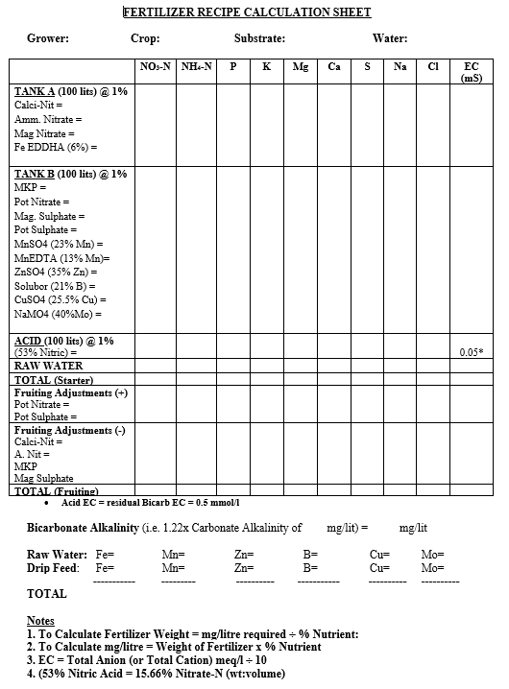
Nutrient Recipe
Based on water analysis
Adjust for nutrients in the water
Uses straight ingredients
Different recipe for fruiting and ripening
Change over is critical and earlier than you think

Slide 20
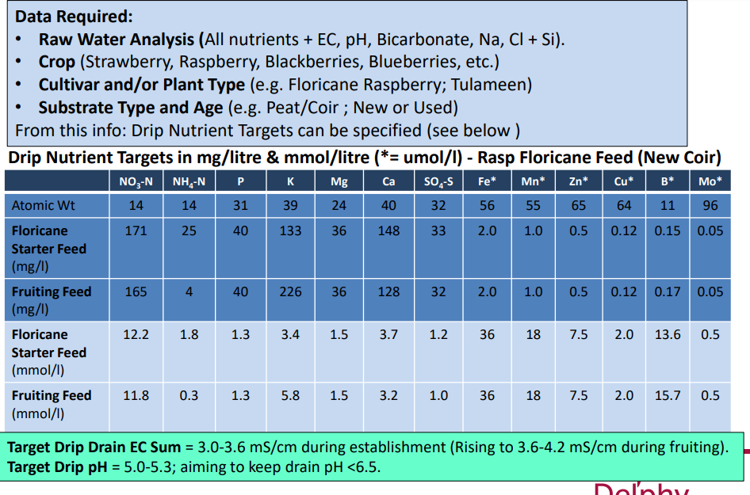
Nutrient targets
Are well defined
Send sample away about once a month
They don’t very a lot, water source should not vary a lot.

Slide 21
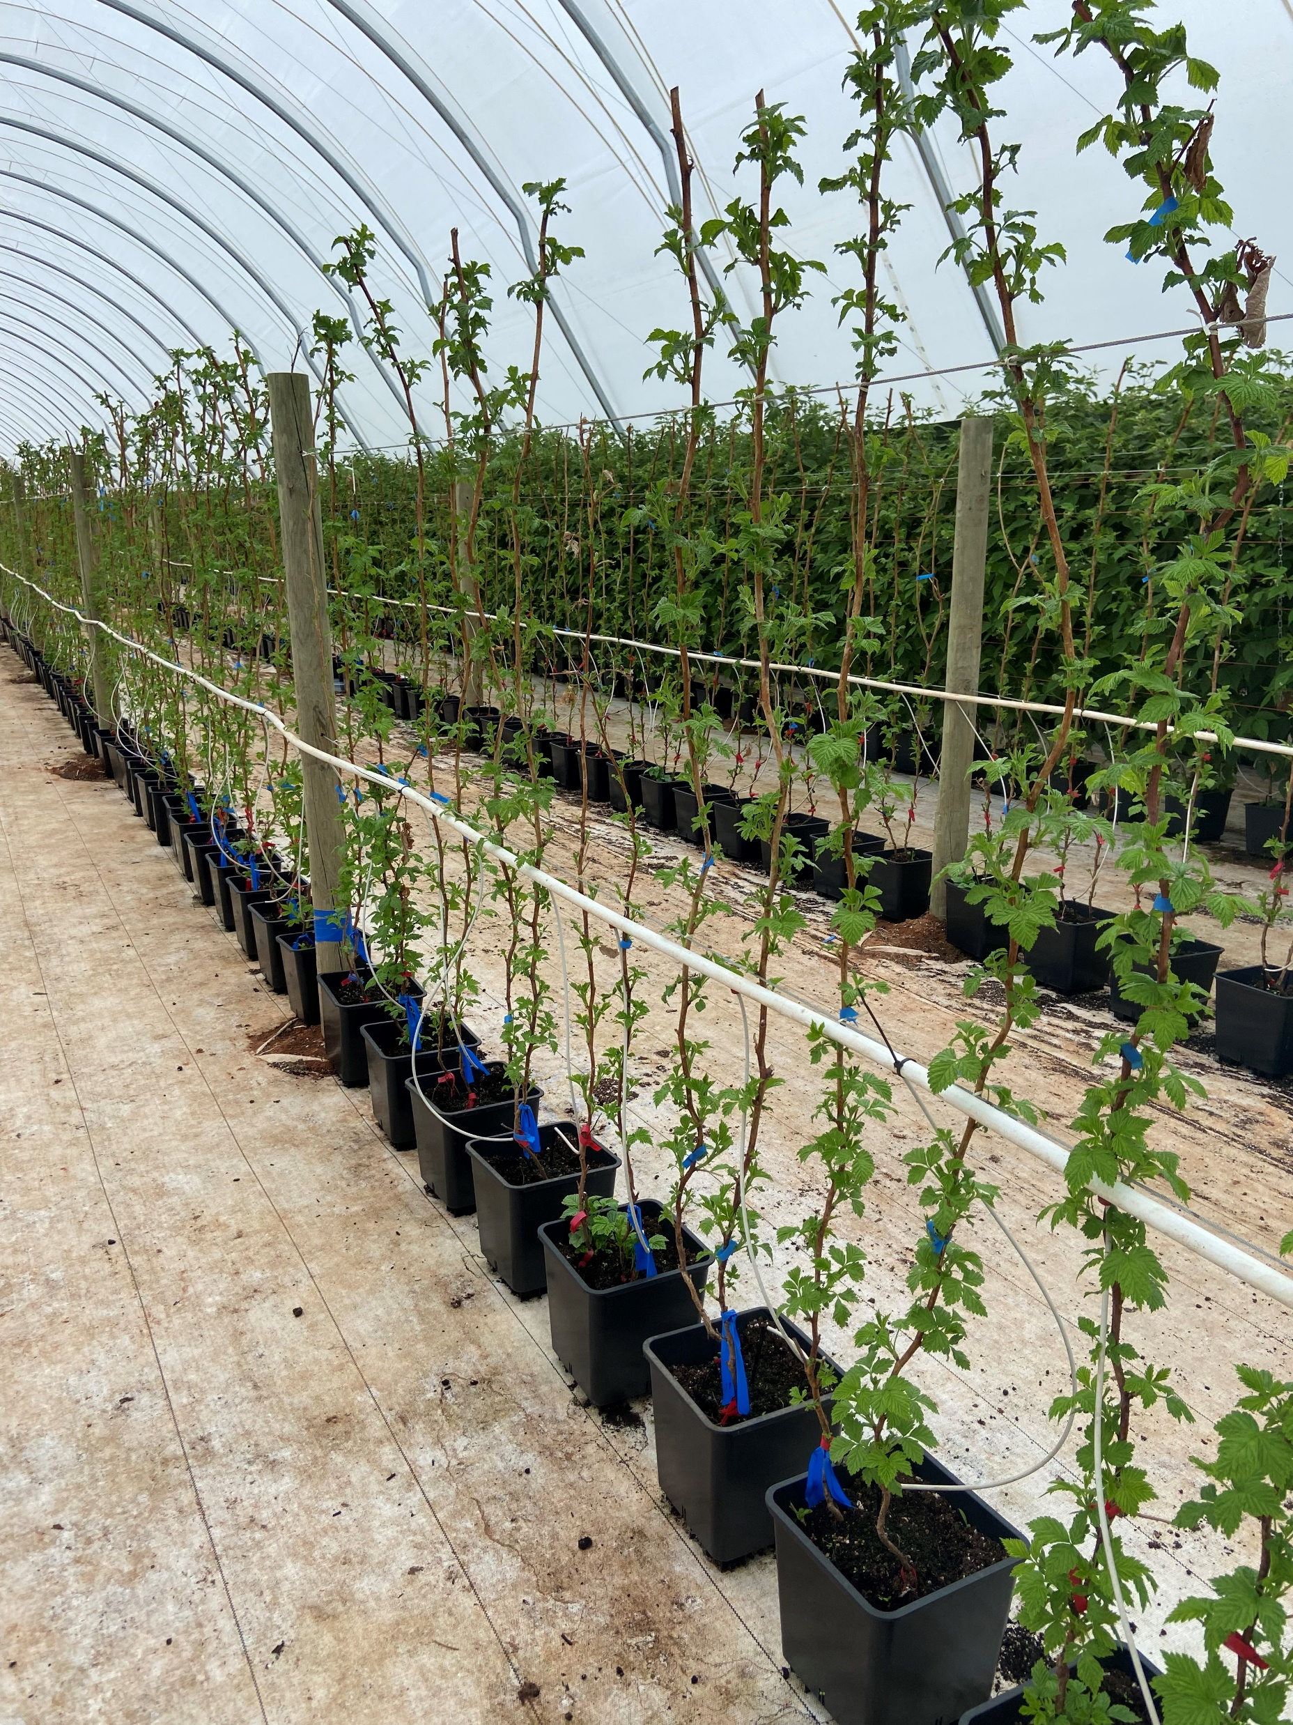
Long Cane Nursery Stock
Bud break and cane assessment
Once lateral growth has begun, viability measurements can be taken to assess cane quality
  cane height
  cane caliber
  % budbreak
Further down the line, assessing the ratio of vegetative to fruiting laterals allows for some early yield forecasts
Notes:
As these canes begin to grow, there are a few measurements than can be taken that will give you an early indication of plant performance. Yield potential is set at the nursery stage, so its worthwhile knowing what the maximum, or ideal, performance of those canes are before they have been too heavily influenced by the growing environment. This also serves as a quality check of your nursery stock, which can be useful when starting out and testing different suppliers.
Cane height should be between 1.4 and 1.7m, depending on the chosen variety and we expect about 60% budbreak.
Cane caliber is also worth looking at, and is usually measured around the 1m mark on the cane. Canes that are too thin might not be able to sustain a heavy yield, and canes that are too thick might trend towards a dense, vegetative canopy. The ideal range we are looking for is 7-15mm.
Once the laterals start to differentiate, we can start looking at the ratio of vegetative to fruiting laterals. Long cane raspberry has shown consistent apical dominance the last two years, so the top laterals will show flower buds before the bottom ones will. Once you start to see the first set fruit on the upper laterals, you should be able to take an accurate count of how many of those laterals are generative, as opposed to vegetative.

Slide 22
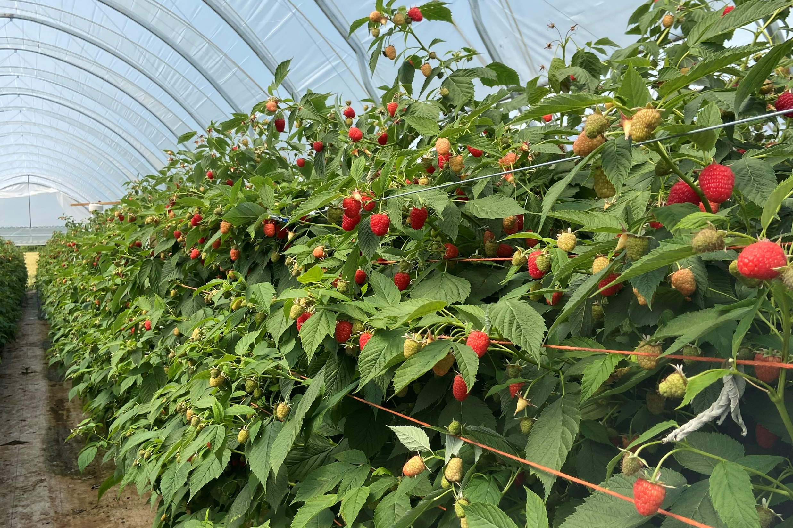
Long Cane Raspberry Production
Varieties and Yield Forecasting
Primocane variety (ex Kwanza)
--Typically grown at 4.5 canes per linear meter
20 fruits per lateral
Average fruit weight of 5g per berry
Each fruiting lateral will give rise to approximately 100g per lateral
-Potential crop is 1.67 kg/cane
- Potted canes primocanes varieties from the nursery usually arrive shorter, with a smaller calibre compared to floricane varieties.
Notes:
With yield forecasting in mind, lets jump ahead for a second here and see what we can expect from long cane raspberries. Dormant long cane raspberries can be categorized into primocane and floricane varieties. Primocane varieties such as Kwanza, are typically placed at 4.5 canes/linear m. They put out 20 fruits per lateral, with an average fruit weight of 5 g/berry, each lateral should yield about 100g of fruit. The potential crop here is about 1.67kg/cane.

Slide 23
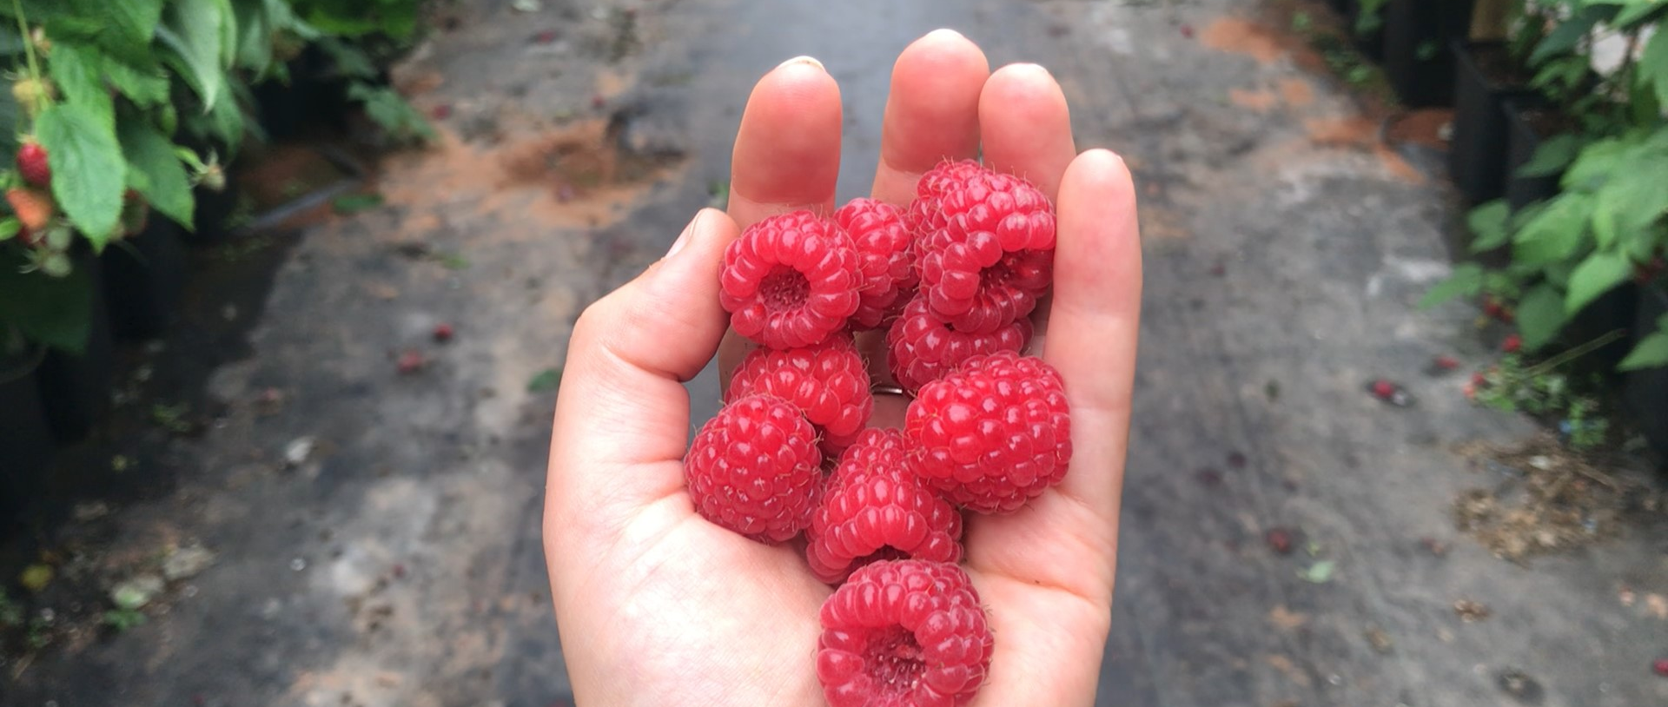
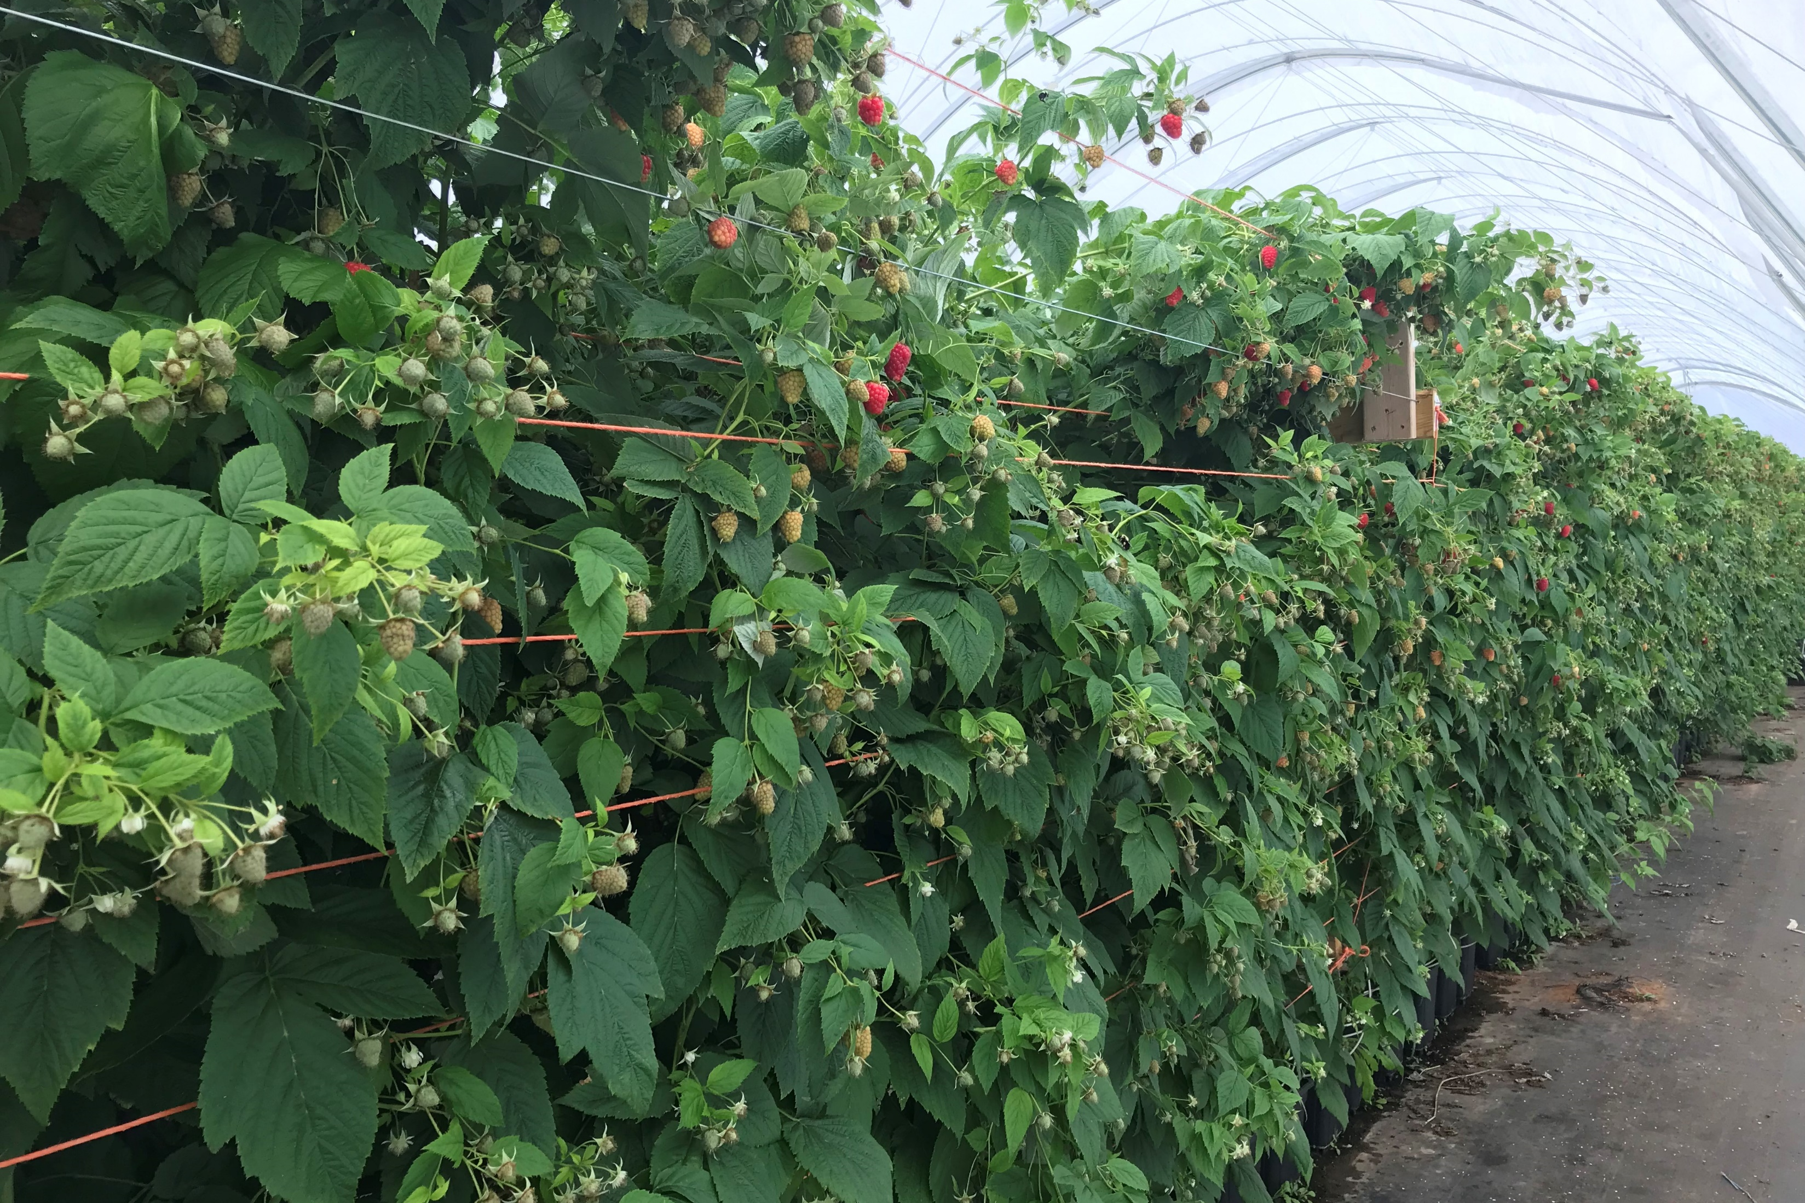
Long Cane Raspberry Production
Varieties and Yield Forecasting
Floricane Variety (ex. Tulameen)
--Typically grown at 6 canes per linear meter
-An average fruiting lateral will yield 12 fruits
-Average fruit weight of 5g per fruit
- Each fruiting lateral will produce around 60g of fruit per lateral
-Potential crop is 900g/cane
Notes:
The other group of dormant long canes that are available for production are floricanes, such as Tulameen. These are typically grown at 6 canes per m. Floricane varieties typically grow shorter laterals compared to primocanes, so they can be packed in a bit tighter to maximize weight per space.
Floricane varieties typically will put out 12 fruits per lateral, with an average weight of 5g/fruit, meaning that each fruiting lateral will produce about 60g of fruit. This adds up to a potential crop of 900g/cane. Over the last two years, we saw an average price of $13/kg

Slide 24
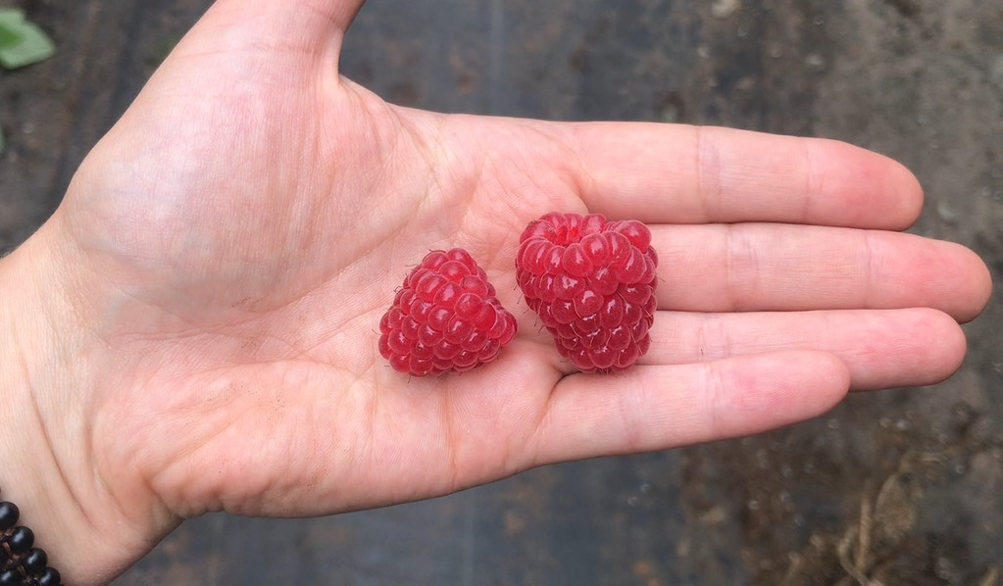
Long Cane Raspberry Production
Fruit Size
Notes:
Just a few things I wanted to touch on when it comes to fruit size:
Fruit size is also going to vary depending on planting date – the closer you plant to summer solstice, the smaller those first fruits are going to be.
Fruit size will go down as you progress through harvest – individual early fruits may start out around 6 or 7 g/berry, but this works its way down as the harvest window comes to a close. This photo here shows the fruit off a batch of canes close to the end of harvest, compared to one of the first picks off of the next successional planting.
Fruit size is going to go down if your EC is too high.

Slide 25
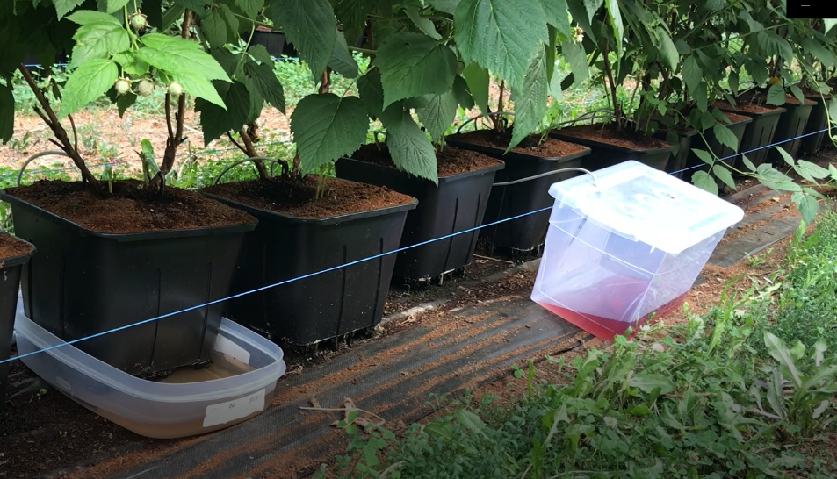

Irrigation Management
For plants grown in limited volumes of substrate, excess irrigation is crucial.
Compensates for differences in dripper output
Compensates for different plant water use across different pots
Minimize salt (EC) build-up in the substrate
Even replacement of nutrients that have been taken up by the plant in large amounts
Leachate should be managed, however: excess leachate contributes to unnecessary costs of fertilizer and water, as well as increases humidity in the space which can be detrimental to the crop
Notes:
Irrigation is the absolute engine room for this production system, it has a huge impact on plant growth and the quality and size of the berries harvested. One of the key features in assessing your current input levels and make adjustments to better suit the crop water needs is going to be leachate. Too much water leaching out? Not enough? This is where you will see that on an hourly and daily basis, and allows you to make adjustments so that the overall yield is not impacted. While encouraging nutrient solution to drain out of the pots may seem wasteful, there are a few reasons as to why this is a necessary evil.
First off, it will compensate for differences in dripper output, as well as different plant water use across different pots.
Secondly, it will minimize salt build-up in the substrate by flushing a good proportion of them out on a daily basis, and will replace some of the nutrients that have been taken up in large amounts.
(QR code here is to walk-through video)

Slide 26
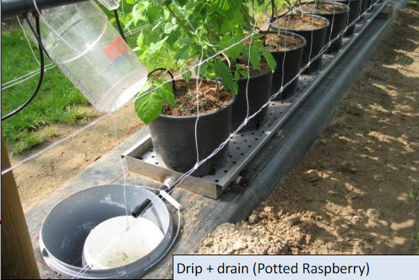
Irrigation Monitoring Stations
-3 leaching stations per acre
Target over all 30% drain volume over the day
Needs to show some drain mid morning
Notes:
I’ve included a photo of an ideal drain monitoring station for long cane raspberry.
These stations need to be monitored on a daily basis. While that might seem like a lot, it doesn’t demand a significant amount of time, and is relatively easy to incorporate into the daily routine. The jug above is collecting the water that comes out of the drippers. This is a great way to verify what you have scheduled versus what is actually happening in the crop from a volume, pH and EC perspective. We have a set of pots set up on a metal collection tray, which is going to funnel all of the leachate from the bottom of the pots out into the white bucket underneath. This solution is where we want to take our drain pH, EC and volume measurements. Comparing the drip volume compared to the drain volume will give us that %drain value that we are targeting. The EC and pH values of that drain are also going to be quite telling and will dictate what the following day irrigation schedule looks like. For more information on this, I highly recommend you check out those qr codes, or come and talk to me and we can get it sorted.

Slide 27
Irrigation Management
- 175 ml/ pot per irrigation
- 5x to 30 times per day
Start at the top of the hour for 1 minute
Start at 6:00 shut off at 5:00
Adjust from there
Start irrigation early in the day, and shut off early
Raspberries don’t like wet feet

Slide 28

Irrigation Management and Fertigation
Irrigation is the ‘powerhouse’ of the entire system – inability to provide sufficient water to the crop will significantly impact fruit quality and yield
pH
Drip irrigation targets:
Coir = 5.2-5.4
Peat = 5.3-5.6
EC
Drip EC = 1.2-2.0 mS
Drip EC+ drain EC = 4
Leachate/Drainage
24 hour average = 30%
*targets throughout the day will vary depending on time
Notes:
We won’t be able to do a deep dive here today, but we have some great resources available already on this topic that you can access via QR codes, and it will be addressed much more in depth in the production guide as well. (top code = GITW)
Irrigating and fertilizing a containerized crop is very different than a soil-based one, and takes some pretty major adjustments in order to do this correctly. Where one large watering a day is the norm for traditional production, this would run right through a container of substrate once the water saturation point has been reached, and would result in a lot of water and fertilizer being lost to the weeds. Containerized production systems requires multiple small shots of water every day to maintain an even substrate moisture, feed the plant, and supplement nutrients in an otherwise inert growing media.
In the spirit of keeping things brief, I’ve included the pH, EC and leachate targets here for your information. This is what you are aiming for in your fertigation solution – that is the fertilizer solution that has been dosed into your raw water, and then run into the crop. We want that solution to have a pH drip target that is suitable for your growing mix when it comes to maximizing nutrient availability, as well as maintain an EC that will maximize fruit size and quality.
The third target we need to maintain is leachate, or drainage.
(drain EC= 2.0-2.8 mS for a fruiting crop)

Slide 29
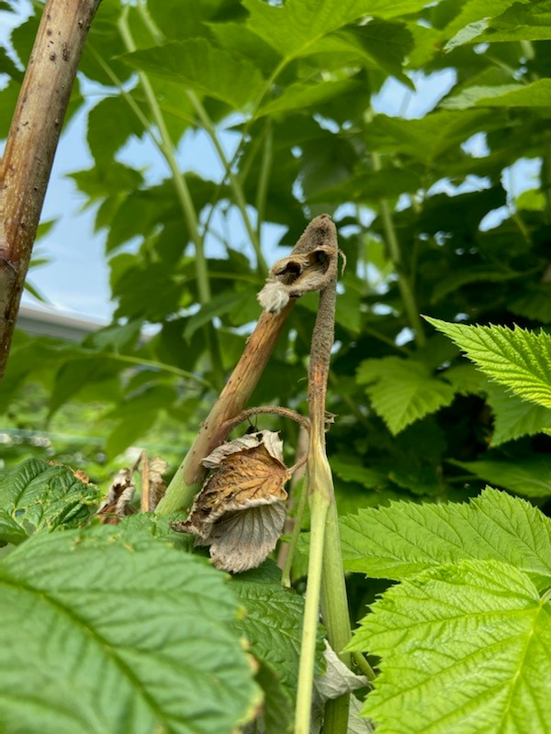
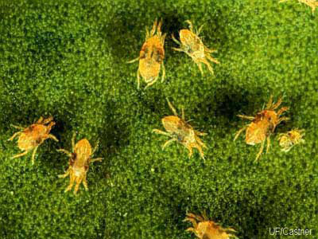
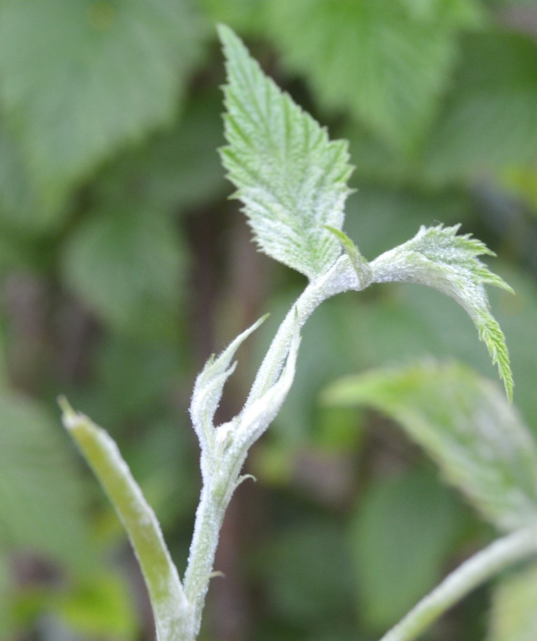
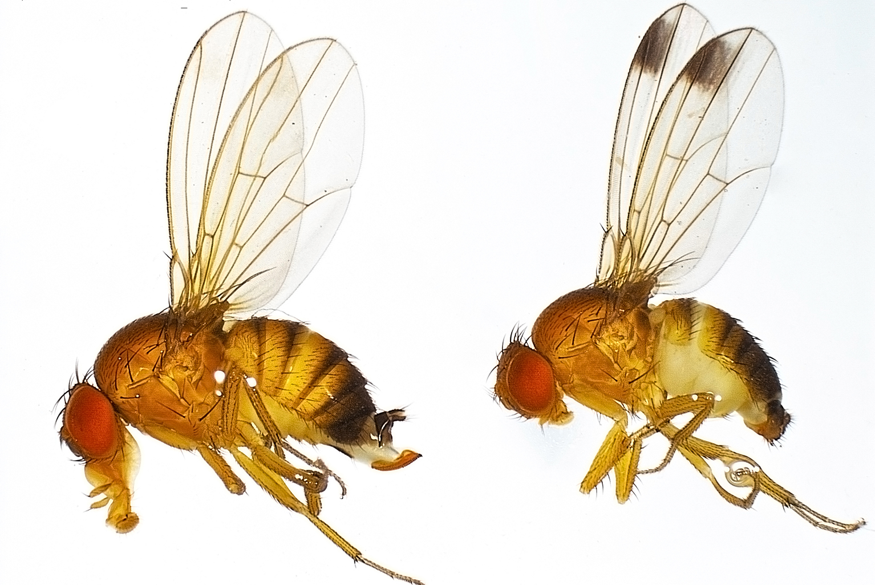
Long Cane Raspberry Production
Pest and Disease Pressure
Spotted wing drosophila (SWD), Botrytis, Mites, and Powdery mildew are the most commonly found issues for protected raspberry production
Witnessed fruit damage caused by hummingbirds
Notes:
Plant disease is usually highly correlated to an imbalanced growing environment, especially in a scenario with excess moisture being added to the system. Botrytis, for example, is one that thrives in high humidity situations where there is restricted air flow. We found that botrytis pressure was significantly lower in the second year of production compared to the first, so we are definitely improving our ability to keep it under control through managing our irrigation as well as more intentional venting and sprays.
Next up we have mites which are typical pests in high temperature areas, especially where there is limited air movement. The best thing that can be done for these is to scout regularly, and implement a program of biologicals/conventional sprays to ensure the populations don’t get too large.
One thing we didn’t have much of an issue with over the last two years is Powdery mildew. While this is commonly found in protected spaces, and we were warned that this would be a problem, we were lucky throughout the span of the pilot program and hopefully pressure remains low into the future.
Taking a step away from issues that are highly linked to growing conditions are SWD and birds. SWD population management relies heavily on crop sanitation, which is removing all ripe fruit from the crop before it can facilitate population growth of any SWD that are present in the crop. Monitoring is a good practice to keep an eye on population density in the area as well.

Slide 30
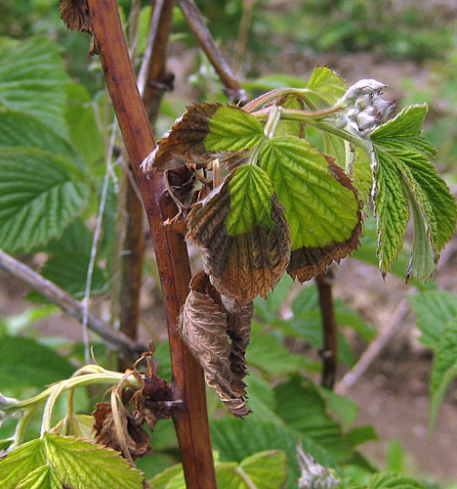
Early-Season Scouting
Phytophthora
  Root rot which primarily shows itself during the first heat of the season
  Canes will suddenly wilt and turn brown
  Usually expressed as brown colouration of the roots, with a sharp transition to white, uninfected wood within the rots or crown
http://whatcom.wsu.edu/ipm/manual/rasp/phytophthora.html
Notes:
Once we start seeing that lateral growth, we of course become vulnerable to pests and disease.
Long cane raspberries are a little bit different than traditional field berry crops in that yearly ‘spray schedules’ are not necessarily applicable for the long cane raspberry system. The registered products available don’t have a lot of systemic action, meaning that products are applied when conditions are conducive to pest or disease development, or in response to early finds during scouting walks. Where scouting is highly important for any crop, its especially important when you don’t have that baseline protection already applied to the plants. Cultural practices also become even more highly important here as well.
One of the major disease we are looking for right out of storage is Phytophthora. This fungus causes root rot in red raspberries, and typically shows itself during the first heat of the season where the canes will suddenly wilt and turn brown.
While there are limited options for tackling this in long cane raspberry, a potassium phosphite-based solution is a solid option that should be applied right after planting to help treat any canes that may be carrying infection from the nursery stage. 5-10L of potassium phosphate can be added to a 1000L B tank to be administered through the drip, alongside normal fertigation to protect the roots against the fungus.

Slide 31
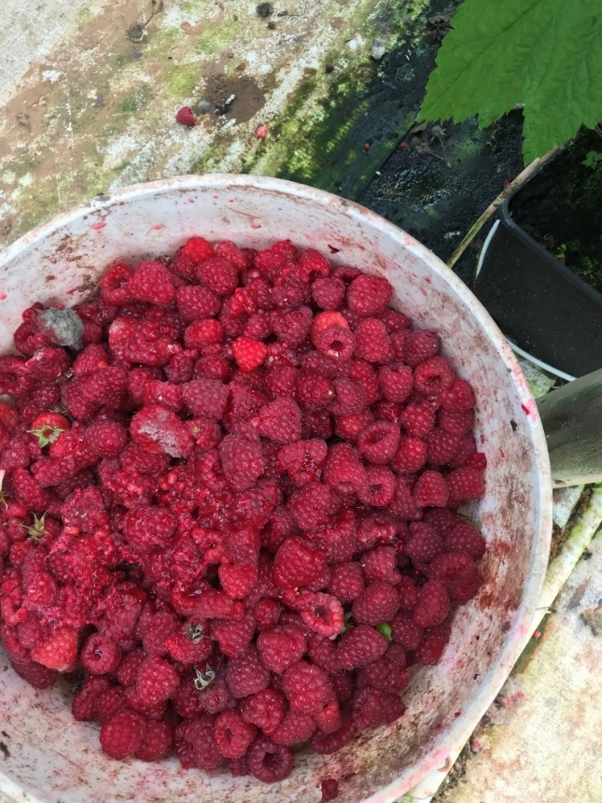
Full-Season Scouting
Botrytis
  To be scouted through the entirety of the growing season
  Colonizes any part of the cane
  Causes blossom blight, preharvest rot, post-harvest storage rot and cane infections
  Highly linked to environmental (humidity) management
  Can cause loss of laterals, as well as renders fruit unmarketable if left unchecked
Notes:
Next on our list is botrytis! So this is something we are always going to be looking for as the season progresses. As nursery stock is pulled out of the cooler, look for botrytis colonization on the new canes. Fungicides are typically applied to the stock before going in, however many months have passed since then. An early application of a fungicide right out of storage is not a bad idea to hinder any infection that may be hiding there.
Later in the season as lateral expansion takes place, we are looking for a different suite of issues that could develop in the rapidly growing tissues.
Plant disease is usually highly correlated to an imbalanced growing environment, especially in a scenario with excess moisture being added to the system. Botrytis, for example, is one that thrives in high humidity situations where there is restricted air flow. Where we see significant fluctuations in moisture and temperature during the summer, humidity management is crucial to reduce the stress on the plants and limit the opportunities for fungi to take hold. Managing the irrigation water can be an easy way to address humidity as well – over irrigation adds a lot of moisture into the space, and could be reduced through a basic monitoring program.
No single control measure alone will effectively control this disease, and effective timing and use of fungicides will be critical in its management. Picking fruit during the coolest part of the day, and cooling quickly, should help maintain shelflife and quality. Maintaining a one and a half to two-day picking schedule is also important, remembering to remove infected fruit from the field at the time of picking, and ensuring a good distance between the crop and the cull piles.
Resistance to several FRAC groups has been reported in other areas of the world, so maintaining fungicide effectiveness is very important through proper rotation.

Slide 32
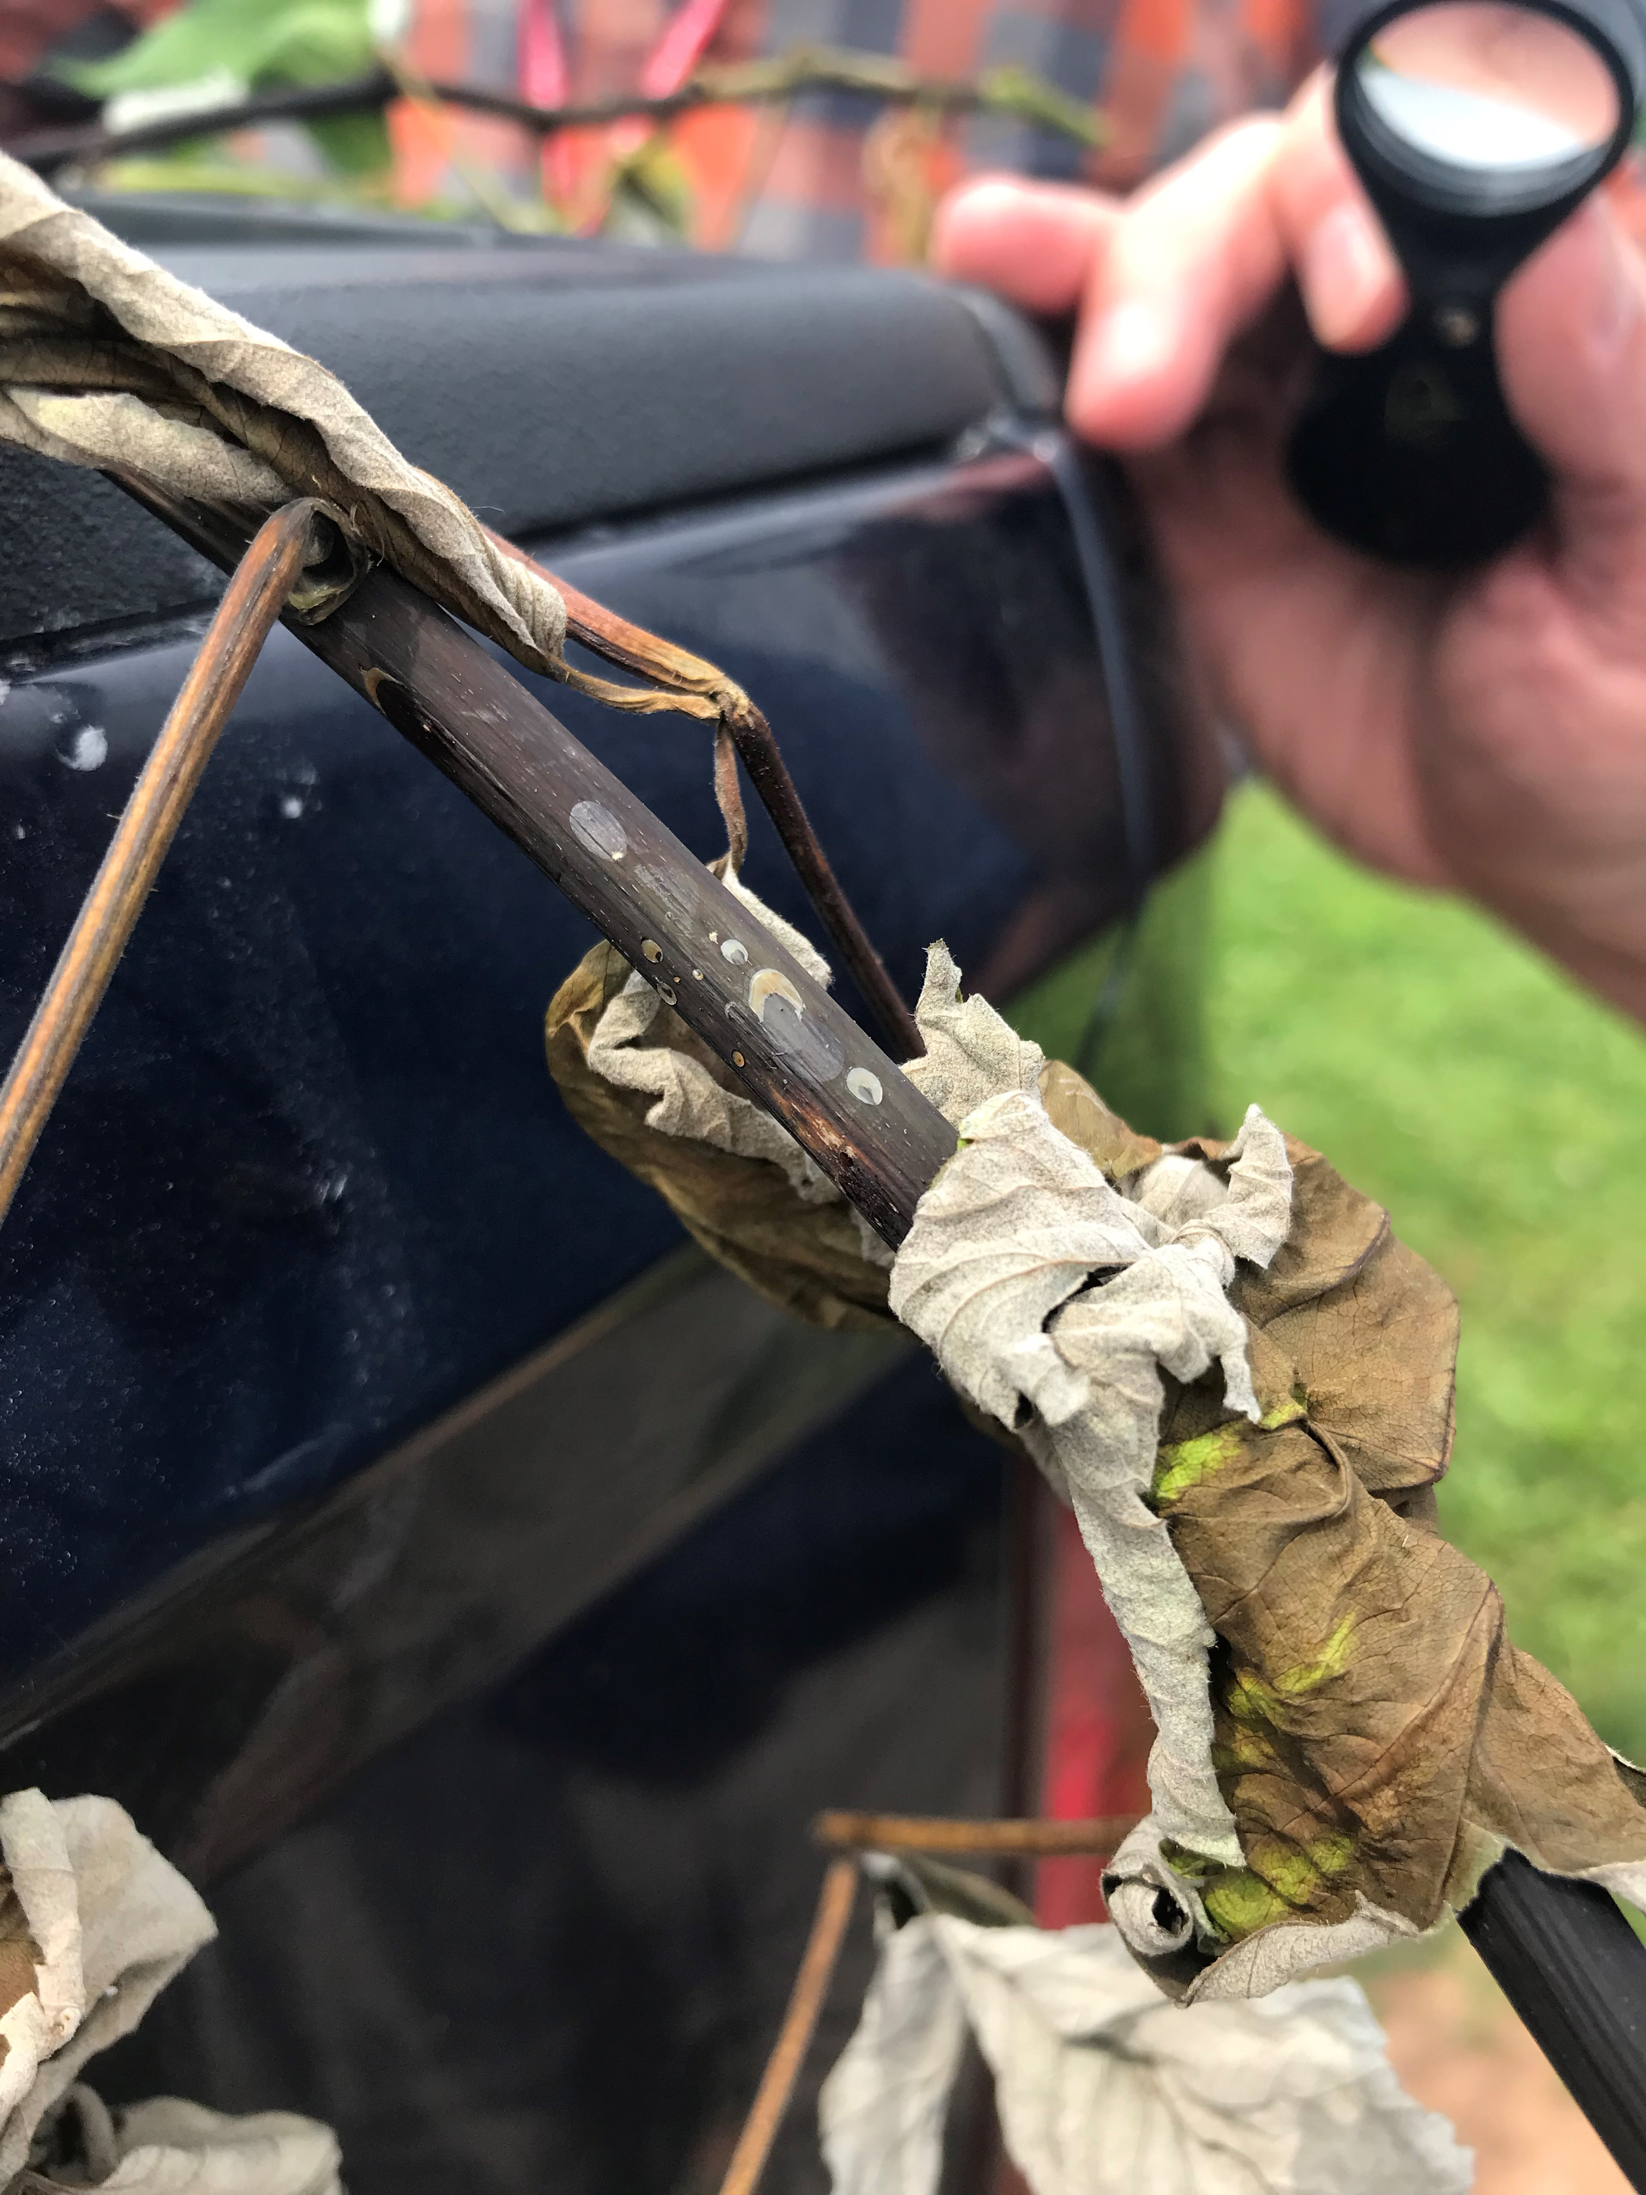
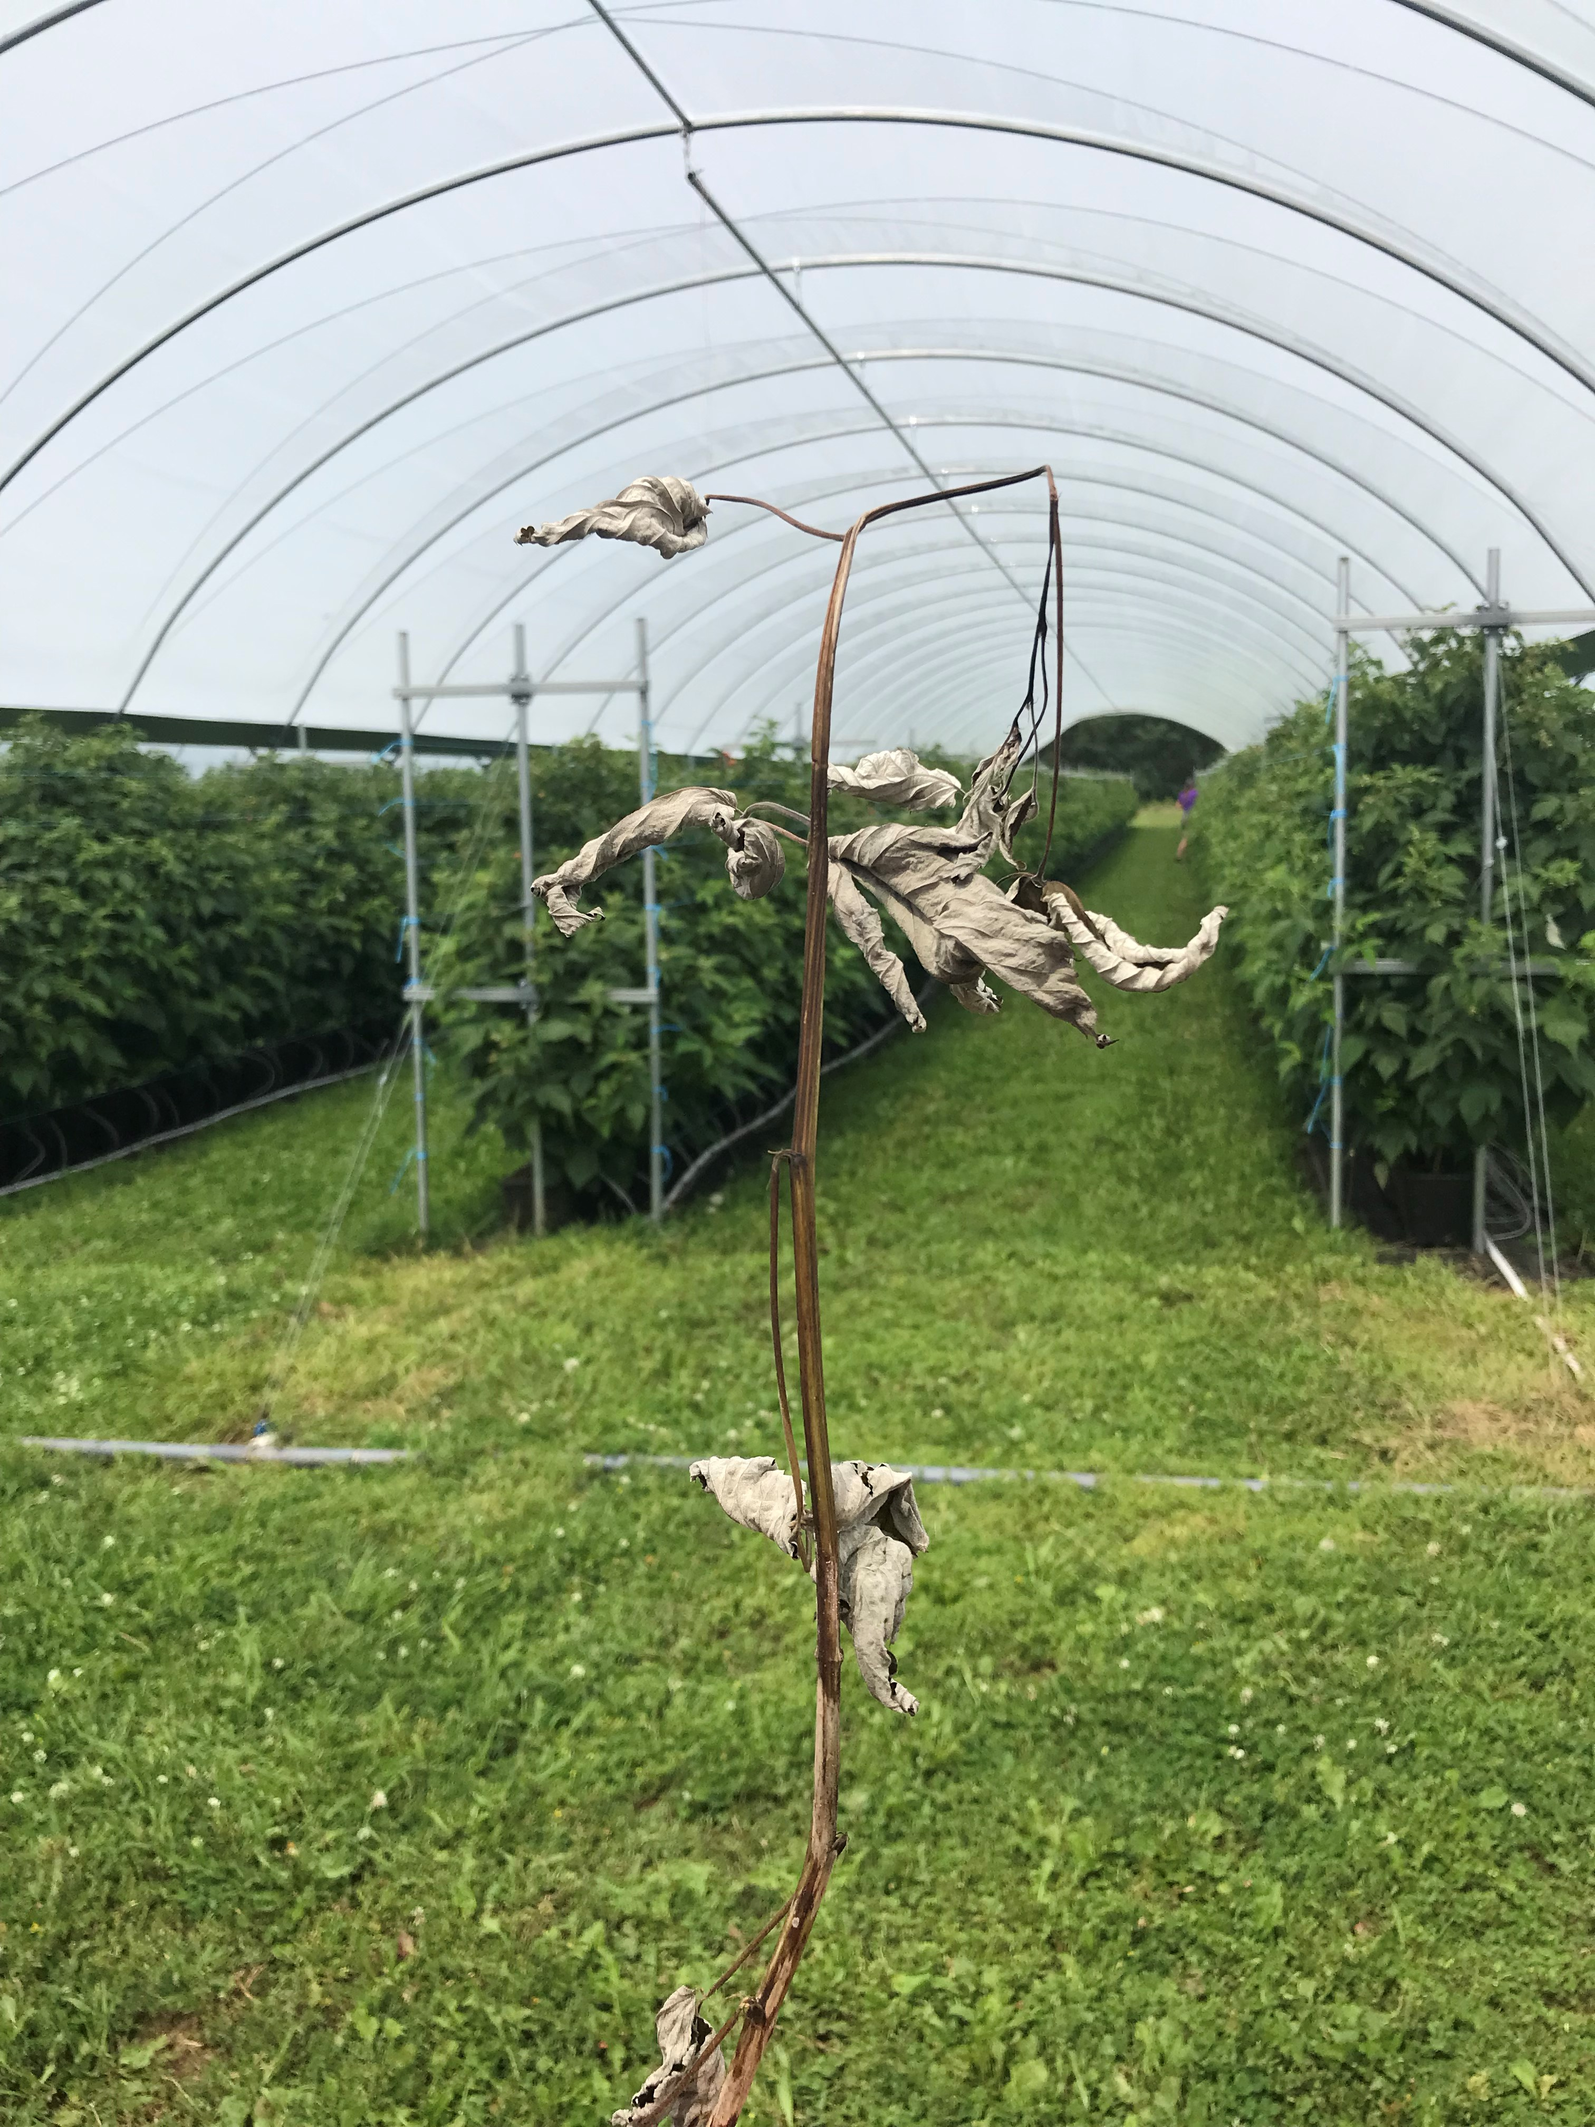
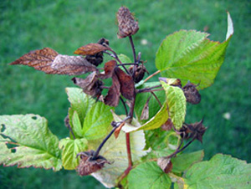
Mid-Season Scouting
Fireblight
Originates from nursery stock or nearby wildstock infected with the bacteria
Infection can take place through wounds caused by piercing insects (ex. Tarnished plant bug, earwigs, ants) as well as pollinators (bees)
Spread is made worse by over-fertilization, temperatures over 18ºC, high humidity, free water, wind, open wounds on the plant and activities which would move the bacteria from plant to plant (pruning, picking, etc.).
Photo credit: https://cpb-us-e1.wpmucdn.com/blogs.cornell.edu/dist/2/7303/files/2020/11/Fireblight.Bonye_.leaf_.jpg
Notes:
One disease to be aware of, and we have likely heard of it from our neighbourly apple growers, is fire blight. This rarely takes hold in raspberry crops, however it is highly infectious and can be devastating if left unchecked.Tight scouting for typical fireblight symptoms is crucial for keeping the disease under control, as commonly used pesticides cannot control this bacteria
This disease can be carried on-farm from the nursery, or can happen in situ from nearby sources. Infection can take place through insect-derived wounds, so its important to keep an eye on insects in the tunnels before flowering.
When we are limited in the products we have available, focusing on the growing environment is one of the best tools we have to reduce the impact of disease. Increasing airflow through venting, or the use of fans, will reduce ooze formation as a function of lower temperature and humidity. By reducing the amount of the ooze, we can limit the amount of highly contagious material being produced in the space, and hopefully manage the spread. Over-fertilization is a culprit of increasing the speed with which a bacteria can take over, especially where we have open wounds on the plants that facilitate easy infection
I’ve included a few photos here of some characteristic symptoms. First off we will start with the shepards crook, where the lateral tissue has actually folded back on itself as we can see in the photo. Next up we have some of the bacterial ooze coming out of the infected plant. This is highly contatious, and can be a mechanism for spread if you aren’t careful abut sanitation from plant to plant. Finally we have a photo fromcornell, showing how an infected flower truss might look. In this case, it was a bloom infection vectored by a pollinator.
Managing insect pests, destroying nearby wildstock of plants that could be harbouring disease, manging the fertility, humidity and moisture in the space, scout regularly, and make sure that nursery plants are being purchased from a reputable source are all contributing factors to reducing the likelihood of widespread fireblight.

Slide 33
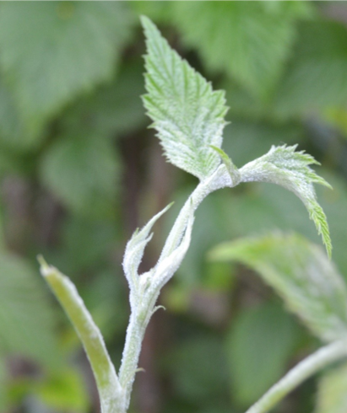
Mid-Season Scouting
Powdery Mildew
  Infrequent disease of field raspberries but commonly found in high tunnel systems
  Grows on plant surfaces as opposed to within plant tissues
  Decrease photosynthetic area of the plant while actively removing sugars that would otherwise be used for berry production
Notes:
Powdery mildew is versatile because it will grow on leaves, petioles, blossoms, and berries.
Careful monitoring of irrigation so as not to be overwatering the crop and maintaining adequate ventilation will go a long way to controlling this disease. If problems persist, weekly fungicide applications may be required. Many fungicides used for botrytis are also registered for powdery mildew. For a complete spray program for powdery mildew, please visit Perennia’s website

Slide 34
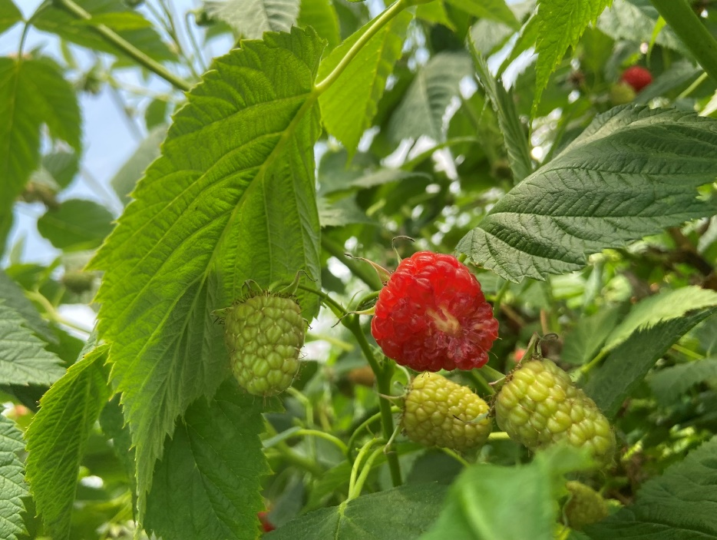
Late-Season Scouting
Birds
Mostly hummingbirds and a few starlings observed
Ripe fruits were rendered unmarketable by their feeding habits
Ideally deterrants (sound machines, visual aids) should be installed well before the onset of ripe fruit to
Notes:
Once we start to see the onset of ripe fruit, we have a few new pests to keep our eyes on.
One thing we were surprised to find during the pilot program was the pressure of hummingbirds on our ripe fruit. They would typically feed only on red fruits, not completely finishing, but usually jumping from fruit to fruit. While netting is a strategy that can be used, we also see a significant reduction in air movement as a result of this, which can have significant implications on humidity-related growth issues and diseases. We found that the use of a sound machine worked well to deter them. The literature suggests combining a sound machine with visual deterrents as well to really help keep them out of the space.

Slide 35
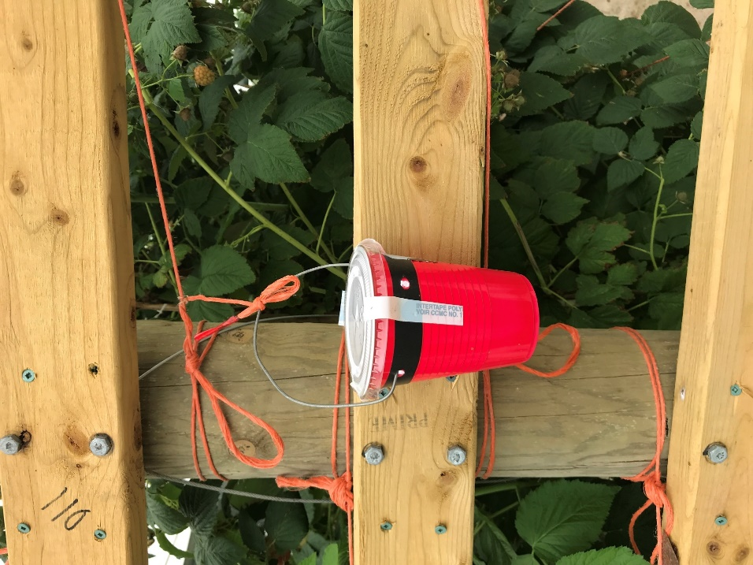
Late-Season Scouting
Spotted Wing Drosophila (SWD)
  Small (2-3 mm) invasive vinegar fly which causes significant damage to a wide range of soft fruit
  Causes significant damage to soft fruit
  Trapping is an important tool for getting a sense of population dynamics
  Check out Perennia’s raspberry spray guide for a list of registered products
Notes:
One of the biggest threats to soft berry production is SWD.
Spotted wing drosophila does its damage by laying eggs in ripening fruit before it is fully mature. The larvae quickly develop and feed on the inside of the fruit. Once the adult lays her eggs, the larvae quickly develop, consuming the berry from the inside, decreasing the fruit’s shelf life and severely decreasing the marketable yield of the infected fruit.
These red solo cups are a common tool for population monitoring. Once a fly has been captured, unless the crop is to be harvested within 3-4 days, treatment should begin on all susceptible (ie those with ripe fruit) plantings. Maintaining a clean crop is crucial for population management as well, ensuring that all ripe fruit are removed ASAP.

Slide 36
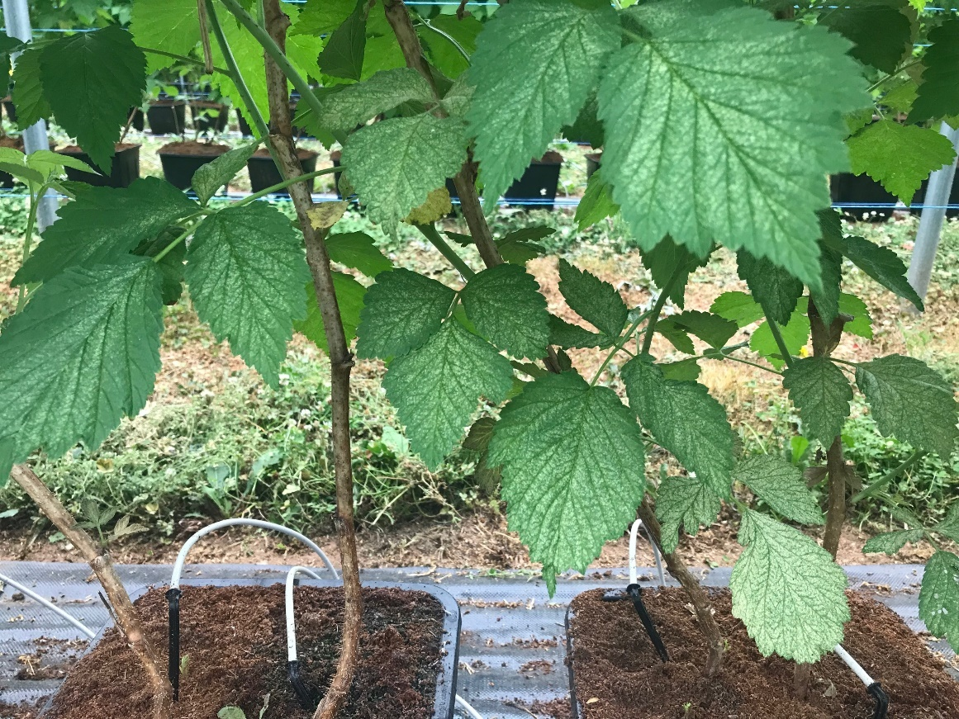
Full-Season Scouting
Insects
Found on the undersides of leaves using a 10-20x magnifying glass.
Adults will be greenish-yellow with two distinctive dark spots on their backs.
Foliar symptoms become apparent as populations rise to extremely high levels
As the damaged spots age, they become necrotic and can result in defoliation in extreme cases.
Mites thrive in high-temperature environments, characteristic of high tunnel production throughout the summer.
Notes:
Two-spotted spider mites will have multiple generations per year.
Early detection before damage occurs, and when populations are low, is key for managing and controlling Two-spotted spider mites because they can be very hard to control once the population establishes.
Early-season mites are usually controlled using miticides. Selecting the most appropriate product should be based on the stage of the Two-spotted spider mites found to maximize the impact of the intervention. Perennia’s Raspberry Spray Guide outlines the options surrounding specific products registered for use on Two-spotted spider mites. As bloom and harvest approach, many growers will switch from chemical interventions to the release of biological control agents. The controlled environment is very conducive for the introduction and survival of Two-spotted spider mites predators. Depending on the population size of the Two-spotted spider mite, the timing of release and crop stage, multiple releases may be needed in order to establish the predator population and control the mite population. The timing of the release is key. Two-spotted spider mites will need to be present to feed the predator, but they should not be out of control so that there are so many that the predators cannot bring the Two-spotted spider mites population under control.

Slide 37
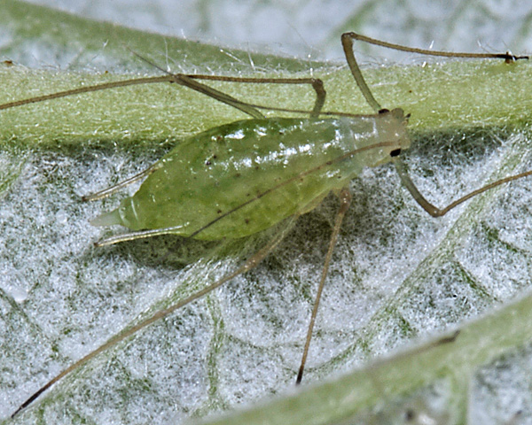
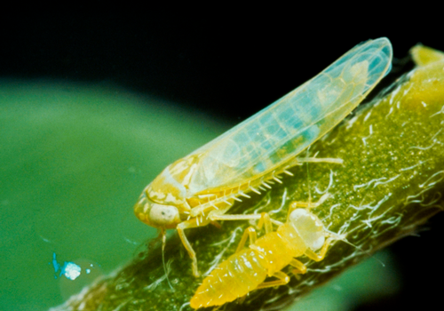
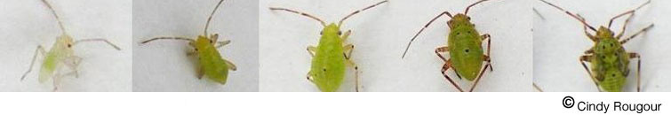

Full-Season Scouting
Insects
Notes:
I don’t want to spend too much more time talking here in the interest of time, so be sure to check out the pest and disease section of our production guide which will also touch on: aphids, thrips, tarnish plant bug, leaf hoppers, and so much more.

Slide 38

Fruit Production
Harvesting
Once the fruit are ready for harvesting, the crop is typically picked on a 1.5 – 2 day cycle
Picking should take place first thing in the morning before the tunnels have a chance to heat up
Once picked, berries should be precooled for an hour around 5-6ºC, then brought down to 3-4ºC for longer storage and transport to market
Recording cull fruit volumes can serve as triggers for management corrections
Each planting will pick 5-6 weeks
Each picker will pick 4 kg/hour
Notes:
While one of the benefits of protected production is an accelerated growing degree hour accumulation, it does result in a faster transition from immature to overly ripe fruit, which can leave you more highly susceptible to SWD. Regular harvesting is important in picking fruit before it is too far gone and will be very helpful in mitigating this risk.
Picking should take place first thing in the mornings, where it is cooler in the tunnels for both the berries and the workers. Some growers will split plantings to facilitate picking and spraying on alternating days. From there the berries move into high-capacity coolers to remove tunnel heat and extend shelf life. The temperature should not drop below 2ºC as this can cause damage of the fruit and render it unmarketable.
Each harvest of marketable fruit should see subsequent removal of unmarketable fruit as well. Leaving overly mature fruit or plantings in tunnels can quickly lead to increases in Spotted winged Drosophila, botrytis and other issues. Due to the higher level of control compared to a field setting, these cull volumes should make up a very small percentage of what is pulled out of the crop. Protection from the rain is a huge contributer to maximizing marketable yield, and can keep the crew working despite what is happening outdoors.
For anyone curious for the other benefits of protected, substrate-based production, I am happy to have a conversation about it!

Slide 39


Slide 40

Control Costs
Picking efficiency
Grow own canes?
Control over head
Get more out of the market

Slide 41
Where does it fit?
Bedding plant business
Bedding plants are empties out by early June
Move in raspberries from storage
Picking by August 1st and finish mid September
U-pick
Open rain or shine
Collecting more revenue
In soil production
Install raspberries in ground with Umbrella Tunnel
Switch to LCR after you burn out the ground
Notes:
Mothers day- May 10th?

Slide 42

Future
Blackberries
Blueberry
Better varieties
Cheap labour
Environmental Issues

Slide 43



Thank You for Listening!
Questions?
Stay tuned: Long cane raspberry production guide coming March 2023
Notes:
Otherwise, I will say thank you for listening, and please let me know if you have any questions

