Slide 1
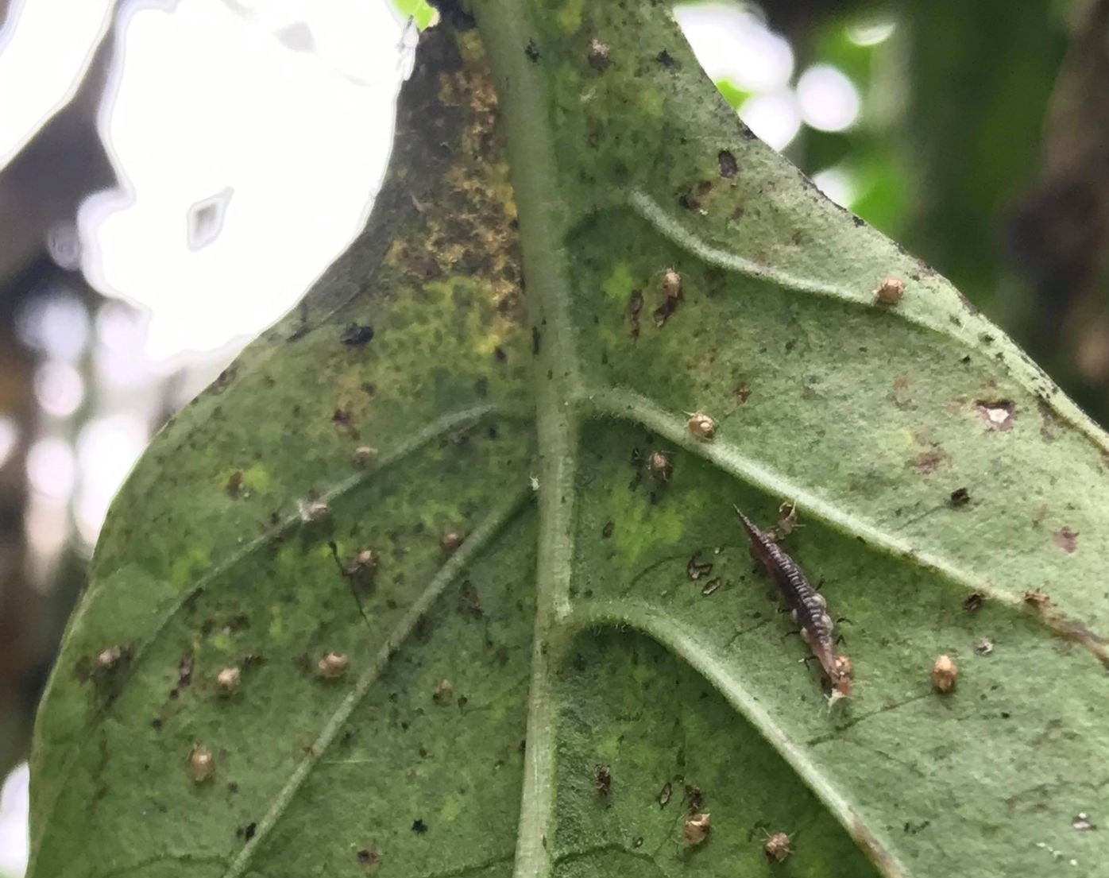

How to manage your biological control agents
By Geneviève Labrie, Ph. D.
New Brunswick Hort Congress March 15th 2023

Slide 2
Outline of the presentation
Biological control agents information sheets
Type of introduction (vrac, cards, strips, eggs, larvae, pupae, adults…)
Number of introductions and dose
Plan of introduction (planning for preventive or curative control)

Slide 3
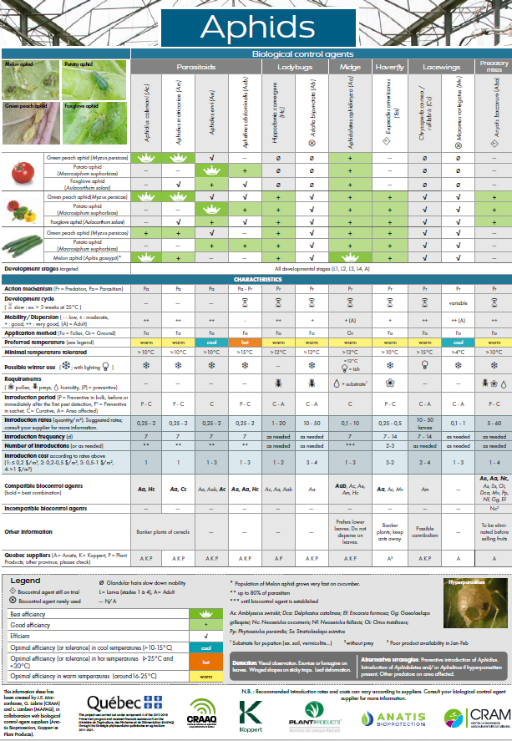
Biological control agents information sheets
Aphids
Whiteflies
Spider mites
Thrips
Gnats
Informations collected on technical sheets, scientific papers and revised by Suppliers companies
French version: https://www.cram-mirabel.com/wp-content/uploads/2023/03/affiches-ravageurs-FR-2022_final_web.pdf
English version: https://www.cram-mirabel.com/wp-content/uploads/2023/03/affiches-ravageurs-ANGL-2022_final_web.pdf

Slide 4
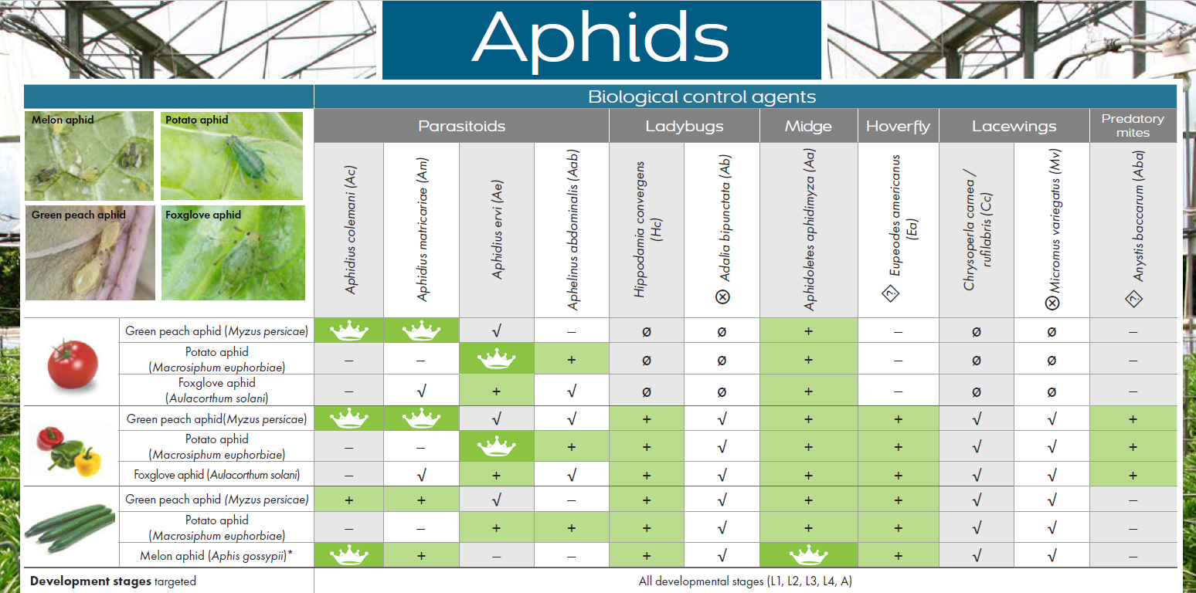
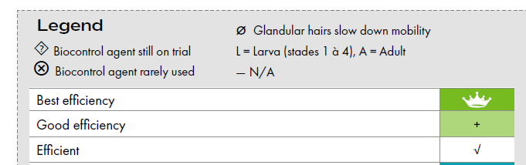
How to extract information on the factsheets
Crops
Pest species
Biological control agents
Best control agent in each crop
Developmental stages targeted

Slide 5
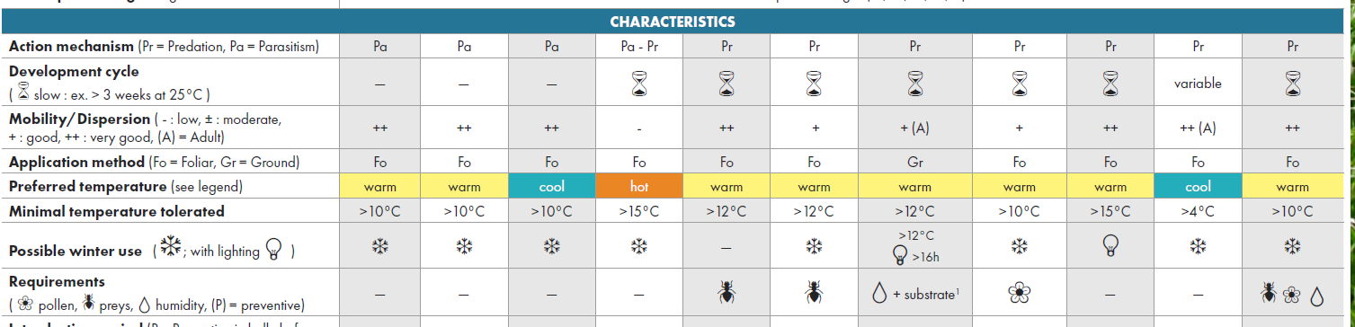
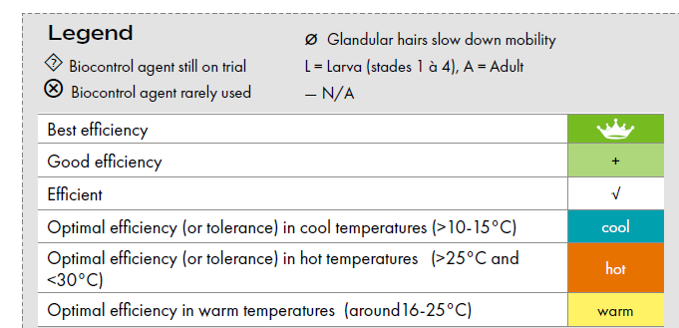
How to extract information on the factsheets
Characteristics of the biological control agents:
  Predator or parasitoid
  Time to develop from eggs to adult
  Mobility on the plant and in the greenhouse
  Type of application (foliar or on the ground)
  Preferred temperatures
  Minimal temperatures tolerated
  Possible winter use
  Requirements

Slide 6
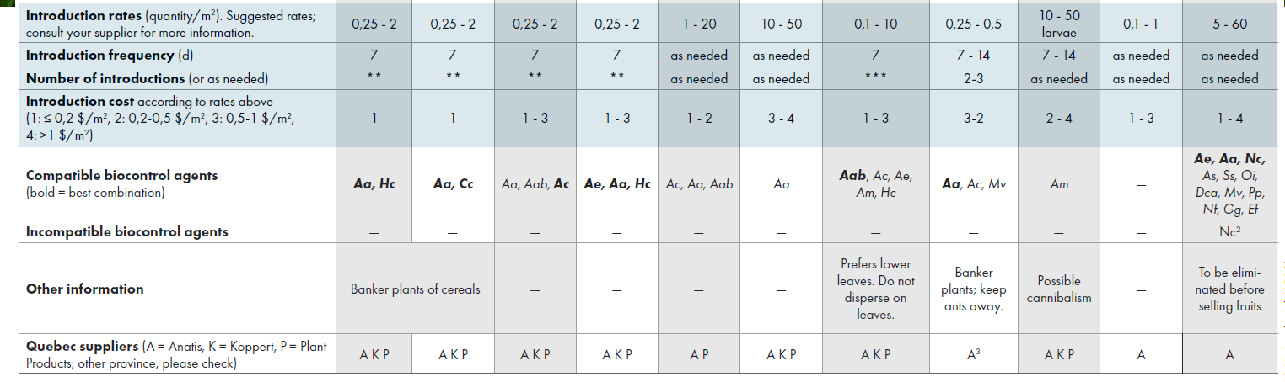
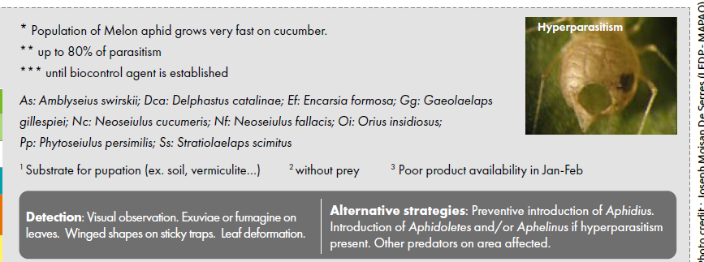
How to extract information on the factsheets
How to use the agent:
  Introduction rates
  Introduction frequency
  Number of introductions
  Range of introduction costs
  Compatibility with other biocontrol agents
  Incompatibility with other biocontrol agents
  Other informations
  Suppliers (in Québec)

Slide 7
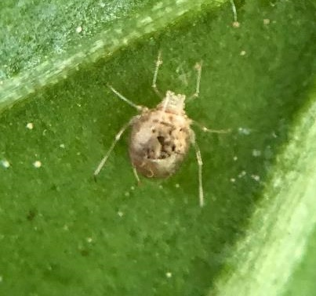
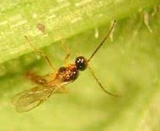
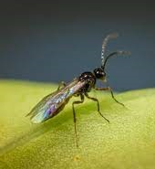
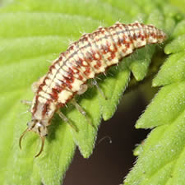
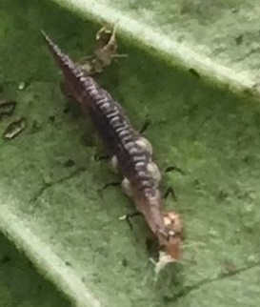
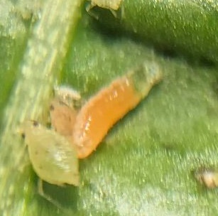
Biological control agents for aphids
Parasitoid A. colemani (+ A. aphidimyza)
Biggest aphids = A. ervi
Hyperparasitism at the end of summer – Add predators (lacewings, hoverflies, midge) and/or Aphid mix
Hyperparasitism
Hole of emergence not perfectly round
Photo: Plant products
Photo: Koppert
Photo: Anatis

Slide 8
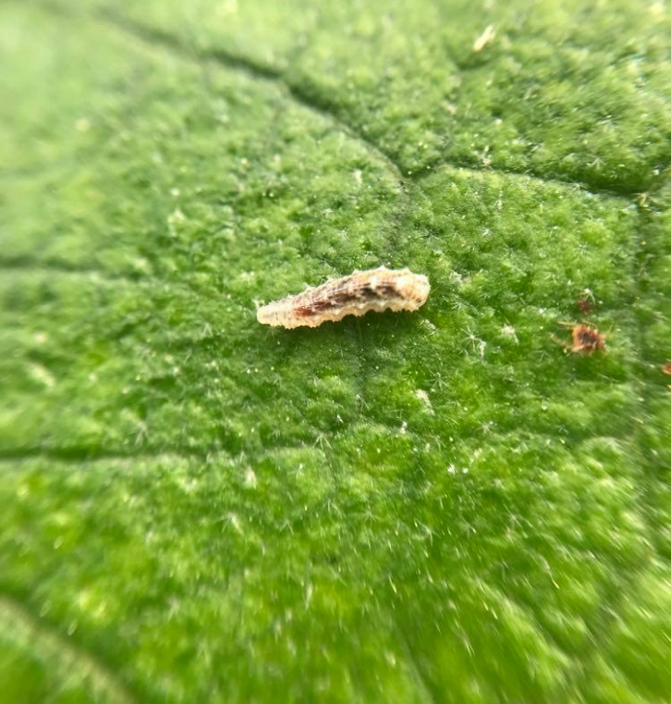
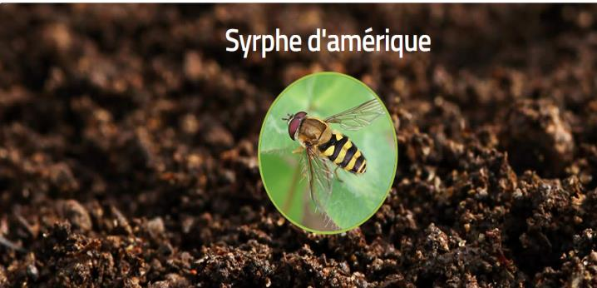
New biocontrol agents for aphids: American hoverfly Eupeodes americanus
From research at UQAM (Quebec) and Vineland Research Center (Ontario):
  Could be used as lower as 12°C
  Eat ~ 400 melon aphid/day
  Compatibles with Aphidoletes and parasitoids
  Highly attracted by flowers (Alyssum, Coriander…)
Larve de syrphe
Anatis Bioprotection
  Produced by Applied Bionomics (BC, distributed by Anatis Bioprotection in Quebec)

Slide 9
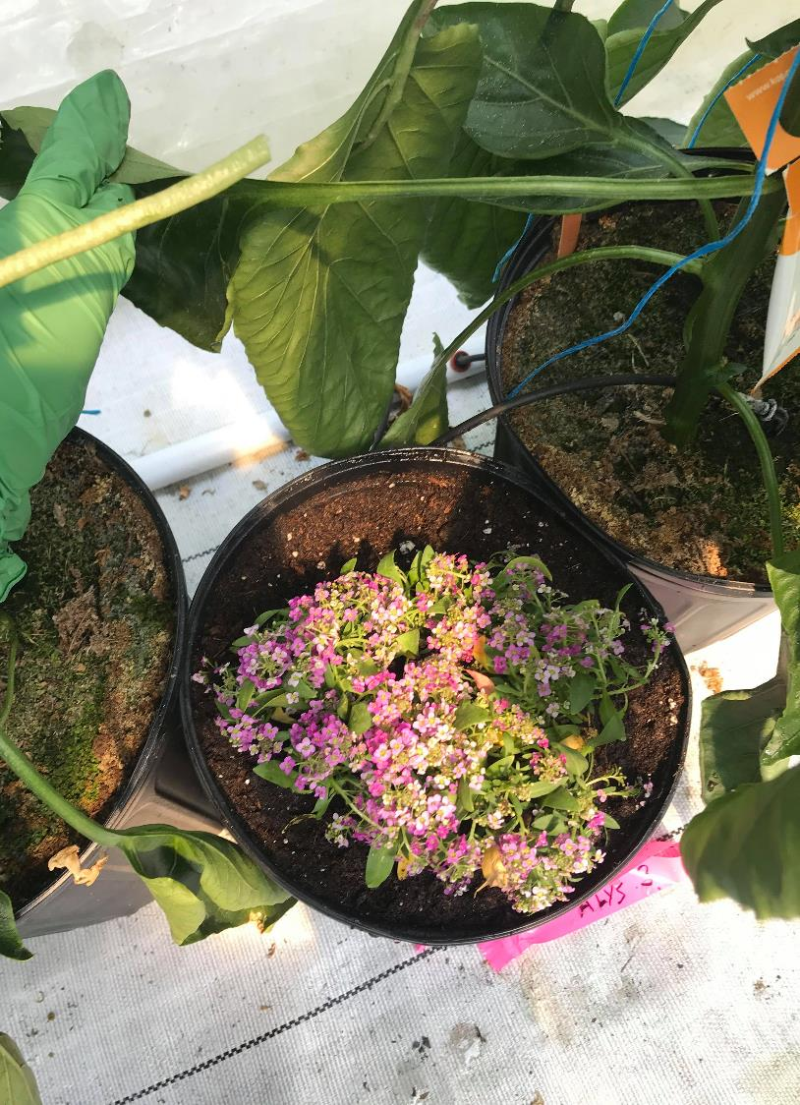
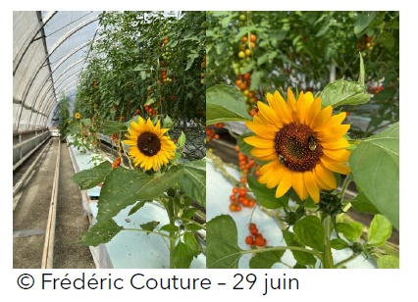
Research projects for the use of flowers for biocontrol agents
Alyssum: very good for Orius, hoverflies, ladybeetles
Dwarf sunflower: very good for Dicyphus hesperus (Tissier et al. 2022)
Trials of coriander for ladybeetles, hoverflies and lacewings (Quesnel et al. 2023)

Slide 10
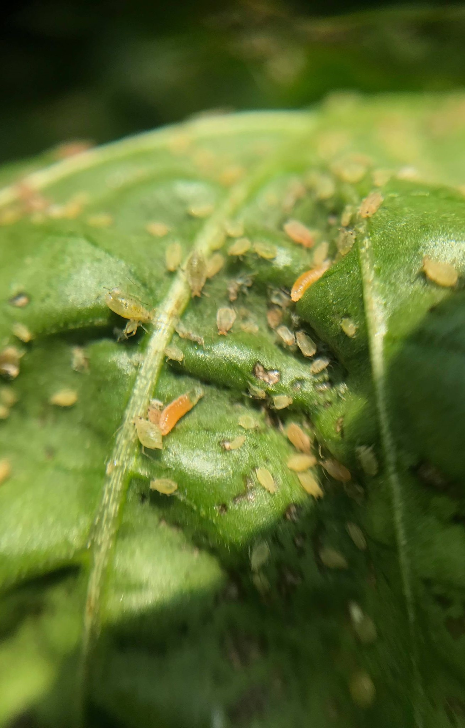
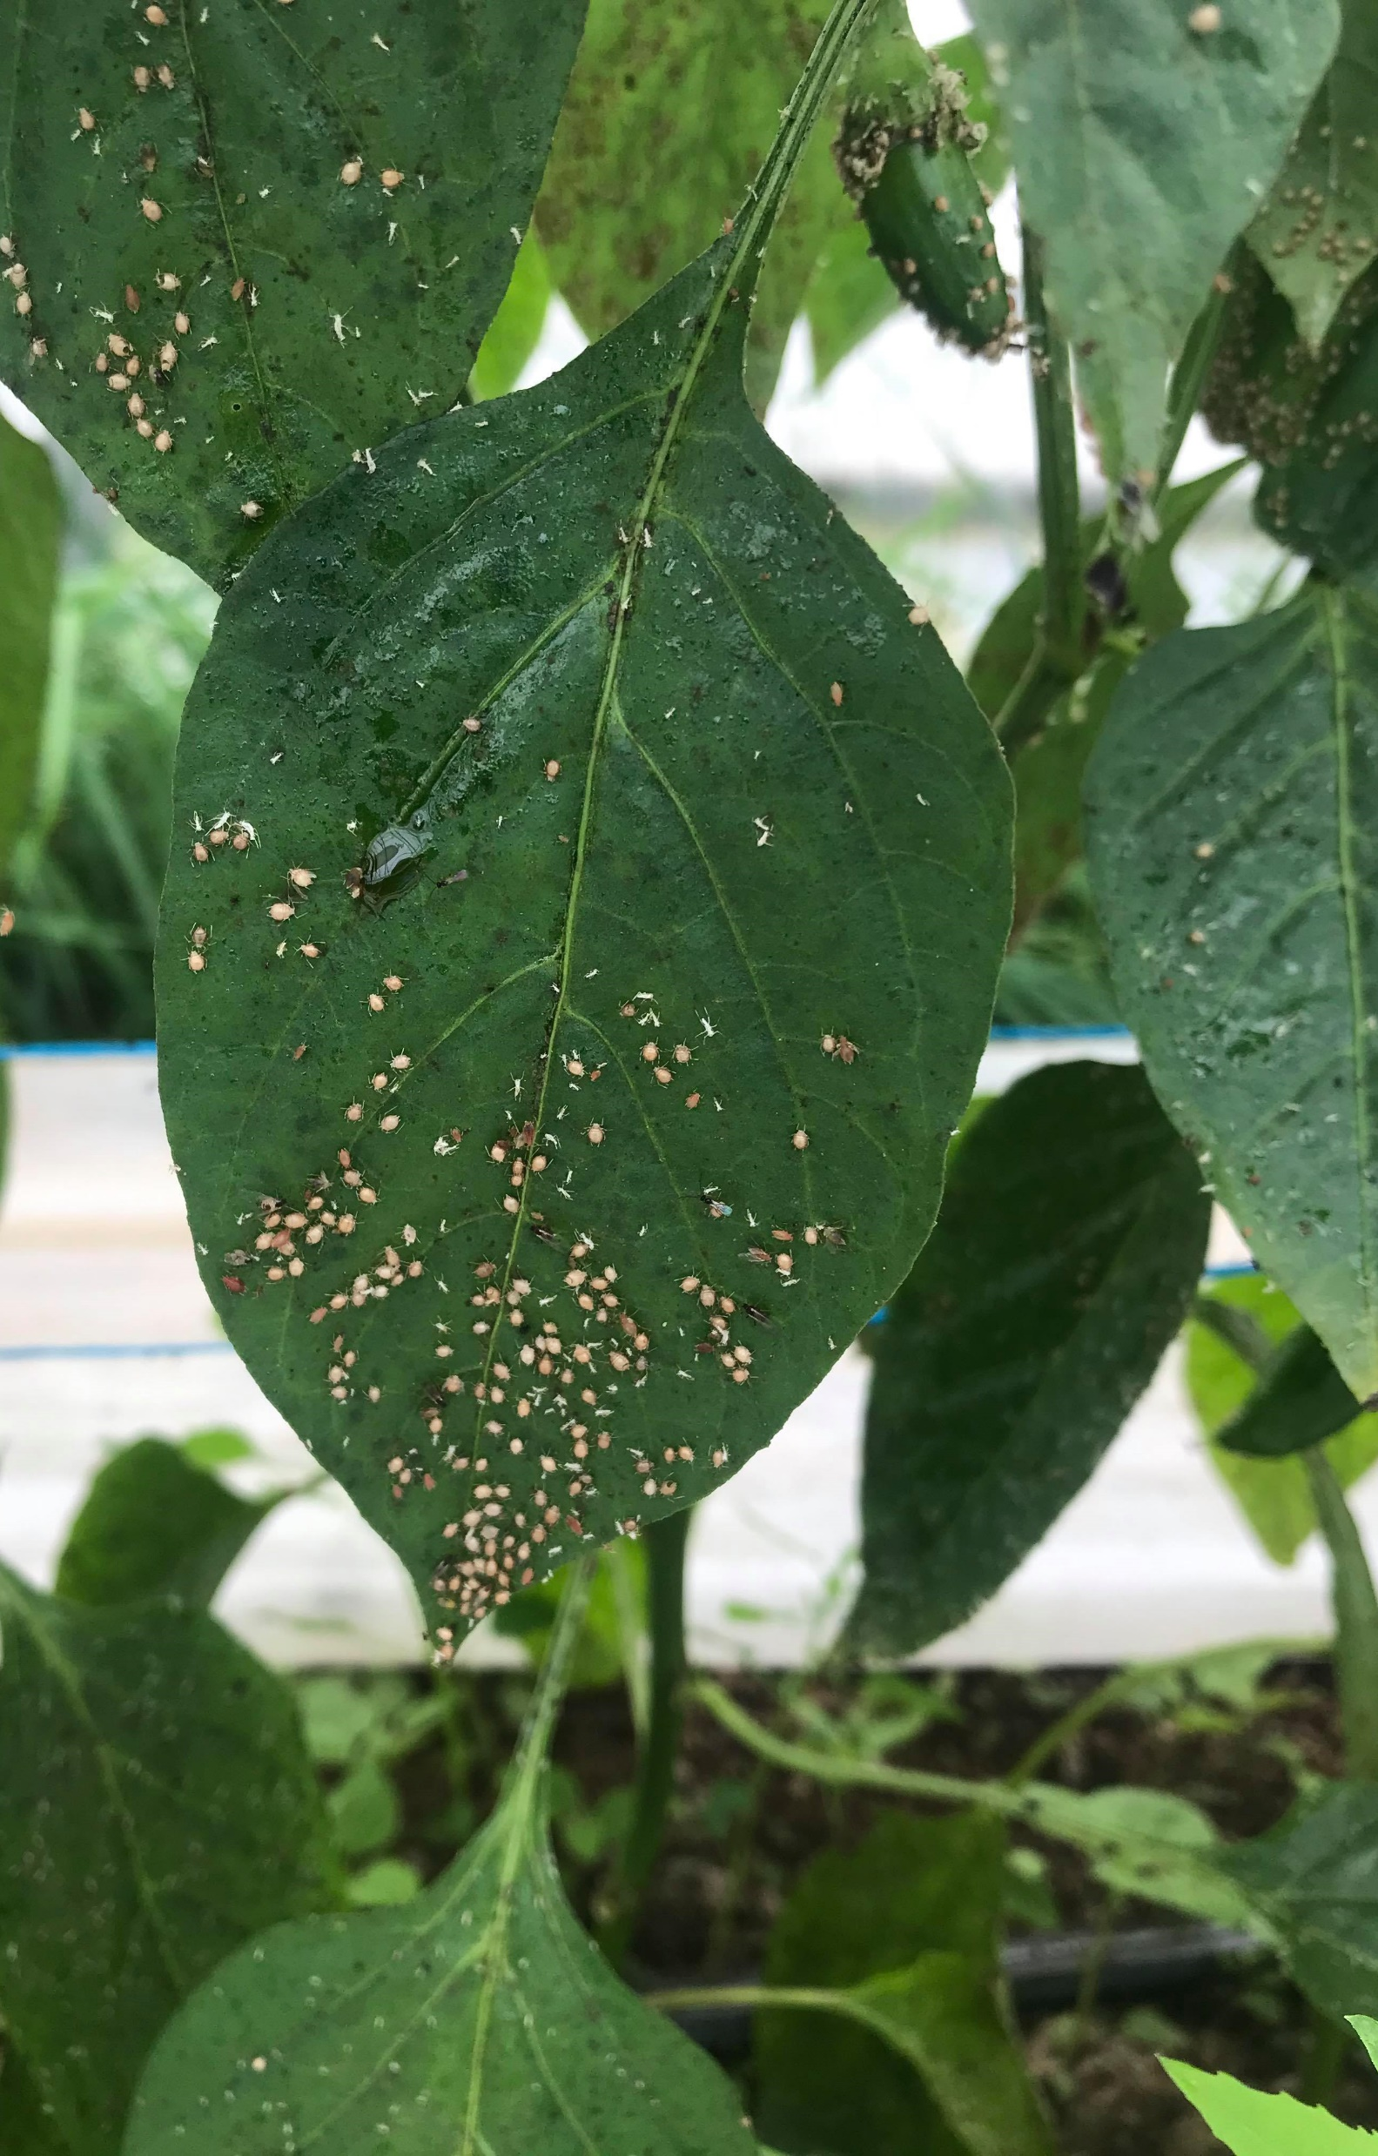
Banker plants
Aphidoletes aphidimyza
Aphidius colemani
One of the best mix of biocontrol agents for aphids: Aphidius colemani and Aphidoletes aphidimyza
Banker plants could be used in prevention

Slide 11
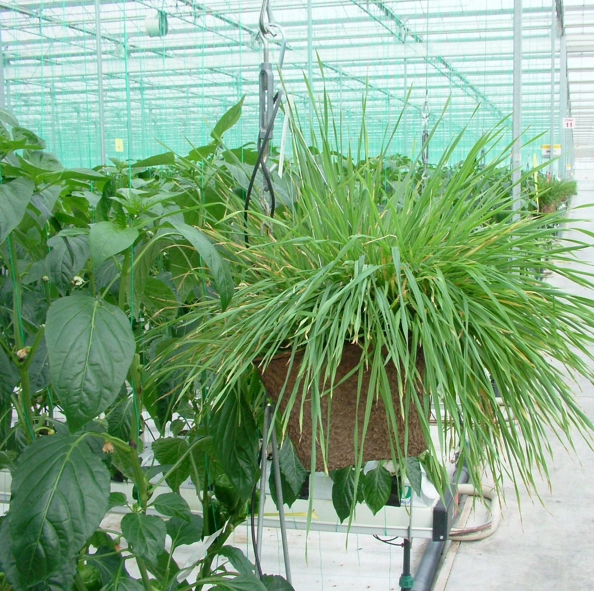
Banker plants for aphid control with A. colemani
grain plant,
wheat aphids,
pot with hanger and perlite substrate
To be replaced regularly
https://www.canr.msu.edu/news/common_banker_plants_in_insect_biological_control_systems
Photo: Plant Products

Slide 12
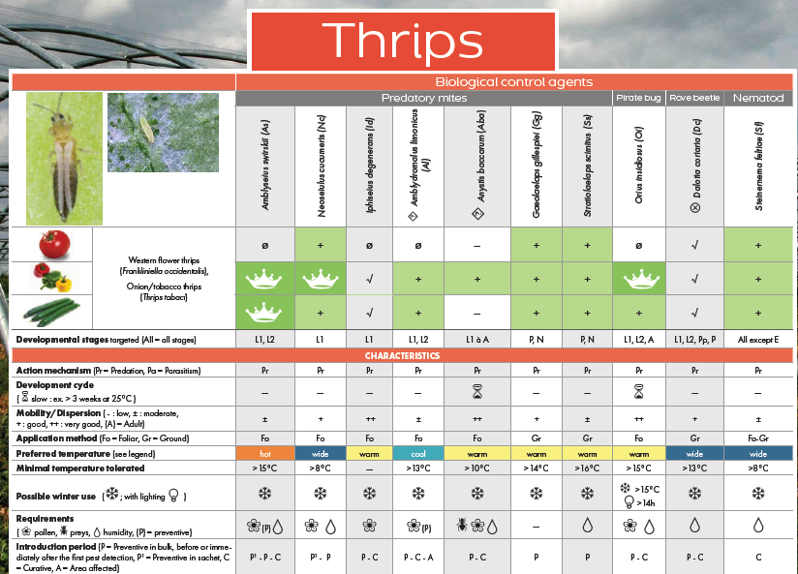
  Thrips pupae in soil: Add predatory mites on the soil = Stratiolaelaps scimitus (active in depth) and Geolaelaps gillespiei (active at surface)
https://www.cram-mirabel.com/wp-content/uploads/2023/03/affiches-ravageurs-ANGL-2022_final_web.pdf

Slide 13
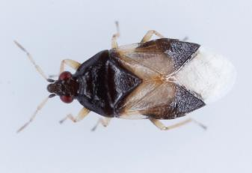
  Young larvae on plants: Neoseiulus cucumeris, Amblyseius swirskii (>15°C)
Larvae and adults on plants: bug Orius insidiosus
* Will replace cucumeris with swirskii or californicus when temperature is rising in the greenhouse
https://www.cram-mirabel.com/wp-content/uploads/2023/03/affiches-ravageurs-ANGL-2022_final_web.pdf

Slide 14
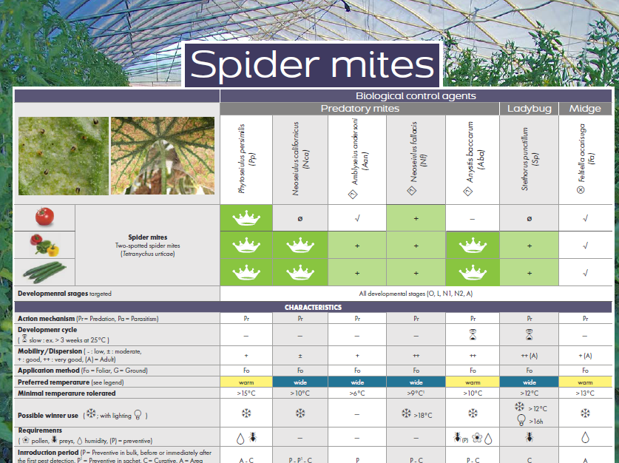
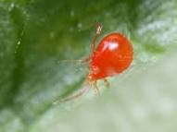
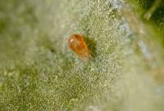
In prevention = N. californicus
With prey = P. persimilis (with misting and > 15°C)
Combination of P. persimilis and N. californicus most used
Anystis baccarum very efficient (but is new)

Slide 15
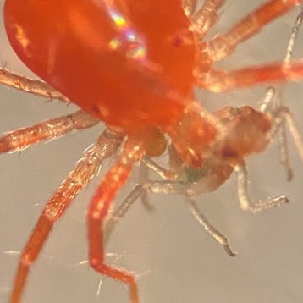
Anystis baccarum – indigenous species – new biocontrol agents
Developed by Vineland Research Center and Applied Bionomics
Efficacy = P. persimilis and N. cucumeris (trials in CRAM)
Consume also aphids and thrips
Could be predator of other biocontrol agents
In trials in laboratory: compatible with A. aphidimyza, N. cucumeris. A. swirskii
Photo: Applied Bionomics

Slide 16
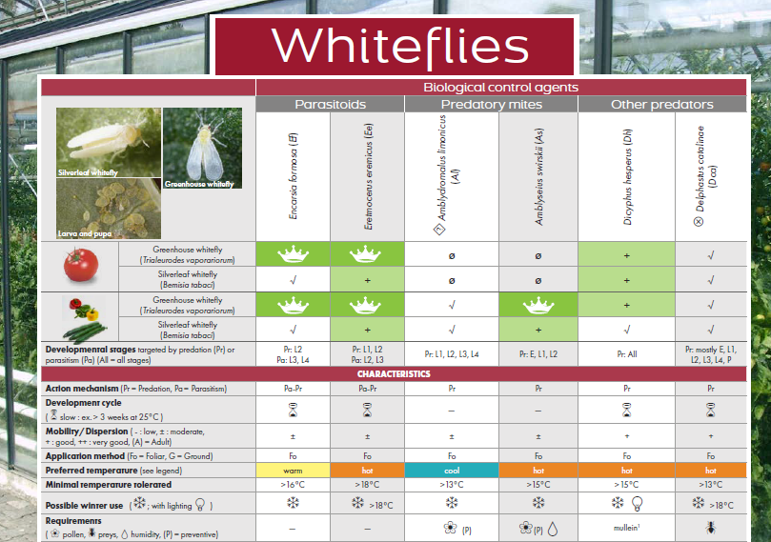
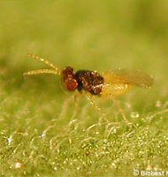
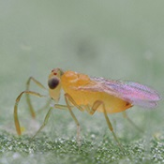
Best agents: Encarsia formosa and Eretmocerus eremicus
Selective leaf thinning as to not remove parasitized whiteflies.
Leave leafs on ground.
Dicyphus hesperus on banker plant of mullein
Eretmocerus eremicus
Encarsia formosa
F. Dumont, CRAM

Slide 17
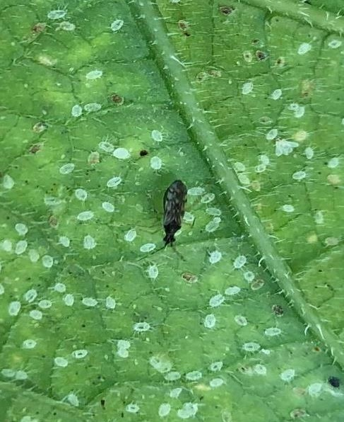
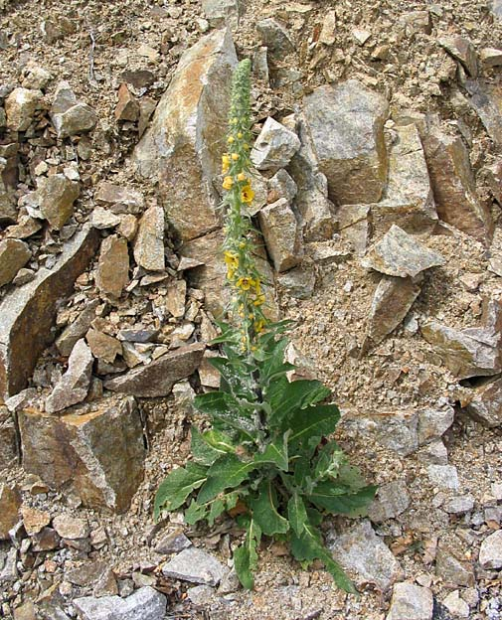
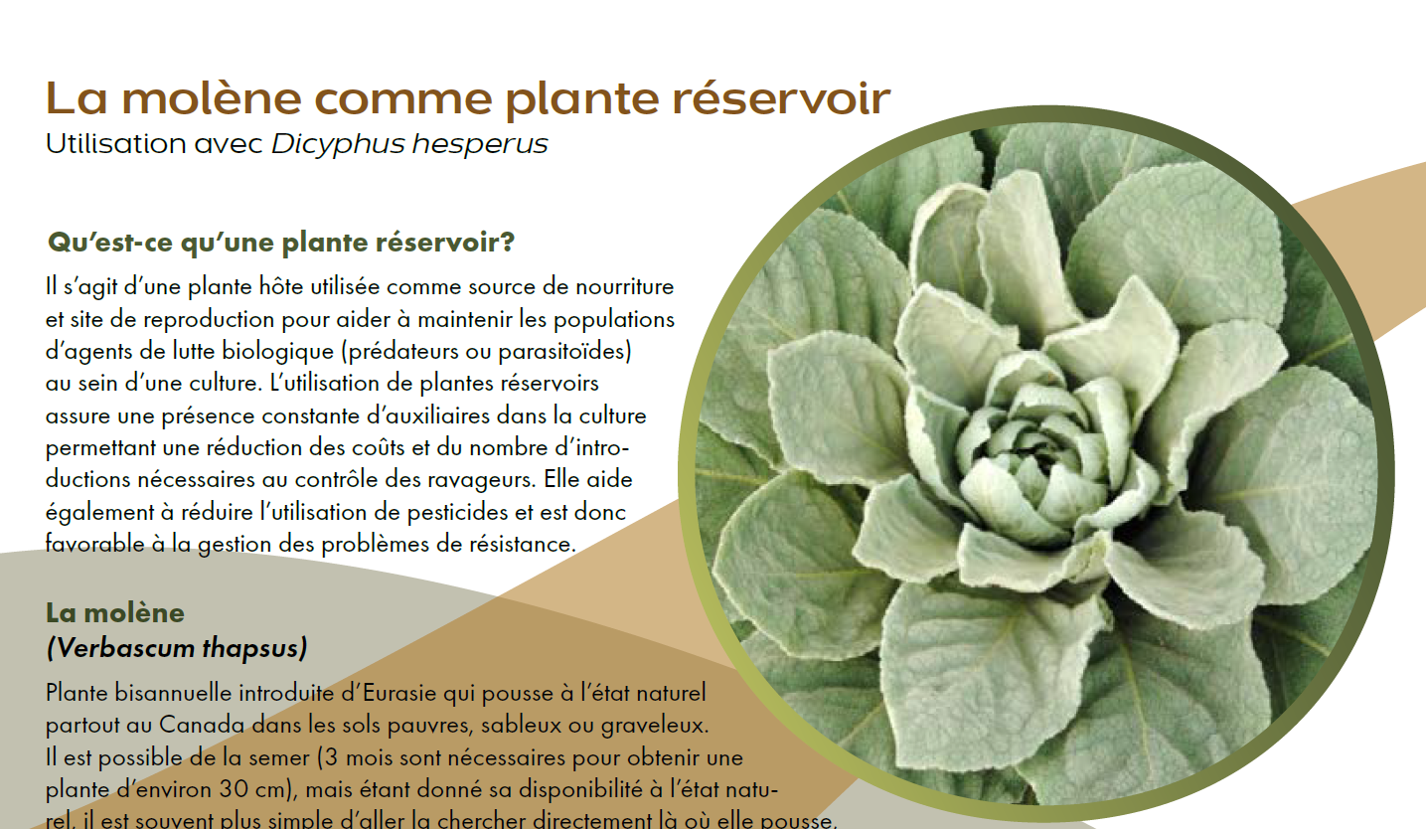
Whiteflies - Dicyphus hesperus
Banker plant of mullein (Verbascum thapsus)
Research projects to develop zoophagous lines of the predators
Photo: Wikipedia

Slide 18
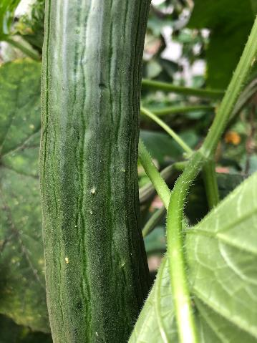
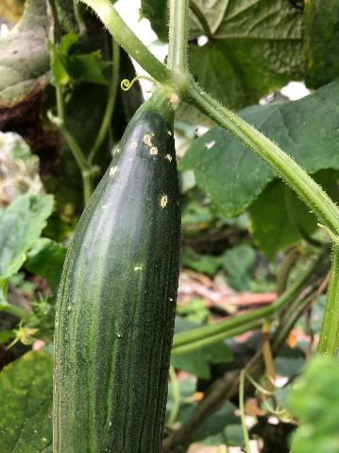
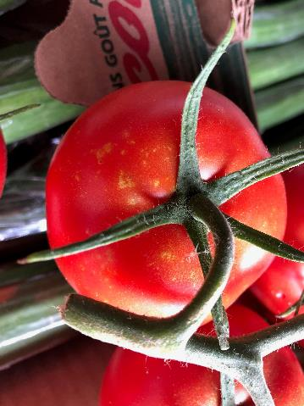
Damages by Dicyphus hesperus if predator population is too high
Reduce population with Safer’s soap (on crops or mullein)

Slide 19
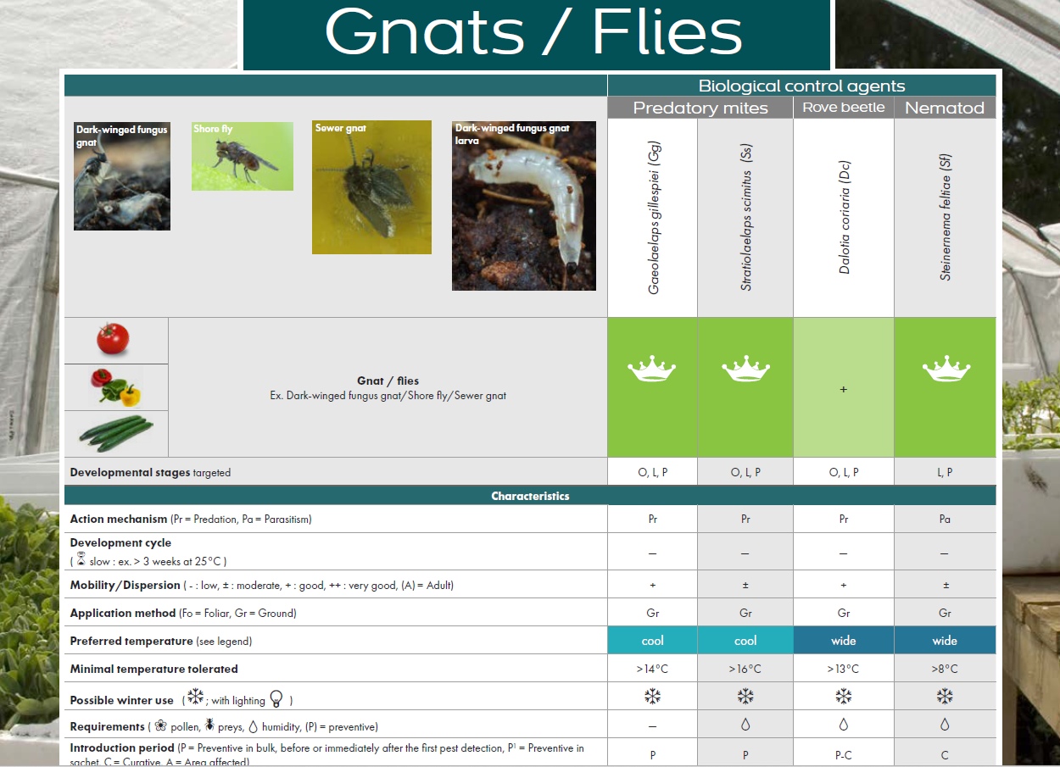
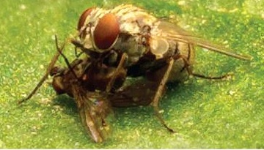
  Add predatory mites on the soil = Stratiolaelaps scimitus (active in depth) and Geolaelaps gillespiei (active at surface)
  Preventive introduction
Coenosia attenuata = natural predator of flies

Slide 20
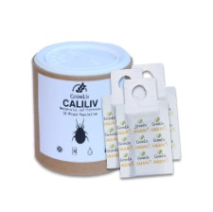
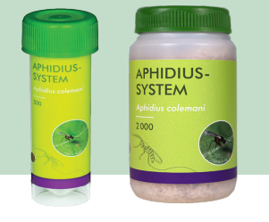
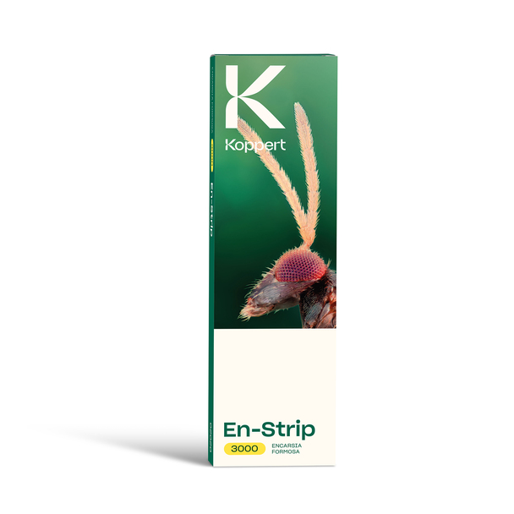
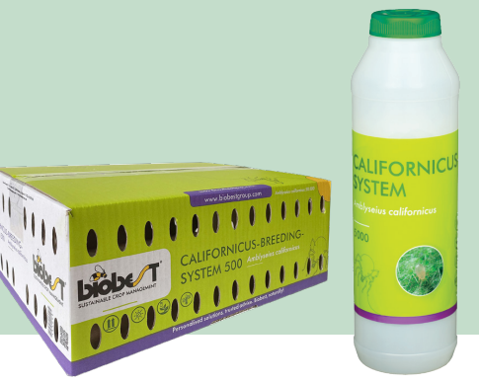
Type of introduction
Ex. sachets
(Anatis Bioprotection)
Different ways to introduce biological control agents:
  Eggs, larvae, pupae or adults
  Vermiculite (curative)
  Vials (curative)
  Sachets (preventive)
  Cards (with eggs or pupae)
Ex. Vials (Plant Product)
Ask your supplier
Ex. Strips with whiteflies pupae with Encarsia
(Koppert)
Ex. Breeding boxes or vials
(Plant Products)

Slide 21
Why biological control failed sometimes?
Not the right identification of the pest and introduction of the wrong agent
Delay in the introduction of the agents (infestation too heavy for the dose)
Viability of the biological control agents (problem during transport)
Not the right dose (preventive vs curative)
Worst conditions of introduction for the biological control agent (temperature too high or low, humidity, ants…)

Slide 22
Viability of biological control agents
Very important to check the viability of biological control agents when you receive it
Research project (CRAM) to evaluate the viability of biological control agents at different period of the year
A
B
C
Protocols to evaluate the viability available at Buithenhuis, R. 2014. Grower Guide: Quality assurance of biocontrol products. Vineland Research and Innovation Centre.

Slide 23
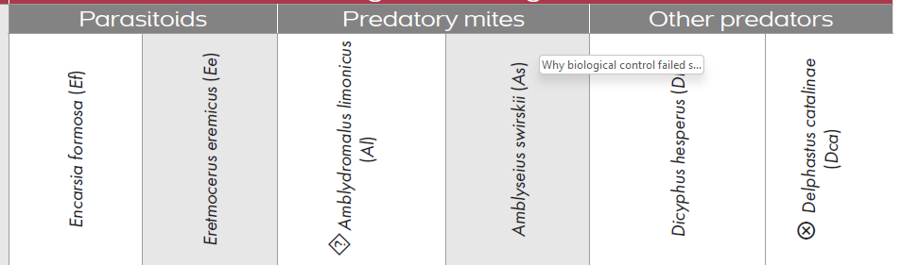
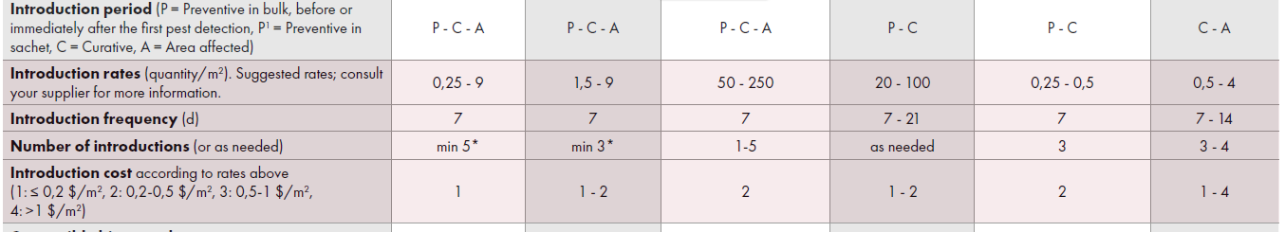
Number of introductions and dose
Ex. Whiteflies
Introduction rates and frequency could differ by suppliers
Introduction frequency is also variable with pest, biological control agents and level of infestation

Slide 24
Plan of introduction
Planification of the introduction of biological control agents before the beginning of the season:
  Have to request to the suppliers one week in advance
  When infestation began → can increase very fast
  Preventive introductions (with banker plants) and regularly is the key of success, mainly for aphids.
Establish a timeline of introduction with your supplier
  Will receive different biological control agents at different time during season
  Should be adjusted if infestation become heavy
  Have to take into account : crops, presence or not of screen, misting; historic of infestation, costs

Slide 25
Example of a plan of introduction
From Martin, 2022. Colloque maraîcher en serres 2022.

Slide 26
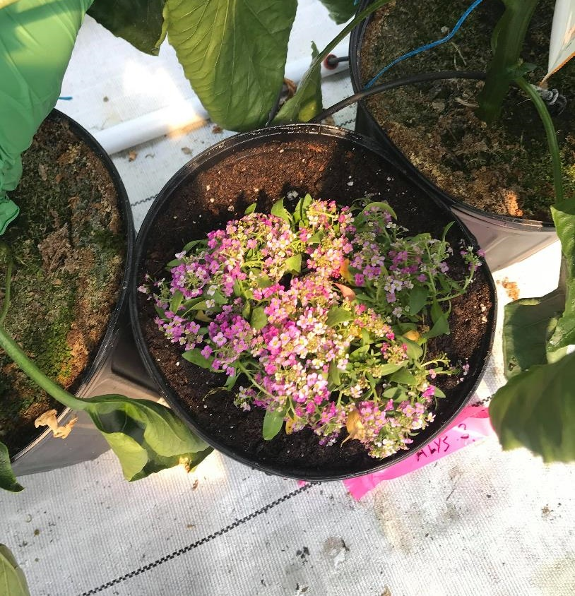
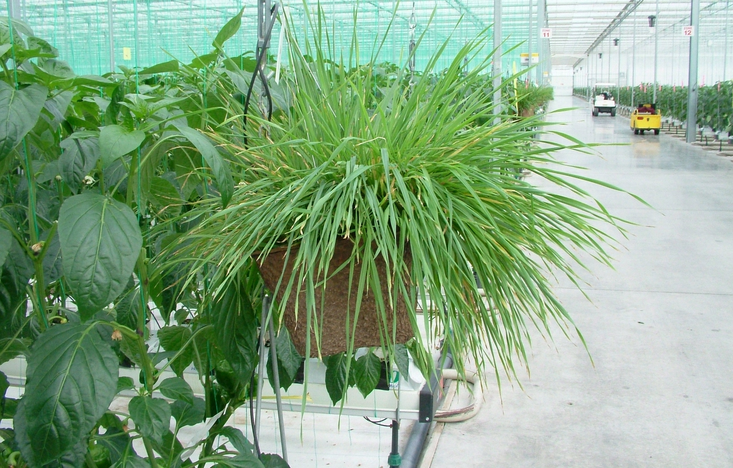
In conclusion
Efficacy of control program = prevention
  Banker plants
  Attractive flowers
  Preventive introduction
Be responsive
  Change to curative rates when pest is increasing
If loosing control: use pesticides which are compatible with biological control agents

Slide 27
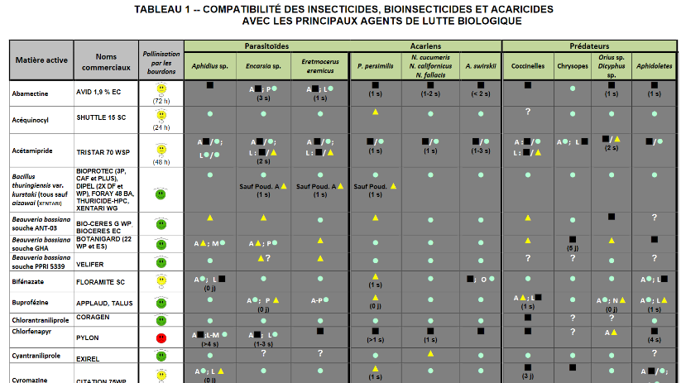
Compatibility of insecticides with biocontrol agents
https://www.agrireseau.net/documents/Document_108942.pdf

Slide 28
In conclusion
Efficacy of control program = prevention
  Banker plants
  Attractive flowers
  Preventive introduction
Be responsive
  Change to curative rates when pest is increasing
If loosing control: use pesticides which are compatible with biological control agents
Preventive program of introduction $ < loosing control of the pests

Slide 29
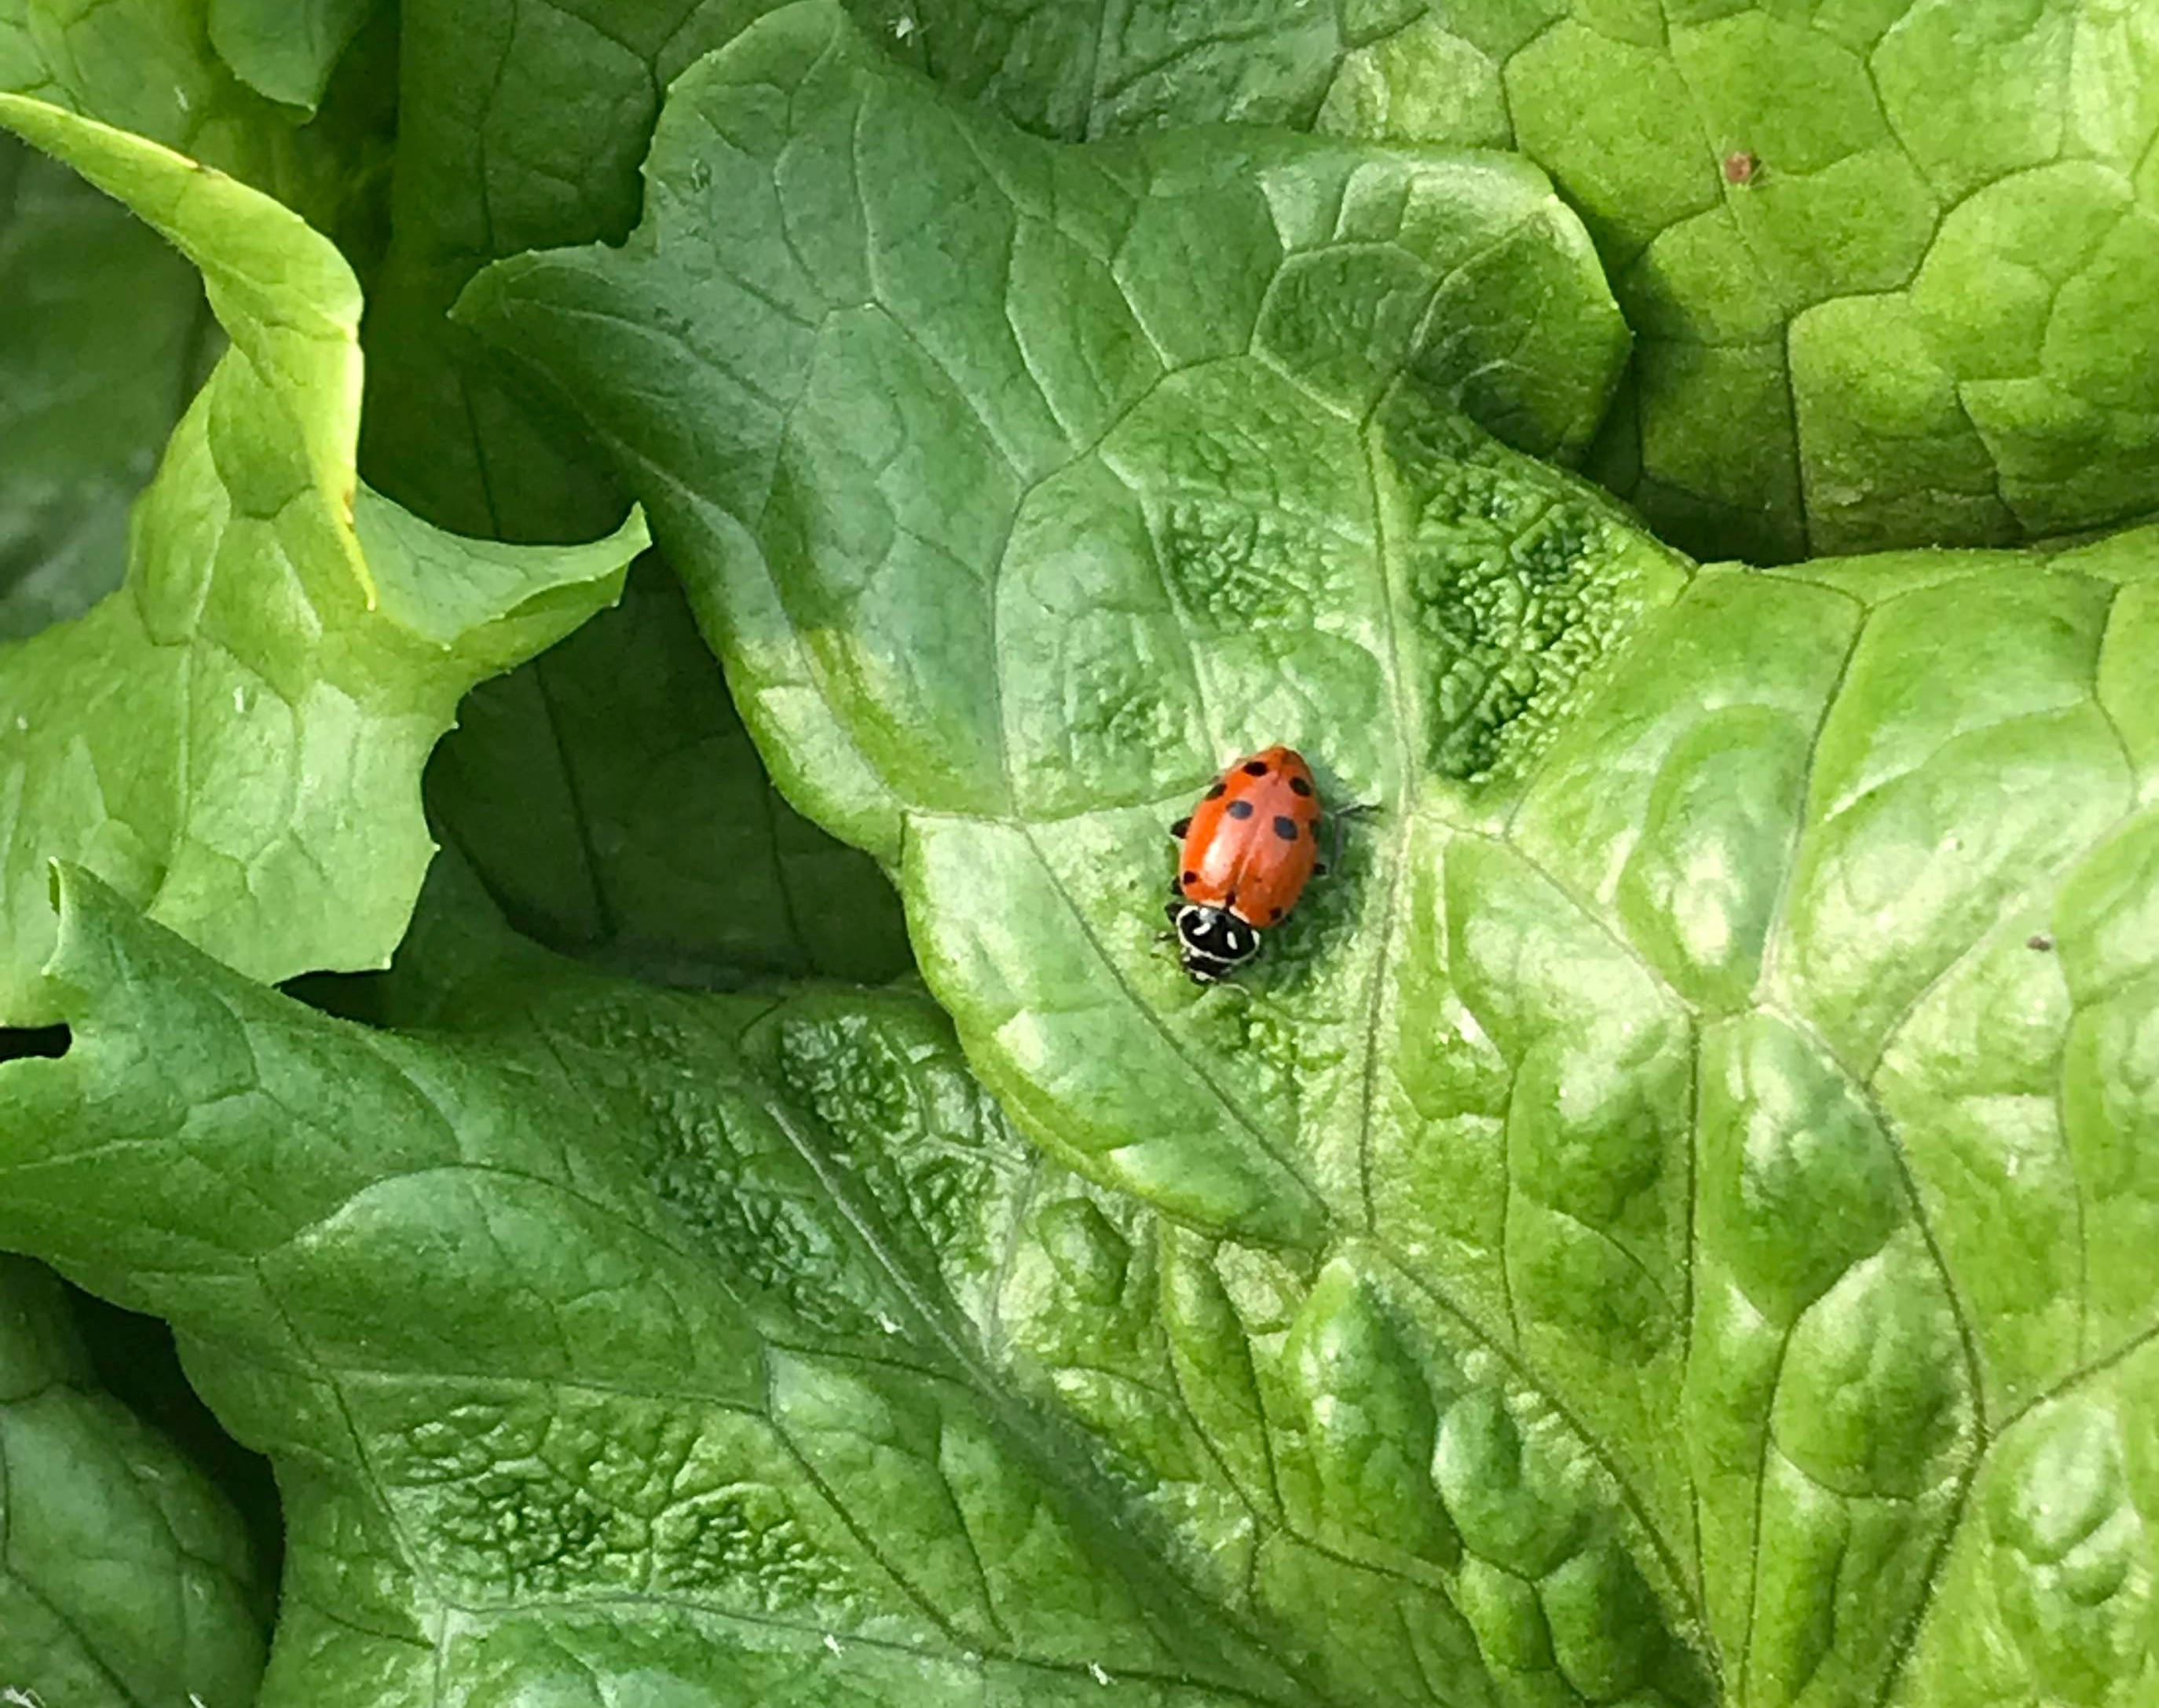

Acknowledgements
Anatis Phytoprotection
Plant Products
Koppert
Louise Voynaud (CRAM)
Research team (CRAM)
Collaborators of Serres sentinelles
$ Québec

