Slide 1

Food Safety in a Processing Environment
New Brunswick Hort Congress
March 15, 2023

Slide 2
Overview
What is driving food safety?
Provincial or Federal Licensing?
What is GFSI?
What are buyers demanding for Food Safety?

Slide 3

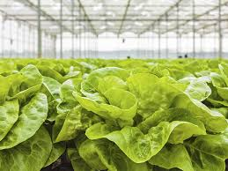
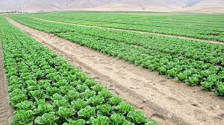

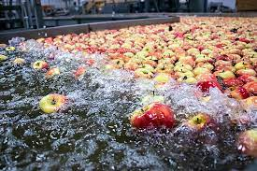

Fresh Fruit and Vegetables
What are the requirements for Grow, Harvest, Pack and Process FF&V:
A show of hands, who has
Safe Food for Canadians License
Certification to CanadaGAP
Notes:
The CanadaGAP manuals are designed for use by operations involved in the production, handling and brokerage of fruits and vegetables in Canada. The manuals cover production, packing, repacking, storage, wholesaling and brokerage activities.

Slide 4
Importance of Food Safety
Food Borne Illness in Canada - 4 million Canadians / year
  11,600 hospitalizations and 238 deaths / year
  Health care burdened with costs
  Long term health effects
  Lost productivity
Food Recalls
  Damage reputation of the processor, retailers and the country
  Can cost millions of dollars
  Why so many recalls? Good or Bad?
Notes:
According to a study published in the Int Journal of Food Microbiology “an estimated 1 million cases of acute bacterial foodborne illness in Canada cost nearly $1.1 billion yearly”
Health care during illness and long term health problems for some causes of illness
Reputation is hurt and the cost of a recall can close a facility
Lost productivity during illness
Biological hazards are viruses, pathogenic bacteria, parasites
Chemical hazards are drug residues, herbicides/pesticides, fuels, non food chemicals and allergens (allergens are a major cause of food recalls
Physical includes glass, metal, stones
Other includes food with non allowed additives or potential tampering concerns
Jack in the Box – 1992
Odwalla Apple Juice – 1996 – Solution: tighter regulations
Hudson beef – 1997 – 25 million lbs of gr beef
Spinach – 2006
Sandwich meat – Canada – 2008
Numerous produce recalls in the past decade
Jack in the box – paid out hundreds of millions in lawsuits – preventable by cooking to 71C
Odwalla apple juice – they were not pasteurizing the juice – they thought E. coli could not survive the acidic conditions
Hudson – E. coli affecting ground beef – the biggest recall involved Hallmark/Westland Meat Packing = 143,000,000 pounds
Maple Leaf Foods – Listeria in sandwich meat 57 cases of Listeriosis and 23 deaths
AND Numerous produce recalls (romaine, green onions, onions, spinach)
Pet food due to contaminated flour with melamine

Slide 5
HACCP is the Answer
HACCP = Hazard Analysis Critical Control Points
Internationally recognized (180 countries)
Proactive in Hazard ID for your product → implement control measures
Farm to Fork (On Farm Food Safety → Processor HACCP)
Notes:
Developed in the 1950’s-60’s by NASA and Pillsbury Foods
Now adopted by 180 United Nations member countries
You ID hazards and prevent them as opposed to relying on end product testing
Hazards vary by sector of the food continuum
To assure food safety the HACCP system is applied from farm to fork
OFFS = On Farm Food Safety

Slide 6
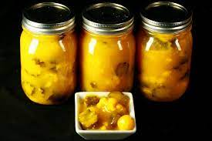
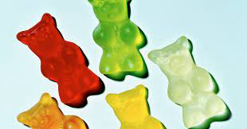
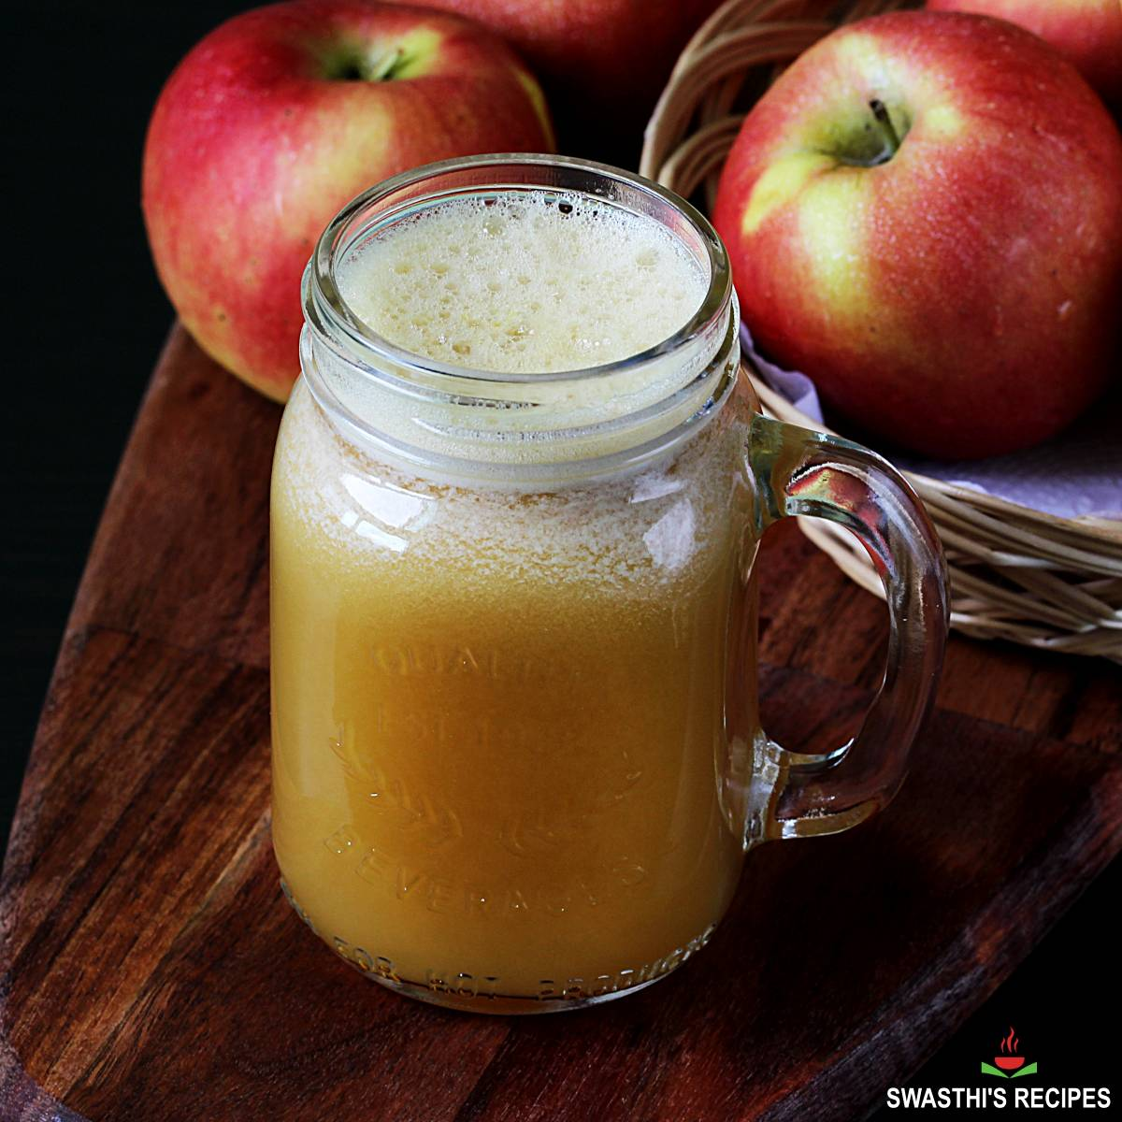
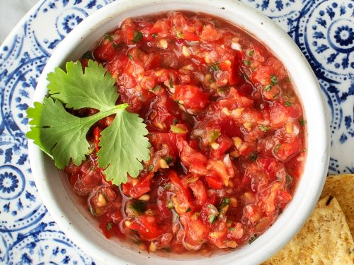
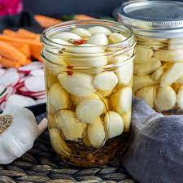
Food Processing - you know you want to!!

Slide 7
Provincial Food Premises License
NB Health – Food Premises License
Class 3, 4 or 5 License is based on risk
Benefits:
  Low cost to enter, hone your business skills
  Requirements are easily achievable – some documentation
  Qualifications of operator – food handler course
Downside:
Products must stay in the province
Access to retail may be limited
Notes:
Class 3 – Lowest risk – no food prep on site (public markets, convenience stores)
Class 4 – Medium risk – Restaurants and grocery stores with food prep
Class 5 – High risk – abattoirs, dairies, fish salting and canneries
There are requirements detailed in the NB Public Health Act
Proof of food safety training and how you will train staff on food safety controls
Water testing
Written cleaning program
For class 4 & 5 written programs on critical steps (cooking, pasteurizing required to kill pathogens)

Slide 8
Safe Food for Canadians Regulation
Enforced by the CFIA
Assures food safety for all commodities
Allows:
  Trade between provinces/Territories
  Imports
  Exports
Enacted to ensure equivalence with trading partners (USA = FSMA)
The regulation is outcome based
Notes:
CFIA is the Canadian regulator of food products to assure food safety (has the job of assuring CDN processors can export their products plus makes food safe for Canadians)
The SFCR is the Safe Food for Canadians Regulations
Prior to this there was a lot of holes in controlling food safety
Now the regulatory authority covers interprovincial trade, export and imports
CFIA regulates all food commodities from meat, fish, fresh fruits and vegetables
THIS LICENSES IS REQUIRED IF YOU DO CERTAIN ACTIVITIES AS IT RELATES TO FOOD

Slide 9
CFIA SFCR License
Requirements:
  Preventive Control Plan (PCP) – a written document that does two things:
    ID hazards for each ingredient / process step
    Develop Control Measures for each hazard
  Preventive Controls (PC) – written procedures that deal with hazards in the processing environment
Notes:
PCP
Control Measures must be proven
Cooking vegetable lasagna to a given internal temperature
Does this time and temp result in death of all pathogens

Slide 10
Preventive Controls
Recall / Complaints / Notification of FS Incidents
Conveyances / Equipment
Establishment
Consumer Protection
Sanitation and Cleaning
Loading / Unloading / Storage
Processing Environment
Competency of Staff
Traceability
Pest Control
Hygiene
Notes:
Each bubble is a preventive control for different aspects of the facility

Slide 11
Traceability
Trace 1 step back and 1 step forward
Identify where a given ingredient was used
One Step Back
One Step Forward
Inputs
Processing
Shipping
Suppliers
Ingredients
Lasagna Processor
Daily Production
Sobeys
Customers
Additives
Costco
Packaging
Sysco
Processing aides
Save On Foods
Notes:
Benefits of Traceability:
Reduce scope of a recall ($)
Protect consumers by removing affected product
Increase trust in the food you sell

Slide 12
CFIA License
Benefits -
More market access - ship to other provinces and Export
Licensing allows you to be an importer if you like (with additional requirements)
Access large retail markets (Sobeys, Loblaws)
Downsides:
Large amounts of paperwork
Need qualified food safety staff
Retail may require more (i.e. GFSI)

Slide 13
What is GFSI?
Retailers getting tired of recalls & the costs
GFSI formed in 2000 by the largest (EU) retailers
  Now includes 100’s of retailers & processors globally
  Assures strong HACCP standards
  Reduce audit fatigue
  Assure food safety and information sharing
  Once Certified Recognized Everywhere
Privately owned – food safety certification standards
Voluntary but not if you want to access large retail
Notes:
GFSI = Global Food Safety Initiative
Non governmental organization
Made up of the biggest retailers and manufacturers globally
Benchmarking is a GFSI role. They assure the food safety standards developed are effective and address emerging hazards
Privately owned and not part of government
Voluntary but when you want to get into retail they demand GFSI

Slide 14





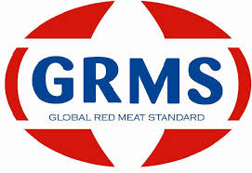







GFSI Program Standards
Farm Fork
Source https://mygfsi.com/how-to-implement/recognition/
Notes:
JFSM = Japan Food Safety Management System – Perishable (animal, plant) products
AsiaGAP = FFV, Tea, Grains
EFI = Equitable Food Initiative – farming of plants and post harvest handling

Slide 15
GFSI
The standards are prescriptive and exhaustive for a good reason
Recognized and implemented Globally
Certification provides you access to retail or foodservice
  Not all retailers have the same rules! You need to ask.
  To attain GFSI Certification you will need to be licensed with CFIA (SFCR License)
You are required to contact your CB if your company has any regulatory violations, recalls.
Notes:
Retailers globally have been promoting the adoption of GFSI standards. To do business they have made it a condition that you are certified with one of the GFSI standards.
They also require you to be licensed and legally able to produce food in Canada.
Retailers have programs for new entrants or to support locally made products. But the goal is to transition those processors to GFSI.
Generally the retailers want to buy your products for national distribution. This means that you need to licensed by CFIA.
Because certification bodies nor GFSI has any regulatory authority you must notify the certification body if you have had any recalls, regulatory infractions that affects food safety you must notify the certification body.
Loss of certification means you will lose business and even suffer penalties from the retailers.
Entering the retail market has costs associated with realizing your product on to those store shelves.
Can you supply the volumes, is your facility capable.
Automation of your production may be necessary.
Audit costs are variable (sq ft of facility, # of employees, number of lines / products and may be:
1st audit (full audit)- $(10-15K),
2nd audit - $(8-12K),
3rd audit - $(8-12 K),
4th audit is a full audit again.

Slide 16
Important Considerations
If you are considering a food processing business or want to expand, keep these things in mind:
Who is your targeted customer?
  Are you committed to meet their demands?
Access resources offered by Food and Beverage Atlantic (pitch your product)
Invest in training (food handler, Intro HACCP etc.)
Get advice before you build or lease a facility
Budget for a qualified food safety team lead

Slide 17
Daryl Loback BSc Food Science
30 years of food industry experience
Consult clients to achieve licensing with CFIA, labelling and formulation of food products, packaging, shelf life studies
Consult clients with: certification to BRCGS, FSSC 22000, SQF
Provide guidance on new construction or renovations
Conduct gap assessments in your facility to identify a roadmap for improvement
Email: daryl@foodsafetyculture.ca
Ph: 780-995-6897

Slide 18
QUESTIONS

