Slide 1
Common garlic diseases in
New Brunswick
NB Hort Congress, March 2023
Michael Tesfaendrias, Ph.D., P. Ag.
NBDAAF
IPM Specialist: Plant Pathology
(506) 453 3478
Michael.tesfaendrias@gnb.ca

Slide 2
Garlic production in NB
Garlic is typically grown in NB in small scale
The demand for locally grown garlic in NB has risen in the past few years with increasing number of producers growing the crop.
Mostly grown under organic production system.

Slide 3
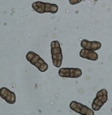
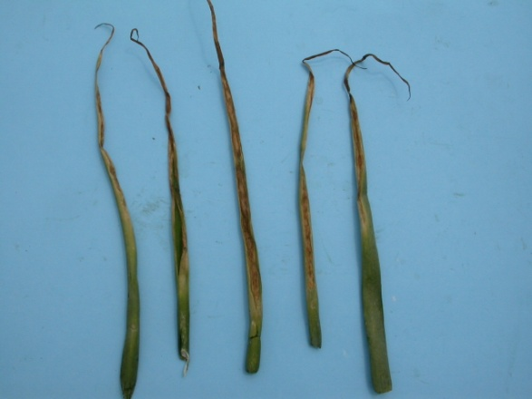
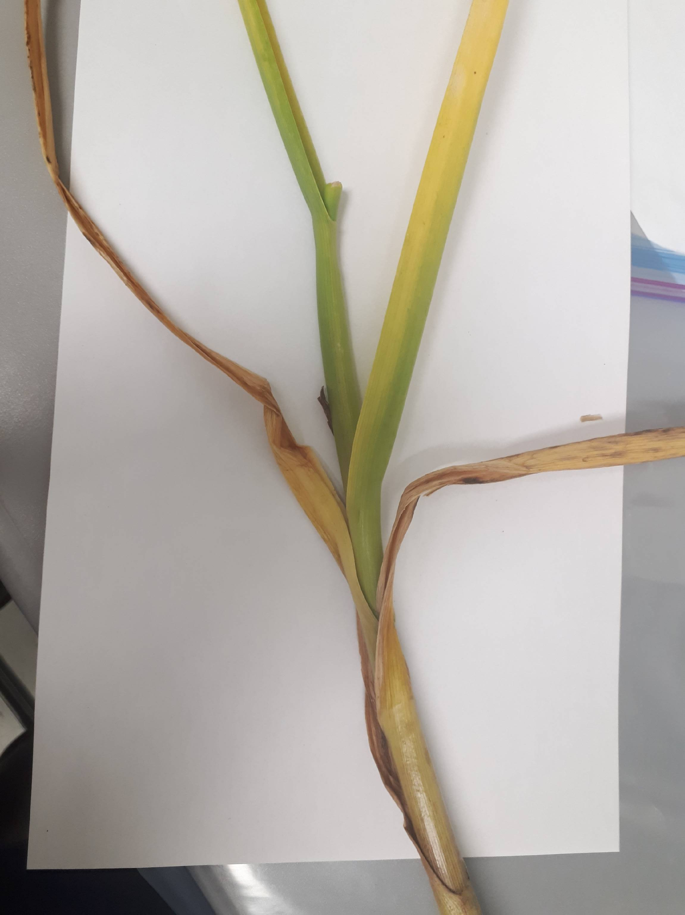
Stemphylium leaf blight (S. vesicarium)
Infection occurs when warm weather (15-26⁰C) coincides with prolonged
(≥6h) leaf wetness or heavy dews.
Weak plants are at highest risk of infection.
The pathogen overwinters on infected plant debris.
Stemphylium leaf blight management
Monitor your field regularly
Rotate out of allium crops for at least three years.
Bury plant debris.
Good spacing/reduced plant density
Chemical control

Slide 4
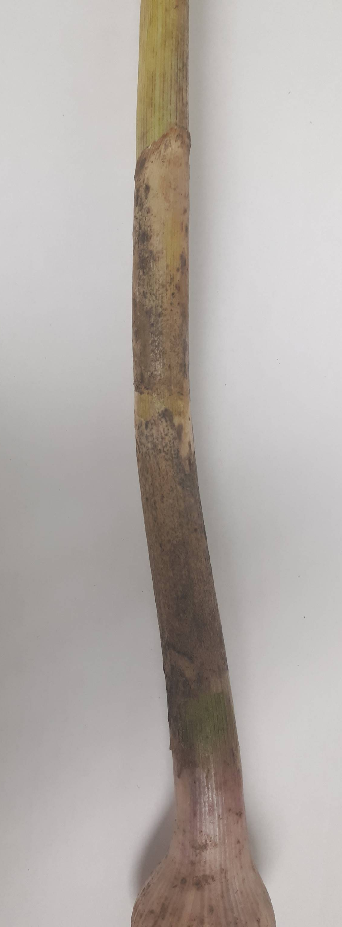
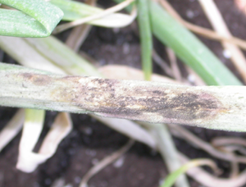
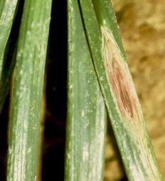
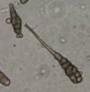
Purple blotch (Alternaria porri)
Infection occurs when warm weather (18-30⁰C) coincides with prolonged dews or leaf wetness.

Slide 5
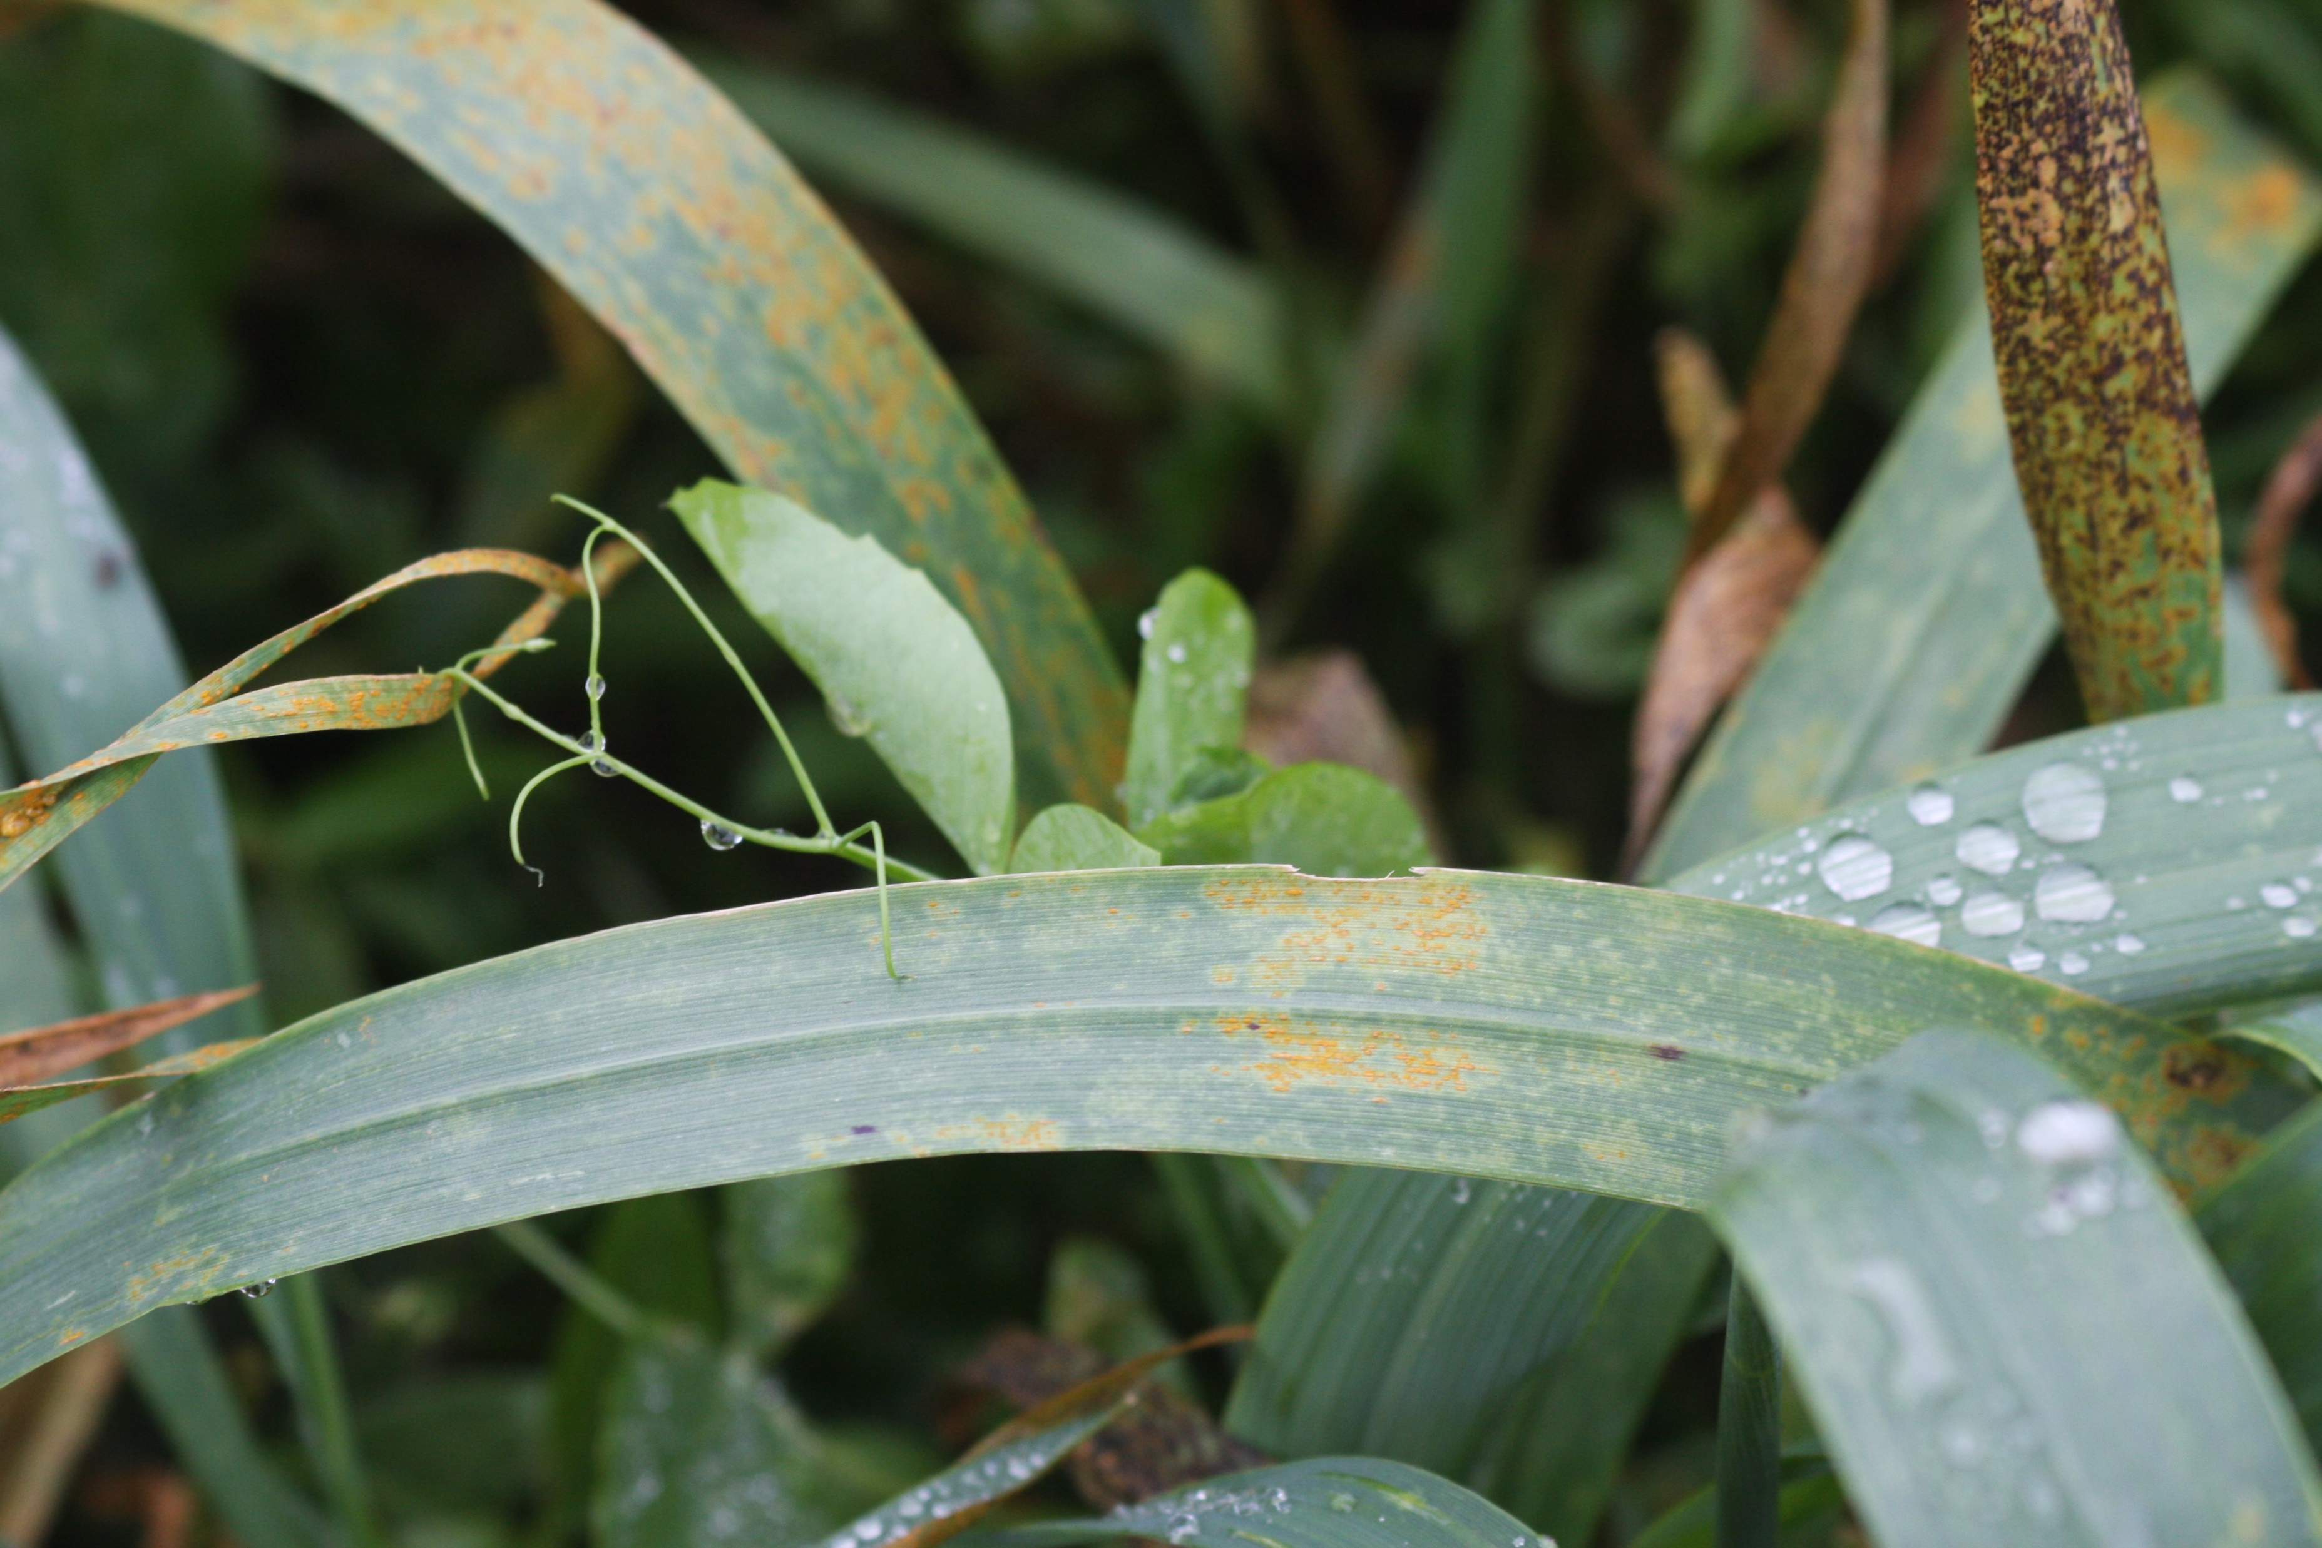
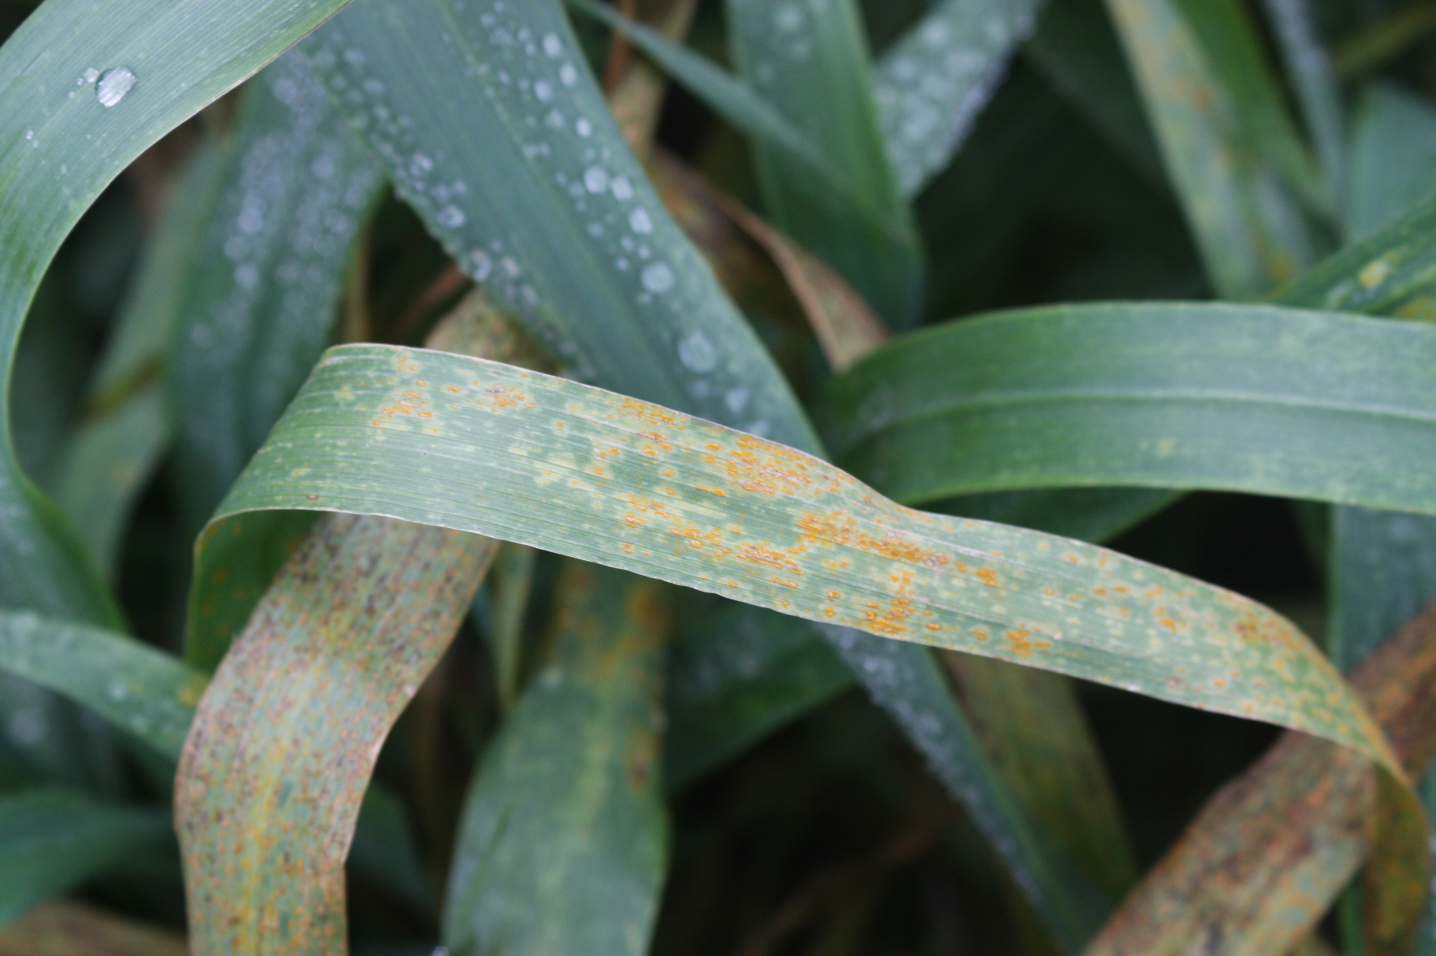
Rust (Puccinia allii)
Rust is active during cool weather (14º and 24ºC) and humid condition (100%RH) conditions.
When infection is severe, bulb size and quality can be reduced.
Rotate 2 to 3 years
Destroy volunteer

Slide 6
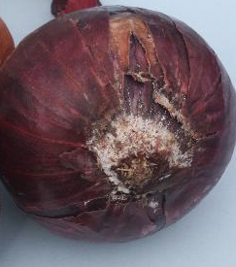
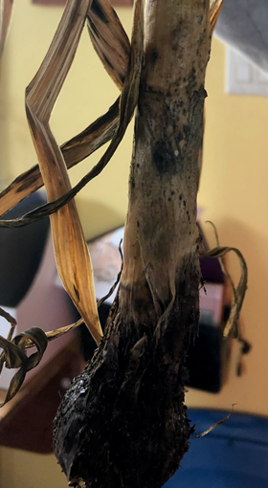
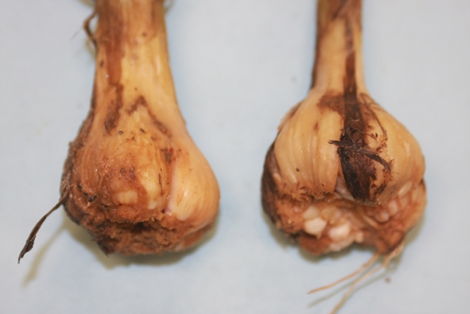
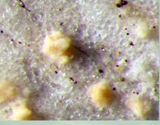
Fusarium basal plate rot (Fusarium oxysprum f. s. cepae)
Warm soil temperatures (25-28⁰C) and hot conditions favour infection
Disease incidence is higher when roots, bulbs or the basal plate are wounded by insects, nematodes or other pathogens
Fusarium basal plate rot management
A 3-4 year of rotation out of alliums and other crops such as corn and tomato
Plant disease resistant garlic varieties
Protect plants from physical damage
Cure garlic bulbs properly before storage.
Store garlic bulbs at temperatures of ≤ 4⁰C and low relative humidity (70%).

Slide 7
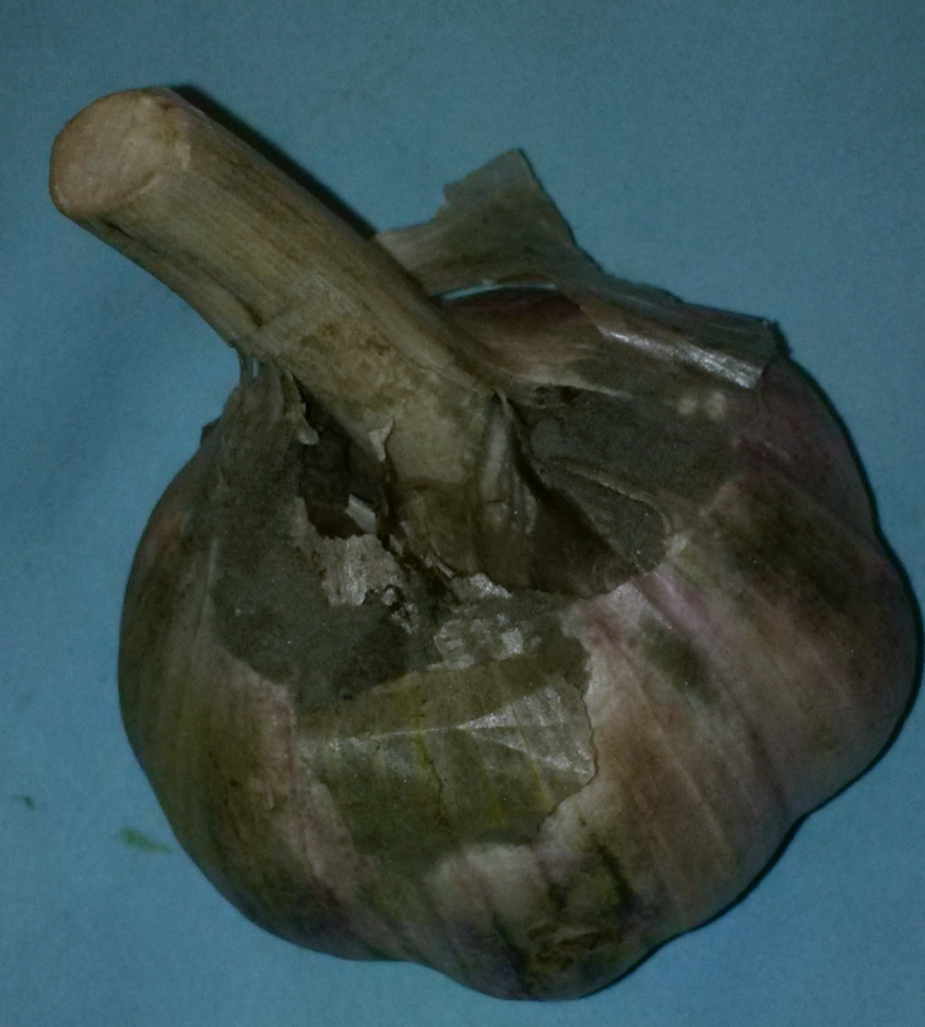
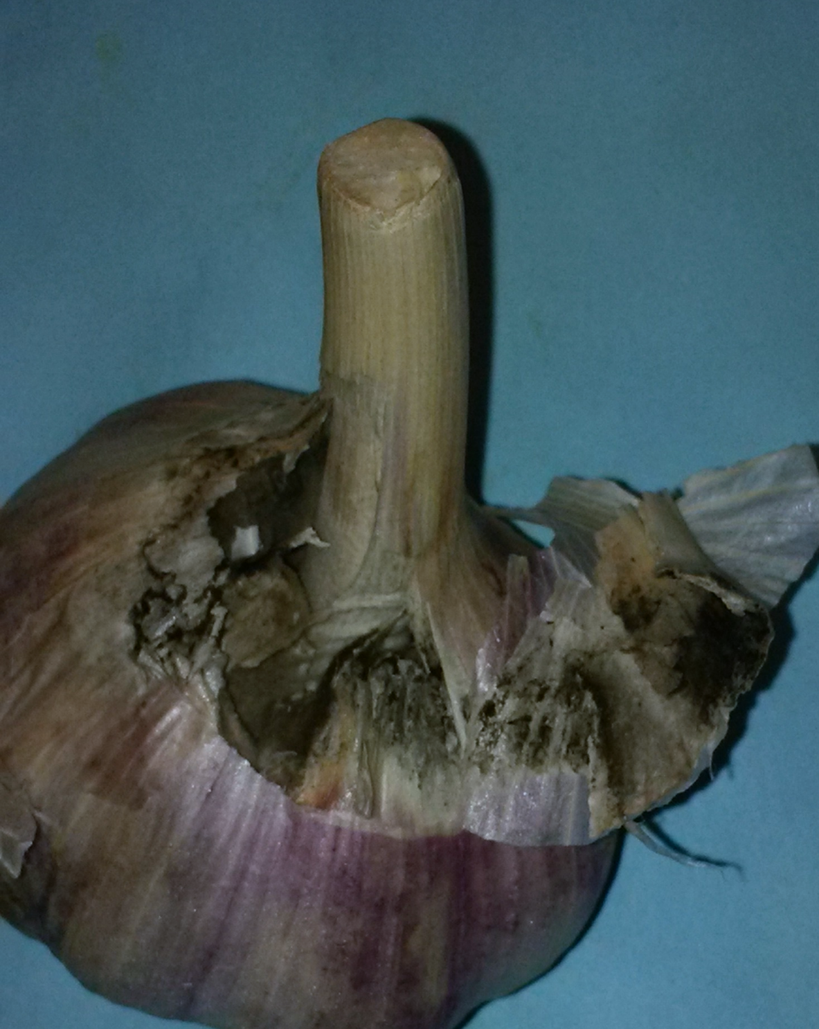
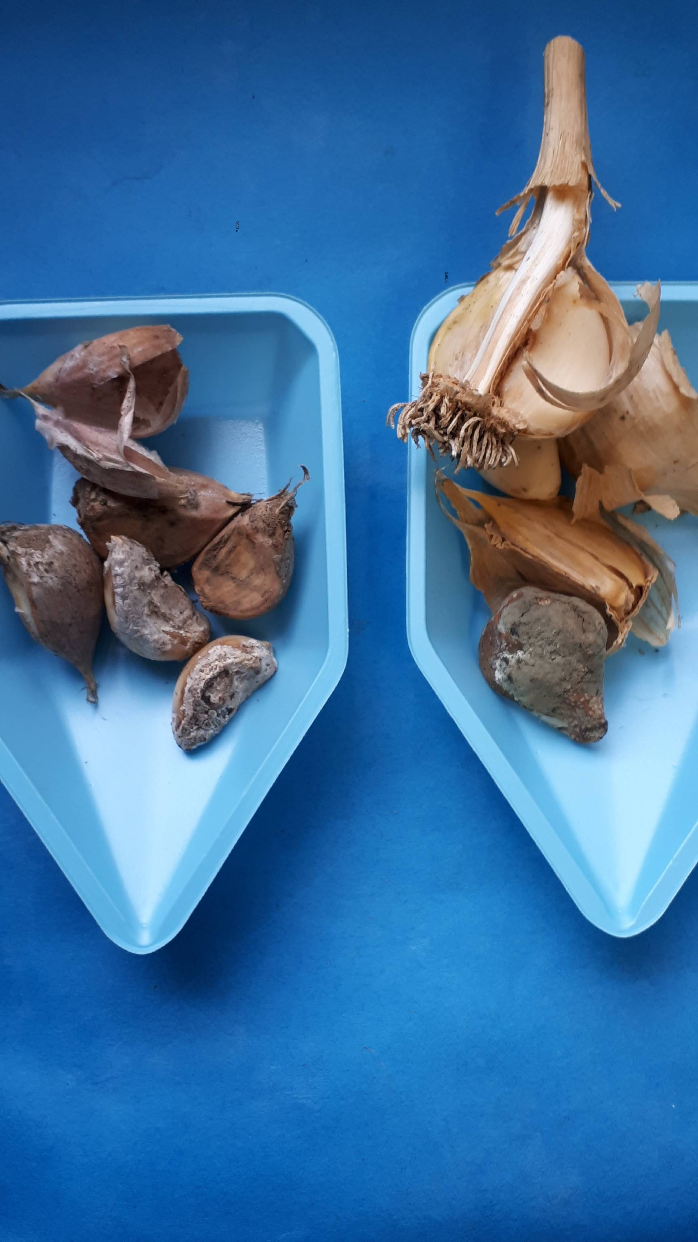
Botrytis neck rot (Botrytis spp.)
Initial infection starts in the field, but generally appears during storage.
Infection: Cool (15-20⁰C) and wet weather conditions
Bruised and damaged garlic can be infected during harvest
Botrytis neck rot management
Avoid late season nitrogen fertilizer and late season irrigation.
Minimize damage to garlic bulbs during harvest.
Harvest only when the plants are mature, and necks are well cured.
Store in cold (≤ 5⁰C) and ventilated with RH 65 to 75%.

Slide 8
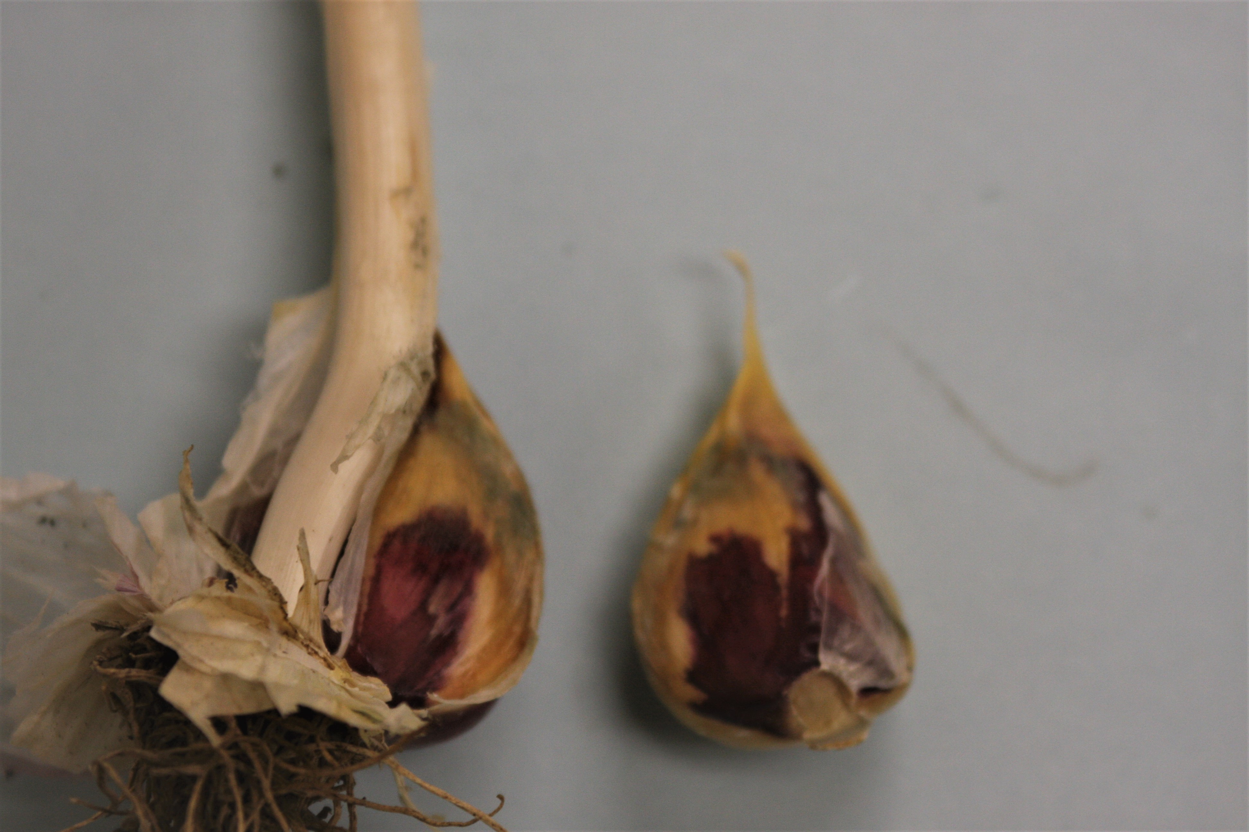
Blue mould rot (Penicillium spp.)
Transmitted on seed cloves
Infection occurs through wounds
Garlic plants are more susceptible during warm temperatures (22-25⁰C).
Planting garlic too early in late summer may increase the severity of clove rot.
Blue mould rot management
After harvest, avoid trimming the tops too close to cloves and to the basal plate
Promptly dry or cure harvested garlic bulbs.
Remove all diseased bulbs before cracking and planting

Slide 9
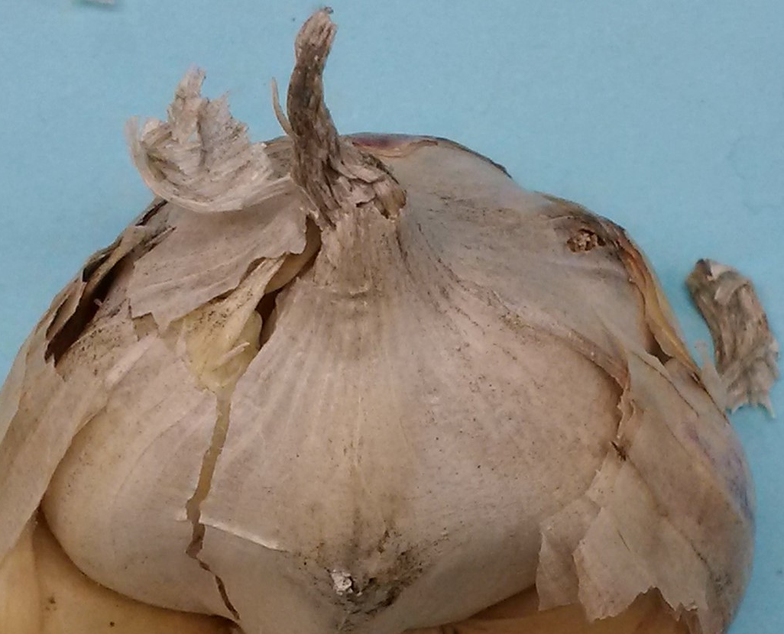
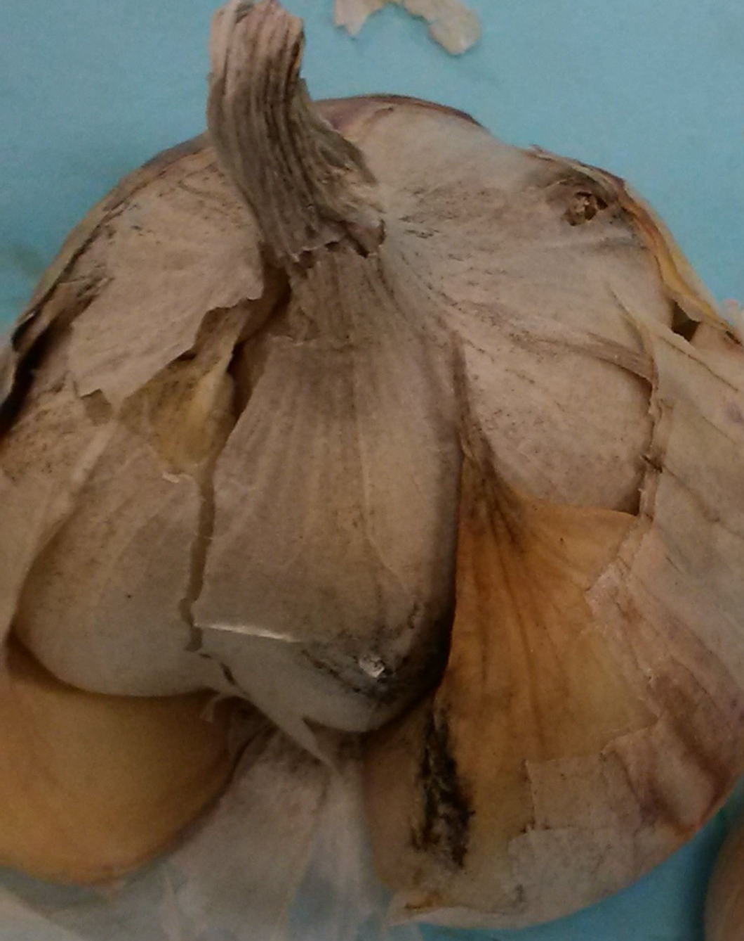
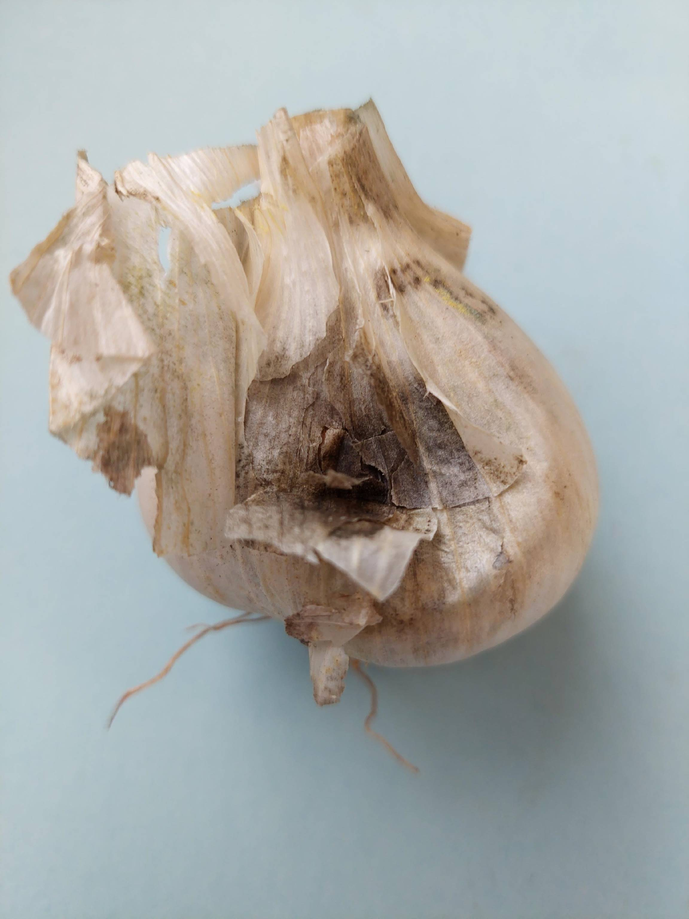
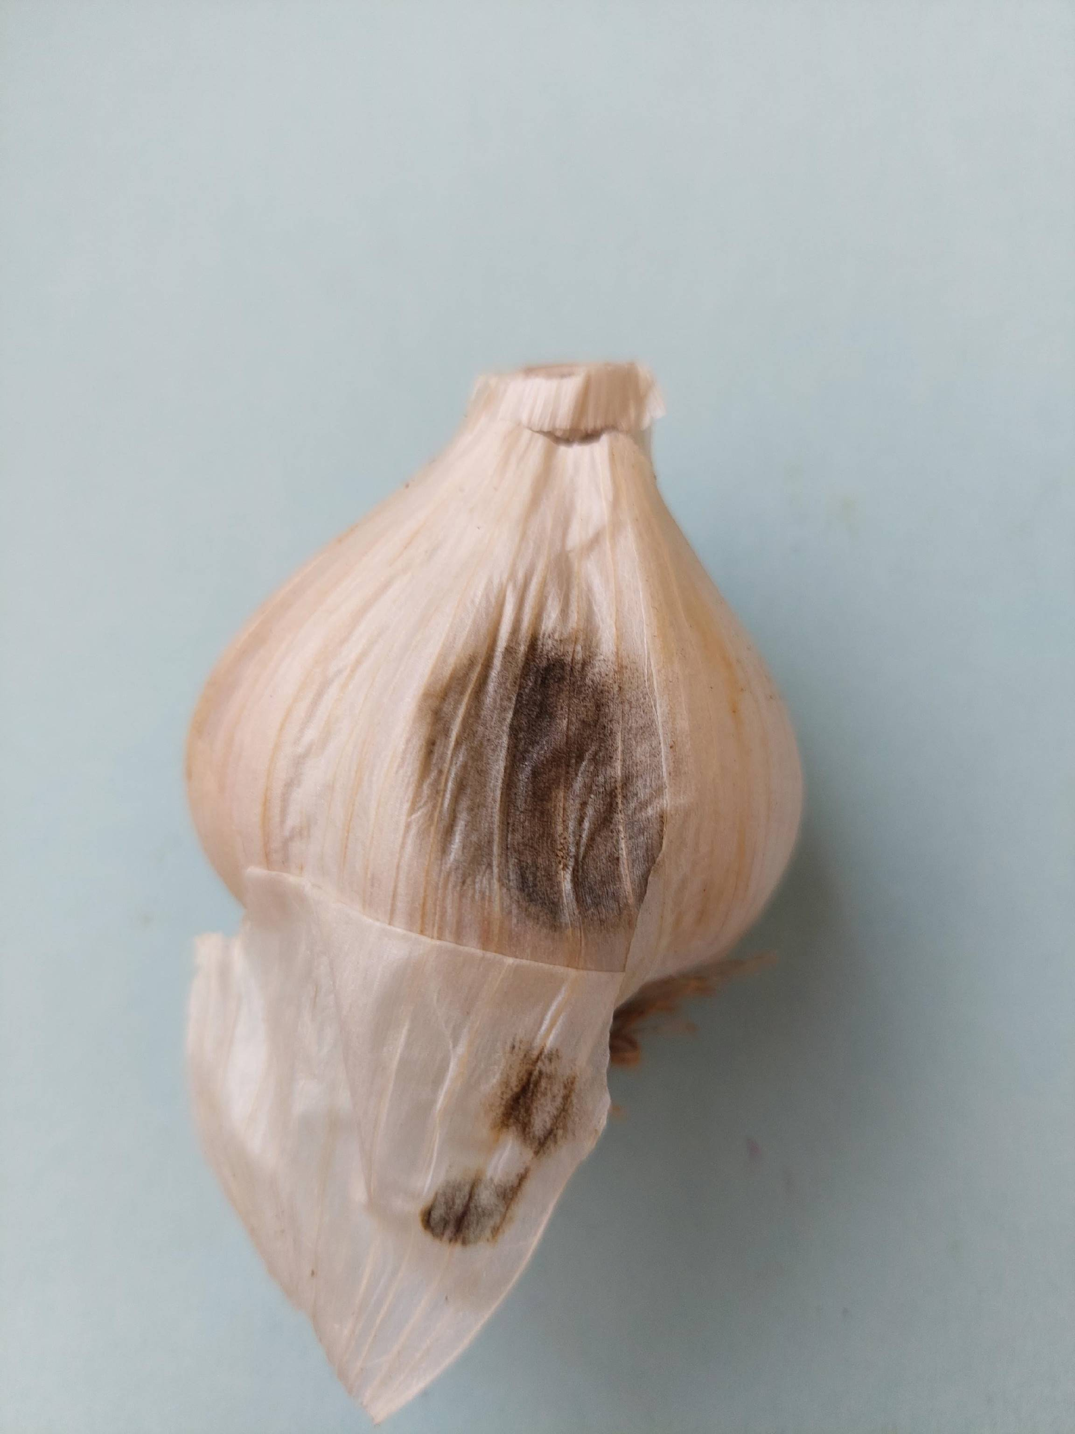
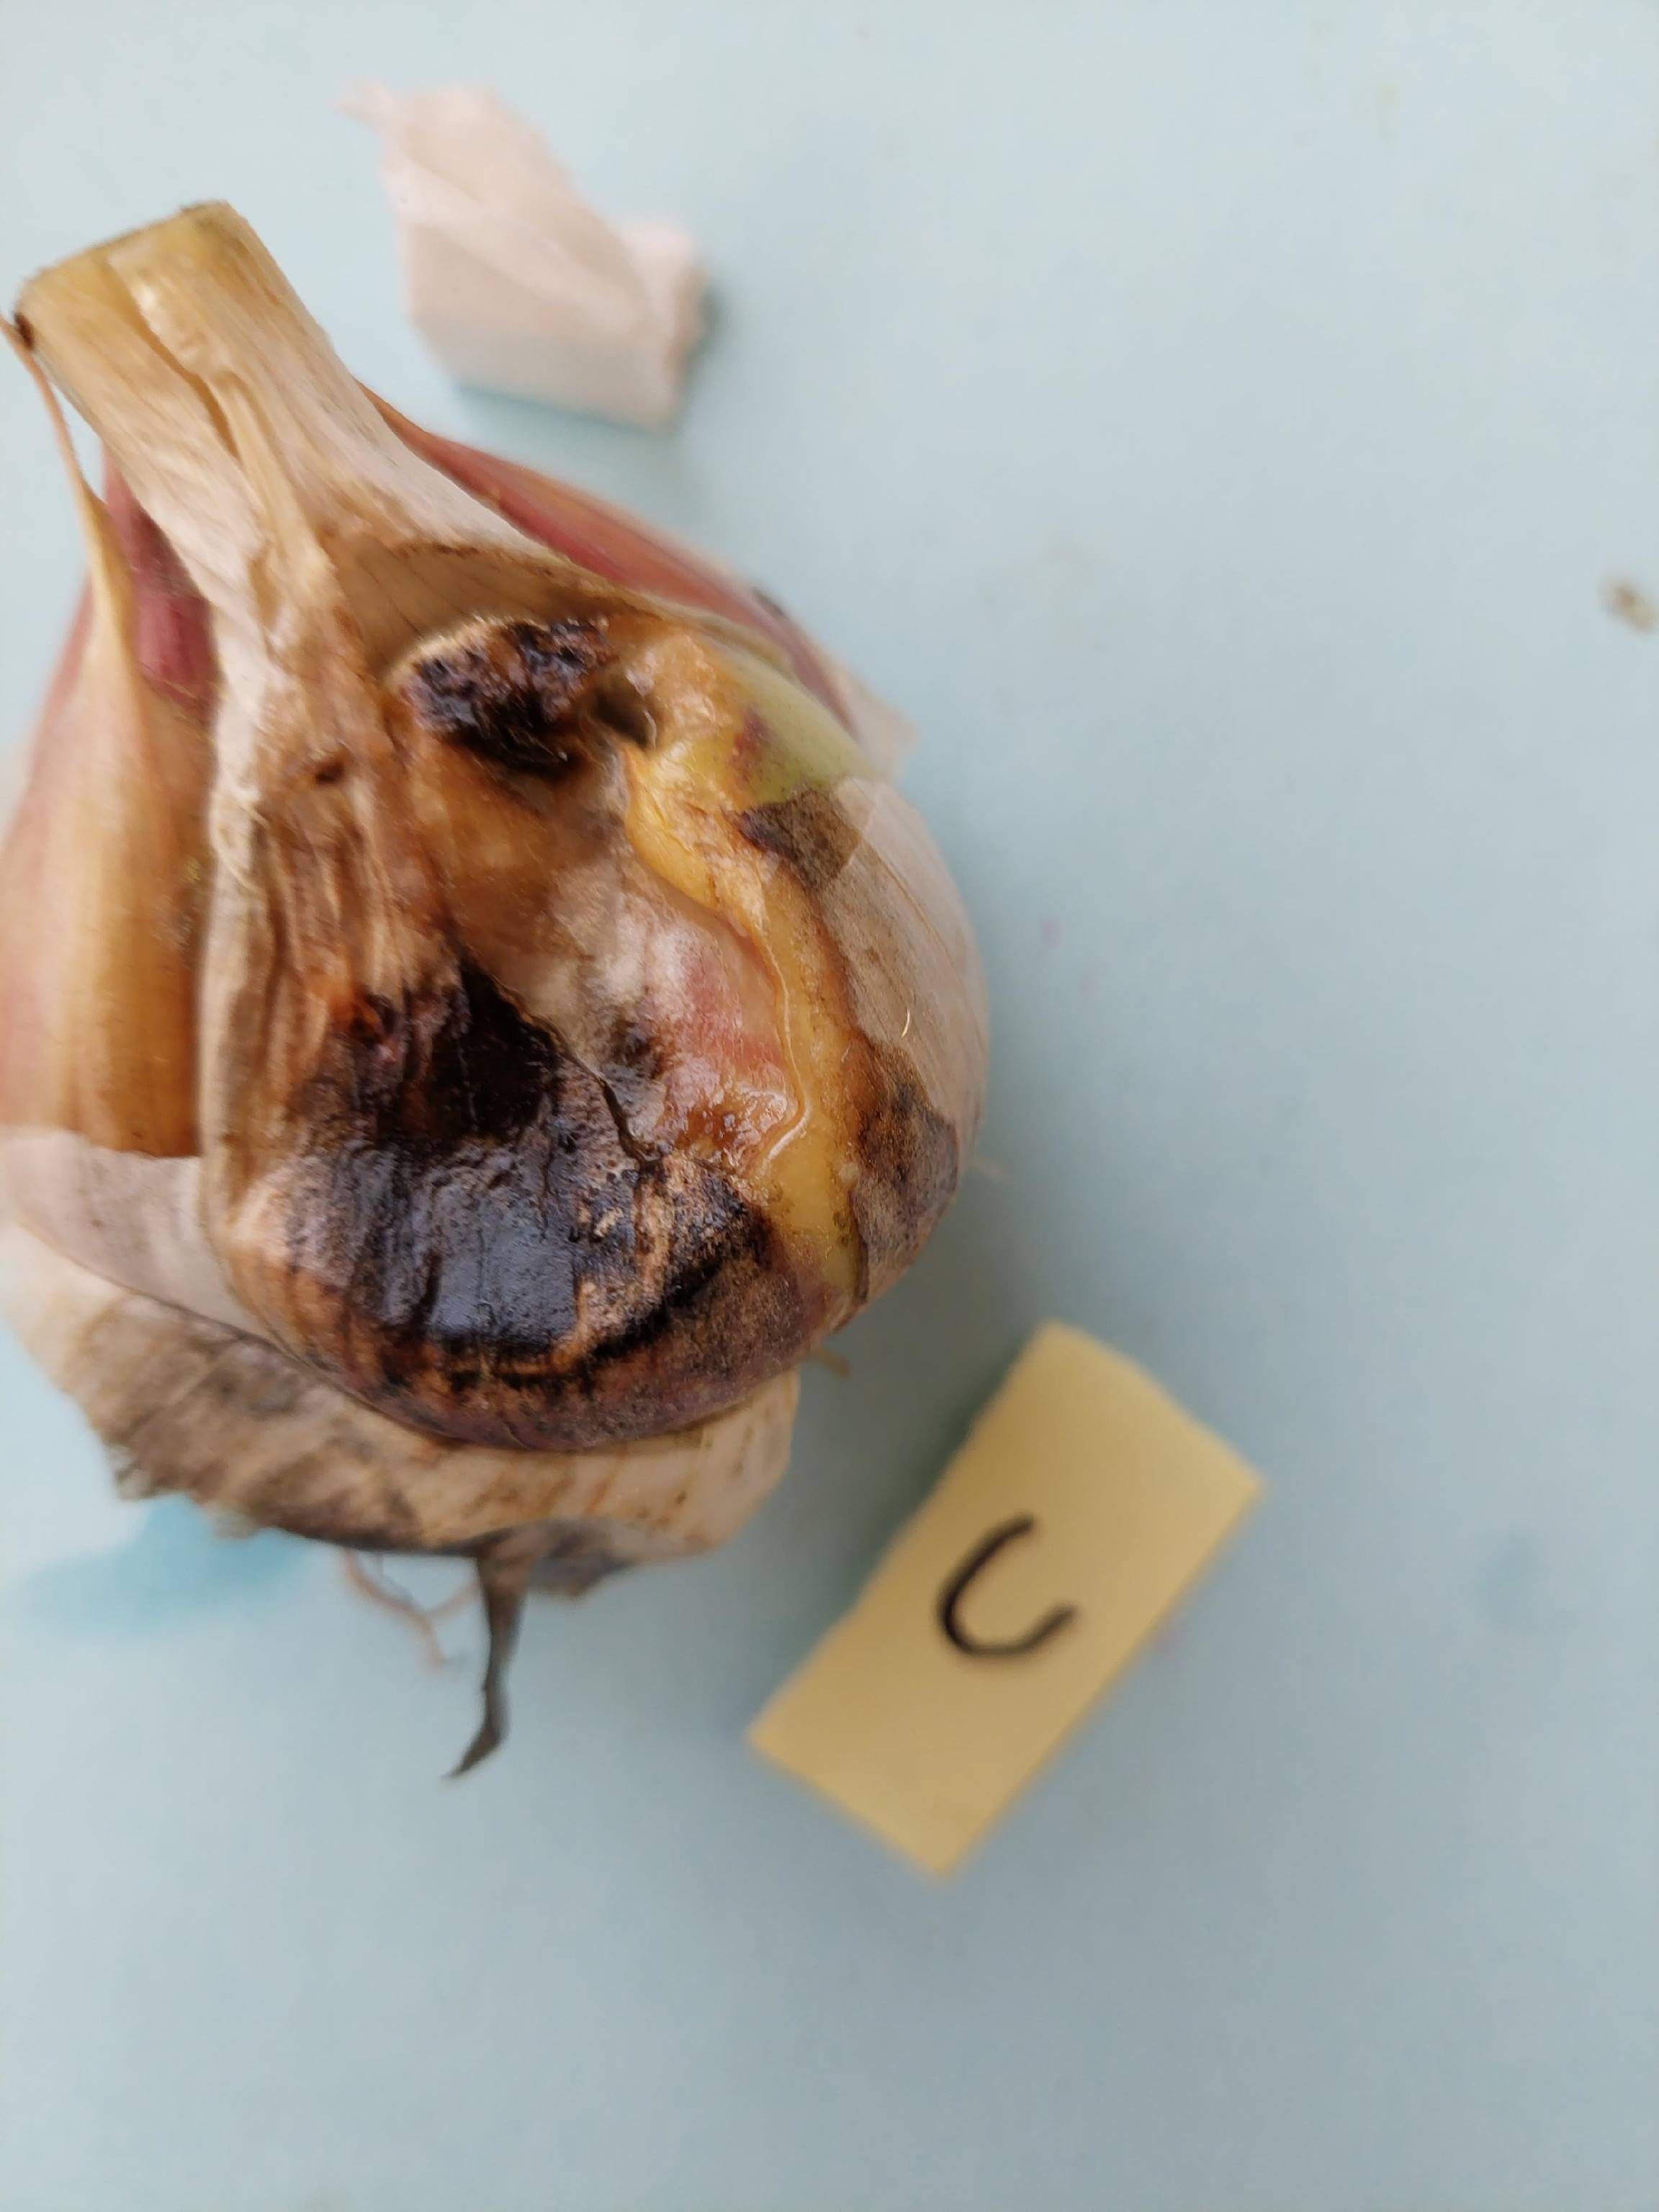
Embellisia skin blotch
(Embellisia allii)
Mostly appears during:
Warmer, humid summers
and in wet years
Poor drying conditions after harvest.
In garlic stored wet and cool
Diseases Management
Proper drying and storage conditions with humidity < 70% slows
fungal development.
Do not store diseased garlic bulbs.

Slide 10
Stem and bulb nematode (Ditylenchus dipsaci)
Nematodes: multicellular, non segmented roundworms
One of the most important parasitic nematode of garlic and other alliums
Live and feed within plant leaves, stems and bulbs.
Female nematodes lay 8-10 eggs a day within the host tissue for 25-50 days.
Migrate to soil only when the host plant is no longer
a suitable site for nematode feeding and reproduction

Slide 11
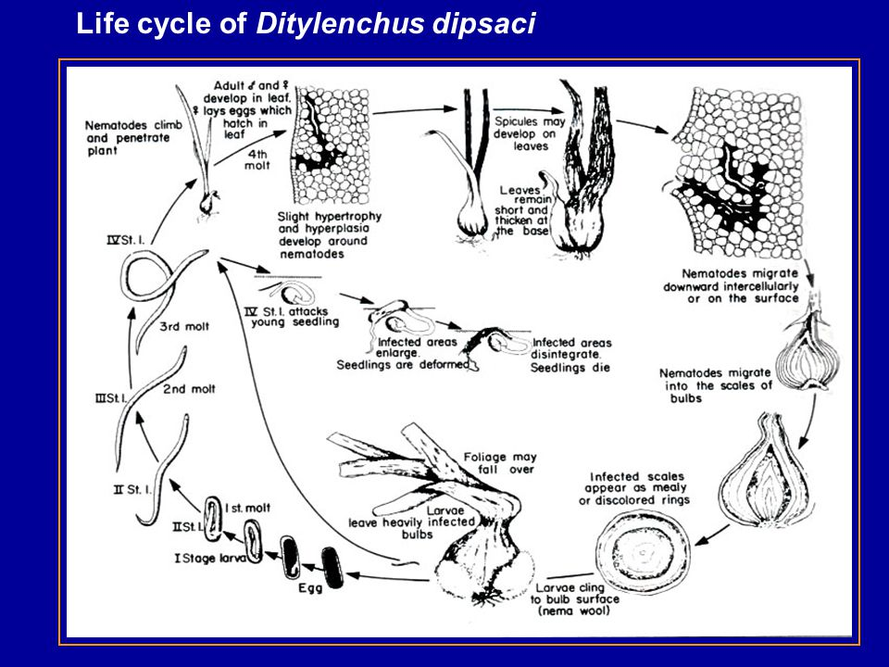
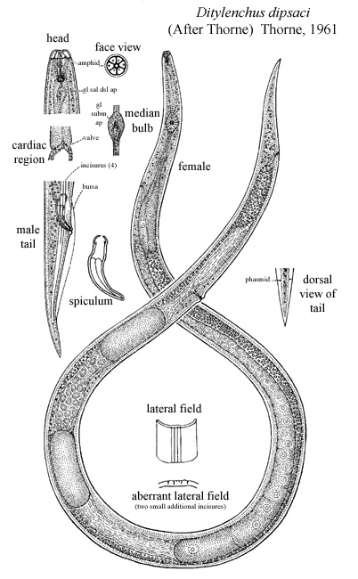
-SBN can survive for many years in or on dry plant material
-Become active again with rehydration

Slide 12
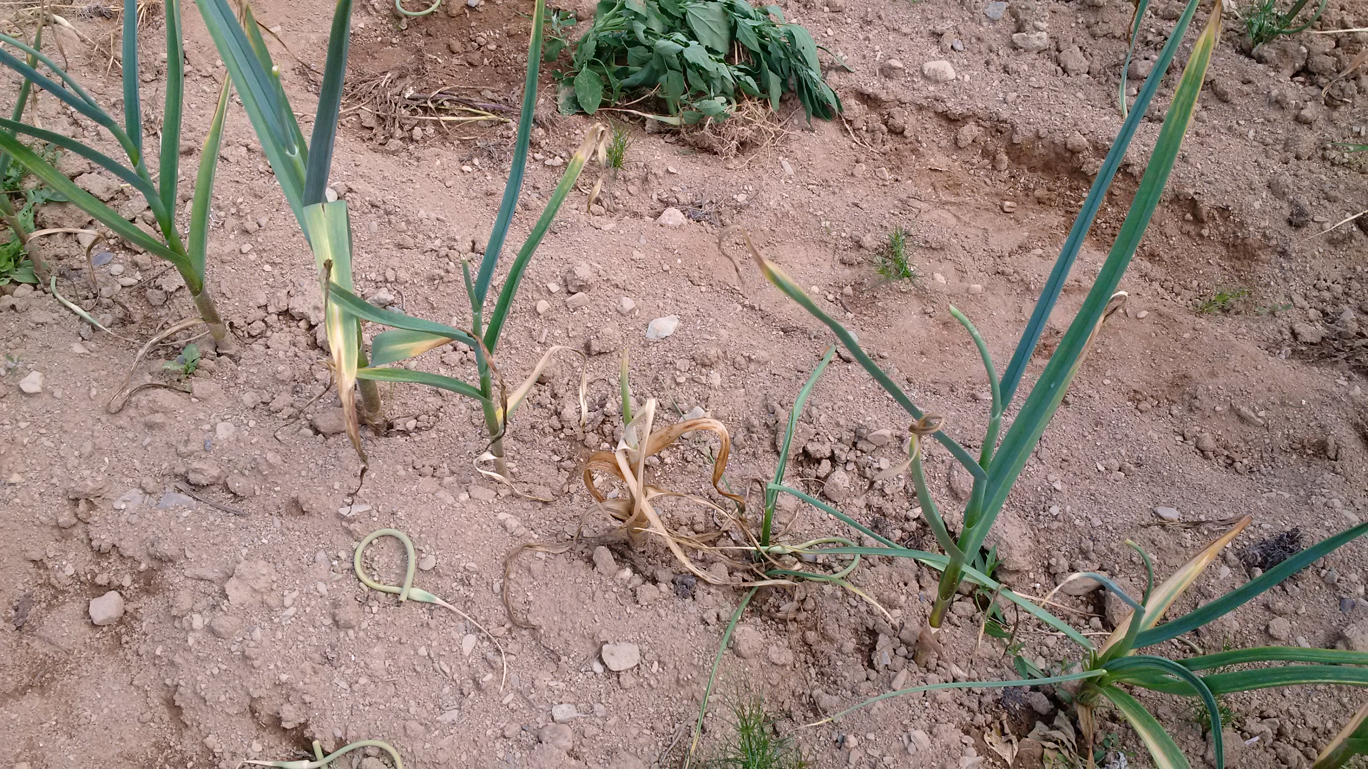
Stem and bulb nematode

Slide 13
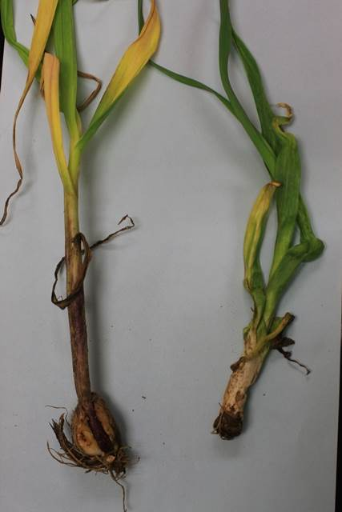
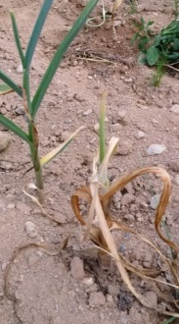
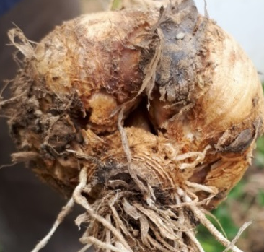
Stem and bulb nematode
Leaves appear twisted and malformed
Infected plants turn yellow and die
Severely infected garlic bulbs are soft, discoloured and deformed, with a portion of the roots absent.
Distorted growth of garlic bulbs with a roughened corky texture.

Slide 14
Nematode infected bulbs can be easily infected by secondary pathogens in the field and/or by postharvest pathogens in storage.

Slide 15
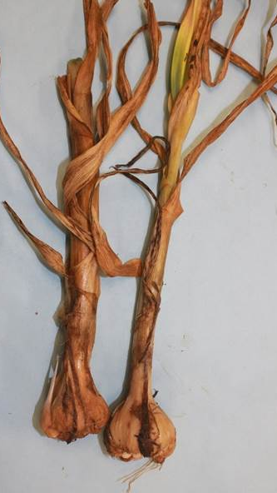
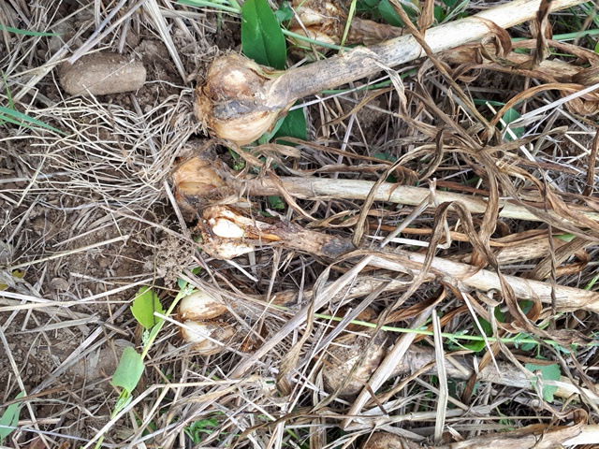
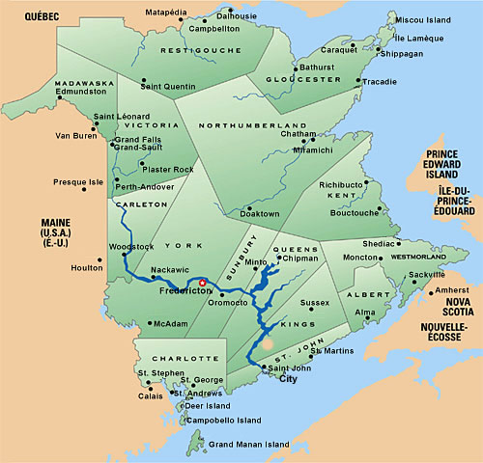
Stem and bulb nematode in NB
In 2017, NBDAAF conducted a survey
Confirmed presence of SBN in NB garlic fields.

Slide 16
Nematode Management
Plant clean, nematode free garlic seed.
Avoid using garlic for seed from an infested field.
Rotate to non-Allium (non-susceptible) crops for up to 3 - 4 years. Avoid legumes in the rotation.
Remove weeds and volunteers during rotation.
Cover crop: mustard, rapeseed, oilseed radish and sorghum-Sudan grass before planting garlic.
Completely remove cull bulbs and crop residues from the field if soil tests confirm the presence of nematodes.

Slide 17
Nematode Management
Implement proper sanitation to prevent spread of the nematode from infested to non-infested fields.
  Clean machinery prior from nematode-infested fields prior to entering a new field
  Rogue out symptomatic plants throughout the growing season
Chemical control (Fumigation)
  Velum Prime (Floupyram (G7))

Slide 18
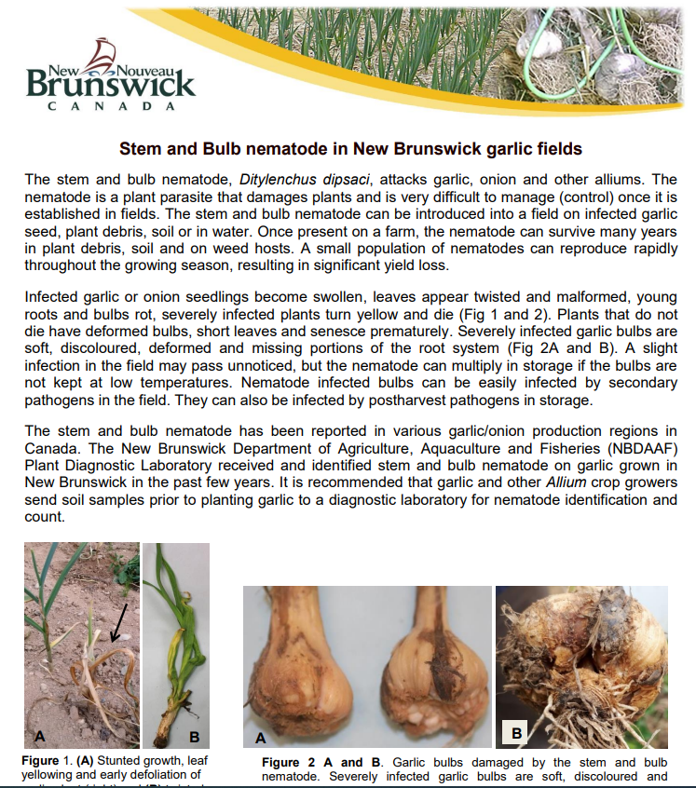
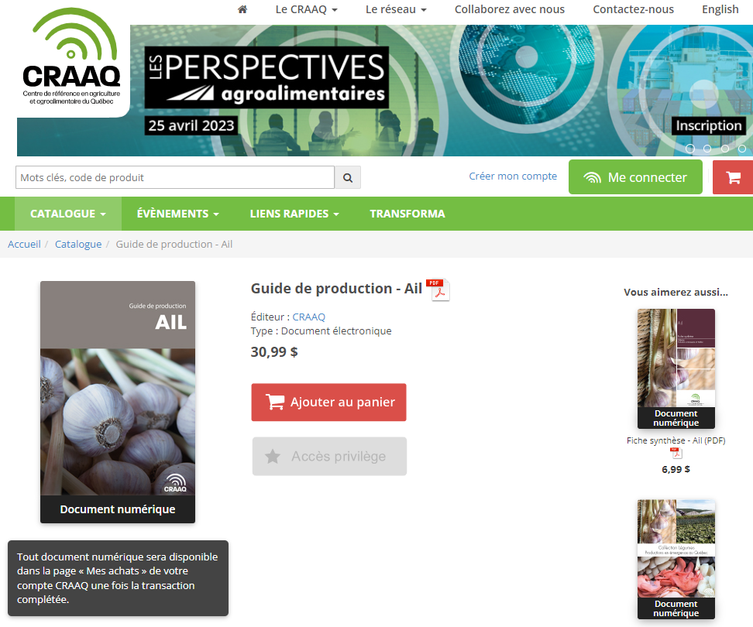
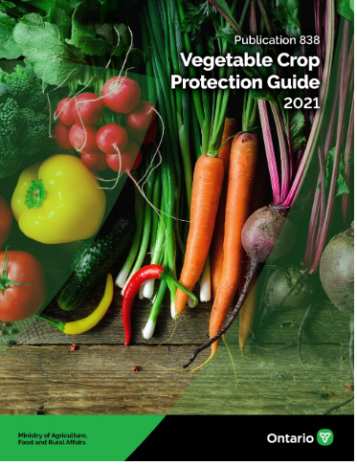
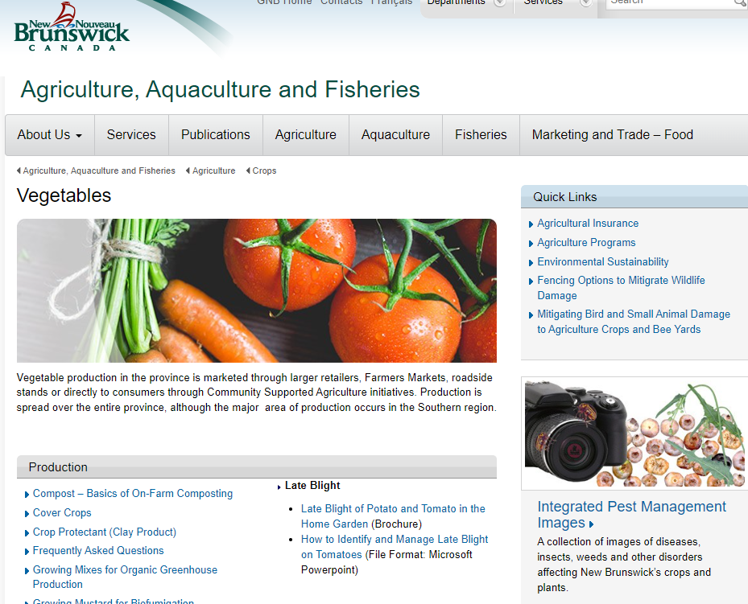
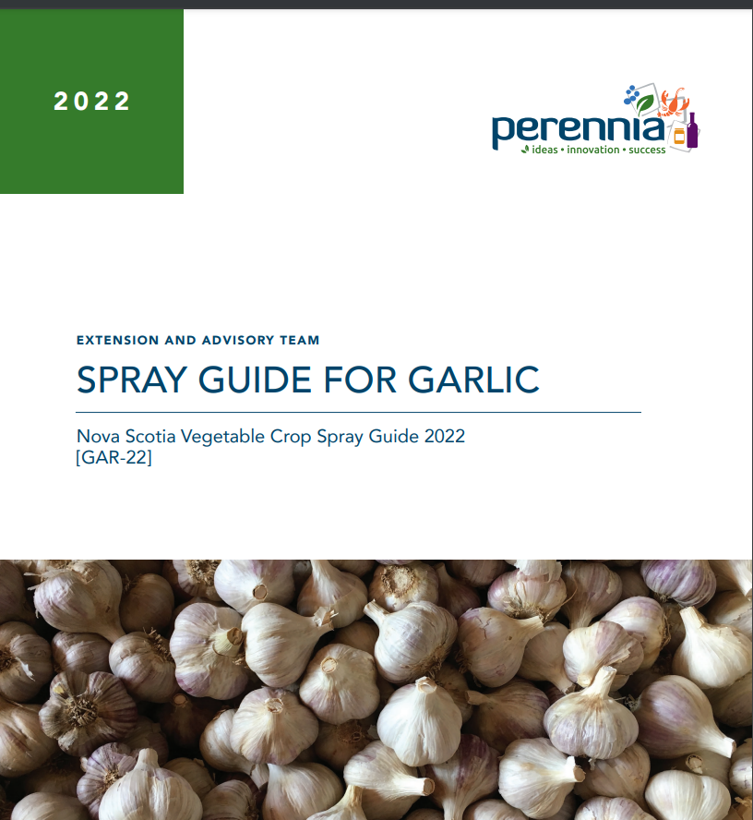
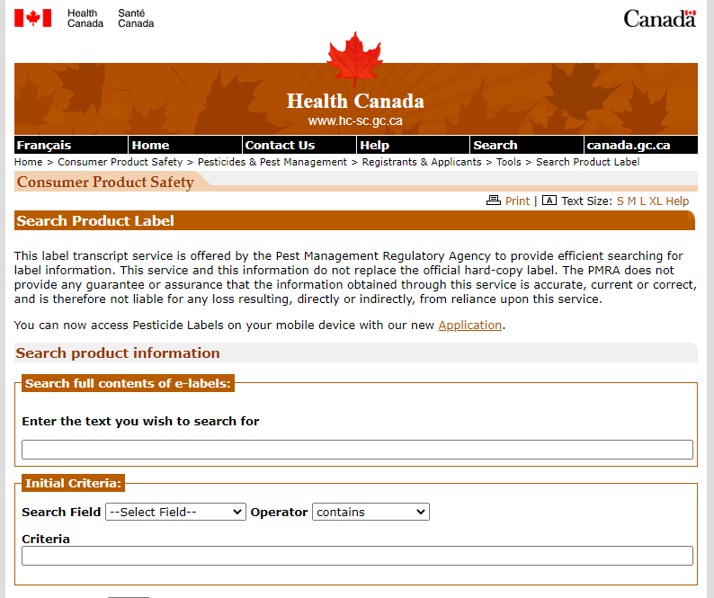
Resources
PMRA http://hc-sc.gc.ca/cps-spc/pest

Slide 19
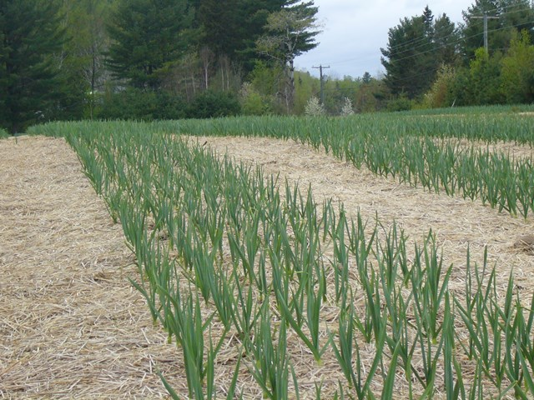
Thank You
Merci

