Slide 1
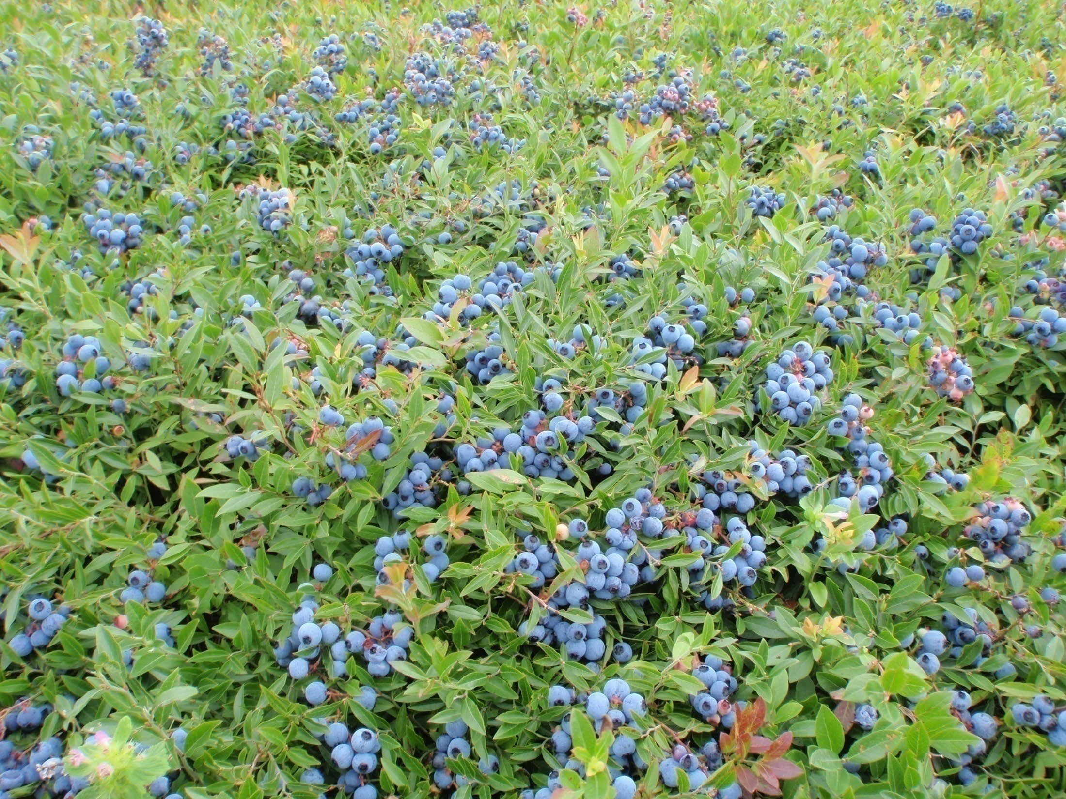
WBANA Canada 2.0

Slide 2
Today’s presentation:
Background \History.
What has changed since 2018?
What Value does WBANA Canada bring?
Moving Forward 2023-24.

Slide 3
Background/ History.
October 2018: all processors and Grower Associations are members of WBANA Canada and meet at Symposium in Fredericton.
Large inventory still negatively affecting prices. Oxford holds most of the inventory
Oxford receives $$$$$ from province of Nova Scotia and New Brunswick to do own promotions. Ragnar Kamp informs WBANA Canada of potentially leaving organization.
WBANA Canada Hired Knightsbridge Marketing Consulting ( Stuart Strathdee) in late 2019 with ACOA financial assistance.

Slide 4
Strategic Plan
Stuart Strathdee meets with Industry people including Oxford to evaluate where we were and where we need to be.
Strategic Plan is developed based on Industry Feedback.
8 Core strategies were identified.
Meetings set for Moncton, NB to establish next steps.
COVID-19 CHANGED EVERYTHING !
Stuart Strathdee suddenly passes away July 2021!

Slide 5
What has changed since 2018?
Market demand has been very strong. There was no inventory prior to 2022 crop!
Demand for Wild Blueberries has continued to grow. New Processors in Quebec and in Nova Scotia.
Positive Changes to SPBQ ( Quebec producers) Board.
In 2020, a Sub Committee formed to look at making Health Committee more efficient. New Chair, more members from Canada!
New Health research, Human Trials looks promising. Effects of Wild Blueberries on Fat Oxidation Rates in Aerobically Trained Males.
Dr. Kalt continues to be an important resource in making decisions on projects to support and developing Health Message.
Meetings set for Moncton, NB to establish next steps. COVID-19 CHANGED EVERYTHING !
Stuart Strathdee suddenly passes away July 2021!

Slide 6
What Value does WBANA Canada bring?
Since 1981, production has grown from 40 million pounds to close to 400 million pounds in 2023! Growth has been mostly in Canada! Your fruit!
WBANA is responsible for the Antioxidant story that has and continues to drive demand! We are working on the next big thing: Anthocyanins.
Health research continues to provide proof that Wild Blueberries are healthy for people. ( Papers published on cognitive function in Adults, Diabetes, etc.)
Published paper by Dr. Charles Forney, Agriculture Canada Kentville: compared Wild to Cultivated: Chemical components show WILD are Better!

Slide 7
What Value does WBANA Canada bring?
NEXT: WBANA Canada has arranged to have Wild and Cultivated compared by professional taste panel. Results will be available in the coming months.
US TRADE INVESTIGATION 2020-21. WBANA Canada represented the Industry successfully against US tariffs.
MINIMUM .20 cents per pound in your pocket for 2021, 2022 !
* Market reports: WBANA Canada has arranged for Gilbert Lavoie to produce and present 4 annual Market reports for the Industry. Producers now get accurate information on where the fruit is going, what price it is sold at and what the Field Price ( range) should be.

Slide 8
Moving Forward 2023-24.
WBANA Canada is moving from a Transitional Board to a new Board. We have 2 Co-Chairs, Zack Fisher New Brunswick and Hugo Chapedelaine from Quebec.
Other members will be named at the next meeting.
We have identified two consulting firms ( Deloitte and Food and Wellness Group) that will assist WBANA Canada in implementing the strategic plan and development of new marketing approach.
Improve communications : continue to take advantage of new technologies, like zoom, etc.

Slide 9
Questions

