Slide 1
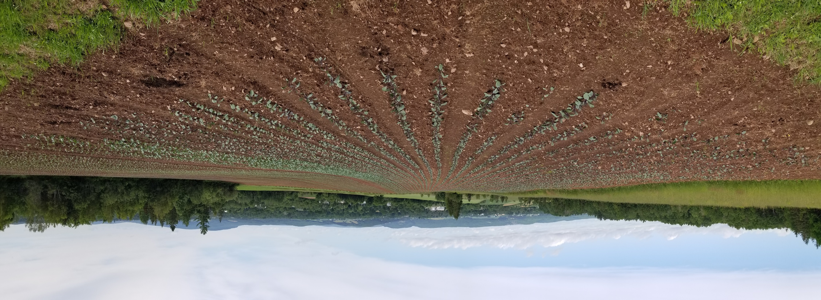
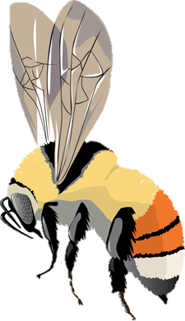


Promoting wild bees in agricultural spaces
Jess Vickruck
Hort Congress 2023
Fredericton, NB
@jessvickruck

Slide 2
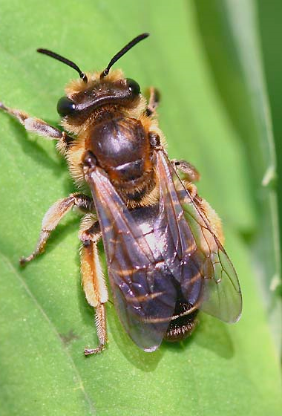
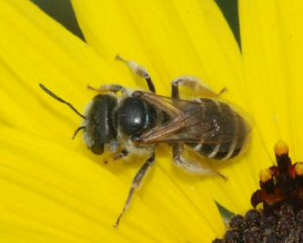
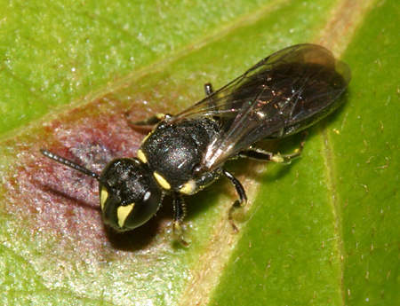
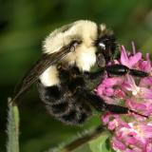
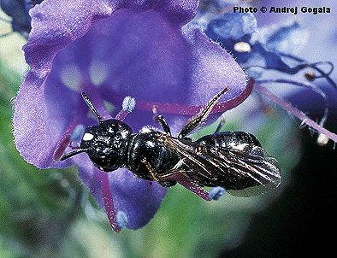
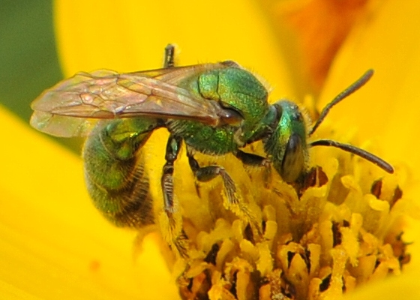
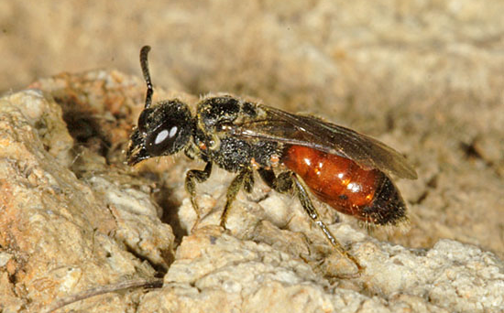
What is a wild bee?
Not managed by humans
  i.e. honeybees, some bumblebees, blue orchard bees
These can be native or introduced species

Slide 3
Wild bee diversity in Canada
Over 930 species of wild bee in Canada
Most are solitary and nest in the ground

Slide 4
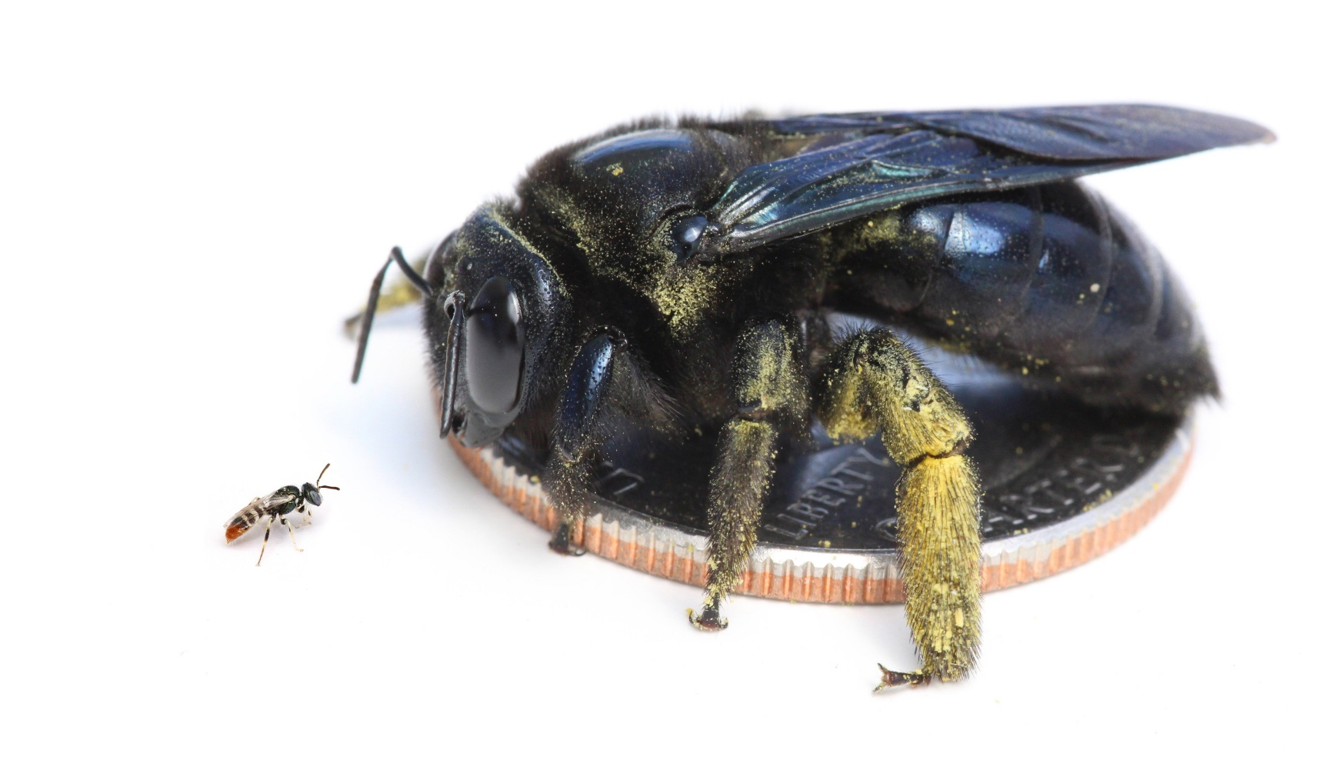
Wild bee diversity in Canada
Over 930 species of wild bee in Canada
Most are solitary and nest in the ground
Bees In Your Backyard

Slide 5
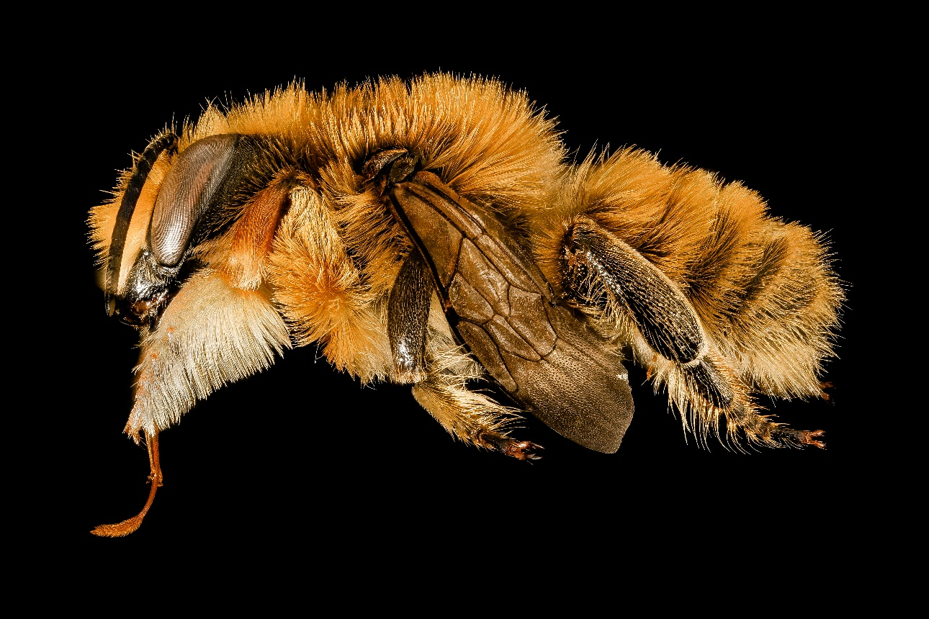
Bee diversity in Atlantic Canada
Atlantic Maritime Ecozone – 252 species (and counting)
177 species nest in the ground (70%)
111 solitary, 61 social, 68 parasitic
87 floral generalists, 21 floral specialists, 76 no reported floral associations
Megachile latimanus
Data from beesofcanada.com
Notes:
Solitary 107 + 4 presumed
Eusocial 39 + 22 presumed eusocial
Parasitic 62 + 6 social parasites

Slide 6
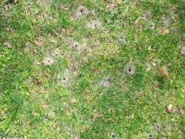
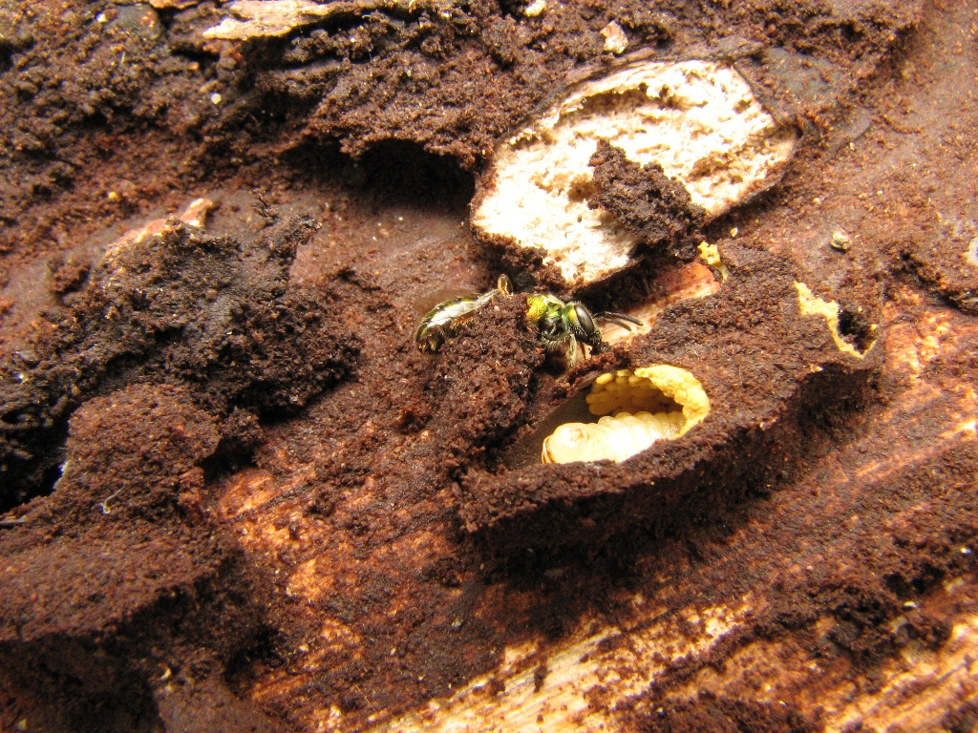
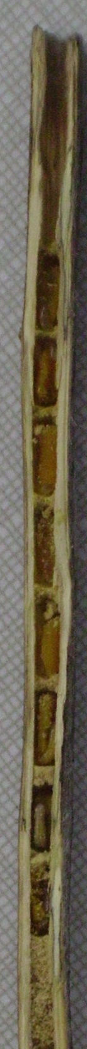
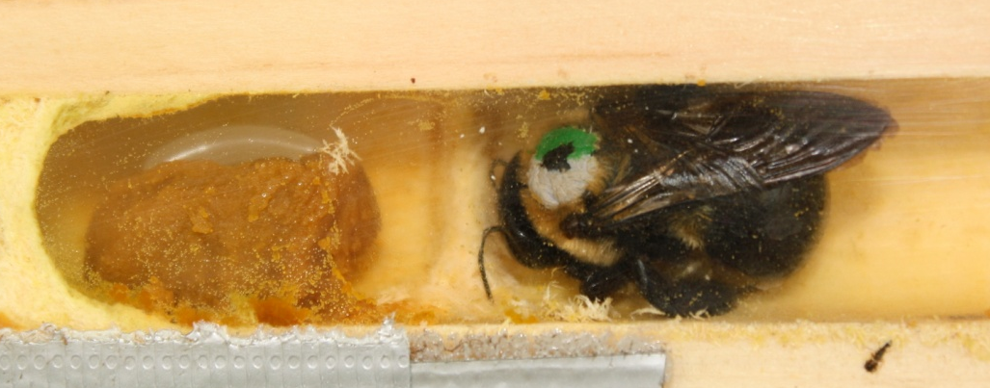
Where do wild bees live and what do they eat?
In the ground
Twigs
Cracks and crevices
Rotting logs
Snail shells!
Eat pollen and nectar
M. Lopez-Uribe
Beatriz Moisset -CC BY-SA 4.0, https://commons.wikimedia.org/w/index.php?curid=77002498
J Vickruck

Slide 7
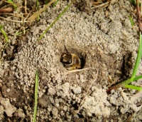

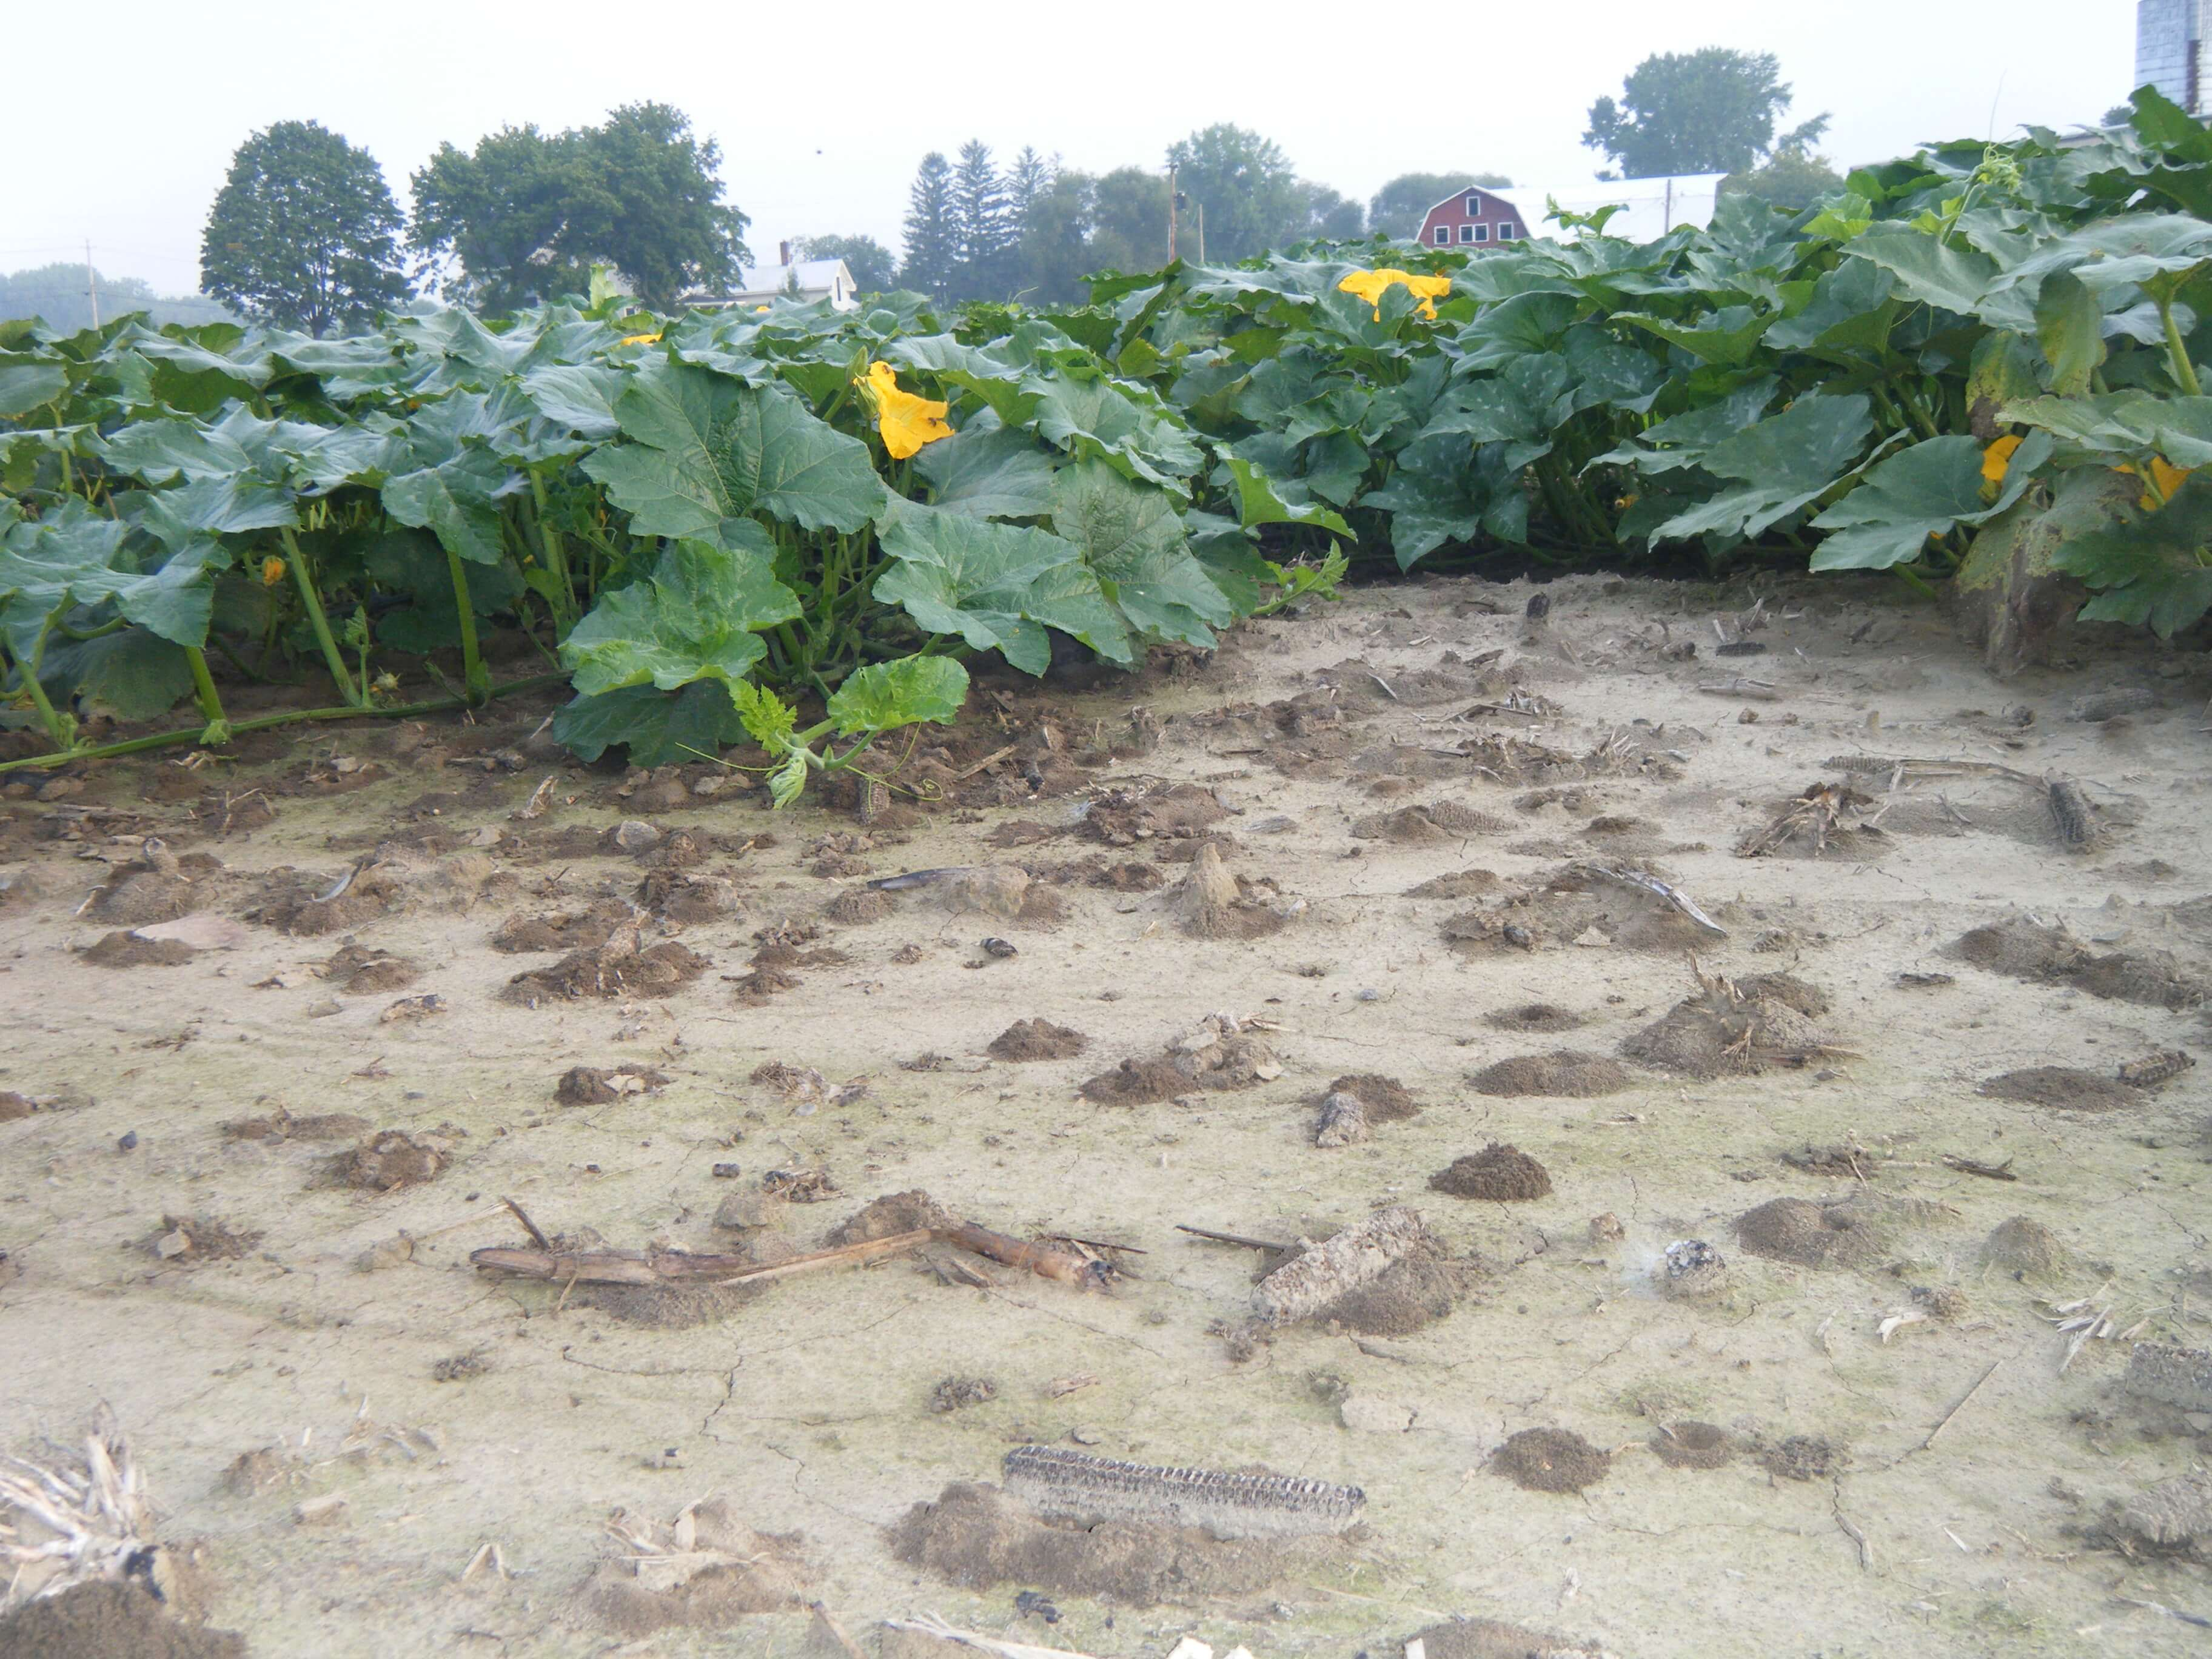
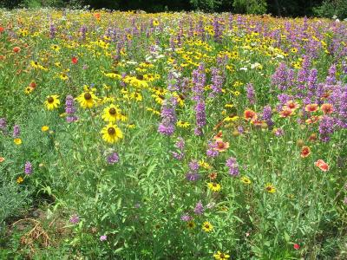
Habitat requirements for wild bees
M. López-Uribe
Food
Shelter
A short commute!
Notes:
Colletes inequalis

Slide 8
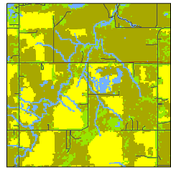

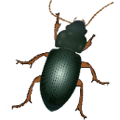

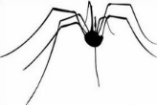
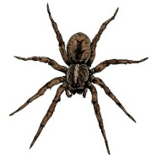
Biodiversity and ecosystem services
LANDSCAPE
OFF-FIELD
HABITAT
W
YIELD
BENEFICIAL
INSECTS

Slide 9
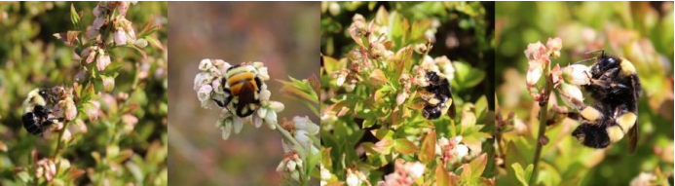
The value of wild bees in agriculture
  Bees nesting at the periphery pollinate crops
  Many species more efficient pollinators than honeybees
  Wild bee pollination is free

Slide 10
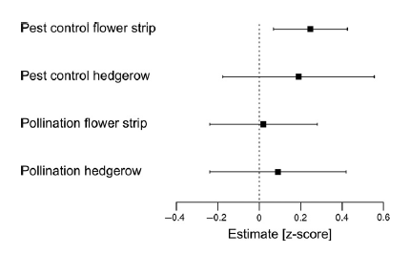
Habitat that is good for pollinators is good for lots of other things too
Home for other beneficial insects
  Carabid beetles and spiders
Wild bees are a food source for other animals as well
Decrease soil erosion
Improve water quality
Albrecht et al 2021

Slide 11
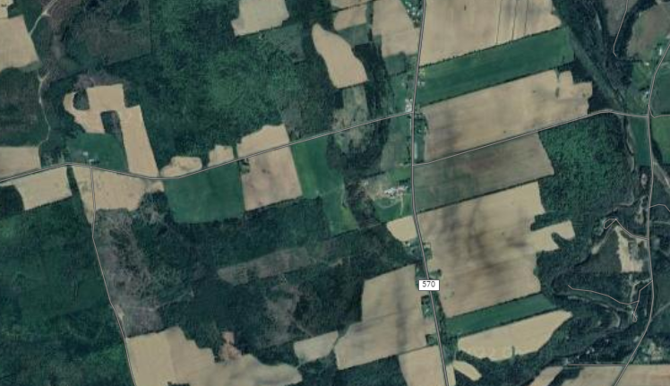
Challenges for wild bees in agriculture
Landscape simplification
  Loss of food and nesting sites
Constant soil disturbance
  Destroys nests of many species
Pesticide exposure
Disease transmission from managed bees

Slide 12

Wild bee abundance and diversity decreases further away from where their nest is located

Slide 13
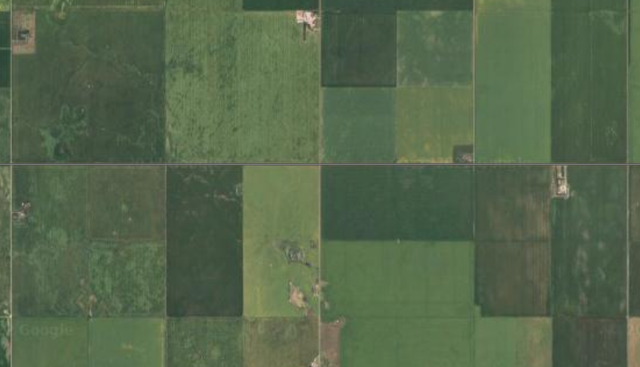
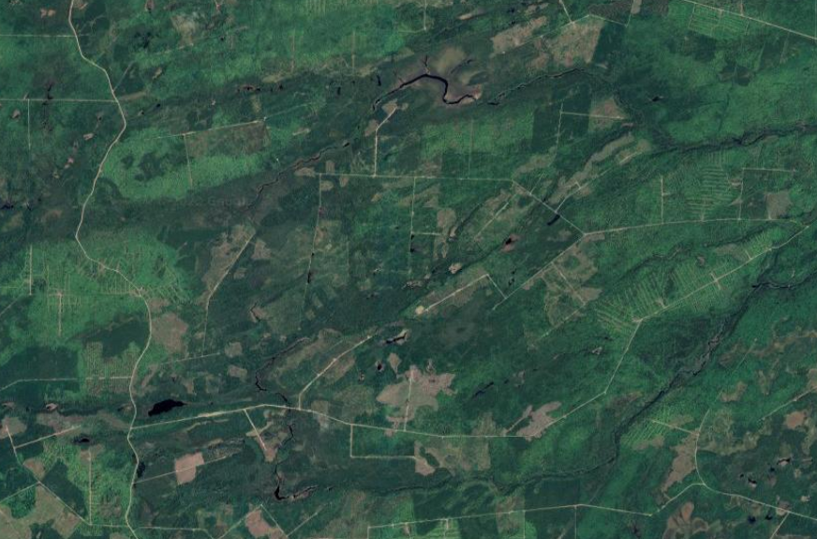
At the community level, a lot of what we know comes from Prairie systems
Central Alberta
New Brunswick

Slide 14
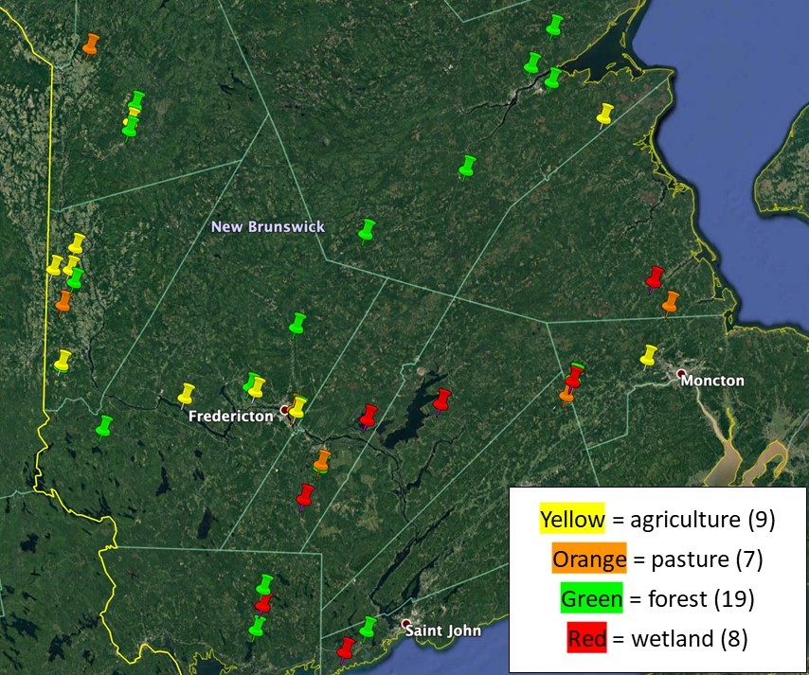

How does landscape type influence the wild bee community in NB?
43 sites across 4 habitat types
Pamela MacKinley

Slide 15

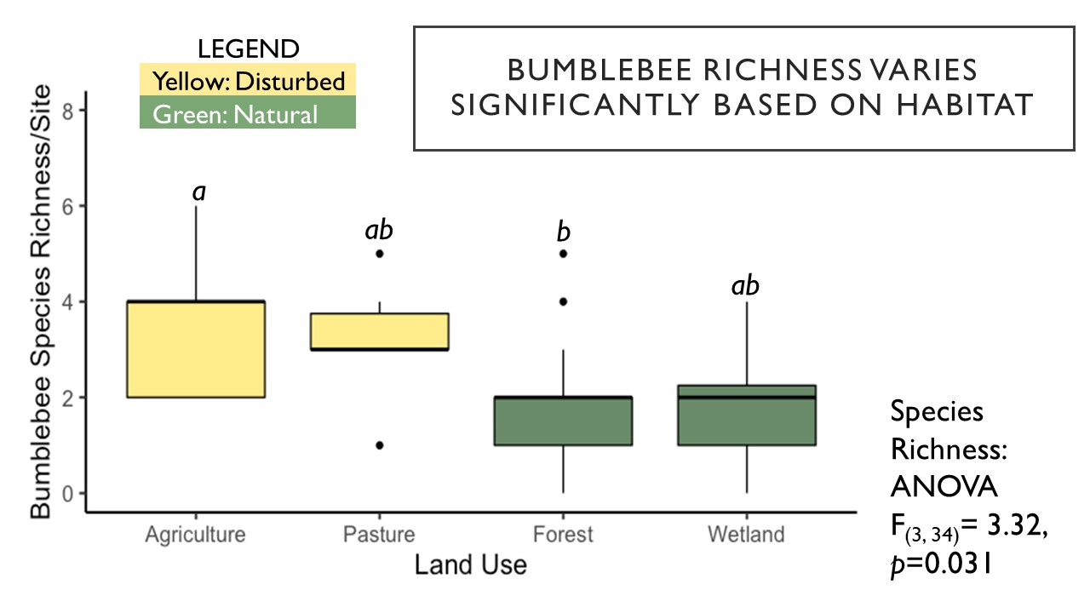

Disturbed sites had higher species richness than forest or wetland
Naomi Meed
Almeera Ahmed
Notes:
Parasitic species insularis, fernaldae, don’t think we ever caught fervidus in a disturbed site

Slide 16
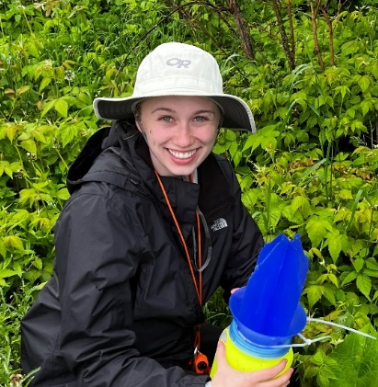
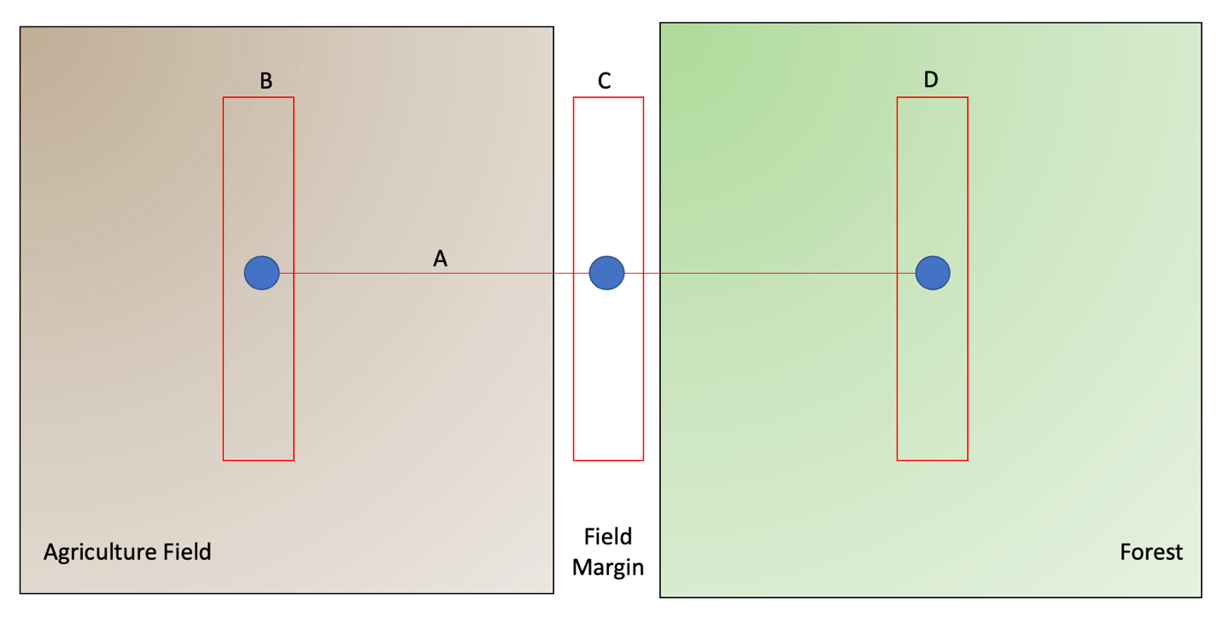
Bees often use floral resources we don’t think about, like potato flowers!
Abby Malayny
Blue vanes set up (blue circles) once a month from Jun-Aug
Bees netted along floral survey transects when potato in bloom

Slide 17
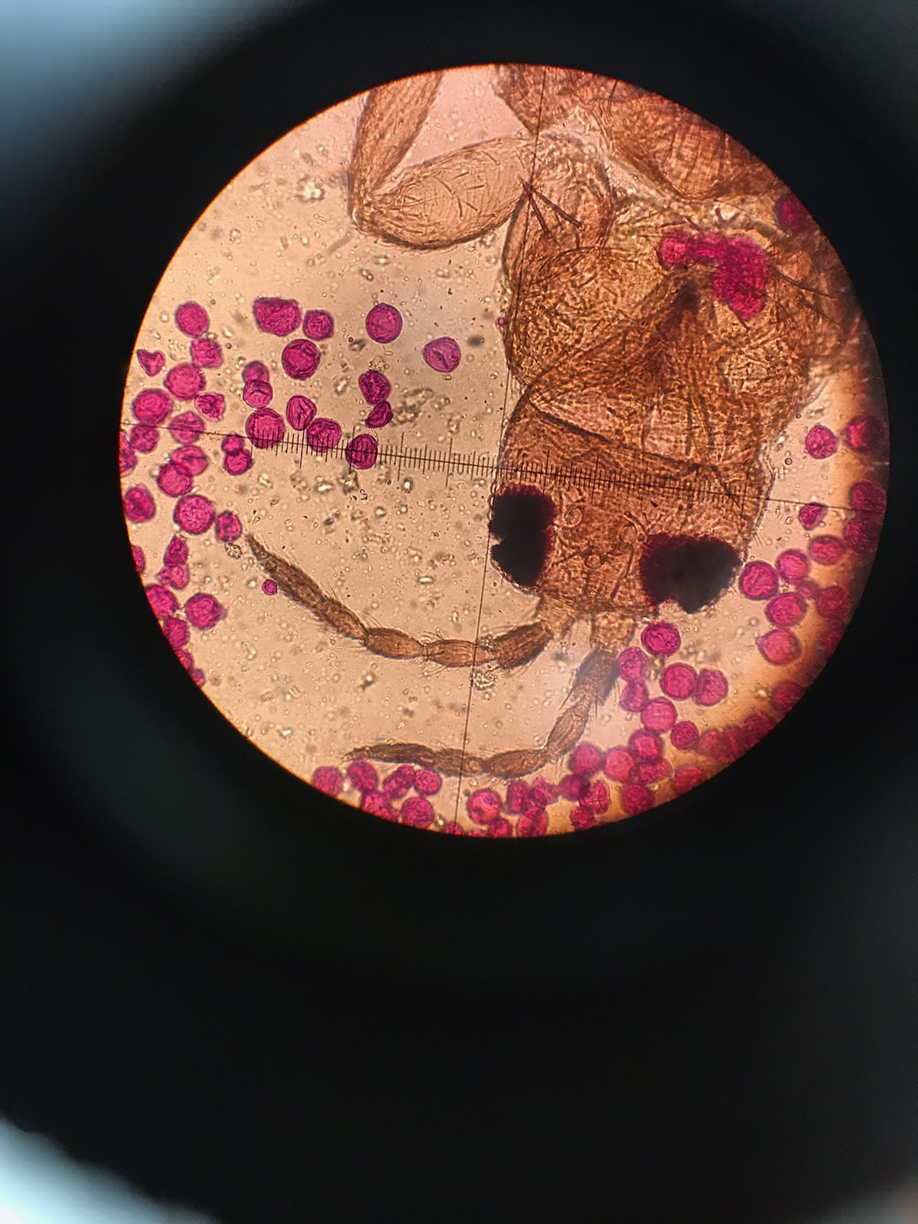
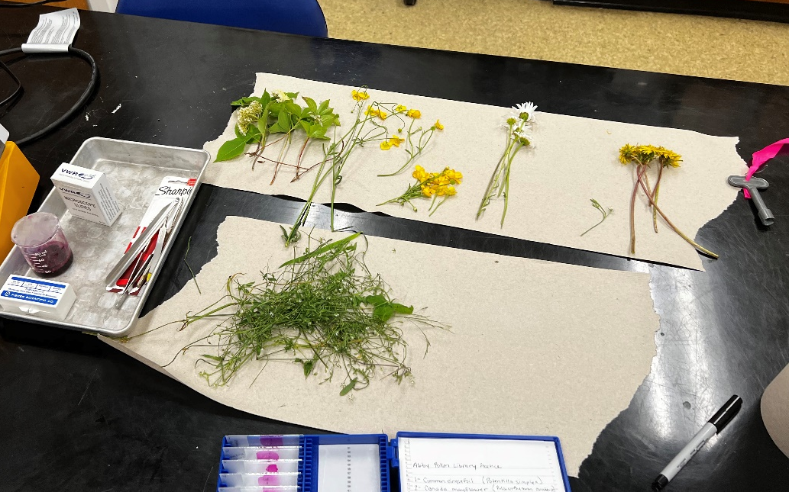
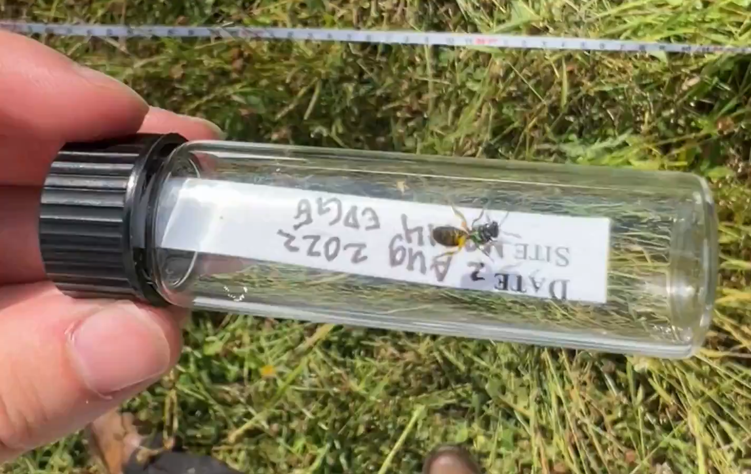
Wild bees collect potato pollen, and fly it back to other places
23/62 (37%) of bees collected potato pollen
Of bees with potato pollen 11 were collected in potato fields, 11 from field margins and 1 from the forest
Bumble bees most commonly collected with potato pollen
Photos: Abby Malayny

Slide 18
What do we think it means? (so far at least)
Field edges may be extra important for wild pollinators in New Brunswick!

Slide 19
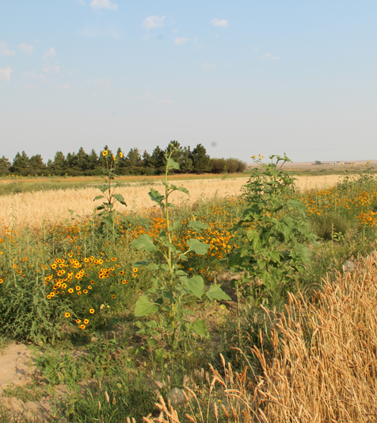
Ways to promote wild bee diversity – pollinator strips
Can also be called a pollinator meadow
An area on farm typically planted with pollinator friendly plants
Provides supplemental food, nesting resources, and shelter
Notes:
Xerces.org

Slide 20
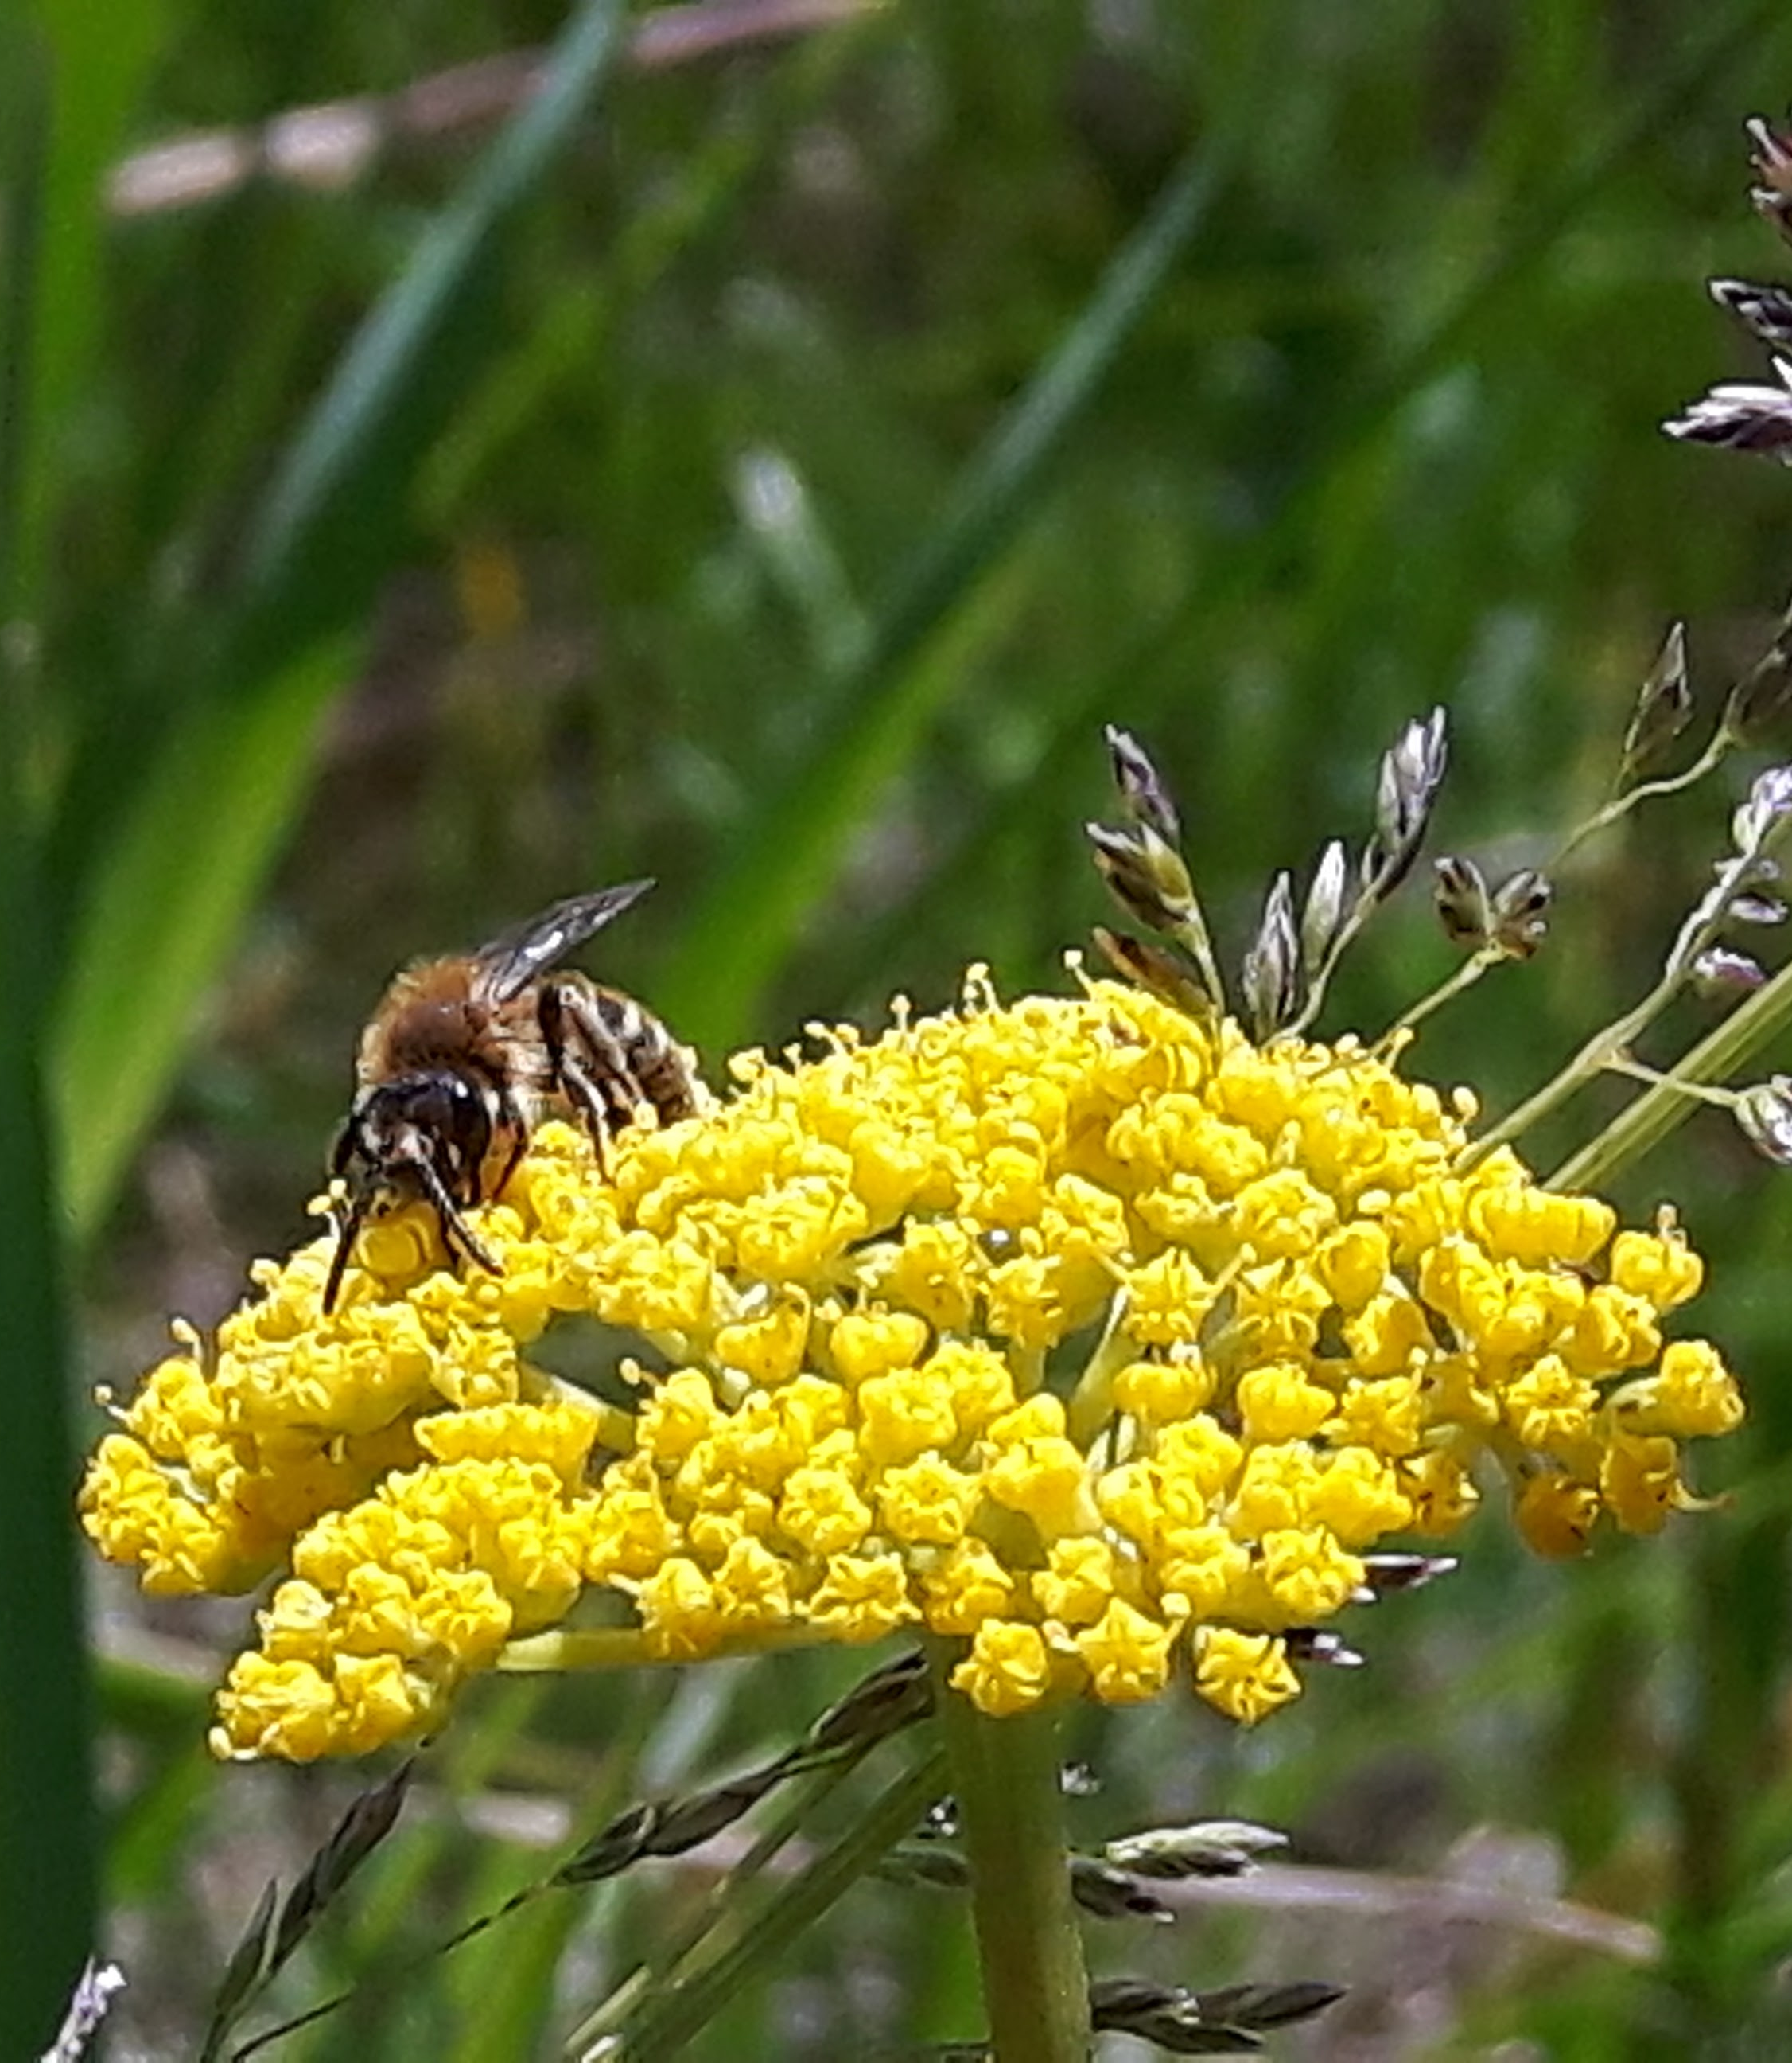
Selecting a site
Good option for marginal land
Areas next to hedgerows, windbreaks or riparian areas
Ideally someplace protected from spray
Adequate soil fertility and drainage
Somewhere that you will get to enjoy!

Slide 21
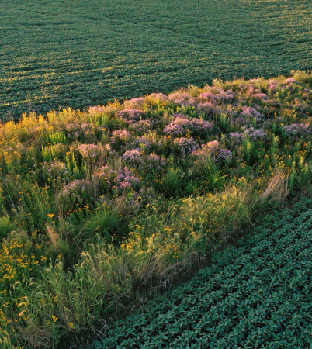
Selecting a seed mix
Easy to establish
Low maintenance
Flowers that will bloom across the season
  Late blooming flowers especially important
Photo: Sam Knowleton

Slide 22
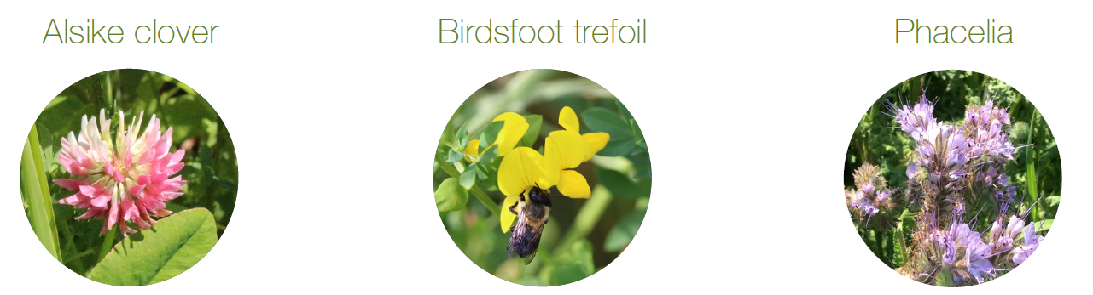
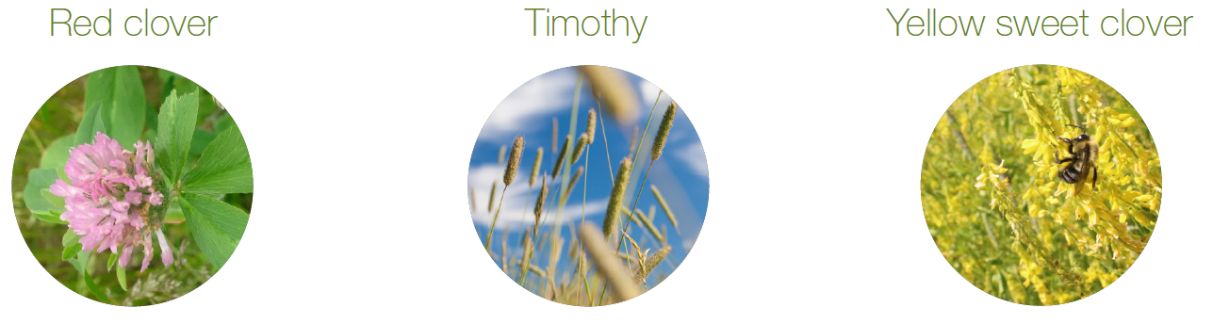
One option - Developed for the Maritimes
Developed by Dr. Nancy McLean & Dr. Robyn McCallum @ Dalhousie University
Images modified from Operation Pollinator pamphlet

Slide 23
Agricultural Climate Solutions New Brunswick
1
2
3
4
5
Advanced cropping systems
Enhanced forage management
Enhanced pasture management
Advanced nitrogen management
Landscape functionality
BMPS:
- Cover cropping
- Reduced tillage
BMPS:
Reduced tillage
Legume addition (40%) in forage- grass-legume mixtures
BMPS:
pH correction
Legume addition (40%) in forage- grass-legume mixtures
BMPS:
4 R nutrient management
Use of urease and nitrification inhibitors (e.g. SuperU)
BMPS:
- Pollinator strips and/or riparian zone enhancements
Kernza Project
Sequester carbon
Mitigate GHG emissions
Provide environmental co-benefits (air, water, soil and biodiversity)

Slide 24
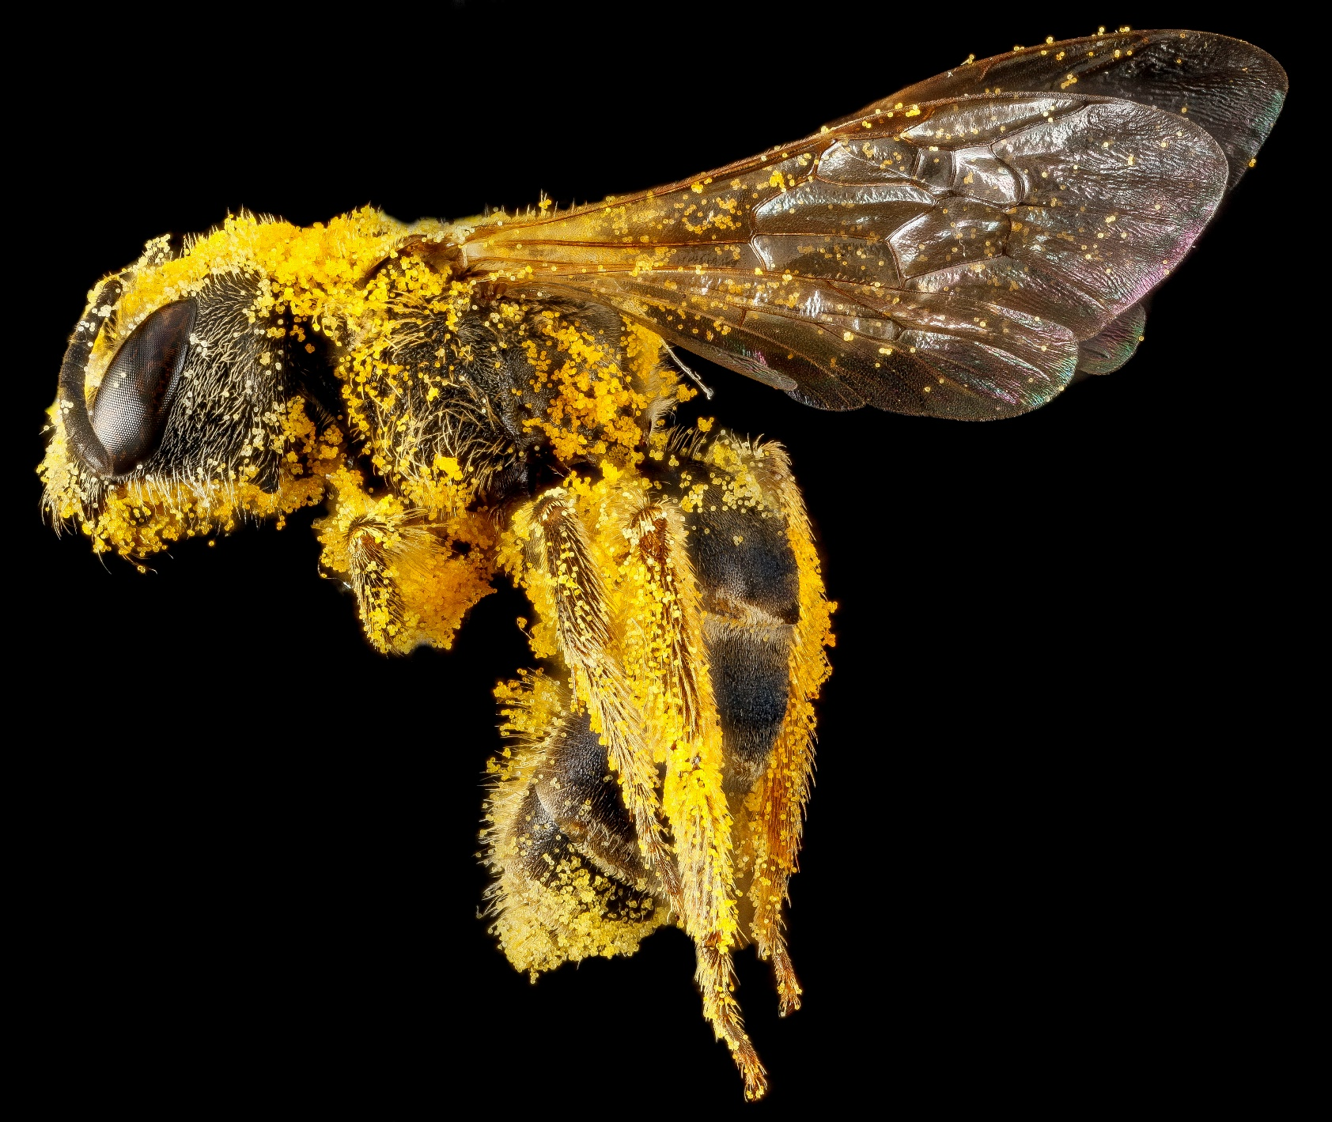
Thank you!
Jess Vickruck
jess.vickruck@agr.gc.ca
506 460 4475
@jessvickruck
Halictus ligatus

Slide 25
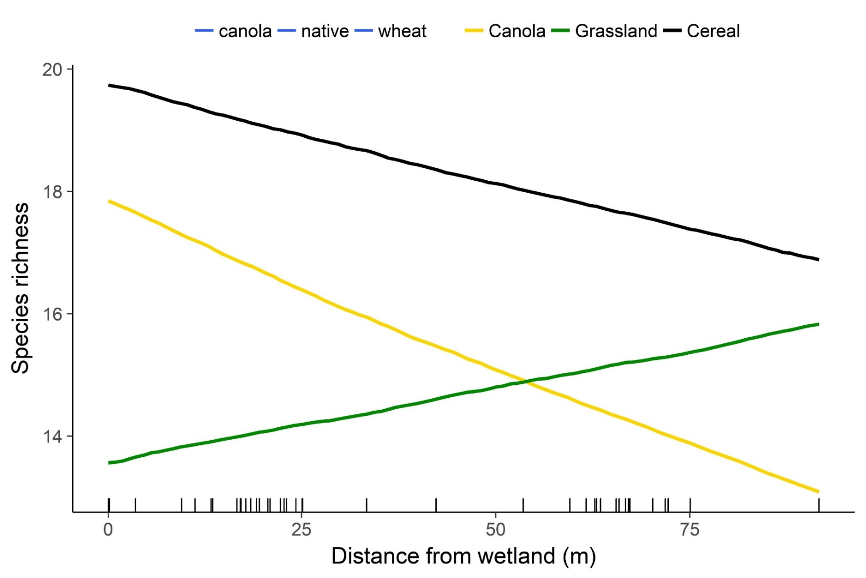
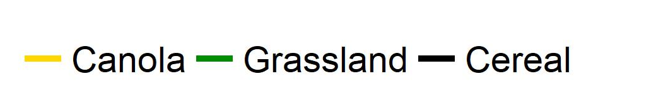
Evidence from the Canadian prairies
The number of species increases in grasslands further away from the wetland
Increase in nest site diversity?
Vickruck et al 2019

Slide 26
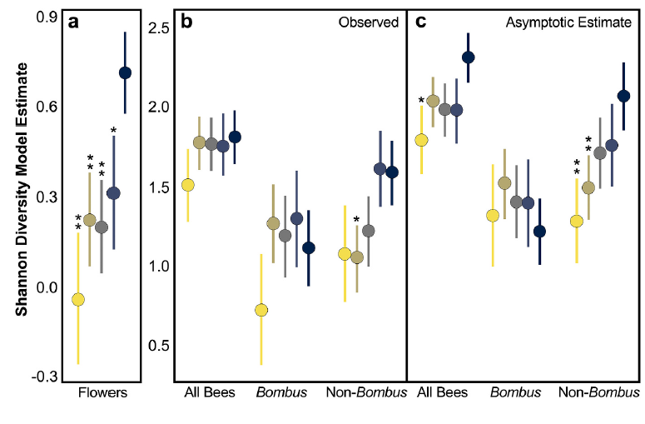
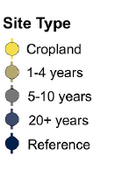
Bees return to restored pothole wetlands quite quickly
Overall bees diversity returns to pre-disturbance levels within 1-4 years
Purvis, Vickruck et al 2020

Slide 27
Bumblebees can fly further, so they come in first
But bumblebee diversity returns even more quickly
Large body size likely allows them to fly in sooner
Purvis, Vickruck et al 2020

Slide 28
Smaller-bodied bees return more slowly, but do come back
It takes the other species longer to recolonize restored grassland spaces
Time for cavity and twig nesting nest sites to develop
Purvis, Vickruck et al 2020

Slide 29
Meta-analysis of studies from across NA, Europe and New Zealand
The more different kinds of flowers you have, the higher the pollination services there are to the crop
Pollination services increase rapidly with flower strip establishment
Albrecht et al 2021

Slide 30
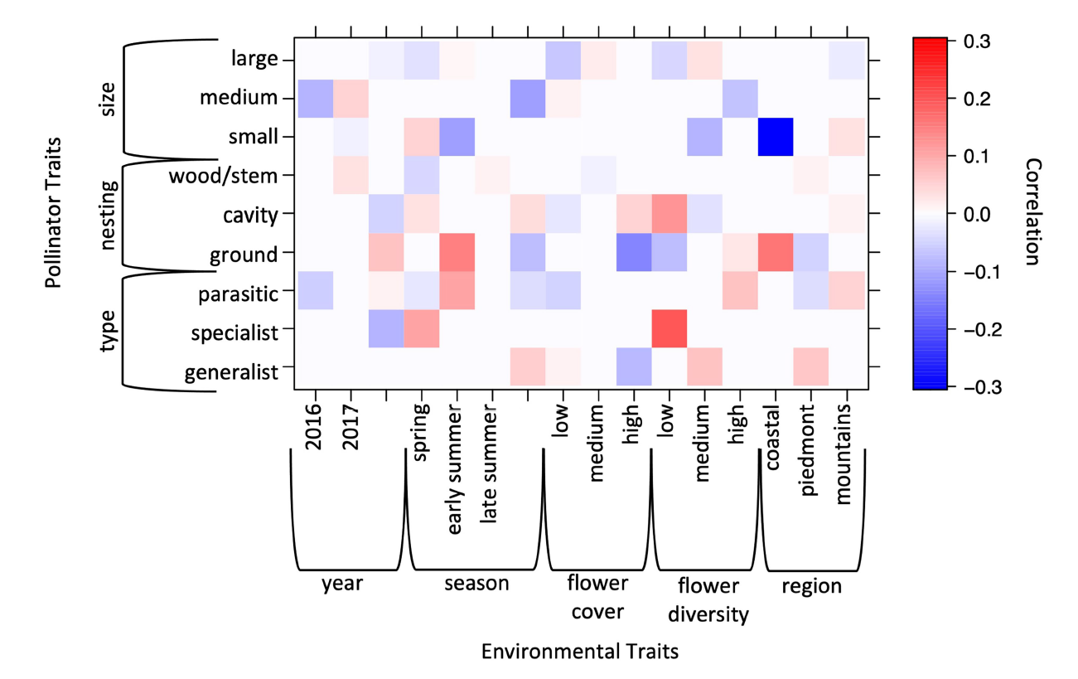
Pollinator plantings in North Carolina
All different types of seed mixes and locations across multiple habitat types
Three years of sampling
Flower diversity and cover important factors
Modified from Levenson and Tarpy 2023

Slide 31
Site establishment
Best established in May but can be a bit later
Mow area (depending on site)
Herbicide treatment
Light tillage (recommended by Dr. McCallum)
Broadcast spreader of drill (1/2 inch deep or less)
Seeding rate 22 lbs/acre (25 kg/ha)
*if broadcasting half seeding rate (11 lbs/acre) and decrease spreading width to half

Slide 32
Site maintenance
Fertilization not required
Can mow after alsike clover finishes blooming to encourage regrowth
To reduce weed competition, mow 1-2 months after planting

