Slide 1


Managing Cucurbit Diseases
Meg McGrath
Cornell University, School of Integrative Plant Sciences
Plant Pathology and Plant-Microbe Biology Section
Long Island Horticultural Research and Extension Center
Riverhead, New York. mtm3@cornell.edu
Cornell University is an equal opportunity, affirmative action educator and employer.
Notes:
30 min time slot. 16 March 2023. New Brunswick Hort Congress.

Slide 2
Keys to Success in Disease Management
Be Proactive!
Know what diseases have + could occur.
Become familiar with symptoms.
Understand biology of pathogen; survival and dispersal.
Learn practices for managing main diseases.
Implement Basic Cultural Management Practices.
Rotation, separation. Minimize leaf wetness.
Manage weeds. Sanitation: before + after crop.
Be Observant!
Look for disease symptoms. Record with camera.
Ensure Diseases are Accurately Identified.
Be Prepared to Act!
Rogue diseased plants when appropriate (early; ex. virus).
Have sprayer ready to apply fungicides.
Notes:
Focus on prevention. Don’t wait until you have a disease problem before you start thinking about managing. Recognize plant diseases are challenging to manage.

Slide 3
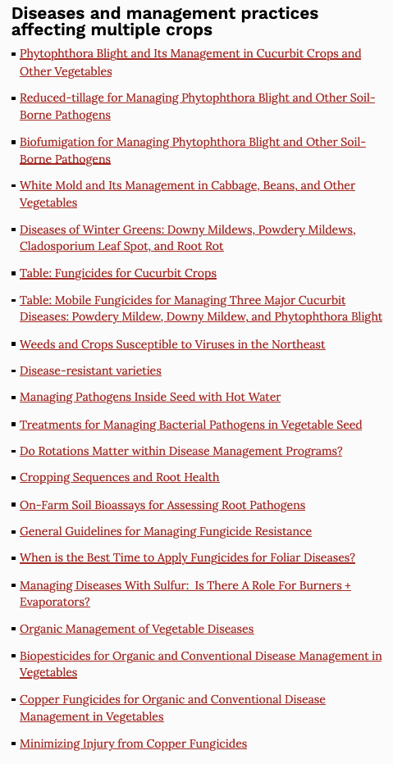
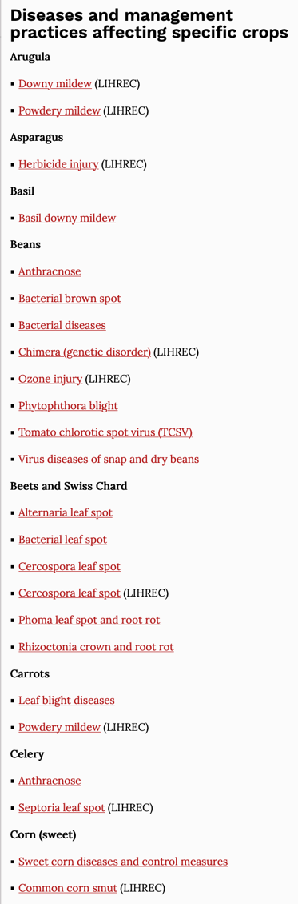
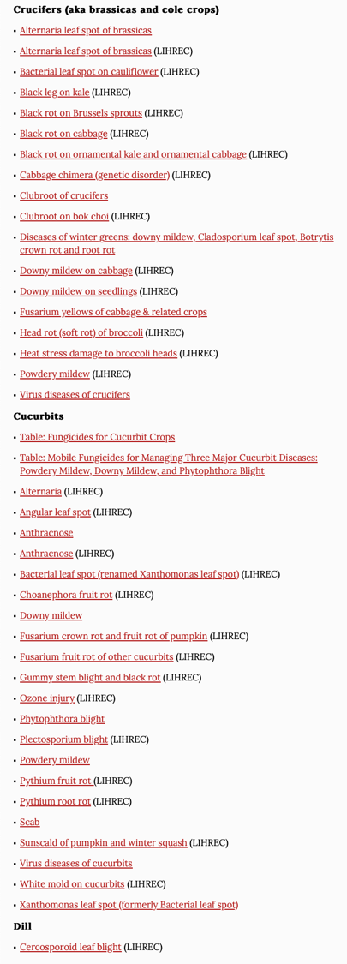
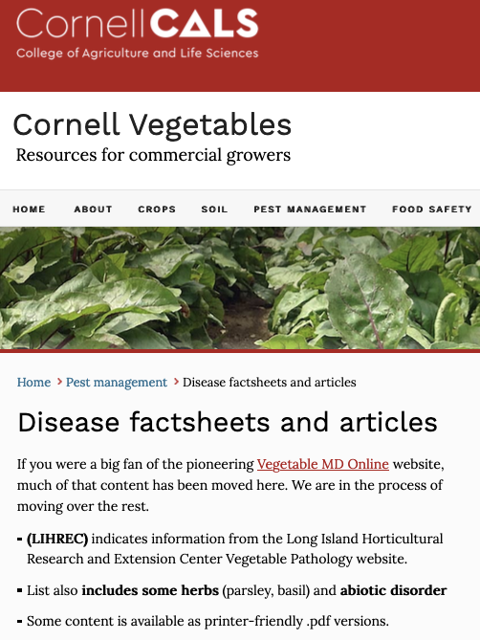
https://www.vegetables.cornell.edu/
pest-management/disease-factsheets/

Slide 4
Canada – United States: Important Differences
Cucurbit disease occurrence:
downy mildew and Phytophthora blight important in U.S.
Fungicides registered:
More in U.S, especially biopesticides, mostly because efficacy data not required. Also more labeled uses.
Few have different names. Cantus = Endura.

Slide 5
Top Facts – Managing Vegetable Diseases
Accurate diagnosis:
- essential for selecting appropriate management practices.
Pathogens vary in how they survive and spread plus favorable conditions.

Slide 6
Top Facts – Managing Vegetable Diseases
Cultural management practices:
- vary among diseases.
- based on knowledge about pathogen’s biology.
Foundation of a good plant disease management program.
Good plant disease management program =
Cultural practices
Fungicides

Slide 7
Cultural Disease Management Practices
Resistant varieties.
Pathogen-free seed.
Rotate crop plantings. Target = pathogens that survive in soil. Best implemented before pathogen has built up.
Mulch: plastic and organic.
Separate crops susceptible to same water- or wind-dispersed pathogens.
Sanitation in greenhouse (target pathogens surviving on surfaces):
- clean + disinfect benches + planting materials (trays). Manage weeds.
Sanitation in field (target pathogens surviving in soil and spread):
- clean + disinfect equipment between fields.
- don’t work in crops when leaves wet, esp with bacterial disease.
Drip irrigation. Overhead irrigation mid-day.
Promptly after harvest mow and incorporate crop debris.

Slide 8
Top Facts – Managing Vegetable Diseases
Resistant varieties vary substantially in:
- degree of suppression provided.
- durability of their resistance.

Slide 9
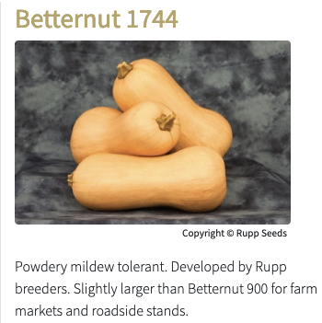
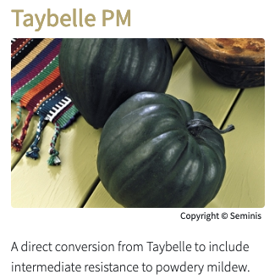
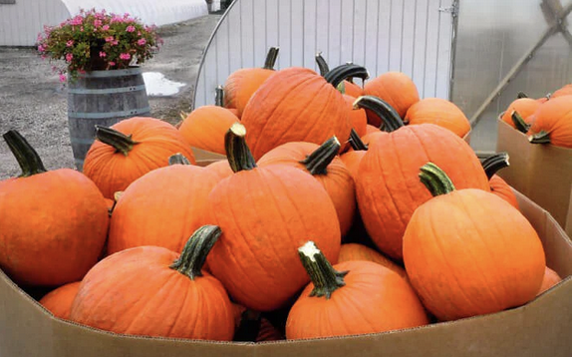


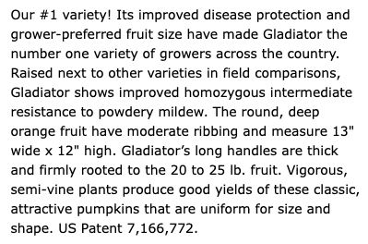
Squashes and Pumpkins
Intermediate resistance
Powdery mildew tolerant
Homozygous best
control improved with fungicides

Slide 10
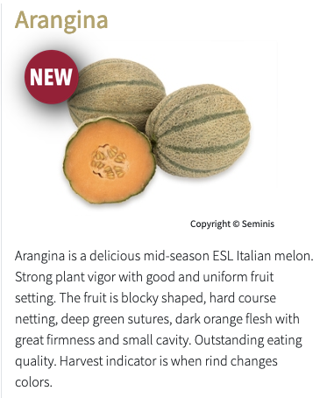
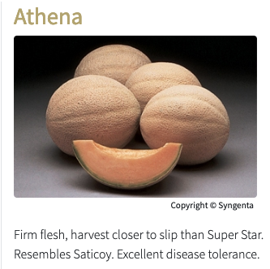


Cantaloupe: Race specific resistance. Excellent but specific

Slide 11

https://www.vegetables.cornell.edu/
pest-management/disease-factsheets/

Slide 12
Fungicides - Tips to Maximizing Control
Accurate diagnosis is critical especially with targeted fungicides that have narrow spectrum of activity.
Knowledge about resistance in pathogen to targeted fungicides.
Some diseases cannot be controlled with fungicides: bacterial wilt, cucurbit yellow vine disease.
Start applying preventively or at first symptom. No fungicide can cure an established infection. Few have any curative activity.
Best to apply before rain because leaf wetness provides favorable conditions for infection by many bacterial and fungal pathogens; powdery mildew fungus is an exception.
Good coverage important, especially with contact fungicides.
Use in combination with cultural management practices.

Slide 13
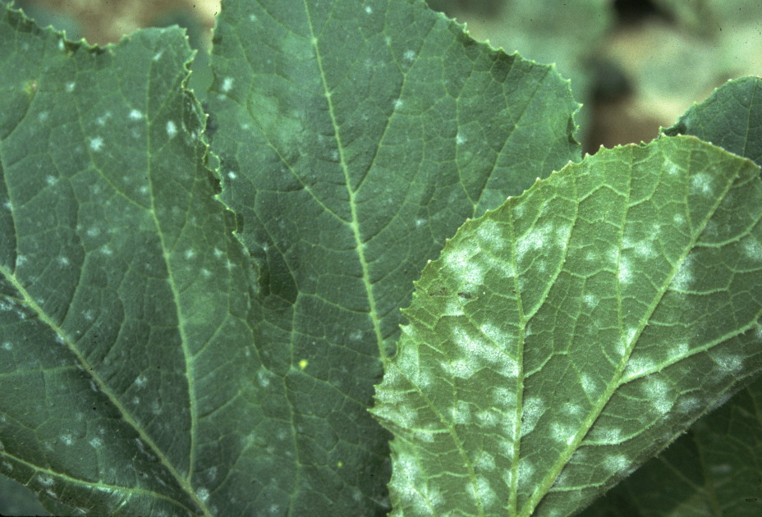
Cucurbit Powdery Mildew
Resistant varieties
Fungicides

Slide 14
Cucurbit Powdery Mildew
Control on upper leaf surface
Contact Fungicides:
chlorothalonil copper (Cueva)
mineral oil (SuffOil-X, etc.)
Biopesticides (suppression):
Double Nickel Serenade Opti
Cyclone Tivano
Vegol Regalia Maxx
MilStop OxiDate

Slide 15
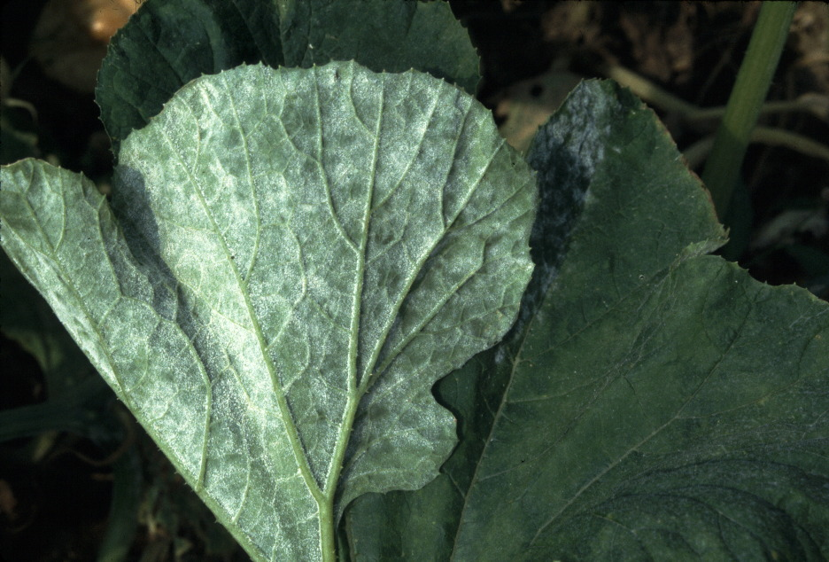
Notes:
Leaf on a plant treated with just the protectant fungicide chlorothalonil. Limited to no fungicide spray is deposited on the lower surface of leaves. Consequently very poor control of powdery mildew on the lower surface of leaves when just a protectant used.

Slide 16
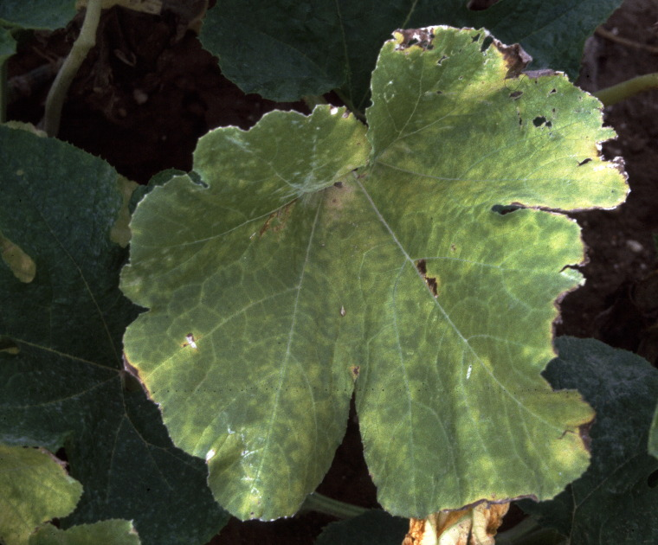
Notes:
When PM is not controlled well on the lower surface of leaves they turn yellow and then die prematurely.

Slide 17
Cucurbit Powdery Mildew
Managing Effectively with Targeted, Mobile Fungicides:
- Need information about resistance in pathogen.
Requires research: isolate testing or seedling bioassays.
Not on product labels.
- Must apply more than 1 due to label restrictions.
- Expect changes in recommendations!
NOTE: not unique to this disease

Slide 18
Cucurbit Powdery Mildew Targeted Fungicides
Recommended, listed by FRAC Group and by efficacy:
50: Vivando, Property (Prolivo in U.S.)
3: Proline, Miravis Duo, Mettle, Aprovia Top, Nova (Rally)
7: Aprovia, Aprovia Top, Miravis Duo, Luna Sensation
NOT Recommended because of resistance
7: Cantus (Endura), Pristine, Fontelis, Sercadis (Merivon)
11: Cabrio, Reason, Quadris Top
13: Quintec

Slide 19
Recommended Powdery Mildew Targeted Fungicides
Other Labeled Diseases of Cucurbits
Vivando, Property (50)
Proline (3) Gummy stem blight/black rot
Mettle (3) GSB/BR (suppression)
Luna Sensation (7 + 11)
Nova (3)
Aprovia (7) GSB/BR, Alternaria, Anthracnose
Aprovia Top (3 + 7) GSB/BR, Alternaria, Anthracnose
Miravis Duo (3 + 7) GSB/BR, Alternaria, Anthracnose

Slide 20
Cucurbit Diseases caused by Bacteria
Angular leaf spot and Xanthomonas (Bacterial) leaf spot
Resistant varieties. Angular leaf spot
Pathogen free seed. Esp. Angular leaf spot
Manage cucurbit volunteer plants.
Rotation. Esp. Xanthomonas leaf spot
Rogue affected plants early.
Drip irrigation. Overhead irrigation mid-day. These bacteria spread by splashing water.
Don’t work in crops when leaves wet.
Apply copper and biopesticides; preventively best.
Promptly after harvest mow and incorporate crop debris.

Slide 21
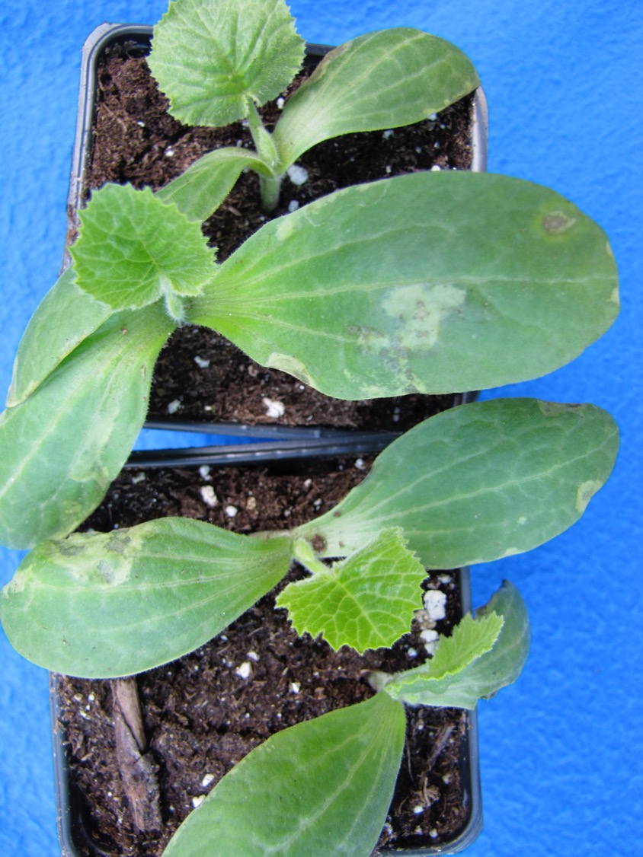
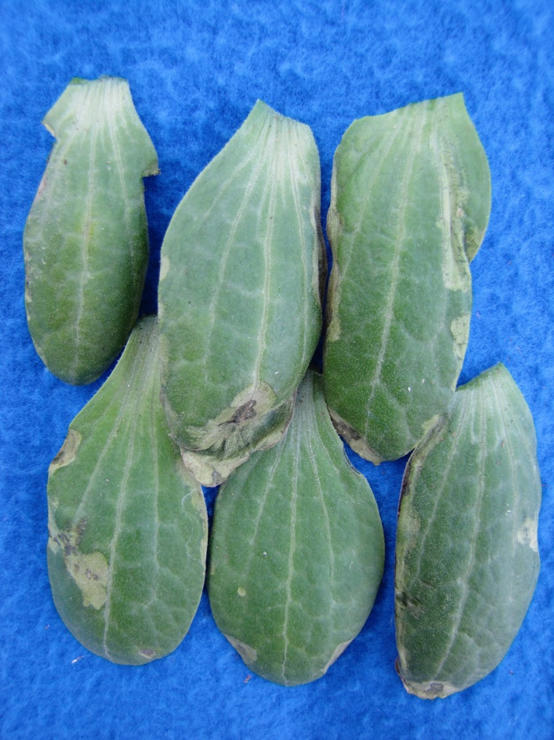
Angular Leaf Spot - Zucchini

Slide 22
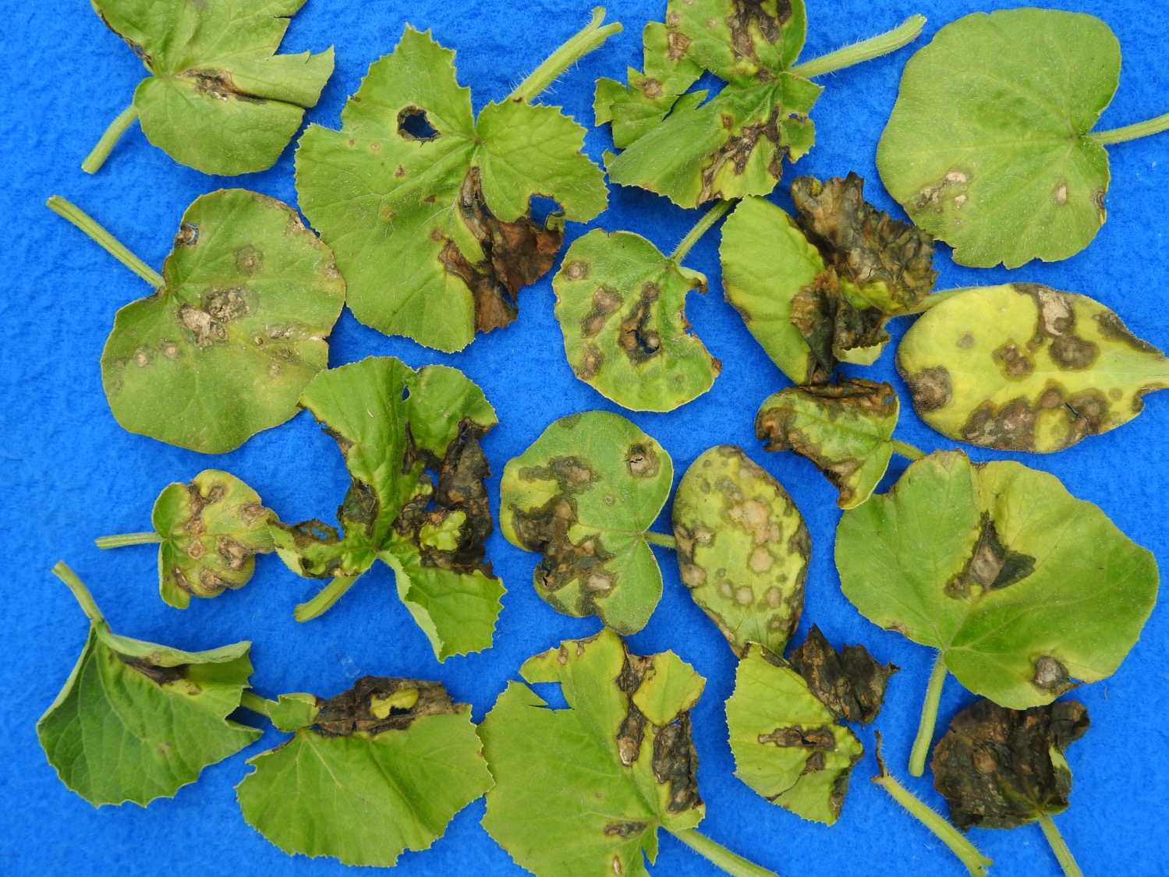
Angular Leaf Spot
Winter squash

Slide 23
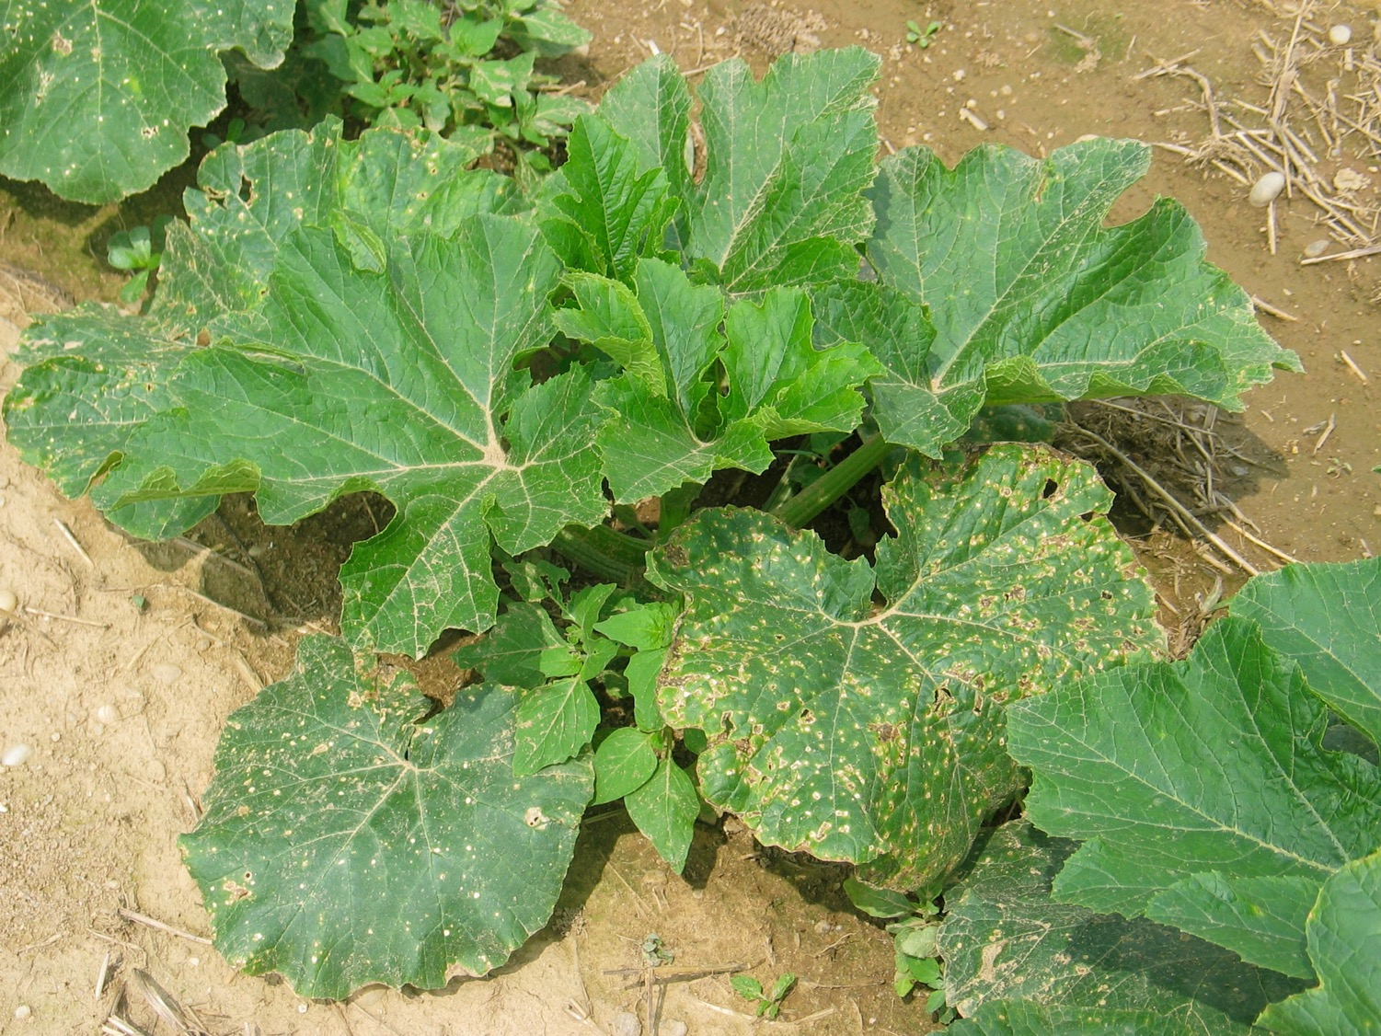
Bacterial Leaf Spot - Pumpkin

Slide 24
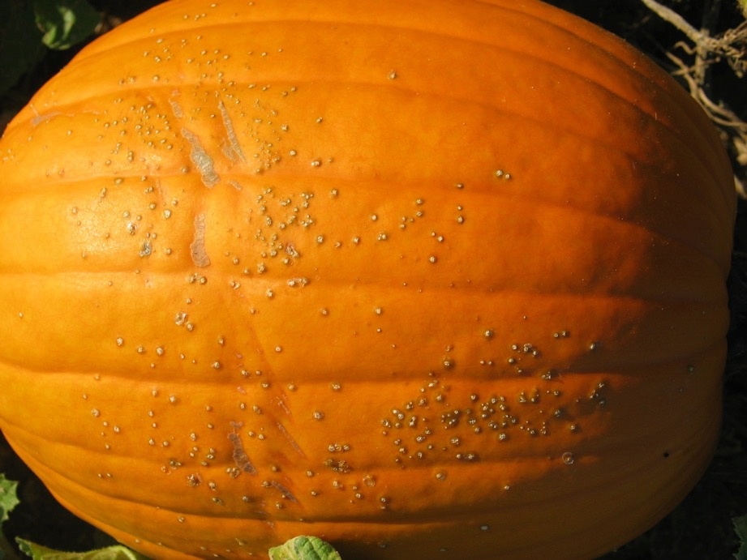
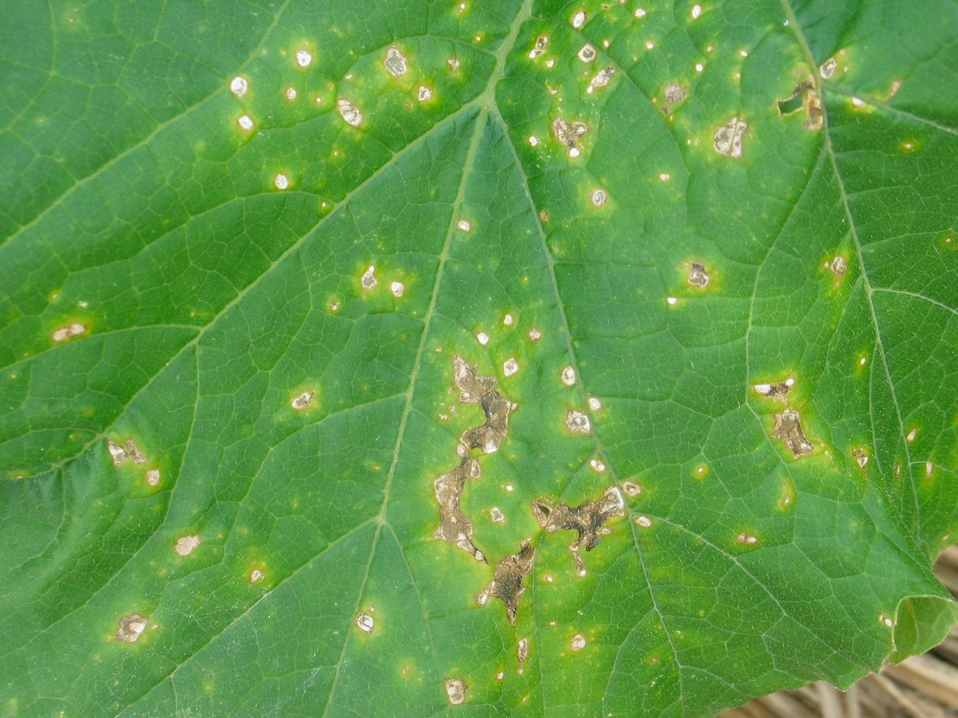
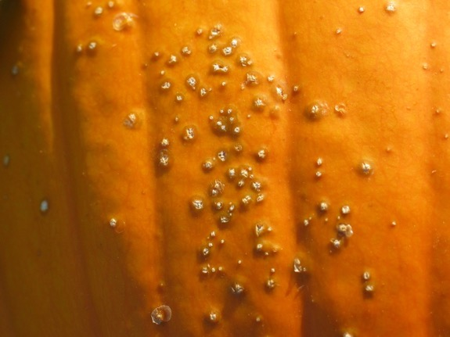
Bacterial Leaf Spot
Pumpkin

Slide 25
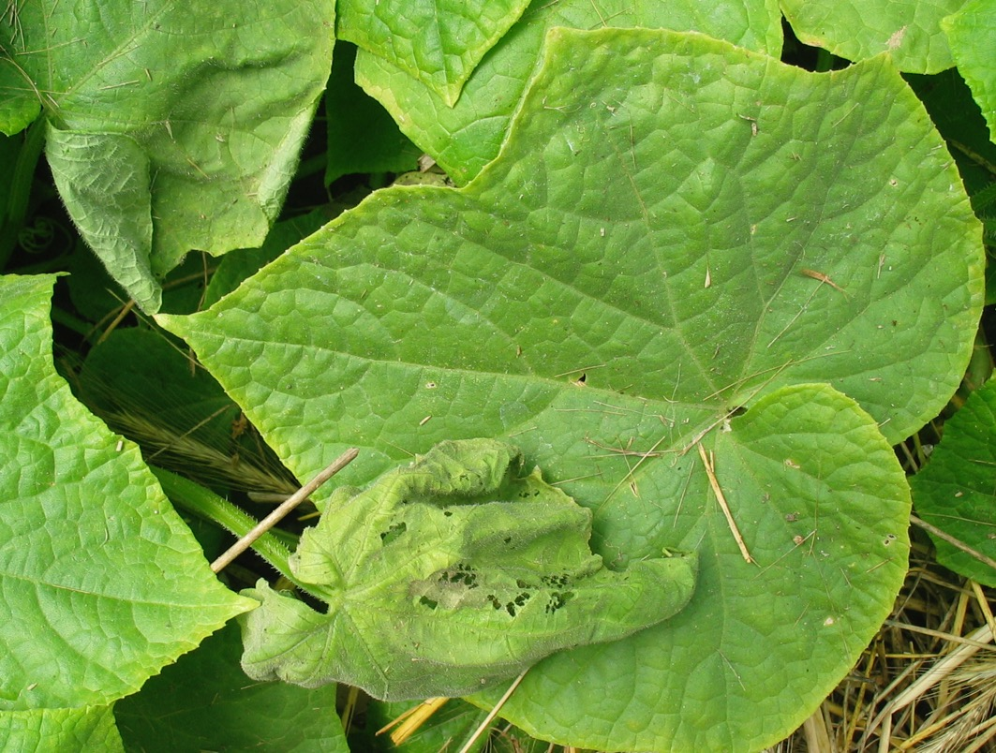
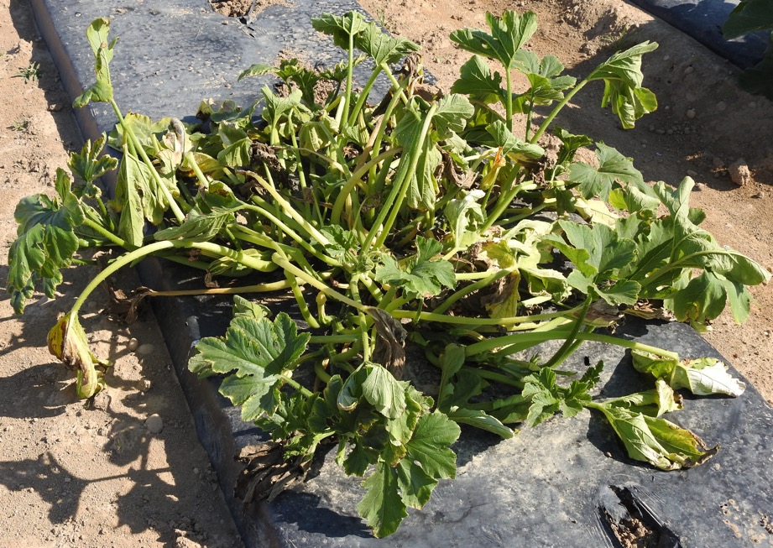
Cucurbit Diseases caused by Bacteria
Bacterial wilt
Resistant varieties (few).
Manage cucumber beetles.

Slide 26
Gummy Stem Blight / Black Rot
Pathogen-free seed. Treated seed.
Resistant varieties (few).
Rotate. 4 years recommended.
Drip irrigation.
Fungicides. Resistance has developed to targeted fungicides.
Manage powdery mildew.
Avoid wounding fruit during harvest.
Store winter squash properly: Cure 1 - 2 wks at 25 C. 13 C and 60% RH.
Promptly incorporate debris. Mow first. Remove when feasible.

Slide 27
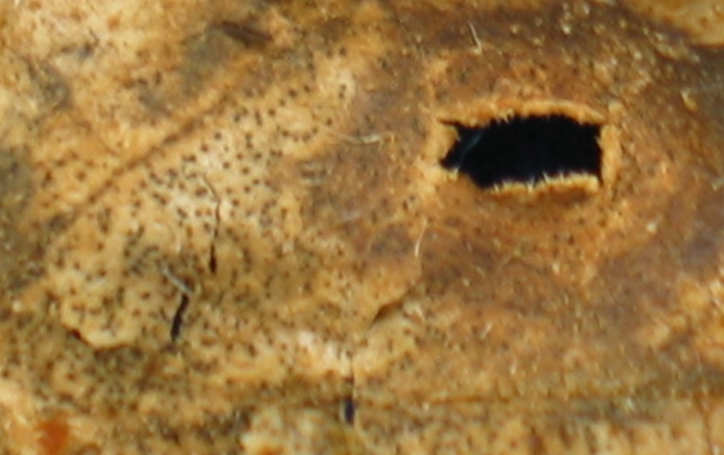
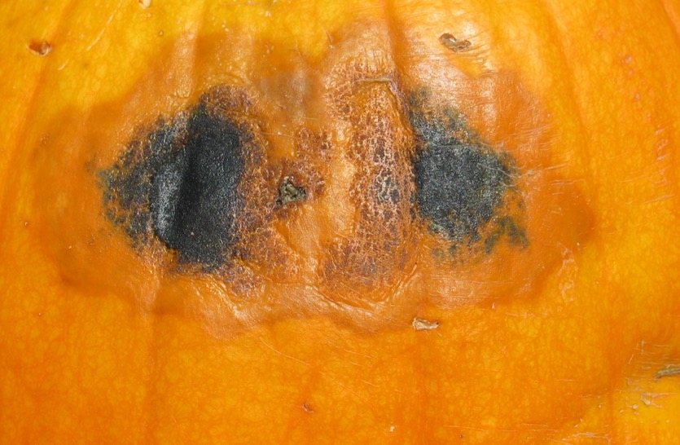
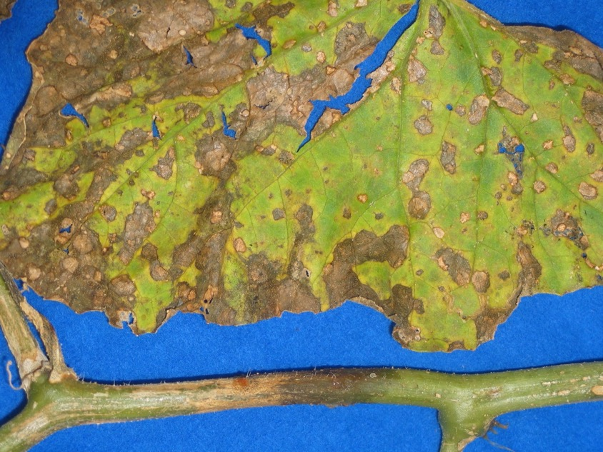
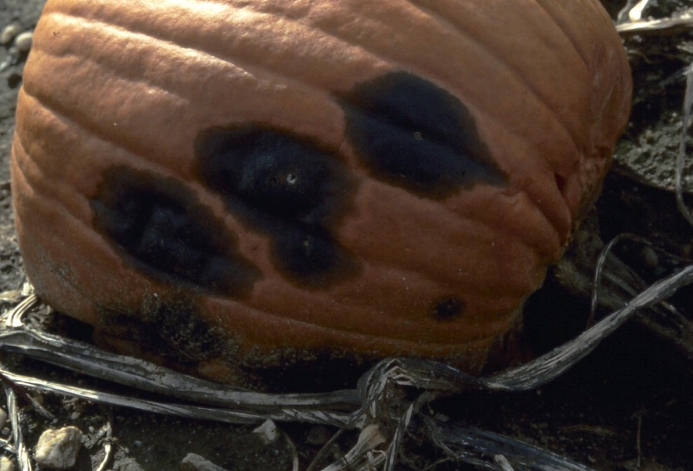
Melon – Gummy Stem Blight
Pumpkin – Black Rot

Slide 28
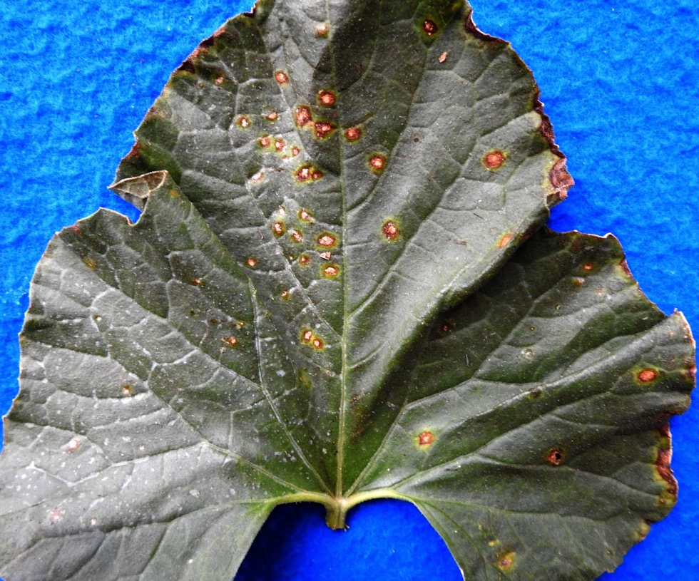
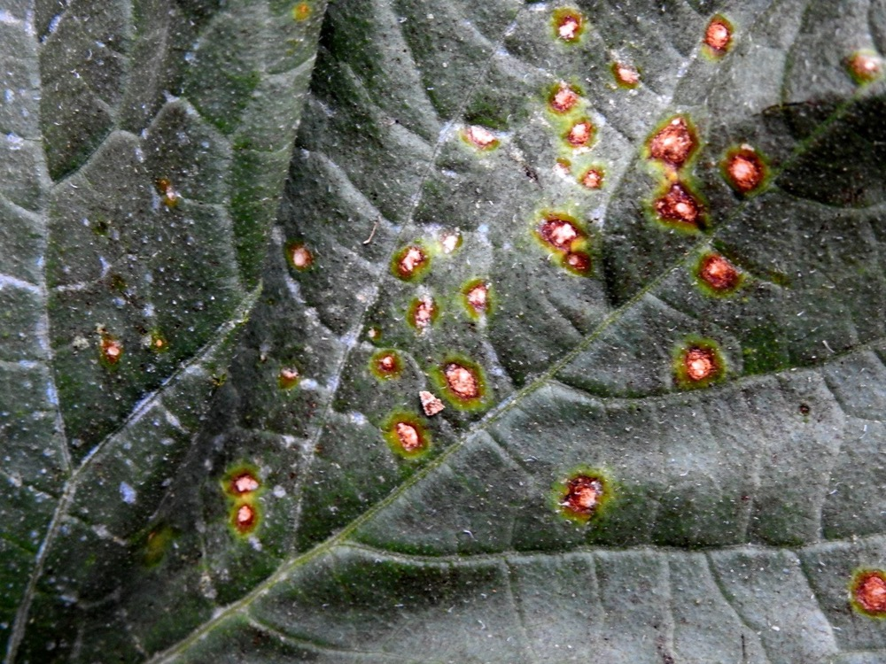
Alternaria Leaf Blight
Drip irrigation.
Fungicides. Resistance potential.
Promptly incorporate debris.
Pathogen-free seed.
Resistant varieties (few).
Rotate.

Slide 29
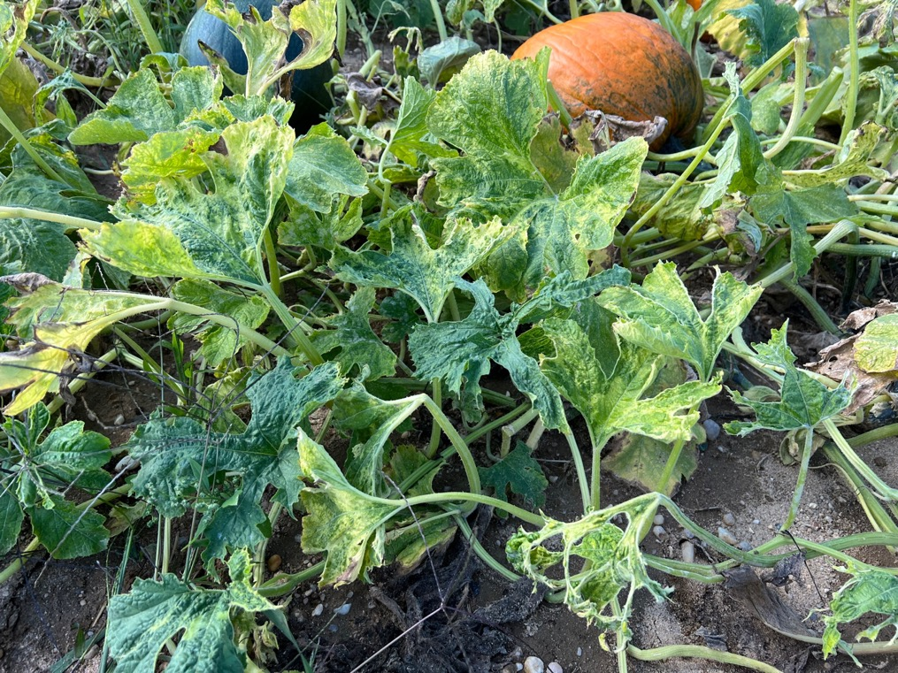
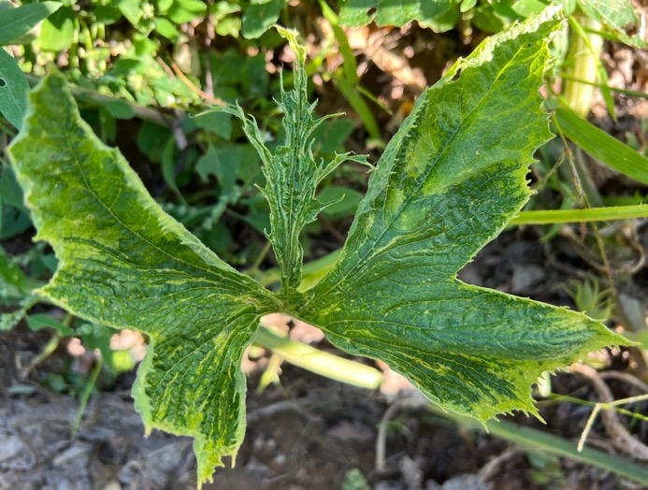
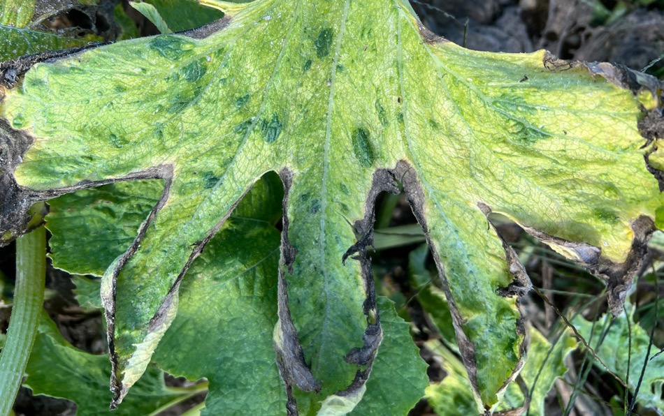
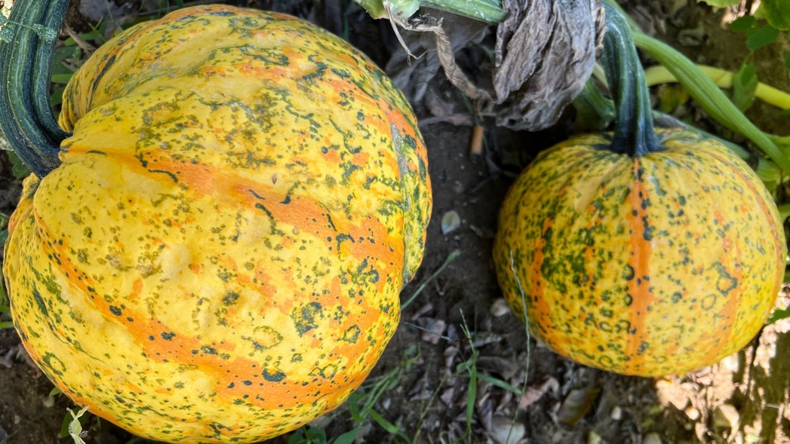
Virus
Symptoms
Leaves
Fruit

Slide 30
Viruses Affecting Cucurbit Crops
Zucchini Yellow Mosaic Virus (ZYMV)
Seed-borne. Volunteer plants potential source.
Aphid-vectored, mechanical transmission.
2022 NY: most common, often NOT associated with aphids.
Cucumber Mosaic Virus (CMV)
Aphid-vectored. Many weed hosts.
2022 NY: found associated with many aphids; orchards.
Squash Mosaic Virus (SqMV)
Seed-borne. Cucumber beetle-vectored. 1 detect in NY in 2022.
Watermelon Mosaic Virus (WMV)
Aphid-vectored.
Papaya Ringspot Virus (PRV)
Aphid-vectored.
2022 high incidence viruses and aphids in Quebec.

Slide 31
Managing Cucurbit Viruses
Dry year = favorable. Aphids attracted to irrigated crops.
Resistant varieties. Few, most genetically modified.
Virus-free seed (ZYMV). Do not save seed.
Control volunteer cucurbit plants (ZYMV).
Remove affected plants found early.
Manage weeds around production fields.
Control aphids with insecticides on other crops.

Slide 32
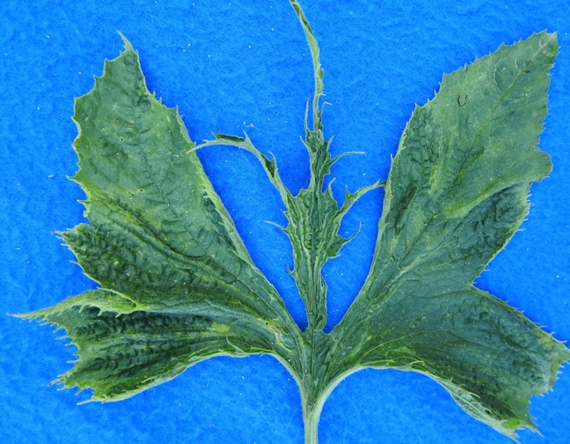
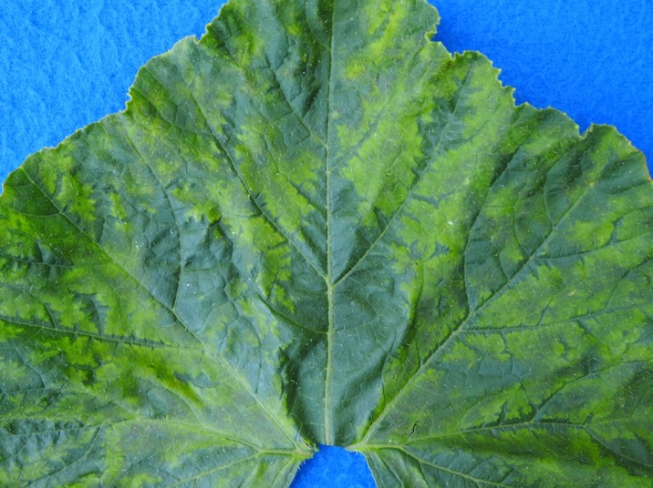
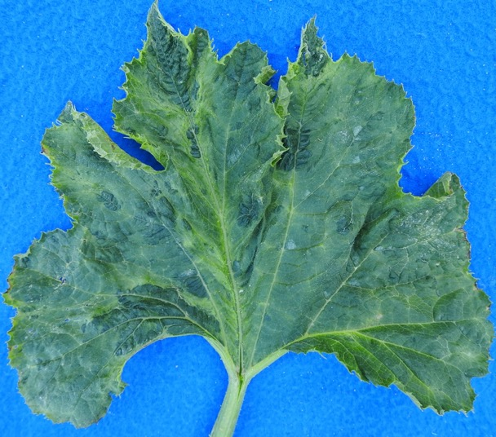
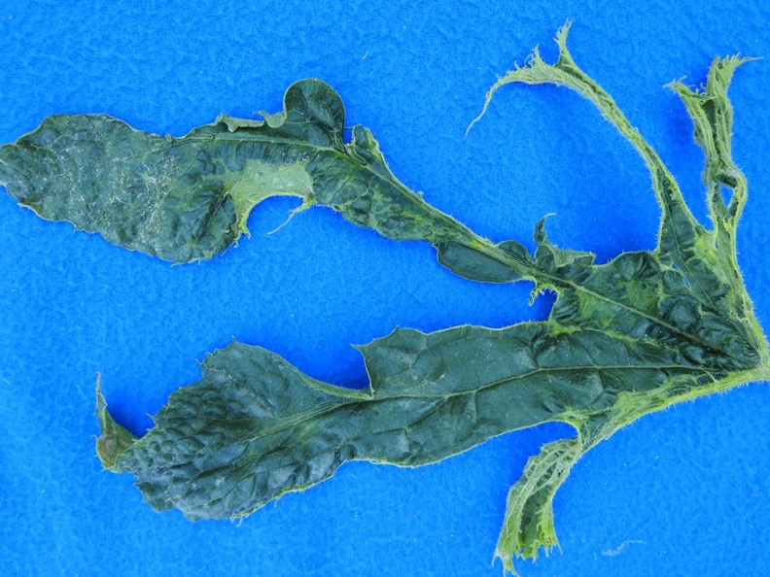
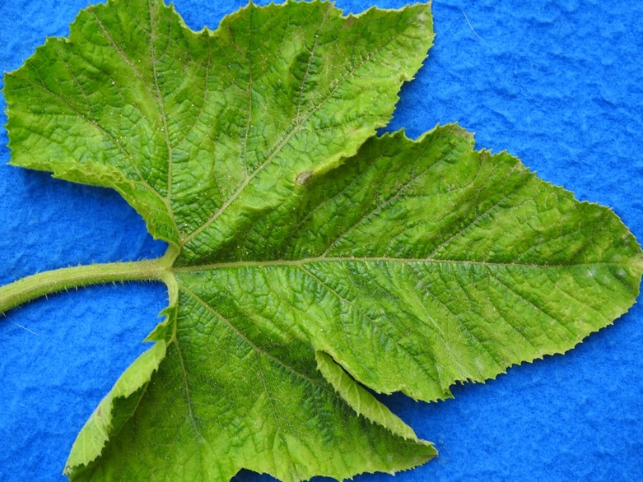
Leaves
that tested
positive for
ZYMV

Slide 33
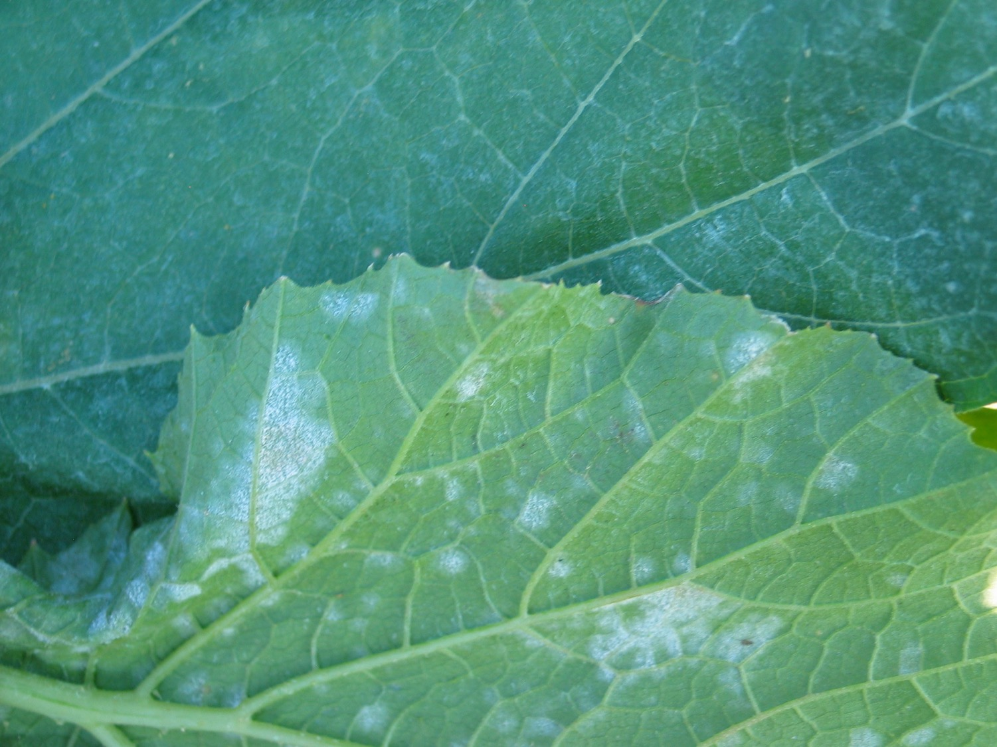
Questions?
Thank You!

