Slide 1
Monitoring for major cranberry insect pests
New Brunswick Hort Congress
March 15-16, 2023
Fredericton, NB
Chris Maund
chris.maund@gnb.ca
506-453-3477
Integrated Pest Management Specialist
(Entomologist) and Provincial Apiarist
NB Department of Agriculture, Aquaculture and Fisheries

Slide 2
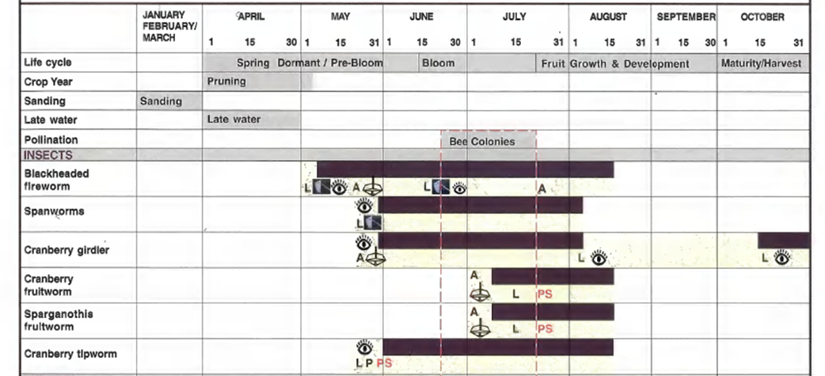
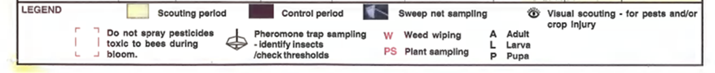
Cranberry scouting calendar
(most cranberry insect pests) in southern NB
Scouting is 7 to 10 days later in northern NB

Slide 3
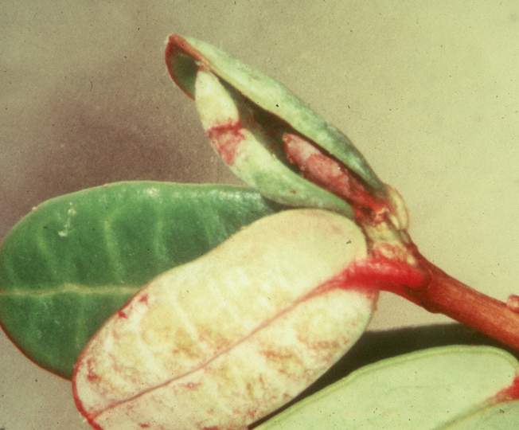
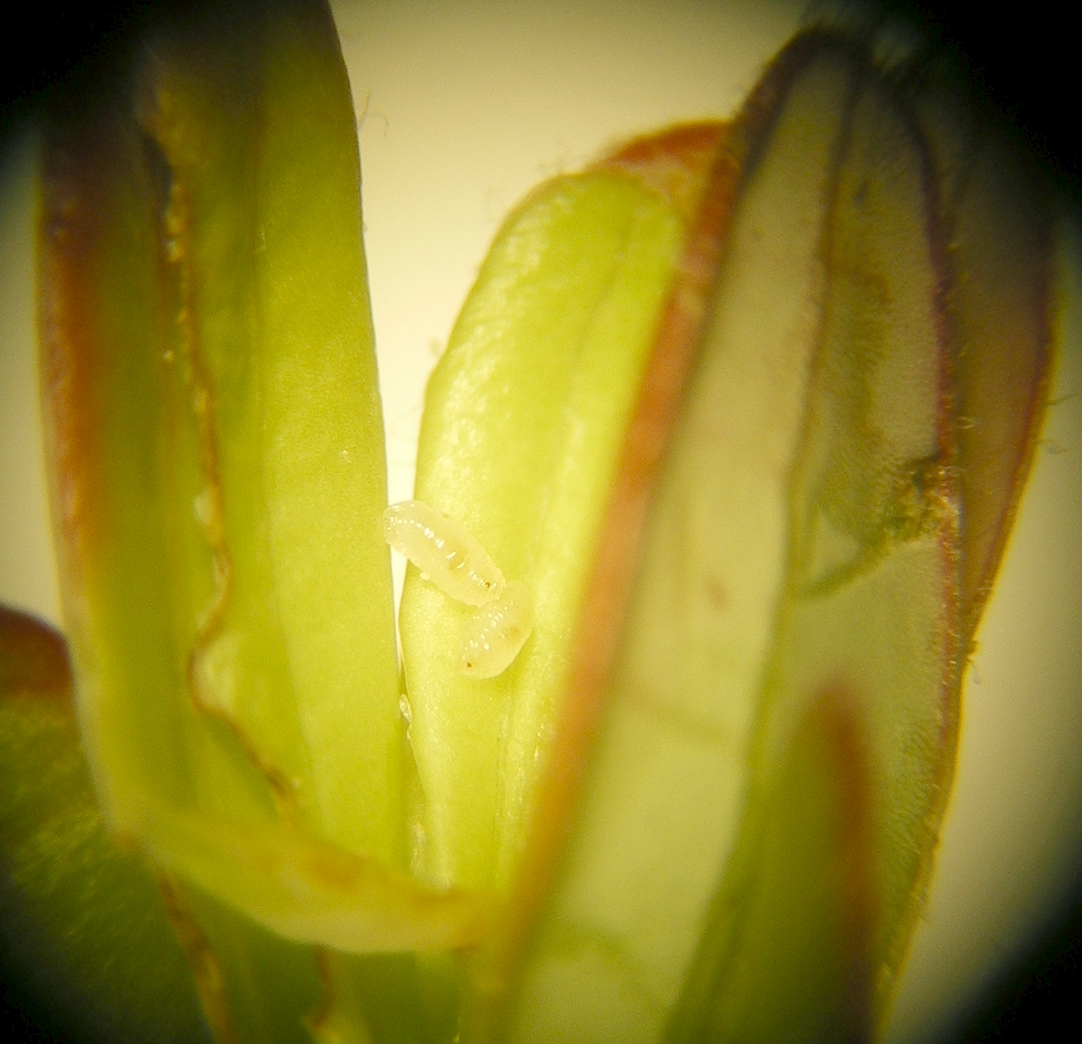

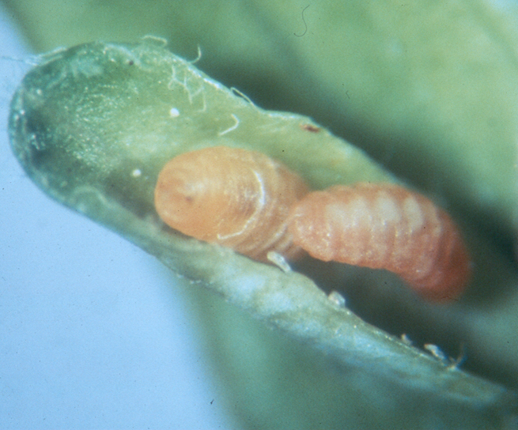
Cranberry tipworm,
Dasineura oxycoccana
Monitoring : 2 X 50 tips per field, weekly
or look for cupped leaves
control: peak egg hatch
(most samples: white / opaque maggots) Prepupae – orange.
resample: 3 days after 1st control for dead / live maggots
better control in early season

Slide 4
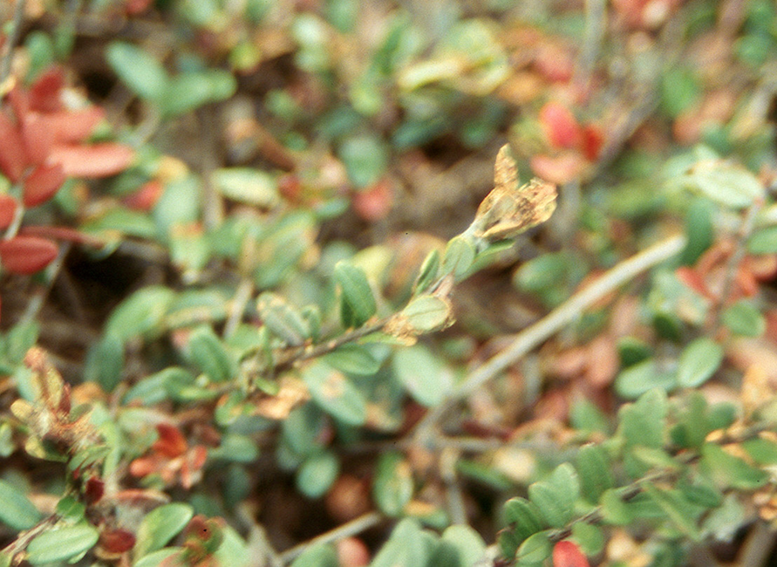
Blackheaded fireworm
Rhopobota naevana
Larval scouting period: Early to Late - May
Monitoring
Sweep net : 3 sets of 25 sweeps per hectare, weekly
(2 times a week near threshold levels)
THRESHOLD: 1 larva per 25 sweeps
VERIFY: Visually inspect plant tips for feeding damage
LARVAE: black head, wiggle
History of problems: Visually inspect for larvae

Slide 5
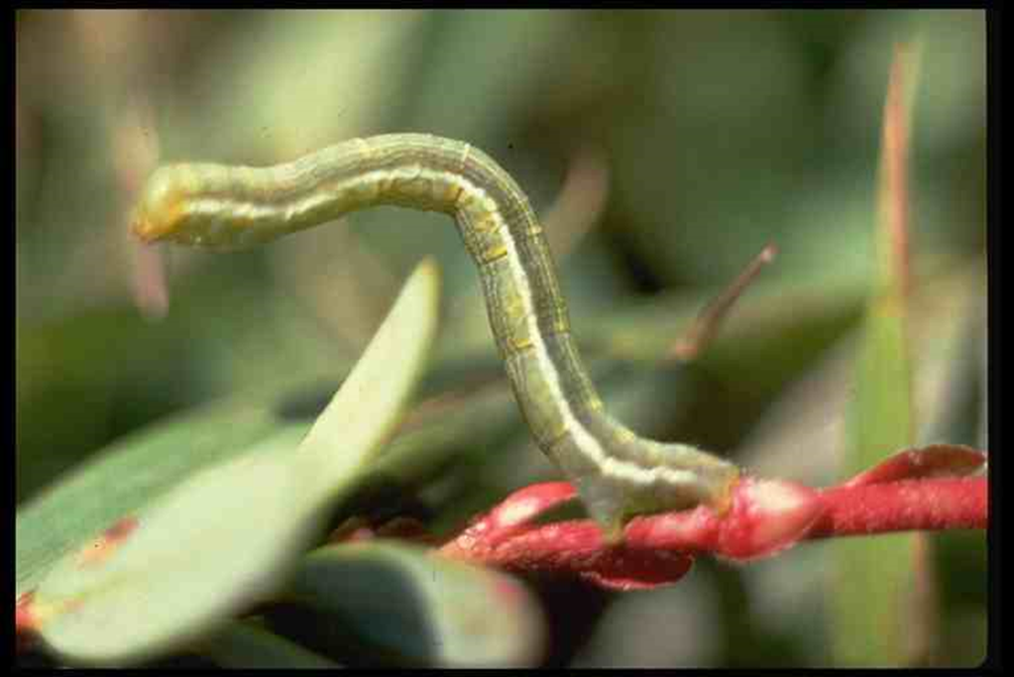
Spanworms - various species
Larvae: Late - May to mid - June
usually minor pests;
LARVAE: no prolegs (false legs) in middle of body, loop
Monitoring: 3 sets of 25 sweeps per hectare, weekly
(2 times a week near threshold levels)
THRESHOLD: 18 larvae per 25 sweeps
add all spanworm species
VERIFY: Visually inspect for damage on cranberry plants

Slide 6
Caterpillars - other than spanworms
Larvae : Late - May to mid - June
usually minor pests
Monitoring: (same as for spanworms)
THRESHOLD: 4 & 1/2 larvae per 25 sweeps
add all remaining caterpillars that do not loop
VERIFY: Visually inspect for damage on cranberry plants
Possible evening / night sweeping if unusual year

Slide 7
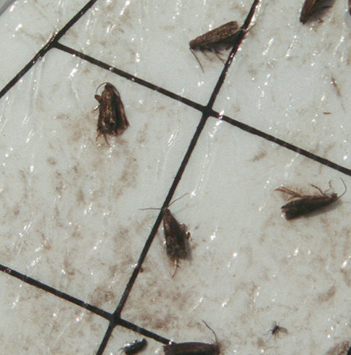
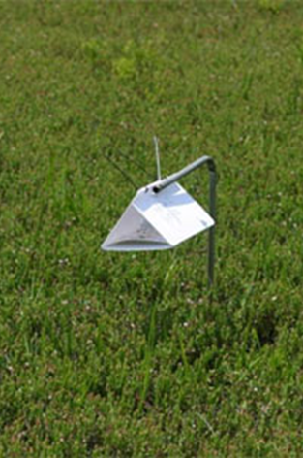
Blackheaded fireworm
Rhopobota naevana
Adult monitoring period: Late - May to Mid - August
Pheromone traps: WING TRAP; lure lasts 4 weeks
RATE : 2 traps per 5 hectares
Monitor once a week
Calculate: Moths / Trap / Day
THRESHOLD: none
apply a control 10 days after peak capture
if previous problems encountered
IDENTIFICATION: brownish / grey moths with light / dark patterns
(similar species appear on trap)
Wingspan 10 mm
Delta trap
(photo credit: Rutgers)

Slide 8
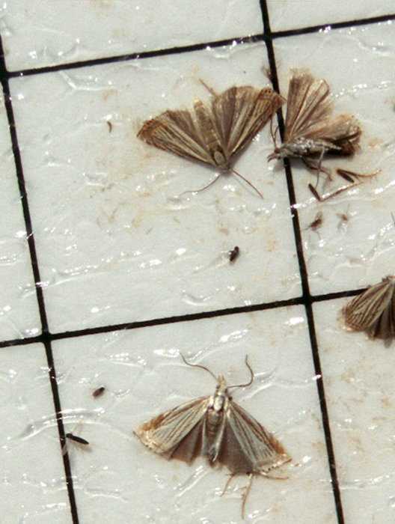
Cranberry girdler
Chrysoteuchia topiaria
Adult monitoring period: Late - May to Early - August
Pheromone traps: WING TRAP; lure lasts 4 weeks
RATE : 2 traps per 5 hectares
Monitor once a week
THRESHOLD: 100 cumulative moths PER TRAP by early August
apply a control if no controls made for other moths
verify if larval damage observed in previous Summer
IDENTIFICATION: brownish / grey moths with light / dark patterns
(similar species appear on trap)
Wingspan 15 mm
Delta trap
(photo credit: Rutgers)

Slide 9
Cranberry fruitworm
Acrobasis vaccinii
THE MOST IMPORTANT CRANBERRY PEST
Determining timing for control measures
Sampling: collect 5 sets of 10 uprights, weekly
- do not sample field edges
When: from early bloom until after 50% OOB occurs

Slide 10
Calculation of 50% Post Out Of Bloom (POOB)
Randomly go to 5 to 10 locations to calculate POOB
Count: Buds, Flowers (with petals), Pinheads (petals have fallen off), Berries
POOB =TOTAL A: # Pinheads + # Berries
TOTAL B: # Buds + # Flowers (with petals) + # Pinheads + # Berries
Take samples before 50% out of bloom stage
Take samples until after 50% out of bloom stage
For first sample after 50% OOB, then:
Subtract the 2nd last POOB rate (before 50% OOB) from the last sample (1st sample after 50% OOB) and divide this by the number of days between samples = rate of change in bloom per day (value = X)
50 minus the POOB rate from 2nd last sample = OOB rate needed to get 50% OOB (value = Y)
Y/X = number of days after 2nd last sample when 50% OOB occurred

Slide 11
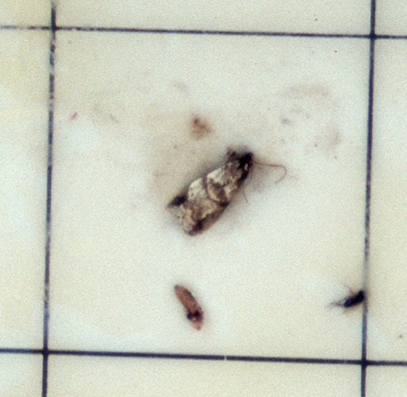

Cranberry fruitworm
Acrobasis vaccinii
Adult monitoring period: Start of July to Late - August
Pheromone traps: WING TRAP; lure lasts 4 weeks
RATE : 2 traps per 5 hectares
Monitor once a week
Moth identification: Two black dots in centre of each forewing
THRESHOLD: none yet established
traps: optional - help in evaluating control measures
verify by inspecting fruit for live YOUNG larvae
(more than a few percent berries with live larvae)
larvae leave frass (excrement) inside fruit
Delta trap
(photo credit: Rutgers)

Slide 12
Cranberry fruitworm – POOB pesticide application and variety
Consult your local agricultural representative for your area
Guideline (from Maine)
Current thinking:
Stevens (and early varieties): 1st spray: the 50% OOB day.
- Consult local recommendations for pesticide – safe for bees
Howes: 1st spray: 7 to 10 days after 50% OOB
Unable to monitor for egg-laying:
2nd spray: 10 to 11 days later
Very high populations: 3rd spray: 10 to 11 days later
- Most need 2 sprays; some only 1 spray

Slide 13
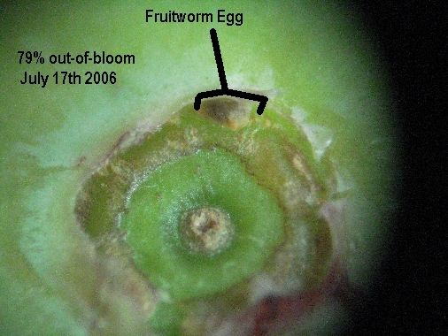
Cranberry fruitworm: egg laying monitoring
Monitor Egg laying activity: to determine need for a 2nd spray
Need a dissecting microscope
Photo: C. Armstrong, Maine
Table from Maine Number of Hectares (Number of Acres) | Number of Berries Checked | Number of Viable Eggs Needed to Trigger Spray during profitable berry prices | Number of Viable Eggs Needed to Trigger Spray during very low berry prices (< $0.30 per lb.) (0.45 kg)(US $)
0-2 (0-5) | 200-250 | 1 | 2
2.4 or 2.8 (6 or 7) | 251-350 | 2 | 4
3.2 or 3.6 (8 or 9) | 351-450 | 3 | 6
4 or 4.5 (10 or 11) | 451-550 | 4 | 8
for each additional 0.8 hectares (2 acres) | add 100 berries | add 1 egg | double the number determined at left

Slide 14
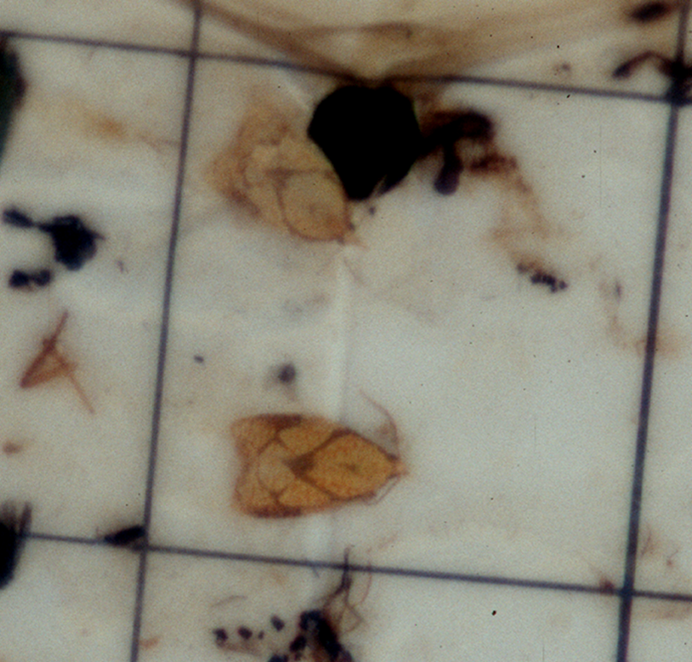
Sparganothis fruitworm, Sparganothis sulfureana
Has become more numerous at some sites
Traps: to time sprays
Wingspan 15 mm
Delta trap
(photo credit: Rutgers)

Slide 15
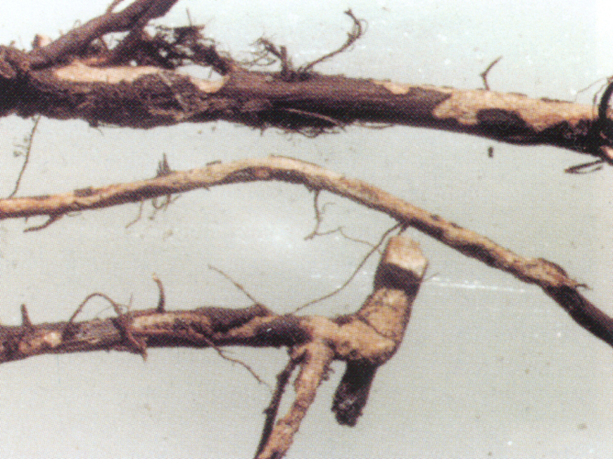
Cranberry girdler - larvae
Chrysoteuchia topiaria
Larval monitoring period: August and September
Monitor once a week
(if necessary - or if had high adult populations)
Look for: weak plants with reddish brown leaves
VERIFY: pull up plants
inspect: girdled runners
excrement (resembles sawdust)
larval presence
Control: Flood 6 days after Early Blacks harvested - risky!!!???
May adversely affect following year’s crop
(CONSULT BEFORE ATTEMPTING)

Slide 16
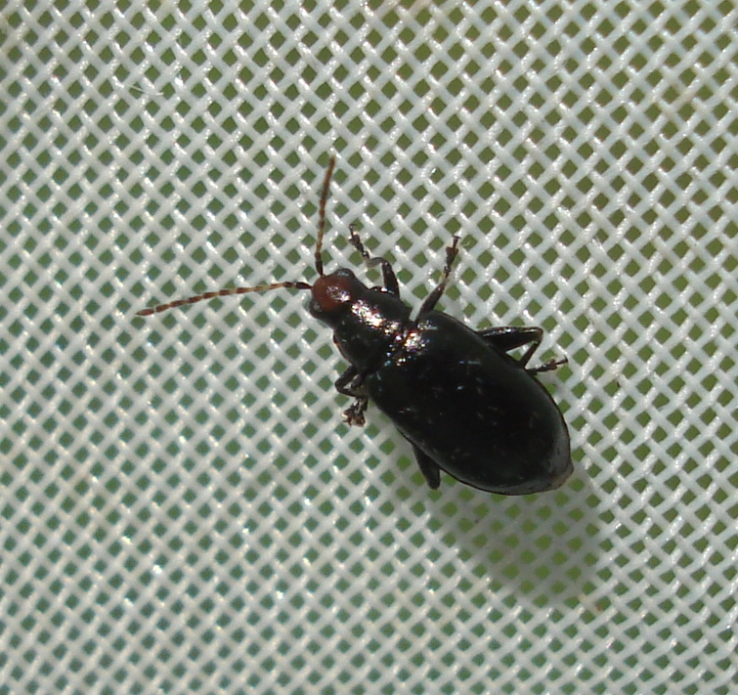
Red-headed flea beetle
Adults: July / Aug / Sep
3.5 to 5 mm long
High populations may affect bud development for the next year.
Identification: look at head in bright light or use a light
(photo credit: Maine)

Slide 17
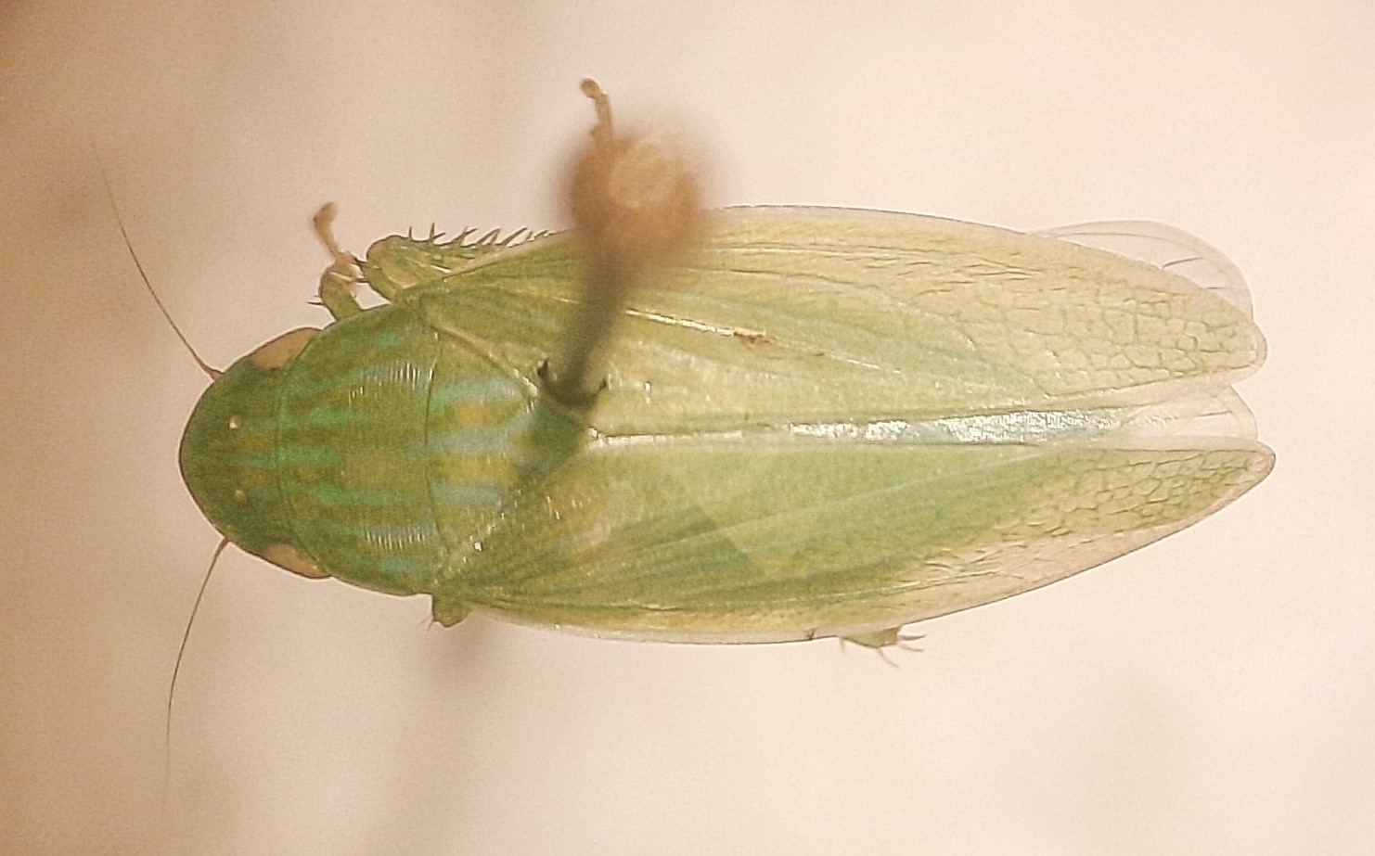
New insect (pest??) to look out for: Leafhoppers
Gyponana serpenta DeLong.
Family: Cicadellidae – leafhoppers.
Sub-family: Gyponinae.
Adults in NB in late July 2021
Possible concern if 100 to 200 per 25 sweeps???
Not known if this species transmits a plant disease
No reports of this species on cultivated cranberry.
Monitoring: look for leaf hopping insects
Use a sweep net if needed.

Slide 18
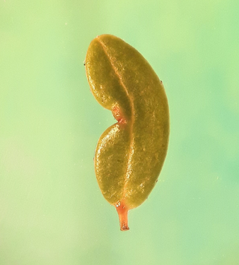
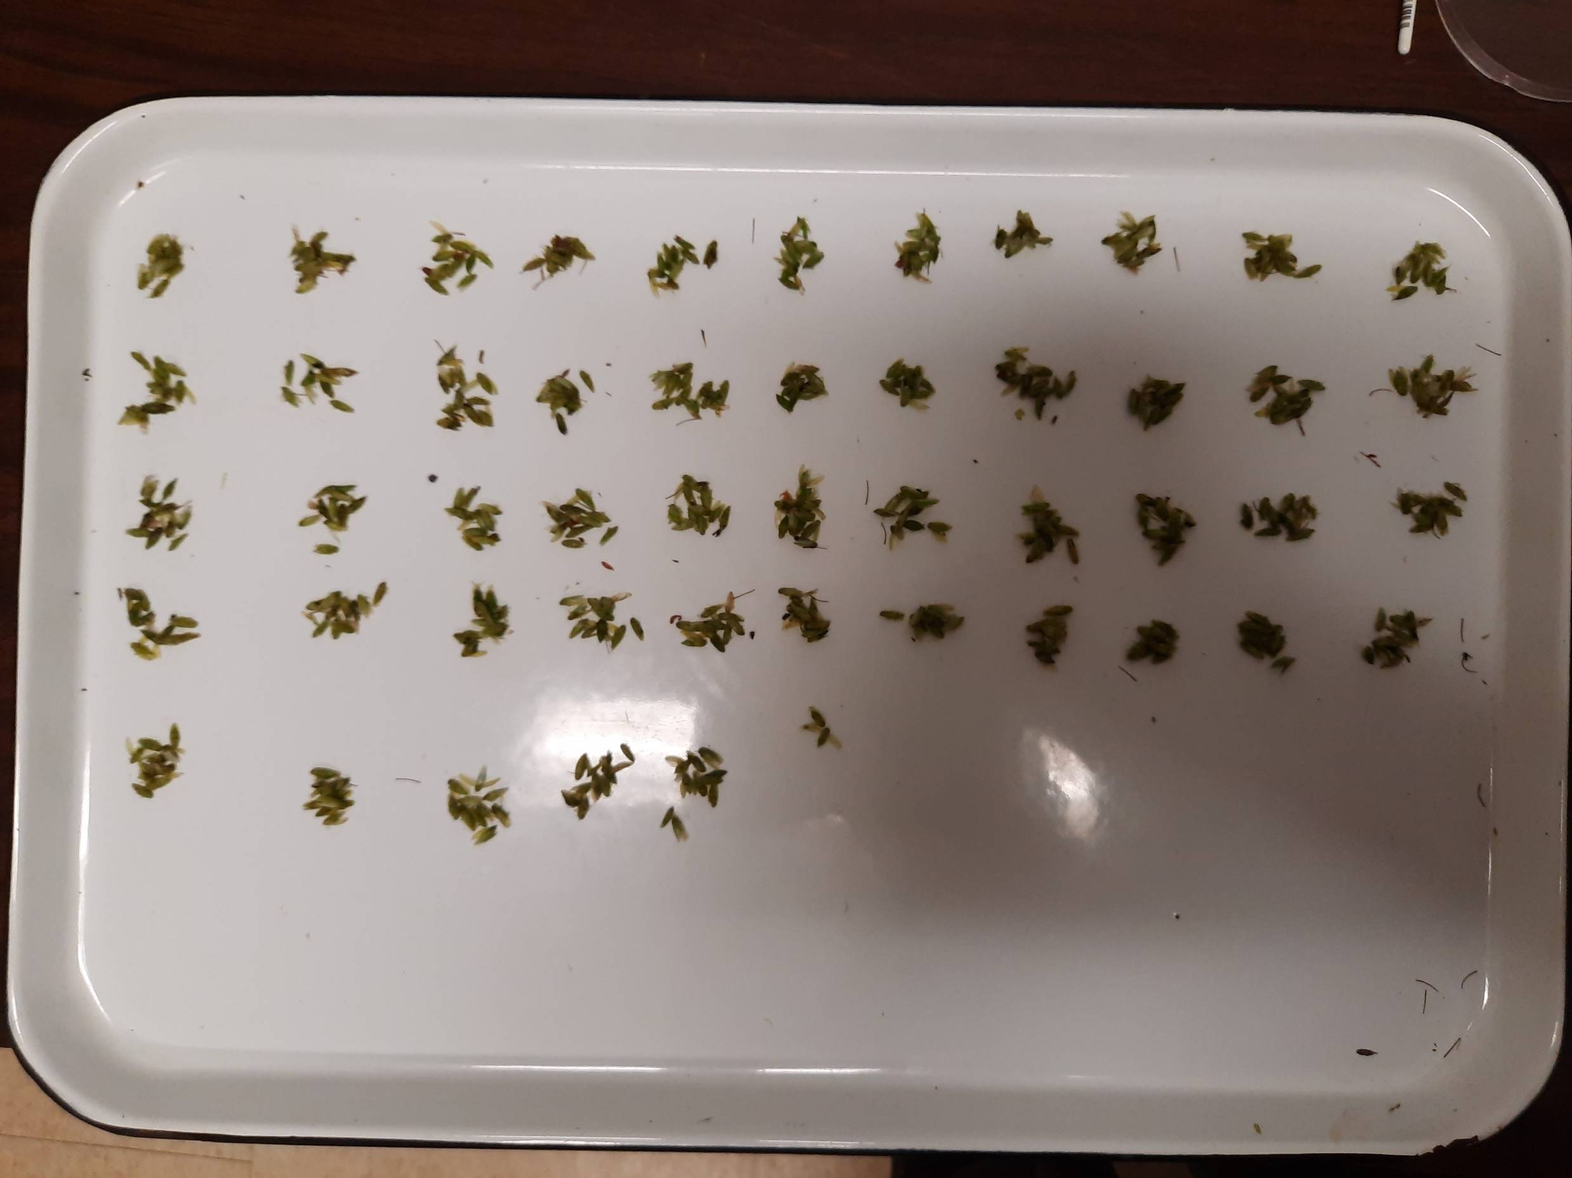
Gyponana serpenta DeLong.
492/25 sweeps (15 inch diameter sweep net)
populations are patchy
Sign of leafhopper feeding damage

Slide 19
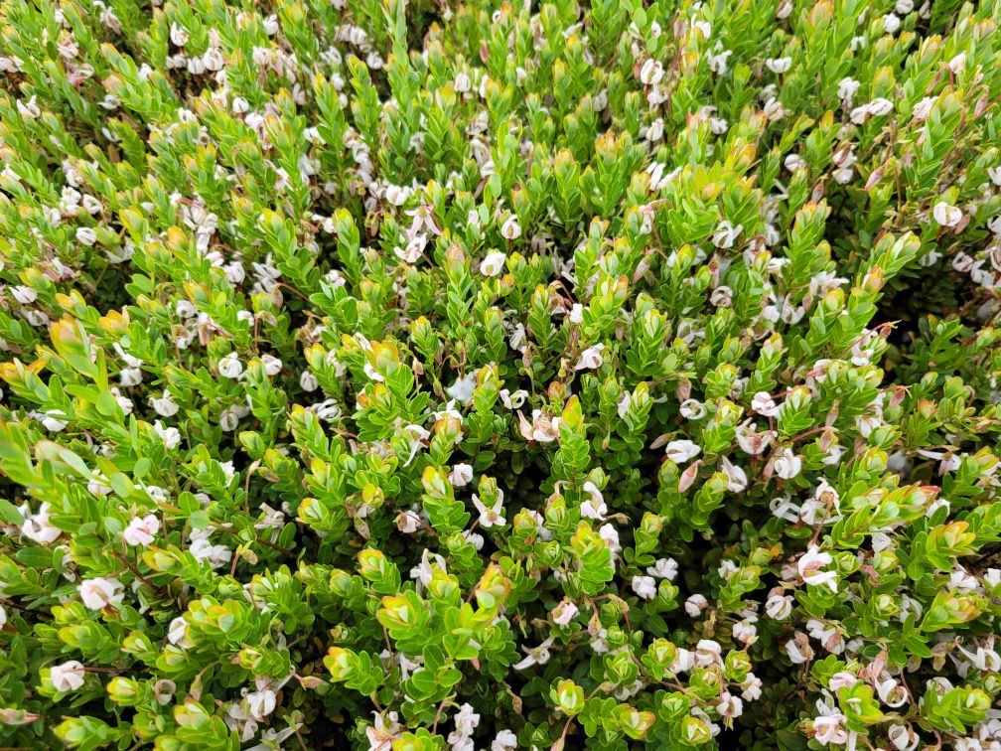
Spittlebugs (Meadow spittlebug??)

Slide 20
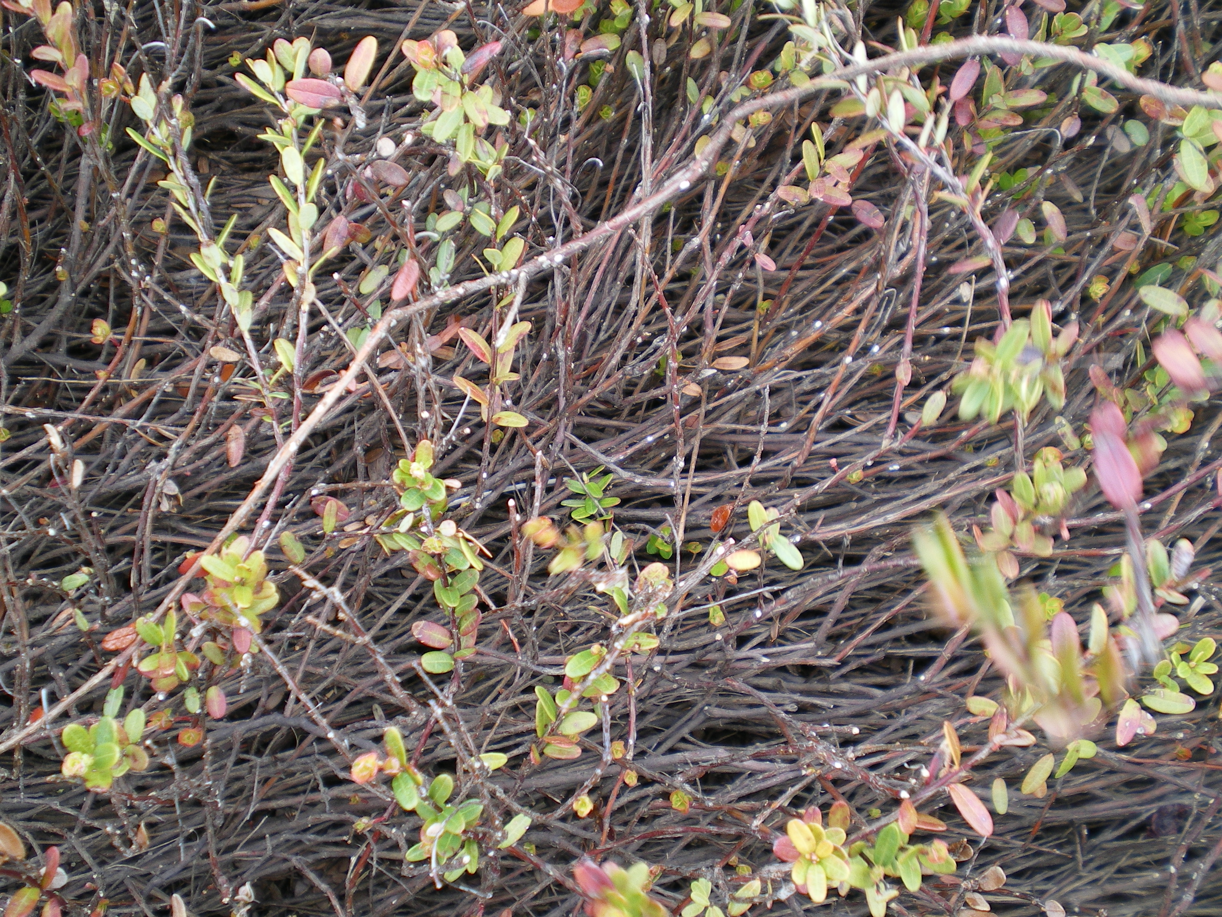
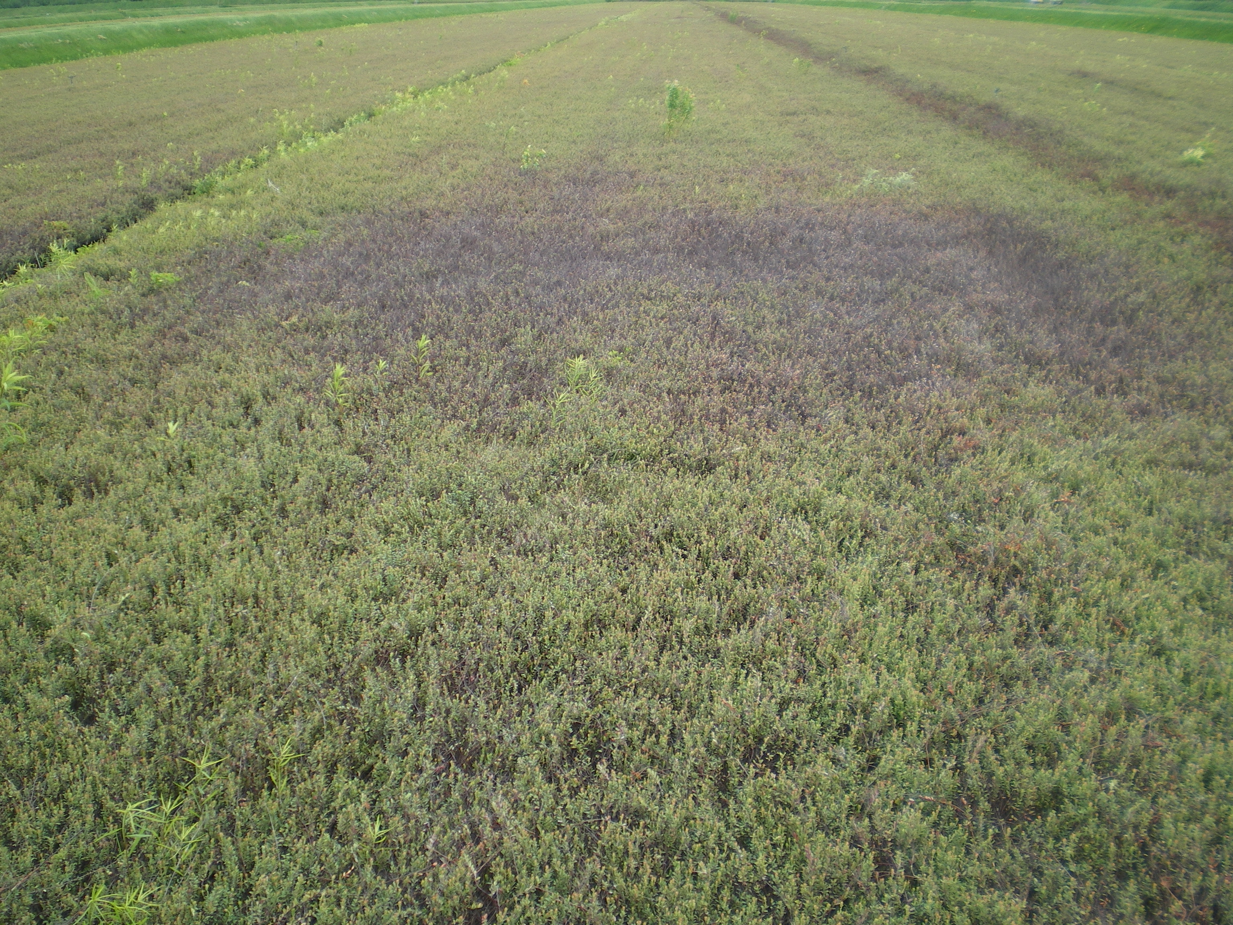
Scale insects (Dearness scale)

Slide 21
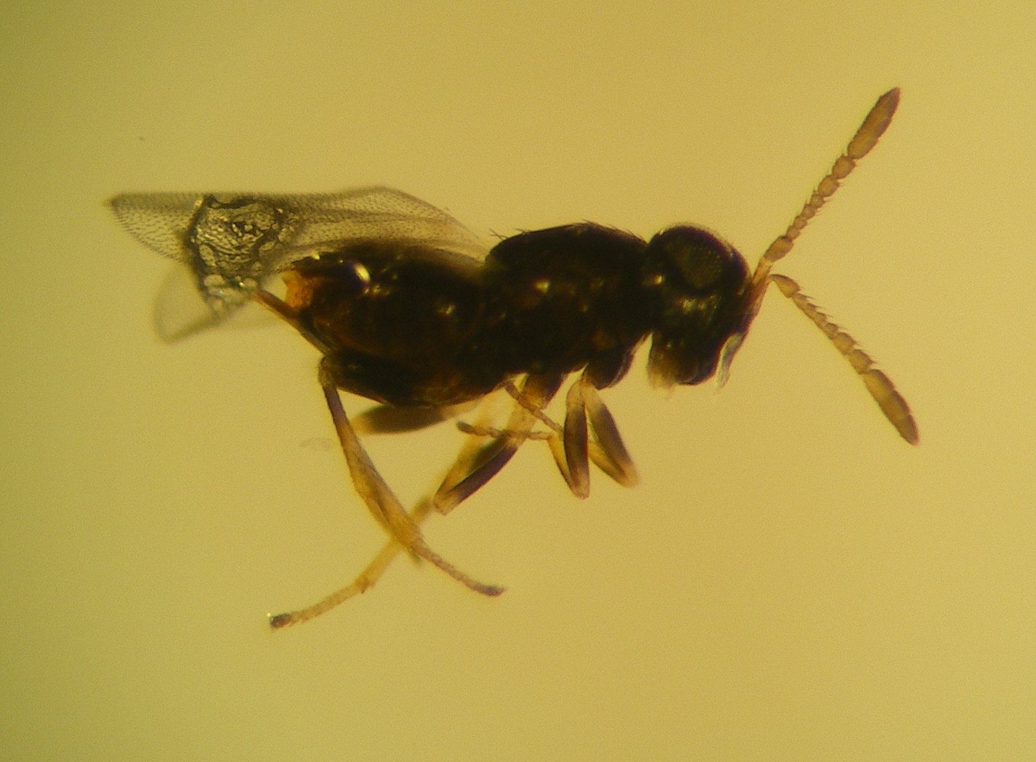
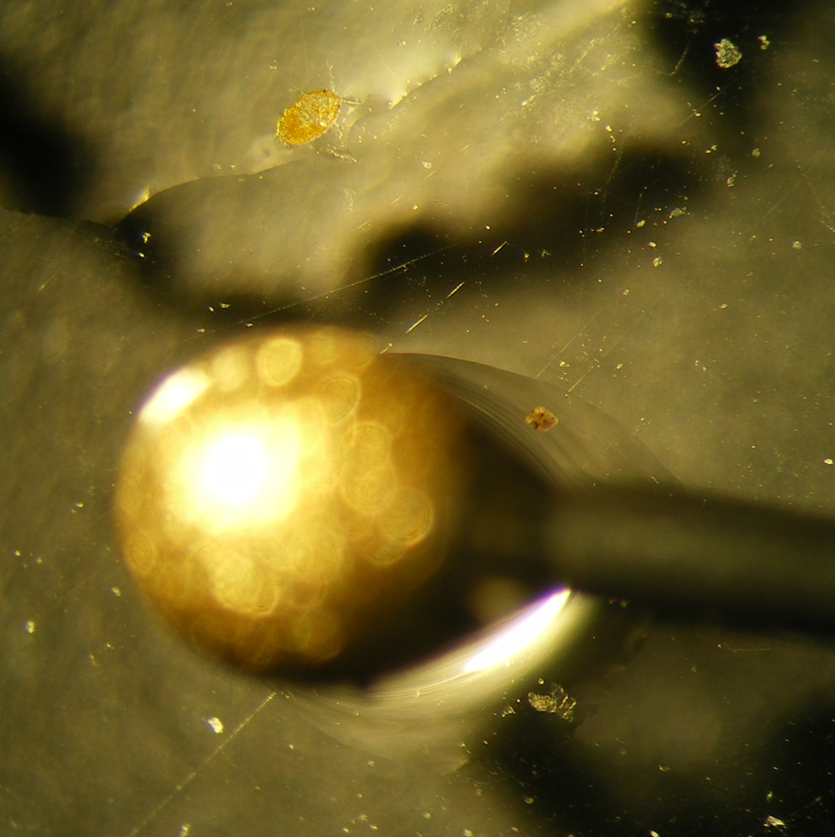
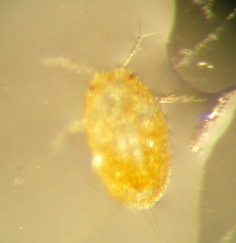
Dearness scale crawler stage & parasitoid wasp from adult scale

Slide 22
Monitoring: Is the problem due to insects?
2022:
no flowers in some beds, no fruit in some beds
entire area affected: likely environmental problem
Excessive heat / drought: petals dry up and fall off
Lack of evapotranspiration (not enough water getting to flowers)
- check moisture levels in soil

Slide 23
Other insect pests: on the horizon or already here in low numbers ????
July 2022: Massachusetts
Organic or low input cranberry bogs:
Found cranberry black bug, Plagiognathus repetitus:
nymphs (May): adult (June and July).
Also Found: Blunt nosed leafhopper
Also Found: Golden Case Bearer beetles
Wisconsin (2016) :
The Cranberry Toad Bug – An Emerging Pest of Cranberries

Slide 24
Evaluate your monitoring program:
Pre - harvest Assessment
SAMPLE: At least two 1-litre samples per 5 hectares
Take : 100 Berries per sample
Inspect :
Cranberry fruitworm damage: frass in berry
Sparganothis damage: no frass in berry
Other damage:
small berries (poor pollination)
red dots: plant bug feeding damage
diseases
mechanical damage (trampling), etc.
Determine yield

Slide 25
Management Recommendations
Perennia (Nova Scotia)

Slide 26
Thank you

