Slide 1
Common strawberry and raspberry diseases in New Brunswick
NB Hort Congress, 2023
Michael Tesfaendrias, Ph.D., P. Ag.
NBDAAF
IPM Specialist (Plant Pathologist)
(506) 453 3478
Michael.tesfaendrias@gnb.ca

Slide 2
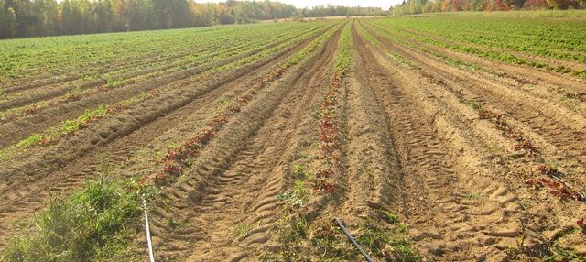
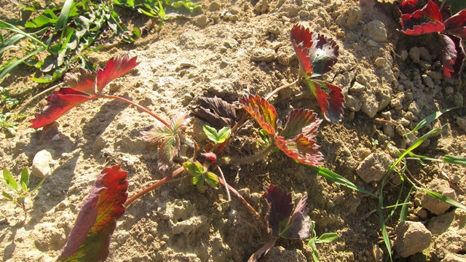
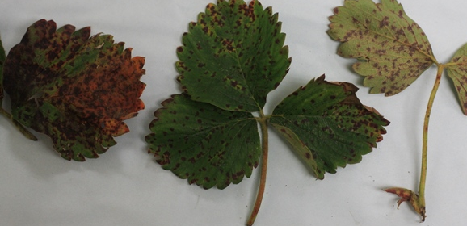
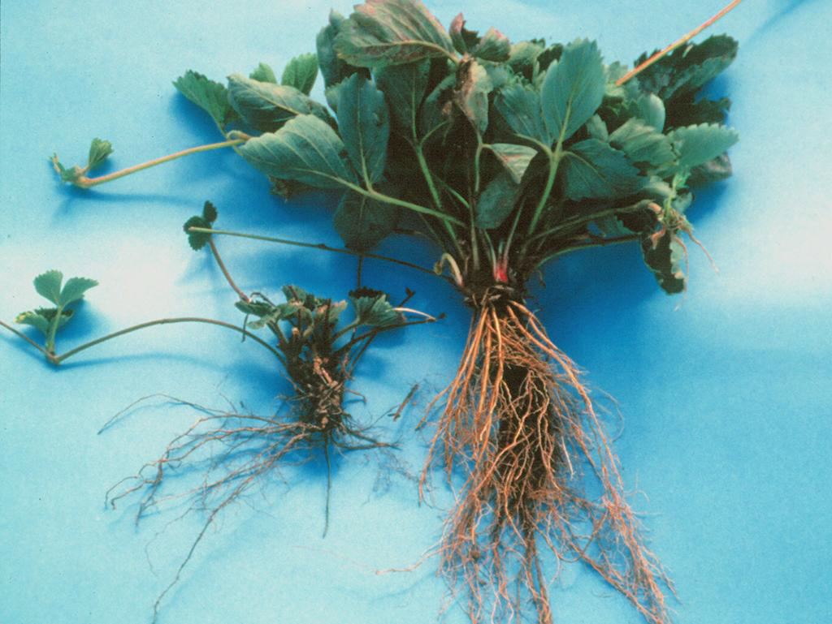
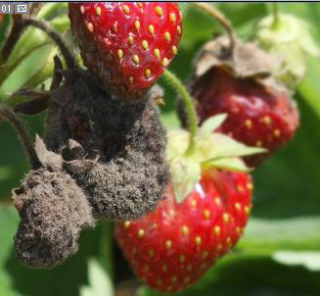
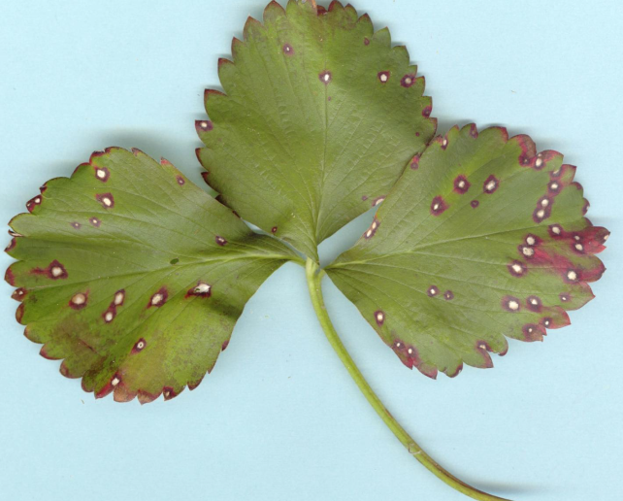
Strawberry Diseases

Slide 3
Black Root Rot
A complex disease caused by more than one pathogen
    Various fungi
    Nematodes
  Strawberry plants under stress (due to water logging, winter injury, fertilizer burn, soil compaction, herbicide damage, drought or excess water) are more prone to the disease.

Slide 4
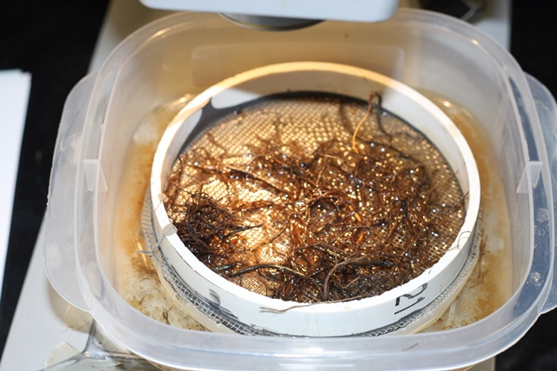
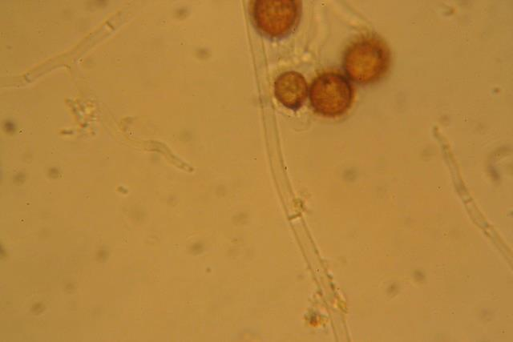

Slide 5

Black Root Rot
Smaller root system
Less fibrous root system
Fewer feeder roots
Reduced crop vigor and productivity
Yield loss

Slide 6
Black root rot management
Avoid low-lying area and poorly drained soils
  Plant into raised bed: improve soil drainage and reduce compaction
Improve soil texture
  Incorporate organic matter
  Plant cover crop at least 1 year prior to strawberry
Maintain plant vigour
Mulch plants with straw in late fall
      Prevent winter injury
Fungicide application
  Quadris, Scholar

Slide 7
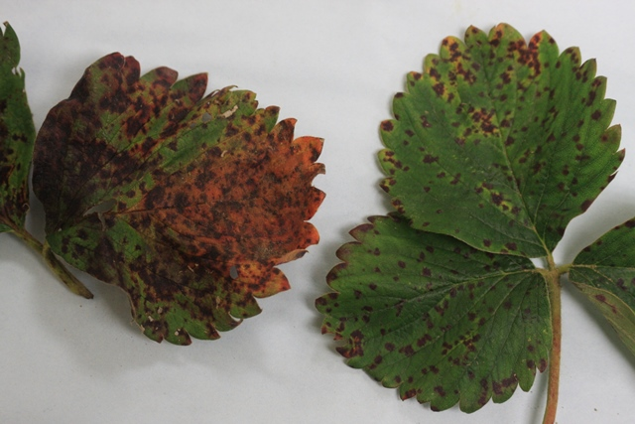

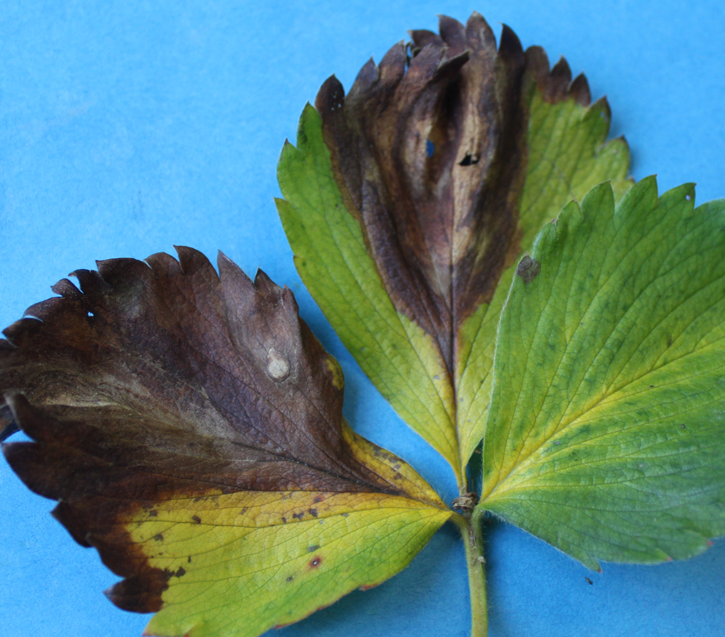
Leaf scorch, common leaf spot and leaf blight
High incidence during wet and warm conditions
If infection is significant, plants become weakened and susceptible to root diseases and winter injury
Reduce vigour and fruit size Reduce yield
Overwinter in infected dead or living leaves
Leaf scorch (Diplocarpon earliana)
Common leaf spot (Mycosphaerella fragariae)
Leaf blight (Phomopsis obscurance )

Slide 8
Leaf scorch, common leaf spot and leaf blight management
If possible: select resistant or less susceptible varieties
Plant in well drained soil
Promote good air circulation
  Wider rows
  Good weed management
Irrigation management
  Irrigate early during the day: foliage dries more quickly
Mowing at renovation
Apply fungicides
  Captan, Equal, Topas, Copper, Pristine….

Slide 9
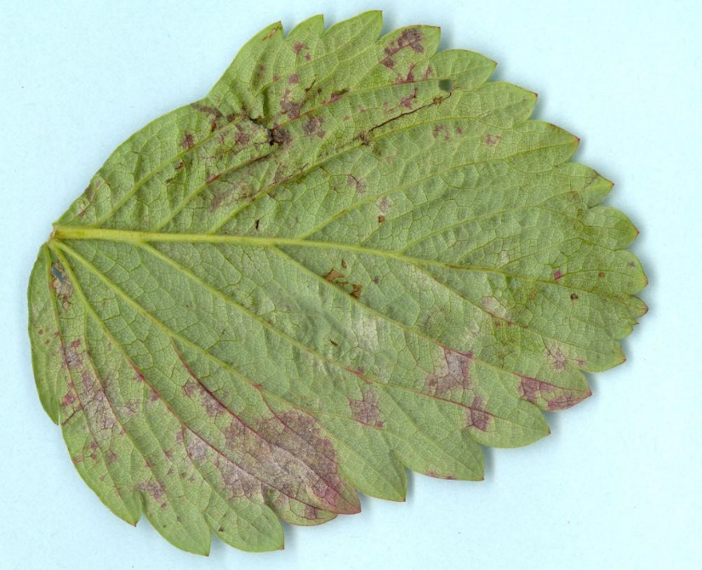
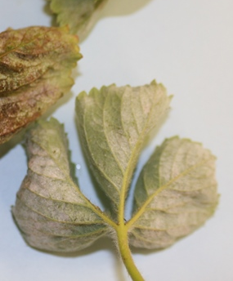
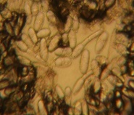
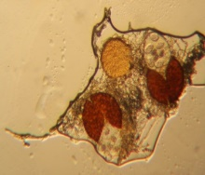
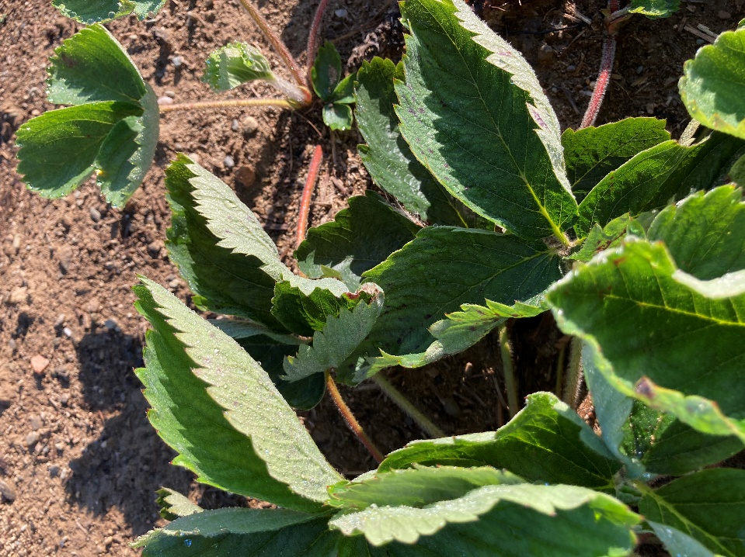
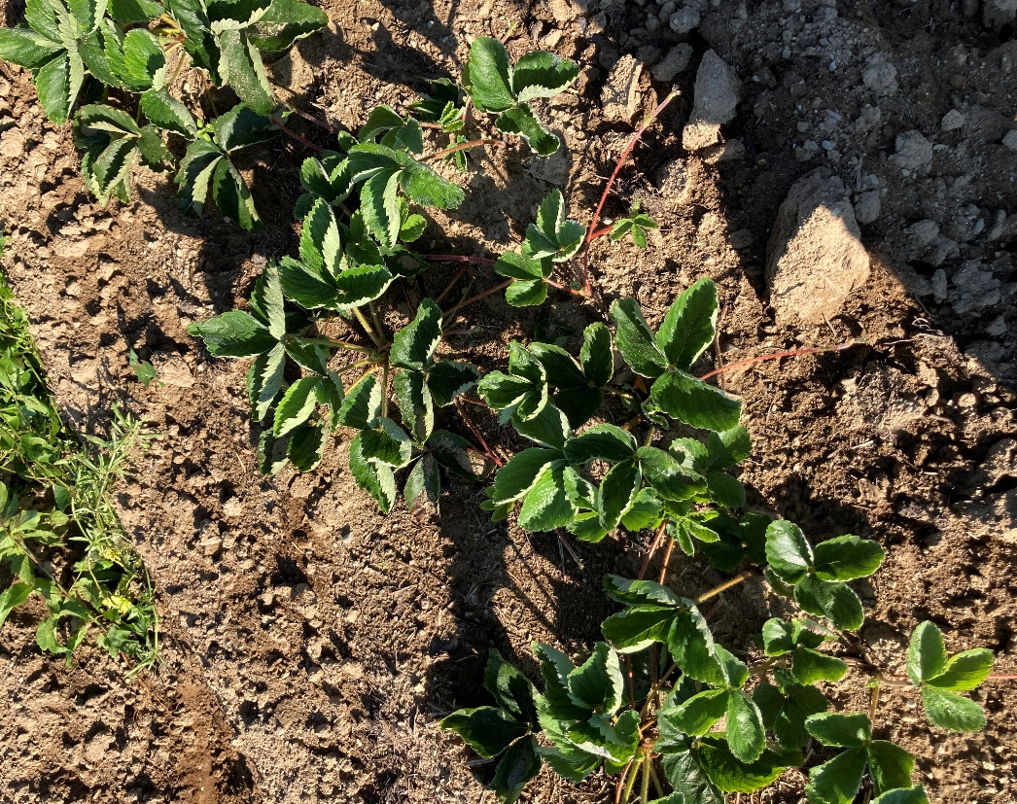
Powdery mildew (Podosphaera aphanis)
Favourable weather for infection: High humidity and cool to warm
temperatures (15–27⁰C)
Notes:
Caused by Sphaerotheca macularis f.sp. fragariae

Slide 10
Powdery mildew management
Select less susceptible cultivars
Proper spacing
Mow and remove foliage at renovation
Apply fungicides if necessary
  Nova, Pristine, Flint, Actinovate, Regalia Maxx…..

Slide 11
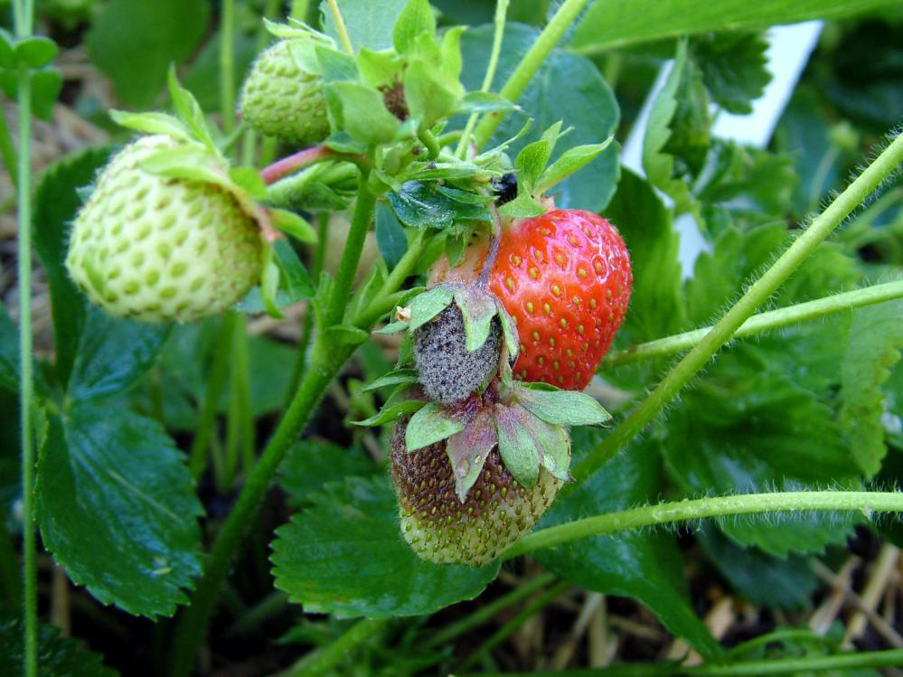
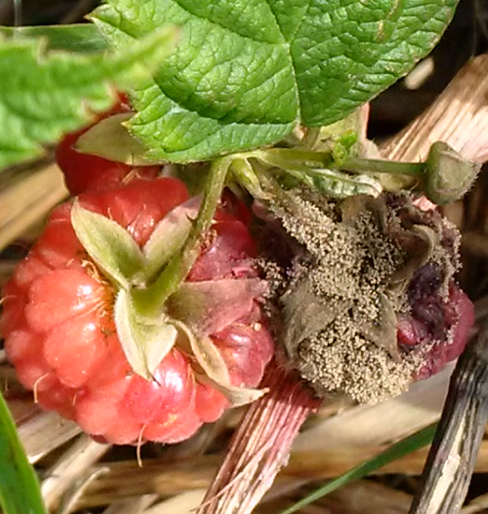
Botrytis/Gray mould/Fruit rot (Botrytis cinerea)
Susceptibility to Botrytis increases in:
- Older plantings where crop debris have built up over time
-Blossoms injured by frost

Slide 12
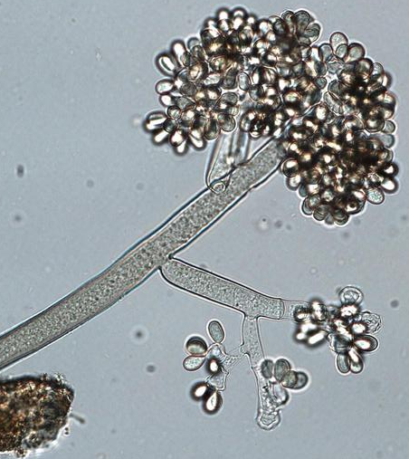
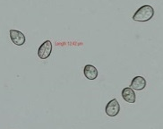

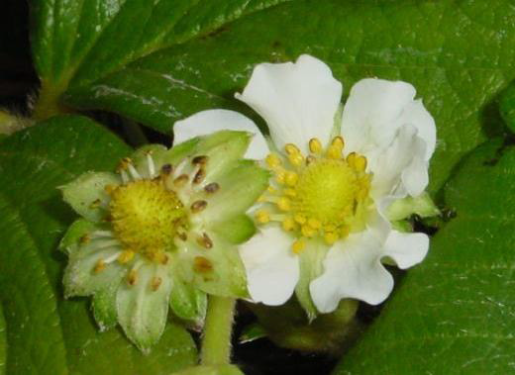


Botrytis starts to sporulate during spring
spores released
Botrytis overwinters in organic debris or sclerotia
Latent period
Botrytis infects during prolonged wetness periods

Slide 13
Botrytis/Gray mould/Fruit rot) management
Promote good air circulation
Good weed management
Proper fertilization
Irrigation management
  Irrigate early during the day: foliage dries more quickly
Remove old foliage during renovation
Harvest often and early in the day
Fungicides/biocontrol
  Captan, Bravo, Cantus, Switch, Pristine, Fontelis, Fracture, Serenade, Root shield, Actinovate…
  Spray timing (flower bud visible - preharvest)

Slide 14
Anthracnose (Colletotrtichum spp.)
Infects fruit, leaves, petioles and the crown
Wide host range (Strawberry, blueberry, eggplant, tomato, pepper, apple, grapes, …)
The disease can be introduced into a field on infected plants
Overwinter on infected plants and plant debris
Infection is favoured by warm, humid and wet condition.
Spores are spread by splashing water, wind driven rain, people or equipment moving through the field.

Slide 15
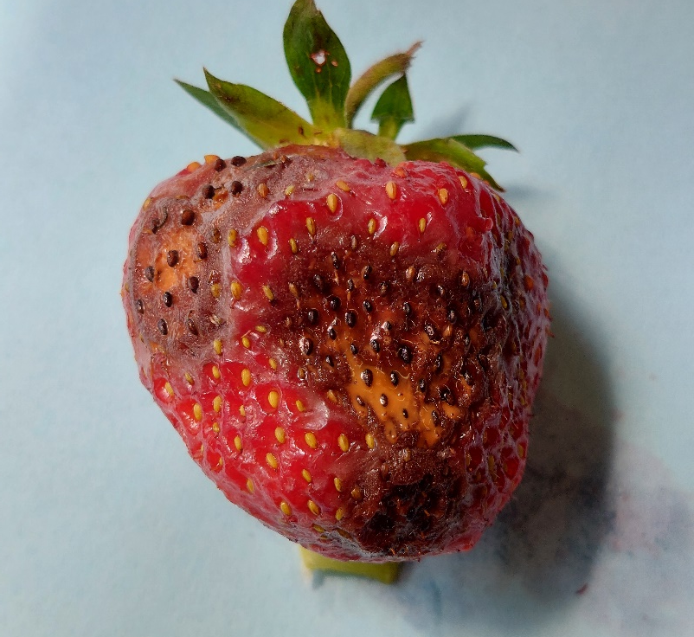
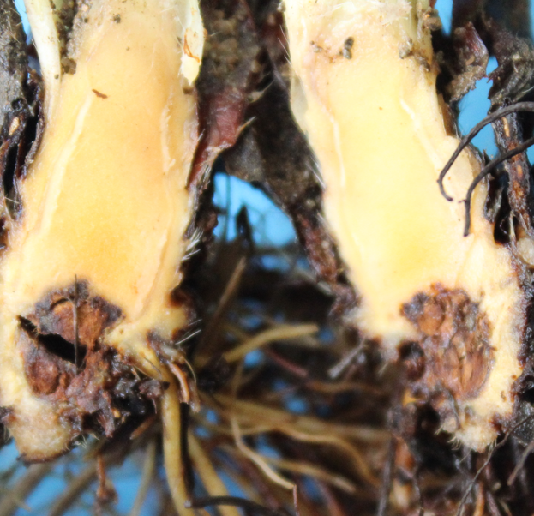
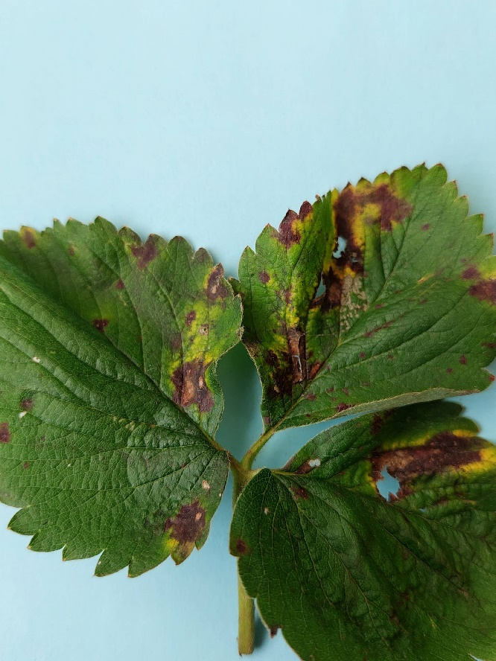
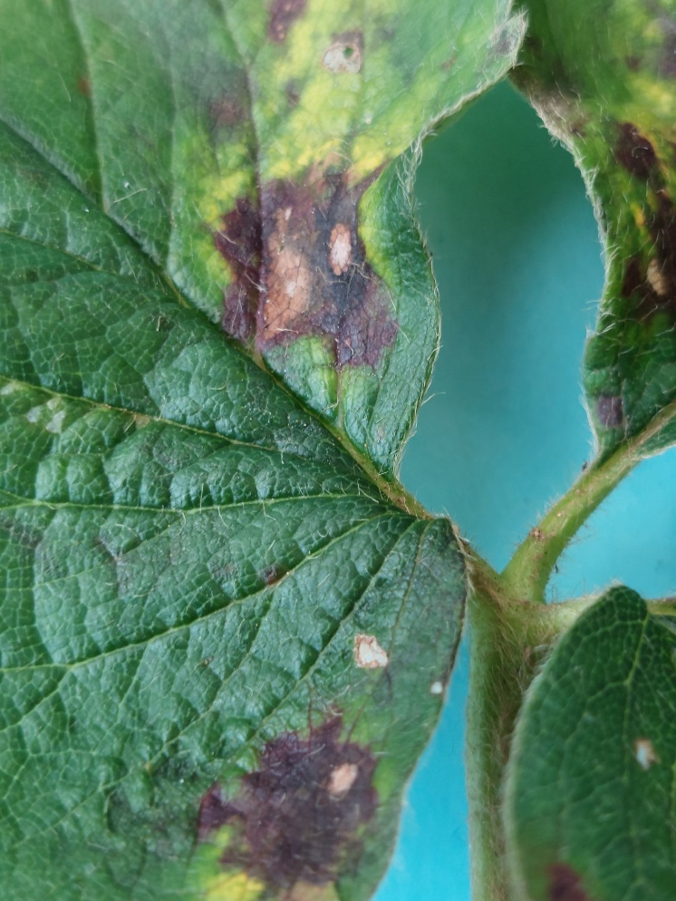
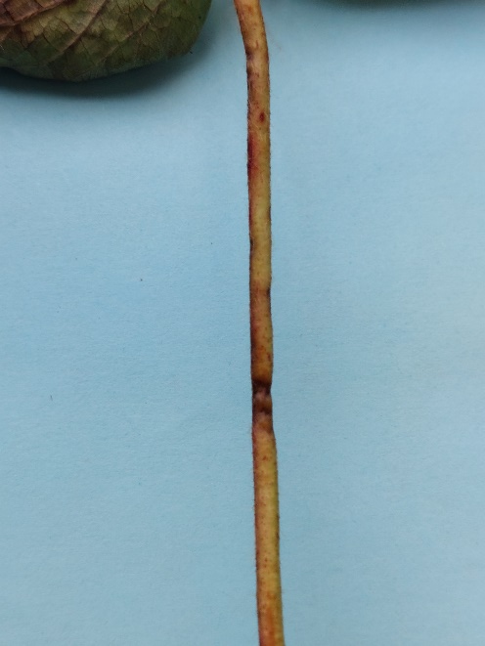
Anthracnose
Anthracnose (Colletotrichum) fruiting bodies

Slide 16
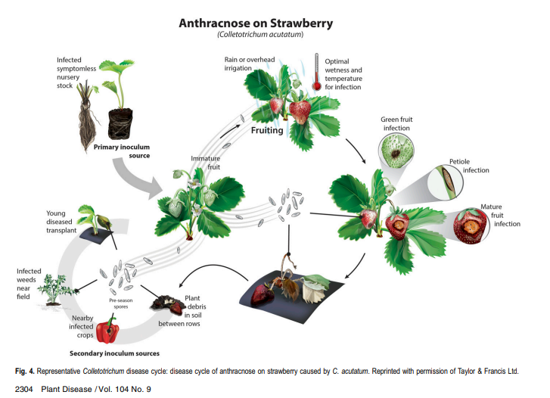

Slide 17
Anthracnose management
Use disease-free planting material
Proper irrigation
Mulching
Sanitation
  Remove infected plant parts
  Avoid movement in strawberry field when the plants are wet
Chemical control (preventative)

Slide 18
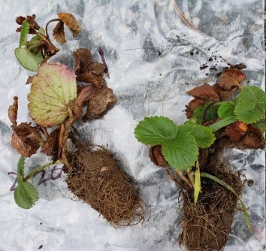
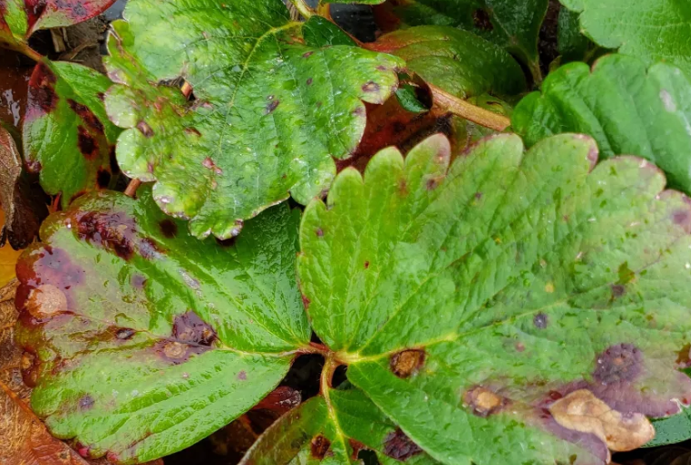
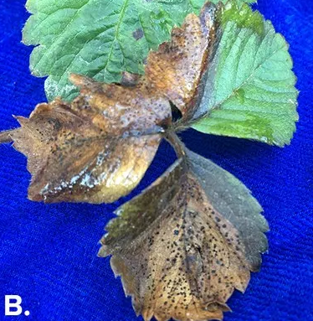
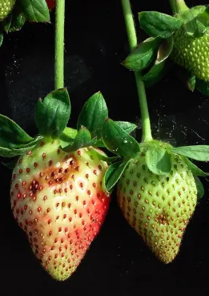
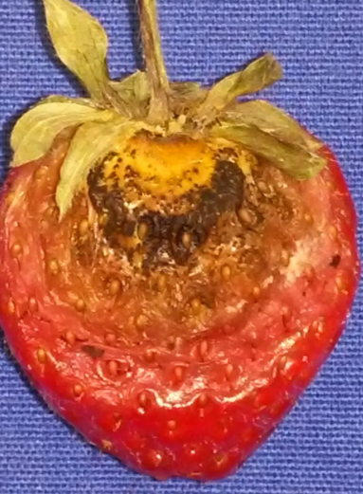
Pest Alert: Neopestalotiopsis – an emerging strawberry disease
2017: First reported in Florida
Fall 2020: At a location in Ontario on crown and foliage of cultivar Albion
The pathogen infects all parts of the strawberry plant – fruit, leaves, petioles, crown and roots
Symptoms on leaves progress very quickly during warm wet conditions
OMAFRA
OMAFRA
OMAFRA
PenState U
OMAFRA
Notes:
OMAFRA

Slide 19
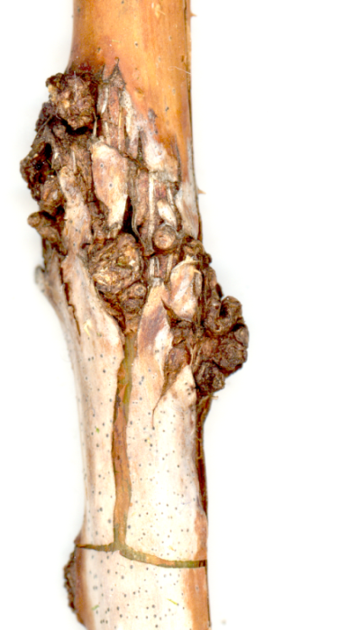
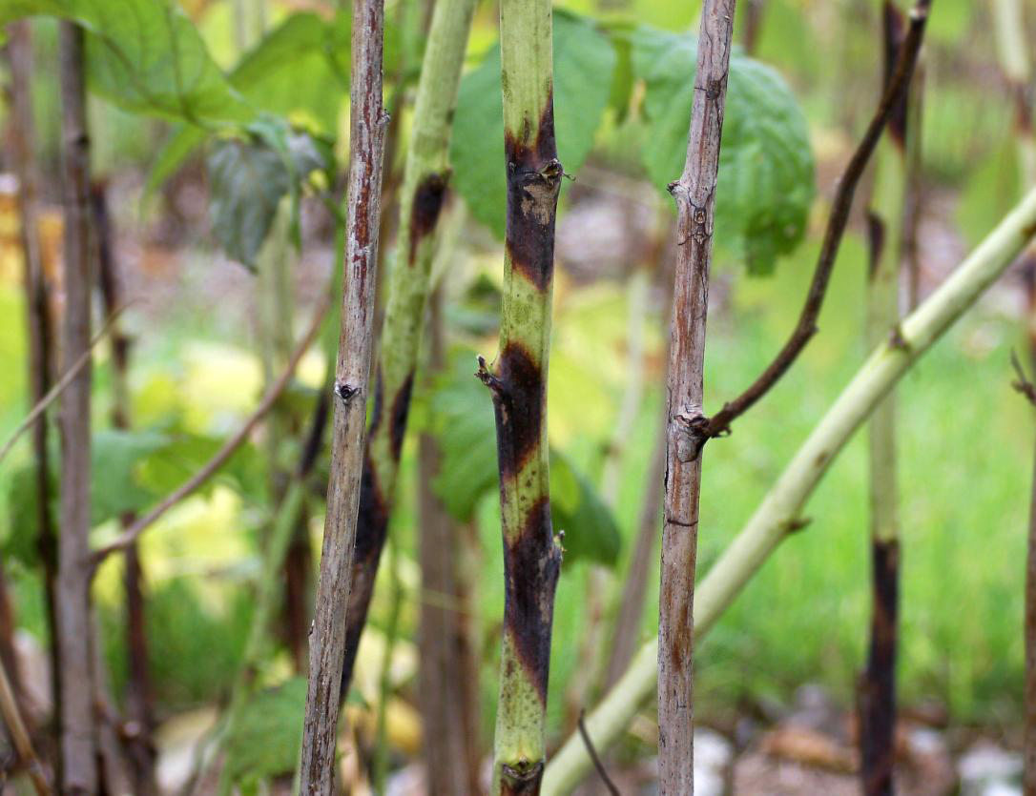
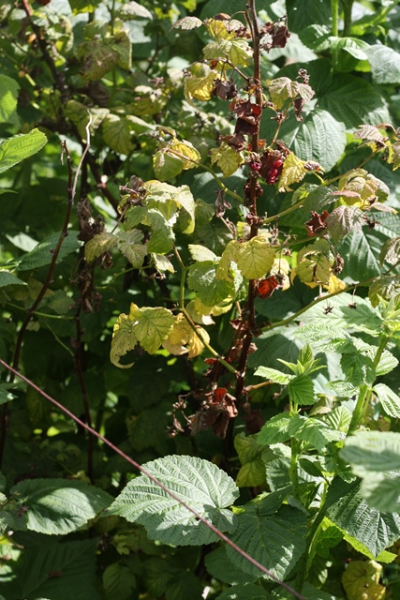
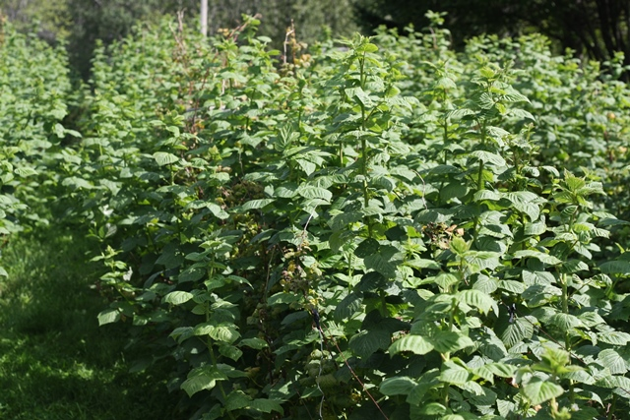
Raspberry Diseases

Slide 20
Spur Blight (Xenodidymella applanata formerly Didymella applanata)
Infection: High cane density, weeds, high RH and rain (wetness)
Yield loss due to:
  Infection of fruit bearing spurs that are produced on the side branches
  Premature leaf drop
  Kills buds on the canes that later develop into fruit bearing side branches
  Berries produced on diseased canes can become dry, small, and seedy.

Slide 21
Spur blight management
  Site with good air circulation
  Prune excess young canes
  Sanitation
    Cut canes that produced fruit
    Cut and remove infected canes
  Chemical control (fungicides)
    Lime sulfur, Ferban, Tanos

Slide 22
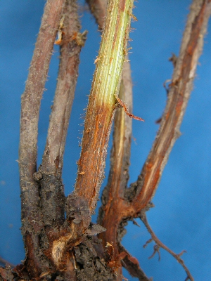
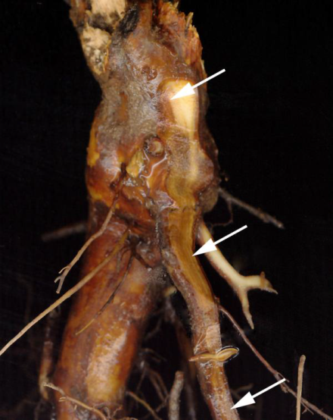
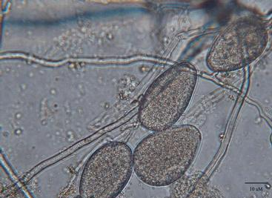
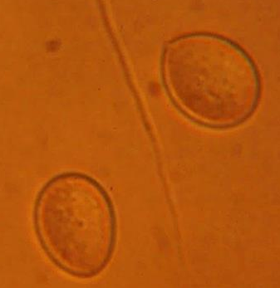

Phytophthora root rot (Phytophthora spp.)
OMAFRA
Soil-borne pathogen
Prolonged soil saturation: infectious spores (zoospores) are released and can infect roots or crowns.
Infection: Temperature ≥10ºC and wet soil
  Most frequently in spring and fall
Excessive moisture: Suffocates root resulting root death
  Foliar and root decay symptoms like phytophthora root rot
Notes:
Resting spores swim

Slide 23
Phytophthora root rot management
Use clean plant stock
Planting in non-infested soils
Avoid low-lying areas or clay soils
Improve drainage
  Use of raised beds
  Proper irrigation management
  Use less susceptible cultivars
Fungicides (Partial management)
  Ridomil Gold, Aliette, Phostrol

Slide 24

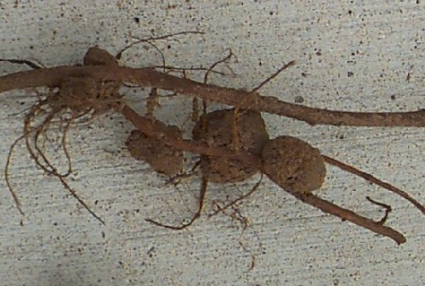
Crown gall and cane gall (Agrobacterium tumefaciens and A. rubi)
Soil borne bacteria
Infects via wound: natural, mechanical (pruning, weeding or pests), frost
Wet soil promotes bacterial movement
Crown and cane gall management
Site selection
Inspection at planting: plant disease free plants
Remove infected plants
Minimize stress and injury
OMAFA
Notes:
OMAFA

Slide 25
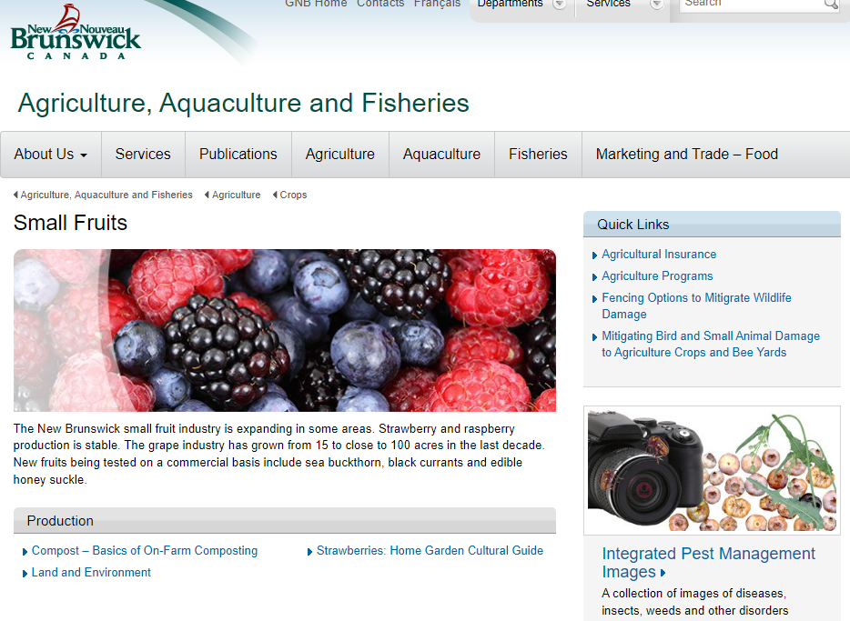
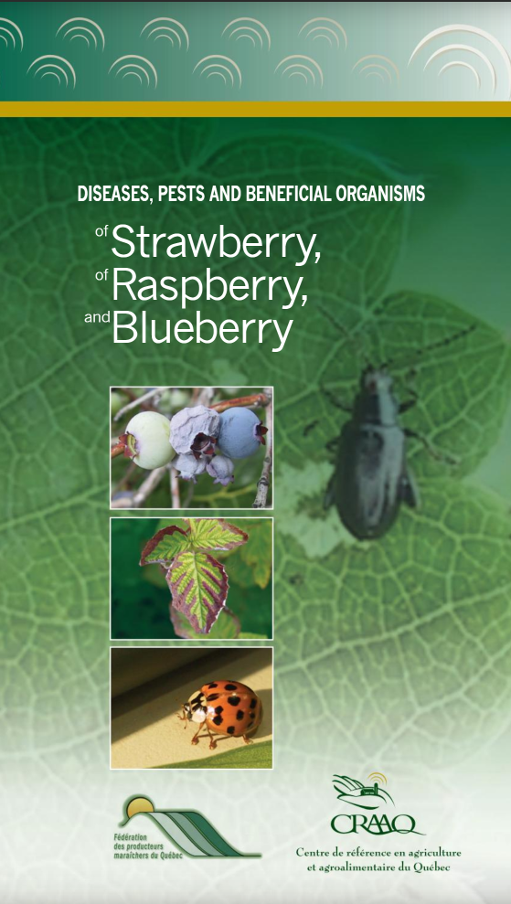
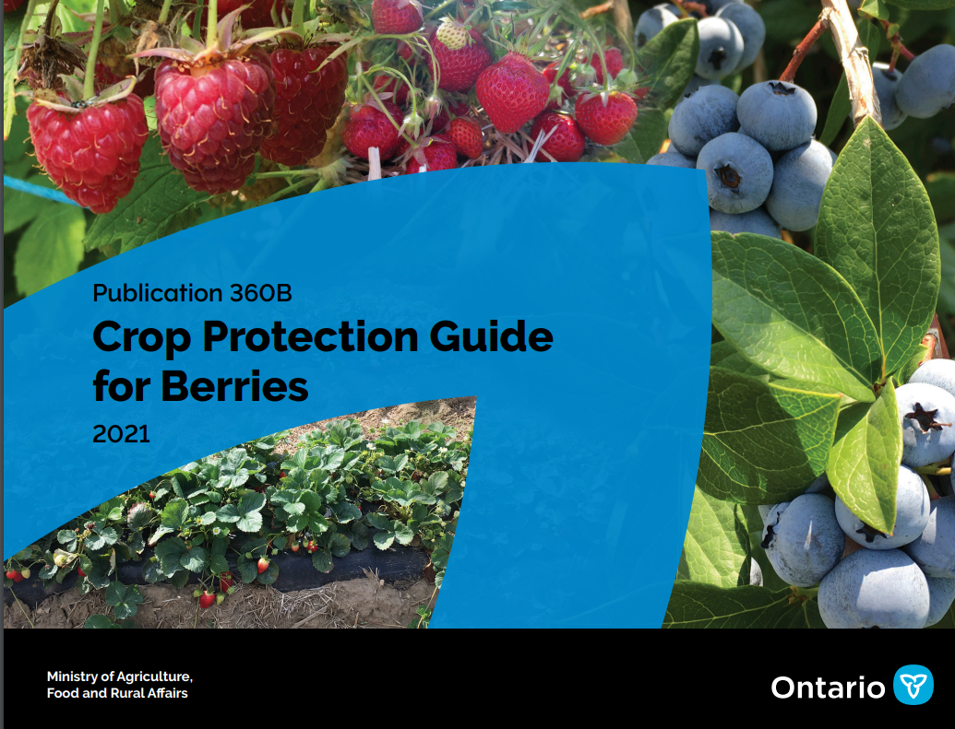
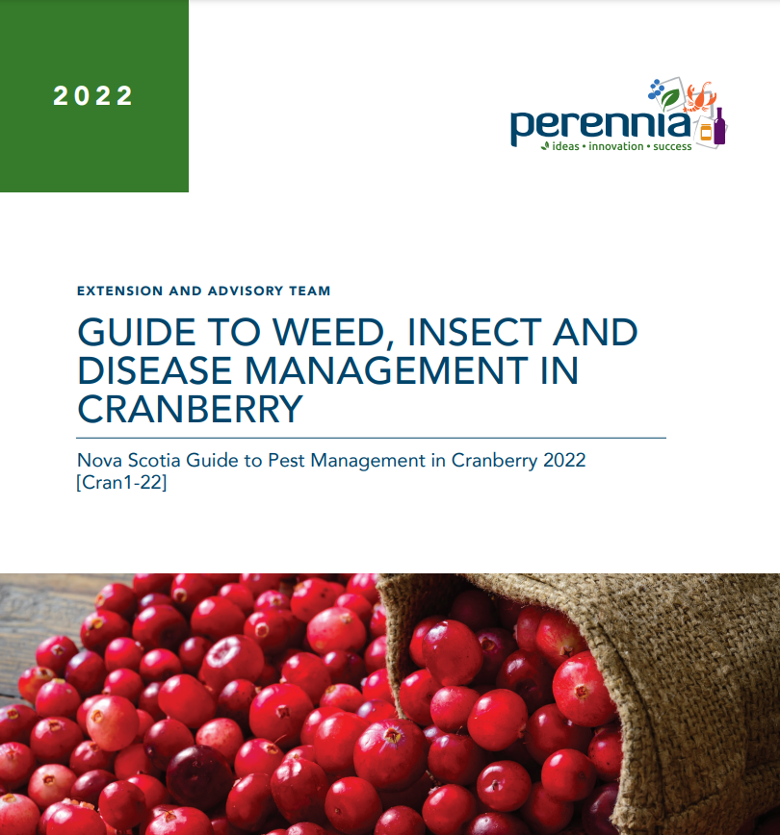
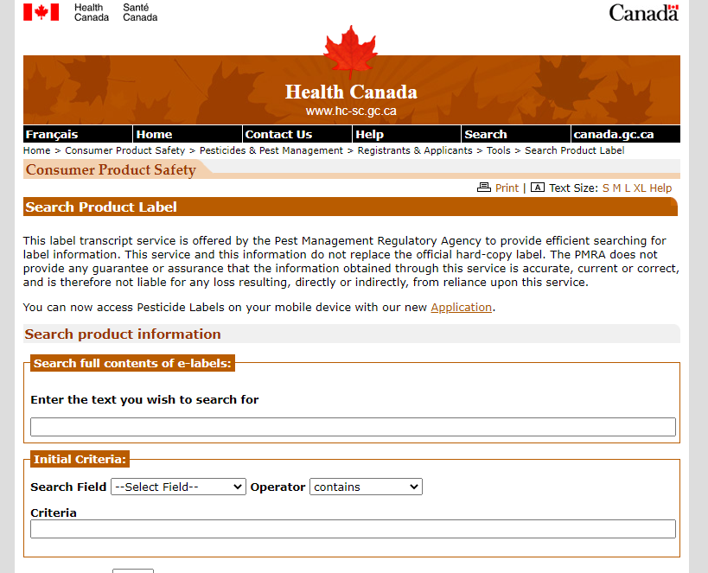
Resources
PMRA http://hc-sc.gc.ca/cps-spc/pest
Notes:
Resources

Slide 26
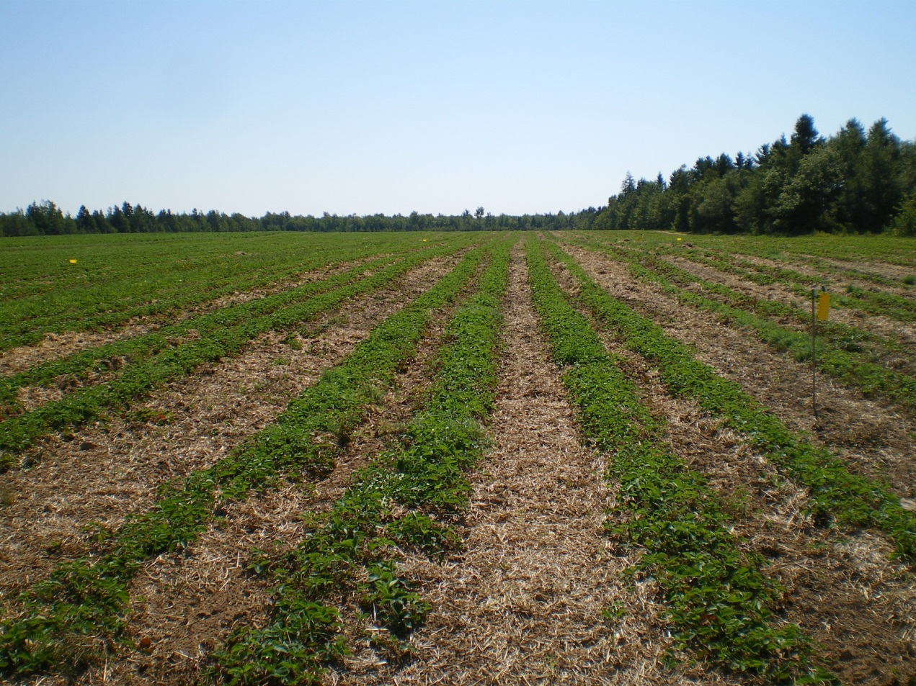
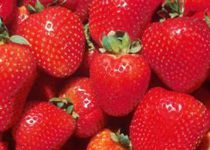
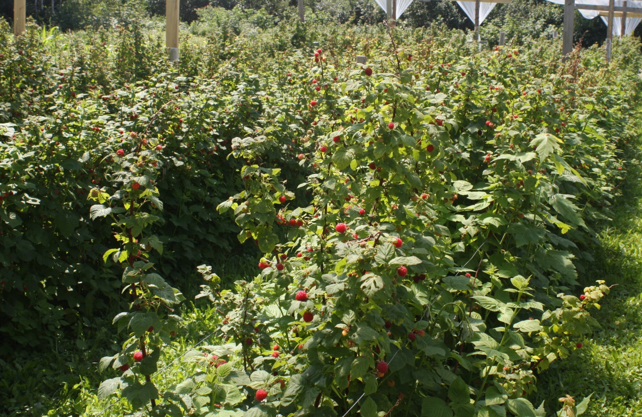
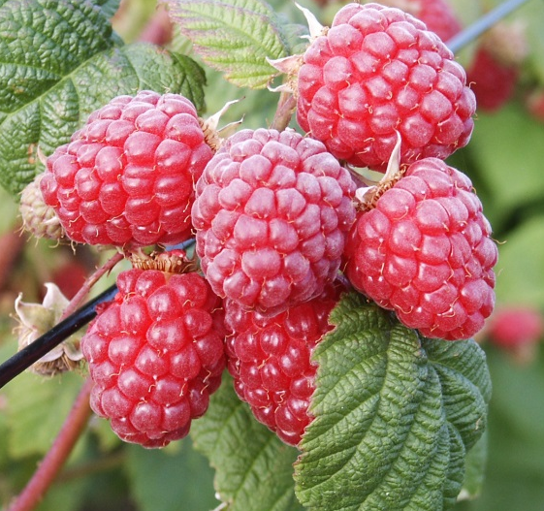
Thank You
Merci

