Slide 1
Common and Emerging Pests in Small Fruits
- insects (and mites)
New Brunswick Hort Congress
March 15-16, 2023
Fredericton, NB
Chris Maund chris.maund@gnb.ca
506-453-3477
Integrated Pest Management Specialist
(Entomologist) and Provincial Apiarist
NB Department of Agriculture, Aquaculture and Fisheries

Slide 2
Strawberry | Raspberry
Cyclamen mite Strawberry bud weevil Tarnished plant bug Root weevils (black vine weevil and strawberry root weevil) Twospotted spider mite (& Bryobia mites) Strawberry aphid | Raspberry fruitworm Strawberry bud weevil Tarnished plant bug Raspberry cane borer Raspberry crown borer

Slide 3
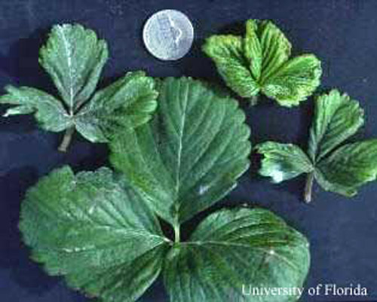
Strawberry: Cyclamen mite
Damage: crinkled distorted leaves
Monitoring: 5 X 5 method, V pattern
- when: spring, pre & post bloom, before renovation
COLLECT: 25 damaged crowns (5 per site)
REQUIRES: lab confirmation (send to DAAF)
THRESHOLD: 3/25 infested crowns
3) Physical control: crop rotation
Large leaf: undamaged

Slide 4
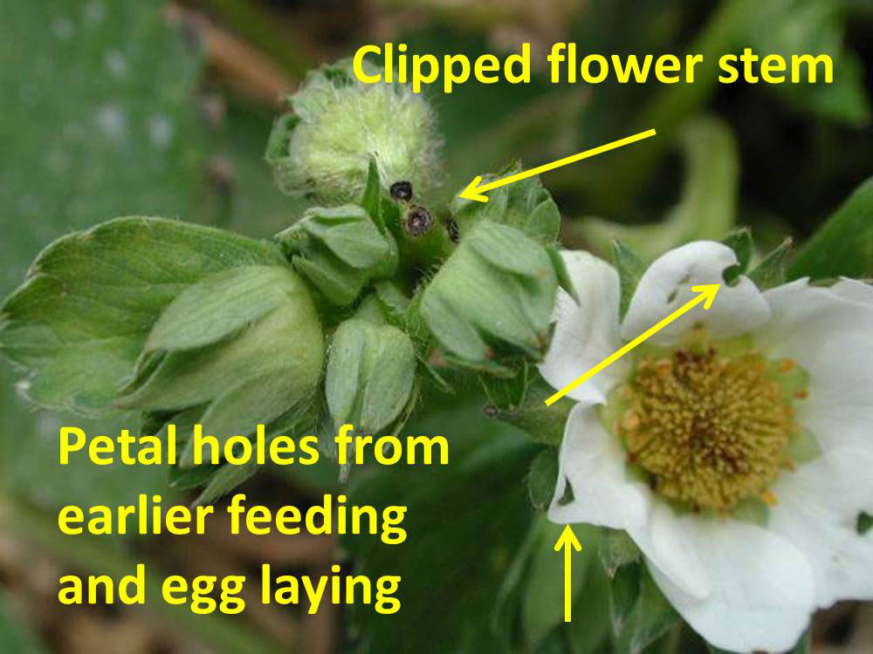
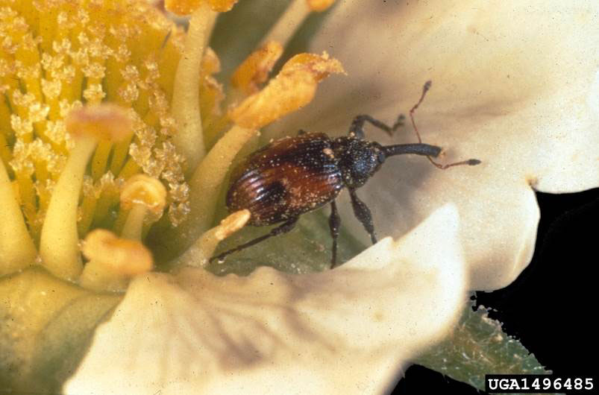
Strawberry: Strawberry bud weevil
Slides: OMAFRA
1) Monitoring: weekly, unopened buds
- concentrate on field edges
Adult weevils: 5 sites of 30 by 60 cm (1 X 2 feet)
adult threshold: 1 adult per 5 sites
No threshold if history of problems
Bud damage: look for chewed buds (before 1st spray)
- Look for green partially clipped buds after 1st spray)
-Threshold:
- 1st spray: 6.5 damaged buds per 5 sites
after 1st spray: 6.5 green partially clipped buds (fresh damage) per 5 sites
No threshold if history of problems

Slide 5
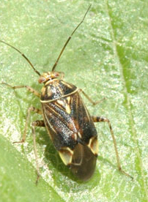
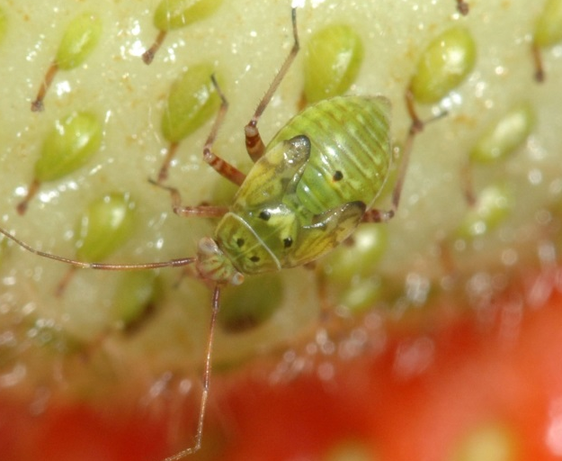
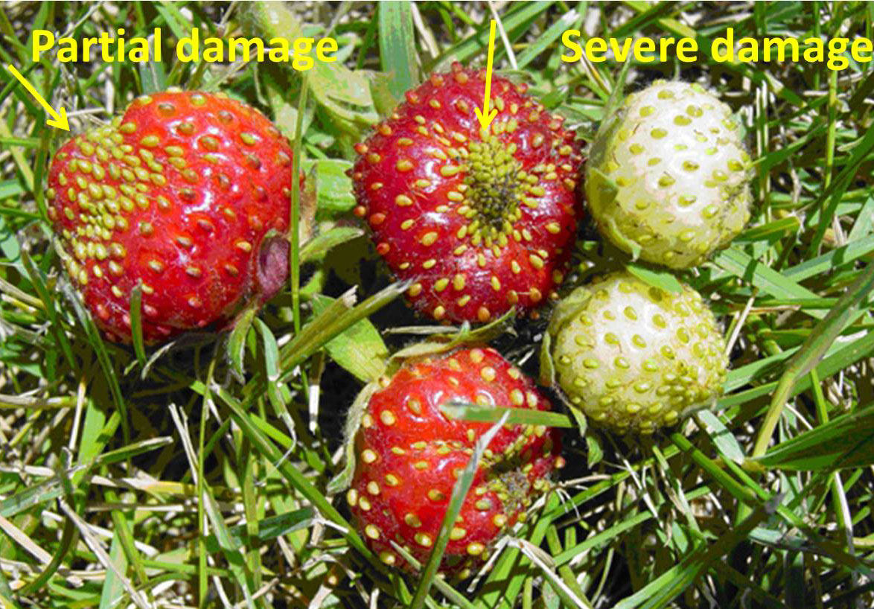
Strawberry: Tarnished plant bug (TPB)
Slides Jeff Hahn, University of Minnesota
Adult is 6 mm (1/4 inch) long. white “V” mark.
Damage:
Nymphs and adults feed on developing
flowers and fruit.
Monitoring: weekly, as soon as buds
develop until 30 days before harvest.
- tap 15 clusters from 15 plants
(3 clusters at each of 5 sites)
THRESHOLD: 7.5 tarnished plant bugs
per 15 clusters
Slide: Thaddeus McCammant Central Lake College

Slide 6
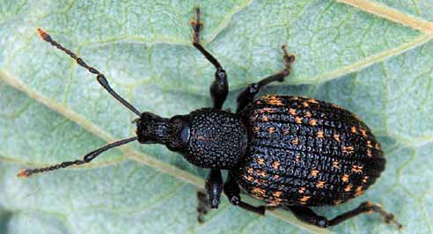
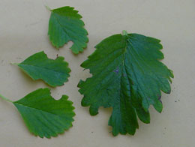
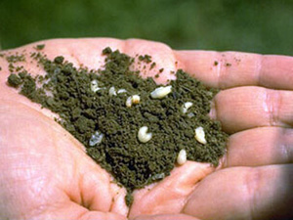
Strawberry: black vine weevil (BVW) & strawberry root weevil (SRW)
Slide: (BVW) Washington State
Monitoring: weekly, feeding damage on roots and grubs
in and near roots. Plants stunted. Leaves prematurely
red.
THRESHOLD: 5 affected sites / hectare (2 / acre)
Mature larva: (BVW) 8 mm (1/3rd inch); (SRV) 5 mm (1/5th inch).
Physical control: crop rotation
Slide: berries Northwest
Slide: Cornell

Slide 7
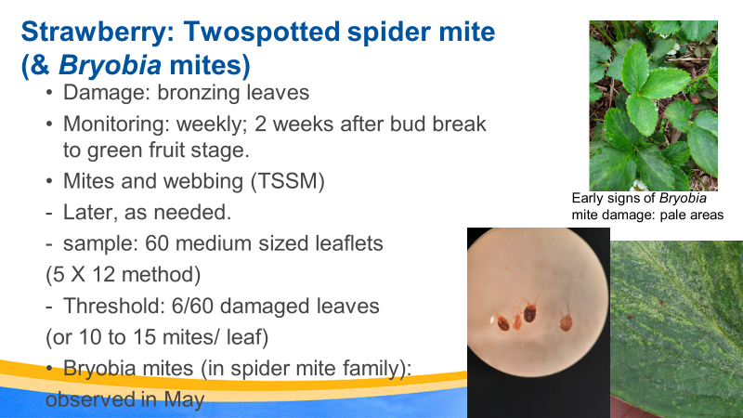

Slide 8
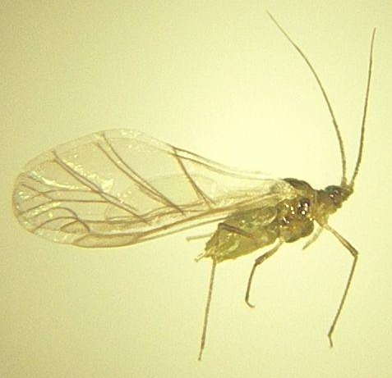
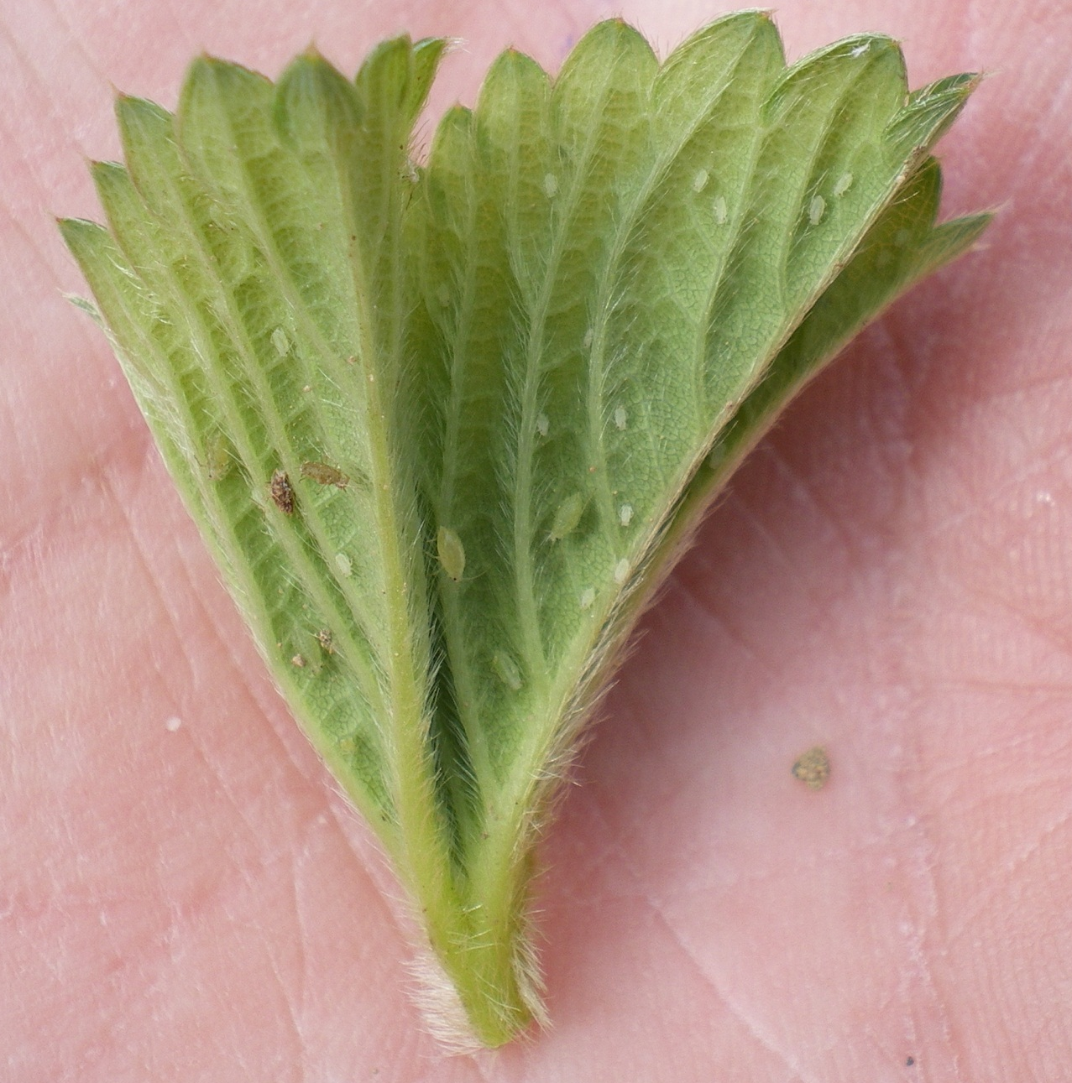
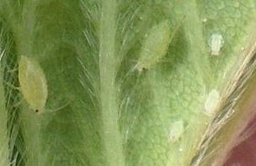
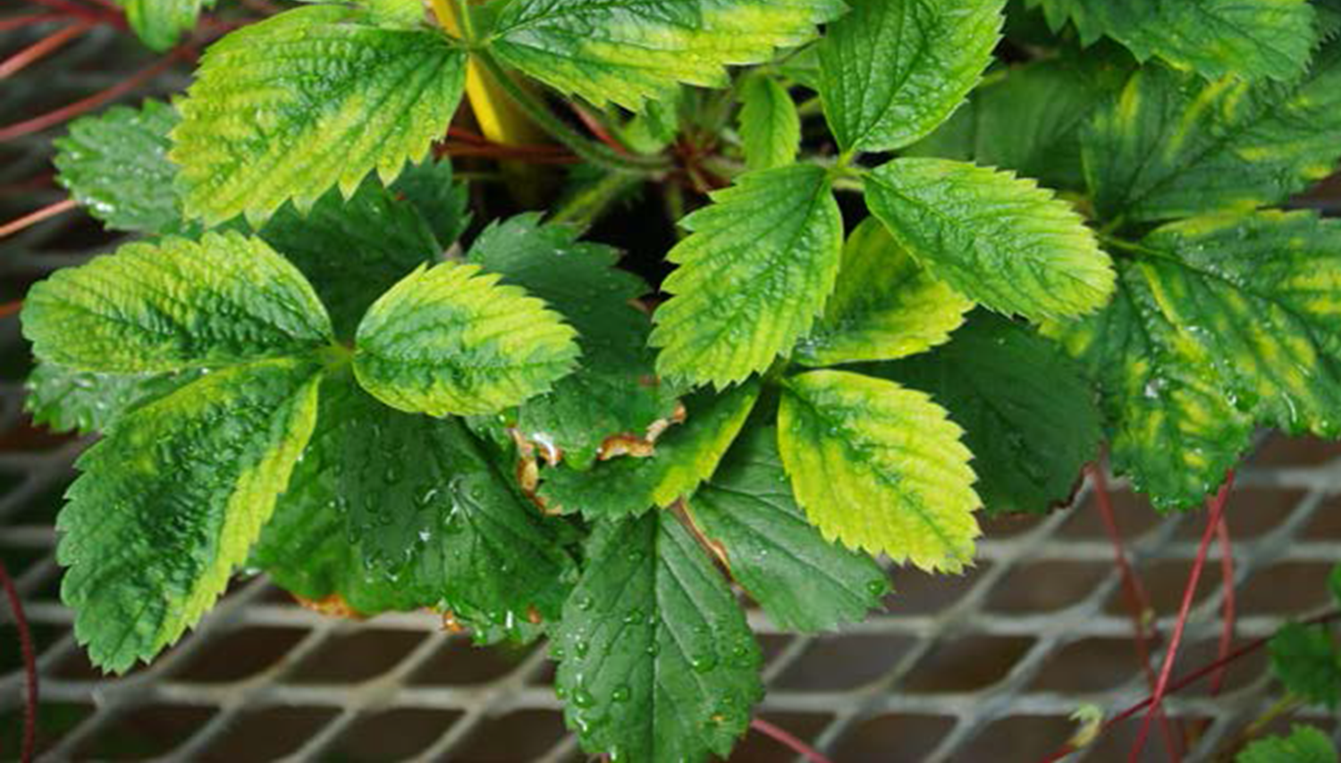
Strawberry: Strawberry aphid
Monitoring: 60 unopened leaves
Action threshold: 15 aphids / 60 leaves
Damage: discoloured leaves
Potential viruses
Physical control: Rotate field after two fruiting years
New Brunswick information:
StrawberryAphids.pdf (gnb.ca)
Pucerondufraisier.pdf (gnb.ca)
Slide: Nova Scotia

Slide 9
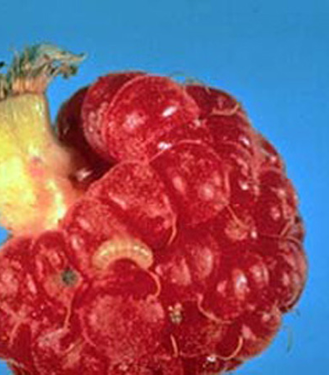
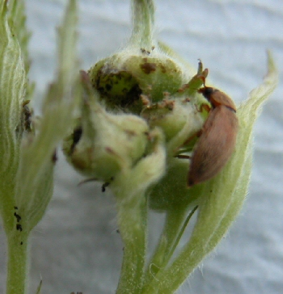
Raspberry: Raspberry fruitworm
Slide: Cornell
Monitoring: (adult beetles (3 mm)) weekly
Developing buds to green fruit stage
- tap 100 clusters (bud, flower, green fruit)
5 X 4 (buds) method: 20 clusters
THRESHOLD: 1 adult per 100 clusters
Slide: OMAFRA

Slide 10
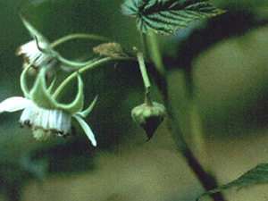
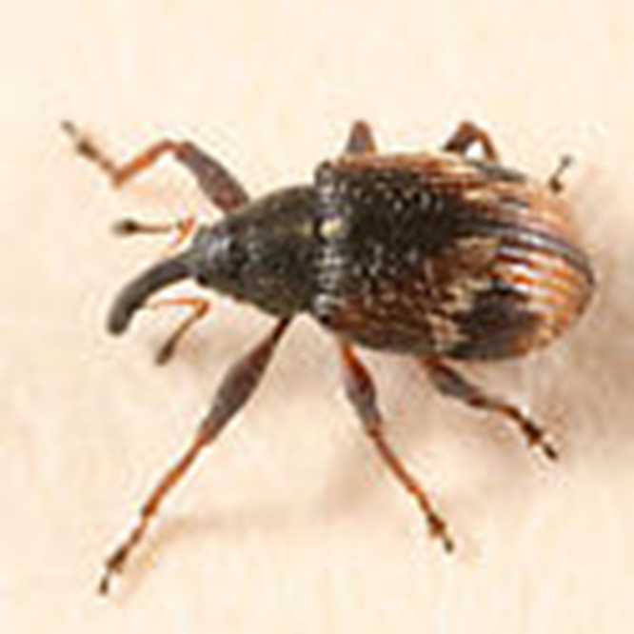
Raspberry: Strawberry bud weevil on raspberry
Life stage monitored: adult (3 mm)
Monitor: unopened buds until all are opened
Tap: 5 sites X 20 clusters (100 buds)
Threshold: 6 adults / 100 clusters
Slide: Cornell
Slide: bugguide

Slide 11
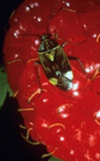
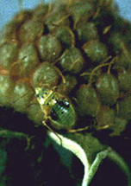
Raspberry: Tarnished plant bug on raspberry
Monitor: nymph / adult stages (do not confuse with aphids)
- 5 X 10 clusters
- weekly: developed bud to 30 days before harvest
Damage: Nymphs and adults feed on developing flowers and fruit.
Threshold: 25 tarnished plant bugs / 50 clusters
Slides: Cornell

Slide 12
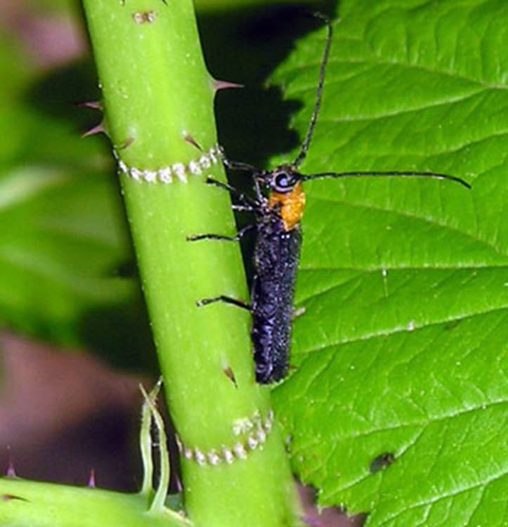
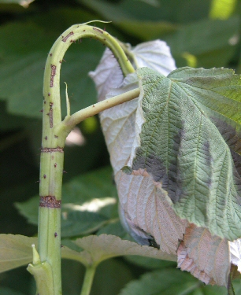

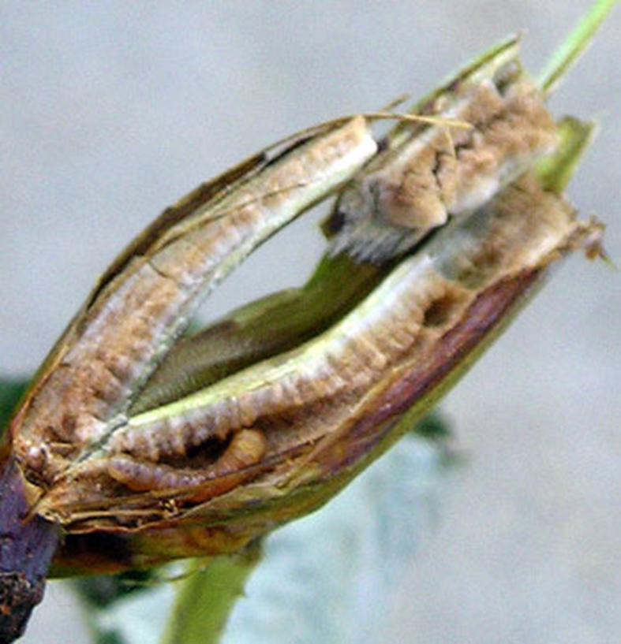
Raspberry: Raspberry cane borer
Damage: Adult girdles cane
Larva: feed inside cane and bore down to
crown for overwintering.
Monitor: (weekly) new wilted damage
June to early September (5 X 5 metres)
Remove & destroy wilted tips
Threshold: 5 damaged canes (25 metres) may require a pesticide
Fall & winter: Inspect crowns & roots & remove
Slide: OMAFRA

Slide 13
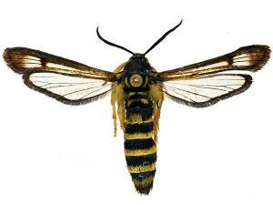
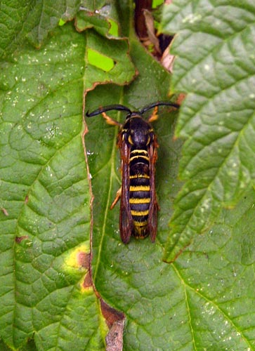
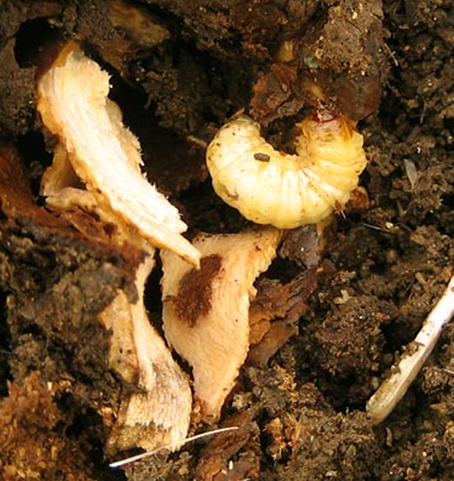
Slide: Discover Life
Raspberry: Raspberry crown borer
Damage : Infested canes wilt, foliage prematurely red
Infested crowns and roots: Crowns swell and may die.
Larval damage: in base of cane (two-years)
Monitor: weekly (June onwards) (5 X 5 metres of row)
Wilted canes
Destroy and remove damaged canes
May require pesticide for 2 consecutive years.
Slides: Washington State Un.

Slide 14
Summary
Monitor
Identify pests /damage
Apply controls, if warranted
Do a pre-harvest assessment
Keep records
Assess your management practices

Slide 15
Thank you / merci

